Slide 1



感恩遇见，相互成就，本课件资料仅供您个人参考、教学使用，严禁自行在网络传播，违者依知识产权法追究法律责任。
更多教学资源请关注
公众号：溯恩英语
知识产权声明

Slide 2
高考应用文热点
—科技类
2025
Polly

Slide 3
目录
01.
vocabulary
02.
background information
03.
function
04.
pros & cons
05.
linking expressions
06.
suggestions
07.
prospect
08.
practice

Slide 4
科技发展相关词汇
‌人工智能与数字技术
计算机与网络技术
cutting-edge（前沿的）
state-of-the-art（最先进的） empower（赋能）
integrate（融合）
‌Artificial Intelligence (人工智能)‌ ‌Algorithm (算法)‌ ‌
Digital Device (数码设备)‌
‌‌Virtual Reality (虚拟现实)
DeepSeek ChatGPT
Big data（大数据）
‌Cybersecurity (网络安全)
‌Data Encryption (数据加密)‌
‌Network Infrastructure (网络基础设施) ‌ mobile apps（移动应用程序）online payment（在线支付）
‌基础科学术语
‌
工业与创新技术
能源与生物技术
‌Renewable Energy (可再生能源)‌ ‌Genetic Engineering (基因工程)‌ ‌Biotechnology (生物技术)‌
‌Advanced Science (尖端科学)‌ ‌Quantum Computing (量子计算)‌ ‌‌Milestone (里程碑)‌
‌Autonomous Vehicle (自动驾驶汽车)‌ ‌Automation (自动化)‌Technical Innovation (科技创新)
‌Sophisticated Equipment (尖端设备)‌ ‌High-tech Park (高科技园区)‌

Slide 5
background information
the way we work/learn
play a crucial role in enhancing high school students' learning efficiency
offer a wealth of learning resources
allowing us to review lessons and do exercises anytime, anywhere.
the way we communicate
stay in touch with friends
share our school life
reshape the way we interact with machines
broaden our horizons by connecting with people from different backgrounds
the way we live
become an integral part of our daily lives
The impact of technology on high school students' lives is significant.
revolutionize various aspects
of people's lives since its emergence

Slide 6
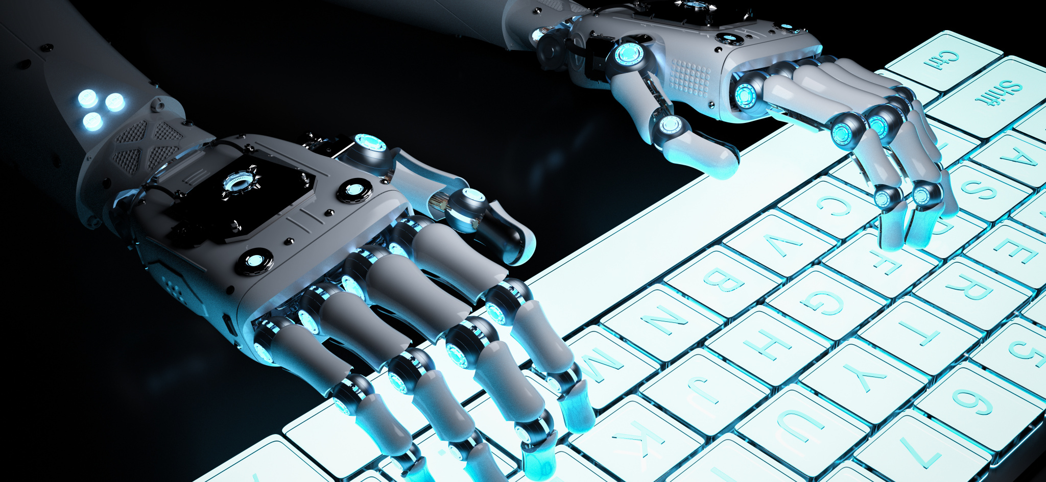
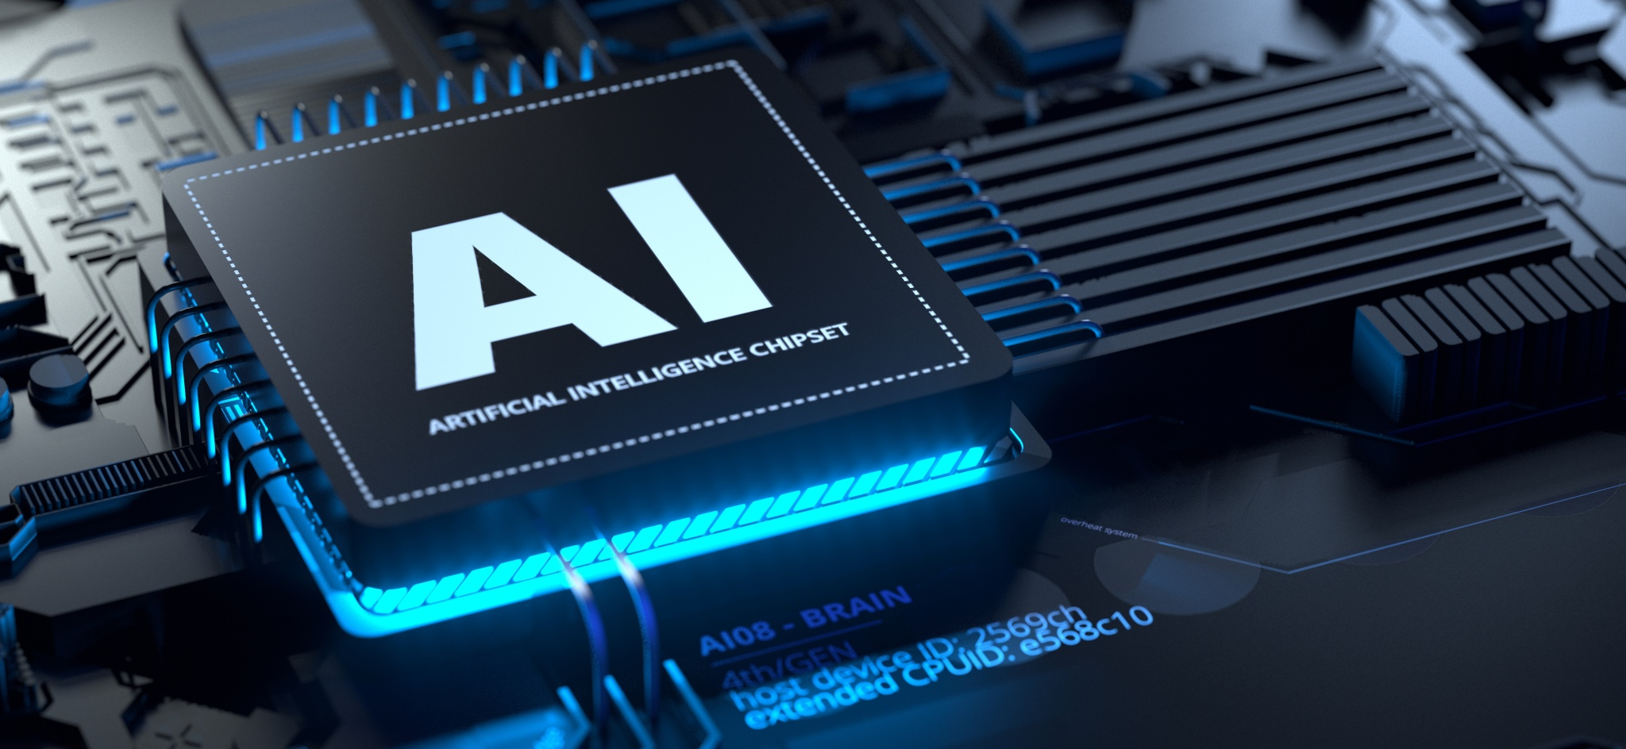
function
01 Education & Learning
Solve complex maths problems with AI-powered tools通过AI工具解决复杂数学问题
Generate high-quality texts and answer complex questions生成高质量文本并解答复杂问题
Tailor learning experiences to individual needs根据个人需求定制学习体验
Provide real-time feedback提供实时反馈
Offer access to resources around the clock支持全天候访问学习资料
use AI for instant homework help,tailored quizzes, and language practice利用AI进行即时作业辅导个性化测验和语言练习
Deep-seek, an AI model for its powerful language-processing and reasoning abilities一个具备强大语言处理和推理能力的AI模型
02 Healthcare & Wellness
Enhance diagnostic accuracy through medical AI models（医疗AI模型提升诊断精准度）
Predict epidemics by analyzing global health data（通过分析全球健康数据预测流行病）
Diagnose rare diseases via medical image analysis（通过医学影像分析诊断罕见疾病）
Optimize mental health support with emotion-sensing chatbots（通过情绪感知聊天机器人优化心理健康支持）
Transform healthcare with personalized AI-driven treatments（AI驱动的个性化治疗变革医疗）

Slide 7


03 Security
Enhance security systems with facial recognition（通过面部识别增强安防系统）
Detect deepfake content using AI authenticity checks（通过AI真实性检测识别深度伪造内容）
Monitor public safety through real-time crowd behavior analysis（通过实时人群行为分析保障公共安全）
Prevent cyberattacks with predictive threat modeling（通过预测性威胁建模预防网络攻击）
04 Communication & Globalization
Provide instant translation for cross-cultural collaboration（提供即时翻译以促进跨文化协作）
Provide instant translation for seamless cross-border communication（提供即时翻译实现无障碍跨国交流）
Facilitate international conferences with AI-powered transcription（转录技术助力国际会议）
Connect global talent through AI-matched networking platforms（AI匹配的社交平台连接全球人才）
Automate multilingual customer service interactions（自动化多语言客户服务交互）

Slide 8

pros
Study efficiently and independently高效自主学习
Enhance learning efficiency‌提升学习效率
Personalize study plans‌定制学习方案
‌Identify knowledge gaps‌定位知识盲区
Provide instant feedback‌即时反馈指导
Open up new possibilities for communication, productivity, and innovation为沟通、生产力和创新开辟新的可能性
Offer unparalleled convenience, connectivity, and access to information that was inaccessible previously提供无与伦比的便利性、连接性和对以前无法访问的信息的访问
make classes more vivid and interesting使课堂更加生动有趣
improve our learning enthusiasm greatly极大地提高了我们的学习热情

Slide 9

Be a major source of distraction成为分心的主要来源
Affect productivity and personal relationships影响工作效率和人际关系
May provide incorrect information if not properly trained or updated, which lowers our working efficiency.如果没有经过适当的培训或更新，可能会提供不正确的信息，从而降低我们的工作效率。
Hinder the development of critical thinking and problem-solving skills阻碍批判性思维和解决问题能力的发展
Provide inaccurate information and solutions提供不准确的信息和解决方案
Weaken critical thinking弱化批判性思维
Impair memory retention削弱知识留存
Accelerate academic dishonesty加速学术不端
violate fairness and integrity in educational environments在教育环境中违反公平和诚信
cons

Slide 10


linking
Admittedly,there are a rich blend of benefits of it, ranging from...to...
不可否认，它有很多好处，从……到...
Nevertheless, it may also pose threats , such as ...
然而，它也可能带来威胁，例如……
Despite these advantages,...they can also ...
尽管有这些优点，……他们也可以……
To maximize the pros while minimizing the cons
为了最大限度地发挥优点，同时最大限度地减少缺点
emphasize its role as a ‌thinking aid‌ rather than a ‌brain substitute
强调它作为一种“思维辅助工具”而不是“大脑替代品”的作用是可行的

Slide 11



suggestions
It’s feasible for the school to organize training sessions to teach us how to use AI tools properly and effectively establishing AI usage guidelines.
Let's continue to explore and embrace the wonders of technology, shaping a brighter future for all.
Undoubtedly,with the rules and efforts, we can embrace AI’s convenience while preserve human creativity.
让我们继续探索和拥抱技术的奇迹，为所有人创造更光明的未来。
.毫无疑问，通过规则和努力，我们可以在保持人类创造力的同时，拥抱人工智能的便利。
学校可以组织培训课程，教我们如何正确有效地使用人工智能工具,建立人工智能使用指南

Slide 12

Prospect
Hold immense promise前景广阔
Keep evolving不断的演变
Be expected to integrate even more advanced features,enabling more people to experience their benefits
预计将集成更高级的功能，使更多人能够体验到它们的好处
Open up new possibilities for our future为未来开启新的可能性
Be significant advancements in AI’s ability to interact with the world
人工智能与世界互动能力的重大进步
Breakthroughs in robotics, autonomous transportation, and even creative fields like art and music
机器人技术、自动驾驶交通，甚至是艺术和音乐等创意领域的突破
It’s also crucial to address ethical issues to make sure it benefits humanity
解决道德问题以确保它造福人类也至关重要
With continuous progress and updates, ... is bound to be an indispensable part of our lives, more accurate and reliable.
随着不断的进步和更新，……必然是我们生活中不可缺少的一部分，更加准确可靠。

Slide 13

Practice
1.宁波一模——生活中具有重大影响的科技产品
学校英语俱乐部将组织关于“生活中具有重大影响的科技产品”的讨论，请你作为代表发言，内容包括：
（1）介绍一项产品及其影响；
（2）对该产品的展望。

Slide 14
Good morning, everyone.
Today, I am thrilled to share with you a technological item in our life: Artificial Intelligence (AI). AI involves the development of computer systems designed to perform tasks that normally require human intelligence.
By automating routine tasks and providing innovative solutions to complex problems, AI has already made waves in various aspects. It is transforming healthcare with personalized treatments, enhancing security with facial recognition, and even teaching languages with unmatched efficiency.
Looking ahead, AI is bound to become an indispensable part of our lives. I anticipate significant advancements in AI’s ability to interact with the world, leading to breakthroughs in robotics, autonomous transportation, and even creative fields like art and music. While the future with AI holds immense promise, it’s also crucial to address ethical issues to make sure it benefits humanity.
Thank you.
大家早上好！
今天，我非常荣幸能与大家分享一项深刻影响我们生活的科技产物——人工智能（AI）。人工智能是指开发能够执行通常需要人类智能的任务的计算机系统。
通过自动化日常任务并为复杂问题提供创新解决方案，AI已在多个领域掀起变革浪潮。它正通过个性化治疗革新医疗行业，通过面部识别技术增强安防能力，甚至以无与伦比的效率助力语言教学。
展望未来，AI必将成为我们生活中不可或缺的一部分。我预见，AI与世界的交互能力将取得重大进步，从而在机器人技术、自动驾驶交通，甚至艺术和音乐等创意领域取得突破。尽管AI的未来充满希望，但我们仍需解决伦理问题，以确保其造福全人类。
谢谢大家！

Slide 15

Practice
2.金丽衢应用文—— AI and our study
假如你是李华，你们学校的校报英语论坛正在组织一次讨论活动。主题是AI and our study。请你写一篇英语文章投稿，内容包括：
1.AI 用于学习的现状
2.你的看法或建议。

Slide 16
Nowadays, AI tools like ChatGPT and language apps are revolutionizing learning. We use AI for instant homework help,tailored quizzes, and language practice.
Admittedly,there are a rich blend of benefits of it, ranging from enhancing learning efficiency, personalizing study plans to identify knowledge gaps. Nevertheless, it may also pose threats3, such as weakening critical thinking and accelerating academic dishonesty.
To maximize the pros while minimizing the cons4, it’s feasible for the school to organize training sessions to teach us how to use AI tools properly and effectively and establish AI usage guidelines, emphasizing its role as a ‌thinking aid‌ rather than a ‌brain substitute‌.
Undoubtedly,with the rules and efforts, we can embrace AI’s convenience while preserve human creativity.
如今，像ChatGPT和语言应用这样的人工智能工具正在彻底改变学习方式。我们使用人工智能进行即时作业帮助、量身定制的测验和语言练习。
不可否认，它有很多好处，从提高学习效率，个性化学习计划到发现知识盲区。然而，它也可能带来威胁，比如削弱批判性思维，加速学术不端。
为了最大限度地发挥优点，同时最大限度地减少缺点，学校可以组织培训课程，教我们如何正确有效地使用人工智能工具，并建立人工智能使用指南，强调其作为“思维辅助工具”而不是“大脑替代品”的作用。
毫无疑问，通过规定和努力，我们可以在保持人类创造力的同时，拥抱人工智能的便利。

Slide 17

Practice
3.“科技创新在身边”主题班会
上周五，你班举行了“科技创新在身边”主题班会。请据此写一篇英文报道向学校英文网站投稿，内容包括：
1.班会目的
2.班会过程
3.班会反响

Slide 18
Intended to fuel students’ passion for science and foster the creative thinking，our class held/organized a class meeting titled/themed “Technological innovation Around Us”last Friday.
At the beginning, the meeting commenced with/kicked off with our teacher giving examples of modern/contemporary technological innovations, through which we gained a deep insight into the connotation and value of technological creative thinking./followed by students’ representatives showcasing their technological projects and innovations. Afterwards,we had a heated/lively interactive session, where we discussed how the technological items have changed/ reshaped/ revolutionized various aspects of our daily lives since their emergence, such as ChatGPT, VR and Smartphone etc.
Overall, this meeting is literally an unforgettable, educational and inspiring experience for us Not only does it deepen my understanding of the significance of technological innovation in our daily life, but it also motivates me to engage in future technological innovations.
为了激发学生对科学的热情，培养学生的创造性思维，我们班上周五组织了一次以“科技创新在我们身边”为主题的班会。
首先，我们的老师以现代/当代技术创新为例，让我们对技术创新思维的内涵和价值有了深刻的认识。/接著是学生代表展示他们的科技项目和创新成果。随后，我们进行了热烈/生动的互动环节，讨论了科技项目自出现以来如何改变/重塑/革新我们日常生活的各个方面，如ChatGPT、VR、智能手机等。
总之，这次班会对我们/我来说是一次难忘的、有教育意义的、鼓舞人心的经历。它不仅加深了我对技术创新在我们日常生活中的重要性的理解，也激励了我去参与未来的技术创新。

Slide 19
Practice
4.智能图书馆
假定你是李华，上周你体验了学校新开设的智能化图书馆smart library,请你给你的新西兰朋友Michael写一封邮件分享此次经历，内容包括：
1.智能图书馆的设施；
2.你的体验和感受。

Slide 20
Dear Michael,
I hope this email finds you well! Having explored our newly opened smart library, I can’t wait but share this incredible and fascinating experience with you.
There are a rich blend of advanced facilities in the library, ranging from E-Reading Zones,VR Corners to Robot assistant. Upon stepping into the library, I was greeted by a Robot assistant, which improved my efficiency in locating the books I want. Then following that, what impressed me most was the VR corners, where I was offered an immersive and enriching journey back in time on history.
Overall,not only does this smart library make me experience the charm of the cutting-edge technologies, but it also fuels my passion for reading more.What about the smart facilities in your community?Looking forward to your introduction about them. All the best!
Yours,
Li Hua
见信好！
在探索了我们新开放的智能图书馆后，我迫不及待想与您分享这段令人惊叹的奇妙体验。
图书馆融合了丰富的先进设施——从电子阅读区、VR体验区到机器人助手，应有尽有。踏入图书馆时，迎接我的是一位机器人助手，它高效地帮我定位了所需书籍。随后，最令我印象深刻的是VR体验区，在那里我仿佛穿越时空，开启了一场沉浸式的历史时光之旅。
总而言之，这座智能图书馆不仅让我感受到尖端科技的魅力，更激发了我更大的阅读热情。您所在的社区是否也有类似的智能设施？期待您与我分享！祝一切顺利！

Slide 21

Practice
5.2025.1浙江首考——手机拍摄短视频
你将参加英语课上的“一分钟演讲”活动，请你针对部分同学在校园内用手机拍摄短视频的现象写一篇演讲稿，内容包括：
1.陈述看法
2.提出建议
My views on filming short videos on campus

Slide 22
Good morning, everyone! Here and now, I’d like to share with you my opinions about an increasingly rising phenomenon: filming short videos on campus.
It is no denying that there is a rich blend of benefits of shooting short videos on campus, ranging from enriching our campus life,cultivate our innovative thinking and practical abilities to capture moments of our precious campus life.However, it also poses challenges because it may lead to our distraction from studies and invade other’s privacy. To address these issues, it would be wise and beneficial for us to strike a balance between studies and shooting videos and show more respect to other’s privacy when filming videos.
I do believe that, with the balance and respect, not only can we promote our personal growth through filming videos, but we can also create a vibrant campus culture.Thank you for your attention!
大家早上好！今天，我想与大家探讨一个在校园中日益流行的现象——拍摄短视频。
不可否认，拍摄校园短视频益处颇多：它既能丰富校园生活、培养创新思维与实践能力，又能记录珍贵校园时光。然而，这一现象也带来挑战——过度投入可能导致学习分心，甚至无意中侵犯他人隐私。为解决这些问题，我们应在学业与拍摄之间寻求平衡，并在拍摄时更加尊重他人隐私，这将是明智且共赢的选择。
我坚信，通过平衡与尊重，短视频不仅能助力个人成长，更能为校园文化注入活力。感谢大家的聆听！

Slide 23

Practice
6.绍兴二模——技术与个性化学习
近期，你将参加学校组织的英语主题征文活动。请结合自身经历，就“技术支撑下的个性化学习”的主题写一篇短文，内容包括：
（1）陈述观点；
（2）分享体验。
My View on Technology-Supported Personalized Learning

Slide 24
My View on Technology-Supported Personalized Learning
In the digital age, more learners are applying technology to their learning. Personally, AI has revolutionized the way we learn by making learning more personalized than ever before.
From my experience, using AI tools to access resources has made learning more flexible and effective. I once struggled with listening comprehension. Thanks to various language learning apps, I could practice listening with materials anytime,anywhere. Meanwhile, the apps also analyzed my mistakes, allowing me to focus on my weak areas.
In summary, technology empowers tailored learning. By embracing technology, not only can we create a more inclusive and dynamic learning environment, but enable every student to reach their full potential.
我对技术支持的个性化学习的看法
在数字化时代，越来越多的学习者将技术应用于学习中。就个人而言，技术彻底改变了我们的学习方式，使学习比以往任何时候都更加个性化。
根据我的经验，使用AI工具获取资源使学习更加灵活高效。我曾一度在听力理解上遇到困难。得益于各类语言学习应用程序，我可以随时使用材料进行听力练习。同时，这些应用还能分析我的错误，使我能够专注于薄弱环节。
总之，技术赋能个性化学习。通过拥抱技术，我们可以创造一个更具包容性和活力的学习环境，并且助力每位学生充分发挥潜力。

Slide 25

The future belongs to those who prepare for it today.

