Slide 1


感恩遇见，相互成就，本课件资料仅供您个人参考、教学使用，严禁自行在网络传播，违者依知识产权法追究法律责任。
更多教学资源请关注
公众号：溯恩英语
知识产权声明

Slide 2

The World
April 1st-15th, 2025

Slide 3
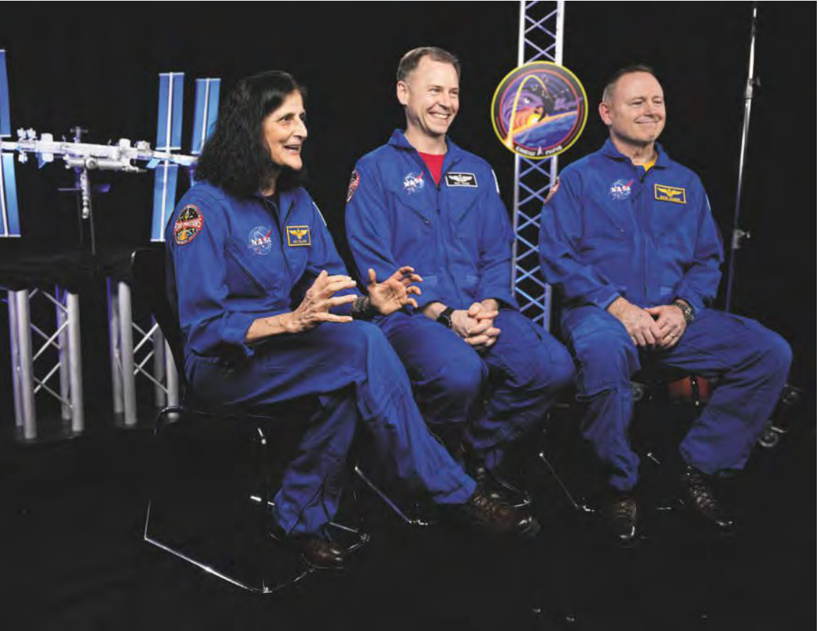
1. Stuck in space for nine months, astronauts would go back ‘in a heartbeat’
被困太空九个月的宇航员表示仍会“毫不犹豫”重返太空

Slide 4
Text Completion
The Washing Post (April 2 2025 A12)
Sunita "Suni" Williams and Barry "Butch" Wilmore have had quite the year: The NASA astronauts were the first people to travel aboard Boeing’s Starliner spacecraft, before technical issues left them ______ (stick) in the International Space Station for months on end. They finally made it back to Earth in a SpaceX Dragon capsule last month, after 286 days in space.
Williams, 59, and Wilmore, 62, set off into space aboard Boeing's Starliner spacecraft on June 5. They were expected to spend about eight days in space, but their return to Earth ___________ (delay) after they encountered issues with the thrusters and helium leaks in the propulsion system. _____ on Monday, both said they would be willing to fly on the Starliner again.
"We’re going to rectify all the issues that we encountered, we’re going to fix them, we’re going to make it work," Wilmore said at ___ news conference. "Boeing’s completely committed, NASA is completely committed, and with that I’d get on ___ a heartbeat."
Both Williams and Wilmore described their surprise at just _____ quickly their strength returned after so long in space. "It’s pretty much a miracle _____ (see) how your human body can adapt," Williams said in the news conference, _______ (add) that she was able to run three miles on Sunday. "When all of us came down the ladder and greeted everybody... we were all a little bit wobbly at that time. And it’s amazing within 24 hours how the neuro-vestibular system kicks in and your brain understands what’s going on."
Being away from home for so long was "difficult," according to Wilmore, but he and his family had discussed different ___________ (possible) ----and he likened their experience to that of people working in the military, for the police or in other jobs ___________ require extended periods of time away from home.
stuck
was delayed
But
a
in
how
to see
adding
possibilities
that / which

Slide 5
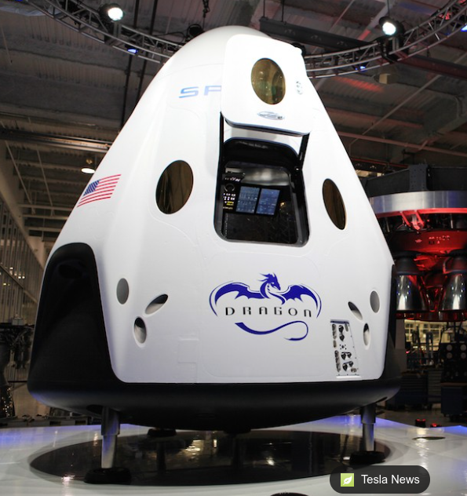
Reading Comprehension
1. What does the underlined word “rectify” in paragraph 3 mean?
A. Complicate. B. Fix.
C. Ignore. D. Purify.
VOCABULARY
2. What was the main reason for the delay in Williams and Wilmore’s return to Earth?
A. Severe weather conditions on Earth.
B. Issues with SpaceX’s Dragon capsule.
C. Thruster malfunctions and helium leaks in Starliner.
D. Problems with the International Space Station’s systems.
DETAIL

Slide 6
Vocabulary
1. on end: continuously, without interruption 连续地
He is a wonderful companion and we can talk for hours on end.
他是个非常好的同伴，我们可以连续聊上好几个小时。
2. liken: If you liken one thing or person to another thing or person, you say that they are similar 把…比作；把…比拟为
Many have likened the experience of virtual reality to being transported to another world.
许多人把虚拟现实体验比作被传送到另一个世界。
Translation
我一连几天呆在这个工作室里。
I spend days on end in this studio.
Translation
诗人常把人生比作旅程。
Poets often liken life to a journey.

Slide 7
Translation
Sunita "Suni" Williams and Barry "Butch" Wilmore have had quite the year: The NASA astronauts were the first people to travel aboard Boeing’s Starliner spacecraft, before technical issues left them stuck in the International Space Station for months on end. They finally made it back to Earth in a SpaceX Dragon capsule last month, after 286 days in space.
美国宇航局宇航员苏妮塔·"苏妮"·威廉姆斯和巴里·"巴奇"·威尔莫尔度过了不平凡的一年：这对宇航员今年率先搭乘波音公司"星际客船"航天器执行任务，却因技术故障滞留国际空间站数月，最终于上月搭乘SpaceX龙飞船返回地球，结束了长达286天的太空征程。
They were expected to spend about eight days in space, but their return to Earth was delayed after they encountered issues with the thrusters and helium leaks in the propulsion system. But on Monday, both said they would be willing to fly on the Starliner again.
他们本来计划将在太空中停留大约8天，但由于推进器和推进系统的氦泄漏问题，他们返回地球的时间被推迟了。但在周一，两人都表示愿意再次乘坐星际飞船。

Slide 8
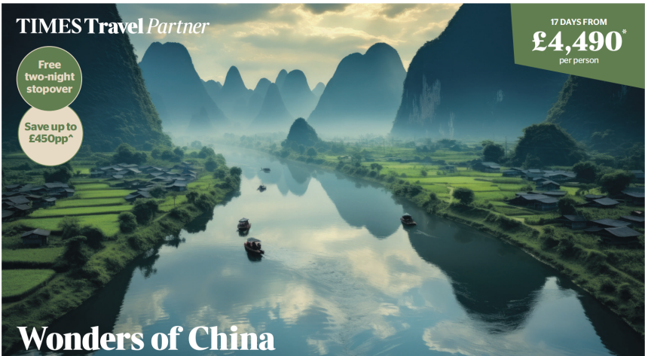
2. Wonders of China
中国奇观

Slide 9
Reading Comprehension
The Times（April 15, 2025 P11)
This all-encompassing 17-day tour of China blends must-see sights with spectacular natural scenery and cultural encounters.
Starting in the bustling capital, Beijing, explore the magnificent Forbidden City and harmonious Temple of Heaven, before a trip to the iconic Great Wall. You’ll discover the ancient city walls of Xian and come face-to-face with the Warriors which have been shrouded in mystery since their discovery in the 1970s.
Next up is a four-night cruise on the Yangtze River, stopping at many highlights along the way. Witness the world’s largest hydroelectric dam, the Three Gorges, and sail peacefully along the Shennong Stream soaking up the dramatic scenery as you pass riverside villages and forest-covered mountains.
No trip to mainland China is complete without seeing their most adorable residents; the giant pandas. Visit Chongqing Zoo’s Panda House for a closer look at these playful bears before boarding a high-speed bullet train to the stunning city of Guilin - one of China’s most picturesque regions. Wind between the dramatic limestone karsts of the Li River with a trip to the lush emerald-green countryside of Yangshuo, and return to Guilin to visit the famous and the colourful Reed Flute Caves.
The trip ends amongst the towering skyscrapers of Shanghai-a city where the old and new sit harmoniously side by side. See the city’s contrasting skyline with an evening cruise along the Huangpu River, find serenity at the peaceful Yu Gardens and explore the magnificent architecture along The Bund. When booking this tour with The Times Expert Traveller, you will get an exclusive complimentary pre-tour extension including an extra hotel night with breakfast and transfers-make sure to quote TIMES-ON when booking.

Slide 10

Reading Comprehension
1. Which transportation is used when traveling from Chongqing to Guilin?
A. Cruise ship
B. High-speed bullet train
C. Domestic flight
D. Private coach
DETAIL
2. Which activity is mentioned as part of the Shanghai itinerary?
A. Visiting the Terracotta Warriors
B. Exploring the Reed Flute Caves
C. Cruising on the Huangpu River
D. Hiking along the Great Wall
DETAIL
3. What type of text is this passage most likely to be?
A. A news report on cultural heritage
B. A promotional advertisement for a tour package
C. An academic article on Chinese geography
D. A personal travel blog about Shanghai
GIST

Slide 11
Vocabulary
1. blend: to combine with sth in an attractive or effective way; to combine sth in this way（使）调和，协调，融合
Their music blends traditional and modern styles. 他们的音乐融合了传统和现代风格。
2. shroud: to hide information or keep it secret and mysterious隐瞒；保密
His family background is shrouded in mystery. 他的家庭背景蒙上了神秘的色彩。
Translation
新旧建筑物相映成趣。
The old and new buildings blend together perfectly.
Translation
这一事件一直笼罩在神秘之中。
The incident has always been shrouded in mystery.

Slide 12
Translation
Starting in the bustling capital, Beijing, explore the magnificent Forbidden City and harmonious Temple of Heaven, before a trip to the iconic Great Wall. You’ll discover the ancient city walls of Xian and come face-to-face with the Warriors which have been shrouded in mystery since their discovery in the 1970s.
从繁华的首都北京出发，探索宏伟的紫禁城和和谐的天坛，然后前往标志性的长城。你会发现西安的古城墙，并与自20世纪70年代被发现以来一直笼罩在神秘之中的兵马俑面对面。
Wind between the dramatic limestone karsts of the Li River with a trip to the lush emerald-green countryside of Yangshuo, and return to Guilin to visit the famous and the colourful Reed Flute Caves.
在漓江壮观的石灰岩喀斯特之间乘风而行，前往阳朔郁郁葱葱的翠绿乡村，然后返回桂林参观著名的色彩缤纷的芦笛洞。

Slide 13
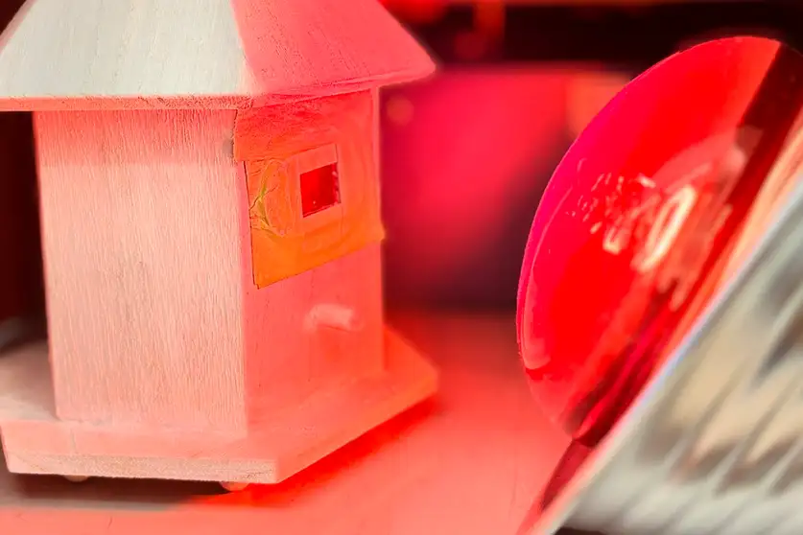
3. Wood made see-through using rice and egg whites
利用大米与蛋清制备可降解透明木材

Slide 14
Reading Comprehension
New Scientist（April 5 , 2025 P17)
Windows and smartphone screens may one day be constructed from transparent wood laced with egg whites and safely composted at the end of their life. Wood has been turned into a transparent material before by removing the organic polymer lignin from it and then injecting epoxy as a replacement, but this results in a non-biodegradable product. Now, Bharat Baruah at Kennesaw State University in Georgia and his team have developed a process that replaces the synthetic epoxy with natural egg white and rice extract. “Previous examples of transparent wood are very hard to synthesise, hard to make and you spend a lot of time and energy and money to make those,“says Baruah. He was inspired to use egg whites by buildings in his home state of Assam in India, which date back to the 1500s and used a cement-like mixture that included sand, sticky rice and egg whites. “That was the cement in those days, and those buildings are still there,” says Baruah. “They’re still there after more than four or five centuries.” The team took sheets of balsa and drenched them with sodiumsulphite, sodium hydroxide and diluted bleach in a vacuum chamber to remove the wood’s lignin and hemicellulose, leaving a paper-like cellulose structure. The voids in the material were then filled with rice extract and egg white before being dried in an oven at 60℃ (140℉) to create a semi-transparent plate with a slight brown tint. “It’s not 100 percent transparent, but it is semi-transparent,” says Baruah. “And it’s biodegradable.” Baruah and his colleagues built a small birdhouse fitted with a transparent wood window as a mock-up, and found that it stayed 5 to 6℃ (9 to 11℉) cooler inside when exposed to a heat lamp than the same birdhouse fitted with a glass window. The research was presented last week at the spring meeting of the American Chemical Society in San Diego, California.

Slide 15
Reading Comprehension
1.What does the underlined word “laced” mean in Paragraph 1?
A.added B. decorated C. equipped D.provided
VOCABULARY
2.What natural materials are used to replace synthetic epoxy?
A. Sand and sticky rice
B. Egg white and rice extract
C. Sodium sulphite and diluted bleach
D. Cellulose and hemicellulose
DETAIL
3.What is Bharat Baruah’s attitude to this new method?
A.positive B. doubtful C. critical D. indifferent
INFERENCE
4.What’s the best title for the text?
A. Ancient Indian Architecture Inspires Modern Science
B. The Challenges of Producing Transparent Wood
C. Biodegradable Transparent Wood: A Sustainable Innovation
D. How to Build a Birdhouse with Natural Materials
GIST
Notes:
【设计意图】通过阅读理解的形式帮助学生理解新闻的主要内容。该新闻主题语境是关于“人与社会”中“社会热点问题”这一子主题，通过学习让学生了解威尔士禁止体罚孩子的法律。

Slide 16
Vocabulary
1. synthesise: to produce a substance by means of chemical or biological processes （通过化学手段或生物过程）合成
Albert Hoffman first succeeded in synthesising the acid in 1938. 艾伯特·霍夫曼于1938年首次成功合成了迷幻剂。
2. drench: to make sb/sth completely wet 使湿透
We were caught in the storm and got drenched to the skin. 我们遇上了暴雨，淋得浑身透湿。
Translation
有很多维生素是人体自身无法合成的。
There are many vitamins that the body cannot synthesize itself.
Translation
我忘了带伞，全身都湿透了。
I forgot my umbrella and got drenched.

Slide 17
Translation
Wood has been turned into a transparent material before by removing the organic polymer lignin from it and then injecting epoxy as a replacement, but this results in a non-biodegradable product.
通过去除木材中的有机聚合物木质素，然后注入环氧树脂作为替代品，木材已经变成了透明材料，但这导致了不可生物降解的产品。
Baruah and his colleagues built a small birdhouse fitted with a transparent wood window as a mock-up, and found that it stayed 5 to 6℃ (9 to 11℉) cooler inside when exposed to a heat lamp than the same birdhouse fitted with a glass window.
Baruah和他的同事们建造了一个装有透明木窗的小型鸟舍作为模型，发现当暴露在加热灯下时，它的内部温度比装有玻璃窗的鸟舍低5到6摄氏度（9到11华氏度）。

Slide 18
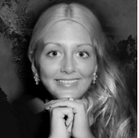

4. The author who started the teen vampire craze
引发青少年吸血鬼热潮的作家

Slide 19
Text Completion
The Week (April 11 2025 P35 )
L.J. Smith gave the world a taste for teenage vampires. The author of the Vampire Diaries series, ________ has sold more than 5 million copies, began writing the tale of a girl caught in a love triangle between two blood-feeding brothers in 1990. ______________ (experience) in negotiating, she signed away rights to her work for just a few thousand dollars—not knowing that the cultural passion for high school vampires would reignite years later. When her publisher started churning out ghostwritten Vampire Diaries books, Smith went around traditional book _________ (channel) to keep control of the narrative.
Raised in Southern California by ____ engineer and a teacher, Lisa Jane Smith started writing her first novel, The Night of the Solstice, in high school, but spent several years as a teacher before ___________ (commit) herself full-time to fiction. She“chose to model her pen name after her two favorite fantasy writers,” J.R.R. Tolkien and C.S. Lewis, said People. The Night of the Solstice sold only 5,000 copies, but it _______ (catch) the attention of the publishing imprint Alloy Entertainment and led to the first three Vampire Diaries books. The following decade, the Twilight series “ushered in a vogue for sexy stories of vampires more toothsome ______ toothy,”said The Telegraph (U.K.). Smith published another Vampire Diariestrilogy from 2009 to 2011, _____ it turned into a cultural sensation when the CW Network picked up a TV adaptation.
“An indefatigable writer,” said The New York Times, Smith kept working “as she went in and out of hospitals” after ______________(diagnose) with an autoimmune disorder. Before she died, she had ___________ (reported) completed Night World, another YA series, as well as a new postapocalyptic novel aimed at adults.
which
Inexperienced
channels
an
committing
caught
than
and
being diagnosed
reportedly

Slide 20
Reading Comprehension
1. What was key to the initial success of L.J. Smith’s The Vampire Diaries series?
A. She was skilled in business negotiations.
B. Her novels became instant global bestsellers.
C. Her work caught the attention of Alloy Entertainment.
D. She completed The Vampire Diaries while still in high school.
DETAIL
2. What does the underlined word “ushered in” in paragraph 2 mean?
A. Bring in. B. Hand in.
C. Take in. D. Give in.
VOCABULARY

Slide 21
Vocabulary
1. reignite: to make sth start burning again （使）重新燃烧；再点燃
Their passion was reignited by a romantic trip to Venice.
去威尼斯的浪漫之旅重新燃起了他们的激情。
2. churn out: to produce mechanically or copiously 大量生产，机械地生产
That young writer churn out about three or four new books every year.
那位青年作家每年能赶写出四五部书。
Translation
你得重新点燃长明火。
You may need to reignite the pilot light.
Translation
他开始用英文很快地创作出大量的文学作品。
He began to churn out literary compositions in English.

Slide 22
Translation
Inexperienced in negotiating, she signed away rights to her work for just a few thousand dollars—not knowing that the cultural passion for high school vampires would reignite years later. When her publisher started churning out ghostwritten Vampire Diaries books, Smith went around traditional book channels to keep control of the narrative.
由于缺乏谈判经验，她以几千美元的价格放弃了自己作品的版权——她不知道对高中吸血鬼的文化热情会在几年后重新燃起。当她的出版商开始大量出版代写的《吸血鬼日记》时，史密斯通过传统的图书渠道来控制故事的叙述。
The following decade, the Twilight series “ushered in a vogue for sexy stories of vampires more toothsome than toothy,”said The Telegraph (U.K.). Smith published another Vampire Diariestrilogy from 2009 to 2011, and it turned into a cultural sensation when the CW Network picked up a TV adaptation.
接下来的十年，《暮光之城》系列“迎来了”如英国《每日电讯报》所说：“比吸血鬼的露出牙齿更性感的故事。”史密斯在2009年至2011年间出版了另一部吸血鬼日记，并在CW电视台将其改编成电视剧后引起了轰动。

Slide 23

5. BBC News 04/08/2025

Slide 24

Dictation
Stock markets in Asia have plunged as fears mount about the cost of US trade policies. Japan’s Nikkei at one point traded over 8% lower before recovering. Donald Trump has ________ his use of tariffs, saying ‘sometimes you have to take medicine to fix something’. In Japan, one of the biggest exporters to the US, the Prime Minister says his government will offer support to companies affected by the tariffs and ____________ to protect jobs. South Korea has promised similar _________.
The US Health Secretary Robert Kennedy has said the most ________ way to prevent the spread of measles is the MMR vaccine. He’s previously been considered a vaccine sceptic.
The UN has warned that cuts to aid budgets could __________ years of progress in reducing maternal mortality. A report says there are fears rates will rise again because of cuts to __________.
Hamas militants say they’ve fired rockets from Gaza into southern Israel, where one person ________ minor injuries. It coincides with fresh efforts to broker a resumption of the Gaza ceasefire. The Israeli military says its troops have killed a Palestinian and wounded two others in Turmus Ayya in the West Bank. Palestinian officials said the victim was a teenager with (UN) US citizenship.
The Dominican Republic has announced plans to bolster _____________ to control illegal migration from neighbouring Haiti. The measures include speeding up the construction of a border wall.
Powerful storms in the central United States have left at least 17 people dead. Many parts of Kentucky, Arkansas, and Tennessee have seen more than 30 centimetres of rain and __________.
European scientists have found a way to detect the ________ of invasive Asian hornets, which threaten native bee populations. It’s hoped the system, which identifies the sound of the hornet hovering near a hive, could be used to send alerts to beekeepers.
defended
take measures
assistance
effective
undermine
foreign aid
sustained
border security
flash floods
presence

Slide 25
Vocabulary
1. tariff: a tax or duty to be paid on a particular class of imports or exports
(政府对进口商品征收的)关税
America wants to eliminate tariffs on items such as electronics.
美国打算取消电子产品等的关税。
2. sceptic: a person who doubts the validity or authenticity of something, especially religious or philosophical beliefs 持怀疑态度的人;怀疑论者
He now has to convince sceptics that he has a serious plan.
他现在得让怀疑者相信他有一个严肃的计划。
Translation
新的关税政策将对进出口贸易产生重大影响。
The new tariff policy will have a significant impact on the import and export business.
Translation
这位怀疑论者认为，没有科学证据支持这一理论。
The sceptic argued that there was no scientific evidence to support the theory.

Slide 26
Translation
Stock markets in Asia have plunged as fears mount about the cost of US trade policies. Japan’s Nikkei at one point traded over 8% lower before recovering. Donald Trump has defended his use of tariffs, saying ‘sometimes you have to take medicine to fix something’. In Japan, one of the biggest exporters to the US, the Prime Minister says his government will offer support to companies affected by the tariffs and take measures to protect jobs. South Korea has promised similar assistance.
亚洲股市暴跌，市场愈发担忧美国贸易政策将带来的代价。日本日经指数盘中一度下跌超过8%，随后有所回升。唐纳德·特朗普为其关税政策辩护称“有时必须服药才能治愈问题”。作为美国最大出口国之一的日本，首相表示政府将为受关税影响的企业提供支持，并将采取措施保护就业岗位。韩国也承诺将采取类似援助措施。
The US Health Secretary Robert Kennedy has said the most effective way to prevent the spread of measles is the MMR vaccine. He’s previously been considered a vaccine sceptic.The UN has warned that cuts to aid budgets could undermine years of progress in reducing maternal mortality. A report says there are fears rates will rise again because of cuts to foreign aid.
美国卫生部长罗伯特·肯尼迪表示，预防麻疹传播最有效的方法是MMR疫苗。他之前被认为是疫苗怀疑论者。联合国警告称，削减援助预算可能会破坏多年来在降低孕产妇死亡率方面取得的进展。一份报告指出，由于多国削减对外援助，人们担忧孕产妇死亡率或将出现反弹。

