Slide 1


感恩遇见，相互成就，本课件资料仅供您个人参考、教学使用，严禁自行在网络传播，违者依知识产权法追究法律责任。
更多教学资源请关注
公众号：溯恩英语
知识产权声明

Slide 2

Letter of asking for help about the first class hiking
—关于第一次班级徒步的求助信
2025.4广东二模应用文分析

Slide 3

Warm-up
01
Have you ever participated in a hiking?
02
What should we pay attention to before or during the trip?

Slide 4
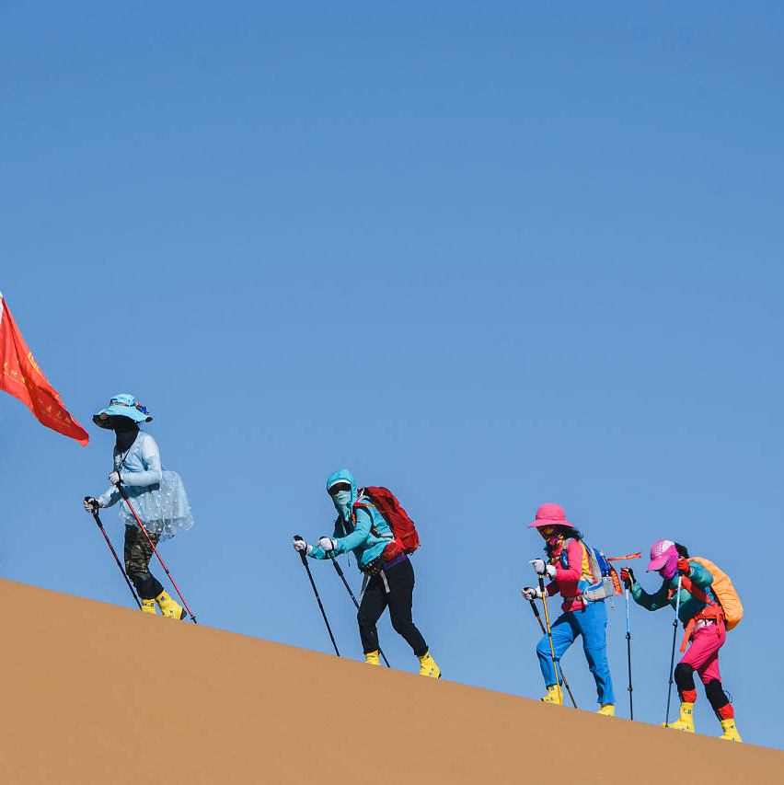
Lead in
What’s most challenging for you in this writing assignment?
Possible difficulties:
1.How to describe a hiking preparation？
2.What the difficulties might be during hiking preparation？
3.What specific guidance can be expected from Mr. Green?
4.How to present the body part logically？
...

Slide 5
Analyze
假定你是李华，你班计划组织首次野外徒步活动，请给酷爱户外运动的外教Mr.Green写邮件，内容包括：
1.活动筹备情况；
2.请求专业指导。
Genre
Receiver
Background
Writing Puporse
Content
Tense
Person
an E-mail of asking for help
Mr.Green
(passionate about outdoor activities)
organize the first class hiking trip
ask for expert guidance and tips (Para.1)
offer an invitation(Para.3)
the current preparation/schedule
the specific difficulties/aspects
simple present tense, future tense
first and second person

Slide 6
Construct
greetings
background information
writing purpose
Beginning
the current preparation/schedule
Letter of asking for help
Body
logic
However
the specific difficulties/aspects
Conclusion
gratitude/invitation/anticipation

Slide 7
Practice and Accumulate
greetings
background information
writing purpose
P1 Beginning
I hope this email finds you well. Our class is organizing its first hiking trip and we'd love your expertise to ensure its success.
Hope this email finds you well!‌ Next Saturday will witness our first class hiking trip. Given your rich expertise as an outdoor enthusiast, we are in great need of your timely and professional guidance. ‌
Hope this email finds you well! With excitement mingling with concerns, we are organizing our first class hiking trip next Saturday. So we'd love your expertise to ensure its success.

Slide 8




Brainstorm
What should be included in a preparation for a class hiking trip?
Safety and Emergency protocols
Core Information
Gear Suggestion
Itinerary
Route
Time for gathering and departure
Duration
Weather...
Clothing
Hiking boots
Maps, First-aid kits,
Water
Snacks...
Lunch Plan (Self-prepared/Group order)
Waste collection
themed activities
group assignments...
Backup Supplies (thermal blankets, headlamps, energy bars)...

Slide 9




What specific guidance can be expected from Mr. Green?
Brainstorm
review our route map
1
check the plan for safety and practicality
4
2
3
share safety guidelines
offer tips on pacing or essential gear checks

Slide 10
What specific guidance can be expected from Mr. Green?
Brainstorm
1. Route Planning and Risk Assessment
How to plan a safe and suitable route for beginners?？
What environmental factors (weather/terrain/wildlife) require priority assessment?
2. Equipment Selection and Use
What gear is a must for wilderness hikes?
How to optimize backpack weight without compromising safety?
Suggestions
3. Navigation and Emergency
How to master map-reading and compass navigation without digital aids?
What emergency protocols are critical for injuries or getting lost?
4. Ecological Conservation and Ethics
How to minimize environmental impact while camping/hiking?
What local regulations or cultural norms must be respected?

Slide 11
Practice and Accumulate
the current preparation/schedule
Body
However
logic
the specific difficulties/aspects
We've chosen a beginner-friendly trail in Green Valley, scheduled for May 15th. Basic preparations—route research, packing lists (maps, first-aid kits, water/snacks), and group assignments — are complete. However, as novices, we'd greatly value your professional input. Could you kindly review our plan for safety and practicality? We'd also appreciate your tips on pacing or essential gear checks.
我们选择了5月15日在Green Valley的一条初学者友好的步道。基本的准备工作——路线调查、打包清单（地图、急救箱、水/零食）和小组任务——都已完成。但是，作为新手，我们非常重视您的专业意见。你能检查一下我们的计划的安全性和实用性吗？我们也很感激关于节奏或基本装备检查的提示。

Slide 12
Practice and Accumulate
the current preparation/schedule
Body
However
logic
the specific difficulties/aspects
As scheduled, the Xishan Forest Trail, a 10km round-trip route, has been selected as our destination. Basic preparations—including maps,first-aid kits and weather conditions—are finalized. Nevertheless, as first-time organizers, we seek your expert advice on the critical uncertainties, such as objectively assessing trail difficulty, and establishing emergency protocols in case of sudden weather shifts or injuries etc. Plus, could you kindly review our thorough plan for safety and adjustments? Your insights will be invaluable.
按照计划，我们选择了往返10公里的西山森林步道作为目的地。基本的准备工作——包括地图，急救包和天气情况——已经完成。然而，作为第一次组织者，我们在一些关键的不确定性方面寻求您的专家建议，例如客观评估赛道难度，以及在天气突然变化或受伤等情况下建立应急方案。另外，您是否可以审阅我们的全面的安全并调整？您的见解将是无价之宝。

Slide 13
Practice and Accumulate
Conclusion
gratitude/invitation/anticipation
Your experience would make this adventure both safe and memorable. Please let us know if you can join or advise. Thank you!
The detailed plan of this adventure is attached below for your reference. Your guidance and involvement would definitely ensure a safe and enriching experience. Please let us know your availability by Friday.
Your reply at your earliest convenience will be highly appreciated. Would you like to join us? Looking forward to sharing this trip with you and I’m confident that it is bound to be a pleasant, fulfilling and unforgettable memory!

Slide 14
Official Sample Writing
Translation
Dear Mr. Green ,
I hope this email finds you well. Our class is organizing its first hiking trip and we'd love your expertise to ensure its success.
We've chosen a beginner-friendly trail in Green Valley, scheduled for May 15th. Basic preparations route research, packing lists ( maps, first-aid kits, water/snacks), and group assignments-are complete. However, as novices, we'd greatly value your professional input. Could you kindly review our plan for safety and practicality? We'd also appreciate tips on pacing or essential gear checks.
Your experience would make this adventure both safe and memorable. Please let us know if you can join or advise. Thank you!
Best regards ,
Li Hua
亲爱的格林先生：
见信好。我们班正在组织第一次徒步旅行，我们希望您的专业知识能确保它的成功。
我们选择了5月15日在Green Valley的一条初学者友好的步道。基本的准备工作——路线调查、打包清单（地图、急救箱、水/零食）和小组任务——都已完成。但是，作为新手，我们非常重视您的专业意见。你能检查一下我们的计划的安全性和实用性吗？我们也很感激关于节奏或基本装备检查的提示。
您的经验会让这次冒险既安全又难忘。请让我们知道你是否可以加入或建议。谢谢你！
祝好！
李华

Slide 15
Sample Writing
Translation
Dear Mr. Green ,
Hope this email finds you well!‌ Next Saturday will witness our first class hiking trip. Given your rich expertise as an outdoor enthusiast, we are in great need of your timely and professional guidance. ‌
As scheduled, the Xishan Forest Trail, a 10km round-trip route, has been selected as our destination. Basic preparations—including maps, first-aid kits and weather conditions checking—are finalized. Nevertheless, as beginners, we are eager for your expert advice on the critical uncertainties, such as the other essential gears and practical emergency protocols. Plus, could you kindly review our thorough plan for safety and adjustments? Your insights will be invaluable.
The detailed plan of this adventure is attached below and your guidance and involvement would definitely ensure a safe and enriching experience. Please let us know your availability by Friday.
Best regards,
Li Hua
亲爱的格林先生：
见信好！下周六我们班将进行第一次徒步旅行。鉴于您是一名经验丰富的户外爱好者，我们非常需要您及时和专业的指导。‌
按照计划，我们选择了往返10公里的西山森林步道作为目的地。基本的准备工作——包括地图、急救箱和天气状况确认——都已完成。然而，作为新手，我们在一些关键的不确定的方面期待您的专业建议，例如其他必须的装备，以及实用的应急方案。另外，您是否可以看一下我们的整个计划的安全性，以便调整。您的见解将是无价之宝。
下面是这次冒险的详细计划,您的指导参与一定会确保一个安全和丰富的体验。请在星期五之前告诉我们您是否有空。
祝好！
李华

Slide 16
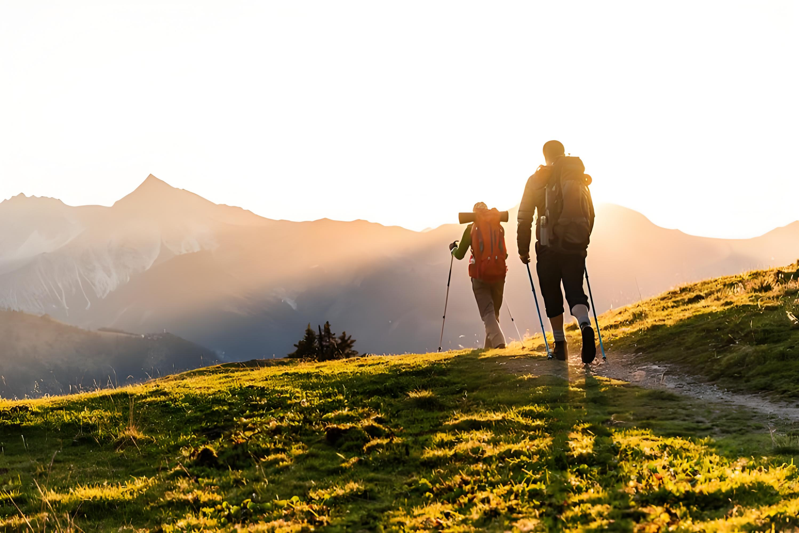
Thank you!

