Slide 1


感恩遇见，相互成就，本课件资料仅供您个人参考、教学使用，严禁自行在网络传播，违者依知识产权法追究法律责任。
更多教学资源请关注
公众号：溯恩英语
知识产权声明

Slide 2

2025.4宁波二模
阅读部分分析
北师大嘉兴附中 吴晨华

Slide 3
题型 | 话题 | 体裁 | 词数
阅读A | 人与社会： Stanford LEAD, a flagship online program | 说明文 | 271
阅读B | 人与自我： Blending art with medicine: My journey of self discovery | 记叙文 | 364
阅读C | 人与自然：Floating City: A solution for humanity’s co-existence with rising seas | 说明文 | 453
阅读D | 人与自我：The Vagus Nerve: the Link between Body and Mind | 说明文 | 359
七选五 | 人与自我： Keys to Healthy Weight and Eating Habits | 说明文 | 233
完形填空 | 人与社会： Food, a Bridge across Cultural Gaps | 记叙文 | 269
语法填空 | 人与社会： Blue-and-white Porcelain: A Symbol of East -West CuiItural Integration | 说明文 | 240

Slide 4

A
人与社会：Stanford LEAD, a flagship online program.

Slide 5
Promote your leadership with Stanford LEAD, our flagship online program. Gain the skills and mindset to succeed in today’s complex world.
What Is LEAD?
Taught by the same world-renowned Stanford Graduate School of Business (GSB) staff who teach in our MBA program, LEAD is a year-long experiential learning journey that enables you to unlock your leadership potential. This highly flexible, adjustable, and actionable program helps you build the leadership and innovation skills needed to drive change, solve real-world challenges, and achieve your personal and professional goals.
Through Stanford GSB’s innovative and academically-thorough online curriculum, you’ll tackle your own real-world obstacles by integrating course concepts with daily business challenges. The program provides a unique opportunity to expand your perspectives by exchanging ideas with an incredibly diverse global group of peers, while receiving personalized, practical feedback from Stanford GSB professors, course advisors, and classmates throughout your learning journey.
Who Should Attend?
●Mid-or senior-level professionals committed to adopting creative strategies to advance organizations’ leadership.
●Engaged leaders passionate for development skills to better team performance.
●Emerging leaders focusing on up-leveling their career path and master the foundations of impactful leadership.
Application Process for Stanford LEAD
The application process requires you to complete three components: the online application, a short essay, and an online video interview.
Fees& Payment
Your program fee includes tuition and course materials. Fees are subject to change, as are programs, dates, and professors.
Upon admission, payment details including an online payment link will be sent by email. Full payment confirms your admission. Payment is accepted by bank wire transfer or credit card.
21. What can we learn about LEAD?
A. It offers on-campus courses.
B. It is a Stanford MBA program.
C. It focuses on theoretical learning.
D. It aims to improve leadership skills.
22. Who will apply for this program?
A. New teachers.
B. Retired professors.
C. Graduating students.
D. Ambitious managers.
23. What is stated about Fees & Payment?
A. Program fees might vary.
B. Fees exclude course materials.
C. Cash payment is acceptable.
D. Payment is due before application.
应付的，应给的

Slide 6
文本语言分析与运用
an experiential learning journey
unlock leadership potential
build the innovative skills
solve real-world challenges/ tackle real-world obstacles
integrate with
exchange with
an incredibly diverse global group of peers
receive personalized, practical feedback
be subject to change
focus on theoretical learning
体验式学习之旅
解锁领导潜能
培养创新技能
解决现实世界的挑战/解决现实世界的障碍
与……整合/融合
与…交流
与一个极其多样化的全球同行群体
接受个性化的、实用的反馈
随时可能发生变化
注重理论学习

Slide 7
文本语言分析与运用
1. This highly flexible, adjustable, and actionable program helps you build the leadership and innovation skills __________(need) to drive change, solve real-world challenges, and achieve your personal and professional goals.
2. Mid-or senior-level professionals ___________(commit) to adopting creative strategies to advance organizations’ leadership.
3. ___________(engage) leaders passionate for development skills to better team performance.
4. __________ (emerge) leaders focusing on up-leveling their career path and master the foundations of impactful leadership.
5. Upon_______________________(admit), payment details including an online payment link will be sent by email.
6. Payment is due before application.
Most of the problems were due to human error.
Rose is due to start school in January.
Payment is due on 1 October.
Our thanks are due to the whole team.
She's due for promotion soon.
needed
committed
Engaged
Emerging
admission/being admitted
由于；因为
预定；预期；预计
到期
应支付；应给予；应归于
应有；应得到

Slide 8
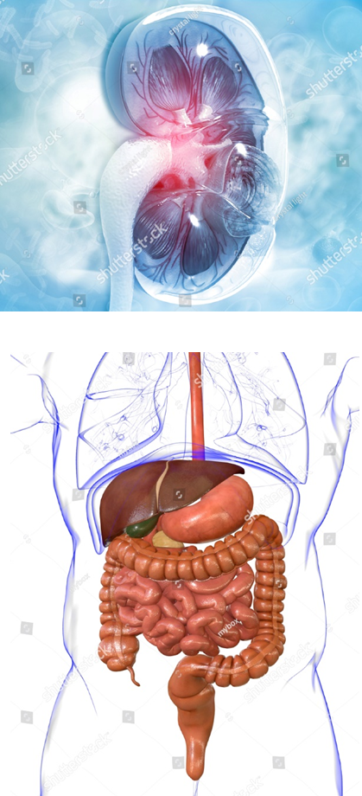
B
人与自我：Blending art with medicine: My journey of self discovery

Slide 9
My fingers trembled as I signed the pre-medical application form. The watercolor brushes on my desk stared back at me like abandoned friends. I’m Lora an 18-year-old who secretly drew brain diagrams on napkins while classmates drew cartoons. “Art feeds the soul but starves the body,” Mom always said. Her words haunted me as my biology textbooks slowly buried my drawing pads.
Then came the school career fair that changed everything. Dr. Eleanor Whitman from Harvard asked us to list our “hidden skills”. My hand shook as I wrote “observing details”—something I’d learned from painting flower petals. “That’s medical research’s most needed skill!” she exclaimed, sharing how a student turned microbiology notes into textbook illustrations. My lab partner whispered, “Remember our photosynthesis (光合作用) comic?” For the first time, my two worlds didn’t feel so separate.
The real surprise came during hospital volunteering. Watching surgeries, I noticed something—the steady hands of doctors reminded me of my brushwork. When a boy struggled to describe his pain, I drew a fire-breathing dragon on his cast. “You made medicine speak,” the nurse said. Slowly, my drawing pads filled with cells that looked like colored-glass art and X-rays arranged like abstract paintings.
Mr. Dawson, our career counselor, helped connect these dots. On his whiteboard, my medical knowledge and art skills overlapped in a bright yellow circle labeled “Medical Illustration”. He showed me job listings I never knew existed—graphic designers for science apps, 3D modelers for anatomy (解剖) classes. “Your ‘impractical’ skill makes you stand out,” he said, pointing to my dragon drawing now used in pain management workshops.
Today, my microscope and paintbrushes share the same desk. The same hands that once hesitated between them now create 3D models of viruses for vaccine education. Sometimes I teach young patients to draw their feelings instead of describing them. My story isn’t about heart and reality canceling each other out—they just multiply possibilities.
In time order
Conflict:医学理性与艺术感性的直接冲突
Turning point:艺术与科学并非割裂
Real surprise:艺术转化为医学沟通工具
Confirmation: “医学知识 + 艺术技能 = 医学插画”
Conclusion:心（艺术）与现实（医学）并非相互排斥

Slide 10
My fingers trembled as I signed the pre-medical application form. The watercolor brushes on my desk stared back at me like abandoned friends. I’m Lora an 18-year-old who secretly drew brain diagrams on napkins while classmates drew cartoons. “Art feeds the soul but starves the body,” Mom always said. Her words haunted me as my biology textbooks slowly buried my drawing pads.
Then came the school career fair that changed everything. Dr. Eleanor Whitman from Harvard asked us to list our “hidden skills”. My hand shook as I wrote “observing details”—something I’d learned from painting flower petals. “That’s medical research’s most needed skill!” she exclaimed, sharing how a student turned microbiology notes into textbook illustrations. My lab partner whispered, “Remember our photosynthesis (光合作用) comic?” For the first time, my two worlds didn’t feel so separate.
The real surprise came during hospital volunteering. Watching surgeries, I noticed something—the steady hands of doctors reminded me of my brushwork. When a boy struggled to describe his pain, I drew a fire-breathing dragon on his cast. “You made medicine speak,” the nurse said. Slowly, my drawing pads filled with cells that looked like colored-glass art and X-rays arranged like abstract paintings.
Mr. Dawson, our career counselor, helped connect these dots. On his whiteboard, my medical knowledge and art skills overlapped in a bright yellow circle labeled “Medical Illustration”. He showed me job listings I never knew existed—graphic designers for science apps, 3D modelers for anatomy (解剖) classes. “Your ‘impractical’ skill makes you stand out,” he said, pointing to my dragon drawing now used in pain management workshops.
Today, my microscope and paintbrushes share the same desk. The same hands that once hesitated between them now create 3D models of viruses for vaccine education. Sometimes I teach young patients to draw their feelings instead of describing them. My story isn’t about heart and reality canceling each other out—they just multiply possibilities.
24. What can be inferred about Lora from paragraph 1?
A. She had given up the hobby of drawing.
B. She was excited about studying medicine.
C. She felt torn between art and medical study.
D. She regretted not practicing painting earlier.
25. Dr. Eleanor thought of Lora’ s “hidden skills” as ______.
A. a plus. B. a leisure.
C. a distraction. D. a burden.
26. How did Lora’s hospital experience influence her?
A. It helped develop her surgical skills.
B. It directed her toward doctor training.
C. It boosted her enthusiasm for abstract art.
D. It convinced her of art’s role in healthcare.
27. What message does the author want to convey?
A. Follow the beaten track to success.
B. A picture is worth a thousand words.
C. Don’t put all your eggs in one basket.
D. Two strings to your bow light the way.

Slide 11
文本语言分析与运用
Word bank on vocational exploration and interdisciplinary integration
1.describe “conflicting and feeling torn”
描述 情感矛盾，纠结
在A和B之间犹豫
像被抛弃的朋友一样回望着我
描述理想与现实的矛盾
艺术滋养灵魂，但不能养家糊口
现实考量压制了艺术追求
Her words _______________(萦绕心头) as my biology textbooks ___________(逐渐取代、掩埋) my drawing pads
2. describe Integration
在一个明亮的黄色圆圈中重叠 ，表示学科或事物间的融合交汇 overlap in a bright yellow circle
共用一张书桌 ，象征不同事物共处、融合 share the same desk
我的故事并非是内心追求与现实相互抵触 —— 而是增加了更多可能（融合的意义）
hesitate between... and...
stare back at me like abandoned friend
Art nourishes the soul, but can't support a family
lingered in my mind
slowly buried
My story isn’t about inner-pursuit and reality clashing —they just add more possibilities

Slide 12
文本语言分析与运用
翻译文本
Lili’s struggle
在大学宿舍里，莉莉在一个诱人的艺术实习机会和一项必修的科学项目之间犹豫不决。她的画笔像被遗弃的伙伴一样望着她。她知道艺术能滋养她的心灵，但这个项目关系到学分。她备受煎熬，陷入了这种两难的境地。
In the college dormitory, Lily hesitates between a tempting art internship and a compulsory science project. Her paintbrushes stare/ gaze at her like abandoned companions/ mates. She knows art feeds her spirit/nourish her soul, but/ yet the project is related to academic credits. Torn, she’s stuck/caught in this dilemma.

Slide 13
文本语言分析与运用
句子仿写：
My fingers trembled as I signed the pre-medical application form. The watercolor brushes on my desk stared back at me like abandoned friends. I’m Lora an 18-year-old who secretly drew brain diagrams on napkins while classmates drew cartoons. “Art feeds the soul but starves the body,” Mom always said. Her words haunted me as my biology textbooks slowly buried my drawing pads.
Then came the school career fair that changed everything. My hand shook as I wrote “observing details” .
The real surprise came during hospital volunteering.
The same hands that once hesitated between them now create 3D models of viruses for vaccine education.
My story isn’t about heart and reality canceling each other out—they just multiply possibilities.
我的手指颤抖了当我注意到一张照片，上面写着“Brian拍的照片”时。这些文字和照片上的人像一个嘲笑者一样盯着我。然后是Brian的微笑和解释。他温柔而温暖的话语减轻了我内心的负罪感。抬起头，看着Brian的眼睛（非谓语），我意识到我的哥哥曾经是一个弱小的人，现在正以他自己的方式照看着我，成为我真正的守护天使（非谓语）。如果没有这次经历，我不会明白，兄弟情谊不是大小、年龄和力量的问题，而是相互理解、关心和宽容。
My fingers trembled as I noticed a picture which was written “Photo by Brian”. The words together with the person in the picture stared back at me like a mocker. Then came Brian’s smile and explanation. His soft and warm words relieved the guilt within me. Raising my head and looking into Brian’s eyes, I was aware that my brother who had been once small and weak was now watching over me in his own way, being my true guardian angel. Had it not been for this experience, I wouldn’t have understood that brotherhood is not about size, age and strength, it’s just about mutual understanding, care and tolerance.

Slide 14
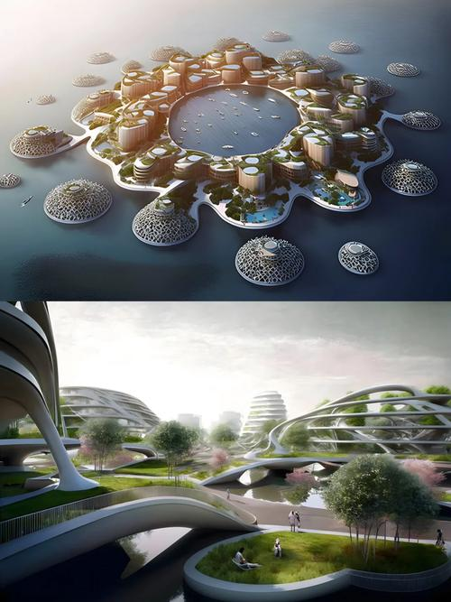
C
人与自然：Floating City: A solution for humanity’s co-existence with rising seas

Slide 15
Global sea levels continue to rise despite efforts that cities around the world are making to reduce the effects of climate change and their carbon emissions. One firm, however, is hoping to battle the effects of climate change. Driven by alarming estimates that 36.6 million people in Asian coastal cities like Mumbai could face flooding by 2070, Luca Curci Architects, based in Venice, Italy, has released Floating City — a design that would allow urban areas to rise with the waters while making use of renewable energies to reduce their own carbon emissions.
Each 25-acre unit houses 50,000 residents on interconnected platforms, with potential expansion for 200,000and buildings are capped at 90 meters tall for stability. “Structures must be flexible like bamboo in wind to resist waves,” explains architect Curci. To achieve this, seawater resistant materials are given priority to, while hollow sections in platforms help them float. Meanwhile, movable bridges are constructed to link these “water neighborhoods” to mainland transport systems.
The project team also envisions a mix of renewable energy sources extracting power from wind, water, and the sun to power the city. During extreme weather, platforms automatically separate and regroup using intelligence algorithms inspired by how fish schools avoid hunters.
Compared to building artificial islands, this method preserves 68% more marine (海洋) life and uses surfaces that absorb rainwater to reduce flooding risks. However, challenges persist. Seawater slowly harms materials, requiring repair every four months, and emergency plans for extreme weather are still under way. “This isn’t about abandoning coasts but evolving with them,” notes designer Tim Fu.
While some question long-term possibility, the design redefines urban resilience. Unlike rigid sea walls, these dynamic structures harmonize with oceanic rhythms, offering a blueprint for climate solutions. “Cities must learn to dance with the waves,” Curci says. This philosophy could transform humanity’s relationship with rising seas, turning threats into sustainable opportunities.
Lead in:
Floating city
The design
Advantages and disadvantages
Significance

Slide 16
Global sea levels continue to rise despite efforts that cities around the world are making to reduce the effects of climate change and their carbon emissions. One firm, however, is hoping to battle the effects of climate change. Driven by alarming estimates that 36.6 million people in Asian coastal cities like Mumbai could face flooding by 2070, Luca Curci Architects, based in Venice, Italy, has released Floating City — a design that would allow urban areas to rise with the waters while making use of renewable energies to reduce their own carbon emissions.
Each 25-acre unit houses 50,000 residents on interconnected platforms, with potential expansion for 200,000and buildings are capped at 90 meters tall for stability. “Structures must be flexible like bamboo in wind to resist waves,” explains architect Curci. To achieve this, seawater resistant materials are given priority to, while hollow sections in platforms help them float. Meanwhile, movable bridges are constructed to link these “water neighborhoods” to mainland transport systems.
The project team also envisions a mix of renewable energy sources extracting power from wind, water, and the sun to power the city. During extreme weather, platforms automatically separate and regroup using intelligence algorithms inspired by how fish schools avoid hunters.
Compared to building artificial islands, this method preserves 68% more marine (海洋) life and uses surfaces that absorb rainwater to reduce flooding risks. However, challenges persist. Seawater slowly harms materials, requiring repair every four months, and emergency plans for extreme weather are still under way. “This isn’t about abandoning coasts but evolving with them,” notes designer Tim Fu.
While some question long-term possibility, the design redefines urban resilience. Unlike rigid sea walls, these dynamic structures harmonize with oceanic rhythms, offering a blueprint for climate solutions. “Cities must learn to dance with the waves,” Curci says. This philosophy could transform humanity’s relationship with rising seas, turning threats into sustainable opportunities.
28. What drove Luca Curci Architects to come up with a new design?
A. Energy crisis. B. Potential disasters.
C. Tourism expansion. D. Overcrowded cities.
29. Which of the following best describes Luca Curci’s design?
A. Fictional and renewable.
B. Adaptable and innovative.
C. Eco-friendly and immovable.
D. Wave-resistant and conventional.
30. A limitation of Luca Curci’s design is that ______.
A. it threatens marine life
B. it lacks clean energy options
C. it requires regular maintenance
D. it ignores coastal water changes
31. Which of the following can be a suitable title for the text?
A. Ocean Protection: Life under Threat
B. Rising with the Tides: Floating Cities
C. Connecting to the Future: Eco Solutions
D. Coastal Design: Inspiration from Bamboo

Slide 17
文本语言分析与运用
熟词生义：
__________(drive) by alarming estimates(__________) that 36.6 million people in Asian coastal cities like Mumbai could face flooding by 2070, Luca Curci Architects, _________(base:__________________) in Venice, Italy, has released Floating City — a design _______ would allow urban areas to rise with the waters while making use of renewable energies ___________(reduce) their own carbon emissions.
I can give you a rough estimate of the amount of wood you will need.
I spend a lot of time in Britain but Paris is still my base.
Each 25-acre unit ________(house:__________________________________) 50,000 residents on interconnected platforms, with potential expansion for 200,000 _______ buildings are capped (___________) at 90 meters tall for __________(stable).
The project team also envisions(_______________) a mix of renewable energy sources ___________ (extract) power from wind, water, and the sun to power the city.
vision:__________ → visible:____________ →visual: ___________ → envision: _________
→visibility:_________ → visionary:______________
The following extract is taken from her new novel.
This article is extracted from his new book.
During extreme weather, platforms _____________(automatic) separate and regroup (__________________) using intelligence algorithms _______(inspire) by how fish schools avoid hunters.
Driven
v.估计
based
以…为据点（或总部等）
that
to reduce
n.（对数量、成本等的）估计；估价
n. 据点；总部；大本营
houses
v. 是（某物）的贮藏处（或安置处）
and
v.覆盖
stability
v.想象，预想
extracting
v.想象，预想
n.视力/视觉
adj.看得见的
adj.视觉的
n.能见度
adj.有眼力的,想象力丰富的n.有远见的人
n.摘录；选录；选曲；节录
v.选取；摘录；选录
automatically
v. 重新组合/编组
inspired

Slide 18

D
人与自我：The Vagus Nerve: the Link between Body and Mind

Slide 19
It is late at night. You wander empty streets, heart pounding, muscles tense, sensing danger nearby. Now imagine the same situation, but without these responses. Would you still feel afraid? Experiences like this unveil a profound truth: our minds are not just products of the brain but emerge from its constant dialogue with the body.
At the heart of this connection is the vagus nerve (神经) — the body’s longest nerve. It winds its way from the brain throughout the head and trunk, issuing commands to our organs and receiving feelings from them. Much of the confusing range of functions it regulates are automatic and operate without conscious control. These complex responses engage a group of neural networks that link brain and body. The vagus nerve is, in one way of thinking, the conduit of the mind.
The primary function of the vagus nerve is to dampen the body’s responses. After a fear episode, for example, the body’s powerful, life-saving threat response must be ended to restore resting heartbeat, breathing, blood flow and the rest. So powerful is its influence that the vagus nerve can literally stop the beating heart. Conversely, it can also stimulate bodily responses by releasing the brakes to accelerate.
The vagus nerve is the biological basis for many new therapies (疗法) worldwide. However, some people have taken the vagus nerve’s wide-ranging bodily influence as an invitation to engage in false science. In some corners of the Internet, so-called polyvagal therapy—physical or breathing exercises that some claim reset the vagus nerve — is proposed to address just about any disorder of the mind or body. There’s little evidence that these popular therapies are anything but comfort.
The vagus nerve doesn’t need to be a cure for everything — its worth appreciating all on its own. Neuroscientists compare the vagus to an orchestra conductor, harmonizing bodily systems to compose our conscious experience. Professor Linda Rinaman once said, “We’re not just brains in jars. Our thoughts and feelings are rooted in flesh and blood.”
Introduce a truth
Vagus nerve
Vagus nerve’s function
Bad influence
Significance

Slide 20
It is late at night. You wander empty streets, heart pounding, muscles tense, sensing danger nearby. Now imagine the same situation, but without these responses. Would you still feel afraid? Experiences like this unveil a profound truth: our minds are not just products of the brain but emerge from its constant dialogue with the body.
At the heart of this connection is the vagus nerve (神经) — the body’s longest nerve. It winds its way from the brain throughout the head and trunk, issuing commands to our organs and receiving feelings from them. Much of the confusing range of functions it regulates are automatic and operate without conscious control. These complex responses engage a group of neural networks that link brain and body. The vagus nerve is, in one way of thinking, the conduit of the mind.
The primary function of the vagus nerve is to dampen the body’s responses. After a fear episode, for example, the body’s powerful, life-saving threat response must be ended to restore resting heartbeat, breathing, blood flow and the rest. So powerful is its influence that the vagus nerve can literally stop the beating heart. Conversely, it can also stimulate bodily responses by releasing the brakes to accelerate.
The vagus nerve is the biological basis for many new therapies (疗法) worldwide. However, some people have taken the vagus nerve’s wide-ranging bodily influence as an invitation to engage in false science. In some corners of the Internet, so-called polyvagal therapy—physical or breathing exercises that some claim reset the vagus nerve — is proposed to address just about any disorder of the mind or body. There’s little evidence that these popular therapies are anything but comfort.
The vagus nerve doesn’t need to be a cure for everything — its worth appreciating all on its own. Neuroscientists compare the vagus to an orchestra conductor, harmonizing bodily systems to compose our conscious experience. Professor Linda Rinaman once said, “We’re not just brains in jars. Our thoughts and feelings are rooted in flesh and blood.”
32. How does the author introduce the topic in paragraph 1?
A. By sharing a story.
B. By creating a scene.
C. By asking a question.
D. By defining a concept.
33. What does the underlined word “conduit” in paragraph 2 mean?
A. Channel. B. Product.
C. Mirror. D. Nature.
34. What does paragraph 4 mainly talk about?
A. The popularity of a biological treatment
B. The effectiveness of breathing exercises.
C. The misuse of unproven nerve therapies.
D. The evidence of vagus nerve’s functions.
35. What do Linda Rinaman’s words imply?
A. Blood circulation determines our emotions.
B. Physical health is unrelated to mental states.
C. Body and mind interact to form experiences.
D. Our brain stores feelings separate from body.

Slide 21
心怦怦跳
肌肉紧张
揭示深刻的真理
蜿蜒前行
发布命令
调节功能
无意识操作
抑制身体的反应
强有力的挽救生命威胁的应对措施
解决精神障碍
一点也不
治疗方法
根植于血肉之中
pounding heart/ beating heart
tense muscles
unveil a profound truth
wind its way
issue commands
regulate functions
operate without conscious control
dampen the body’s responses
powerful, life-saving threat response
address disorder of the mind
anything but
a cure for
be rooted in flesh and blood

Slide 22
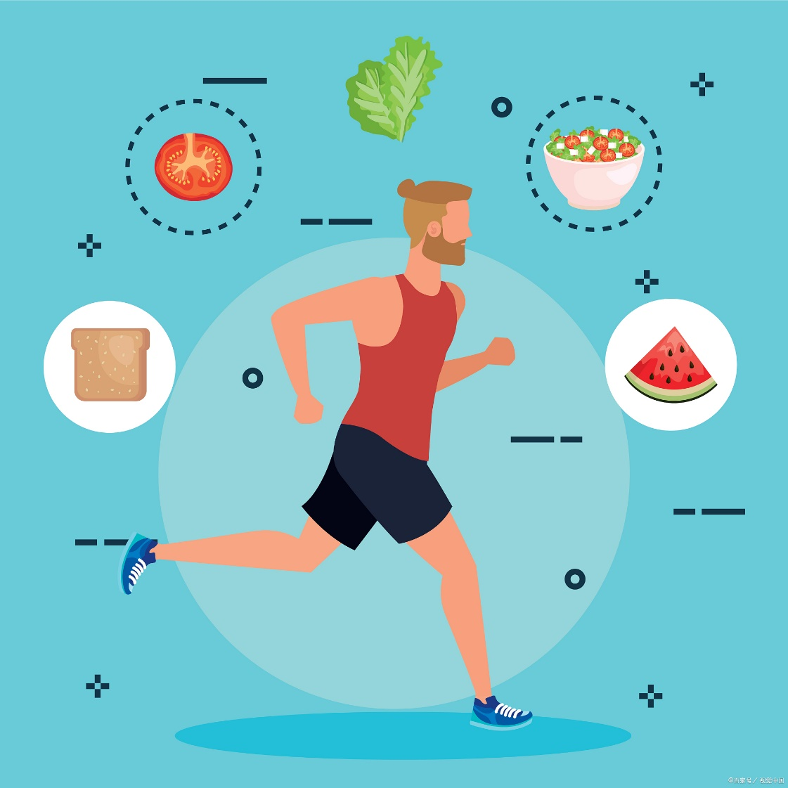
七选五
人与自我：Keys to Healthy Weight and Eating Habits

Slide 23
Step1 读文本大意、理篇章结构
General → Specific →General
The path to healthy weight combines two key elements. Exercise and eating habits form its foundation. Some believe they demand lots of effort or planning. But that’s not true. In fact, the best way to work them into our lives is by making small changes that gradually become part of our routine. ___36___
Regular Exercise
Teens should get 60+ minutes of daily physical activity. ___37___ All that matters is that each week you get the right balance of activity, including dancing, brisk walking, or stair-climbing. Breaking works into 15-minute “exercise snacks” (e. g., morning yoga, lunchtime walks) throughout the day makes goals more achievable. This strategy avoids burnout while keeping energy steady.
Good Eating Habits
___38___ Actually, crash diets cause weight rebounds. A 2022 study found 80% of teens regained weight post-diet. Therefore, teens should eat a variety of foods, and there’s nothing wrong with the occasional treat. A candy bar somehow beats snapping daily.
To build lasting habits, reshape your mindset. ___39___ When stressed, try brief walks rather than reaching for snacks. Track weekly progress with a checklist—small achievements boost motivation strongly.
In conclusion, creatively design routines blending exercise and nutrition in your own way. ___40___ While others choose gym workouts, you might prefer playing Frisbee with your dog. Knowing what’s right for you will make it a lot easier to do!

Slide 24
Step2 读选项，抓关键
A. You’re all different after all.
B. Independence matters in habit-building.
C. View food as fuel, not emotional comfort.
D. Low-calorie diets ensure steady weight loss.
E. Eating well doesn’t mean dieting over and over.
F. It doesn’t mean doing tough exercises or hitting the gym.
G. Here’s how to make these other healthy habits just as easy.
句间衔接
指代、代词
关键词

Slide 25
Step3 逐一分析、聚焦上下文
The path to healthy weight combines two key elements. Exercise and eating habits form its foundation. Some believe they demand lots of effort or planning. But that’s not true. In fact, the best way to work them into our lives is by making small changes that gradually become part of our routine. ___36___
Regular Exercise
Teens should get 60+ minutes of daily physical activity. ___37___ All that matters is that each week you get the right balance of activity, including dancing, brisk walking, or stair-climbing. Breaking works into 15-minute “exercise snacks” (e. g., morning yoga, lunchtime walks) throughout the day makes goals more achievable. This strategy avoids burnout while keeping energy steady.
Good Eating Habits
___38___ Actually, crash diets cause weight rebounds. A 2022 study found 80% of teens regained weight post-diet. Therefore, teens should eat a variety of foods, and there’s nothing wrong with the occasional treat. A candy bar somehow beats snapping daily.
G
A. You’re all different after all.
B. Independence matters in habit-building.
C. View food as fuel, not emotional comfort.
D. Low-calorie diets ensure steady weight loss.
E. Eating well doesn’t mean dieting over and over.
F. It doesn’t mean doing tough exercises or hitting the gym.
G. Here’s how to make these other healthy habits just as easy.

Slide 26
Step3 逐一分析、聚焦上下文
The path to healthy weight combines two key elements. Exercise and eating habits form its foundation. Some believe they demand lots of effort or planning. But that’s not true. In fact, the best way to work them into our lives is by making small changes that gradually become part of our routine. ___36___
Regular Exercise
Teens should get 60+ minutes of daily physical activity. ___37___ All that matters is that each week you get the right balance of activity, including dancing, brisk walking, or stair-climbing. Breaking works into 15-minute “exercise snacks” (e. g., morning yoga, lunchtime walks) throughout the day makes goals more achievable. This strategy avoids burnout while keeping energy steady.
Good Eating Habits
___38___ Actually, crash diets cause weight rebounds. A 2022 study found 80% of teens regained weight post-diet. Therefore, teens should eat a variety of foods, and there’s nothing wrong with the occasional treat. A candy bar somehow beats snapping daily.
G
F
A. You’re all different after all.
B. Independence matters in habit-building.
C. View food as fuel, not emotional comfort.
D. Low-calorie diets ensure steady weight loss.
E. Eating well doesn’t mean dieting over and over.
F. It doesn’t mean doing tough exercises or hitting the gym.
G. Here’s how to make these other healthy habits just as easy.

Slide 27
Step3 逐一分析、聚焦上下文
The path to healthy weight combines two key elements. Exercise and eating habits form its foundation. Some believe they demand lots of effort or planning. But that’s not true. In fact, the best way to work them into our lives is by making small changes that gradually become part of our routine. ___36___
Regular Exercise
Teens should get 60+ minutes of daily physical activity. ___37___ All that matters is that each week you get the right balance of activity, including dancing, brisk walking, or stair-climbing. Breaking works into 15-minute “exercise snacks” (e. g., morning yoga, lunchtime walks) throughout the day makes goals more achievable. This strategy avoids burnout while keeping energy steady.
Good Eating Habits
___38___ Actually, crash diets cause weight rebounds. A 2022 study found 80% of teens regained weight post-diet. Therefore, teens should eat a variety of foods, and there’s nothing wrong with the occasional treat. A candy bar somehow beats snapping daily.
G
F
E
A. You’re all different after all.
B. Independence matters in habit-building.
C. View food as fuel, not emotional comfort.
D. Low-calorie diets ensure steady weight loss.
E. Eating well doesn’t mean dieting over and over.
F. It doesn’t mean doing tough exercises or hitting the gym.
G. Here’s how to make these other healthy habits just as easy.

Slide 28
Step3 逐一分析、聚焦上下文
To build lasting habits, reshape your mindset. ___39___ When stressed, try brief walks rather than reaching for snacks. Track weekly progress with a checklist—small achievements boost motivation strongly.
In conclusion, creatively design routines blending exercise and nutrition in your own way. ___40___ While others choose gym workouts, you might prefer playing Frisbee with your dog. Knowing what’s right for you will make it a lot easier to do!
C
A. You’re all different after all.
B. Independence matters in habit-building.
C. View food as fuel, not emotional comfort.
D. Low-calorie diets ensure steady weight loss.
E. Eating well doesn’t mean dieting over and over.
F. It doesn’t mean doing tough exercises or hitting the gym.
G. Here’s how to make these other healthy habits just as easy.

Slide 29
Step3 逐一分析、聚焦上下文
To build lasting habits, reshape your mindset. ___39___ When stressed, try brief walks rather than reaching for snacks. Track weekly progress with a checklist—small achievements boost motivation strongly.
In conclusion, creatively design routines blending exercise and nutrition in your own way. ___40___ While others choose gym workouts, you might prefer playing Frisbee with your dog. Knowing what’s right for you will make it a lot easier to do!
C
A
A. You’re all different after all.
B. Independence matters in habit-building.
C. View food as fuel, not emotional comfort.
D. Low-calorie diets ensure steady weight loss.
E. Eating well doesn’t mean dieting over and over.
F. It doesn’t mean doing tough exercises or hitting the gym.
G. Here’s how to make these other healthy habits just as easy.

Slide 30
文本语言分析与运用
词组和常考表达
1.把…… 和…… 结合起来
combine...with...
2.构成基础
form the foundation
3.成为…… 的一部分
become part of
4.体育活动
physical activity
5.把…… 分解 /分成
break...into...
6.锻炼计划
workout routines
7.极速节食
crash diets
8.体重反弹
weight rebounds
9.重塑你的思维模式
reshape your mindset
10.把…… 融入
blend...in
11. 把…… 看作
view...as...
12.情感慰藉
emotional comfort
13.稳定减重
steady weight loss
14.高强度运动
tough exercises
15.去健身房
hitting the gym

Slide 31
文本语言分析与运用
长难句语法填空并翻译
1. In fact, the best way _________(work) them into our lives is by making small changes__________gradually become part of our routine.
实际上，将它们融入我们生活的最佳方式是做出一些小改变，这些改变会逐渐成为我们日常生活的一部分。
2.__________(break) workouts into 15 - minute “exercise snacks” (e.g., morning yoga, lunchtime walks) throughout the day makes goals _______________(achieve) . This strategy avoids burnout _______ keeping energy steady.
将锻炼分散到一整天，分成 15 分钟的 “锻炼小食”（比如晨练瑜伽、午餐时间散步），会让目标更容易实现。这种策略能避免倦怠，同时保持精力稳定。
3.When ________(stress), try brief walks rather than ________(reach) for snacks. Track weekly progress with a checklist—small ______________(achieve) boost motivation strongly.
感到压力大时，试着散散步，而不是伸手去拿零食。用清单记录每周的进展 —— 小成就会极大地提升动力。
to work
that
Breaking
more achievable
while
stressed
reaching
achievements

Slide 32
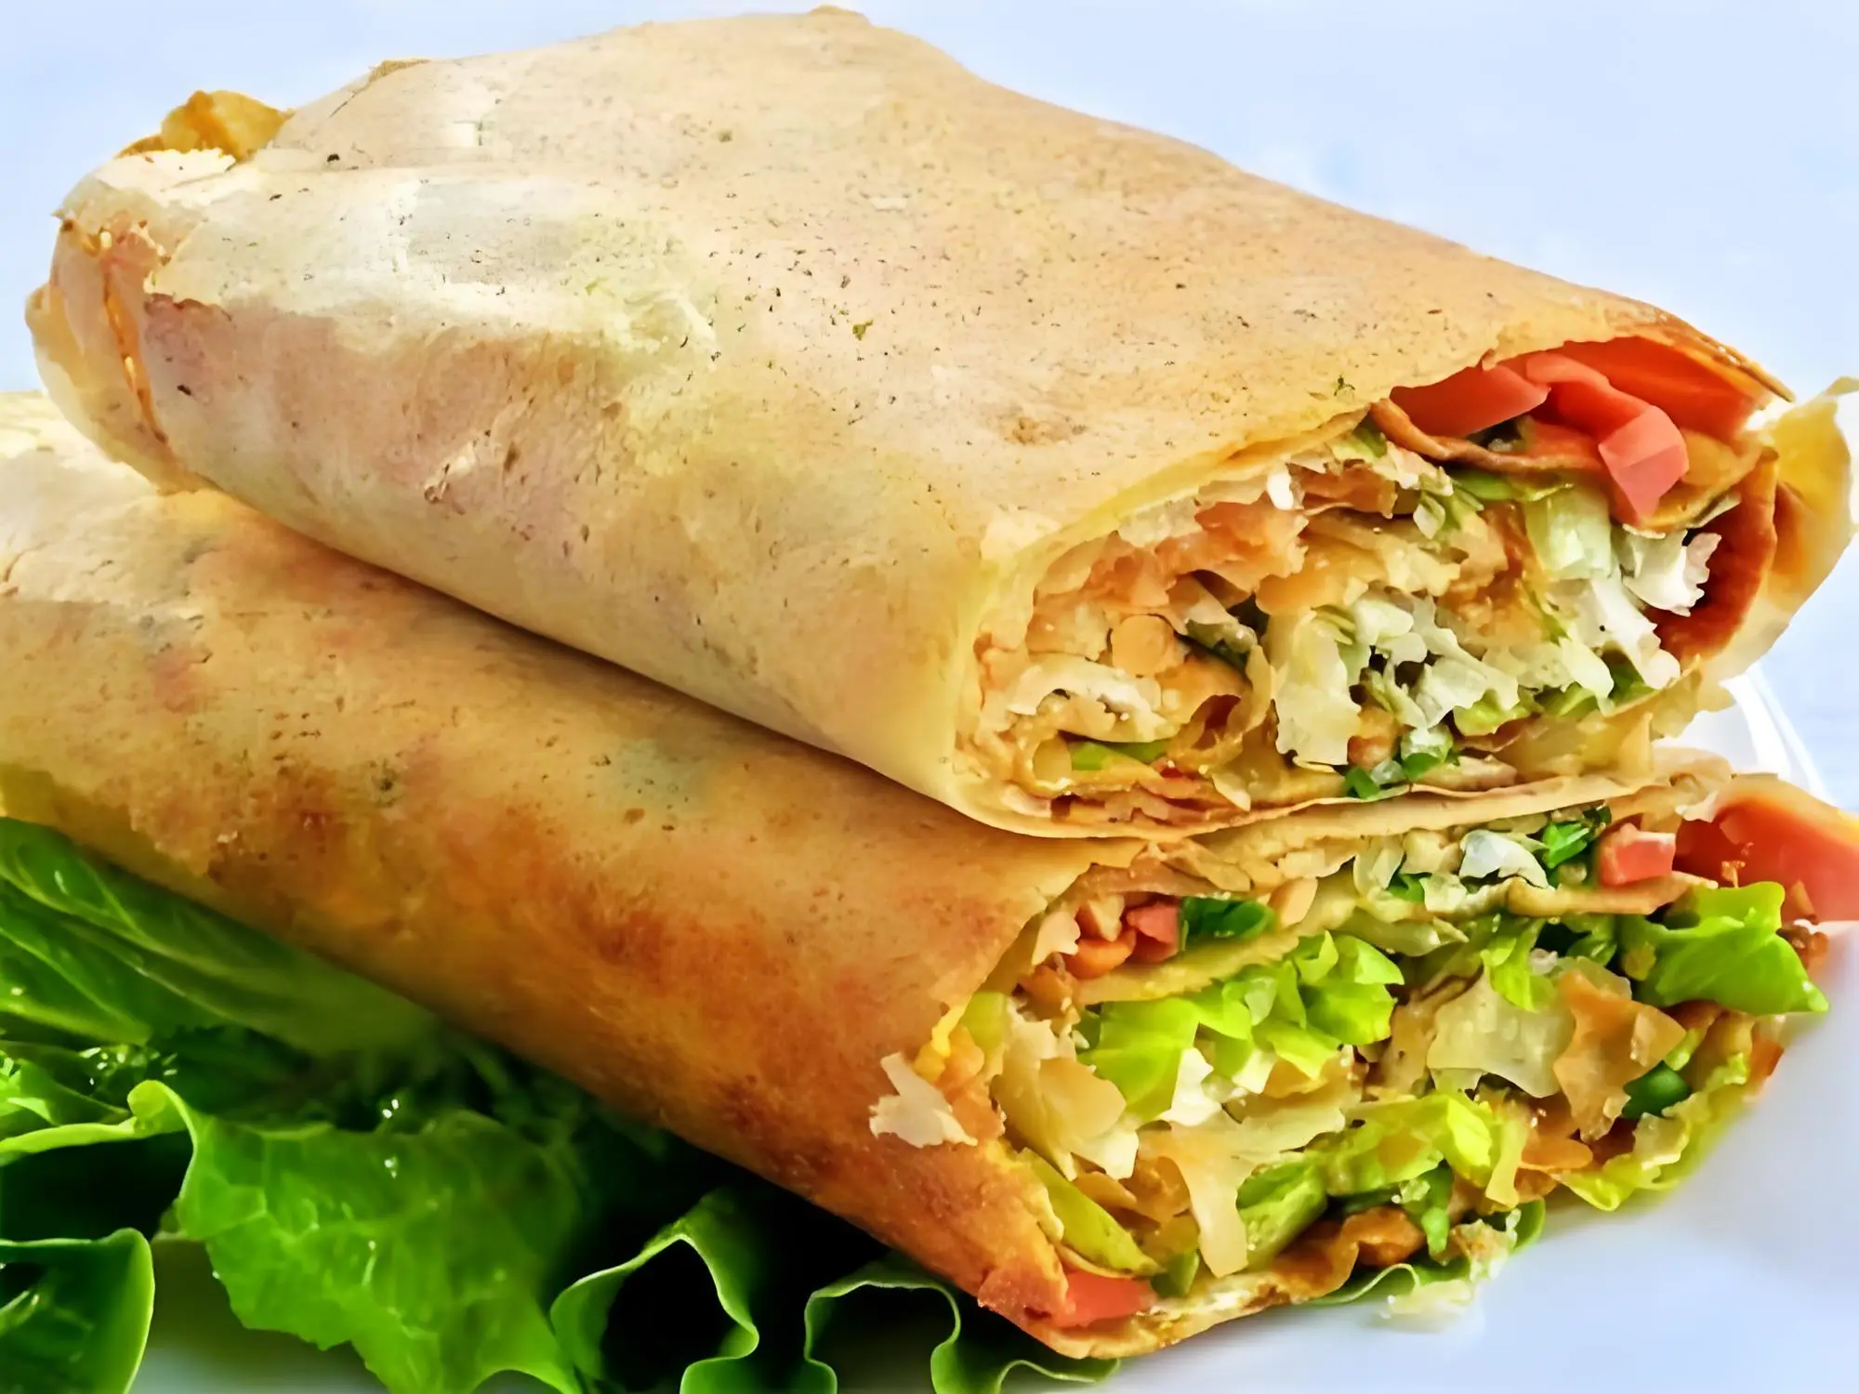
完形填空
人与社会：Food, a Bridge across Cultural Gaps

Slide 33
Step1: 选项全击破
41. A. adventure B. struggle C. routine D. necessity
42. A. messy B. ordinary C. strange D. special
43. A. mattered B. worked C. rested D. changed
44. A. praised B. postponed C. concluded D. launched
45. A. purchase B. review C. prepare D. receive
46. A. joked B. hesitated C. insisted D. protested
47. A. laid out B. held back C. heated up D. gave away
48. A. argued B. denied C. admitted D. added
49. A. identity B. interest C. personality D. quality
50. A. freed B. relaxed C. amused D. connected
51. A. betrayed B. overlooked C. envied D. misled
52. A. borrowing B. authoring C. promoting D. sponsoring
53. A. stories B. photos C. recipes D. quotes
54. A. game B. question C. gift D. lunch
55. A. tastiest B. heaviest C. oldest D. fastest
凌乱的
发起，开始着手
抗议
布置，陈列
身份
有联系的，相关的
忽视，俯瞰
创作，署名
赞助
食谱

Slide 34
Step2: 首尾定主题
Food, a Bridge across Cultural Gaps
While her French classmates ate salads, Li Mei took out a package of steamed rice. When she transferred to a high school in Paris, her lunch became a daily ___41___. One Monday, one boy Pierre pointed at her lunch and whispered, “That looks ___42___!” Li Mei flushed, quietly avoiding the cafeteria.
Everything ___43___ when her history teacher, Mr. Dupont, ___44___ a project “Food & Culture Week”. Each student was to ___45___ a traditional dish and present its cultural significance. Li Mei ___46___ — would anyone care about Chinese food here? Eventually, she decided on jianbing, a flavor from hometown.
On presentation day, she ___47___ the materials with trembling hands. To her surprise, Pierre volunteered to help cook. As they spread the batter (面糊), he ___48___. “I made fun of your food at first, but now I see it’s part of your ___49___.” When the crispy jianbing was served, classmates crowded around, asking questions about Chinese New Year traditions.
The event made everyone ____50____. Students who once ____51____ her now greeted her warmly. A girl named Sophie even proposed ____52____ a French-Chinese cookbook together for the school fair and suggested including family dishes passed down through generations.
On the final day, ____53____ filled a book titled Bites Beyond Borders. Holding it, Li Mei realized that cultural gaps weren’t about walls but doors — waiting to be unlocked. A simple ____54____ had taught her more about belonging than any textbook.
“Food is the ____55____ foreign policy,” Mr. Dupont said, biting into a red bean croissant.
struggle
strange
changed
lunch
tastiest

Slide 35
Step3: 主体找线索
Food, a Bridge across Cultural Gaps
While her French classmates ate salads, Li Mei took out a package of steamed rice. When she transferred to a high school in Paris, her lunch became a daily ___41___. One Monday, one boy Pierre pointed at her lunch and whispered, “That looks ___42___!” Li Mei flushed, quietly avoiding the cafeteria.
Everything ___43___ when her history teacher, Mr. Dupont, ___44___ a project “Food & Culture Week”. Each student was to ___45___ a traditional dish and present its cultural significance. Li Mei ___46___ — would anyone care about Chinese food here? Eventually, she decided on jianbing, a flavor from hometown.
On presentation day, she ___47___ the materials with trembling hands. To her surprise, Pierre volunteered to help cook. As they spread the batter (面糊), he ___48___. “I made fun of your food at first, but now I see it’s part of your ___49___.” When the crispy jianbing was served, classmates crowded around, asking questions about Chinese New Year traditions.
The event made everyone ____50____. Students who once ____51____ her now greeted her warmly. A girl named Sophie even proposed ____52____ a French-Chinese cookbook together for the school fair and suggested including family dishes passed down through generations.
On the final day, ____53____ filled a book titled Bites Beyond Borders. Holding it, Li Mei realized that cultural gaps weren’t about walls but doors — waiting to be unlocked. A simple ____54____ had taught her more about belonging than any textbook.
“Food is the ____55____ foreign policy,” Mr. Dupont said, biting into a red bean croissant.
struggle
strange
changed
launched
prepared
hesitated
laid out
admitted
identity
connected
overlooked
authoring
recipes
lunch
tastiest

Slide 36
文本语言分析与运用
Word bank themed cultural differences and integration
1. Food is __________________________ (是某人身份认同的一部分 ).
2. Culture gaps weren’t _____________________________________.
文化差异并不是隔阂，而是一扇扇等待被开启的门。
3.A simple lunch ______________________________________________________________.
一顿简单的午餐比任何一本教科书都更能让她体会到归属感的含义。
4.Food is the __________________________________ foreign policy.
美食是最有吸引力（美味的）的外交策略。
part of one's identity.
barriers, but doors waiting to be opened.
can make her understand the meaning of belonging better than any textbook.
the most appealing (delicious/tastiest )

Slide 37
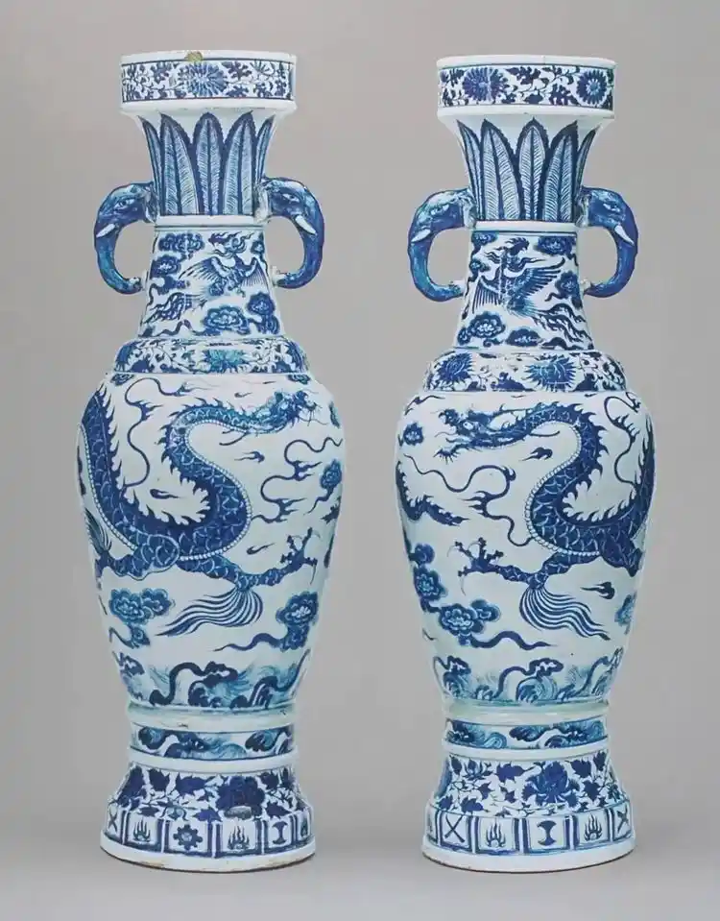
语法填空
人与社会：Blue-and-white Porcelain: A Symbol of East-West Cultural Integration

Slide 38
Blue-and-white porcelain (青花瓷), a product of ___56___ (share) creativity, tells a story of how East and West craftsmanship harmonized. In the Yuan Dynasty, Persian merchants brought special pigments (颜料) to Jingdezhen, where porcelain traditions ____ _ 57__ _ (perfect). Local craftsmen mixed these pigments with white clay, creating the iconic blue patterns. By painting traditional Chinese designs using foreign materials, they achieved a perfect __ ___58_ __ (combine) of traditions.
Over the centuries, this technique steadily advanced. During the Ming Dynasty, porcelain became a major export. European ___59___ (noble) loved its unique charm, calling it “white gold”. To meet their needs, Chinese artists added European elements like rose patterns to traditional landscapes, making the porcelain more appealing ___60___ westerners.
Modern artists still use these old techniques in creative ways. At ___61___ London show in 2025, a young maker used 3D printers ___62___ (shape) vases but hand-painted them with dragons and Greek myths side by side. Visitors said it felt like ancient China meeting modern Europe through hybrid art.
Today, this global dialogue continues in museums worldwide. A Ming-era dish that once belonged to a French King ___63___ (sit) in the Louvre. Its journey from Jingdezhen to the Palace of Versailles, marked by countless hands across continents, reflects how beauty goes beyond borders. ___64___ Craig Clunas noted, “The blue that fascinates the world is never ____65____ (mere) a color — it is a language.”
shared
56. shared
非谓语动词做定语，表示被动，“共同的”
57. were perfected
过去式谓语 ，表被动
58.combination
名词
59.nobles
名词复数
60.to
介词，固定用法 appeal to sb 吸引某人
61. a
冠词 ,前文未提及
62.to shape
非谓语, use sth to do
63.sits
谓语,表示现在状态
64.As
定语从句引导词，表示正如...,正像...
65.merely
副词
were perfected
combination
nobles
to
a
to shape
sits
As
merely

Slide 39
9.为满足...需求
to meet their needs
10. 在传统山水画中加入玫瑰图案等欧洲元素
add European elements like rose patterns to traditional landscapes
11. 让瓷器对西方人更具吸引力
make sth more appealing to westerners
12. 以创造性的方式运用这些古老技艺
use these old techniques in creative ways
13. 就像是古代中国与现代欧洲通过混合艺术相遇
feel like ancient China meeting modern Europe through hybrid art
14. 反映了美是如何跨越国界的
reflect how beauty goes beyond borders
15. 正如...所说
As sb noted
16. 令世界着迷的东西
sth that fascinates the world
文本语言分析与运用
1. 一种融合共享创意的产物
a product of shared creativity
2. 完善传统
perfect traditions
3. 当地工匠
Local craftsmen
4. 标志性的蓝色图案
the iconic blue patterns
5. 实现了完美融合
achieve a perfect combination
6. 几个世纪以来
over the centuries
7. 技艺不断稳步发展
technique steadily advances
8. 成为主要出口商品
become a major export

Slide 40
文本语言分析与运用
文本再填空
Blue-and-white porcelain (青花瓷), a product of shared creativity, tells a story of _____ East and West craftsmanship harmonized. In the Yuan Dynasty, Persian merchants brought special pigments (颜料) to Jingdezhen, ______ porcelain traditions were perfected . Local craftsmen mixed these pigments with white clay, creating the_______(icon) blue patterns. By painting traditional Chinese designs ______(use) foreign materials, they achieved a perfect combination of traditions.
______ the centuries, this technique steadily advanced. During the Ming Dynasty, porcelain became a major export. European nobles loved its unique charm, calling it “white gold”. ______ (meet) their needs, Chinese artists added European elements like rose patterns to traditional landscapes, making the porcelain more appealing to westerners.
Modern artists still use these old techniques in creative ways. At a London show in 2025, ___ young maker used 3D printers to shape vases but hand-painted _____ with dragons and Greek myths side by side. Visitors said it felt like ancient China _______(meet) modern Europe through hybrid art.
Today, this global dialogue continues in museums worldwide. A Ming-era dish that once belonged to a French King sits in the Louvre. Its journey from Jingdezhen to the Palace of Versailles, _______(mark) by countless hands across continents, reflects how beauty goes beyond borders. As Craig Clunas noted, “The blue that fascinates the world is never merely a color — it is a language.”
how
where
iconic
using
Over
To meet
a
them
meeting
marked

Slide 41

Thanks for your attention

