Slide 1



感恩遇见，相互成就，本课件资料仅供您个人参考、教学使用，严禁自行在网络传播，违者依知识产权法追究法律责任。
更多教学资源请关注
公众号：溯恩英语
知识产权声明

Slide 2


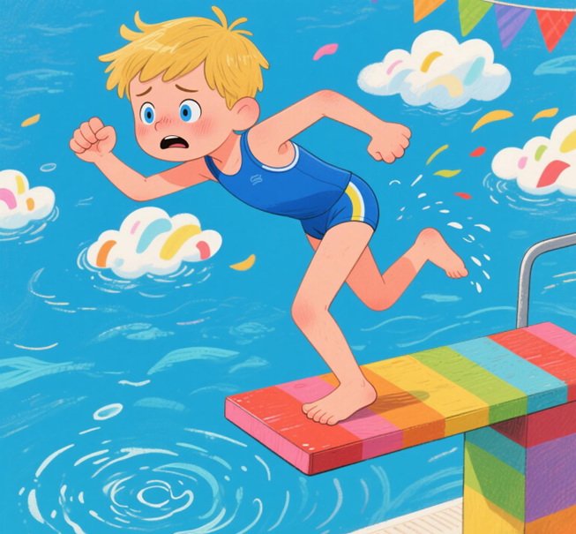
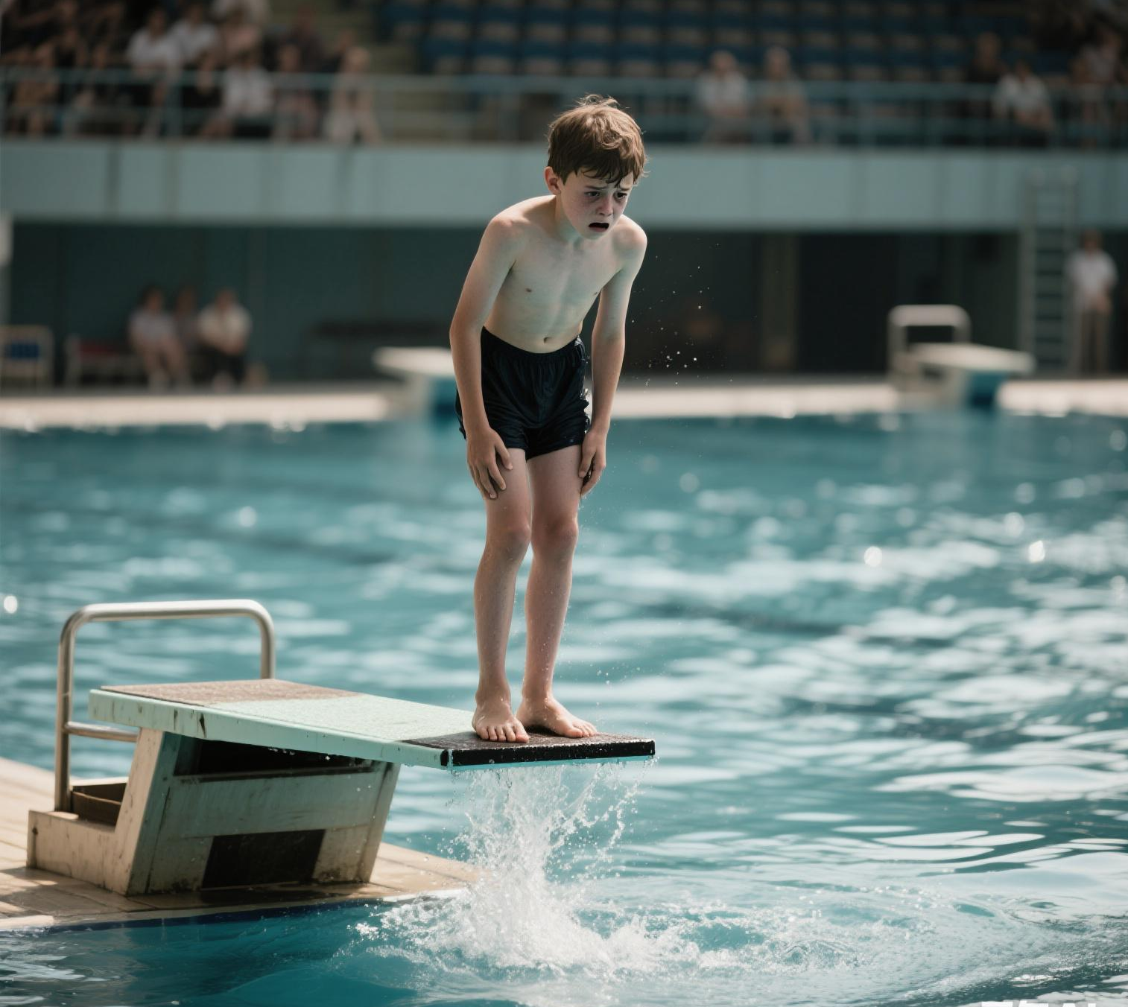
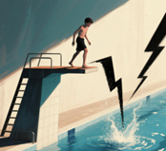
2025
高二 七彩阳光期中考续写
害怕跳水的男孩
采用：动作三步拆解法+
“人物成长公式”
刘艳

Slide 3

读原文 找出记叙文要素
The camp’s diving board (跳水板) loomed over Ethan, making his stomach churn (搅动). His palms were sweaty as he shuffled forward in the line of campers. The instructor’s voice boomed, “Everyone jumps today, or no certificate (证书)!” Ethan’s throat tightened. Seven years ago, a near-drowning in a lake had filled his mind with fear—dark water swallowing his screams, lungs burning for air. Now, at fourteen, he was trapped again.
The boy ahead of him, Jake, leapt off the board with a whoop, slicing into the water like a knife. The crowd cheered, but Ethan barely heard them. His legs turned to lead. What if I froze? What if they laughed? Last week, his little sister looked up at him with wide eyes and said, “You’re my hero, Ethan.” But he was not a hero. He gripped the railing (栏杆), staring at the lake’s surface—it mirrored dark clouds, turning like a storm in the sky today.
A hand clapped his shoulder. “Your turn, Ethan,” Coach Miller said gently. The man’s eyes held no judgment, only quiet encouragement. Ethan forced one foot onto the board. It creaked, swaying under his weight. Below, the water seemed to yawn wider, hungry. His childhood nightmare flashed: arms and legs struggling, bubbles rising as he sank…
“Breathe, kid,” Coach murmured. “Fear’s just a bully. Face it, and it backs down.” Ethan’s fingers trembled, but he took another step. The board dipped. Maybe I can…
Para 1: The first raindrop hit his cheeks as Ethan inched toward the trembling edge.
Para 2: The water was colder than expected, but the darkness never came.

Slide 4
记叙文要素
Time | During a summer camp, on a rainy day with dark clouds and a stormy atmosphere.
Place | At a summer camp by a lake, with a diving board looming over the water
Characters | Ethan (protagonist):A 14-year-old boy traumatized by a childhood near-drowning, struggling with fear of water. Coach Miller (deuteragonist):The instructor who provides gentle encouragement ("Fear’s just a bully. Face it."),
Contradiction | Internal Conflict 内心冲突: Fear of drowning (triggered by the diving board and stormy lake) vs. the urge to prove himself (to his sister, the camp, and himself).Struggle between self-doubt ("I am not a hero") and the hope for growth ("Maybe I can…"). External Conflict 外部冲突: The camp’s requirement: "Everyone jumps today, or no certificate," creating a deadline-driven challenge. Social pressure: Fear of being laughed at by others if he freezes or fails.
Theme | Courage is not the absence of fear but the courage to act despite it. Facing fears leads to personal transformation and self-discovery.

Slide 5
读原文
The camp’s diving board (跳水板) loomed over Ethan, making his stomach churn (搅动). His palms were sweaty as he shuffled forward in the line of campers. The instructor’s voice boomed, “Everyone jumps today, or no certificate (证书)!” Ethan’s throat tightened. Seven years ago, a near-drowning in a lake had filled his mind with fear—dark water swallowing his screams, lungs burning for air. Now, at fourteen, he was trapped again.
The boy ahead of him, Jake, leapt off the board with a whoop, slicing into the water like a knife. The crowd cheered, but Ethan barely heard them. His legs turned to lead. What if I froze? What if they laughed? Last week, his little sister looked up at him with wide eyes and said, “You’re my hero, Ethan.” But he was not a hero. He gripped the railing (栏杆), staring at the lake’s surface—it mirrored dark clouds, turning like a storm in the sky today.
A hand clapped his shoulder. “Your turn, Ethan,” Coach Miller said gently. The man’s eyes held no judgment, only quiet encouragement. Ethan forced one foot onto the board. It creaked, swaying under his weight. Below, the water seemed to yawn wider, hungry. His childhood nightmare flashed: arms and legs struggling, bubbles rising as he sank…
“Breathe, kid,” Coach murmured. “Fear’s just a bully. Face it, and it backs down.” Ethan’s fingers trembled, but he took another step. The board dipped. Maybe I can…
Para 1: The first raindrop hit his cheeks as Ethan inched toward the trembling edge.
Para 2: The water was colder than expected, but the darkness never came.
找出前文伏笔
1动词短语
2名词短语
3情节搭建的主要行为动作句式

Slide 6
读原文 找出前文的细节描写
人物心情与情绪
英文词汇 / 短语 | 中文翻译 | 情感 / 场景指向
stomach churn | 胃搅动 | 紧张、焦虑
sweaty palms | 手心出汗 | 紧张、恐惧
throat tightened | 喉咙发紧 | 焦虑、窒息感
trapped | 被困住 | 无助、被束缚感
legs turned to lead | 双腿像灌了铅 | 沉重、行动困难（心理压力导致）
childhood nightmare | 童年噩梦 | 创伤回忆带来的恐惧
What if I froze? / What if they laughed? | 要是僵住了怎么办？/ 要是被嘲笑怎么办？ | 自我怀疑、害怕失败

Slide 7
读原文 找出前文的细节描写
身体动作描写
shuffled forward | 拖着脚向前走 | 犹豫、不情愿的动作
gripped the railing | 抓住栏杆 | 寻求支撑、紧张的肢体语言
inched toward the edge | 慢慢挪向边缘 | 小心翼翼、缓慢的动作
forced one foot onto the board | 勉强将一只脚迈上跳板 | 强迫自己行动，体现内心挣扎
fingers trembled | 手指颤抖 | 紧张、恐惧的细微动作
leapt off the board with a whoop | 大喊一声从跳板跃下 | （Jake 的动作）轻松、自信的对比

Slide 8
读原文 找出前文的细节描写
环境描写
diving board loomed | 跳水板若隐若现 | 压迫感、威胁性的场景
dark clouds mirrored in the lake | 湖面倒映的乌云 | 压抑、预示暴风雨的环境氛围
water seemed to yawn wider, hungry | 湖水仿佛张得更开，饥肠辘辘 | 拟人化描写，强化危险、吞噬感
creaked, swaying under his weight | 跳板在体重下吱呀作响、摇晃 | 不稳定感，增强心理压力

Slide 9
读原文 找出前文的细节描写
对话描写
“Everyone jumps today, or no certificate!” | “今天所有人都要跳，否则没有证书！” | 规则压力，推动情节的外部要求
“You’re my hero, Ethan.” | “你是我的英雄，伊桑。” | 妹妹的信任，与 Ethan 的自我怀疑形成对比
“Breathe, kid.” / “Fear’s just a bully. Face it, and it backs down.” | “深呼吸，孩子。” / “恐惧只是个恶霸。直面它，它就会退缩。” | 教练的鼓励，传递战胜恐惧的信念

Slide 10
Para 1: The first raindrop hit his cheeks as Ethan inched toward the trembling edge.
情节搭建
How does Ethan’s body react to the rain and the creaking board?
What memories or voices echo in his mind at this moment?
How does Ethan position his body as he jumps—does he lean forward, tense his muscles, or open his arms instinctively?
Did he finally decide to jump? （yes）
What thoughts flash through his mind during the brief moment of falling—childhood fear, Coach Miller’s words, or his sister’s face?
Para 2: The water was colder than expected, but the darkness never came.

Slide 11
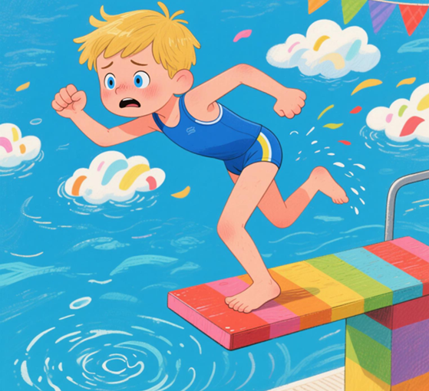
Para 2: The water was colder than expected, but the darkness never came.
How does Ethan’s body respond to the cold water initially?
What replaces the "darkness" he feared in the water?
How do the sounds around him change when he surfaces?
What life lesson does Ethan realize during or after surfacing from the water, connecting his action to overcoming fear?
What subtle gesture or thought shows his transformation after the dive?

Slide 12
难点1：跳水过程如何生动描绘？
动作描写思维方法（三步拆解法）
分解动作→联动感官→对比过去
1. 动作分解：从 “犹豫” 到 “突破” 的关键节点
准备阶段：腿部 / 手臂的紧张姿态（如 “膝盖微屈”“手指蜷缩”）
起跳瞬间：决定性动作（如 “踮起脚尖”“身体前倾”）
下落过程：身体姿态变化（如 “双臂展开”“肌肉紧绷”）
2. 感官联动：用简单词汇刻画真实体验
听觉：跳板吱呀声、风声、心跳声
触觉：空气掠过皮肤的触感、跳板的震动
视觉：水面的模糊 / 清晰、天空的快速变化
3. 心理映射：用 “对比” 简化描写难度
过去恐惧时的动作（如 “四肢乱挥”）vs. 现在的主动控制（如 “身体绷直”）
外部激励（妹妹的话 / 教练的鼓励）在动作中的体现（如 “想起妹妹的笑容时手指舒展”）

Slide 13
Para 1: The first raindrop hit his cheeks as Ethan inched toward the trembling edge.
前文取材+心理活动
因紧握栏杆而沁汗的手掌在湿木上微微打滑，如同他翻涌的胃袋。跳板吱呀作响 —— 与他狂跳的心跳共振。
His palms, still sweaty from gripping the railing, slid slightly on the wet wood, echoing the churn in his stomach. The board creaked—a sound that matched his racing heartbeat.
“你是我的英雄。” 妹妹的声音在风雨中萦绕，与米勒教练的话交织：“恐惧只是个恶霸。” 伊桑凝视湖面，乌云在水中荡起涟漪，恍若童年的怪物。
“You’re my hero,” his sister’s voice whispered in the storm, mixing with Coach Miller’s words: “Fear’s just a bully.” Ethan stared at the lake, where dark clouds rippled like the monsters of his childhood.

Slide 14
Para 1: The first raindrop hit his cheeks as Ethan inched toward the trembling edge.
前文取材+眼神+动作描写
但这次，他没有退缩，而是闭眼勾勒出妹妹信任的目光。他深吸一口气，气息如脚下的跳板般发颤，随后松开了栏杆。
But this time, instead of shrinking back, he closed his eyes and visualized his sister’s trusting gaze. With a breath that shuddered like the board beneath him, he let go of the railing.
衔接二段首句：
时间仿佛被拉长。他感受冷雨拍打面颊，听见心跳如鼓，随后 ——水面迎上来。
Time seemed to stretch thin. He felt the cold rain on his face, heard his own heartbeat drumming in his ears, and then—the water rushed up to meet him,

Slide 15
难点2：人物成长和变化如何生动体现？
成长公式 = 【过去动作复刻】→【现在动作反转】+【感官反馈】+【隐喻点题】
1. 感官对比法：用 “五感” 变化映射内心蜕变
触觉：过去入水时 “窒息的水” vs. 现在 “冰冷但清醒的水”
听觉：过去 “自己的尖叫” vs. 现在 “欢呼声 / 心跳的胜利节奏”
视觉：过去 “黑暗湖水” vs. 现在 “阳光穿透的金色水面”
2. 动作呼应法：重复前文动作但赋予新意义
身体反应：从紧绷到舒展（对比过去）
3. 隐喻简化法：用日常比喻替代抽象心理
恐惧 =“恶霸（bully）”（前文教练语）→ 续写 “恶霸变小了 / 变成影子”
成长 =“跳板从巨大变得渺小”“湖水从吞噬者变成挑战者”

Slide 16
Para 2: The water was colder than expected, but the darkness never came.
对比+前文取材
记忆中令人窒息的禁锢感消失了，唯有刺骨的凉意唤醒肌肉，驱动他划动。他用力蹬水，双臂破水如刀 —— 像杰克那样利落，而非当年溺水时的慌乱扑腾。
Instead of the choking grip of memory, there was only the sharp bite of cold, waking his muscles into motion. He kicked hard, arms slicing through the water like the knife -Jake had been—not the thrashing of a drowning boy.
对比+环境描写
浮出水面时，阳光扑面，他听见欢呼声—— 妹妹的呼喊、教练的掌声。肺部充盈空气，而非水，他的脸上绽开笑容。
When he broke the surface, sunlight hit his face, and he heard cheers—his sister’s voice, Coach Miller’s claps. His lungs filled with air, not water, and a smile spread across his face.
【现在动作反转】+【感官反馈】+【隐喻点题】

Slide 17
Para 2: The water was colder than expected, but the darkness never came.
对比+前文取材
曾经高大的跳板，此刻显得渺小。他明白恐惧并未消失，却已缩小。就像直面时失去威力的恶霸，他的恐惧如今只是一道影子。
He realized fear wasn’t gone, but it had shrunk. Like a bully who lost its power when you stared it in the eye, his fear was just a shadow now.
曾经，跳板是让他心跳狂乱的恐惧起点；如今，当他踩着水花抬头望去，摇晃的木板上仿佛画着一道崭新的起跑线 —— 原来跨越恐惧的地方，从来都是迎接下一次挑战的开始。
Once, the diving board was the start of his racing heart and fear; now, as he treads water and looks up, the swaying planks seem to mark a brand-new starting line—where fear is overcome, a new challenge always begins.
【现在动作反转】+【感官反馈】+【隐喻点题】
成长口诀：想过去，看现在，五感细节带出来，
一个比喻点明白——成长藏在动作里！

Slide 18
下水作文：
动作描写思维方法（三步拆解法）
分解动作→联动感官→对比过去
The first raindrop hit his cheeks as Ethan inched toward the trembling edge. His palms, still sweaty from gripping the railing, slid slightly on the wet wood, echoing the churn in his stomach. The board creaked—a sound that matched his racing heartbeat.“You’re my hero,” his sister’s voice whispered in the storm, mixing with Coach Miller’s words: “Fear’s just a bully.” Ethan stared at the lake, where dark clouds rippled like the monsters of his childhood. But this time, instead of shrinking back, he closed his eyes and visualized his sister’s trusting gaze. With a breath that shuddered like the board beneath him, he let go of the railing. Time seemed to stretch thin. He felt the cold rain on his face, heard his own heartbeat drumming in his ears, and then—the water rushed up to meet him.
The water was colder than expected, but the darkness never came. Instead of the choking grip of memory, there was only the sharp bite of cold, waking his muscles into motion. He kicked hard, arms slicing through the water like the knife Jake had been—not the thrashing of a drowning boy. When he broke the surface, sunlight hit his face, and he heard cheers—his sister’s voice, Coach Miller’s claps. His lungs filled with air, not water, and a smile spread across his face. He realized fear wasn’t gone, but it had shrunk. Like a bully who lost its power when you stared it in the eye, his fear was just a shadow now. Once, the diving board was the start of his racing heart and fear; now, as he treads water and looks up, the swaying planks seem to mark a brand-new starting line—where fear is overcome, a new challenge always begins.
成长口诀：想过去，看现在，五感细节带出来，
一个比喻点明白——成长藏在动作里！

Slide 19
官方范文
The first raindrop hit his cheek as Ethan inched toward the trembling edge. Raindrops began to patter, mixing with his sweat. “Thirty seconds, Ethan!” Jake called. Mock or motivate? He wasn’t sure. Taking a deep breath, he tried to keep calm as Coach had taught. One step. Another. The edge was inches away. The water below hissed like a snake, threatening to swallow him. Jump or run? His lungs seized/His throat tightened. Then, a memory surfaced—his little sister’s voice last week: “You’re my hero, Ethan.” Determined, gritting his teeth, he jumped forward.
The water was colder than expected, but the darkness never came. Sunlight shone through the water, making the bubbles sparkle as he kicked upward. Breaking the surface, he gasped—not from panic, but exhilaration. The lakeside exploded with cheers. “You did it!” Jake yelled loudest. Shortly after, clutching his certificate, Ethan came to realize, “True courage isn’t fearlessness. It’s choosing to jump despite all the fear.” Glancing at the board, now glowing in the sun after the storm, he cracked a smile. The water still scared him… but no longer controlled him.

Slide 20
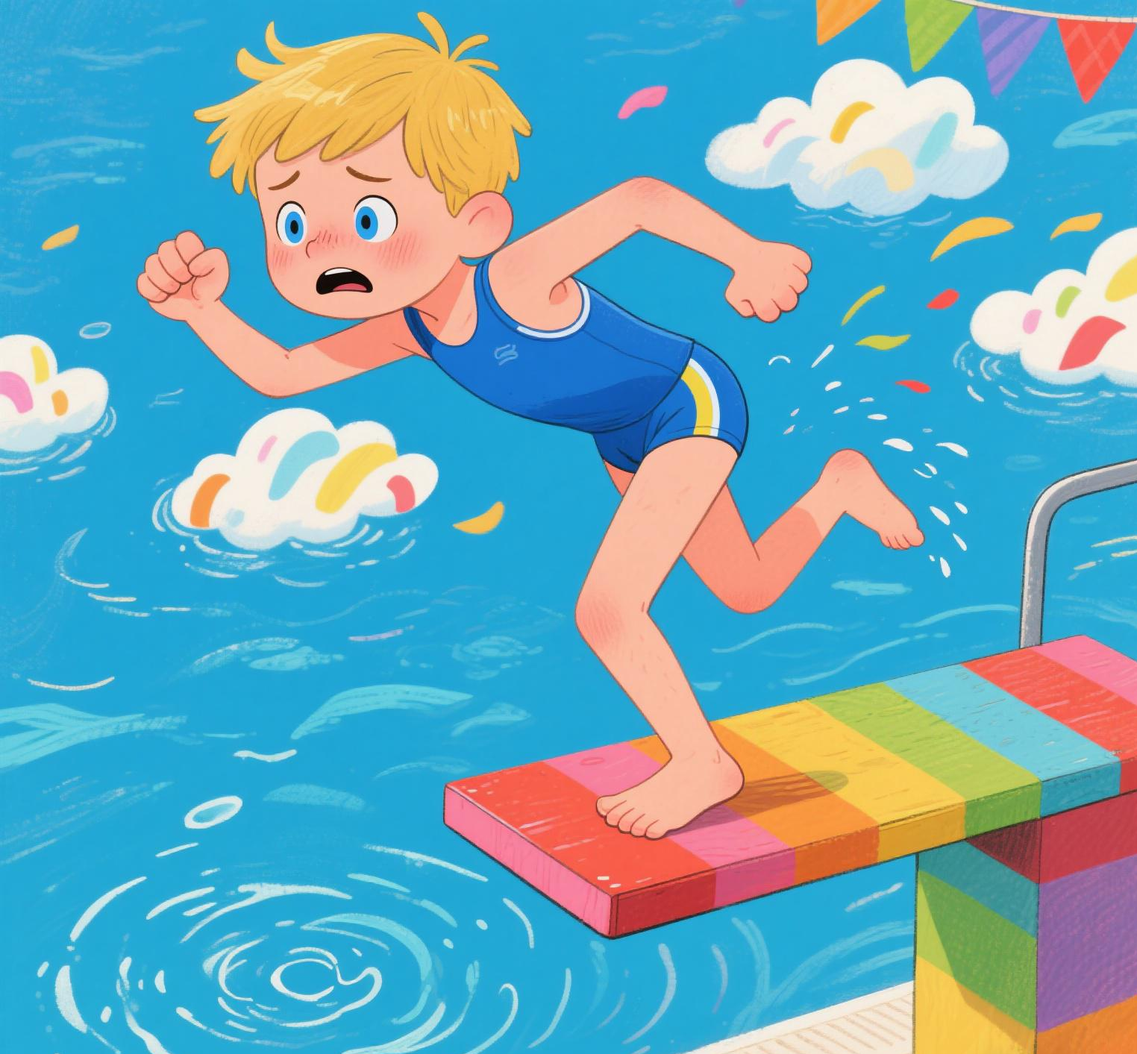
感谢聆听

