Slide 1


感恩遇见，相互成就，本课件资料仅供您个人参考、教学使用，严禁自行在网络传播，违者依知识产权法追究法律责任。
更多教学资源请关注
公众号：溯恩英语
知识产权声明

Slide 2
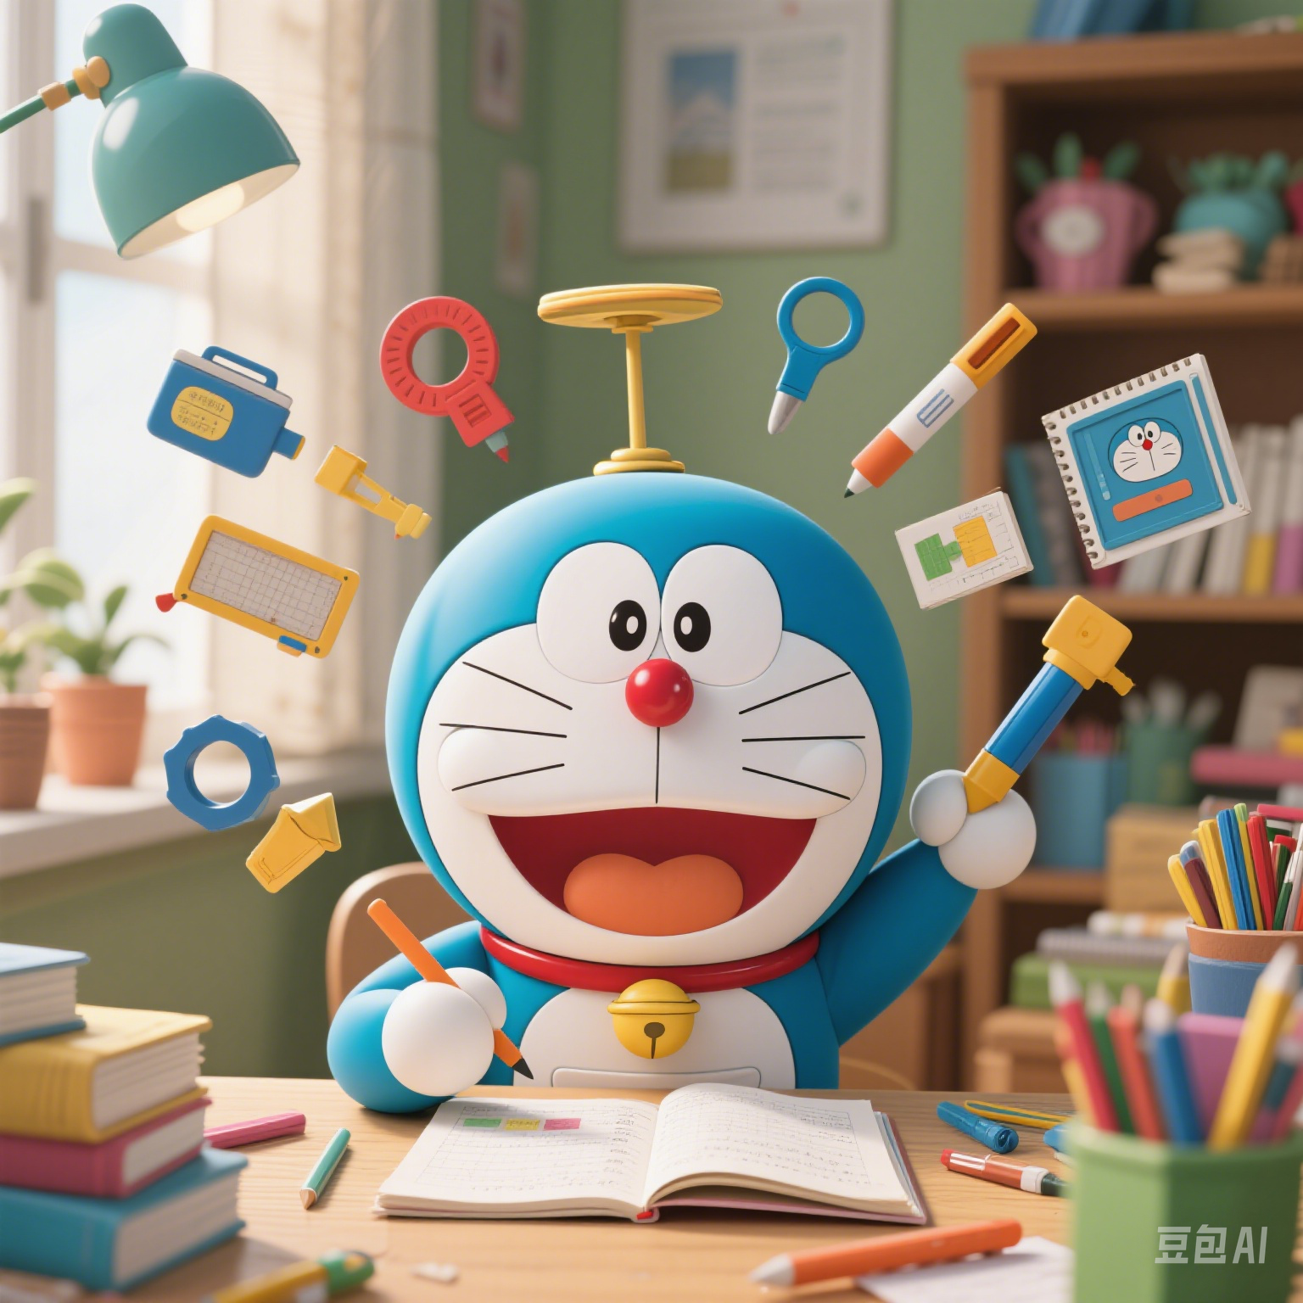
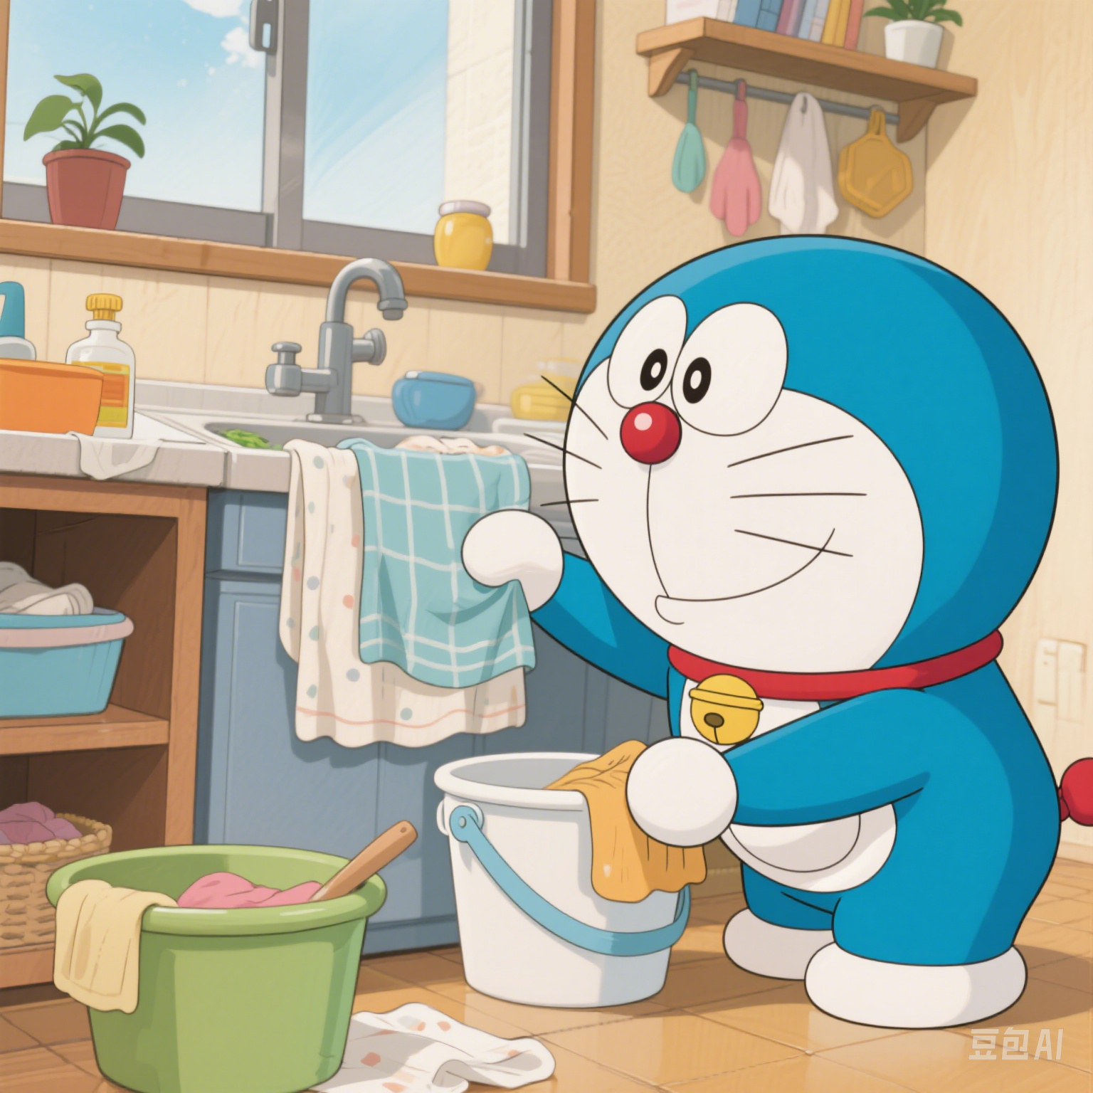
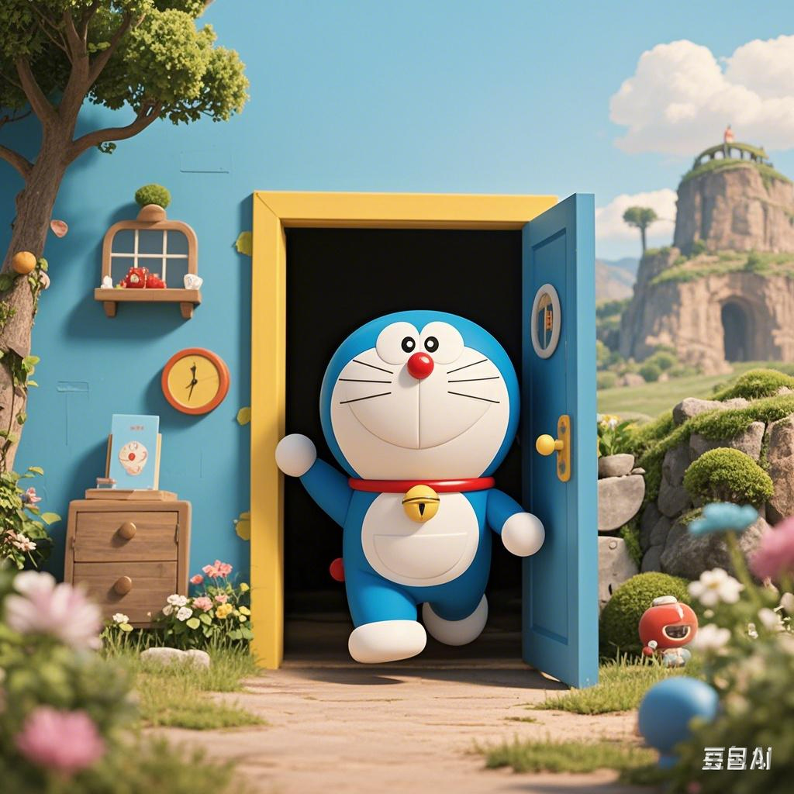
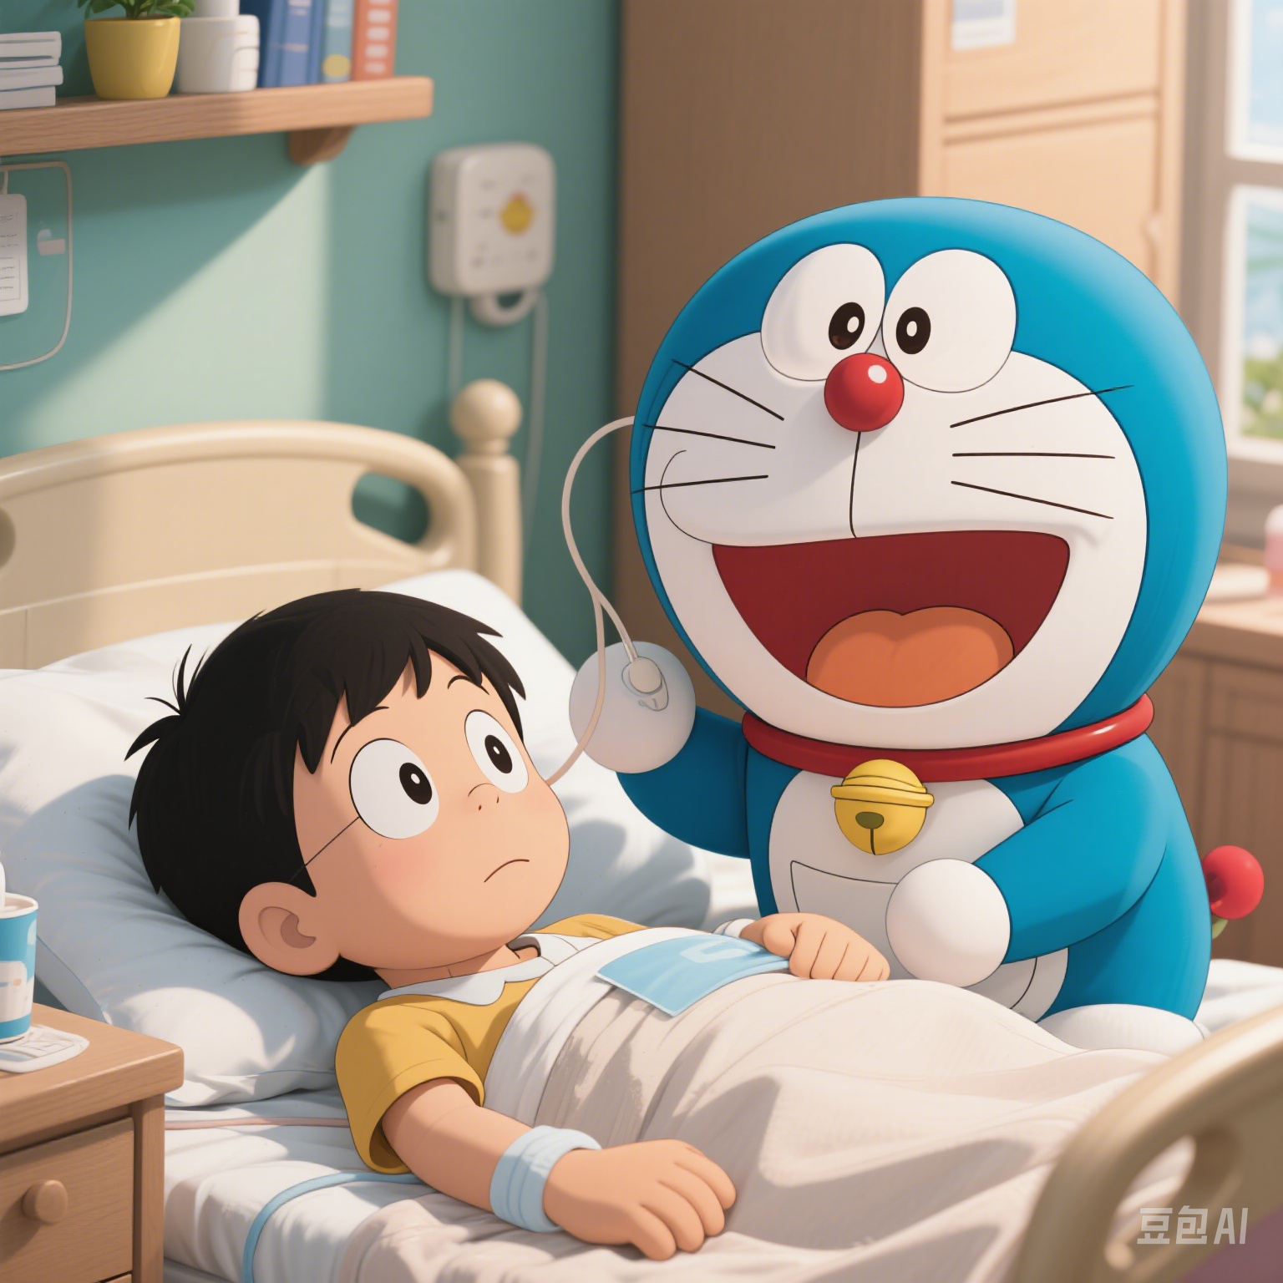
XB4U1 Science Fiction
Reading and Thinking
Explore the relationship between humans and robots
By Jennifer

Slide 3
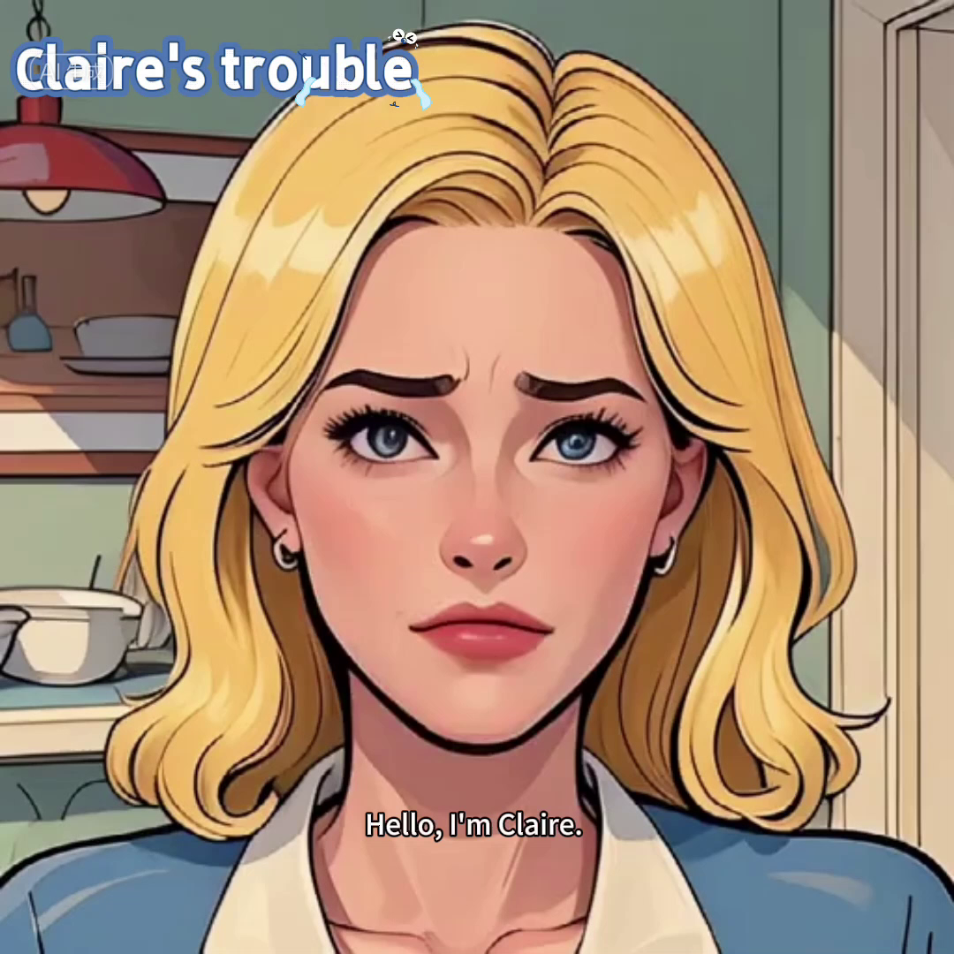
Lead-in
What will the robot be like?
Will Claire get along well with the robot?

Slide 4
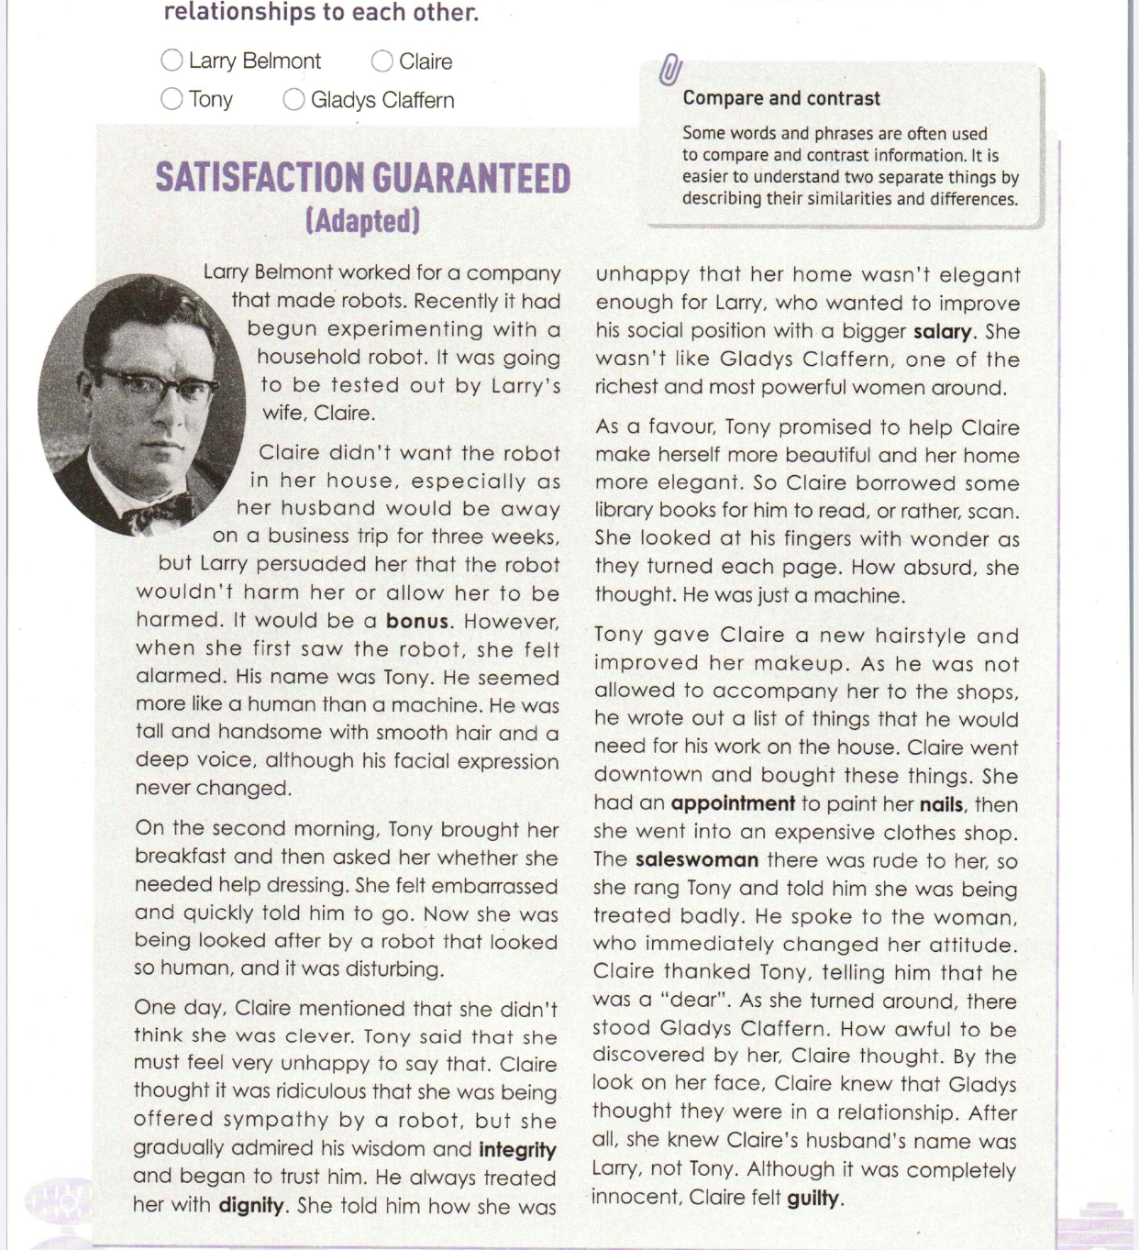

Prediction
satisfaction:n.the good feeling when you get what you want
guarantee:v.to promise with certainty
Focus on the title and the picture to predict:
Isaac Asimov [ˈaɪzək ˈæzɪmɒv] (Jan. 2, 1920-Apr.6,1992) was a famous American science fiction(科幻小说) writer.
Whose satisfaction will be guaranteed?
Who will guarantee the satisfaction?
Will the satisfaction be guaranteed in the end? ……
The possible reasons for adapting the original work into teaching materials are as follows, except .
A.To make it shorter
B.To make the language easier to understand
C.To make it more interesting
D.To get rid of the core values
A good adaptation ought to be more concise(简洁的), accessible(易懂的) and engaging(引人入胜的) without losing the core values of the original work.

Slide 5
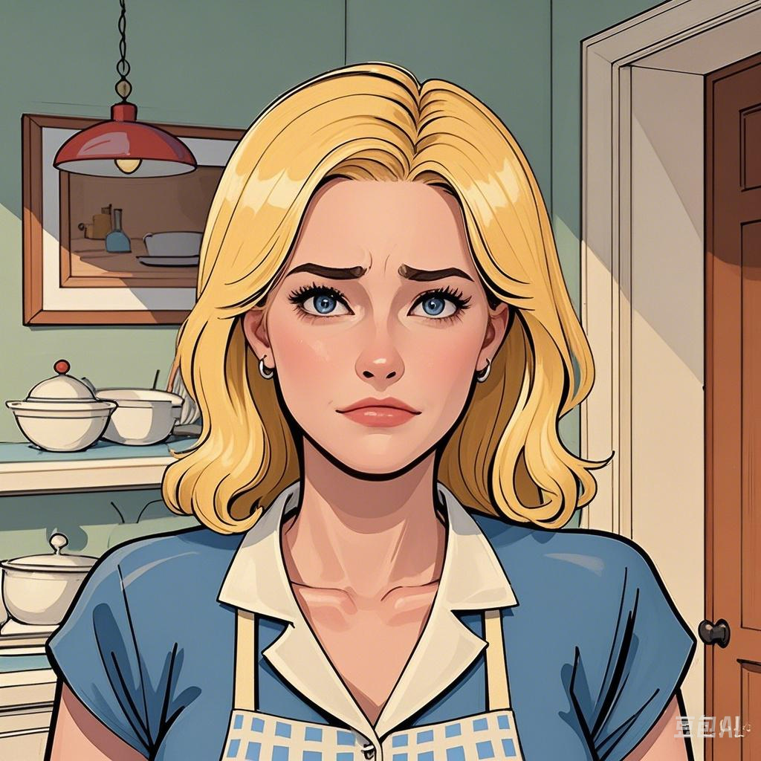

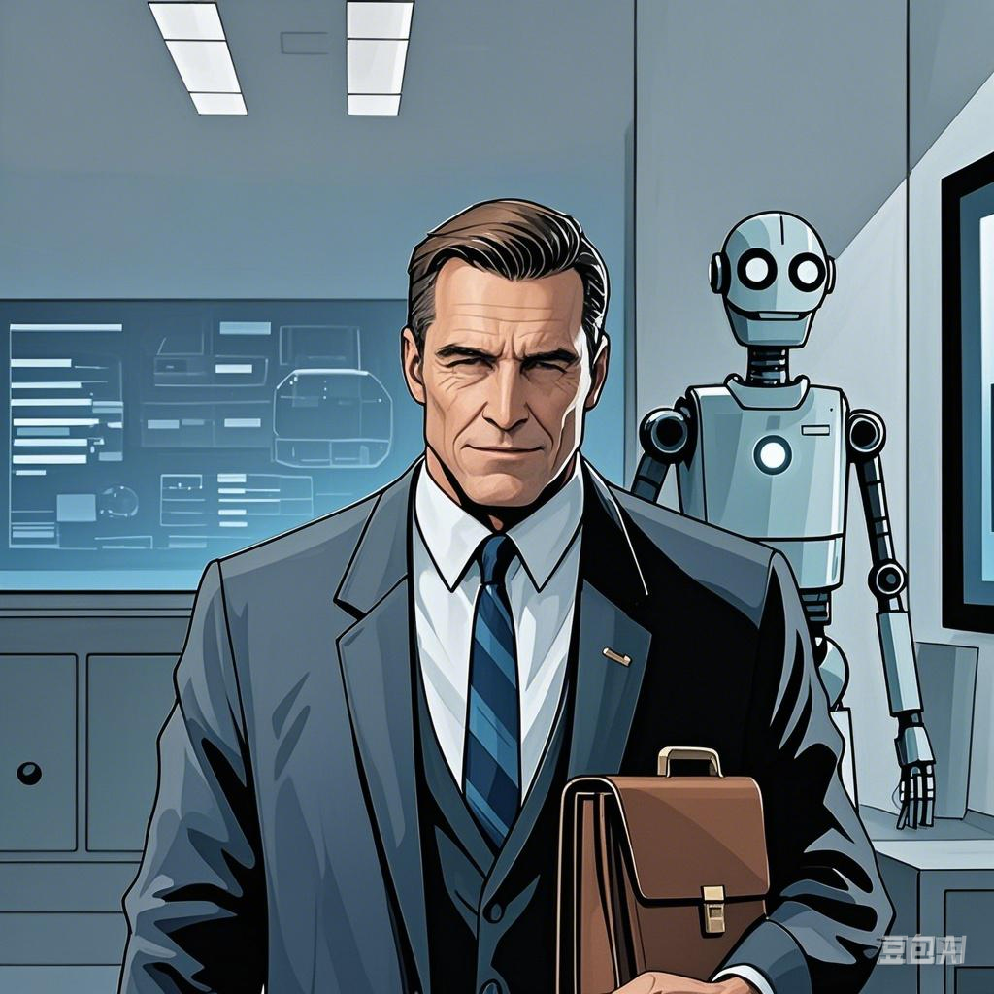
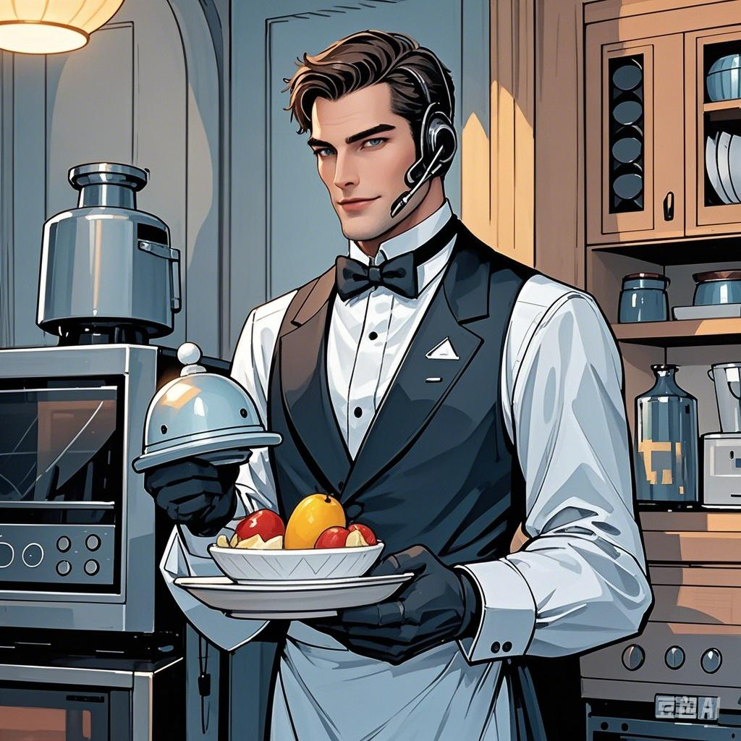
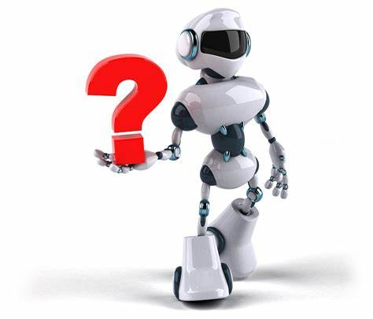
Read for the characters
Figure out the characters and their relationships to each other.
Claire - the wife who stayed with a robot for weeks.
Gladys Claffern-
a rich and powerful woman whom Claire to be.
3
wished
envies(羡慕)
How did Larry persuade Claire to accept Tony's arrival?
friends
couple
tester
testee
Larry persuaded her that the robot wouldn't harm her or allow her to be harmed. It would be a bonus.
Larry Belmont - the husband who worked for a company making .
Tony- the household robot that was by Claire.
tested
robots
What does the word “bonus”mean?
A.risk B.benefit C.challenge D.fault
The result of the test depended on whether Claire was with Tony.
satisfied

Slide 6
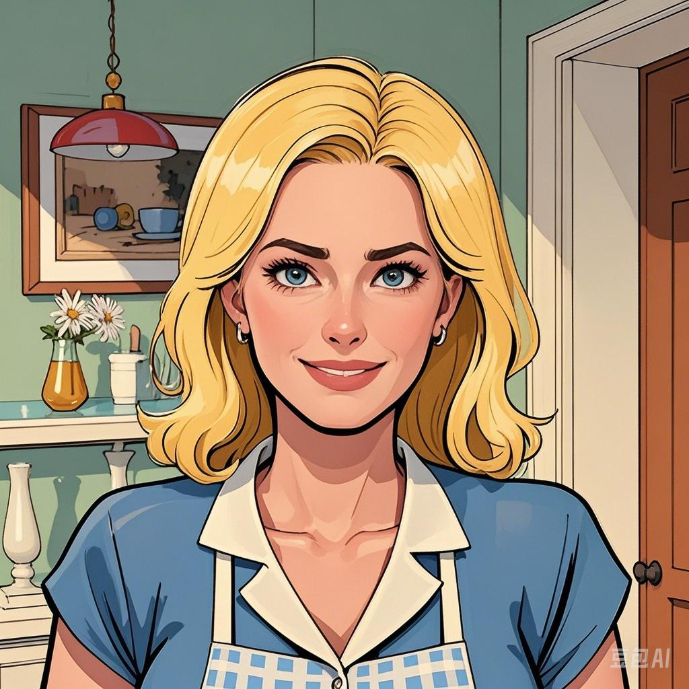
Read for the plot
insecure adj. (of a person) not confident about yourself or your relationships with other people.不自信的,缺乏信心的
Eg. Even though she's a model, she's very insecure about how she looks.
Which of the following best describes Claire?
A.confident B.insecure C.independent D.Ambitious
Claire’s problems
Claire thought she wasn't clever.
Claire thought her home wasn’t .
Claire thought she wasn’t like Gladys Claffern.
Claire was treated
by the saleswoman.
Claire fell off
the ladder.
rudely
elegant
Tony offered
.
Tony
the house completely.
Tony gave Claire a new and improved her .
Tony changed the saleswoman’s .
Tony managed
to her
in time from
the next room.
transformed
hairstyle
catch
sympathy
makeup
attitude
What kind of services did Tony offer except ?
A.life convenience B.spiritual support
C.aesthetic(美的) improvements D.career-building guidance
Tony’s services

Slide 7
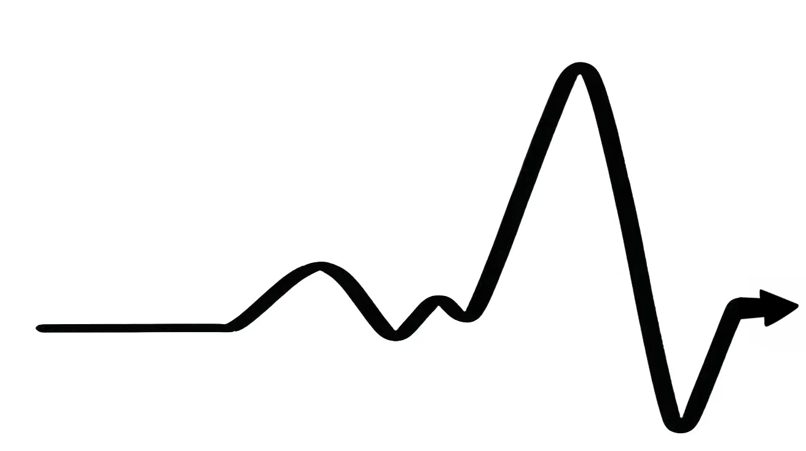



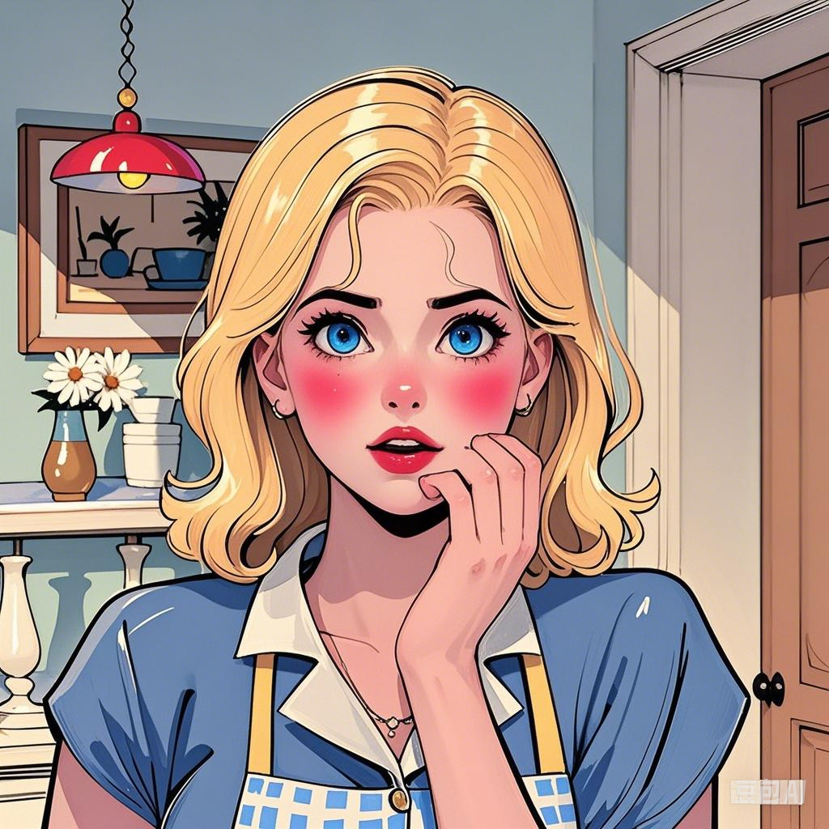
Read for the emotions
How did Claire feel about Tony with the development of the story?
Claire thought it was ridiculous that she was being offered sympathy by a robot, but she gradually admired his wisdom and integrity and began to trust him.(para.4)
Claire thanked Tony, telling him that he was a dear. (para.6)
Claire knew that Gladys thought they were in a relationship. After all, she knew Claires husband’s name was Larry, not Tony. (para.6).
As he held her, she felt the warmth of his body. She screamed, pushed him away, and ran to her room. (para.8).
It was then that Claire realized she had
with Tony.
When she was saved by Tony from falling
Claire didn't want the robot in her house…(para.2)
She felt embarrassed and quickly told him to go.(para.3)
Occasions/Events
He seemed more like a human than a machine.(para.2)
When she was seen to call Tony a “dear” by Gladys
fallen in love
When Tony helped to change the saleswoman’s rude attitude
shy & nervous
Claire was misunderstood by Gladys as having a romantic relationship/an affair(外遇) with Tony.
When Tony offered help to dress Claire
When Tony offered sympathy
before Tony arrived
when she first saw him
guilty
thankful
embarrassed
uneasy
Feelings
unwilling
alarmed
admiring & trusting
Claire’s
attitude
dislike
acceptance
trust
love

Slide 8

Further thinking
1.According to Tony’s action, did Tony fall in love with Claire?
2.As a robot, did Tony really love Claire, or was he just programmed(被设定程序) to meet her spiritual needs?
3.Although Claire knew that Tony was a robot without emotions, why did she still fall in love with Tony?
The night of the party arrived. The clock struck eight. The guests would be arriving soon, so Claire dismissed Tony for the rest of the night. At that moment Tony took her in his arms, bringing his face close to hers. She heard him declare that he did not want to leave her the next day, and that he felt more than just the desire to please her. Then the front door bell rang.
Tony showed signs(迹象) that could be interpreted as his “falling in love” with Claire.
As a robot, it's highly unlikely for Tony to experience true love.
Claire fell in love with Tony, the robot, for the following reasons except .
A. Tony’s good looks attracted her while his super power amazed her.
B. Tony constantly encouraged her and boosted her confidence.
C. Tony always criticized her mistakes to help her.
D. Tony provided not only high-quality service but also emotional companionship and understanding.
“Machines can’t fall in love, but even - when it’s hopeless and horrifying - women can!”
Claire’s personality made it easier for her to fall into irrational(不理智的) love.

Slide 9
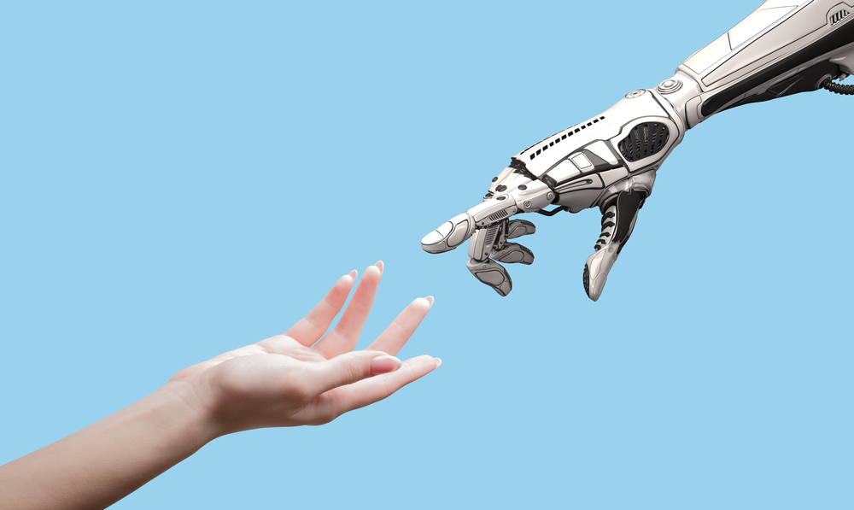
Discussion
What kinds of relationships will we develop with robots in the future? Why?
Partnership
In many industries, the combination of human intelligence and robot precision and efficiency can significantly improve productivity and quality.
Emotional companionship
As the elderly population grows and social pressures increase, the need for emotional support rises, and robots designed to understand and respond to emotions can offer comfort and companionship.
teacher-student relationship
Robots based on AI and big data can provide personalized plans, aiding students to better understand knowledge and increase learning efficiency.

Slide 10



Assignment
Write the ending of the story
Then the front door bell rang.
;
;
;
;
;
;
The next morning a car drove up and took Tony away.
;
;
;
;
;
;
Who rang the bell?
How was the party? Was it successful?
What would happen between Claire and Tony?
What would happen between Claire and Gladys?
What would happen to Tony?
Did he pass the test?
Would he be recognized, upgraded or destroyed?

Slide 11
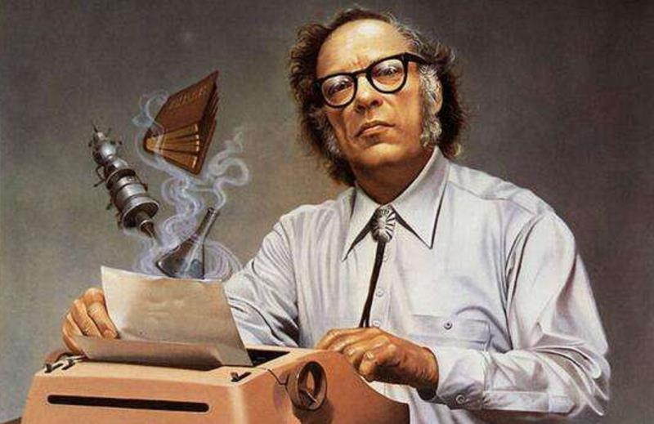
Further information
Isaac Asimov and his Three Laws of Robotics
For Claire, falling in love with a robot is also a kind of emotional harm.
Law 1 A robot may not injure a human being, or, through inaction(不作为), allow a human being to come to harm.
Law 2 A robot must obey the orders given it by human beings except where such orders would conflict(起冲突) with the first law.
Law 3 A robot must protect its own existence(存在) as long as such protection does not conflict with the first law or second law.
The robot wouldn’t harm Claire or allow her to be harmed.

Slide 12
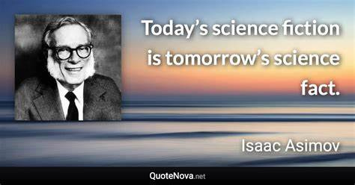

Slide 13
Listen to the rest of the story and see how different is it from your ending.
Then the front door bell rang. Tony let her go and disappeared from sight. It was then that Claire realized that Tony had opened the curtains of the front window. Her guests had seen everything! The women were impressed by Claire, the house and the delicious cuisine. Just before they left, Claire heard Gladys whispering to another woman that she had never seen anyone so handsome as Tony. What a sweet victory to be envied by those women! She might not be as beautiful as them, but none of them had such a handsome lover. Then she remembered — Tony was just a machine. She shouted "Leave me alone" and ran to her bed. She cried all night.
The next morning a car drove up and took Tony away. The company was very pleased with Tony's report on his three weeks with Claire. Tony had protected a human being from harm when he prevented Claire from falling off a ladder. He had also opened the curtains that night so that the other women would see him and Claire, which would make them envy Claire. But even though Tony had been so clever, he would have to be rebuilt — you cannot have women falling in love with machines.
添加题
添加标题

