Slide 1



感恩遇见，相互成就，本课件资料仅供您个人参考、教学使用，严禁自行在网络传播，违者依知识产权法追究法律责任。
更多教学资源请关注
公众号：溯恩英语
知识产权声明

Slide 2

读后续写
段落接续句
写句指南
Fay 2025

Slide 3


01
★理论来源孙三五老师★
理论参考：孙三五老师！
续写衔接和情节推进的四种方法：
假设提示句是：A did / was sth.
01
B’s response
B did sth / felt ... in response to A’s behavior. （针对A的行为，B做什么或B什么感受？）
02
Then, A did ...
Then, how did A do it? (即A如何做那件事？）
What was sth? (具体解释提示句中的某一个关键词内容）
03
Explanation
04
Cause-effect
based on A’s behavior: Why (did A do it)? / What (is the result)? （即因果推理，A为什么这样做？或者A这样做带来什么结果？）

Slide 4

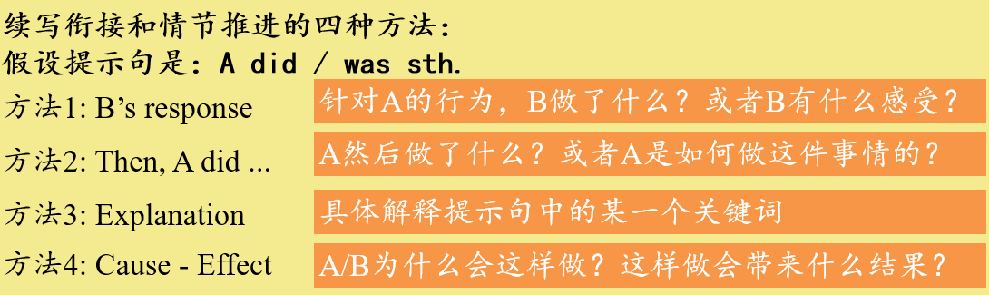
宁波十校
Para1:The next morning, I walked into the library director’s office, saying with resolution, “I have an idea.”
03
Explanation
02
Then, A did ...
01
B’s response
P1 ending: Prepare for the program in the following weeks
Para2:Weeks later, the moveable library program started, bringing libraries to different communities.
04
Cause-effect
Change

Slide 5
名校协作体
Para1:On the way back home, I couldn’t shake her from my mind.
03
Explanation
02
Then, A did ...
P1 ending: do more for the woman in the following weeks.
Para2:Several weeks later, the woman came to me.
04
Cause-effect
B’ change
kindness
01
B’s response

Slide 6
新阵地
Para1:Several weeks later, I found an envelope on my desk with the word “Angel” written on it.
03
Explanation
02
Then, A did ...
B’ change
P1 ending: I was deeply touched after reading.
Para2:Deeply touched yet still shaken, I sat there holding the letter, feeling lucky that I followed my inner voice.
03
Explanation
kindness
04
Cause-effect

Slide 7

写好第二句
02
Ensure smooth transition with the text above
Write
your sentences
Make full use of sentences’ pattern
Design reasonable description of actions & emotions
ARE
Actions respond emotions

Slide 8
R
Useful
sentences 'patterns
A
E
A wave of 情N. surged through/waved over sb So 情adj. was sb that sb did sth Overwhelmed with 情N., sb. did sth. To one’s 情N., sb. did sth. 情adj. and 情adj., sb. did sth. 情adj. as/though sb was, sb did sth. | 某种情感席卷了某人 太…以至于… 充斥着某情绪， 某人做了某事。 令某人…， 某人做了某事。 又XX情感又XX情绪，某人做了某事。 尽管某人很XX， 但是某人做了某事。
Sb. did 1, doing 2./Doing 2, sb. did 1 Sb. did 1, (with) 他人 doing/done 2. Having done sth, sb did sth. Upon doing sth, sb. did sth. Determined to do 1, sb did 2. The moment sb did sth, sb did sth. “….,” sb said/各种说, one’s voice filled with 情N./doing sth. Never had sb done sth. Barely could sb wait to do sth. (Without hesitation, sb did sth) At that moment, it dawned on sb that…/ sb realized that… 句式不唯一 | 某人在1同时在做2。（两个动作） 某人在做1，同时他人在做2。 做了1后，某人做了2. 一…,就… 一…,就… 下决心做某事，某人做了啥事。 “…,”某人说， 声音里充满了XX情感/做了某事 某人从未做过。 迫不及待做（毫无犹豫做） 在那一刻，某人意识到。。。
情绪描写
动作描写

Slide 9
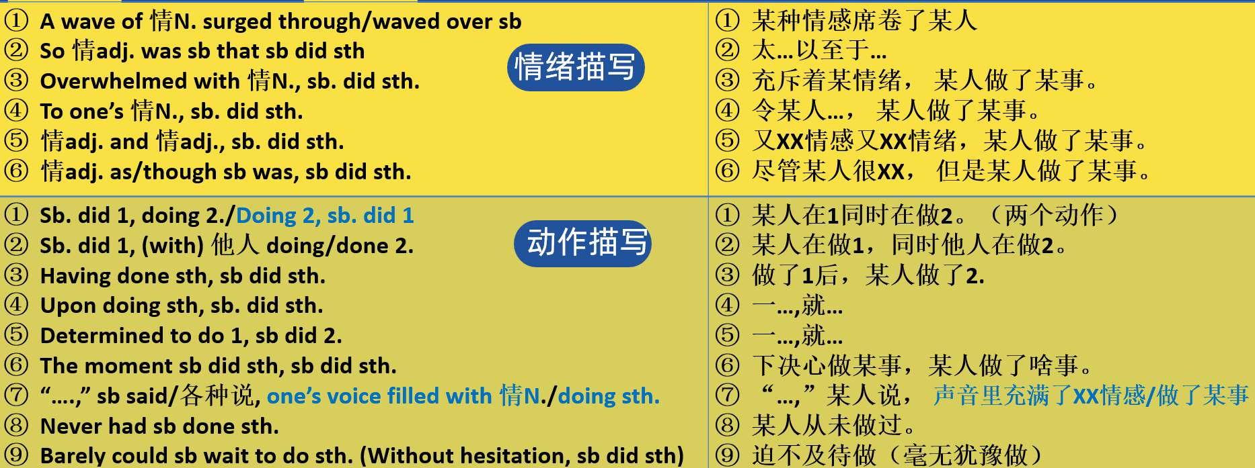

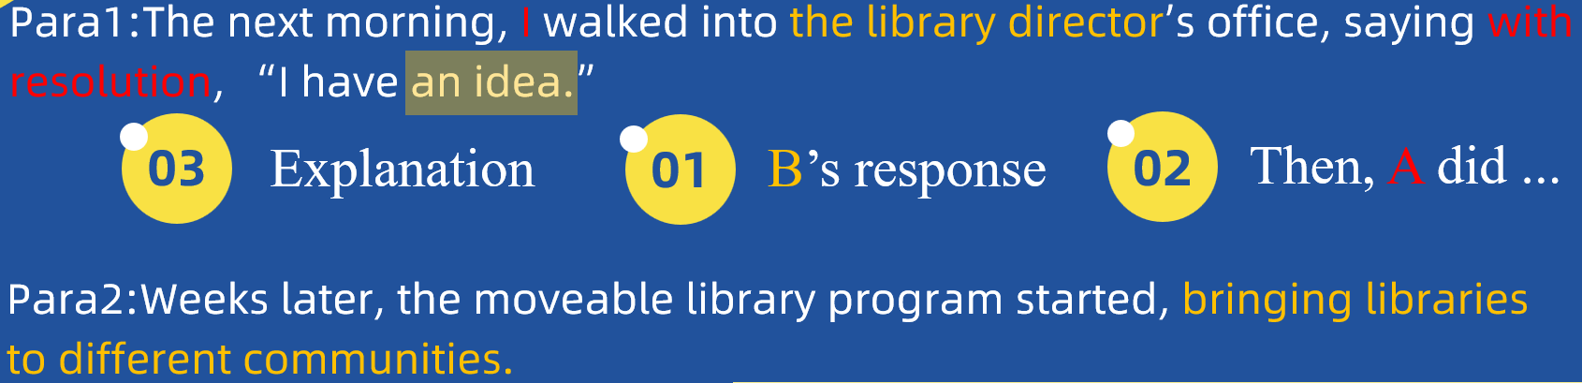
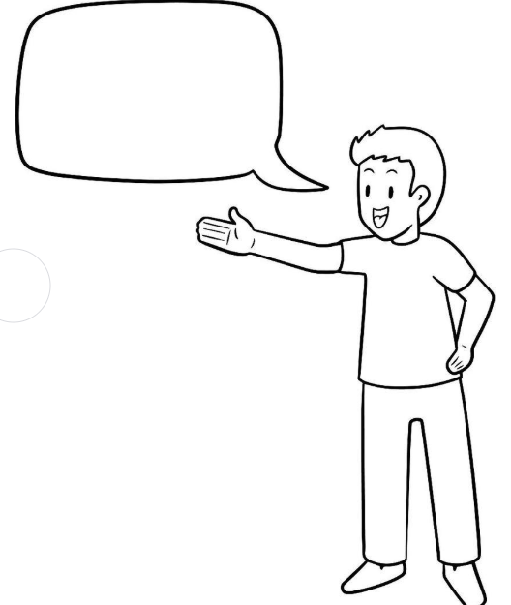
宁波十校
情绪描写
头
01
B’s response
语言描写
肢体动作
03
Explanation
直接说
间接说
02
Then, A did ...

Slide 10

例句
1.Overwhelmed with surprise and confusion, the director raised his head and looked at me, trying to understand my unexpected proposal.
2. Surprised and puzzled, the director looked up at me, his eyes filled with curiosity.
3. "What do you mean?" the director asked, his voice filled with surprise and confusion.
01
B’s response
1. Overwhelmed with a sense of determination, I presented/explained my plan for a movable library to the director.
2. Enthusiastic and determined, I explained how we could reach more communities with a movable library.
03
Explanation
02
Then, A did ...
“We can launch a movable library project,” I said, my voice filled with determination and passion.
“We can start a movable library project,” I suggested, keeping my gaze firmly on the director.
“ We can launch a mobile library project!" I exclaimed, my eyes fixed intently on the director.

Slide 11
宁波十校
情绪描写
头
01
B’s response
语言描写
肢体动作
03
Explanation
直接说
间接说
Change
外-内-外
02
Then, A did ...
情节模式1：I 解释 idea------director 同意 -------I 着手准备
情节模式1：I 解释我的困境+我的 idea（director感兴趣+I具体阐述idea）------director 同意支持 ------I 着手准备
情节模式2：director 反应/困惑好奇 +I 解释------director 支持同意------I 着手准备

Slide 12

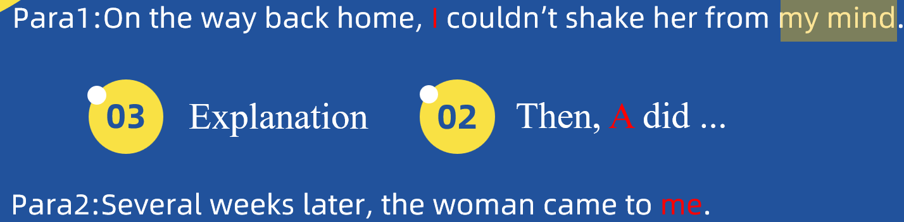

名校协作体
例句：
①Overwhelmed with a wave of empathy and concern, I couldn't help but think about the stark contrast between our lives.
②Visions of her empty living room popped into my head, a stark reminder of the hardship she faced.
③Feeling a deep sense of responsibility, I made a silent promise to help her in any way I could.
03
Explanation
Visions of…
Images of…
Scenes of…
Pictures of…
Memories of …
回扣原文
直接说
间接说
自言自语
自己回忆
原文线索
…popped into my head
…flashed through my mind
… flashed before my eyes
…raced through my thoughts
B’ change
内--外—内
02
Then, A did ...
情节模式1：I 回忆（怜悯同情）--下决心---------继续帮助
kindness
再次帮助：物质/精神(how）+ 个人/社会（how）

Slide 13
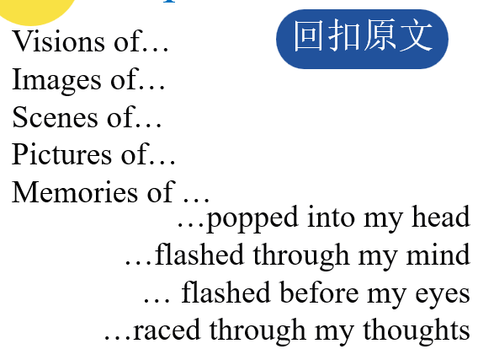
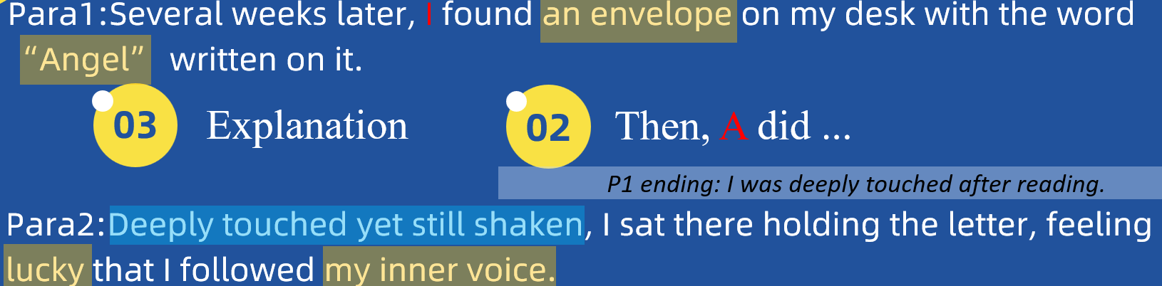
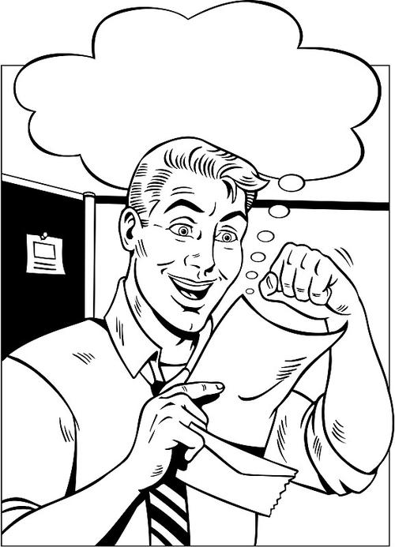
新阵地
例句：
①Curious and puzzled, I opened it and found a heartfelt letter from the man I had met on the train that day.
②“Angel? Angel...” I murmured, memories of the man I had met on the train immediately flooding back.
03
Explanation
B’ change
内/外
02
Then, A did ...
情节模式1：困惑—恍然大悟---------读信—触动I 回忆-----
kindness
头
手
情节模式2：
肢体动作

Slide 14

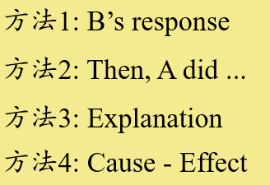
肢体动作
情绪表达
语言描写
宁波十校Para2:Weeks later, the moveable library program started, bringing libraries to different communities社区/团体.
Local community（当地社区）
Urban community（城市社区）
Rural community（农村社区）
Children's Community
Senior Community
People from different communities
I
名校协作体Para2:Several weeks later, the woman came to me.
The woman’s change-----外在/内心
新阵地Para2:Deeply touched yet still shaken, I sat there holding the letter, feeling lucky that I followed my inner voice.
协同原文
The inner voice----对自己/对他人

Slide 15


Homework
03
完成第二段段首句的衔接句。
回读原文，找出原材料中的协同点
构建每段话的大致情节模式

Slide 16
谢谢您的观看
Thanks for Watching

