Slide 1


感恩遇见，相互成就，本课件资料仅供您个人参考、教学使用，严禁自行在网络传播，违者依知识产权法追究法律责任。
更多教学资源请关注
公众号：溯恩英语
知识产权声明

Slide 2
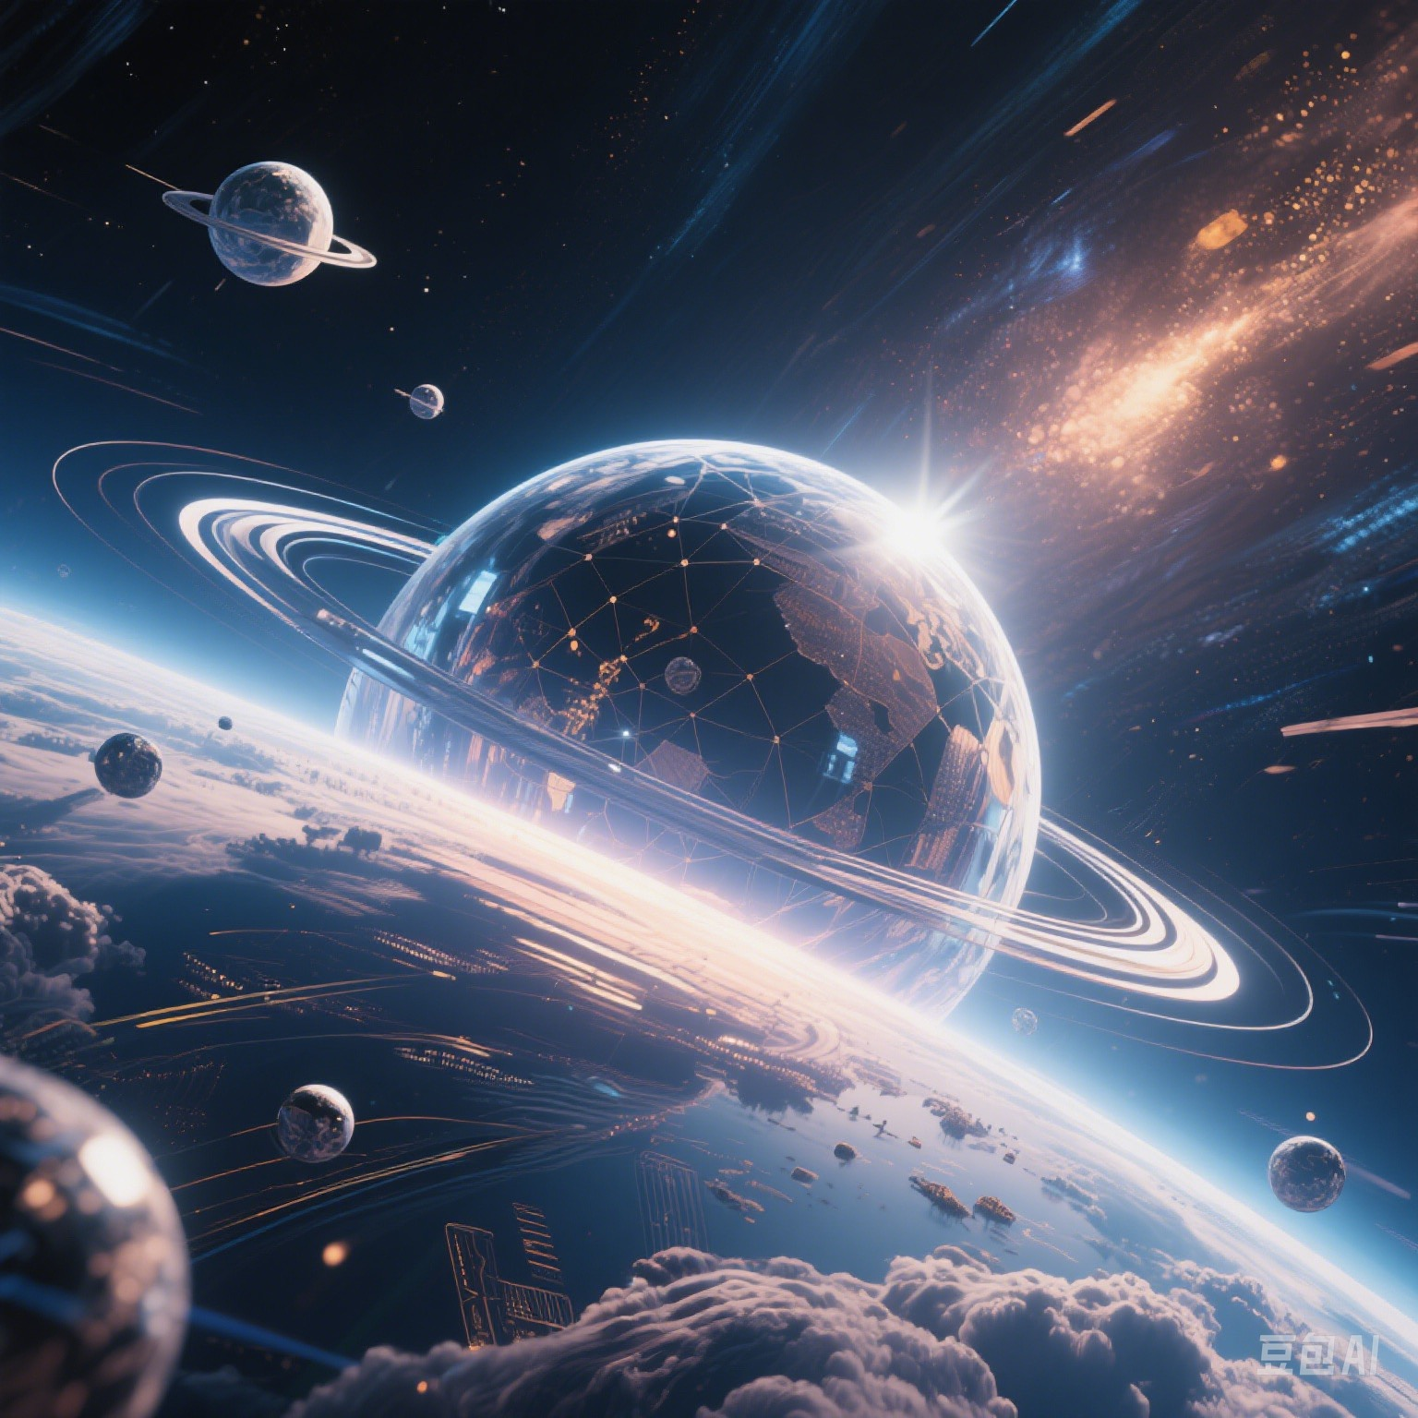
XB4U1 Science Fiction
Write a Sci-fi Short Story
广东梅县外国语学校
陈 妮
Notes:
豆包生成图片

Slide 3
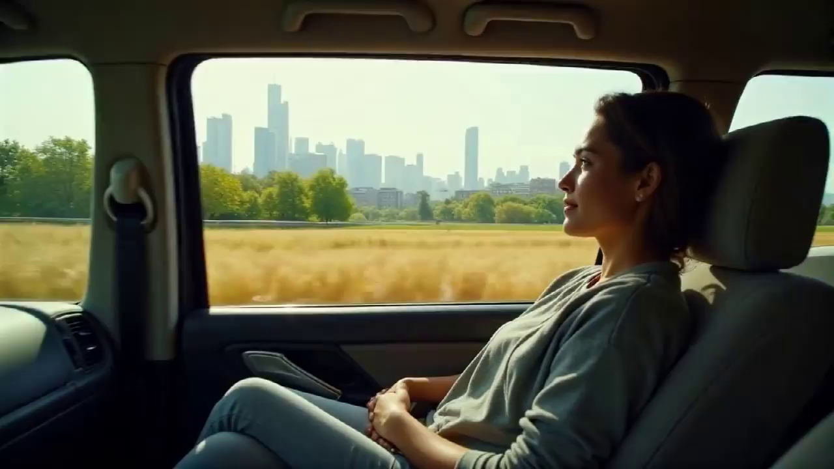
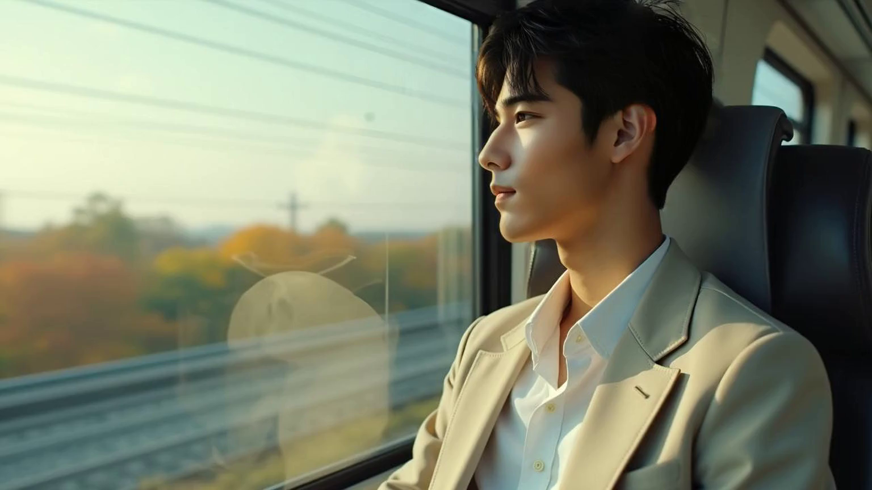
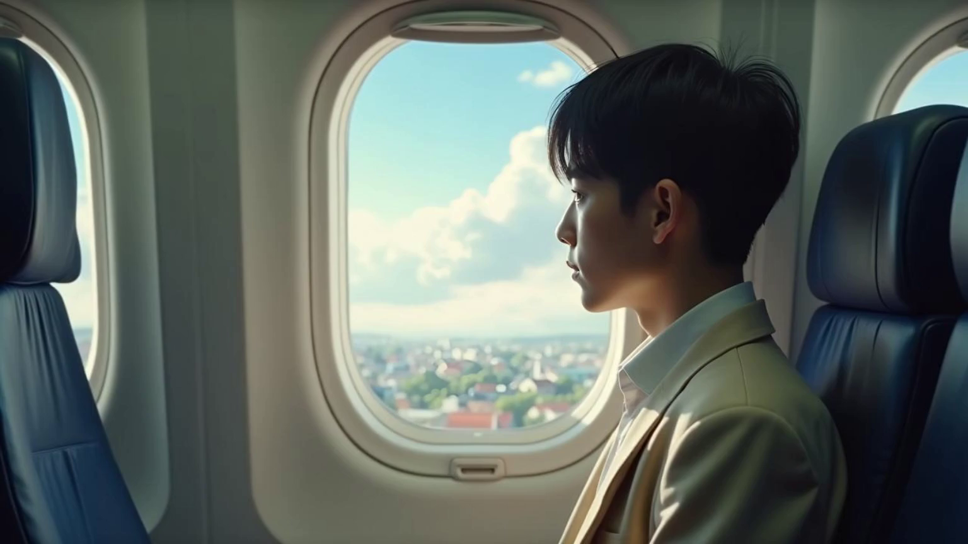
Car | Train
Plane | Time Machine
60km/h
200km/h
?
800km/h
> light speed(3.0×10⁸m/s)
What will time machine look like?
How will time machine work?
Notes:
白日梦视频生成AI视频，

Slide 4
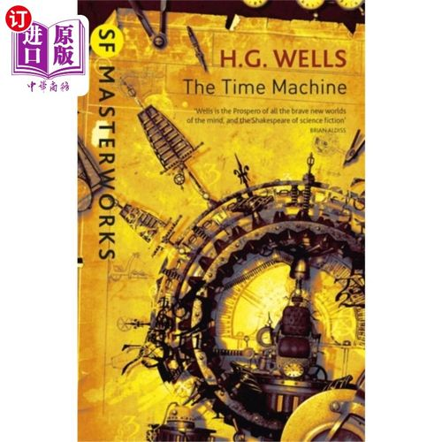
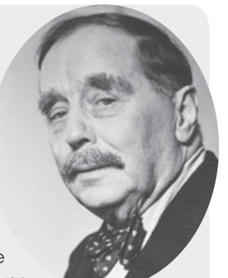
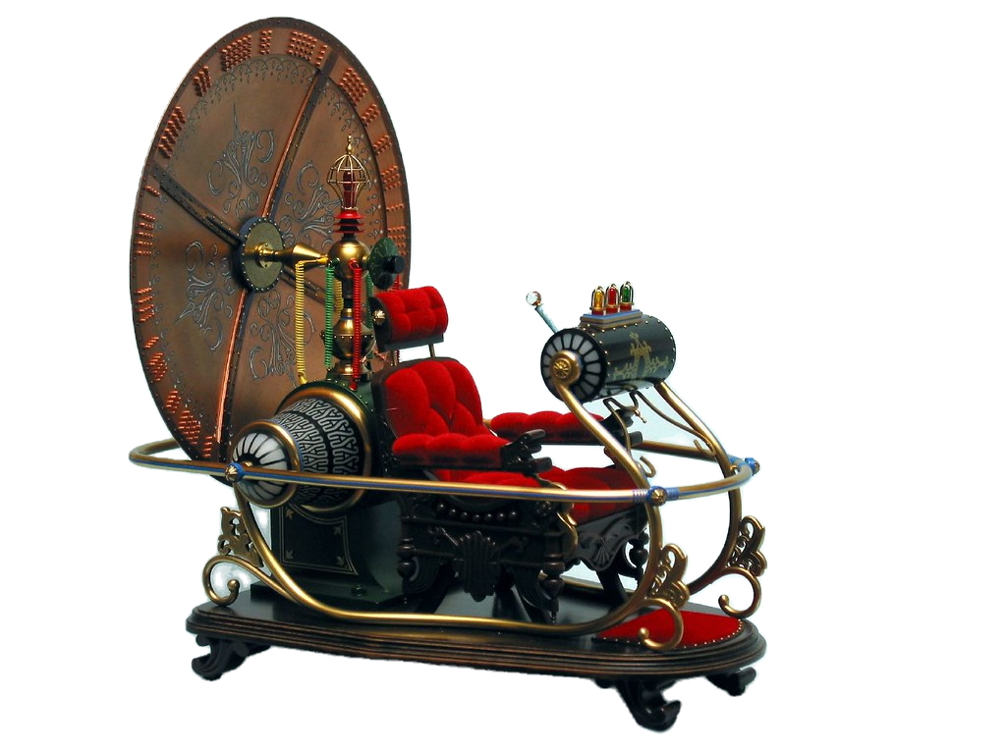
Herbert George Wells(1866 — 1946), “The Father of Science Fiction”,
English novelist, teacher, historian and journalist
starting lever
main panel
The Time Machine
the first science fiction
about time travelling
the Time Machine
Notes:
, tells the story about a time traveller who can travell around time because of the the time machine.

Slide 5
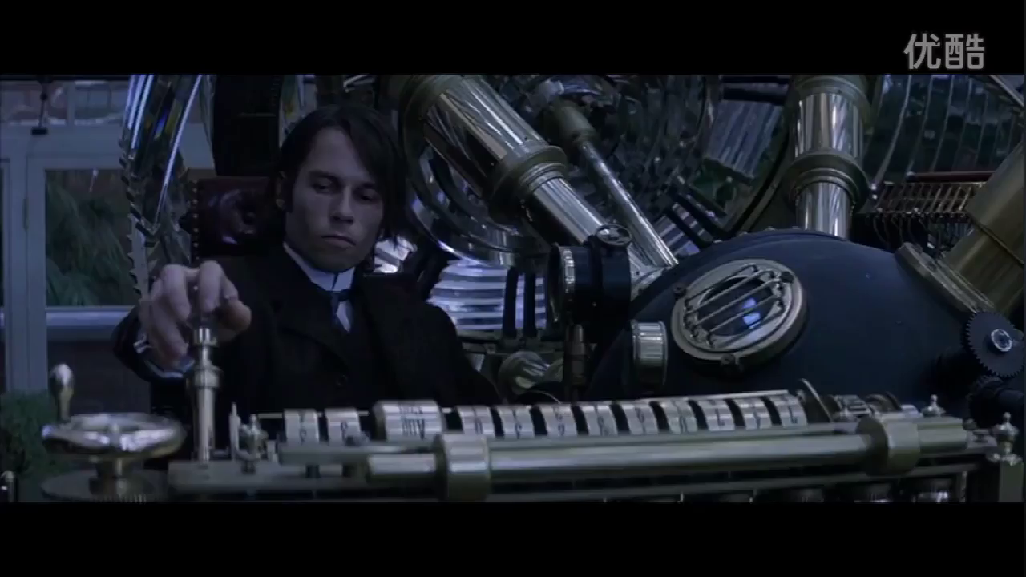
How many times did “I” start the Time Machine?
push forward
pull back
Notes:
first person

Slide 6
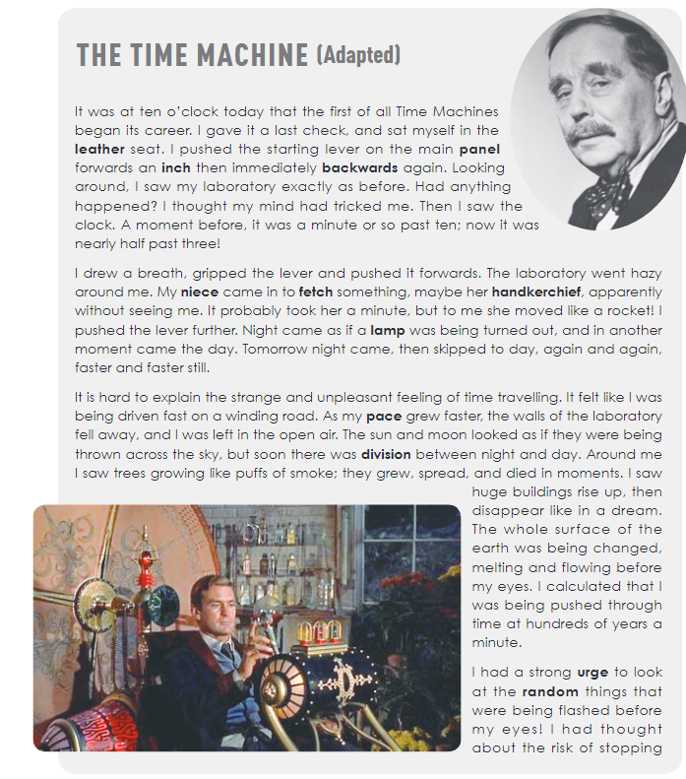

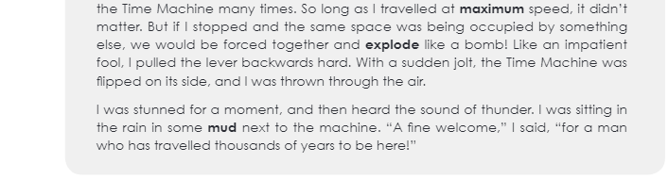
How many times did “I” start the Time Machine?
I pushed the starting lever on the main panel forwards an inch then immediately backwards again.
the 1st time
the 2nd time
I drew a breath, gripped the lever and pushed it forwards.
the 3rd time
I pushed the lever further.
Like an impatient fool, I pulled the lever back hard.
the 4th time

Slide 7








Times | What I Saw | What I Thought | How I Felt
The 1st Time: | Lab : __________
 | Clock:____--____
The 2nd Time: | Lab: _____________
 | Niece: move like a ________
The 3rd Time: | Lab:____________
 | Moon and sun: as if they _______ __________ between night and day
 | Trees: grew, spread and ____ in moments Huge buildings: rise up and _______ Earth: changed, ________ and ____.
The 4th Time: | I was sitting in the _______ in some________
Notes:
活动：给视频配字幕（match）

Slide 8
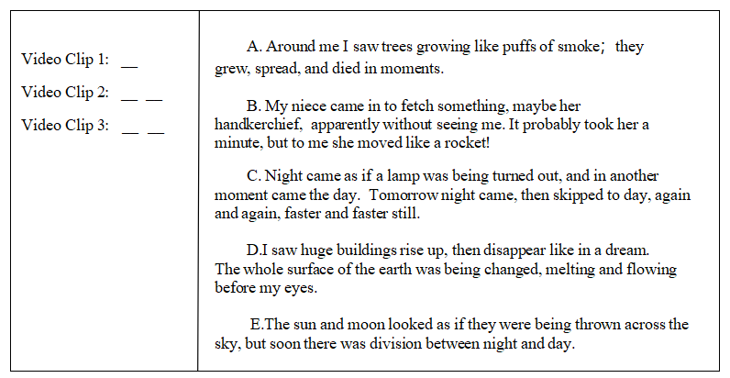
Match the sentences with video clips

Slide 9
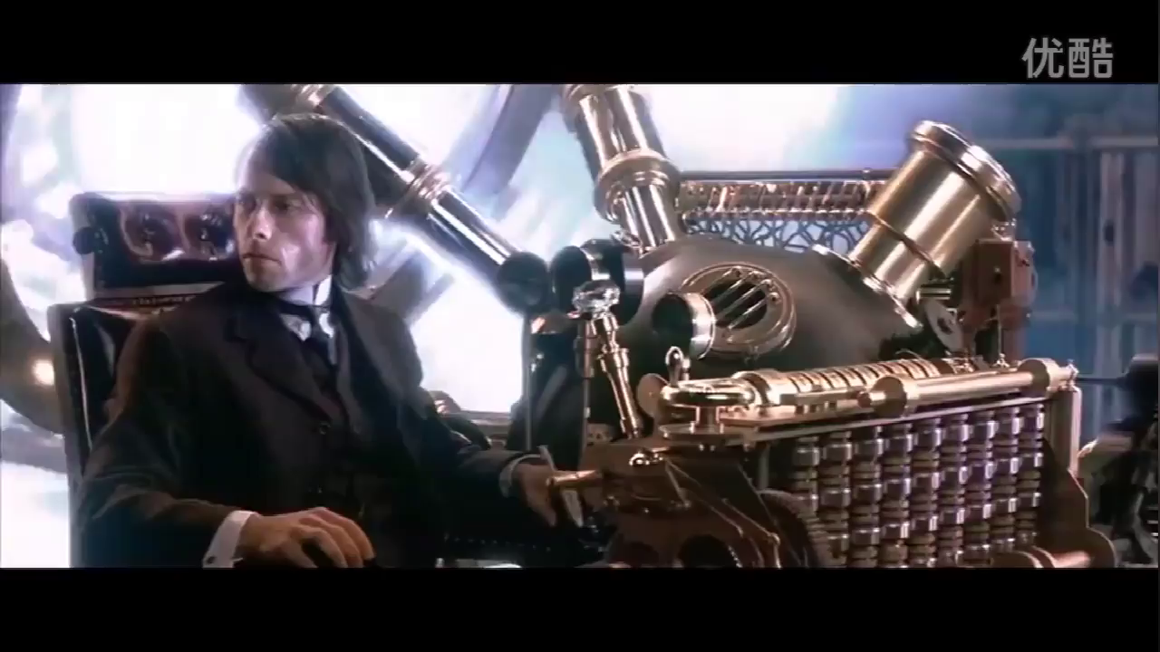
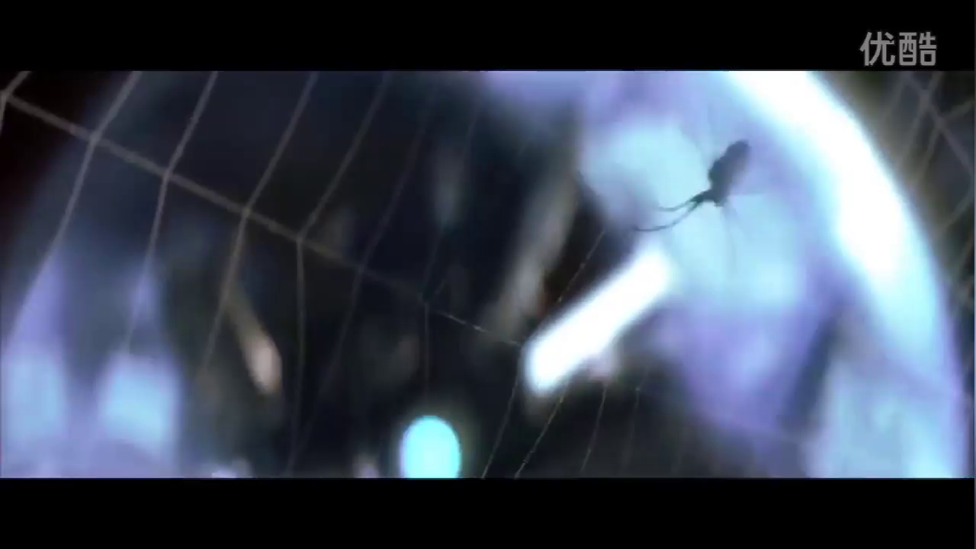
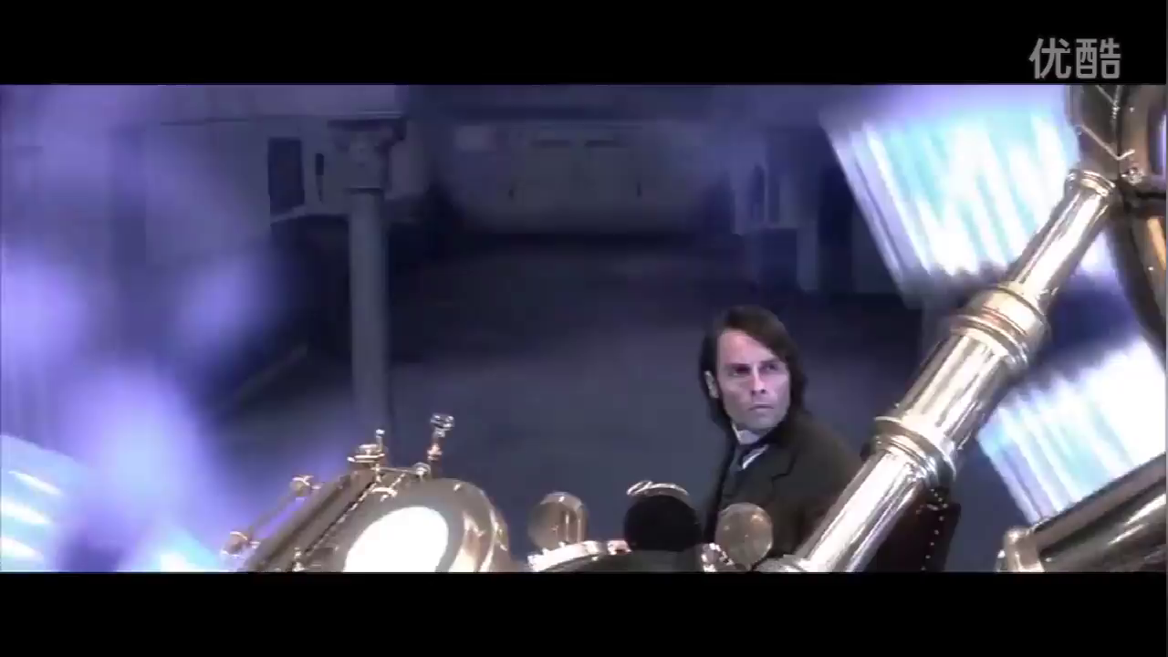
Sentences
vs
Video Clips
Video Clip 1
Video Clip 2
Video Clip 3

Slide 10

Video Clip 1
Literary Device:
Overstatement
B. My niece came in to fetch something, maybe her handkerchief, apparently without seeing me. It probably took her a minute, but to me she moved like a rocket!
（仿写）我的心跳如此剧烈, 以至于能让宇宙中的每一座时钟都停止。
it could stop every clock in the universe
My heart pounded so violently that_____________________________________
Notes:
好处，仿写句子（deepseek生成例子）

Slide 11


Video Clip 2
Literary Device:
Metaphor
C. Night came as if a lamp was being turned out, and in another moment came the day. Tomorrow night came, then skipped to day, again and again, faster and faster still.
E. The sun and moon looked as if they were being thrown across the sky, but soon there was division between night and day.
（仿写）那些钢铁建筑就像巨大的冰镜，在烈日下渐渐融化。
melting under the sun
The steel buildings were giant icy mirrors , _________________________.

Slide 12



Video Clip 3
Literary Device:
Simile
A. Around me I saw trees growing like puffs of smoke；
they grew, spread, and died in moments.
D. I saw huge buildings rise up, then disappear like in a dream.
The whole surface of the earth was being changed, melting and flowing before my eyes.
（仿写）我的时光机看起来像一个水晶球，上面有两个按钮。
looks like a crystal ball with two buttons
My time machine ________________________________________.

Slide 13









micro macro
faster and faster
surface changed;
flew, melted
rose up, disappeared
grew, spread and died
100 years=1 moment
lab went hazy;
as if lamp;
be thrown
walls fell away
niece like rocket
1 day=1 moment
10:01--3:30
5 hours=1 moment
What I saw

Slide 14



Writing Task
Write a sci-fi story about a time machine you will invent, and your journey through time.
when
time machine
?
where
what you see
How you feel
who

Slide 15



How to Write A Good Sci-fi Story?
Imagination
time machine: appearance, operation
see, feel
Theme
explore the future of human
reflect the impact of technology

Slide 16
felt like I was being driven fast on a winding road
was stunned
我既兴奋又紧张，紧紧地闭上眼睛，双手紧紧地握着。（翻译）
Overwhelmed with excitement and nervousness
______________________________, I closed my eyes tightly and held my hands firmly.
Nervous
overwhelmed with nervousness/anxiety
my heart pounds
be rooted to the spot
breathe a huge sigh of relief
release pent - up tension
take the edge off nervousness
How I felt

Slide 17
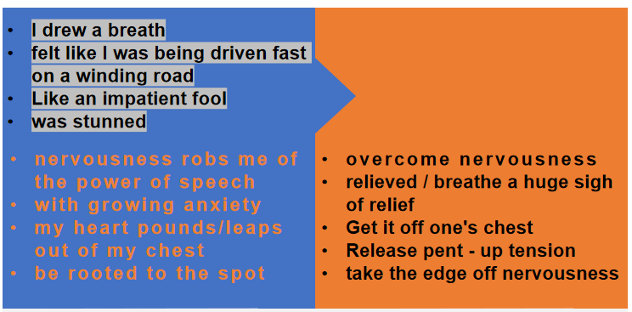
…she move like a rocket…
Night came as if lamp was being turned out
It felt like I was being driven fast on a winding road.
...trees growing like puffs of smoke...
...huge buildings disappear like in a dream.
The sun and moon looked as if they were being thrown across the sky
… she moved like a rocket.
... I was being pushed through time at hundreds of years a minute.
Literary Devices
feeling
expressions
simile
metaphor
overstatement

Slide 18
How to Write A Good Sci-fi Story?
Language
literacy devices
feeling expression
Imagination
time machine: appearance, operation
see, feel
Theme
Theme
explore the future of human
reflect the impact of technology
Watch 3 video clips, find out reasons for time travel

Slide 19
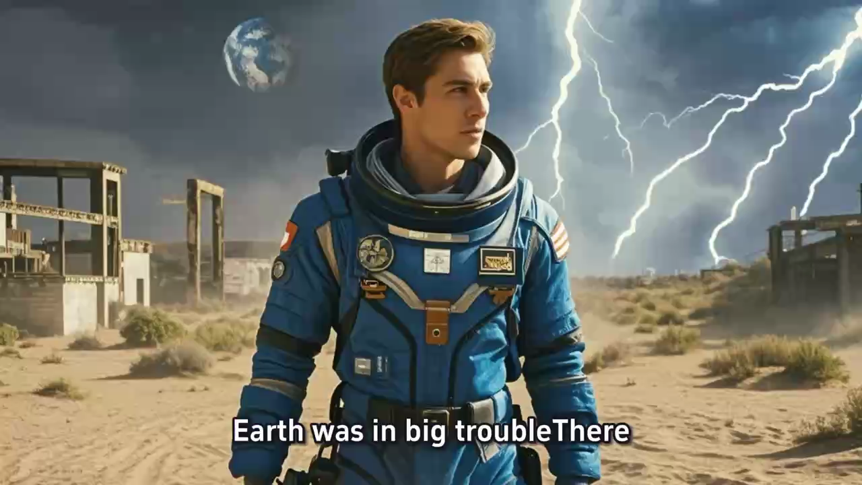
Interstellar
星际穿越

Slide 20
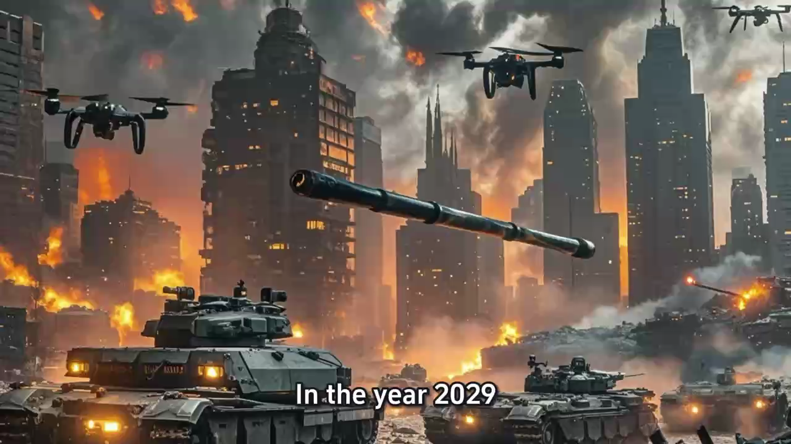
The Terminator终结者

Slide 21
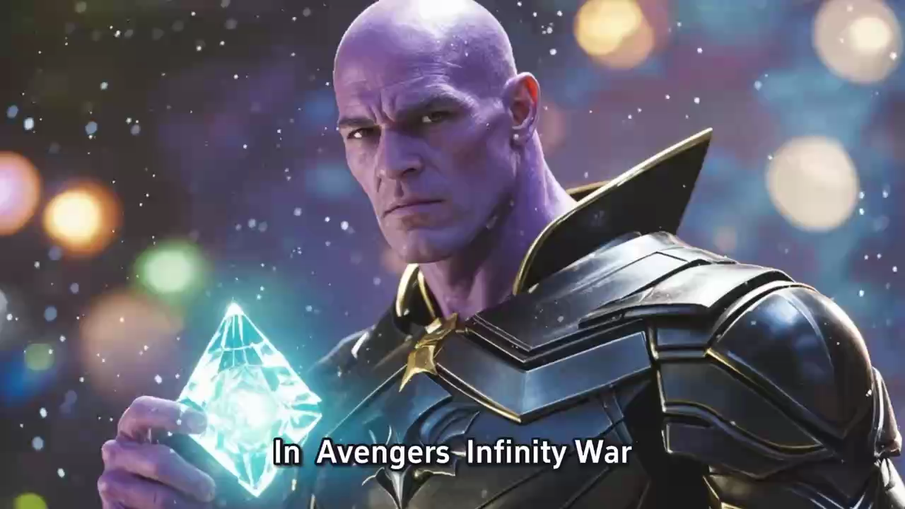
Avengers: Endgame
复仇者联盟4：终局之战

Slide 22
How to Write A Good Sci-fi Story?
Imagination
time machine: appearance, operation
see, think, feel
Language
literacy devices
feeling expression
Theme
reason: solve problems, save human

Slide 23
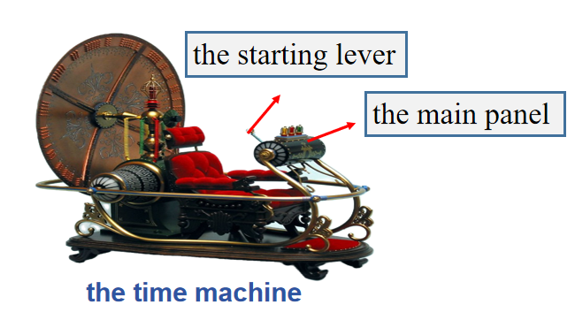
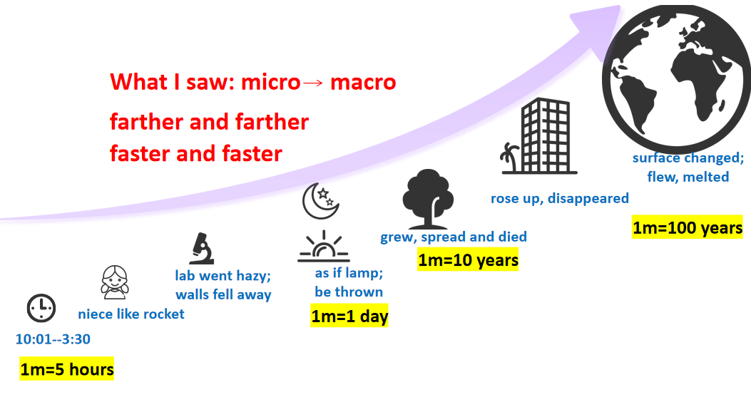
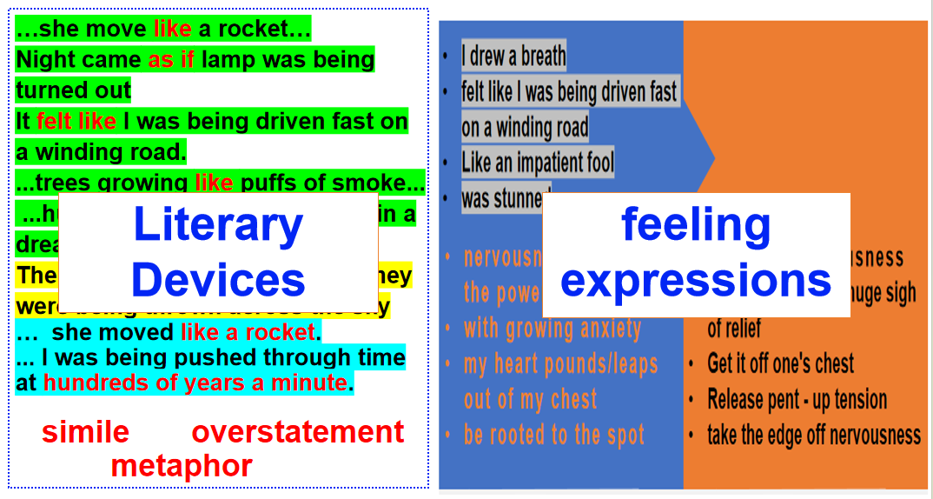
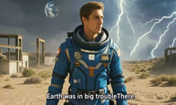
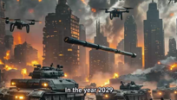
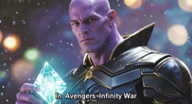
How to Write A Good Sci-fi Story?
Imagination
time machine: appearance, operation
see, feel
Language
literacy devices
feeling expression
Theme
reason: solve problems, save human

Slide 24
Writing Time
Notes:
豆包生成图片

Slide 25
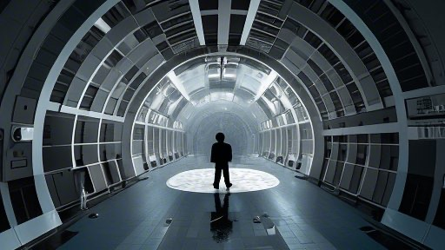
destinations
(future / past)
interesting things,
people
go to the future
appearance
see, feel
operation
turn the clock back

Slide 26
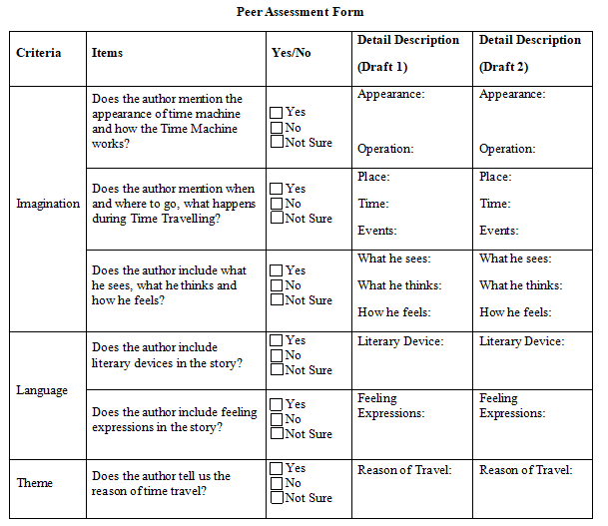
四、Writing Circle
Step 1: Leader ask everyone’s idea
Step 2: Write
Step 3: Everyone read draft, Others give feedback
Notes:
计时器

Slide 27
How to Write A Good Sci-fi Story?
Imagination
time machine: appearance, operation
see, feel
Language
literacy devices
feeling expression
Theme
reason: solve problems, save human

Slide 28
Homework
1. Polish your story;
2. Made a video for your story using AI
(highly recommend:剪映，即梦)
Today’s science fiction is tomorrow’s science fact.
—Isaac Asimov

Slide 29
Thank You

