Slide 1


感恩遇见，相互成就，本课件资料仅供您个人参考、教学使用，严禁自行在网络传播，违者依知识产权法追究法律责任。
更多教学资源请关注
公众号：溯恩英语
知识产权声明

Slide 2


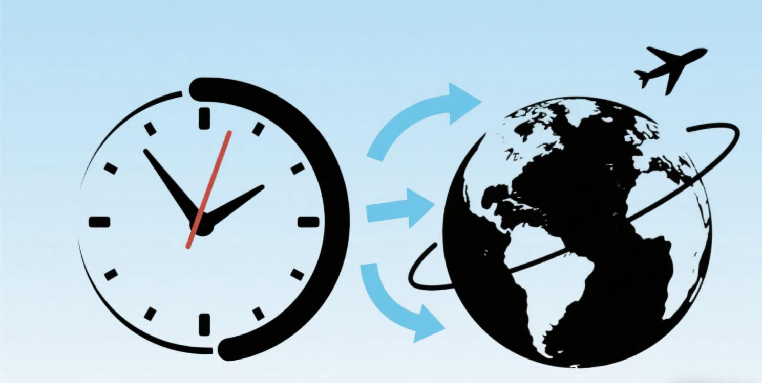
2025
读后续写转场技巧 1
时间和空间转场
短语句型和思维方式整合
Judyliu

Slide 3
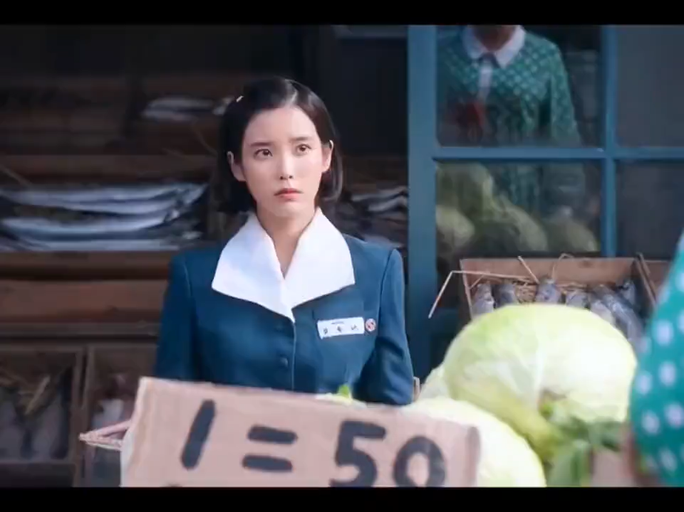

韩剧《苦尽甘来》的经典转场
Transition in Literature
Transition in Film/TV

Slide 4

文学中的转场（Transition in Literature）
定义：在文学作品（如小说、散文）中，转场是指通过语言技巧实现场景、时间或空间的切换，使叙事从一个段落自然过渡到另一个段落，保持情节连贯或制造叙事节奏变化。转场可以是时间的跳跃（如从白天到夜晚）、地点的转换（如从室内到室外），或视角的转移（如从主角内心独白转向外部事件）。

Slide 5
中文术语 | 英文术语 | 定义与功能 | 文学 / 影视示例
时间转场 | Temporal Transition | 跨越时间（过去 / 现在 / 未来）的叙事衔接，通过时间词、事件暗示或环境变化实现。 | 文学："Years later, the letter still lay unopened on the desk."（多年后，信仍未拆开放在桌上。） 影视：用落叶飘落暗示季节变化。
空间转场 | Spatial Transition | 地点切换，通过方位、感官描写或动作引导场景转换，保持空间逻辑连贯。 | 文学："Descending the stairs, she entered a room filled with the scent of cinnamon."（下楼时，她进入一个弥漫肉桂香的房间。） 影视：通过推开房门的动作切到新场景。
蒙太奇 | Montage | 影视中通过剪辑组合碎片化镜头，暗示时间压缩或主题关联（文学中类似 “跳接” 手法）。 | 影视：快速剪辑主角从童年到成年的照片，配合旁白 “二十年过去了”。
场景转换 | Scene Shift | 段落或镜头间的场景切换，可通过环境描写、动作或留白实现。 | 文学："The conversation died as the door closed. Outside, the storm raged on."（门关上时，对话终止。外面，暴风雨仍在肆虐。） 影视：黑屏后切到新场景。
声音转场 | Sound Bridge | 利用声音延续实现场景过渡，增强时空连贯性（影视常用，文学中通过听觉描写暗示）。 | 影视：前一场景的钢琴声延续到下一场景的室内镜头，暗示空间转换。

Slide 6
时间转场：
1快速转场（瞬间 / 突发动作，节奏紧凑）
核心句型公式（校园生活场景适用）
No sooner had sb. done sth. than sb. did sth.
（过去完成时 + 一般过去时，部分倒装）
The moment/instant sb. did sth., sb. did sth.
（直接衔接，强调瞬间动作）
Before sb. could react/utter a word, sb. did sth.
（突出动作超前性）
核心句型公式（校园生活场景适用）
No sooner had sb. done sth. than sb. did sth.
（过去完成时 + 一般过去时，部分倒装）
The moment/instant sb. did sth., sb. did sth.
（直接衔接，强调瞬间动作）
Before sb. could react/utter a word, sb. did sth.
（突出动作超前性）

Slide 7
学校举办运动会。同学们都很期待。运动会开始，第一项是跑步比赛。运动员们在起跑线准备，裁判（referee）鸣枪。运动员们冲出去，观众们欢呼。小明跑得很快，跑在前面。突然，他摔倒。大家很担心，有人跑过去帮忙。老师也赶紧过来，查看小明的情况。
原始段落（无快速衔接词）
The school held a sports meeting. The students were all looking forward to it. The sports meeting started, and the first event was the running race. The athletes were getting ready at the starting line, and then the referee fired the starting gun. The athletes rushed out, and the audience cheered. Xiaoming ran very fast and was in the front. Suddenly, he fell down. Everyone was very worried, and some people ran over to help. The teacher also came over quickly to check on Xiaoming's condition.

Slide 8
学校举办运动会，同学们都满心期待着。运动会一开始，第一项跑步比赛就拉开帷幕。运动员们刚在起跑线站定，（No sooner had the athletes taken their positions at the starting line than）裁判便鸣枪示意。刹那间（The instant the starting gun went off），运动员们如离弦之箭般冲了出去，观众们也随即爆发出热烈的欢呼。小明跑得飞快，一马当先。可还没等大家反应过来（Before anyone could react），他就突然摔倒了。见状，大家心急如焚，毫不耽搁（Wasting no time），几位同学立刻冲过去帮忙。与此同时，老师也在听到动静的第一时间（At the sound of the commotion）赶来，查看小明的状况。
修改后段落（运用快速衔接词）
The school held a sports meeting, and the students were all eagerly looking forward to it. No sooner had the athletes taken their positions at the starting line than the referee fired the starting gun. The instant the starting gun went off, the athletes dashed out like arrows, and the audience burst into enthusiastic cheers right away. Xiaoming ran extremely fast and took the lead. But before anyone could react, he suddenly fell down. Seeing this, everyone was extremely worried. Wasting no time, several classmates immediately rushed over to help. At the same time, the teacher also came over to check on Xiaoming's condition the moment she heard the commotion.

Slide 9
时间转场：
2 较短时间转场
1. In a flash of one's eye：表示“转眼间；一瞬间”。语法考点：在句子中作时间状语，位置灵活，可置于句首或句中；常与一般过去时搭配，描述过去瞬间发生的动作。
2. Without hesitation：意为“毫不犹豫地”。语法考点：在句中作状语修饰动词，后直接接动词原形；句子时态根据具体语境确定。
3. It wasn't long before...：表示“没过多久就……”。语法考点：before引导时间状语从句，主句常用一般过去时，从句也用一般过去时；it作形式主语。
4. Before sb. could do sth., sb. did sth.：意思是“某人还没来得及做某事，另一人就做了某事” 。语法考点：before引导的时间状语从句用could + 动词原形，主句用一般过去时。
5. In a split second：意为“在一瞬间；刹那间”。语法考点：在句中作时间状语，位置灵活；常与一般过去时搭配，描述过去瞬间发生的事，使用时要保证句子主谓宾结构完整。

Slide 10
时间转场：
2 较短时间转场
6. In an instant：“立刻；马上”。语法考点：在句中作时间状语，可放在句首、句中或句末；多与一般过去时或一般现在时搭配，取决于描述动作的时间，使用时要确保句子逻辑清晰，动作主体明确。
7. In no time：表示“很快；立刻；马上”。语法考点：在句中作时间状语，常位于句末；可与各种时态搭配，需注意和“soon”区分，它更强调时间的短暂快速。
8. Right away：“立即；马上”。语法考点：在句中作状语修饰动词，可置于句首、句中或句末；常用于一般现在时或一般过去时的句子中，表达即时行动，要注意与句子其他成分搭配，确保语义通顺。
9. In a jiffy：意思是“一会儿；马上”。语法考点：在句中作时间状语，通常放在句末；常用于一般现在时或一般将来时的句子中，表示即将发生的短暂动作；在正式写作中使用频率较低 。

Slide 11

那天在学校图书馆，我在找一本很重要的书。图书馆里人很多，书架也很复杂。我找了很久，一直没找到。后来我的同学来了，他帮我一起找。最后我们找到了那本书。
原始段落（无较短时间衔接词）
That day in the school library, I was looking for a very important book. There were many people in the library, and the bookshelves were complicated. I searched for a long time but couldn't find it. Later, my classmate came and helped me look for it together. Finally, we found the book.

Slide 12
那天在学校图书馆，我在找一本很重要的书。图书馆里人很多，书架也错综复杂。我刚找了一会儿（Before I could search for long），转眼间（In a flash of my eye），我的同学就来了。他毫不犹豫地（Without hesitation）加入了找书的队伍。没过多久（It wasn't long before），我们就找到了那本书。
修改后段落（运用较短时间衔接词）
That day in the school library, I was looking for a very important book. There were many people in the library, and the bookshelves were complicated. Before I could search for long, in a flash of my eye, my classmate arrived. Without hesitation, he joined me in looking for the book. It wasn't long before we found it.

Slide 13
时间转场：
3 表示时间慢的短语和句型罗列
After what seemed like a century/age：字面意思是 “在看起来像一个世纪 / 年代之后”，实际表达 “仿佛过了很久”，用于强调等待或经历某件事的过程感觉十分漫长。在句中引导时间状语，后面接主句，主句常用一般过去时。
With time ticking by / With time passing by：“随着时间的流逝”，with 引导的独立主格结构作状语，强调时间的逐渐推移。在句中位置灵活，可置于句首或句中，句子时态根据具体情境确定，常与进行时或完成时搭配。
It seemed like hours/days/weeks before...：“似乎过了好几个小时 / 好几天 / 好几个星期才……”，it 作形式主语，before 引导时间状语从句，表达某件事发生之前经历了漫长的时间，主句和从句常用一般过去时。
Slowly but surely：“缓慢但稳步地”，用于描述事情进展虽然缓慢，但持续推进，最终会达成结果。在句中作状语，修饰动词，句子时态不限。
Little by little：“逐渐地；一点一点地”，表示程度或数量的逐渐变化，在句中作状语，修饰动词、形容词或副词，句子时态根据语境确定，常用于描述变化的过程。

Slide 14
考试结束了，学生们都很紧张，想知道成绩。大家在教室里等着，心里很不安。老师终于来了，拿着成绩单。同学们都围上去看自己的成绩。
原始段落（无时间慢的衔接词）
The exam was over. The students were very nervous and eager to know their scores. They waited in the classroom, feeling restless. Finally, the teacher came in, holding the report cards. The students gathered around to check their scores.

Slide 15
考试结束了，学生们都紧张得不行，满心急切地想知道成绩。在教室里等待的每一分每一秒，都仿佛被无限拉长（After what seemed like a century）。随着时间一分一秒地过去（With time ticking by），大家的心里愈发不安。似乎过了好几个小时（It seemed like hours before），老师才终于慢悠悠地走进来，手里拿着成绩单。同学们这才缓缓地、一个一个地围上去（Slowly but surely），一点一点地凑近（Little by little），查看自己的成绩。
修改后段落（运用时间慢的衔接词）
The exam was over. The students were extremely nervous, burning with eagerness to know their scores. After what seemed like a century, they waited in the classroom, and with time ticking by, their restlessness grew. It seemed like hours before the teacher finally came in slowly, holding the report cards. The students then slowly but surely gathered around, little by little getting closer to check their scores.

Slide 16
空间转场：
What sb. saw/heard/knew next was...
语法：what 引导主语从句，主句谓语多为 be 动词，时态与上下文一致。
What greeted sb. was...
语法：what 引导主语从句，强调进入新场景的第一印象，时态常为一般过去时。
A closer look explained everything.
语法：简单句，强调细节揭示，时态随语境变化（过去 / 现在）。
With a closer look, sb. did sth.
语法：with 短语作状语，后接人物动作，时态与主句一致。
Once home/inside/outside, sb. did sth.
语法：once 引导省略式时间状语从句（省略主语 + be），主句时态多为一般过去时。
On one's way (back) to/back sp., sb. did sth.
语法：on 短语作状语，to 后接地点名词，back 后接地点副词（如 home），时态灵活。
As sb. moved from...to..., ...
语法：as 引导时间状语从句，描述空间移动过程，主从句时态一致。
Following the sound/light/smell of..., ...
语法：现在分词短语作状语，感官名词前加定冠词，时态多为过去时。
Entering..., sb. found oneself in...
语法：现在分词短语作时间状语，oneself 与主语一致，主句描述新空间状态。

Slide 17
放学了，我离开学校。路上有一家商店，我看到里面有很多人。我回家打开门，妈妈在厨房做饭。我走进房间放下书包，然后去帮忙。
原始段落 无空间转场（平铺直叙）
School ended, and I left the school. There was a store on the road, and I saw many people inside. I went home, opened the door, and my mom was cooking in the kitchen. I entered my room, put down my schoolbag, and went to help.

Slide 18
放学铃响，我踏出教室（Once outside the classroom）。沿着熟悉的街道走，街角新开的面包店飘来的香味吸引了我（Following the smell of freshly baked bread from the new bakery on the corner）。走近一看（With a closer look），橱窗里的牛角包金黄酥脆。继续往家走（On my way back home），社区花园里的樱花树正在盛开，花瓣飘落在小径上。
推开家门（Once home），迎接我的是（What greeted me was）妈妈在厨房忙碌的身影和饭菜的香气。走进房间（Entering my room），我发现书桌上放着一张社区活动传单。仔细一看（A closer look explained everything），周末将举办烘焙工作坊，就在街角的新面包店。我立刻跑回厨房，跟妈妈分享这个发现。
修改后段落（有空间转场（融入句型，增强画面感）
When the school bell rang, I stepped outside the classroom. Following the smell of freshly baked bread from the new bakery on the corner, I walked along the familiar street. With a closer look, the croissants in the window were golden and crispy. On my way back home, cherry blossoms from the community garden were in full bloom, their petals falling on the path.
Once home, what greeted me was the sight of Mom busy in the kitchen and the aroma of food. Entering my room, I found a flyer for a community event on my desk. A closer look explained everything: there would be a baking workshop on the weekend at the new bakery around the corner. I immediately ran back to the kitchen to share the news with Mom.

Slide 19
实战
Each October, I strongly requested my parents to take us to a pumpkin (南瓜) field to choose pumpkins, but it never happened. I was extremely astonished when my father came home with the most incredible news about a pumpkin lantern carving party at the Pumpkin Field, which was just a short distance away.
I shouted out in disbelief, and my younger brother, Tex, shouted the pumpkin lantern carving party repeatedly with excitement. However, my father mentioned a rumor about something awful and unexpected happening there, sounding concerned. Regardless of it, Tex and I quickly leaped into the car and fastened our seat belts, eager to leave for the Pumpkin Field. On the way, Tex announced with delight that he would choose the biggest pumpkin, while I remarked with confidence that “greatest” wasn’t a real word and that I would choose the coolest one. Tex yelled that he would choose the one to make the most frightening pumpkin lantern. My dad cut in, cautioning us about too much enthusiasm and suggested having a Plan B if Plan A didn’t work out.
No reply! Tex and I kept up our excitement, laughing and talking. The journey was especially awesome as we witnessed all sorts of Halloween decorations along the route. Tex informed me that we were driving near our destination, pointing to sparkling orange lights and a blinking Pumpkin Field sign. “Yeah! Yes! It wasn’t a long drive,” I said. “Be careful, pumpkins! Here we come!”
Appearing before us were pumpkins of all sizes scattered throughout the field. We arrived there thrilled and desperate to find pumpkins of all sizes. Tex declared he would choose an enormous one, but upon approaching, to his disappointment, he noticed a hole in it when he found one. He then hurried to another perfect pumpkin, only sad to find someone had taken a bite out of it.
That’s when I noticed the Pumpkin Field Closed sign.
Finally, we agreed to hold our own pumpkin lantern carving party the next day.

Slide 20
下水作文
That’s when I noticed the Pumpkin Field Closed sign. Heavy disappointment coiled around me, rooting my feet to the ground. Before Tex could whimper, his face crumpled, tears welling. “But we drove so far!” he stammered, voice trembling. I looked at Dad, whose gaze softened—then he smiled. “Plan B, remember?” No sooner had the words left his mouth than Tex’s tears vanished, replaced by excitement. “Plan B!” he shrieked, yanking Dad’s hand. “We’ll make jack-o’-lanterns at home!”
Finally, we agreed to hold our own pumpkin lantern carving party the next day. That evening, once inside, Mom had set out carving tools and stickers. “Coolest face first!” I said, handing Tex a marker. He frowned. “Scariest—three eyes and fangs!” He scribbled a jagged mouth, making us laugh. Without hesitation, Dad sliced open pumpkins, and we scooped out pulp, seeds popping into a bowl. When the first lantern glowed, its light lit up Tex’s pumpkin-speckled nose and our messy but happy living room “wonderland.” What greeted us most warmly wasn’t the candlelight, but Mom’s cinnamon-roasted seeds—their aroma mixing with laughter, turning a disappointing night into a warmer memory.

Slide 21
参考范文
That’s when I noticed the Pumpkin Field Closed sign. A wave of disappointment washed over me, as I was glued to the land, a bit lost and heartbroken, Tex, froze for a moment before his face twisted in confusion. “But...but we came all this way!” he stammered, his voice breaking. I glanced at my dad, whose eyes softened with sympathy. “It’s okay, Tex,” I said, ruffling his hair and trying to sound uplifting. “Let’s not give up so soon. Maybe we can come up with something even better!” Dad’s eyes lit up, and he whispered, “Plan B?” Tex’s excitement returned instantly as he shouted, “Plan B!”
Finally, we agreed to hold our own pumpkin lantern carving party the next day. That evening, we brainstormed ideas at the dinner table, sketching designs on paper and laughing at Tex’s designed ridiculous pumpkin faces with three eyes! I giggled. “And this one’s wearing a hat!” Tex cut in, his earlier disappointment now completely forgotten. Later, Dad helped us carve the pumpkins we had bought on our way home. Finally, we turned our living room into a pumpkin wonderland. As we presented the glowing pumpkin lanterns with satisfaction, a warm sense of pride filled me. Looking at our creations, I realized that setbacks can lead to even greater fun when you have family by your side.

Slide 22


2025 高考加油！

