Slide 1


感恩遇见，相互成就，本课件资料仅供您个人参考、教学使用，严禁自行在网络传播，违者依知识产权法追究法律责任。
更多教学资源请关注
公众号：溯恩英语
知识产权声明

Slide 2


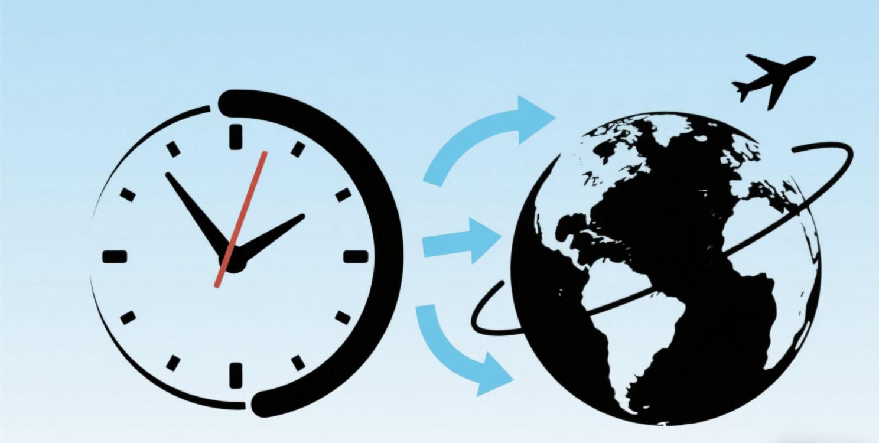
2025
读后续写转场技巧2
蒙太奇，场景和声音转换
短语句型和思维方式整合
Judyliu

Slide 3


韩剧《苦尽甘来》的经典转场
Transition in Literature
Transition in Film/TV

Slide 4

文学中的转场（Transition in Literature）
定义：在文学作品（如小说、散文）中，转场是指通过语言技巧实现场景、时间或空间的切换，使叙事从一个段落自然过渡到另一个段落，保持情节连贯或制造叙事节奏变化。转场可以是时间的跳跃（如从白天到夜晚）、地点的转换（如从室内到室外），或视角的转移（如从主角内心独白转向外部事件）。

Slide 5
中文术语 | 英文术语 | 定义与功能 | 文学 / 影视示例
时间转场 | Temporal Transition | 跨越时间（过去 / 现在 / 未来）的叙事衔接，通过时间词、事件暗示或环境变化实现。 | 文学："Years later, the letter still lay unopened on the desk."（多年后，信仍未拆开放在桌上。） 影视：用落叶飘落暗示季节变化。
空间转场 | Spatial Transition | 地点切换，通过方位、感官描写或动作引导场景转换，保持空间逻辑连贯。 | 文学："Descending the stairs, she entered a room filled with the scent of cinnamon."（下楼时，她进入一个弥漫肉桂香的房间。） 影视：通过推开房门的动作切到新场景。
蒙太奇 | Montage | 影视中通过剪辑组合碎片化镜头，暗示时间压缩或主题关联（文学中类似 “跳接” 手法）。 | 影视：快速剪辑主角从童年到成年的照片，配合旁白 “二十年过去了”。
场景转换 | Scene Shift | 段落或镜头间的场景切换，可通过环境描写、动作或留白实现。 | 文学："The conversation died as the door closed. Outside, the storm raged on."（门关上时，对话终止。外面，暴风雨仍在肆虐。） 影视：黑屏后切到新场景。
声音转场 | Sound Bridge | 利用声音延续实现场景过渡，增强时空连贯性（影视常用，文学中通过听觉描写暗示）。 | 影视：前一场景的钢琴声延续到下一场景的室内镜头，暗示空间转换。

Slide 6
蒙太奇转场：通过碎片化场景拼接、时间压缩、符号重复强化成长轨迹
季节 / 时间状语串联法
句型：Spring came and went, then summer... By the time autumn leaves fell, sb. had + 过去分词
语法：时间状语从句 + 过去完成时，压缩时间流逝，突出阶段变化
重复动作对比法
句型：In the first month, sb. did sth. awkwardly. By the third month, the same action was done skillfully.
语法：分号 / 句号分隔对比句，动词时态一致（一般过去时），强调同一动作的熟练度变化
物品象征法
句型：The once-new [物品] grew worn/tattered as sb.’s [成长领域] advanced.
语法：比喻修辞，物品状态变化映射人物成长，主句用一般过去时
场景闪回法
句型：Flashbacks of [过去场景] collided with the present [当前场景], revealing how sb. had changed.
语法：现在分词短语作状语，主句用过去时，突出过去与现在的对比

Slide 7

小明英语不好，开始努力学习。他每天背单词，练习听力。后来他参加英语演讲比赛，获得了冠军。
原始段落 无蒙太奇（平铺直叙）
Xiao Ming was weak in English and started to study hard. He memorized words and practiced listening every day. Later, he participated in an English speech contest and won the championship.

Slide 8
修改后段落（有空间转场（融入句型，增强画面感）
第一幕：单词本的蜕变
三月，小明的单词本崭新空白，笔尖在 “abandon” 上犹豫颤抖（In March, Xiao Ming’s vocabulary notebook was brand new, his pen hesitating over "abandon"）。六月，纸页泛黄，密密麻麻的笔记旁画满星星 —— 那是他第一次听懂英文歌的日子（By June, the pages turned yellow, star stickers crowding next to notes from the day he first understood an English song）。
第二幕：镜子前的演练
深秋的傍晚，他对着浴室镜子练习自我介绍，声音卡在 “Hello, my name is”（In late autumn, he practiced self-introductions in the bathroom mirror, voice sticking on "Hello, my name is"）。隆冬的清晨，同样的镜子映出他穿着校服的挺拔身影，演讲稿在掌心攥出褶皱却字句清晰（In midwinter, the same mirror reflected his straight posture in school uniform, the speech script crumpled in his hand but every word steady）。
第三幕：舞台高光
当春樱再次挂满枝头，聚光灯下的他撕开决赛信封 ——“冠军” 二字与三年前单词本上的第一个涂鸦字母遥相呼应（When cherry blossoms bloomed again, he tore open the final envelope under the spotlight: the word "Champion" echoed the first scribbled letter in his vocabulary notebook three years ago）。

Slide 9
场景转场：
With + 环境 / 感官描写，sb. did sth.
语法：with 引导的独立主格结构作状语，通过环境细节暗示场景切换，时态与主句一致（常用一般过去时）。
As + 动作 / 声音，the scene shifted to...
语法：as 引导时间状语从句，主句用 “scene shifted to” 明确场景转换，从句描述触发转换的关键动作 / 声音。
The sound of... signaled the transition to...
语法：用声音作为场景转换的信号，“signal” 后接名词短语，时态常用一般过去时。
Cutting through the [原场景元素], [新场景] emerged.
语法：现在分词短语作状语，通过 “cutting through” 体现场景的穿透性转换，主句描述新场景的出现。

Slide 10
老师在课堂上讲课，学生们认真听讲。下课铃响了，大家收拾东西，去操场玩。
原始段落 无场景转换（平铺直叙）
The teacher was giving a lesson, and the students listened carefully. The bell rang, so everyone packed their things and went to the playground to play.

Slide 11
粉笔划过黑板的吱呀声中（With the screech of chalk on the blackboard），老师刚在公式末尾画上句号，下课铃便清脆地响了起来（As she finished the equation with a period, the bell rang clearly）。收拾书本的哗啦声里（Cutting through the rustle of textbooks），操场的喧闹声渐渐清晰 —— 篮球撞击地面的砰砰声、同学的欢呼声，正从窗外涌进来。小明合上笔记本，跟着人流涌出教室，阳光一下子裹住了他的校服（The sound of basketballs hitting the ground signaled the transition to the vibrant playground outside）。
修改后段落 有场景转换（运用句型，增强画面感）
With the screech of chalk on the blackboard, the teacher had just dotted the end of a formula when the bell rang clearly. Cutting through the rustle of textbooks being closed, the noise of the playground emerged—thumps of basketballs, cheers of classmates—pouring in through the window. Xiao Ming closed his notebook and followed the crowd out of the classroom, where sunlight immediately wrapped around his uniform.

Slide 12
声音转场：利用声音的延续性 / 关联性实现场景无缝切换
[原场景声音] lingered as the scene shifted to...
语法：过去分词 / 动词过去式（lingered）作谓语，as 引导时间状语从句，时态统一为一般过去时，强调声音延续到新场景。
The sound of [声音 A] faded into [声音 B], bridging the two scenes.
语法：主谓结构（sound faded into）+ 现在分词（bridging）作状语，用 “fade into” 体现声音过渡，时态常用一般过去时。
Before [原场景] ended, [新场景声音] emerged, creating a smooth transition.
语法：before 引导时间状语从句（过去时），主句用过去式（emerged）+ 现在分词（creating）说明效果，突出声音提前介入。
[人物 A 对话] hung in the air, cutting to [新场景人物 B 对话].
语法：过去分词短语（hung in the air）作状语，“cut to” 明确场景切换，适用于对话内容相关联的转场。

Slide 13
李薇在办公室敲键盘，加班到很晚。她收拾东西回家，推开家门，妈妈正在厨房做饭。
原始段落 无声音转场（生硬切换）
Li Wei typed on her keyboard in the office, working late. She packed her things and went home. Pushing the door open, she saw her mom cooking in the kitchen.

Slide 14
键盘的咔嗒声在空荡的办公室里敲了三个小时（The click-clack of the keyboard echoed in the empty office for three hours）。当李薇按下保存键的 “叮” 一声还没消散（Before the soft "ding" of the save button faded），耳边突然涌来油锅的滋滋声 —— 镜头切到厨房，妈妈正把青菜倒进滚烫的油锅里，溅起的油星混着油烟机的轰鸣（the sizzle of oil in the pan emerged, bridging the two scenes）。 “回来了？洗手吃饭。” 妈妈的声音和记忆里的键盘声重叠，李薇这才发现自己的手指还保持着打字的姿势（Mom’s voice overlapped with the lingering keyboard clicks）。
修改后段落 有声音转场（利用键盘声→炒菜声衔接）
The click-clack of the keyboard echoed in the empty office for three hours. Before the soft "ding" of the save button faded, the sizzle of oil in the pan emerged, bridging the two scenes—Mom was sliding greens into the hot skillet in the kitchen, oil splattering amid the hum of the exhaust fan.
"Home already? Wash up for dinner," Mom’s voice overlapped with the lingering keyboard clicks, and Li Wei realized her fingers were still poised as if typing.

Slide 15
实战
1. Ballet was a way of life in Kelly's family. Her elder sister Serena was now dancing at a top college. Though Kelly's mom always wanted her to follow in her sister's footsteps and Kelly herself was good at ballet, her love for ballet had faded years before, and she was eager for a new challenge.
2. One day at school, as Kelly left the dance studio, she walked past the gym, fascinated by boxers ( 拳击手) training inside the boxing ring. She was deeply impressed by how hard they hit and how fast they moved. In fact, she'd long been attracted to boxing.
3. She pulled a piece of paper from her backpack. On the familiar Oakwood High School Club Sign-up Sheet was the phrase: BOXING CLUB TRYOUT (选拔). That was what Kelly really wanted to do. She knew her mom had high expectations for her when it came to ballet. Tired of trying to keep up with her sister, Kelly was ready to carve her own path.
4. The next day, she gathered her courage and told Serena about her new passion. At first, Serena didn't understand and thought she was just joking. But when she saw Kelly was serious, she replied, "You know Mom wants you to be a ballet dancer, right? Besides, boxing is only for boys, and you're so good at ballet. Lean into your strength, Kelly.“
5. "But this is where I want to put my strength," Kelly insisted, "and what exactly does 'only for boys' mean, anyway? Boxing is a sport for everyone!" Gradually, touched by her determination and passion, Serena began to understand and support her. Kelly could feel it. Her sister was going to respect her decision, no matter what. But that was nothing compared to the preparations for the tryout, where she was required to show her footwork and punching (击打) abilities with other candidates. Boxing didn't come natural to Kelly, but she had made up her mind to stick with her choice.
Para.1 Then Kelly began her training, keeping it a secret from her mom.
Para.2 The following Monday, results of the boxing tryout were posted.

Slide 16
下水作文
Then Kelly began her training, keeping it a secret from her mom. In the early days of training, the boxing gym was a foreign and intimidating place. The smell of sweat and leather filled the air as she clumsily put on her gloves, her hands trembling with a mix of nerves and excitement. Weeks passed, and her dedication began to show. The once shiny gloves started to show signs of wear, scuffed and marked from countless impacts. Her arms, initially weak and easily fatigued, now moved with newfound strength and speed. By the end of the month, she could spar with her peers, her footwork quick and her punches packing a real punch. Every bruise, every drop of sweat, was a testament to her growing passion and determination.
The following Monday, results of the boxing tryout were posted. As Kelly approached the notice board, her heart raced like a wild horse. Flashbacks of her late - night training sessions, when the gym was deserted except for her and the rhythmic thud of the punching bag, played in her mind. She scanned the list with bated breath. When she finally saw her name among the successful candidates, a wave of euphoria washed over her. Tears of joy welled up in her eyes as she let out a triumphant cry. Serena, who had been standing beside her, wrapped her in a warm embrace. Together, they made their way home, the weight of the secret now replaced by a sense of pride and anticipation. As they opened the front door, Kelly knew that she was about to face her mother and share the news that would change the course of her life. But she was ready, her new - found confidence fueling her courage.

Slide 17
参考范文
Para.1 Then Kelly began her training, keeping it a secret from her mom.Everyday after school, she sneaked to the gym to practice the basic abilities of boxing, which was totally novel to her as a beginner. Exhausting and tough as the training was, the dream of becoming a real boxer offered her endless motivation. Her tears, her sweat and the injures witnessed her efforts and remarkable progress. Finally came the tryout day. Everyone present wore puzzled looks at the first sigh of Kelly, thinking it impossible for a girl to compete with boys. Unexpectedly, as the stepped onto the boxing ring, her skillful footwork and punching abilities took the audience’s breath away. With the applause bursting out, a wave of confidence and accomplishment welled up in her mind.
Para.2 The following Monday, results of the boxing tryout were posted. Her heart thumping wildly, she took a glance at the result. The moment she spotted her name on the winner list, she leapt to her feet with excitement, letting out a cry, “ My efforts paid off !” Serena cast an admiring gaze at her and held her in the arms tightly. Determined to reveal the secret to mom, they rushed home with a mixed feeling of uneasiness and thrill. Scratching her hand, Kelly stammered, “Mom... I would like to carve my own path to boxing.” A look of shock and slight anger spread over mom’s face at first. However, having heard Serena’s explanation of Kelly’s determination and efforts, she decided to abandon the ballet dream for Kelly and support her new pursuit.

Slide 18


2025 高考加油！
时间空间蒙太奇，场景声音巧串联；
时间转场时间词，状语从句显变迁
（季节 / 年份 / 事件引，过去完成缩时间）。
空间转场方位引，感官描写场景连
（动作引路环境变，方位动词牵线穿）。
蒙太奇里碎片跳，对比重复成长现
（物品蜕变动作变，时空压缩镜头闪）。
场景转换环境带，动作留白换画面
（With 结构铺细节，As 声动场景迁）。
声音转场最灵动，延续关联无缝连
（前声未消后声起，桥接时空意绵绵）。
转场自然文连贯，读写皆通妙笔连！

