Slide 1


感恩遇见，相互成就，本课件资料仅供您个人参考、教学使用，严禁自行在网络传播，违者依知识产权法追究法律责任。
更多教学资源请关注
公众号：溯恩英语
知识产权声明

Slide 2

The World
April 16th-30th, 2025

Slide 3
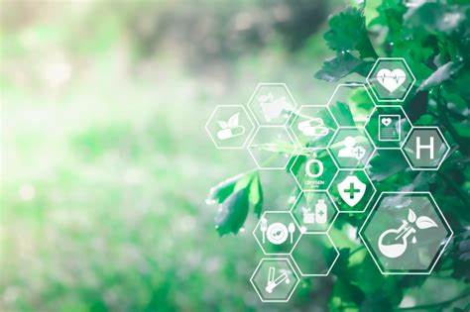
1. Write Your Own Nature Prescription
大自然疗愈法

Slide 4
Text Completion
Reader’s Digest (May/June, 2025 P63)
Write Your Own Nature Prescription
You don’t need to see your doctor to start experiencing the benefits of being outdoors. Here are some simple tips from our experts on how to incorporate nature into your daily routine: * __1__ If your schedule allows, try to get up as the sun rises and wind down as the sun sets. * Get early morning sun, preferably by walking outdoors. __2__ or take the dog out for a quick stroll after breakfast. * Spend five to 20 minutes every day in green spaces. Sip your coffee on the deck instead of on the couch, or take your lunch break under a tree. * __3__ This is where the “go touch grass” idea comes in. Walk barefoot to get the mail or kick off your shoes the next time you’re at an outdoor concert. (Just be careful to watch where you’re going so you don’t step on anything painful!) * Practice nature mindfulness. __4__ Instead, watch the clouds, listen to the birds, or simply observe your surroundings. * Grow a garden. And make sure to get your hands dirty: There are healthy microbes in the soil. __5__, even an indoor herb garden can provide mental health benefits.

Slide 5
Reading Comprehension
1
2
3
4
5
A. Try “grounding” or “earthing.”
B. Remove your shoes at concerts.
C. Match your sleep schedule to the sun.
D. If your access to outdoor space is limited
E. You could go for a walk in a park after work
F. When you’re outdoors, put away your phone.
G. You could park farther away from your work entrance

Slide 6
Vocabulary
1. wind down: If you wind down, you relax after doing something that has made you feel tired or tense. 放松;松弛
I regularly have a drink to wind down.
我经常喝点酒放松一下。
2. mindfulness: the practice of being aware of your body, mind, and feelings in the present moment, thought to create a feeling of calm 正念认知
Mindfulness can be used to alleviate feelings of anxiety and depression.
正念认知可以用来排除焦虑和抑郁。
Translation
他去度假时，开始的几天只是放松放松。
When he goes on holiday, it takes him the first couple of days just to wind down.
Translation
更棒的是，正念能让你以更积极的心态迎接新的一天。
Even better, mindfulness can boost your outlook on the day ahead.

Slide 7
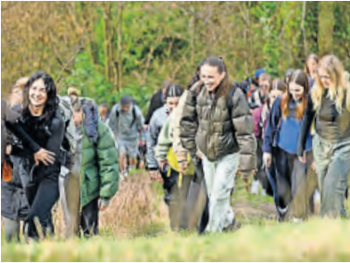
2. Walking groups help Gen Zers give loneliness the muddy boot
步行团体帮助z世代摆脱孤独

Slide 8
Text Completion
The Times (April 24 2025 P11 )
When Joel Moore started sharing his weekend walks on Instagram during the pandemic, he never imagined the ripple effect it would have.
“I realised my friends and I were all going out for walks during lockdown, _____ separately,” said the 27-year-old civil engineer from Pontefract, West Yorkshire. “We decided to post it online that we were going for walks. We met up ... and then even more people wanted to come along. It snowballed.”
_______ began as a handful of friends heading out for some fresh air together has since evolved into Common Ground, ____ community-led walking group co-founded by Moore in 2022 after he connected with fellow solo hikers. The group now _________ (regular) attracts between 30 and 100participants for each event. Peak District walks are among the most popular.
“I’ve always enjoyed going outside,” Moore said. “I found it’s good for ________ (clear) my head, especially with work and being in the office a lot. It can be quite stressful at times, as well as everyone feeling ________ (isolate) and lonely during the lockdowns.
“So then coming out of that, being able to meet up with people, chat to people and have open ___________ (conversation) — the outdoors facilitates that. I realised that’s why I enjoyed it, because you just open up with people, you take that shield down whenever you’re outside. There’s no prejudice.”
He is not alone. Searches for local walking groups spike in winter, and rose across the board after lockdown.
Eighty-two per cent of people aged 18 to 34 believe going for walks ____ (be) good for their mental health — in an Opinium survey of 2,000 people last month they were more likely to say so _____ over-55s. Seventy-three per cent of 18 to 34-year-olds also believe it is easier _______ (talk) about mental health while out in nature, and the same proportion find it helps with loneliness.
but
What
a
regularly
clearing
isolated
conversations
is
than
to talk

Slide 9
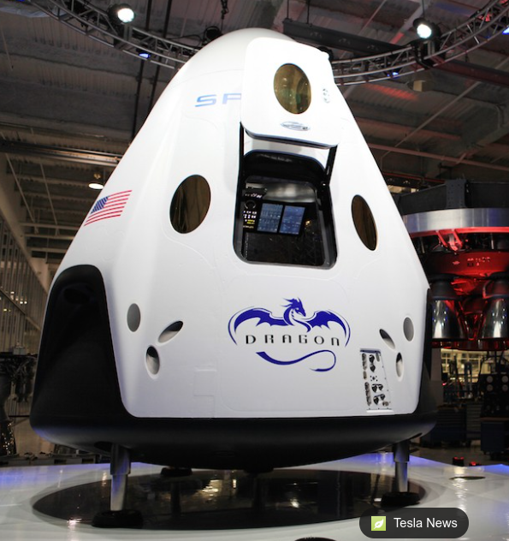
Reading Comprehension
1. What is the primary driving force behind Joel Moore's creation of Common Ground?
A. To promote physical fitness through challenging mountain hikes.
B. To compete with other social media influencers by documenting scenic walks.
C. To establish a professional network for civil engineers in natural settings.
D. To address the psychological isolation caused by lockdowns through communal outdoor activities.
2. Why do younger adults value walking more than older generations?
A. Younger generations have less access to traditional therapy options.
B. Older adults prioritize physical health benefits over psychological ones.
C. Outdoor activities counteract the effects of technology overuse in youth culture.
D. Natural environments may lower social barriers to discussing mental health struggles.

Slide 10
Vocabulary
1. ripple: its effects gradually spread, causing several other events to happen one after the other 连锁反应
If Brazil defaults on its foreign debt, it will cause ripples throughout the world.
如果巴西不还外债的话，这将在全世界引起连锁反应。
2. spike: to rise quickly and reach a high value 迅速升值；急剧增值
When raids and community encounters are offered, traffic and revenue spike to about 5 times the baseline.
Translation
他的辞职将会在整个部门中引起连锁反应。
His resignation will have a ripple effect on the whole department.
当提供突袭和社区遭遇战时，流量和收益会飙升至基线的5倍左右。
Translation
美元猛然升值到三个月来的最高价。
The US dollar spiked to a three-month high.

Slide 11
Translation
What began as a handful of friends heading out for some fresh air together has since evolved into Common Ground, a community-led walking group co-founded by Moore in 2022 after he connected with fellow solo hikers.
一开始是几个朋友一起出去呼吸新鲜空气，后来演变成Common Ground，这是一个由社区领导的徒步团体，摩尔在与其他独自徒步旅行者联系后，于2022年共同创立了这个团体。
“So then coming out of that, being able to meet up with people, chat to people and have open conversations — the outdoors facilitates that. I realised that’s why I enjoyed it, because you just open up with people, you take that shield down whenever you’re outside. There’s no prejudice.”
“因此，在户外活动之后，能够与人见面，与人聊天，进行公开对话——户外活动促进了这一点。我意识到这就是我喜欢它的原因，因为你只要对人们敞开心扉，只要你在外面，你就把那块盾牌取下来。没有偏见。”

Slide 12
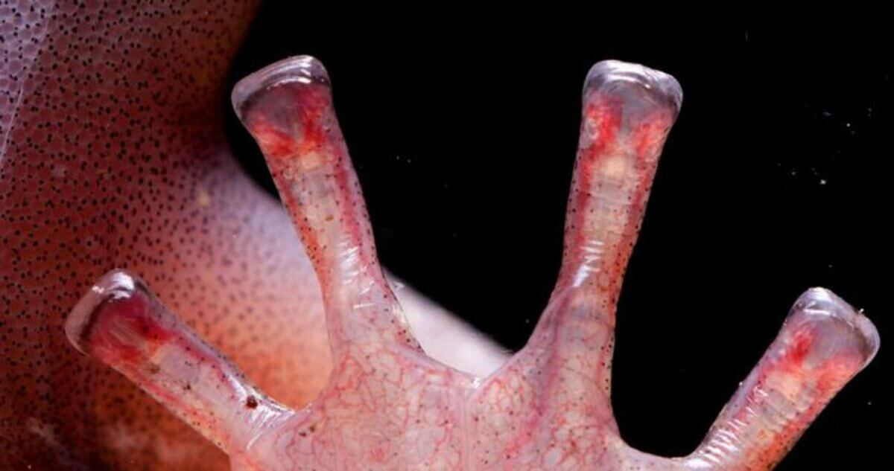
3. Salamanders have blood-powered toes
蝾螈有血液驱动的脚趾

Slide 13
Text Completion
BBC Wildlife（April, 2025 P15)
are known
Wandering salamanders _________ (know) for their agility when traversing the high red wood canopies in their native north-west California. _________, how they leapt and landed so assuredly was something of a mystery-until now.
The tips of a salamander’s square-shaped toes are covered with translucent skin __________ encases visible blood lakes, which were __________ (previous) assumed to aid oxygenation. But new research by Washington State University, published in the Journal of Morphology, has found that salamanders actually fill, trap and drain these lakes to fine-tune their locomotion control.
The study revealed that, by regulating blood flow to the sides of their toe tips, the salamanders can adjust pressure asymmetrically, __________ (improve) grip on irregular surfaces such as tree bark. In addition, by sending ___ rush of blood to their toes, they can aid detachment. The extra blood slightly inflates the toe tips, reducing the area in contact _____ a surface and thus minimising the energy ________ (require) to let go. Such dexterity is crucial when navigating the uneven surfaces of the canopy, and for safe landings when parachuting between branches.
Understanding this mechanism may aid bio-inspired designs, such as prosthetics and even robotic appendages. “Gecko-inspired adhesives already allow surfaces ___________ (reuse) without losing ________ (sticky),” says lead author Christian Brown. “Salamander toes could lead to similar breakthroughs in attachment technologies.”
However
which / that
previously
improving
a
with
required
to be reused
stickiness

Slide 14
Vocabulary
1. encase: to surround or cover sth completely, especially to protect it 把…装箱（或围住、包起）
The reactor is encased in concrete and steel. 核反应堆由钢筋混凝土围住。
2. fine-tune:to make very small changes to sth so that it is as good as it can possibly be 对…微调
We do not try to fine-tune the economy on the basis of short-term predictions. 我们不会根据短期预测而试图对经济作微调。
Translation
他的断腿用石膏包着。
His broken leg was encased in plaster.
Translation
她花了几个小时来微调她的演讲。
She spent hours fine-tuning her speech.

Slide 15
Translation
The study revealed that, by regulating blood flow to the sides of their toe tips, the salamanders can adjust pressure asymmetrically, improving grip on irregular surfaces such as tree bark.
研究表明，通过调节流向脚趾两侧的血液，蝾螈可以不对称地调节压力，提高对不规则表面（如树皮）的抓地力。
The extra blood slightly inflates the toe tips, reducing the area in contact with a surface and thus minimising the energy required to let go. Such dexterity is crucial when navigating the uneven surfaces of the canopy, and for safe landings when parachuting between branches.
多余的血液使脚趾略微膨胀，减少了与表面接触的面积，从而减少了松开所需的能量。在树冠凹凸不平的表面上航行时，以及在树枝间跳伞时安全着陆时，这种灵活性至关重要。

Slide 16
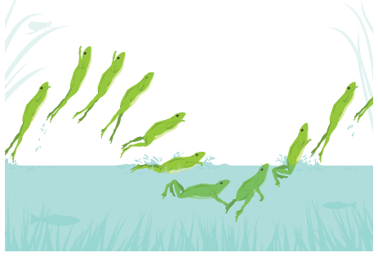
3. Graceful Flop
高速摄像揭示蟋蟀蛙水面运动机制

Slide 17
Reading Comprehension
Scientific American（April , 2025 P13)
If you flick a flat stone toward a pond at just the right angle, it skips across in a series of smooth jumps. Inch-long cricket frogs seem to skitter over the surface of water with similar physics-defying grace. But when Talia Weiss, then an engineering graduate student at Virginia Tech, filmed the frogs with a high-speed camera, she saw a very different picture.
“The motion is so fast that if you look at it with the naked eye, you really can’t tell the difference,” Weiss says.
For a study published recently in the Journal of Experimental Biology, Weiss and her co-authors filmed cricket frogs at up to 500 frames per second, level with the water’s surface, as the frogs moved across. Playing the footage in slow motion, the researchers found that the frogs were not hopping with just their feet breaking the surface, as older studies had described anecdotally, but were actually doing a series of belly flops—sinking for a fraction of a second and then kicking themselves upward with each jump.
Rather than skittering across water like basilisk lizards do, the frogs were rapidly “porpoising”—leaping from the water as they swam. Weiss says their legs may be too slow for true surface hopping. “To jump on the water’s surface, you have to have your legs retracted and ready to push down again by the time you’re approaching the water in every jump,” she explains. “And these frogs don’t prepare for their landing at all; they sort of just belly flop. They don’t retract their legs fast enough to immediately jump again” from the surface.
According to Jasmine Nirody, an organismal physicist at the University of Chicago, who was not involved in the study, “fast animal movements can be really deceiving,” and the new camerawork reveals what the frogs are actually doing. By carefully analyzing such motions, “we can think about how we might be able to use [the frog’s] strategy in various bioinspired robots,” she adds. “Now we know what to look for.”

Slide 18
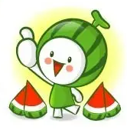
Reading Comprehension
1.Why did earlier studies inaccurately describe the frogs’ movement?
A. Researchers lacked interest in frog behavior.
B. The motion was too fast for the naked eye to observe.
C. The frogs’ legs were not studied carefully.
D. High-speed cameras were unavailable.
INFERENCE
2.According to the study, how do cricket frogs actually move across water?
A. By hopping with their feet breaking the surface.
B. By sinking briefly and kicking upward in belly flops.
C. By skittering like basilisk lizards.
D. By swimming underwater.
DETAIL
3.What’s the best title for the text?
A. The Secret of Cricket Frogs’ Fast Jumps
B. High-Speed Cameras Reveal Frogs’ True Movement
C. Bio-inspired Robots: Learning from Nature
D. Physics of Water-Surface Animals
GIST
Notes:
【设计意图】通过阅读理解的形式帮助学生理解新闻的主要内容。该新闻主题语境是关于“人与社会”中“社会热点问题”这一子主题，通过学习让学生了解威尔士禁止体罚孩子的法律。

Slide 19
Vocabulary
1. skitter: to run or move very quickly and lightly 轻捷地跑；轻快地动
The rats skittered around them in the drains and under the floorboards. 老鼠在下水道和地板下面蹿来蹿去。
2. retract:to move back into the main part of sth; to pull sth back into the main part of sth 缩回；拉回
Torn muscles retract and lose strength, structure, and tightness. 撕裂了的肌肉会收缩，进而丧失力量、结构和紧实度。
Translation
桌子底下有许多甲虫在飞快地向四处爬去。
There were lots of beetles skittering around under the table.
Translation
这只动物缩回到自己的壳里。
The animal retracted into its shell.

Slide 20
Translation
Playing the footage in slow motion, the researchers found that the frogs were not hopping with just their feet breaking the surface, as older studies had described anecdotally, but were actually doing a series of belly flops—sinking for a fraction of a second and then kicking themselves upward with each jump.
用慢动作播放这段视频时，研究人员发现，青蛙跳起来并不是像以前的研究所描述的那样，只有脚露出水面，而是实际上在做一系列的腹部翻筋道——下沉不到一秒，然后每跳一次就把自己踢起来。
“To jump on the water’s surface, you have to have your legs retracted and ready to push down again by the time you’re approaching the water in every jump,” she explains. “And these frogs don’t prepare for their landing at all; they sort of just belly flop. They don’t retract their legs fast enough to immediately jump again” from the surface.
她解释说：“要在水面上跳跃，你必须在每次跳跃接近水面时收回你的腿，并准备好再次向下推。” “这些青蛙根本不为着陆做准备； 它们只是腹部向下翻。 它们收回腿的速度不够快，无法立即“从水面上跳起来”。

Slide 21

5. BBC News 04/28/2025

Slide 22

Dictation
A huge fire sparked by an explosion is continuing to burn at a key Iranian port. At least 14 people were _________ killed by the blast at Shahid Rajai. Officials suggested poorly stored chemicals could be ________, but local media have raised the possibility of sabotage.
Pope Francis has been laid to rest after a funeral mass ________ by hundreds of thousands of people in the bright spring sunshine of St Peter’s Square. He was buried in Rome at his favourite church, Santa Maria Maggiore.
President Trump has suggested he could ______ new sanctions on Russia. He said he had begun to think Vladimir Putin may not want to stop the war in Ukraine and criticised Russian missile attacks on civilian areas.
In a separate social media post, Mr Trump has ________ all American military and commercial ships to be allowed to travel through the Panama and Suez canals _______. It can cost large vessels hundreds of thousands of dollars to pass through either waterway.
The President of the Palestinian Authority, Mahmoud Abbas, has _________ his first-ever deputy and likely ________. Hussein al-Sheikh is a senior aide to Mr Abbas, who is 89.
A letter written ________ the Titanic days before it sank more than a century ago has sold at auction for $________. The author survived the disaster.
reportedly
to blame
attended
impose
called for
for free
appointed
successor
on board
400,000

Slide 23
Vocabulary
1. blast: A blast is a big explosion, especially one caused by a bomb. 爆炸
250 people were killed in the blast.
250人在这次爆炸中丧生。
2. sabotage: If a machine, railway line, or bridge is sabotaged, it is deliberately damaged or destroyed, for example in a war or as a protest.
蓄意破坏，阴谋摧毁(机器、铁路、桥梁)
The main pipeline supplying water was sabotaged by rebels.
供水主管道被叛乱分子蓄意破坏了。
Translation
三人在爆炸中受伤。
Three people were injured in the blast.
Translation
叛乱分子企图蓄意破坏输油管道。
The rebels tried to sabotage the oil pipeline.

Slide 24
Translation
A huge fire sparked by an explosion is continuing to burn at a key Iranian port. At least 14 people were reportedly killed by the blast at Shahid Rajai. Officials suggested poorly stored chemicals could be to blame, but local media have raised the possibility of sabotage.
伊朗一个重要港口因爆炸引发的大火仍在继续燃烧。据报道，沙希德·拉贾伊的爆炸造成至少14人死亡。官员们表示，化学品储存不当可能是罪魁祸首，但当地媒体提出了蓄意破坏的可能性。
In a separate social media post, Mr Trump has called for all American military and commercial ships to be allowed to travel through the Panama and Suez canals for free. It can cost large vessels hundreds of thousands of dollars to pass through either waterway.
在另一篇社交媒体帖子中，特朗普呼吁允许所有美国军用和商用船只免费通过巴拿马和苏伊士运河。大型船只通过这两条水道都要花费数十万美元。

