Slide 1


感恩遇见，相互成就，本课件资料仅供您个人参考、教学使用，严禁自行在网络传播，违者依知识产权法追究法律责任。
更多教学资源请关注
公众号：溯恩英语
知识产权声明

Slide 2
逆向设计在读后续写教学中的应用
A Leap of Courage: Wings of Hope
—咸阳市2025年高考模拟检测二读后续写
礼泉县教育局教研室 高小聪

Slide 3
Contents：
Ⅰ.(Clarify)明确学习目标
Ⅱ.(Determine确定评价标准
Ⅲ.(Implement实施学习活动
(Analyse)回归续写文本
(Evalute)评价考场作文
(Improve)改进提升优化
（
(Develop) 制定续写计划

Slide 4

Ⅰ. Clarify
Objectives
At the end of the class, you will be able to
1. learn to make the given text and the continued-writing part keep in harmony.
2. Correct problems and explore highlights.
3. Develop a review plan for continuation writing.

Slide 5
Ⅱ.Determine
Scoring Principles & Criteria
1.初定档次：根据主题、结构和情节确定所属档次
2.调整分数：从内容完整性、语言准确性、连贯性等维度细化评分
评分程序
评分原则
1. 总分25分，分6档评分 。 2. 单段续写最高12.5分。 3. 词数少于130，酌情扣1-2分。
4. 书写差影响交际降一档 。5. 英美拼写均可接受 。
阅卷标准
档次
分值
标准
要求
5档（优）
21-25
赏心悦目
内容完整新颖，逻辑完全一致，语言高级多样，衔接自然流畅
4档（良）
16-20
清清楚楚
内容合理连贯，逻辑一致，语言较多样准确，衔接有效
3档（中）
11-15
凑凑合合
内容基本完整，逻辑基本一致，语言简单正确，衔接基本清晰
2档（差
6-10
糊里糊涂
内容不完整，逻辑混乱，语言错误多，衔接差
1档
1-5
一塌糊涂
内容严重脱节，逻辑断裂，语言无法理解，无衔接
0档
0
一无所知
未作答/无关内容/全抄原文

Slide 6
Ⅲ. Implement
Analyse
第二节 (满分 25 分)2025年咸阳市二模读后续写
阅读下面材料,根据其内容和所给段落开头语续写两段,使之构成一篇完整的短文。
P1. I burst into Mom's study, waving a brilliant feather like a tiny treasure, “Mom, look what I found! It's a feather from a Vaux's swift (沃氏雨燕) I've been looking for this one for ages!” I bounced on my toes, unable to contain my excitement.
Mom glanced up from her books and smiled, “ it's beautiful!” she said, then took a deep breath, “Sam , next week I will be flying a biplane in the airshow, Would you like to join me?”
P2. I froze. Even the slightest thought of flying made my stomach twist and turn , let alone flying in a biplane—with an open cockpit (驾驶舱) where you could look down and see how far you were from the ground. “No thanks, Mom. Sorry.” I replied as I headed upstairs to my room. With each heavy step, I tried to convince myself—planes are safe, Mom is an amazing pilot and she deserves a brave son. But no matter how much I repeated it, the fear clung to me like a shadow.
P3. That afternoon, while walking home from school, my best friend, Emily, called out, holding a birdcage. “Sam, look! It's a Vaux's swift! I think it got hurt during migration—maybe its natural enemy tried to catch it. The injury isn't too bad, and it should heal in about a week. But the problem is... it’ll alone. Its flock is gone." My chest tightened. “We have to help it find its flock again.” I said worriedly, “If it doesn't, it won't survive the winter. " Emily nodded , “It's so heartbreaking to see it left behind.”
P4.As the days passed and the little bird grew stronger, I couldn't stop thinking about how to help it. Then, like a flash of light , a thought sparked in my head. No matter how scary or impossible it seemed , l was going to make sure this tiny bird caught up with its flock.
P5. On the morning of the airshow, I found Mom. I took a deep breath to steady my pounding heart and declared with determination, “Mom, I'm ready to fly with you today.”
注意:1.续写词数应为150左右;
2.请按如下格式在答题卡的相应位置作答。
Mom's eyes widened in surprise , but a proud smile quickly spread across her face._____________________________
As the biplane rose into the sky, I held the birdcage tightly in my arms.________________________________________

Slide 7
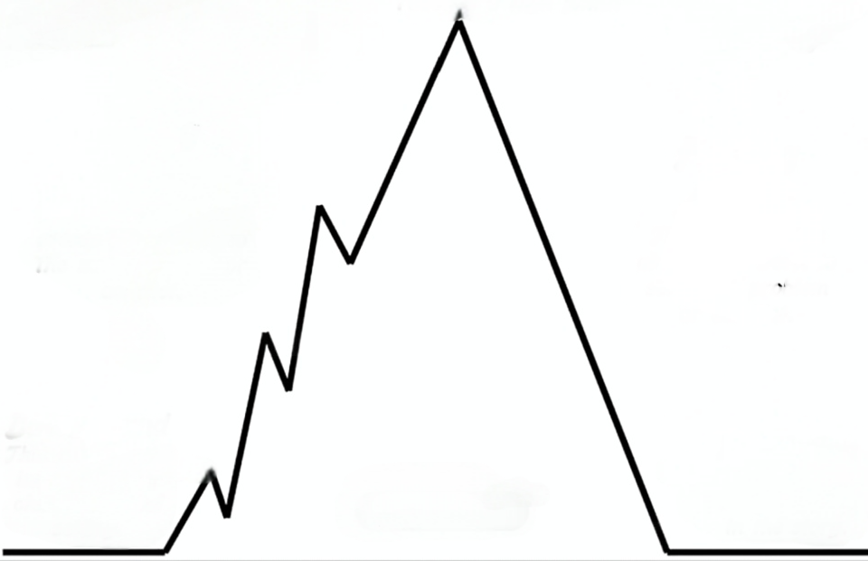
Analyse
Extract the key clues, filter out the useful information
Climax: With the days passing and the bird growing stronger, ________the swift catch up with its flock, I told mom that I was ready _______ with her that day.
I: scared of flying but kind-hearted, ___________ and brave enough to help the little bird
determined
to help
to fly
injured
Rising action3：On seeing an _______ swift saved by Emily, I said that we _______ help it find its flock again.
I & Emily:
worried;
hearbroken;
_________;
Falling action:
Mom's eyes widened in surprise , but a proud smile quickly spread across her face. ...
had to
Rising action2： I tried to convince myself—planes are _______, Mom is an __________ pilot and she deserves a _______ son. But no matter how much I repeated it, the _______ clung to me like a shadow.
anxious
safe
amazing
1. What would Mom and I conversation with?
2. What would Mom and I do?
3. How would my feelings change? What about my mother’s ? Why?
brave
fear
I: internally ____________ and torn
conflicted
refused
Rising action1： I froze, _________mom and headed upstairs to my room with heavy steps.
Ending:
As the biplane rose into the sky, I held the birdcage tightly in my arms. ...
I: terrified;
scared;
____________
escaping
Beginning:
I, Sam, _________Mom’s study, showing off that I had found a brilliant swift’s feather, and mom also considered it beautiful, ___________me to fly a biplane with her in an air show.
1. What would I do and say with the plane rising?
2. What would Mom’s reaction be?
3. How would I help the swift reunite with its flock?
4. How did Mom, the swift and I feel? Why?
burst into
joyful
I: excited; thrilled; _________
Mom: warm/affectionate,
open, __________
inviting
inclusive

Slide 8
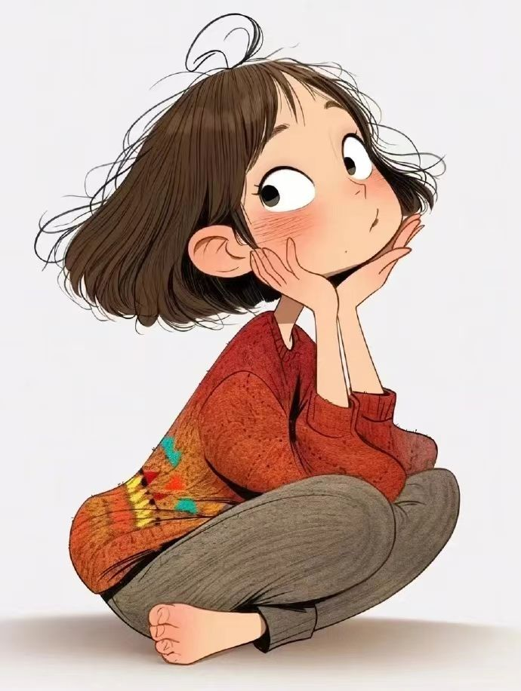
Main idea
Analyse
Sam, fond of birds but afraid of 1______ , he 2_______ to fly a biplane with his pilot mother in an air show. Later, to help an 3_______Vaux's swift (沃氏雨燕)with his friend , he 4_________ his psychological barrier in the end. On the day of the air show, he 5_____a biplane together with his mother and led the little bird 6________(catch) up with the migrating bird flock.
flying
refused
injured
overcame
flew
to catch
Courage and ________
Themes
Growth
Responsibility
Love and ____________
Harmonious ____________ between Humans and Animals
Coexistence

Slide 9
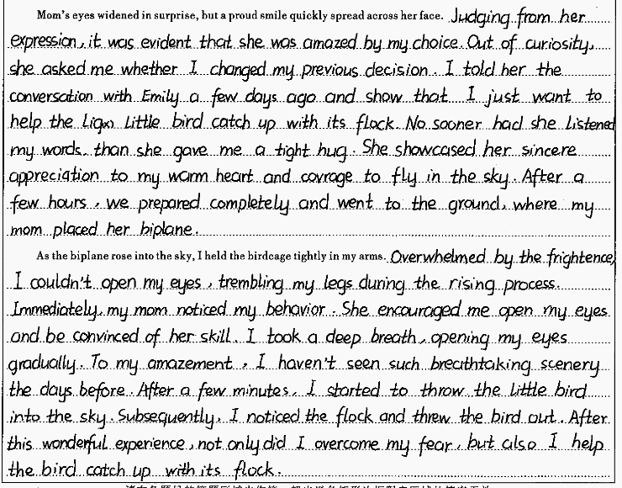
Evaluate
Main idea/ Theme
读后续写的融洽度
  内容评价表 第___档） 分）
四
评价维度 | 评价内容
内容 | 情节内容是否延续
语言 (词汇与语法) | 语言风格是否继承前文？ 语言表达是否准确
连贯性 | 衔接是否自然
主题 | 主题是否得到升华

Slide 10
Improve
Language：
微技能1（语法)：间接引语变直接引语
Mom’s eyes widened in surprise, but a proud smile quickly spread across her face. Judging from her expression, it was evident that she was amazed by my choice. Out of curiosity, she asked me whether I had changed my previous decision. I told her the conversation with Emily a few days ago and show that I just want to help the little bird catch up with its flock.
间接引语读起来平铺直叙，缺少直接引语的一些表现手段;
直接引语更加生动，更能表现说话人的情感和态度，更具有画面感，更容易烘托氛围，在感知上更能引起读者兴趣。
独立状语
"__________________________" asked/said mother__________ and happily, I stammered in a slightly nervous tone swallowed hard,"Emily saved an injured swift the other day, and I wanted to help it catch up with its flock _________
___________________”
Why have you changed your idea?
主语从句
relievedly
showed
anxiously
wanted
/_______/__________
eagerly
desperately

Slide 11
Improve
Language：
微技能2（语法）: 非谓语动词作状语
No sooner had she listened to my words than she gave me a tight hug. She showcased her sincere appreciation for my warm heart and courage to fly in the sky. （After a few hours, we prepared completely and went to the ground where my mom placed her biplane）
___________________, she gave me a tight hug.
Having heard my words
heard
微技能3（语法）: 介词短语做状语
她对我的热心肠以及敢于在空中翱翔的勇气表示由衷地赞赏。
On/Upon hearing my words
________________, she gave me a tight hug.
微技能4英汉互译
showcase one’s sincere appreciate for sth.
Cohenrence：续写第1段最后一句与续写第2段第一句是否衔接？
对......表示由衷的赞赏
微技能5（句式）: with复合结构/ 独立主格结构，主语+谓A +谓B +谓C.
Tip1. 注意与第二段首句衔接
everything prepared
carried
Afterwards, _____________, we ________the birdcage, _______ the hardstand and ___________the open cockpit (驾驶舱)
left for
climbed into

Slide 12
Improve
Language：
微技能6（句式）：增强细节描写，丰富情感与画面感。
As the biplane rose into the sky, I held the birdcage tightly in my arms. (Overwhelmed by the frightence, I couldn’t open my eyes, trembling in my legs during the rising process.) Immediately, my mom noticed my behavior. She encouraged me to open my eyes and be convinced of her skills. I took a deep breath, opening my eyes gradually.
句式1. 倒装句（用...so...that...引导的结构状语从句）
So frightened was I that I wasn’t afraid to open my eyes, my legs trembling with the plane rising.
句式2. 用...too ...to...改写
fright
didn’t dare to open
I was too frightened to open my eyes with the plane rising.
my legs trembling
句式3. 两个形容词短语作状语
Frightened and panicked, I didn’t dare to open my eyes with the plane rising.
句式4. 巧用无灵主句
A wave of fright/panic overwhelmed me so suddenly that I didn’t open my eyes with the plane rising.
句式5. 利用五感法
The continuous roar of the biplane during the rising process made my legs trembling and eyes closed tightly.

Slide 13
Improve
Language：
微技能7:语言描写+动作描写+环境描写
反应人物情感变化
Immediately, my mom noticed my behavior. She encouraged me to open my eyes and be convinced of her skills. I took a deep breath, opening my eyes gradually. To my amazement, I had never seen such breathtaking scenery before. After a few minutes, I started to throw the little bird into the sky. Subsequently, I noticed the flock and threw the bird out. ...
Immediately my mom noticed my_______________, encouragingme,“_____________________________________ .”
nervousness
Take it easy, trust me and we’ll
make it
I _________ (breath) deeply and tried to calm ______
(I) down.
breathed
myself
...I had never seen such breathtaking scenery before:____________, ________________and _____________.
the blue sky
warm sunshine
flying flocks
微技能8. 回扣前文，合理设计情节
原文P4. ... make sure this tiny bird caught up with its flock.
P5. “Mom, I'm ready to fly with you today.”
续写P1. ... I carried the birdcage... P2. ... I held the birdcage tightly in my arms._
作者未能清楚表达如何帮助雨燕赶上鸟群。
...a distant V-shaped formation caught my eye—the flock! I _____ the birdcage with care/ caution, and then the swift_________ for a while, burst into the air and joined its family with a cheerful cry.
opened
hesitated

Slide 14
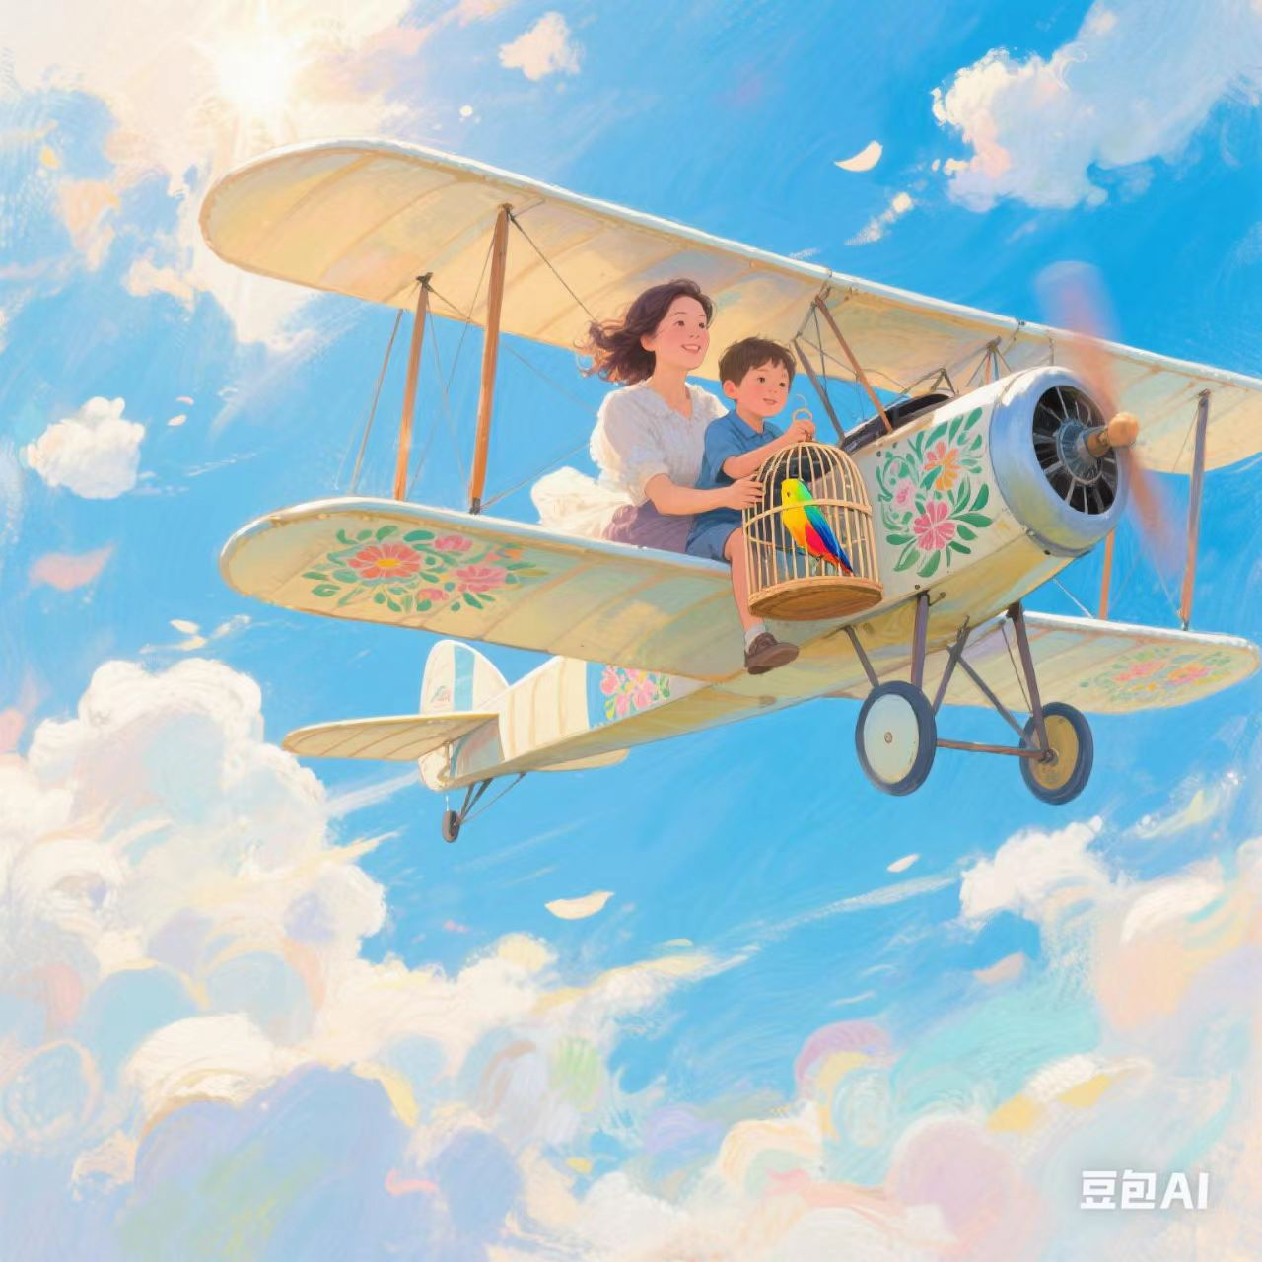
Improve
Language：
微技能9. 结尾 (主题升华，人物成长）
Corage and growth
... After this wonderful experience, not only did I overcome my fear, but I also helped the bird catch up with its flock.
During the process of helping the swift catch up with its flock in the biplane, I picked up my _________, faced the challenge and achieved inner. _________
courage
growth
Love and Responsibility
love
By helping the swift, I come to realized that ______ and _____________ can strengthen our courage and ______________.
responsibility
determination
Harmonious Coexistence between Humans and Animals
Helping the bird return to its family makes me regain courage and confidence. So only when humans and animals _______harmoniously, will we be able to have a _________life.
coexist
brighter

Slide 15
Improve（Rewrite）
Mom’s eyes widened in surprise, but a proud smile quickly spread across her face. Judging from her expression, he 1____________(astonish) by my choice. "Why have you changed your idea?" asked mother 2__________(gentle), I stammered ," Emily saved an injured swift the other day, and... and I’m 3_______(help) it catch up with its flock. 4_________hearing my words, she gave me a tight hug. She showcased her sincere 5____________(appreciate) for my warm heart and courage to fly in the sky. Afterwards, everything 6___________(prepare), we carried the birdcage, headed for the hardstand (停机坪) and climbed into the open cockpit (驾驶舱).
As the biplane rose into the sky, I held the birdcage tightly in my arms. Frightened and 7_________(panic), my legs trembled with the plane 8______(rise). Immediately, my mom noticed my scare and 9________(anxious) , comforting me , “ Take it easy, trust me and we’ll make ___.” I tried to calm myself down. Just then, An V-shaped formation in the sky 11________( catch) our eye—the flock! I opened the birdcage with care, and the swift hesitated for a while, 12______(burst) into the air and reunited with its family with a 13________(cheer) cry. Mother and I also exchanged a 14________ (know) and proud smile. After this wonderful experience, not only did I overcome my fear, but I also helped the bird catch up with its flock.
astonished
gently
to help
Upon/On
appreciation
prepared
panicked
rising
anxiety
it
caught
burst
cheerful
knowing

Slide 16




Advice& Plan
主旨：推敲概括文本意，
宏观主线定主旨
01
情节：细读段首提示句，
融汇文章关键词
02
03
人物：对话表达塑人物，
描写修辞增颜色
04
语言：词汇句式巧继承，
语法时态需留心

Slide 17



Homework
Level1. 整理读后续写前文和
续写部分的词汇、句型
A Leap of Courage:
Wings of Hope
Level2. 画出这篇文章的故事
山(情节、情感、人物)
Lever3. 重新构思完成写作任务

