Slide 1


感恩遇见，相互成就，本课件资料仅供您个人参考、教学使用，严禁自行在网络传播，违者依知识产权法追究法律责任。
更多教学资源请关注
公众号：溯恩英语
知识产权声明

Slide 2
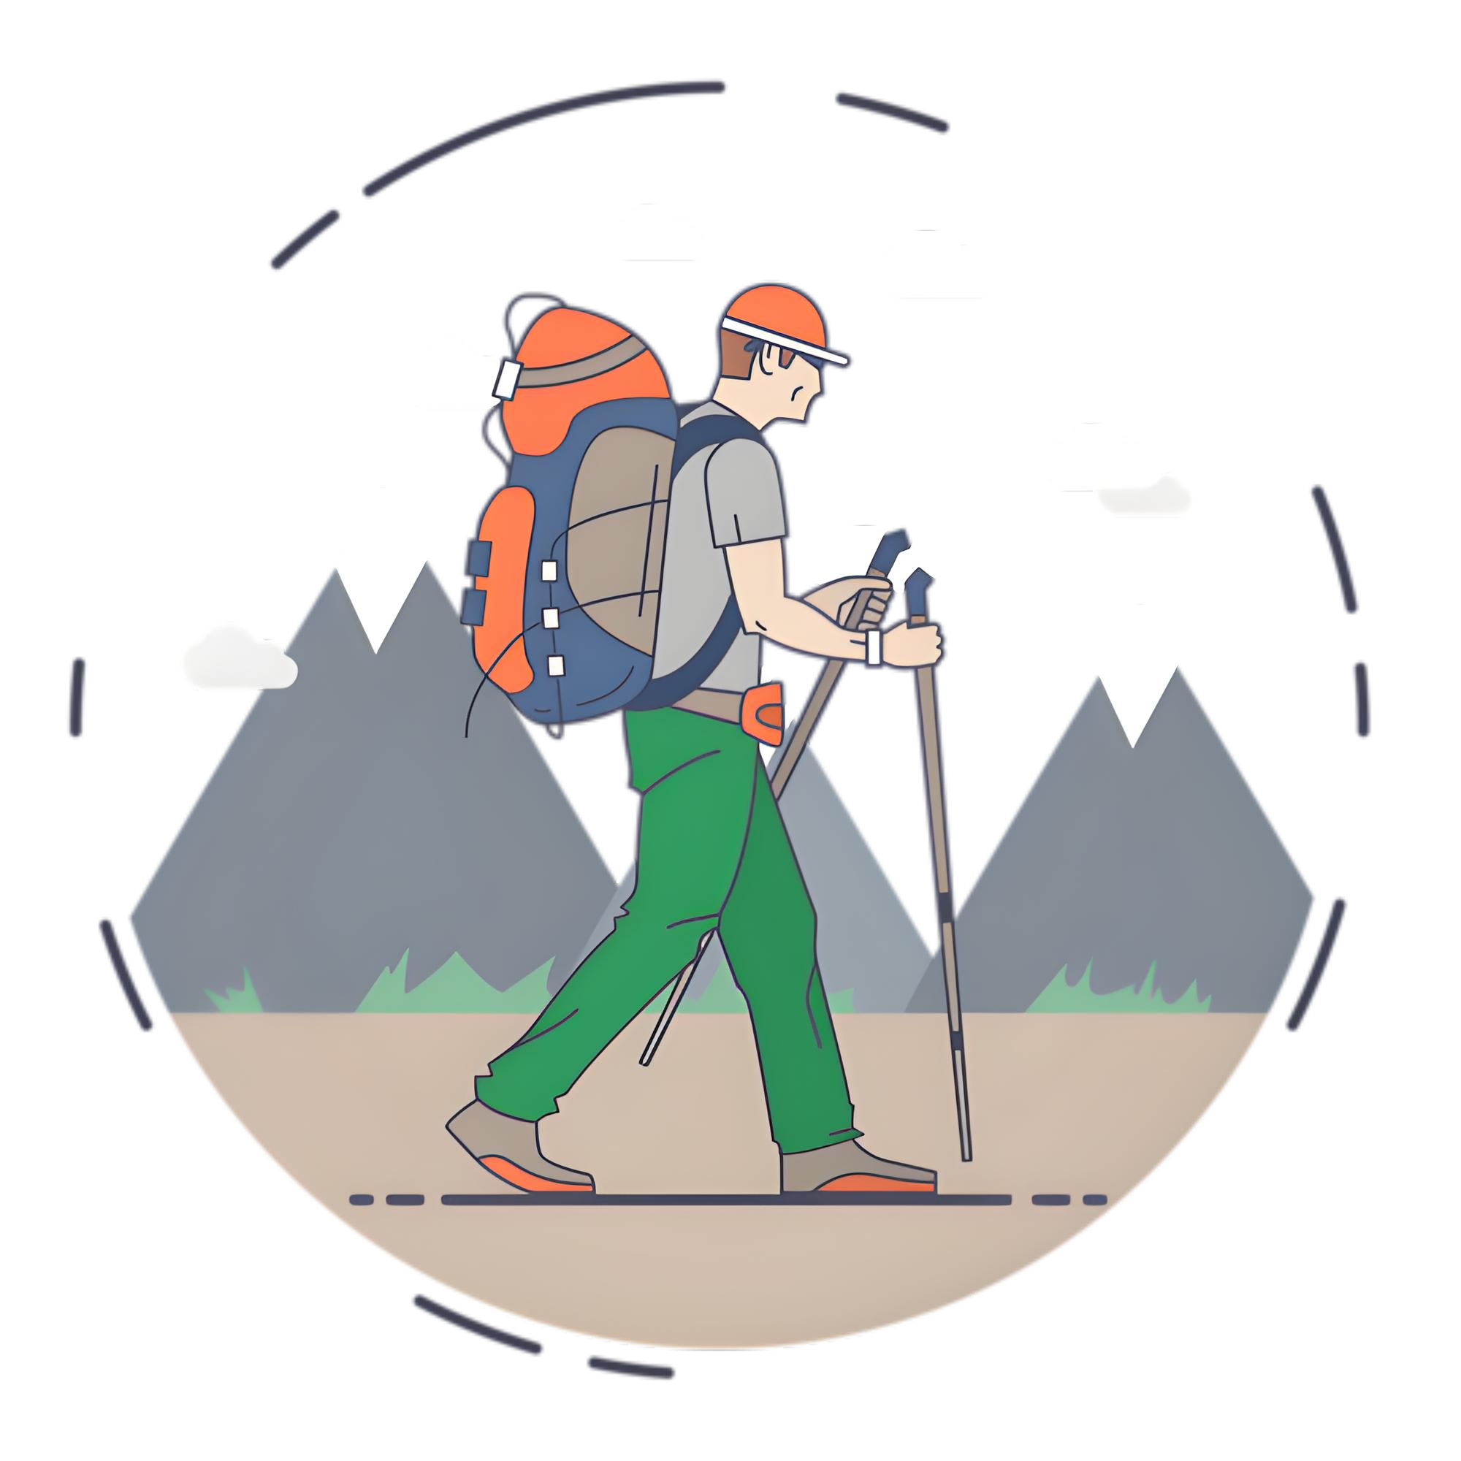
Letter Of Suggestion
About A Hiking
—关于野外徒步的建议信
2025.5强基应用文分析

Slide 3
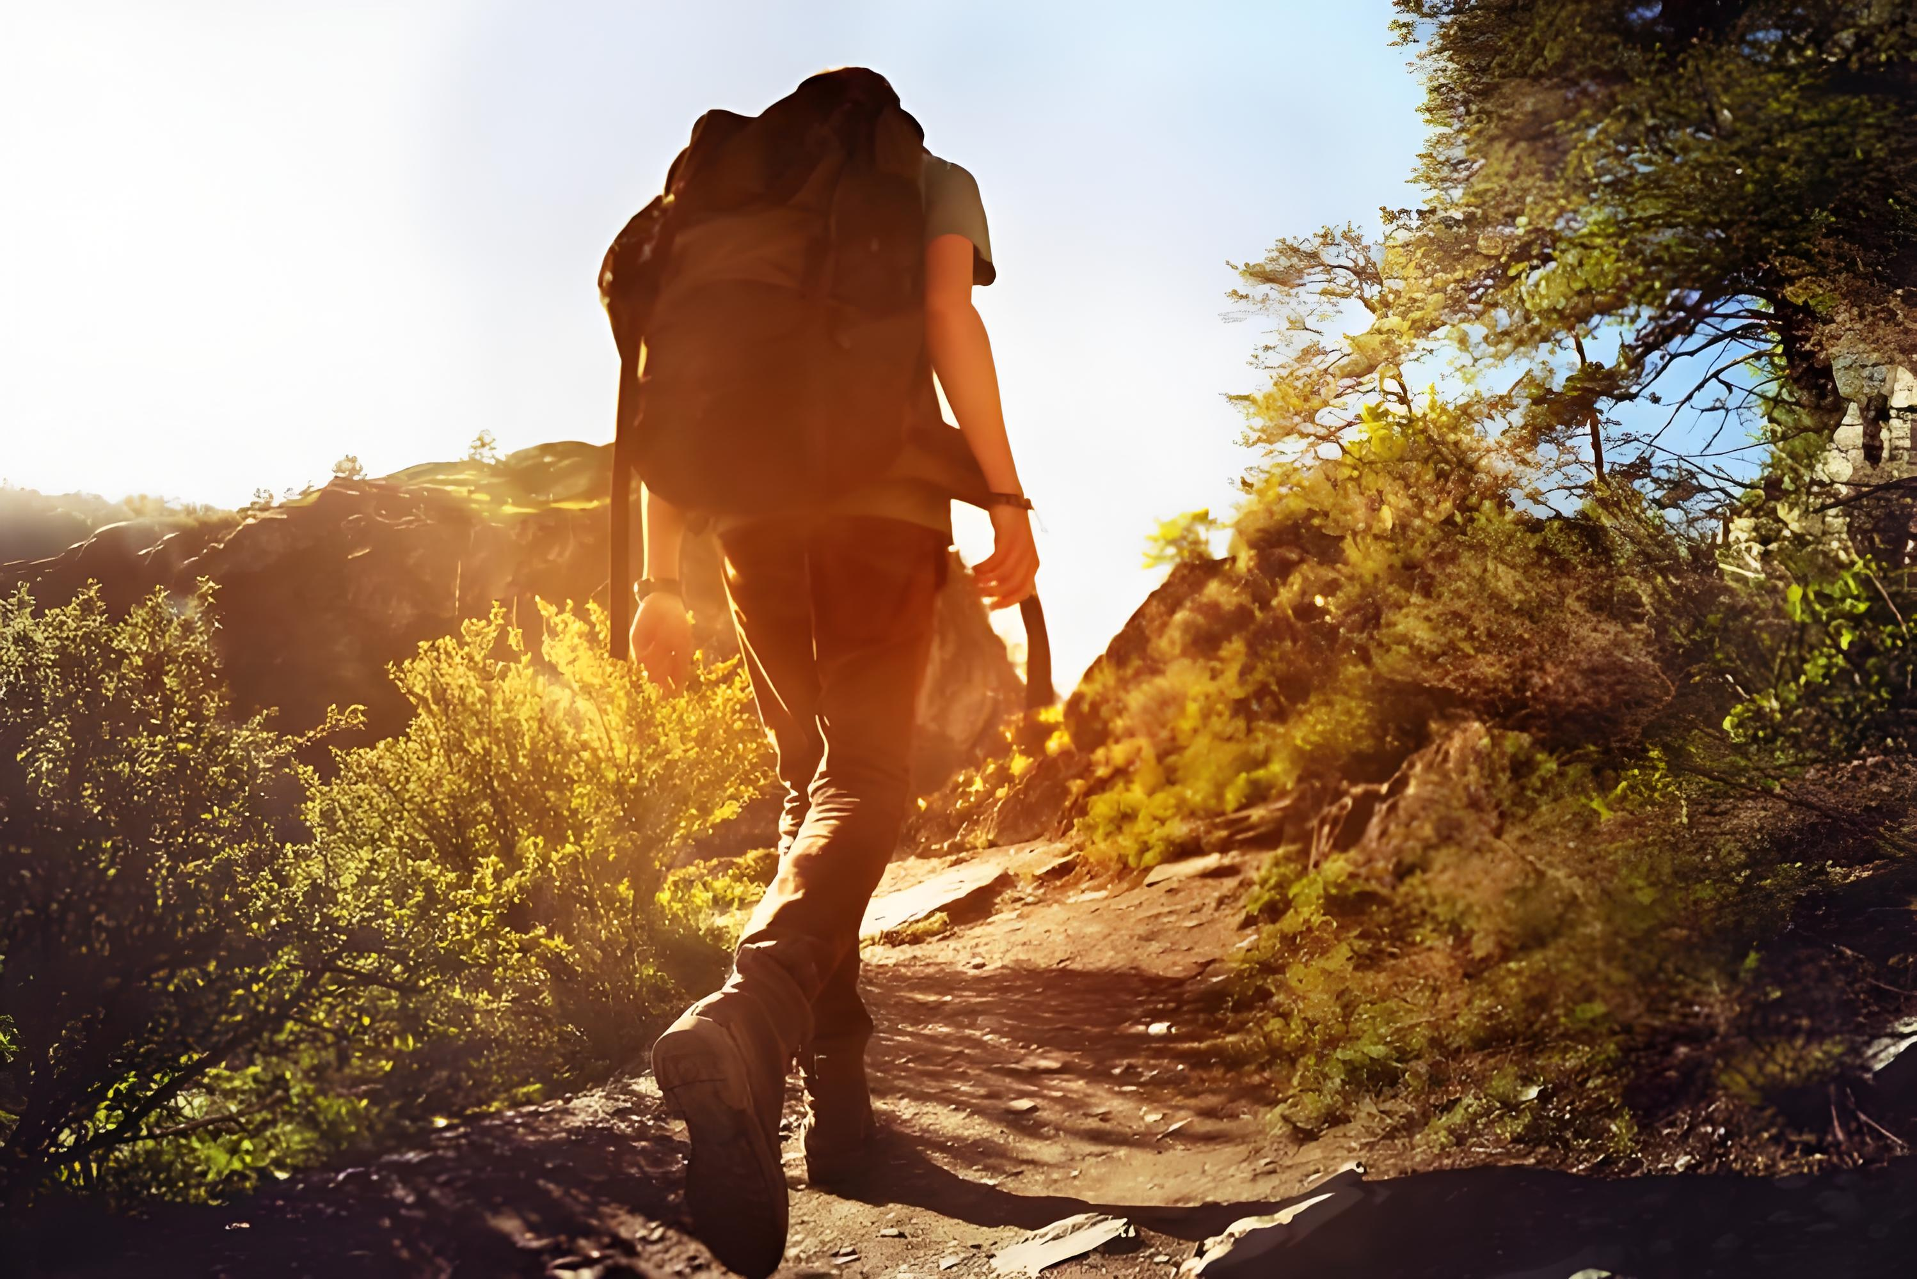
Warm-up
01
Have you ever participated in a hiking?
02
For safety, what should we pay attention to before or during the trip?

Slide 4
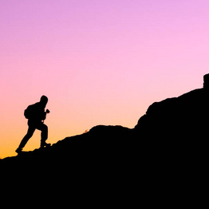
Lead in
What’s most challenging for you in this writing assignment?
Possible difficulties:
1.What might be a suitable route for Alex’s hilking？
2.What suggestions can be offered for Alex’s safety？
3.How to present the body part logically？
4.How to end the letter?
...

Slide 5
Analyze
假定你是李华，你校交换生Alex计划本周六独自去徒步探险，向你咨询相关信息，请你写一封回信，内容包括：
1.推荐一处目的地；
2.提出安全建议。
Genre
Receiver
Background
Writing Puporse
Content
Tense
Person
an E-mail of offering suggestion
Alex(an exchange student)
Alex will hike alone this Saturday
recommend a route and offer practical tips for safety
recommend a suitable route and reason
offer safety tips
simple present tense, future tense
first and second person

Slide 6
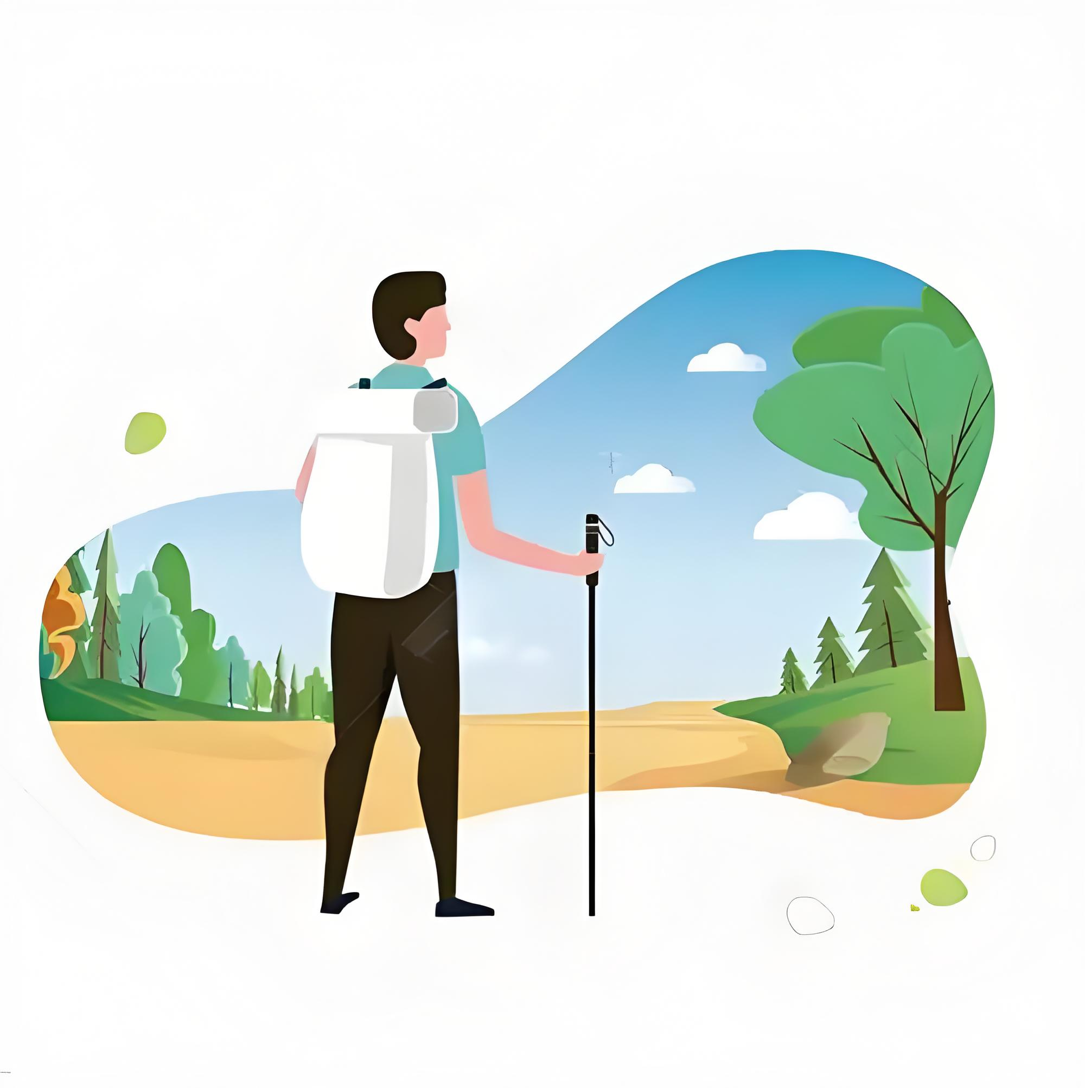
Construct
greetings(communicative function)
background information
writing purpose
Beginning
the ideal route for Alex +reason
Letter of Suggestion
Body
progressive
relationship
tips for safety
Conclusion
wish/anticipation

Slide 7

Brainstorm
Route
Reasons
duration
breathing scenery
accessible location
Name
How do you recommend a suitable destination or hiking route to Alex?

Slide 8
Practice and Accumulate
greetings
background information
writing purpose
P1 Beginning
the ideal route for Alex +reason
I’m excited to hear about your plan for an outdoor hiking adventure this Saturday! I highly recommend the Green Mountain Trail.It offers stunning views and a moderate difficulty level,making it perfect for a day trip.The trail is well-maintained, and there are several scenic spots where you can take a break and enjoy the natural beauty.(风景，难度等级，路况)
I’m thrilled to hear about your hiking plan! For a solo adventure this Saturday, the Green Valley Trail is second to none, which offers breathtaking mountain views, a peaceful lake, and well-marked paths. The trail takes about 4-5 hours to complete, making it ideal for a day trip.（风景，路况，预估时间）

Slide 9




Brainstorm
What suggestions can be offered to Alex regarding safety?
Route Safety Tips
Essential Supplies
Communication Device
Itinerary Notification
water
high-energy food (e.g., energy bars, nuts)to keep your energy levels up
raincoat
hat, sunscreen
sunglasses
comfortable,sturdy shoes
a first-aid kit
Stick to marked trails; avoid unmarked/undeveloped areas or hazards (e.g., cliffs, landslide zones).
Share detailed plans (route, destination, return time) with friends, family before departure
Plan a reasonable duration; return to safe areas before dark.
fully charged phone
a power bank
a solar charger
offline maps
a compass

Slide 10
Practice and Accumulate
the ideal route for Alex +reason
Body
tips for safety
For safety, always check the weather forecast before you set out. Make sure to bring enough water and snacks to keep your energy levels up. It’s also a good idea to let someone know your hiking routh and expected return time,just in case.Wear comfortable,sturdy shoes and consider bringing a small first-aid kit. If possible, bring a map and a compass, even if you have a GPS device. And don’t forget your camera to capture the beautiful moments!
为安全起见，出发前一定要查看天气预报。确保带足够的水和零食，以保持你的能量水平。让别人知道你的远足路线和预计返回时间也是个好主意，以防万一。穿舒适、结实的鞋子，并考虑带一个小急救箱。如果可能的话，即使你有GPS设备，也带上地图和指南针。别忘了你的相机来捕捉美丽的瞬间！

Slide 11
Practice and Accumulate
the ideal route for Alex +reason
Body
tips for safety
Regarding safety, always inform someone about your route and expected return time. Moreover, carry sufficient water, snacks, a first-aid kit, and a fully charged phone with a power bank. Also, it is feasible for you to wear sturdy shoes and check the weather forecast beforehand—avoid hiking if storms are predicted. Plus, remember to stay on marked trails and avoid risky shortcuts.
为了安全起见，一定要告诉别人你的路线和预计返回时间。此外，带上足够的水、零食、急救箱和带充电宝的充满电的手机。此外，你可以穿结实的鞋子，提前查看天气预报，避免在预报有暴风雨的情况下徒步旅行。另外，记得走有标记的小路，避免走危险的捷径。

Slide 12
Practice and Accumulate
Conclusion
wish/anticipation
The trail is truly special—don’t forget to take photos to share later. If you need any tip or information, please feel free to contact me. Stay safe and enjoy every step!
Don’t forget your camera to capture the beautiful moments! Have a great hike and enjoy the adventure!

Slide 13
Official Sample Writing
Translation
Dear Alex,
I’m excited to hear about your plan for an outdoor hiking adventure this Saturday! I highly recommend the Green Mountain Trail. It offers stunning views and a moderate difficulty level,making it perfect for a day trip.The trail is well-maintained, and there are several scenic spots where you can take a break and enjoy the natural beauty.
For safety, always check the weather forecast before you set out. Make sure to bring enough water and snacks to keep your energy levels up. It’s also a good idea to let someone know your hiking routh and expected return time,just in case.Wear comfortable,sturdy shoes and consider bringing a small first-aid kit. If possible, bring a map and a compass, even if you have a GPS device. And don’t forget your camera to capture the beautiful moments!
Have a great hike and enjoy the adventure!
Yours ,
Li Hua
亲爱的Alex：
我很高兴听到你这周六的户外徒步探险计划！我强烈推荐绿山步道。它提供了令人惊叹的景色,中等难度，这使它成为一日游的完美选择。这条小径维护得很好，有几个景点可以让你休息一下，享受自然美景。
为安全起见，出发前一定要查看天气预报。确保带足够的水和零食，以保持你的能量水平。让别人知道你的远足路线和预计返回时间也是个好主意，以防万一。穿舒适、结实的鞋子，并考虑带一个小急救箱。如果可能的话，即使你有GPS设备，也带上地图和指南针。别忘了你的相机来捕捉美丽的瞬间！
祝你徒步旅行愉快，享受冒险之旅！
李华

Slide 14
Sample Writing One
Translation
Dear Alex,
I’m thrilled to hear about your hiking plan! For a solo adventure this Saturday, the Green Valley Trail is second to none, which offers breathtaking mountain views, a peaceful lake, and well-marked paths. The trail takes about 4-5 hours to complete, making it ideal for a day trip.
Regarding safety, always inform someone of your route and expected return time. Moreover, carry sufficient water, snacks, a first-aid kit, and a fully charged phone with a power bank. Also, it is feasible for you to wear sturdy shoes and check the weather forecast beforehand—avoid hiking if storms are predicted. Plus, remember to stay on marked trails and avoid risky shortcuts.
The trail is truly special—don’t forget to take photos to share later. If you need any tip or information, please feel free to contact me.
Best regards,
Li Hua
亲爱的Alex：
很高兴听到你的远足计划！对于这个周六的单人徒步来说，Green Valley 小径是你的不二之选，这里有令人赞叹的山景，宁静的湖泊和标记清晰的小径。这条小径大约需要4-5个小时才能走完，是一日游的理想选择。
为了安全起见，一定要告诉别人你的路线和预计返回时间。此外，带上足够的水、零食、急救箱和带充电宝的充满电的手机。此外，你可以穿结实的鞋子，提前查看天气预报，避免在预报有暴风雨的情况下徒步旅行。另外，记得走有标记的小路，避免走危险的捷径。
这条路真的很特别——别忘了拍照留待以后分享。如果您需要任何提示或信息，请随时与我联系。
李华

Slide 15
Sample Writing Two
Translation
Dear Alex,
I’m thrilled to hear about your hiking plan! Green Valley has 8 hiking trails of varying difficulty and length, offering stunning and breathingtaking wildlife viewing opportunities, which is second to none.
Regarding safety, it is a must for you to carry sufficient water, snacks, a first-aid kit, and a fully charged phone with a power bank. Also, it is feasible for you to wear sturdy shoes and check the weather forecast beforehand. Plus, obey posted signs and stay on designated marked trails to avoid getting disoriented. Last but not least, don’t forget to leave your trip plan with a friend in advance in case of emergency.
Enjoy your time at Green Valley! Stay safe and enjoy every step!
Yours,
Li Hua
亲爱的Alex：
很高兴听到你的远足计划！ Green Valley 有8条不同难度和长度的徒步小径，提供令人叹为观止的野生动物观赏机会，是不二之选。
为了安全起见，你必须携带足够的水、零食、急救箱和带充电宝的充满电的手机。此外，你可以穿结实的鞋子，提前查看天气预报。另外，要遵守张贴的标志，在指定的道路上行走，以免迷路。最后，不要忘记提前把你的旅行计划交给朋友，以防紧急情况。
祝您在 Green Valley 度过愉快的时光！注意安全，享受每一步！
李华

Slide 16
Useful Expressions
我强烈推荐……（青山径/青谷）
一定要/考虑……如果可能的话……别忘了
……也是个好主意。/你必须……/你……是可行的。
提供令人惊叹的/令人叹为观止的/景色
中等难度/有8条不同难度的徒步路线
适合一日游
维护良好
事先查看天气预报
带上足够的水和零食，保持精力充沛
带上急救箱和带充电宝的充满电的手机
即使你有GPS设备，也要带上地图和指南针
告诉别人你的路线和预计返回时间
提前把旅行计划交给朋友以备不时之需
穿舒适、结实的鞋子
走有标记的小路，避免走危险的捷径
遵守张贴的标志，在指定的道路上行走，以免迷路
注意安全，享受每一步！
I highly/strongly recommend ...( Green Mountain Trail/Green Valley)
Make sure to/ consider.../If possible...And don’t forget
It’s also a good idea to.../It is a must for you to.../It is feasible for you to...
offer stunning/breathtaking views
a moderate difficulty level/have 8 hiking trails of varying difficulty
make it perfect for a day trip
be well-maintained
check the weather forecast beforehand
bring sufficient water and snacks to keep your energy levels up
bring a first-aid kit, and a fully charged phone with a power bank
bring a map and a compass even if you have a GPS device
inform someone of your route and expected return time
leave your trip plan with a friend in advance in case of emergency
wear comfortable,sturdy shoes
stay on marked trails and avoid risky shortcuts
obey posted signs and stay on designated marked trails to avoid getting disoriented
Stay safe and enjoy every step!

Slide 17
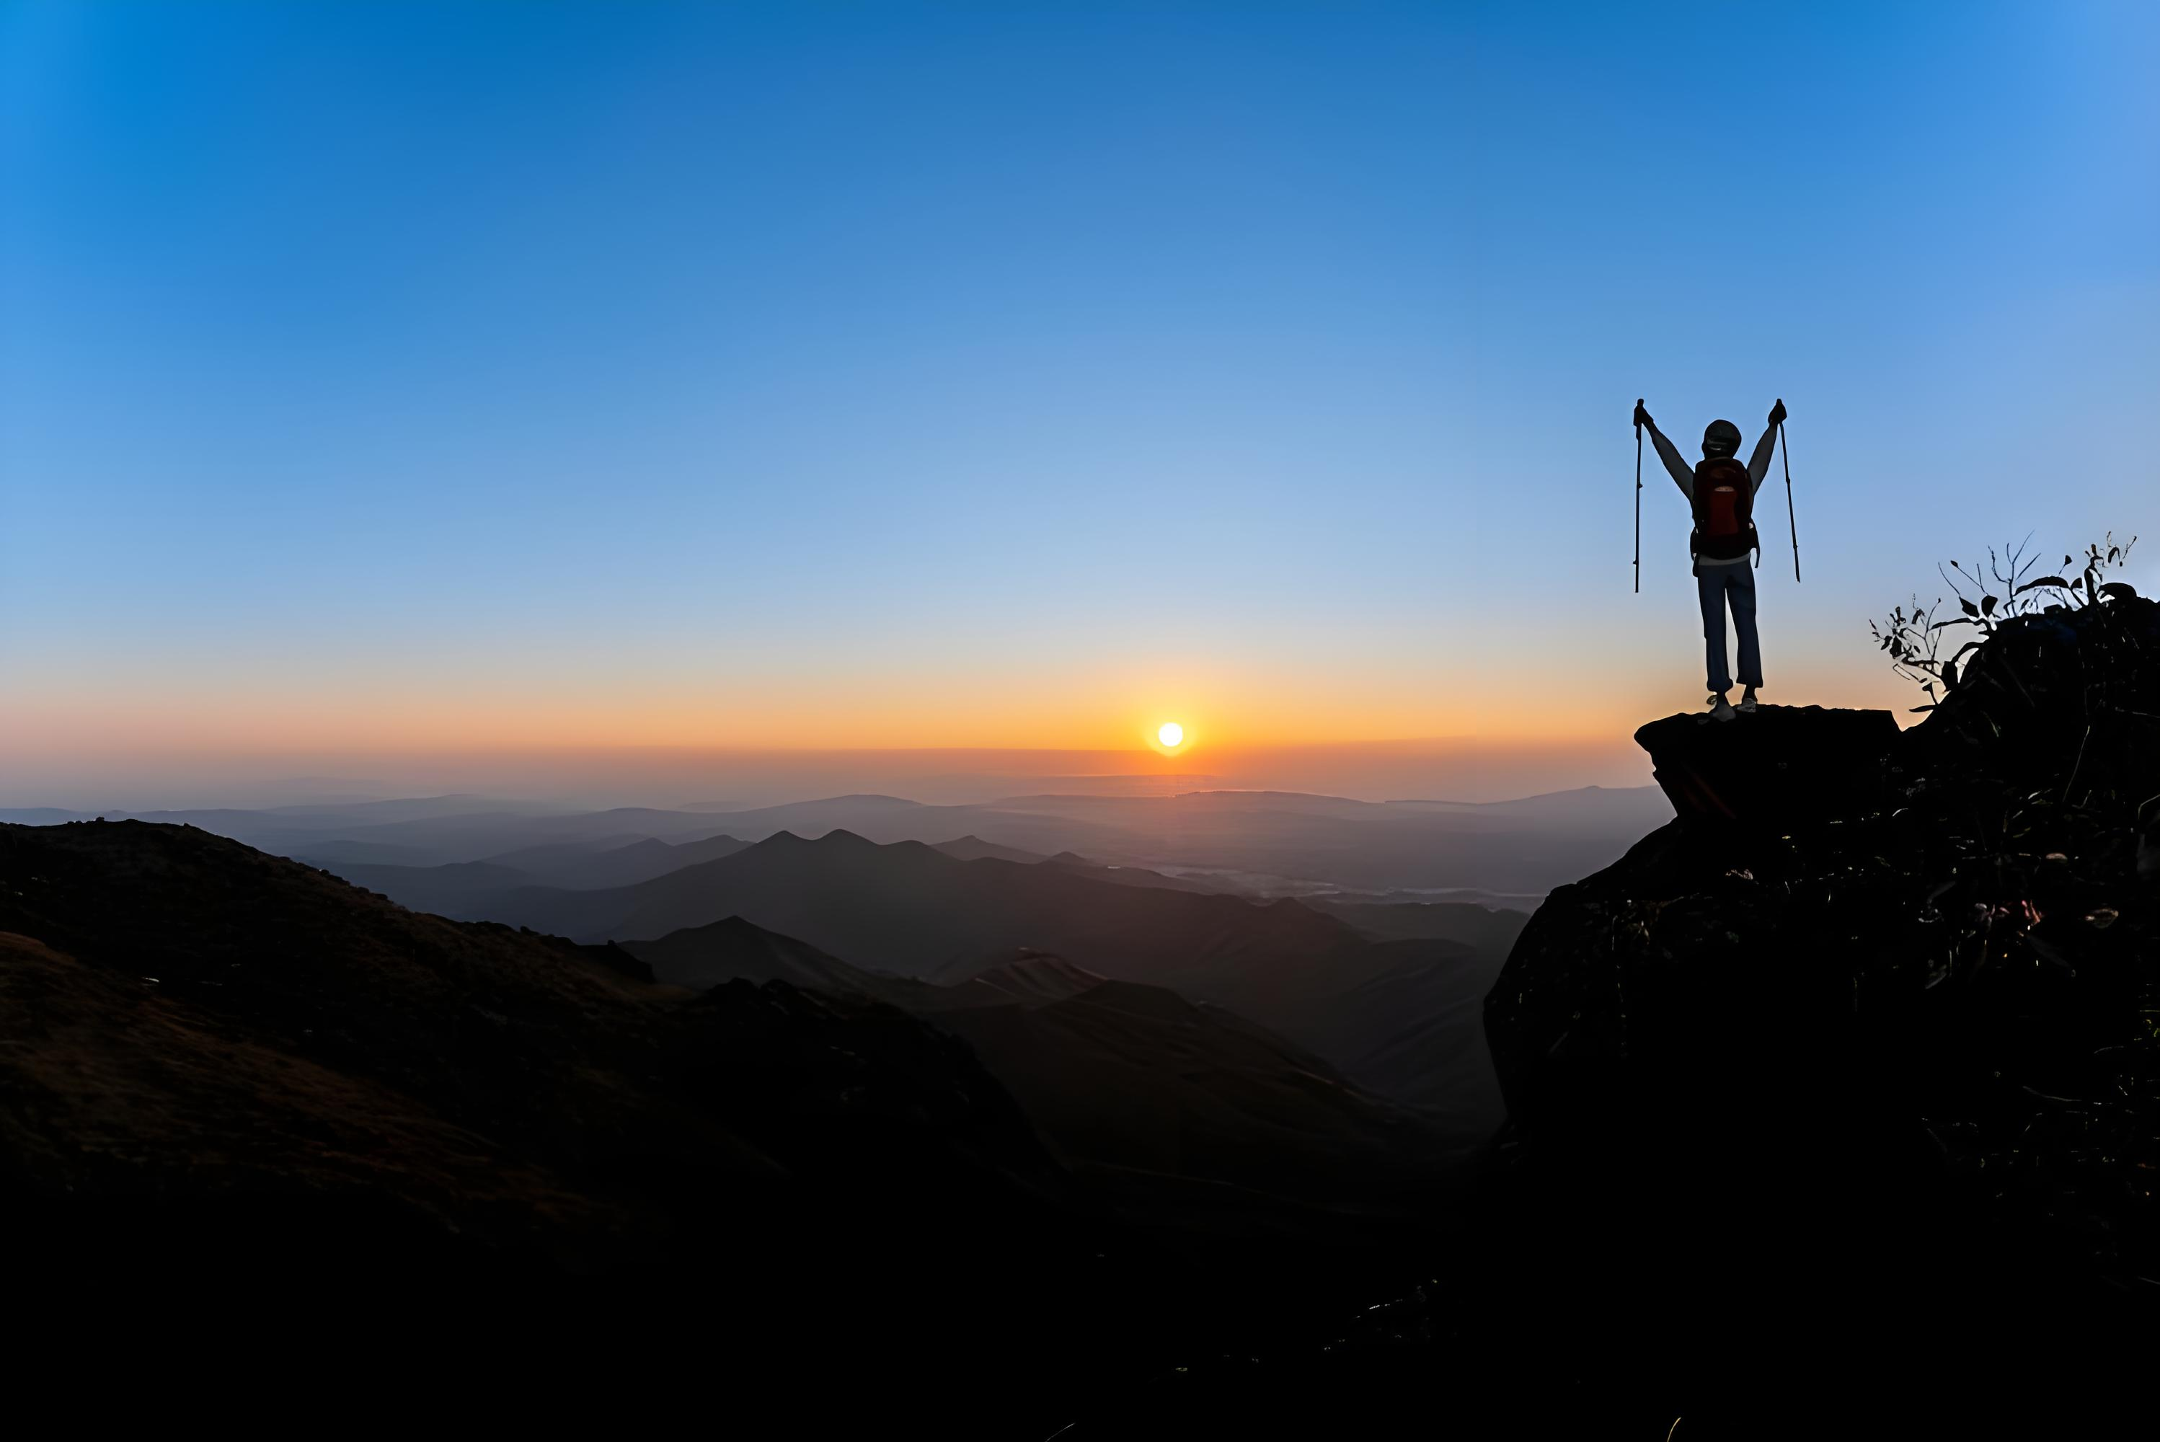
Thank you!

