Slide 1


感恩遇见，相互成就，本课件资料仅供您个人参考、教学使用，严禁自行在网络传播，违者依知识产权法追究法律责任。
更多教学资源请关注
公众号：溯恩英语
知识产权声明

Slide 2

2025高考应用文临门一脚
观点说理与书信立意建构
金山办公软件有限公司
Floda & Ronnie

Slide 3
应用文误区分析与高分原则
01

Slide 4

对应用文写作的理解
应用文是一种基于现实的实用型文章，它是指人们在日常生活、工作、学习中所使用的为某种具体的实用目的而写的文体。
内容要点权重
高于语言结构
说理性应用文=固定公式（观点+三点理由 Firstly, Secondly, Thirdly+客套结尾）
要提升语言水平，把I think改成I deem/reckon，把excellent改成resplendent
词汇选择应服务于概念框架
老师教我要详略得当，每个要点地位一样，那都要平均分配字数，如果是三个要点，那就是分析原因40字，提出建议40字，表达期待40字。
重点内容应占
最大信息密度
复杂句式体现英语水平，文章要有各种长难句，定语从句、非谓语、倒装句……
冗余句式增加阅卷理解负担
So, what is the underlying logic of a good example of practical writing?

Slide 5
A good example

Slide 6
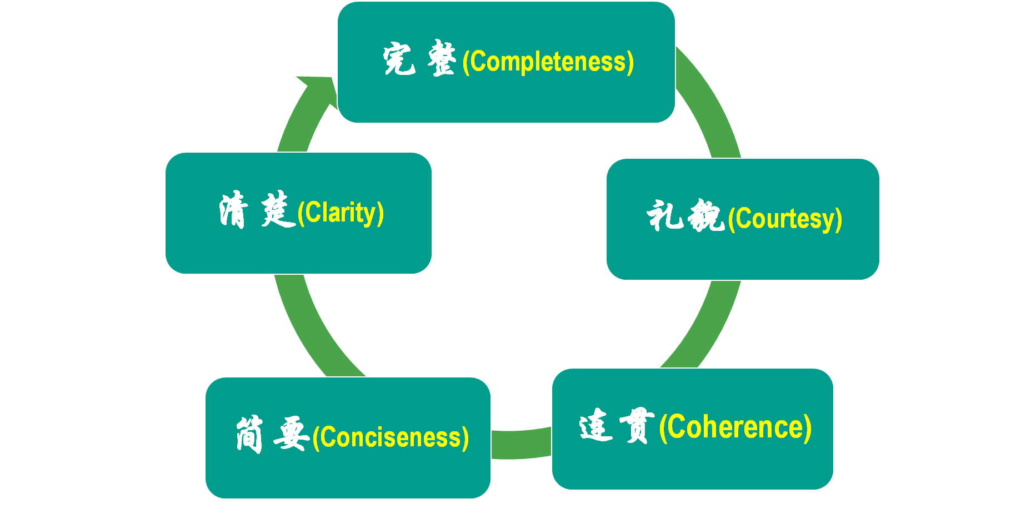
核心原则是“内容为王”
高分作文，不仅仅是因为他们的语言好，而是他们想到的东西，他们表达的东西，特别切题（to the point），思维整体和题目的语义场是高度符合的。
深度思维与内容丰富性是应用文得高分的基本逻辑。
拿到一篇应用文后,抛却结构化的框架,最主要呈现在我们脑中的是各种语言表达及他们融合在一起后的语义场。
对于说理性、议论性的应用文,说理、论证的过程需要按照“功能→情感→文化/精神”的思维层次进行递进,目的的层次由浅入深。
内容要点权重
高于语言结构
词汇选择应服务于概念框架
重点内容应占
最大信息密度
冗余句式增加阅卷理解负担

Slide 7
The importance of topic vocabulary rather than those “advanced” vocabulary
词汇选择应服务于概念框架
Topic Vocabulary: Clear and functional.
Topic Vocabulary: Connects to real-world context
Topic Vocabulary: Sounds native-like
❌ The martial arts club involves esoteric and abstruse physical events.
√ The martial arts club teaches self-discipline and kung fu forms.
Use advanced words only when they fit the topic (e.g., reinvigorated).
Avoid stuffing sentences with fancy words that distract from the message.

Slide 8
思维观点类
应用文的两大方法
02

Slide 9
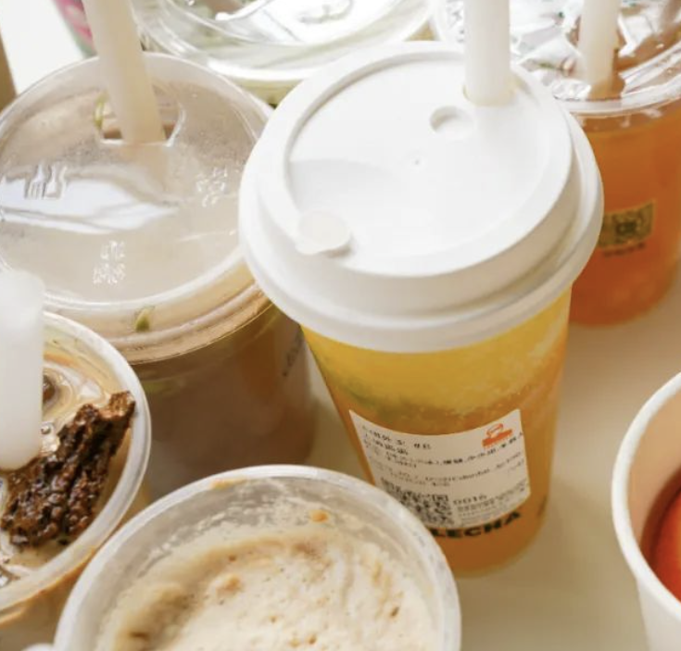





思维激活
Life is filled with countless choices, and each of your decisions often harbors profound reasons. Here are three sets of images.
Make a selection and explain the rationale behind your choice. Think about expressions as many as possible that can help you better clarify your choice.
VS
VS
人教版选必3 Healthy Lifestyle
人教版选必4 Launching Your Career
VS
外研版必修二
Unit4 Writing a movie review

Slide 10
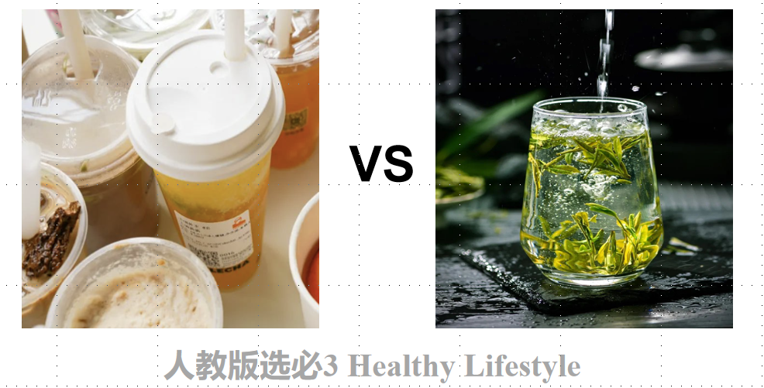
Brain
storming
Milk Tea VS Tea
contain natural antioxidants
promote digestive wellness
numerous health benefits
low-calorie beverage
cultivate mindfulness
connect with nature's rhythm
reduce stress and anxiety
carry centuries-old traditions
symbolize Eastern philosophy
used in traditional ceremonies and rituals
adapt to any season
require simple preparation
…………
offers a rich and creamy flavor
offer creamy textures
a wide range of taste preferences
provide a comforting and soothing experience
be customized with various toppings
associated with social gatherings
enjoyable moments with friends
deliver instant happiness
fuel social media trends
represent global youth culture
blend tradition with novelty
…………

Slide 11
If it really becomes a task……
刚才的语料都能用上吗？
【情境自命题】 假定你是李华，你的外国好友Jack刚到中国，对中国的饮品文化很感兴趣。请你给他写一封电子邮件，推荐一款茶饮，并说明理由。
contain natural antioxidants
promote digestive wellness
numerous health benefits
low-calorie beverage
cultivate mindfulness
connect with nature's rhythm
reduce stress and anxiety
carry centuries-old traditions
symbolize Eastern philosophy
used in traditional ceremonies and rituals
adapt to any season
require simple preparation
…………
offers a rich and creamy flavor
offer creamy textures
a wide range of taste preferences
provide a comforting and soothing experience
be customized with various toppings
associated with social gatherings
enjoyable moments with friends
deliver instant happiness
fuel social media trends
represent global youth culture
blend tradition with novelty
…………
思维方法1：
头脑
风暴
情境与具体任务要求
可用的
语料素材

Slide 12
【情境自命题】 假定你是李华，你的外国好友Jack刚到中国，想试试不同的中国饮品，请你给他写一封电子邮件，推荐一款饮品，并说明理由。
contain natural antioxidants
promote digestive wellness
numerous health benefits
low-calorie beverage
adapt to any season
require simple preparation
reduce stress and anxiety
cultivate mindfulness
connect with nature's rhythm
carry centuries-old traditions
symbolize Eastern philosophy
used in traditional ceremonies and rituals
…………
offers a rich and creamy flavor
offer creamy textures
a wide range of taste preferences
provide a comforting and soothing experience
be customized with various toppings
associated with social gatherings
enjoyable moments with friends
deliver instant happiness
fuel social media trends
represent global youth culture
blend tradition with novelty
…………
头脑
风暴
情境与具体任务要求
可用的
语料素材
思维方法1：

Slide 13
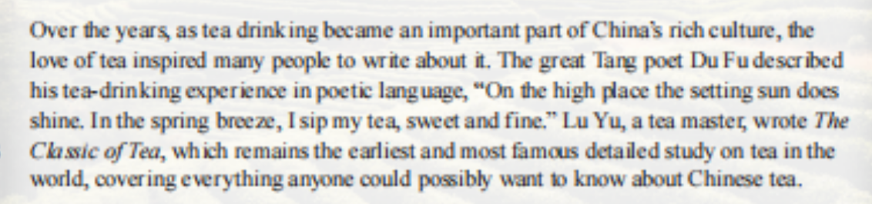
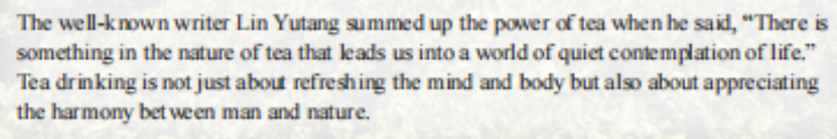
How can I brainstorm?
While we know that tea drinking started in China, its true origin remains something of a mystery. Legend has it that about 5.000 years ago, Shennong came across tea when dried leaves blew into a pot of boiling water, Following his discovery, tea was used as medicine, included in meals and later offered as a refreshing drink to officials and noblemen, Eventually, it became a common drink enjoyed and embraced by all Chinese people.
译林版高中英语教材 Book 8 Unit 2 Extended reading

Slide 14
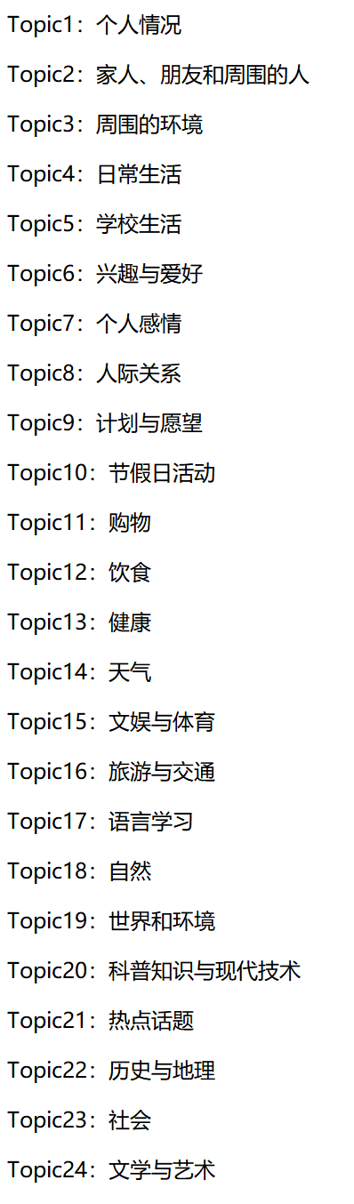
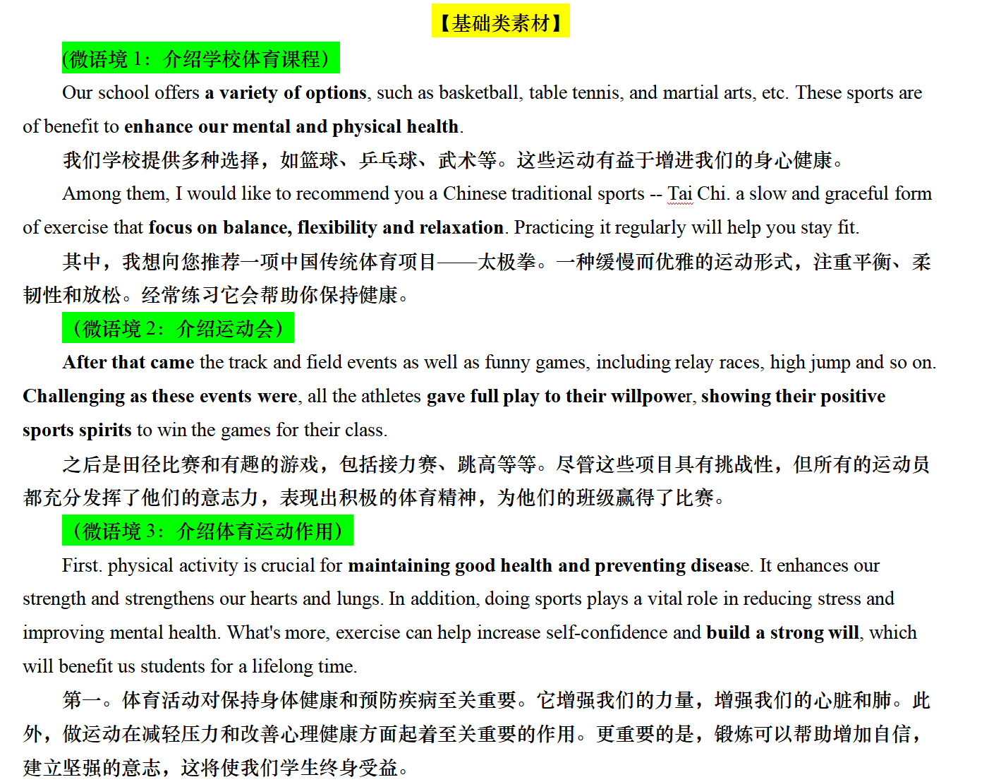
Topic-centered Accumulation Techinique
以教材+习题+外刊为语料源
以话题为主轴

Slide 15

思维层次化
职业特征
adapt teaching styles
balance strictness and care
be instrumental in imparting knowledge
情感
unlock hidden potentials
build critical thinking
light up dark moments
turn failures into lessons
社会影响
shape civilized citizens
break cycles of ignorance
build a well-educated and informed community
思维方法2：
说理、论证的过程需要按照“功能→情感→文化/精神/社会”的思维递进

Slide 16
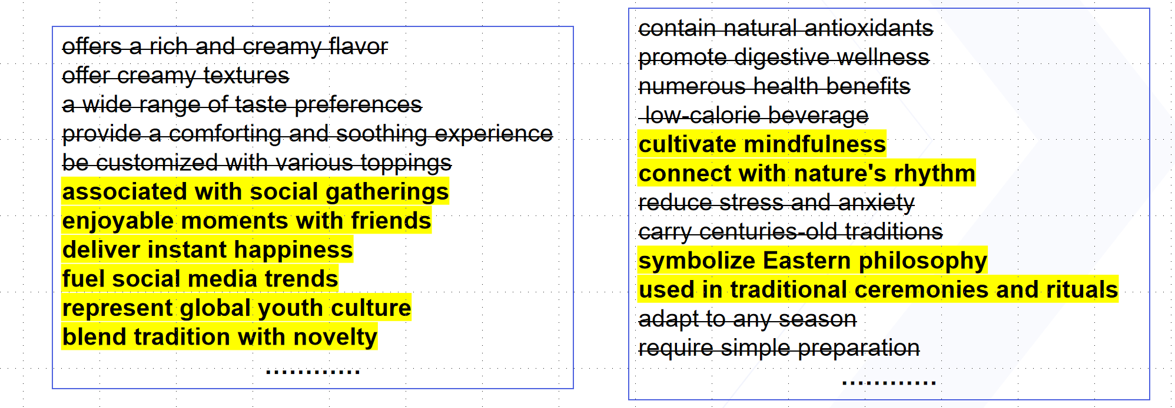
按照“①功能→②情感→③文化/精神/社会”的思维，给语料划分层次

Slide 17
Next, let’s evaluate these two excerpts to determine which one presents a more compelling argument?
Version A
I suggest improving the library because it's important. First, the environment is not good now. Students need better places for study. Second, we need more books. Some books are old. Third, activities can make the library more popular. I hope you will consider my ideas.
Version B
I suggest improving the library because it’s important in three key aspects. Academically, creating quiet study zones will directly support research projects. Culturally, introducing a monthly Book Explorer event—where students recommend books—could boost reading rates. Environmentally, replacing plastic chairs with with those made from recycled materials would align with our Eco-School motto.
Which one is more convincing?
具体化、结构化、情境化

Slide 18
活动类
应用文的要点分析
03

Slide 19
Some key points and idiomatic expressions
流程性活动安排/规划
（目的）、时间、地点、主要活动
邀请原因
兴趣、优势
比赛类活动安排
时间、地点、流程、具体工作
注意事项
截止时间、携带物品、场合规矩
具体活动内容板块
share insights into cultural preservation
hands-on workshops ranging from traditional crafts to modern tech
lively discussions with experts and enthusiasts
interactive sessions like VR demonstrations
poetry recitals or innovation contests
speeches by renowned/prestigious scholars
live performances showcasing ……
对受邀者的好处板块
expand your horizons→ add a new dimension
gain hands-on experience→acquire actionable expertise
connect with like-minded individuals
refresh your perspective with innovative approaches
build meaningful connections
→establish resonant professional bonds
Take home practical skills
→absorb cutting-edge competencies
add a vibrant touch to the event with your unique perspective
bridge cultural gaps through mutual understanding and respect
inspire younger generations to explore
foster a sense of community among diverse participants
create ripple effects that extend beyond the event itself
amplify the message of [core value, e.g., sustainability/creativity]
对活动影响
板块

Slide 20
补充：像活动流程的邀请信
It will kick off with…, closely/subsequently followed by … /The highlight of the activity, undoubtedly, was a… which … Ulitimately, …will put a perfect ending to…
具体活动内容板块
share insights into cultural preservation
hands-on workshops ranging from traditional crafts to modern tech
lively discussions with experts and enthusiasts
interactive sessions like VR demonstrations
poetry recitals or innovation contests
speeches by renowned/prestigious scholars
live performances showcasing ……
会议将以著名学者的演讲拉开序幕，随后是专家和爱好者的热烈讨论，交流新的见解。毫无疑问，活动的最高潮是互动VR演示环节，让参与者亲身体验最前沿的技术。
对受邀者的好处板块
add a new dimension
acquire actionable expertise
connect with like-minded individuals
refresh your perspective with innovative approaches
establish resonant professional bonds
absorb cutting-edge competencies
It will kick off with inspiring speeches by renowned scholars, closely followed by lively discussions with experts and enthusiasts to exchange fresh insights. The highlight/climax of the activity, undoubtedly, will be an interactive VR demonstration session which allows participants to experience cutting-edge technologies firsthand.

Slide 21
多任务融合类
应用文的审题立意
04

Slide 22
Respond to the Task
假定你是高中生李华，将在假期和你校的英国交换生 Jack 共同完成一项研究性学习任务。请给 Jack 写一封邮件，提议研究偶像对高中生成长的影响。内容包括:
1.选题理由;
2.实施方案;
3.征询意见。
What are the tasks which require our response ?
建议（提议）+咨询（征询）+隐含点(情商体现）
①The prompt is appropriately and sufficiently addressed.
议题得到恰当和充分地回应
②A clear and well-developed position is presented in response to the question/s.
呈现的立场清晰且很好地展开
③Ideas are relevant, well extended and supported.
观点和主题相关，且较好地拓展并支撑
④There may be occasional omissions or lapses in content.
内容当中偶尔有遗漏或者失误

Slide 23
要点往往即任务
任务常分主客观
立意兼顾多任务
隐含任务需挖掘
多任务融合类应用文是什么？
一种和传统应用文命题单一体裁任务不同的新趋势，笔者将其称为“多任务融合”类应用文，其主要命题特征就是一封信中包含多个任务或需求，用于解决现实生活中的复杂问题。You need to respond to more than only one task.
You can’t immediately tell the genre.
这一逐渐从单一任务转向多任务融合的命题转变，体现的是对学生更深层次解决问题的能力和批判性思维能力的考察。
在“多任务融合”类应用文中，学生需要在一封信中完成多个任务，如请求信息、提出建议、表达感谢等，需要在不同要点中建构合适的衔接部分和自然承接，这也要求学生在有限的篇幅内展示其语言运用和逻辑思维的能力。
2023年新高考卷
假定你是李华，外教Ryan准备将学生随机分为两人一组，让大家课后练习口语，你认为这样分组存在问题。请你给外教写一封邮件，内容包括；
1. 说明问题；
2. 提出建议。
感谢
问题说明（水平差异、性格冲突、时间协调）
建议（水平分组、性格搭配、三人小组）
最后再次感谢

Slide 24
要点往往即任务
任务常分主客观
立意兼顾多任务
隐含任务需挖掘
例题
假定你是校学生会主席李华，下个月将组织举办一场校园慈善音乐会。请给你校的英国留学生Chris 写一封英语邮件邀请他来参与演出，内容包括:
1.活动介绍;
2.表演形式建议。
变式：
假定你是李华，下个月你校将组织举办一场校园慈善音乐会。请给你校的英国留学生Chris 写一封英语邮件邀请他一起设计节目参与演出，
内容包括:
1.活动介绍;
2.表演形式建议
3. ___________?
• 主任务：邀请Chris参加演出（核心动作）
• 次任务：提供表演建议（辅助动作）
Activity introduction → Transition phrase → Performance suggestions
(e.g. "Given the cultural significance of this event, your performance could...")
Primary purpose: To extend a heartfelt invitation for cultural collaboration
How to transit to the other task: To create make your performance/Given that……，perhaps we could explore the possibility of ….../It never fails to be a fabulous idea that/ it is highly recommended that……
隐含点？(情商体现）

Slide 25
角色反转？
假定你是校学生会主席李华，下个月将组织举办一场校园慈善音乐会。请给你校的英国留学生Chris 写一封邮件邀请他来参与演出，内容包括:
1.活动介绍;
2.表演形式建议。
假定你是英国留学生Chris ，收到了李华的信件，且有意愿参与本次音乐会，请你给他写一封回信，内容包括:
1. 接受邀请；
2. 询问细节
身份分析：写信人与读者在语境中的地位？
要点分析：A+B+ 隐含点？(情商体现）
任务分析：主任务？次任务？地位一致怎么办？
Thank you for your heartfelt invitation—I’m truly moved by your dedication to supporting students in need. It’s inspiring to see kindness turned into action, and I’d be honored to contribute.

Slide 26
Brainstorm
rehearsal dates,
performance duration
Performance form
Equipment availability
思考：征询细节可以从哪些角度出发？如果题干没有提示
Please let me know about the rehearsal dates so that I can adjust my journey.
How long is each performer’s slot? I’d like to plan my piece accordingly.
Will a piano be available? If no, are there restrictions on bringing my own instrument/equipment?
Could you please be so kind as to share the rehearsal dates? This would help me coordinate my schedule seamlessly. Another point I am not certain about is if each performer’s slot has a time limit—knowing this would ensure my piece fits perfectly. I would be more than obliged if you could confirm whether a piano is provided or if I may bring my own. Besides, is there anything that deserves special attention?
could you please be so kind as to ?
another point I am not certain about is if .
I would be more than obliged if .
Besides, is there anything that deserves special attention?

Slide 27
THANKS
20XX/01/01

