Slide 1


感恩遇见，相互成就，本课件资料仅供您个人参考、教学使用，严禁自行在网络传播，违者依知识产权法追究法律责任。
更多教学资源请关注
公众号：溯恩英语
知识产权声明

Slide 2

The World
May 1st-15th, 2025

Slide 3

1. The World at a Glance
世界观察两则

Slide 4
Text Completion
The Week (May 9, 2025P8&9)
Madrid
Unprecedented blackout: Spain and Portugal were hit by a ________ (mass) power outage this week that affected tens of millions of people. France’s southern Basque region was also briefly affected. Trains ________ (abrupt) stopped, forcing passengers to be rescued by bus, but traffic was snarled everywhere because all the streetlights were out. Restaurants, shops, and supermarkets were suddenly plunged into darkness, ____ most schools and businesses shut down, although hospitals kept __________ (function) with generators. Mobile phone service was also affected, leaving many _______ (strand) people unable to get help. Some stores stayed open for cash transactions only, and long lines formed at the few working ATMs. “It’s like when I was younger, 50 years ago,” said Francisco Garcia, 61, a boat restorer in Lisbon. Authorities in both countries were trying to determine _______ the cause of the blackout was sabotage, a cyberattack, mechanical failure, or human error.
Valletta, Malta
Stop selling citizenship: The EU’s top court this week ordered Malta to end ___ (it) “golden passport” program, saying it reduced citizenship to a “mere commercial transaction” in ________ (violate) of EU law. Malta’s investor citizenship scheme offers a Maltese passport—and the EU citizen ship __________ comes with it—for $700,000 after three years of residency or $850,000 after one year. The program, introduced in 2013, quickly became a back door to EU access for money launderers and other criminals, as well as for Russian oligarchs subject ___ Western sanctions. The ruling could also spell trouble for EU countries that offer “golden visas,” including Austria, Cyprus, Greece, Hungary, Ireland, and Portugal. “European passports are not for sale,” said Daniel Freund, a German lawmaker in the European Parliament. “Criminals, autocrats, and terrorists should not be able to buy a ticket into the EU.”
massive
abruptly
and
functioning
stranded
whether
its
violation
that / which
to

Slide 5
Reading Comprehension
1. What continued to function during the blackout using generators?
A. Schools and supermarkets. B. Mobile phone services.
C. Hospitals. D. Traffic lights.
2. According to the EU court, why was Malta’s “golden passport” program criticized?
A. It caused economic inequality in Malta.
B. It turned citizenship into a commercial transaction.
C. It required too long a residency period.
D. It only benefited Russian oligarchs.

Slide 6
Vocabulary
1. strand: If you are stranded, you are prevented from leaving a place, for example because of bad weather. (坏天气等)使滞留，使搁浅
The airport had to be closed, stranding tourists.
机场被迫关闭，造成游客滞留。
2. spell: If something spells a particular result, often an unpleasant one, it suggests that this will be the result. 意味着，招致(常常是不愉快的结果)
If the irrigation plan goes ahead, it could spell disaster for the birds.
如果灌溉计划开始实施，它可能会给鸟类带来灾难。
Translation
登山者被暴风雨困住了。
The climbers were stranded by a storm.
Translation
经济中新的不确定性可能给企业带来麻烦。
New uncertainty in the economy could spell trouble for business.

Slide 7
Translation
Trains abruptly stopped, forcing passengers to be rescued by bus, but traffic was snarled everywhere because all the streetlights were out. Restaurants, shops, and supermarkets were suddenly plunged into darkness, and most schools and businesses shut down, although hospitals kept functioning with generators.
火车突然停驶，迫使乘客乘坐公共汽车，但由于所有的路灯都熄灭了，到处都是交通混乱。餐馆、商店和超市突然陷入黑暗，大多数学校和企业关闭，尽管医院依靠发电机继续运转。
The EU’s top court this week ordered Malta to end its “golden passport” program, saying it reduced citizenship to a “mere commercial transaction” in violation of EU law. Malta’s investor citizenship scheme offers a Maltese passport—and the EU citizen ship that comes with it—for $700,000 after three years of residency or $850,000 after one year.
欧盟最高法院本周下令马耳他终止其“黄金护照”计划，称该计划将公民身份降低为“纯粹的商业交易”，违反了欧盟法律。马耳他的投资者公民计划提供马耳他护照——以及随之而来的欧盟公民身份——居住三年后需交70万美元，居住一年后需交85万美元。

Slide 8
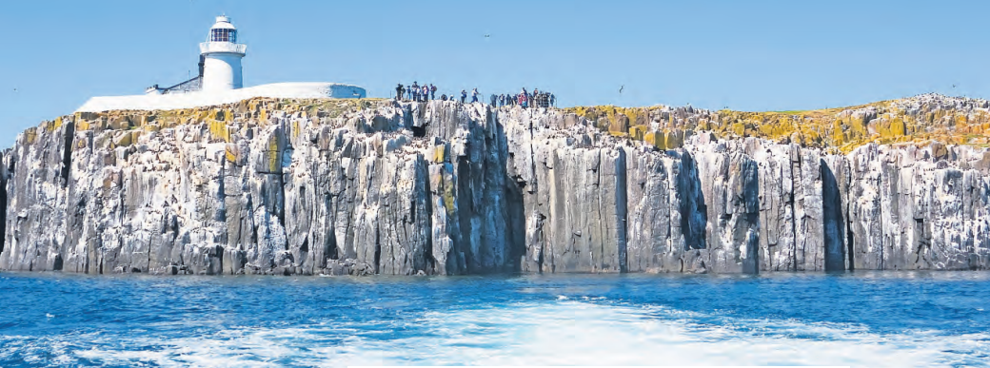
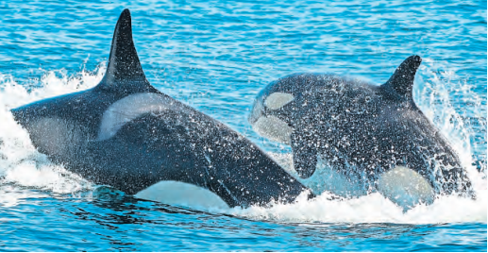
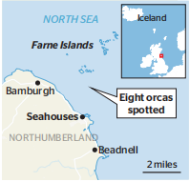
2. Orcas venture near Farne
虎鲸冒险靠近法恩岛

Slide 9
Text Completion
The Times (May 8, 2025 P5)
William Shiel’s family have been running boat trips to the Farne Islands for more than 100 years. He ___________ (hear) stories of the occasional orca long ago, but never in his 40-year career had he seen one for himself.
That changed last week, _____ a group of eight killer whales made a spectacular — and unusual — appearance ____the Northumberland coast, near Bamburgh Castle. ________ (happy), a professional photographer was aboard to capture the encounter which lasted more than half an hour.
____ video has allowed experts to confirm the orcas are from groups that migrate every year from Iceland to Scotland. Rarely, however, do they travel that far down the eastern coast. The Northumberland sightings have raised hopes that new populations _____________ (venture) further into British waters — and staying for longer.
The UK has only two resident orcas. John Coe and Aquarius, as they are known, have been seen regularly around the northwest coast of Scotland for years. Over the decades, their pod dwindled. The females died— their bodies were so full of toxic __________ (pollute) they were unable to reproduce— leaving John Coe and Aquarius doomed to patrol the British Isles like two lonely bachelors.
For each newcomer, experts compared their dorsal fin, unique ___________ (identify) patterns around their eye patch and the pale “saddle patch” on their back with that of the orcas listed in ID catalogues in Shetland and Iceland.
Of the eight orcas spotted on Friday, it has been confirmed that one is a large male known as “72”, from the “27 pod”. Three others have been identified as “Razor”, “Ossa” and “199”, ______ are members of the 65 pod — another of the 12 migratory groups that are known ________(travel) from Iceland to the British Isles. The remaining four have yet to be identified.
had heard
when
off
Happily
The
are venturing
pollutants
identifying
which
to travel

Slide 10
Reading Comprehension
1. What caused the female orcas in John Coe and Aquarius's pod to lose their ability to reproduce?
A. Aging and natural decline B. Toxic pollutants in their bodies
C. Lack of food sources D. Increased human interference.
2. Why do the recent Northumberland orca sightings raise hopes about new populations in British waters?
A. The orcas stayed longer and were photographed professionally.
B. The identified orcas belong to migratory groups from Iceland.
C. The UK’s resident orcas are finally reproducing again.
D. The sightings prove toxins in the water have decreased.

Slide 11
Vocabulary
1. dwindle: to become gradually less or smaller （逐渐）减少，变小，缩小
Support for the party has dwindled away to nothing.
支持这个党派的人渐渐化为乌有。
2. doom: to make sb/sth certain to fail, suffer, die, etc. 注定失败（或遭殃、死亡等）
The plan was doomed to failure .
这个计划注定要失败。
Translation
俱乐部会员人数已从70减少到20。
Membership of the club has dwindled from 70 to 20.
Translation
这桩婚姻从一开始就注定要破裂。
The marriage was doomed from the start .

Slide 12
Translation
For each newcomer, experts compared their dorsal fin, unique identifying patterns around their eye patch and the pale “saddle patch” on their back with that of the orcas listed in ID catalogues in Shetland and Iceland.
对于每一个新来者，专家们将它们的背鳍、眼罩周围独特的识别图案和背上苍白的“鞍状斑块”与设得兰群岛和冰岛的虎鲸ID目录中列出的虎鲸进行了比较。
Three others have been identified as “Razor”, “Ossa” and “199”, which are members of the 65 pod — another of the 12 migratory groups that are known to travel from Iceland to the British Isles.
另外三只被确定为“剃刀”、“奥萨”和“199”，它们是第65群的成员——已知从冰岛到不列颠群岛的12个迁徙群体中的另一个。

Slide 13

3. The worst coffee types for your cholesterol levels
对胆固醇水平影响最大的咖啡类型

Slide 14
Reading Comprehension
BBC Science Focus（May, 2025 P22)
According to the National Coffee Association, the average American drinks just over three cups of coffee a day. It’s often seen as a healthy habit, and for good reason: coffee is linked to a reduced risk of diabetes and certain types of cancer. But coffee also contains natural compounds that can raise cholesterol, and depending on how it’s prepared, your daily pick-me-up could be giving you more of them than you want.
In a study, published in the journal Nutrition, Metabolism and Cardiovascular Diseases, a team of Swedish researchers took a closer look at workplace coffee machines and found that many produce coffee with relatively high levels of these cholesterol-elevating substances.
Unfiltered or boiled coffee is known to contain two cholesterol-raising compounds, cafestol and kahweol, which belong to a group of naturally occurring fats called diterpenes. These have been associated with higher levels of LDL (or ‘bad’) cholesterol and an increased risk of cardiovascular disease. They’ve also been shown to slightly reduce HDL (‘good’) cholesterol. Filtered coffee, by contrast, tends to contain far lower levels of these substances.
“But at work, we get a lot of coffee from machines and no one has really tested these before,” study author Dr David Iggman told BBC Science Focus. To investigate, the team measured the levels of cafestol and kahweol found in coffee from 14 machines across a range of workplaces. They compared these brews to drip coffee, percolator, French press, espresso and boiled coffee.
“From our data, we can say that liquid-model machines are definitely the better option,” Iggman said. These machines, which combine a liquid coffee concentrate with hot water, produce coffee with very low levels of diterpenes, at a similar level to paper-filtered coffee. Meanwhile, machines that used ground or whole beans passed through a metal filter contained higher levels of cholesterol-raising compounds.

Slide 15

Reading Comprehension
1. Which two compounds in coffee are linked to raising cholesterol levels?
A. Caffeine and cafestol
B. Cafestol and kahweol
C. Kahweol and diterpenes
D. HDL and LDL
DETAIL
2. Why did the Swedish researchers focus on workplace coffee machines?
A. Because they are more expensive than home machines.
B. Because they are rarely tested despite frequent use.
C. Because they produce better-tasting coffee.
D. Because they are required by health regulations.
INFERENCE
3. Which of the following is the best title for the text?
A. The Benefits of Drinking Three Cups of Coffee Daily
B. How Coffee Machines Affect Workplace Efficiency
C. Coffee Preparation Methods and Their Impact on Cholesterol
D. A Guide to Choosing the Perfect Coffee Machine
GIST

Slide 16
Vocabulary
1. pick-me-up: something that makes you feel better, happier, healthier, etc., especially medicine or an alcoholic drink 提神物品
A five day holiday in the Bahamas would be a great pick-me-up. 在巴哈马群岛的五日假期很提神。
2. filter: to pass liquid, light, etc. through a special device, especially to remove sth that is not wanted 过滤
The ozone layer filters harmful UV rays from the sun.
臭氧层过滤来自太阳的有害紫外线。
Translation
他发现清新的空气是一种完美的提神剂。
He found the clear air was a perfect pick-me-up.
Translation
所有饮用水必须经过过滤。
All drinking water must be filtered.

Slide 17
Translation
In a study, published in the journal Nutrition, Metabolism and Cardiovascular Diseases, a team of Swedish researchers took a closer look at workplace coffee machines and found that many produce coffee with relatively high levels of these cholesterol-elevating substances.
在一项发表在《营养、代谢和心血管疾病》杂志上的研究中，一组瑞典研究人员仔细研究了工作场所的咖啡机，发现许多咖啡机中这些升高胆固醇的物质含量相对较高。
These machines, which combine a liquid coffee concentrate with hot water, produce coffee with very low levels of diterpenes, at a similar level to paper-filtered coffee. Meanwhile, machines that used ground or whole beans passed through a metal filter contained higher levels of cholesterol-raising compounds.
这些机器将液体咖啡浓缩物与热水混合，生产出的咖啡中二萜的含量非常低，与纸质过滤咖啡的含量相似。与此同时，使用磨碎或全豆通过金属过滤器的机器含有更高水平的胆固醇升高化合物。

Slide 18
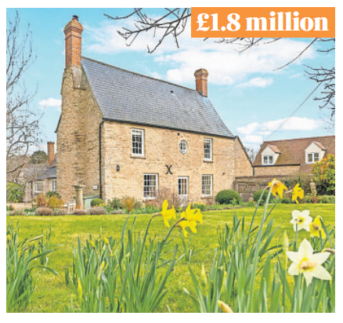
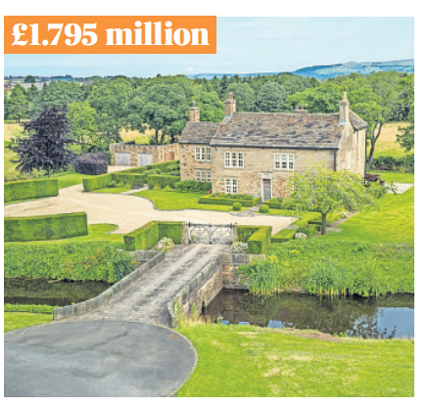
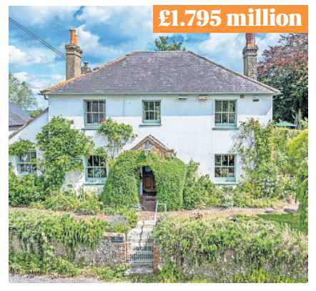
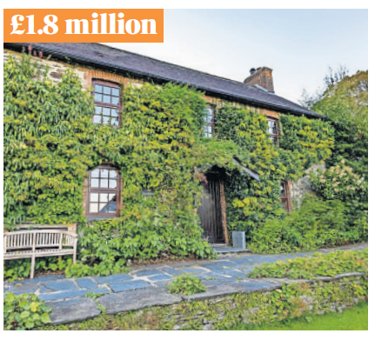
4. What ￡1.8 million buys you in...
180万英镑能买到什么？

Slide 19
Reading Comprehension
The Times（May 9, 2025 P3)
Oxfordshire (￡1.8million)
Orchard House is a spacious family home on the edge of the Cotswolds with a Georgian façade, high ceilings and beautifully maintained gardens with a grapevine-wrapped pergola, a prolific asparagus bed and a good-sized potting shed. On the ground floor there is a generous 500 sq ft living room, kitchen, dining room, office, bathroom and separate WC. Up the curved wooden staircase are four bedrooms and two bathrooms.
EPC D (potential B) — on a scale of A (best) to G (worst)
Upside Off-street parking.
Downside Despite the name, there’s no orchard.
Contact savills.com
Greater Manchester(￡1.795million)
It’s not often that a fully moated 16th-century house appears on the market, but Gidlow Hall is just that. The property, just over two miles from Wigan, has 4,727 sq ft of living space and 7.41 acres of land. It is accessed via a no through lane with a tree-lined sweeping drive, so there is a high degree of privacy. There are three reception rooms, five bedrooms and three bathrooms, including a main bedroom with en suite bathroom and a terrace. There is also a barrel-vaulted cellar and a detached double garage.
EPC C (current and potential)
Upside Further land available.
Downside The bridge can’t be drawn up.
Contact jackson-stops.co.uk

Slide 20
Reading Comprehension
West Sussex(￡1.795million)
With stunning views of the South Downs National Park, Rhiw has no shortage of country charm. It is grade II listed and has exposed timber beams, brickwork and open fireplaces, as well as a conservatory which opens out into the garden. There are three more reception rooms downstairs, plus a large kitchen, shower room and bedroom. Upstairs are three more bedrooms, one with an en suite bathroom. The village of Amberley is close to Storrington and Pulborough.
EPC N/A
Upside Underfloor heating via ground source heat pump.
Downside The balcony is accessed via the bathroom.
Contact hamptons.co.uk
Or ... a ready-made holiday business in Pembrokeshire(￡1.8million)
Clydey Cottages is an award-winning holiday cottage complex, and it’s available to purchase turnkey. The 15.8-acre site, in the heart of Pembrokeshire, includes ten holiday units, a heated indoor swimming pool, sauna, games room, spa treatment room and hot tubs. There are woodland walks, and the farm offers animal feeding and egg collecting, plus beaches a short drive away.
EPC E (potential C)
Upside Future bookings in place.
Downside Cottages could be spruced up.
Contact fineandcountry.co.uk

Slide 21
Reading Comprehension
1.Why might Gidlow Hall in Greater Manchester appeal to buyers seeking privacy?
A. It has a modern security system.
B. It is located near a busy town center.
C. It is accessed via a secluded tree-lined drive.
D. It includes a detached double garage.
INFERENCE
2.What do all four properties have in common?
A. They all include a detached garage.
B. They are all located in rural areas.
C. They provide direct contact information.
D. They have an EPC rating of B or higher.
DETAIL
3. What is the primary purpose of the text?
A. To compare the prices of properties in different regions.
B. To advertise unique homes and a holiday business for sale.
C. To explain the importance of EPC ratings in real estate.
D. To criticize the drawbacks of rural properties.
GIST

Slide 22
Vocabulary
1. en suite: joined onto a bedroom and for use only by people in that bedroom 与卧室配套的
Each bedroom in the hotel has a bathroom en suite. 旅馆里每间卧室都带浴室。
2. complex: a group of buildings of a similar type together in one place （类型相似的）建筑群
The town has one of the best leisure complexes in the country.
这个城镇拥有全国最好的休闲设施之一。
Translation
所有房间都装饰整齐，并设有浴室。
All rooms are neatly decorated and feature en suite bathrooms.
Translation
这个综合体育场还有六个网球场。
The sports complex also has six tennis courts.

Slide 23
Translation
Orchard House is a spacious family home on the edge of the Cotswolds with a Georgian façade, high ceilings and beautifully maintained gardens with a grapevine-wrapped pergola, a prolific asparagus bed and a good-sized potting shed.
果园屋位于科茨沃尔德边缘，是一处宽敞的家庭住宅，带有乔治亚风格的外墙，高高的天花板，以及维护得很好的花园，花园里有爬满葡萄藤的藤架、一个种植大量芦笋的苗圃和一个相当大的盆栽棚。
With stunning views of the South Downs National Park, Rhiw has no shortage of country charm. It is grade II listed and has exposed timber beams, brickwork and open fireplaces, as well as a conservatory which opens out into the garden.
凭借南唐斯国家公园的壮丽景色，莱茵并不缺乏乡村魅力。它是二级保护建筑，有暴露的木梁、砖墙和开放式壁炉，以及一间向花园开放的温室。

Slide 24

5. BBC News 05/13/2025

Slide 25

Dictation
Hamas says it’ll release an Israeli-American hostage, Edan Alexander, as part of efforts to reach a ceasefire deal in Gaza and allow ___________ aid into the territory. The announcement comes a few days before President Trump is due to visit the Middle East.
President Zelensky of Ukraine has responded to Vladimir Putin’s suggestion of talks in Istanbul, saying he was ready to meet the Russian president there ________. President Putin unexpectedly suggested Russian-Ukrainian talks should take place in the Turkish city this Thursday, but Mr Putin didn’t say that he himself would attend.
China and the US both say that _______ has been made at trade talks in Geneva, aimed at averting a _________ trade war. A joint statement with further details is expected on Monday.
Red Cross officials in Nigeria say 23 people have been killed in the central state of Benue in the latest _______ flare-up. Violent clashes have been taking place since April between nomadic Fulani cattle herders and mainly Christian farmers.
President Trump says he’ll sign an executive order on Monday aimed at sharply reducing the cost for millions of Americans of __________ drugs. Mr Trump said Americans should pay the same as the lowest prices ________ in other countries.
People in the Philippines are voting in mid-term elections for 12 Senate seats and nearly 20,000 other political ________. The contest is coloured by a bitter feud between President Marcos and his Vice President Sara Duterte.
And the White House is in discussions with the Royal Family of Qatar to receive a ______ jumbo jet during President Trump’s coming visit to the country for intended use as a ___________ for Air Force One.
humanitarian
in person
progress
damaging
regional
prescription
available
positions
luxury
replacement

Slide 26
Vocabulary
1. avert: If you avert something unpleasant, you prevent it from happening.
避免;阻止;防止
Talks with the teachers’ union over the weekend have averted a strike.
周末与教师工会举行的谈判避免了一场罢工。
2. feud: A feud is a quarrel in which two people or groups remain angry with each other for a long time, although they are not always fighting or arguing 世仇;积怨
There is a long and bitter feud between the state government and the villagers.
州政府和村民间有着长久的深怨。
Translation
及时防止了一场灾难。
A disaster was narrowly averted.
Translation
两个艺术家之间有夙怨。
There is a long-running feud between the two artists.

Slide 27
Translation
China and the US both say that progress has been made at trade talks in Geneva, aimed at averting a damaging trade war. A joint statement with further details is expected on Monday.
中国和美国均表示，在日内瓦举行的旨在避免破坏性贸易战的贸易谈判中已取得进展。预计将于周一发布一份详细说明相关进展的联合声明。
President Trump says he’ll sign an executive order on Monday aimed at sharply reducing the cost for millions of Americans of prescription drugs. Mr Trump said Americans should pay the same as the lowest prices available in other countries.
特朗普总统表示，他将于周一签署一项行政命令，旨在大幅降低数百万美国人的处方药成本。特朗普表示，美国人应该支付与其他国家相同的最低价格。

