Slide 1


感恩遇见，相互成就，本课件资料仅供您个人参考、教学使用，严禁自行在网络传播，违者依知识产权法追究法律责任。
更多教学资源请关注
公众号：溯恩英语
知识产权声明

Slide 2

行业PPT模板http://www.1ppt.com/hangye/
活用教材词汇，靶向高考写作
B1U3 单词拓展
Sports And Fitness
Notes:
模板来自于： 第一PPT https://www.1ppt.com/

Slide 3
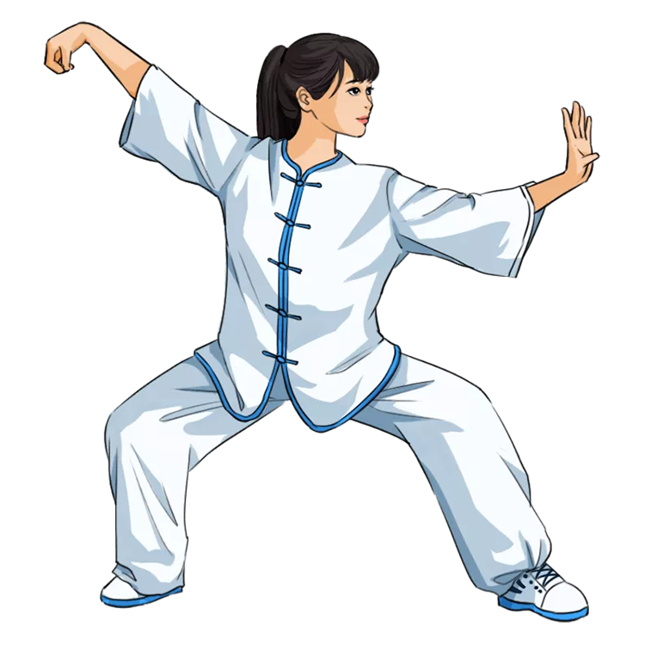

活用词汇
fitness /ˈfɪtnəs/ n.健康;健壮;适合
1.the level of fitness 健康水平
任何人，无论他们的年龄或健康水平，都可以练习并从太极拳中受益。(应用文)
Anyone, regardless of their age or level of fitness, can practice and benefit from Tai Chi.
2. fitness sessions 健身课程
我们举办了关于营养和锻炼的信息丰富的研讨会，烹饪和正念的互动讲习班，体育比赛和健身课程。(应用文之校园健康生活方式活动介绍)
We had informative seminars on nutrition and exercise, interactive workshops on cooking and mindfulness, sports competitions, and fitness sessions.

Slide 4

活用词汇
fitness /ˈfɪtnəs/ n.健康;健壮;适合
3.乍一看，店员认为亨利·亚当斯是个穷人，买不起店里的衣服，于是他把亨利·亚当斯带到一个房间，给了他一套不合身的廉价西装。(应用文之＂戏剧人物评析＂的征文活)
At first sight, the clerk decided that Henry Adams was a poor man who can't afford the clothes m his store, so he led Henry Adams to a room and gave him a cheap suit that didn't fit.
4.因此，当我们搬到一个新的城市，我发现自己在一个新的学校，我决定假装我不知道很多单词，只是为了适应。(续写)
Therefore, when we moved to a new city, and I found myself in a new school, I decided to pretend that I didn't know many words either, just to fit in.

Slide 5
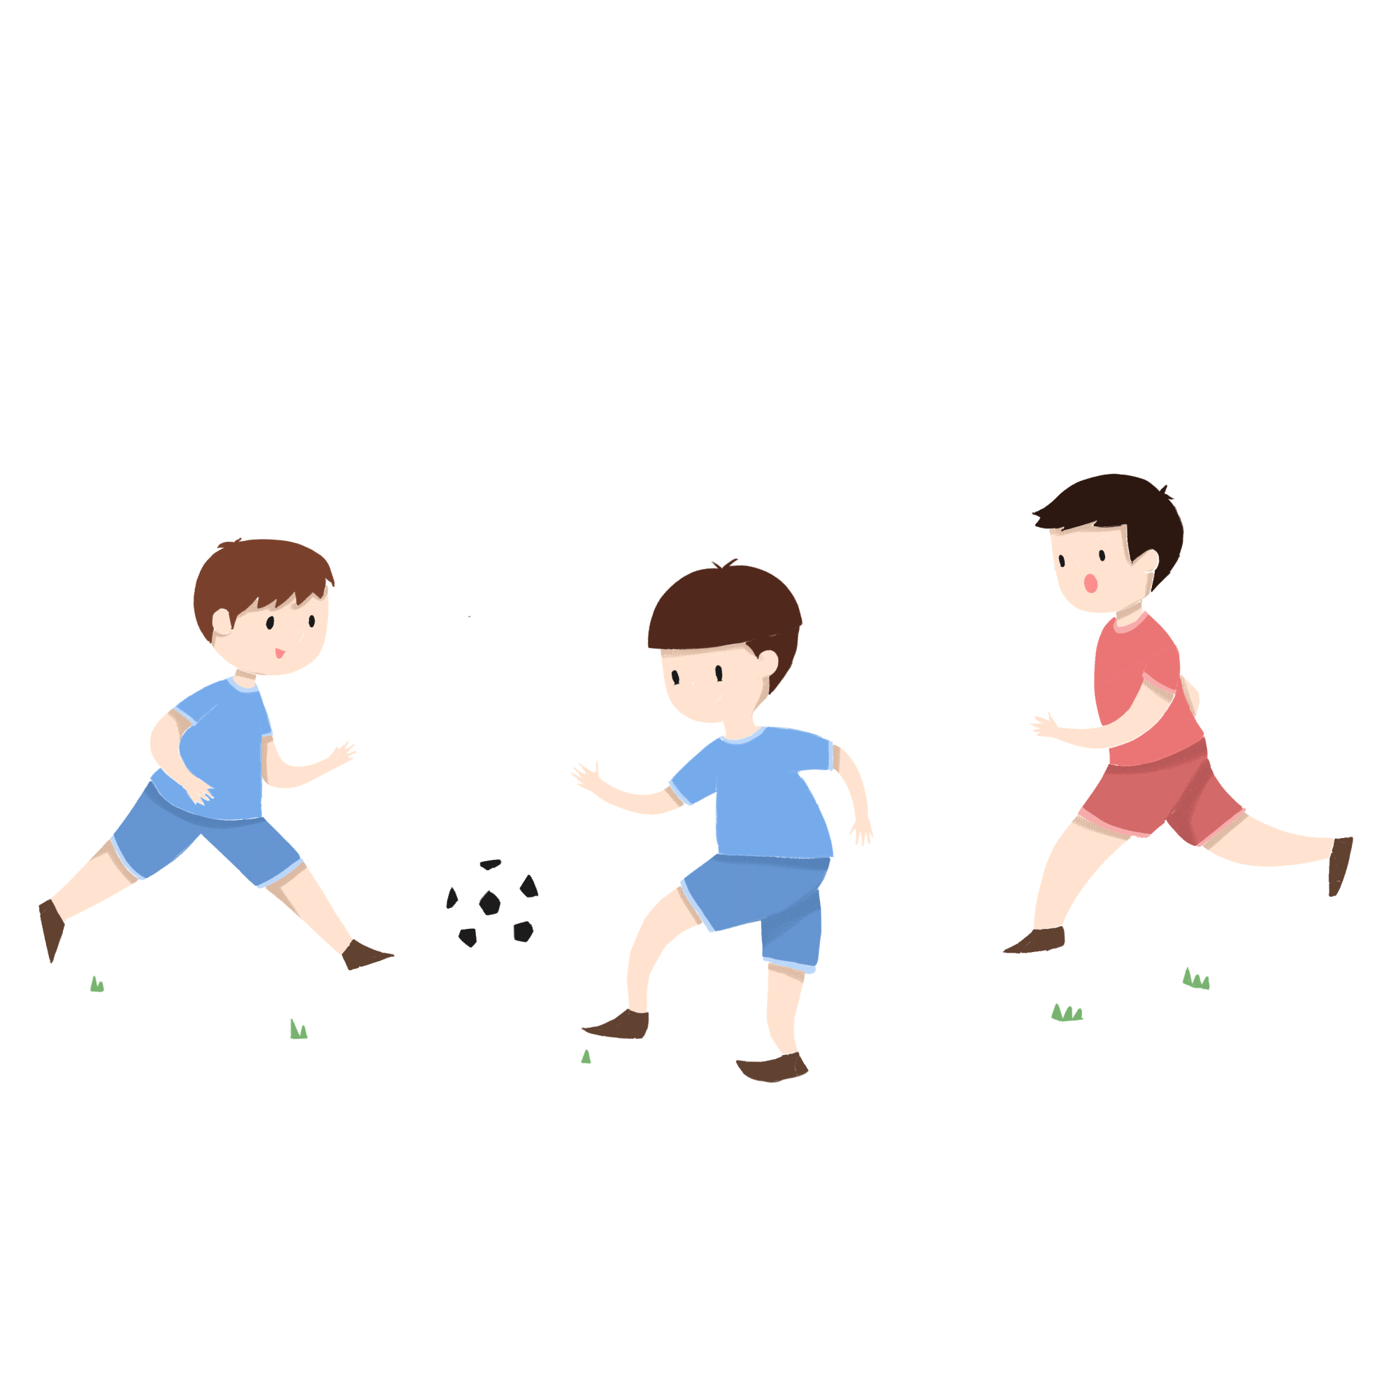
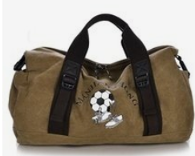
活用词汇
soccer /ˈsɒkə(r)/ n.足球
1.我在昨晚的足球比赛中受了重伤。(2021北京卷应用文之道歉信)
I was severely injured in a soccer game last night.
2.在那一刻，他们所能想到的就是他们喜欢作为一个团队踢足球。
All they could think of at that moment was that they loved playing soccer as a team.
3.我在房子里跑来跑去，把东西扔进足球包后，我发现我的吸湿贴用完了——这是第二天比赛的必需品。(续写)
After flying through the house grabbing and tossing things into my soccer bag, I discovered that I was out of Blister-Block Band­an essential for the next day's game.

Slide 6
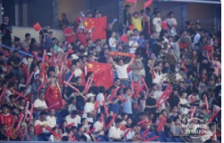
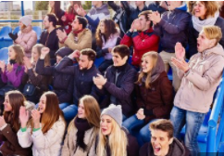
活用词汇
stadium /ˈsteɪdiəm/ n.体育场;运动场
1. 体育场随着人群的吼声而震动，激动人心的雷鸣交响乐在夜空中回荡。(应用文之比赛激动场面)
The stadium vibrated with the roar of the crowd, a thunderous symphony of excitement that echoed through the night.
2. 当她完成这个动作时，她听到了观众惊讶的喘息声。她这一轮结束时，全场掌声雷动。(应用文)
As she completed it, she heard the audience gasp. When her turn was over, applause filled the stadium.

Slide 7


活用词汇
badminton /ˈbædmɪntən/ n.羽毛球运动
1.为了转变这种令人担忧的趋势，据建议，学生应该每45分钟做一次眼保健操，或者通过看远处，踢足球或羽毛球等球类运动来休息眼睛。(应用文之Protecting our eyes to enjoy a bright world 短文投稿)
To reverse this worrying trend, it is suggested that students should do eye exercises every 45 minutes or rest their eyes by looking into the distance or playing ball games like football or badminton.

Slide 8

活用词汇
event /ɪˈvent/ n.比赛项目;大事;公开活动
1. 在活动的第一天，我的学生们分散在球场上参加他们的个人项目。(应用文)
On the first day of the event, my students were scattered all over the ball fields as they took part in their individual events.
2. 我们班正在准备一场全校范围的体育比赛，这次比赛将在我们中学举行，有近20个班级参加。(应用文)
Our class was preparing for a campus-wide sporting event which would be held at our large middle school, with close to twenty classes attending.

Slide 9

活用词汇
ski /ski:/ adj.滑雪的 vi.滑雪
1. 随着时间的流逝，我们的呼吸越来越微弱，双手轻微摆动，希望能引起滑雪爱好者的注意。(续写)
Our breaths weakened with each passing moment, hands waving slightly with the hope of gain any possible attention from skiing lovers.
2.对于我们学生来说，有氧运动，如慢跑、游泳和滑雪，可以锻炼我们的心肺。(应用文)
As for us students, aerobic activities, like jogging, swimming and skiing, develop our heart and lungs.

Slide 10

活用词汇
host /həʊst/ vt.主办;主持 n.主持人
1.为了给学生提供一个表达创意和展示艺术才华的平台，我校准备举办以“文化之美”为主题的艺术展览。(应用文之征集艺术展作品)
To provide a platform for students to express creativity and showcase artistic talents, our school is preparing to host an art exhibition with the theme of "the Beauty of Culture".
2. 作为这次盛会的主办城市是一种独特的荣誉并伴有巨大的责任，我想我是最有资格，理由最充分的的一个。(应用文之申请亚运会志愿者)
Being the host city of the great event is a unique honor which
comes with a great responsibility I assume I'm the most eligible one with the strong reasons.
3. 主持人现场详细讲解了每一件作品。(应用文/续写)
The host explained every work in details on the spot.

Slide 11

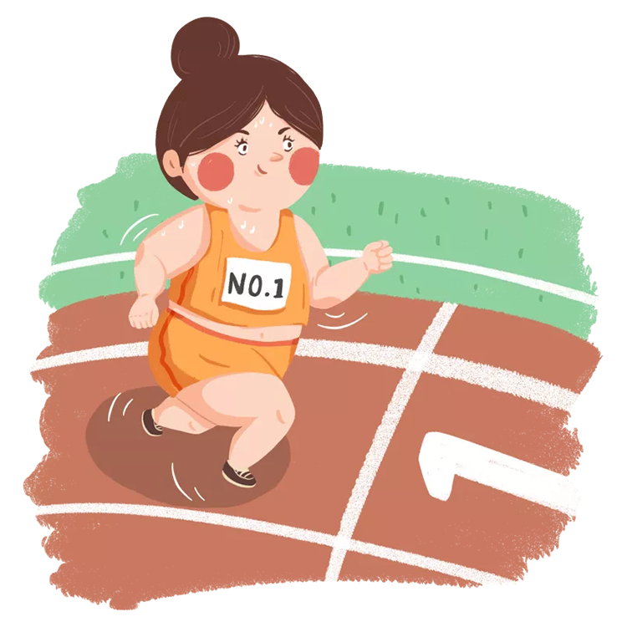
活用词汇
track /træk/ n.跑道;足迹 vt.&vi.追踪
track and field /træk ənd fi:ld/ 田径
1.我们跟着熊在雪地上留下的足迹走。(续写)
We followed the bear's tracks in the snow.
2. 我们又一次出发了，走在一条崎岖不平的山间小路上。(续写)
We set off once more, over a rough mountain track.
3. 我们继续用雷达追踪那架飞机。(续写)
We continued tracking the plane on our radar.
4. 在比赛前一周，学生们需要选择他们的田径项目。(应用文)
A week leading up to the event, the students needed to choose their track and field events.

Slide 12
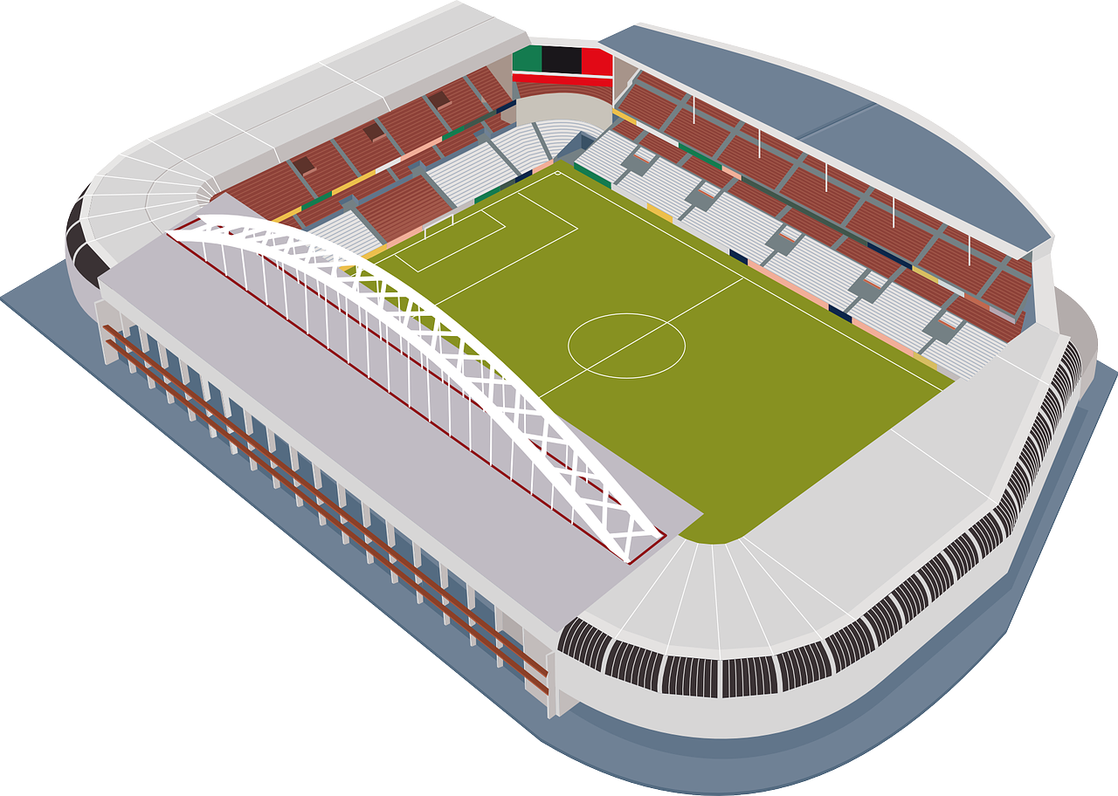

活用词汇
gym /dʒɪm/ n.健身房;体育馆
gymnastics /dʒɪmˈnæstɪks/ n.体操(训练)
1. 比赛将于7月8日上午在我们学校体育馆举行。(2019年全国卷II应用文)
The match will take place in our school gym on the morning of July 8th.
2. 在今天的物质社会中，有很多父母为他们心爱的孩子准备了很多不同场合的衣服，比如聚会的衣服，室内运动的健身服。(应用文)
In today's material society, there are so many parents who prepare lots of clothes for their beloved children for different occasions, such as a dress for the party, gym suit for indoor sports.

Slide 13

活用词汇
gym /dʒɪm/ n.健身房;体育馆
gymnastics /dʒɪmˈnæstɪks/ n.体操(训练)
3.欣赏艺术体操需要安静，而射击中心不允许使用手机，因为你制造的噪音会分散运动员的注意力，将会导致他们在比赛中失败。(应用文之“做一个文明的观众”)
Enjoying artistic gymnastics requires silence and mobile phones are not allowed in shooting centers, because the noises you make will certainly distract the athletes’ concentration, which will cause them to fail in the game.

Slide 14

活用词汇
work out /wɜ:k aʊt/ 锻炼;计算出;解决
1. 我总是想办法把大家联系在一起，但似乎从来没有成功过。(续写)
I always tried to find ways to connect everyone together, but nothing ever seemed to work out.
2. 如果我们能制定出一些让人们遵守的参与规则，事情就会好转。(续写)
Things will turn for the better if we can work out some participation rules for people to obey.

Slide 15

活用词汇
sweat /swet/ vt.&vi.使出汗;流汗 n.汗水
1. 好像几个世纪之后，我终于看到他出现了，额头上满是汗。(续写之2022全国卷Ⅰ)
After what seemed like centuries, I finally saw he showed up with his forehead sweating heavily.
2. 她擦去脸上的汗水。(续写)
She wiped the sweat from her face.
3.到比赛结束时，他已经大汗淋漓了。(续写)
By the end of the match, the sweat was pouring off him.
4.他大汗淋漓。(续写)
He was sweating buckets (= a lot) .

Slide 16
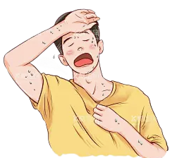
活用词汇
sweat /swet/ vt.&vi.使出汗;流汗 n.汗水
5. 面试过程中，他们的确使我忐忑不安。(续写)
They really made me sweat during the interview.
6. 他感觉全身发热，满身是汗。(续写)
He felt all hot and sweaty.
7. 太阳照在他们身上时，他们已经在冒汗了。(续写)
Already they were sweating as the sun beat down upon them.
8. 我们俩又脏又臭。(续写)
The two of us were dirty and sweaty.

Slide 17
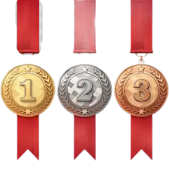
活用词汇
make it /meɪk ɪt/ 获得成功;准时到达
1. 决不向任何困难屈服; 继续努力,总有一天你会成功的。(应用文之劝慰信)
Never give in to any difficulties; keep trying and you will make it one day.
2.我咬紧牙关，鼓起所有的力量，向前冲去，尽我最大的努力保持领先，这样我们的队伍就能获得前三名。(续写)
Gritting my teeth and mustering up all my strength, I charged forward, trying my most to keep ahead so that our team could make it to the top three.

Slide 18
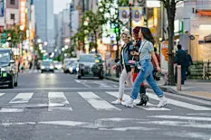
活用词汇
legend /ˈledʒənd/ n.传奇故事(或人物);传说
1. 除此之外，我还想通过品尝美味的当地美食，在熙熙攘攘的城市街头生活中分享一些有趣的故事或传说，让大家了解包容的当地文化。(应用文之寻找外国友人结伴“城市漫步”)
Apart from that, I would like to acquaint you with the inclusive local culture through savoring tasty indigenous cuisine, sharing some intriguing stories or legends amidst the hustle and bustle of urban street life.

Slide 19

活用词汇
athlete /ˈæθli:t/ n.运动员;运动健儿
1.运动员的名字在体育馆中回响，每一次欢呼都是对他们辛苦赢得胜利的骄傲证明。(续写)
The athlete's name echoed through the arena, each cheer a testament to the pride of their hard-earned victory.
2.一想到赛场上的运动员，我就被他们强大的精神所鼓舞。(应用文)
The moment I thought of the athletes on the field, I was inspired by their powerful spirits.
3.近年来，我们校队的运动员在乒乓球比赛中获得了5枚金牌，教练团队也非常专业。(应用文)
Athletes from our school team have won may gold medals of table tennis contests in recent years and the coaching team is also very professional.

Slide 20

活用词汇
master /ˈmɑ:stə(r)/ n.高手;主人 vt.精通;掌握
1. 我知道我们要用筷子，虽然我已经尝试了很多次来掌握这项技术，但每次尝试都失败了。(续写)
I knew we would be using chopsticks, and while I had tried many times to master the technique， I had failed in every attempt.
2.开幕式将于上午9点开始，校长将发表讲话。(应用文之邀请参加音乐节)
The opening ceremony will start at 9:00 am, and the schoolmaster will deliver a speech.
3.当凯普看到他的主人掉进井里时，这个小伙伴转来转去，想把他拽出来。(续写)
When Caper saw his master falling into the shaft, the little good companion ran round and round, reaching down and trying to pull him out.

Slide 21
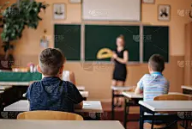
活用词汇
master /ˈmɑ:stə(r)/ n.高手;主人 vt.精通;掌握
4.最后，到了老师颁奖的日子，他叫了五六个孩子来背诵这首诗，就轮到汤姆了。(续写)
At last, the day came on which the master was to give the prize, and after he called upon five or six boys to repeat the poem, it came to Tom’s turn.

Slide 22

活用词汇
honour /'ɒnə(r)/ n.荣誉;尊敬;荣幸
1.我荣幸受邀在此演讲。(应用文之演讲稿)
It is an honour/I feel honoured to be invited to make a speech here.
2. 庆祝端午节是为了纪念古代诗人屈原。(应用文之传统文化)
The Dragon Boat Festival is celebrated in honour of an ancient poet, Qu Yuan.
3.我的妈妈因为工作出色荣获优秀教师的称号。(应用文之2020全国卷Ⅰ)
My mother has been honoured with the best teacher for her excellent work.

Slide 23

活用词汇
honour /'ɒnə(r)/ n.荣誉;尊敬;荣幸
4.我很荣幸邀请你参加我们学校广播电台的英语节目《谈话》的采访。(2022·新高考全国卷Ⅰ应用文之邀请信)
I feel it a great honour to invite you to give an interview on the English program “Talk and Talk” in our school's radio station.
5.他们肃立以示对她的敬意。(续写)
They stood in silence as a mark of honour to her.
6. 今天承蒙邀请到此，深感荣幸。(续写)
It was a great honour to be invited here today.

Slide 24


活用词汇
glory /ˈglɔ:ri/ n.荣誉;光荣;赞美
1.这是我们俩的荣耀！你的鼓舞就像指引我前进的灯塔。(续写)
It’s a glory for both of us!Your inspiration seems a beacon guiding my way ahead.
2. 颁奖典礼结束后，我走到老师的办公室，把证书和奖杯交给他，低声说：“我欠你这个荣誉。”(续写)
I went to my teacher's office after the award presentation. Handing him the certificate and
trophy, I murmured, "I owed this glory to you."

Slide 25
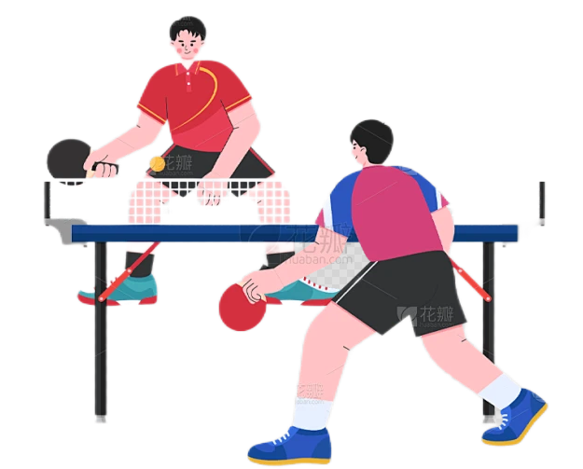
活用词汇
medal /ˈmedl/ n.奖章;勋章
1. 近年来，我们校队的运动员在乒乓球比赛中获得了5枚金牌，教练团队也非常专业。(2017全国III卷应用文之乒乓球队招收新队员)
Athletes from our school team have won five gold medals of table tennis contests in recent years and the coaching team is also very professional.
2.然而，我的失败是注定的：我获得了第四名，这意味着我和我们的团队再一次与奖牌失之交。(续写)
However, my loss was doomed: I finished fourth, which meant I, together with our team, missed out on a medal, once again.

Slide 26
活用词汇
championship /ˈtʃæmpiənʃɪp/ n.锦标赛;冠军赛;冠军称号
champion /ˈtʃæmpiən/ n.冠军;优胜者
1.我们将与其他排球队争夺冠军。(应用文之告知信)
We will compete with other volleyball teams for the championship.

Slide 27
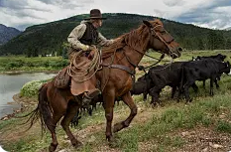
活用词汇
determination /dɪˌtɜ:mɪˈneɪʃn/ n.决心;决定
1.运动教会我们接受挑战,坚定地面对困难。(应用文之短文投稿)
Sports teach us to accept challenges and face difficulties with determination.
2.他们流利的英语口语让我惊叹不已,我决心也要学得一样好。(应用文之短文投稿)
Amazed at their fluent oral English, I was determined to be as good.
3.就在那时我决定继续在农场工作，以便能帮助养家糊口。( 2021浙江卷续写)
It was at that time that I determined to go on working on the farm so that I could help support my family.

Slide 28
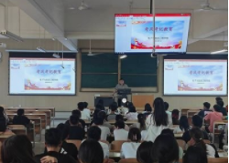
活用词汇
determination /dɪˌtɜ:mɪˈneɪʃn/ n.决心;决定
4.听了我的话，大卫泪流满面地转向我，坚定地表达了自己要完成越野跑的决心。（2022新高考全国卷Ⅰ读后续写）
At my words, with tears rolling down his cheeks, David turned to me and firmly expressed his determination to finish the cross-country run.
5. 决心很好地组织这次主题班会，我写信向你征求关于哪些中国传统文化最吸引外国友人的建议。(2021全国甲卷应用文)
Determined to organize the theme class meeting wonderfully, I am writing to ask you for advice on which traditional Chinese cultures attract foreign friends most.

Slide 29
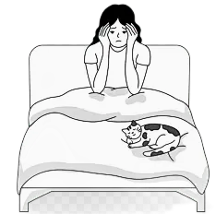
活用词汇
apart /əˈpɑ:t/ adv.分离;分开;成碎片
fall apart /fɔ:l əˈpɑ:t/ 破裂;破碎;崩溃
1.我要崩溃了。我根本睡不着觉。(续写)
I was falling apart. I wasn't getting any sleep.

Slide 30

活用词汇
injure /ˈɪndʒə(r)/ vt.使受伤;损害
injured /ˈɪndʒəd/ adj.受伤的;有伤的
injury /ˈɪndʒəri/ n.伤害;损伤
1.我当时系着安全带,否则我就受伤了。(续写)
I was wearing a seatbelt, without which I would have been injured.
2.他的汽车失控,撞上了卡车,受了重伤。(续写)
He lost control of the car, crashed into the truck and got seriously injured.
3.他们熟练地将伤者移走,在紧急情况下表现得十分冷静。(续写)
They removed the injured with such great skill and were so cool in the emergency.
4.尽管腿受了伤，他还是决心跑完马拉松。(续写)
Though he got/was injured in the leg，he was determined to finish the marathon.

Slide 31

活用词汇
injure /ˈɪndʒə(r)/ vt.使受伤;损害
injured /ˈɪndʒəd/ adj.受伤的;有伤的
injury /ˈɪndʒəri/ n.伤害;损伤
5.救援队像箭一样冲到场,给伤者实施急救,然后急忙把他们送往最近的医院。(续写)
The rescue team dashed to the spot like arrows, offered first aid to the injured and then rushed them to the nearest hospital.
6.委屈的样子╱语调(续写)
an injured look/tone

Slide 32

活用词汇
captain /ˈkæptɪn/ n.(运动队)队长;船长;机长
1.在蒂莫西·怀特的童年时代，美国队长一直是他心目中的英雄。(续写)
Captain America had always been a hero for Timothy \Vhite during his childhood.
2.当我看到我的小女儿蹲坐在湖边，弗林特船长在她周围踱来踱去时，我松了一口气。(续写)
I sighed with relief when I saw my little girl sitting crouched by the lake with Captain Flint pacing around her.

Slide 33
活用词汇
lose heart /lu:z hɑ:t/ 丧失信心;泄气
1.在朋友们的鼓励下，杰克没有灰心，而是继续努力。(续写)
Encouraged by his friends, Jack didn't lose heart and kept on trying.

Slide 34

活用词汇
graceful /ˈgreɪsfl/ adj.优美的;优雅的
1.在整个审讯过程中他表现得文雅而有尊严。(续写)
He conducted himself with grace and dignity throughout the trial.
2.他优雅地向观众鞠了一躬。(续写)
He gave a graceful bow to the audience.
3.这棵树从草地上笔直地立着，它的粉红的花朵随风飘散，就像一个跳舞的芭蕾舞演员。新叶在晨露中闪闪发光。(续写)
The tree stood straight from the grass, its pink blossom blew away with a large gust of wind as graceful a dancing ballerina. The new leaves sparkled with the morning dew.
4.连绵起伏的丘陵美景(续写)
the graceful curves of the hills

Slide 35
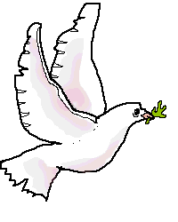
活用词汇
graceful /ˈgreɪsfl/ adj.优美的;优雅的
5.她步态优雅地走上舞台。(续写)
She stepped gracefully onto the stage.
6.接着是一阵震惊的沉默，但然后，从舞台侧翼，一只白鸽优雅地飞向空中，它的翅膀在惊讶的人群中投下了柔和的阴影。(续写)
A moment of stunned silence followed, but then, from the wings, a white dove soared gracefully into the air, its wings casting a gentle shadow over the astonished crowd.

Slide 36
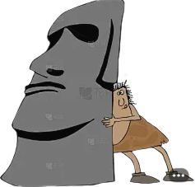
活用词汇
strength /streŋθ/ n.力量;体力
1.所有参赛者在最后一圈都用尽全力加速。(应用文写作之新闻报道)
All competitors sped up with all their strength on the last lap.
2.他用全力推那块石头。(续写)
He pushed against the rock with all his strength.
3.她再也走不动了。(续写)
She didn't have the strength to walk any further.
4.她有非凡的意志力。(续写)
She has a remarkable inner strength.

Slide 37
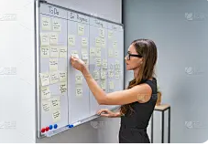
活用词汇
strength /streŋθ/ n.力量;体力
5.你表现得很有毅力。(续写)
You have shown great strength of character.
6. 我非常清楚自己的优点和缺点，所以我决定专注于所有的任务。(2022浙江卷1月读后续写)
Knowing my strengths and weaknesses all too well, I decided to focus on the tasks.

Slide 38

活用词汇
failure /ˈfeɪljə(r)/ n.失败;失败的人(或事物)
1.我很抱歉地告诉你,周末我不能和你外出了。(2021北京卷应用文之道歉信)
I’m sorry to inform you that I will fail to go out with you this weekend.
2.当母亲想向双胞胎道谢时,她不知道说什么好。(2021新高考Ⅰ卷读后续写)
Words failed the mother when she wanted to express her thanks to the twins.
3.当面对困难和失败时，我必须克服它们。(2020年天津卷应用文之介绍成人礼)
When faced with the difficulties and failures, I must overcome them.

Slide 39

活用词汇
give up /gɪv ʌp/ 放弃;投降
1.一开始, 学好英语似乎很难,我甚至没有尝试就想放弃。(应用文之求助信)
In the beginning, learning English well seemed to be so challenging that I wanted to give up without even trying.
2.尽管所有参赛者筋疲力竭,他们都没有半途放弃。(2020新高考Ⅰ卷应用文)
Although their strength was giving out, no competitors gave up halfway.
3.简的精力已经耗尽了。她的脚像灌了铅一样沉重，她瘫坐在树旁，失控地哭了起来。(续写)
Jane's energy had given out. Her feet felt as heavy as lead and she slumped beside a tree，weeping without control.

Slide 40

活用词汇
compete /kəmˈpi:t/ vi.竞争;对抗
1.人生就像一场漫长的竞赛,我们与别人竞争,以超越自己。(续写)
Life is like a long competitive race in which we compete against others to go beyond ourselves.
2. 为了激发学生对自然和艺术的热情，我校英文报将举办一场以“自然之美”为主题的绘画创作比赛。(应用文之通知)
To arouse students' passion for nature and art, our School English Newspaper will hold a painting creation competition on the theme of “The Beauty of Nature”.

Slide 41

活用词汇
compete /kəmˈpi:t/ vi.竞争;对抗
3. 与此同时，他期盼着参加伦敦马拉松比赛。(续写)
Meanwhile, he's hoping to compete in the London marathon.
4.哨声一响，选手们开始各就各位。( 2022新高考全国卷Ⅰ读后续写)
The whistle went off and the competitors began to take their places.

Slide 42

活用词汇
make sense /meɪk sens/ 有道理;合乎情理;表述清楚
1.你可以请老师讲慢一点,这样你就可以理解他讲的内容了。(应用文之建议信)
You can ask the teacher to speak slowly so that you can make sense of what he says.
2.在形势失控之前着手解决该问题是明智之举。(应用文之建议信)
It makes sense to work out a solution to the problem before it gets out of control.

Slide 43

活用词汇
pretend /prɪˈtend/ vi.&vt.叚装;装扮
pretend to do sth. /prɪˈtend tə du ˈsʌmθɪŋ/ 假装做某事
1.弗兰克转过身去,假装没看见我,匆匆走开了。(续写)
Frank turned away, pretending not to notice me, and hurried away.
2.尽管很绝望,但是他对家人佯称一切顺利。(续写)
Despite a feeling of desperation, he pretended to his family that everything was going well.
3.我们假装什么事情也没发生。(续写)
We pretended (that) nothing had happened.
4.她毫无兴趣却装作有。(续写)
She pretended an interest she did not feel.

Slide 44
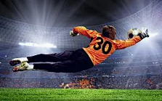
活用词汇
even if /ˈi:vn ɪf/ 即使;虽然
1.即使这对他/她的球队有帮助，足球运动员也不应该假装摔倒。(续写)
A soccer player should not pretend to fall down even if it helps his/her team.

Slide 45
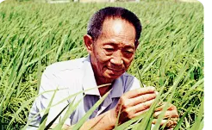
活用词汇
million /ˈmɪljən/ num.一百万
1.我告诉过你无数次不要那样做。(续写)
I've told you a million times not to do that.
2.老妇人告诉我，她曾经是个百万富翁。(续写)
The old woman told me that she used to be a millionaire.
3.他的研究不仅提高了数百万人的生活质量，而且为农业的可持续发展做出了贡献。(2023全国甲卷应用文之历史人物)
His research has not only improved the quality of life for millions of people, but also contributed to the sustainable development of agriculture.

Slide 46

活用词汇
cheat /tʃi:t/ vi.作弊;舞弊 vt.欺骗;蒙骗
1.如果你被发现在考试中作弊，你这学期的所有成绩将被取消。(续写)
If you are found cheating in the exam, all your academic grades for the semester will be canceled.
2.首先，并非所有人都能上网或使用电子设备，因此投票结果并不能反映整个学生群体的真实偏好。此外，作弊也是一个严重的问题。(续写)
Firstly, not all of us have access to the Internet or electronic devices, so the voting result can not reflect the true preferences of the entire student community. Besides, cheating is a significant concern.
3.劳丽想到这件事时微微发抖一下。然后她想：“我真的那么想赢吗？赢真的对我那么重要吗？重要到我愿意为此作弊吗？”(续写)
Laurie shivered slightly as she thought about this. Then she wondered, “Do I really want to win that much? Does winning mean so much to me that I’d be willing to cheat for it?”

Slide 47

活用词汇
audience /ˈɔ:diəns/ n.观众;听众
1.观众鼓掌10分钟。(续写)
The audience was/were clapping for 10 minutes.
2.他的书被搬上银幕后赢得了更广大的观众。(续写)
His book reached an even wider audience when it was made into a movie.
3.全场观众爆发出响亮的掌声。(续写)
The entire audience broke into loud applause.
4. 观众不时鼓掌，热情支持她复出。(续写)
The audience applauded from time to time, enthusiastically supporting her in her comeback.

Slide 48

活用词汇
positive /ˈpɒzətɪv/ adj.积极的;正面的;乐观的
1.照顾好你的思想和感觉，并确保它们能反映出你的积极方面。(续写)
Take care of your thoughts and feelings and make sure they can reflect the positive aspects of you.
2. 梅根坚持认为我们应该让他们知道我的检测结果呈阳性。(续写)
Megan insisted that we should let them know that I had tested positive.

Slide 49
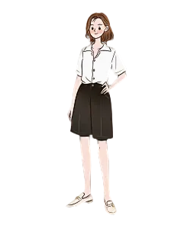
活用词汇
slim /slɪm/ adj.苗条的;单薄的
1.苗条的体形╱身材；纤细的腰肢(续写)
a slim figure/body/waist
2.她是个瘦高个儿。(续写)
She was tall and slim.

Slide 50

活用词汇
diet /ˈdaɪət/ n.规定饮食 vi.节食
1. 此外，我们应该避免在训练中受伤，并有一个健康的饮食保持健康。(2019 年全国Ⅱ卷)
In addition, we should avoid getting hurt during the training and have a healthy diet to keep fit.
2.因此，除非我太忙，否则我大部分时间都在家里吃饭，保持均衡的饮食。(应用文之饮食健康)
Therefore, I mostly eat at home and go on a balanced diet unless I’m too busy.

Slide 51

活用词汇
make a difference /meɪk ə ˈdɪfrəns/ 有作用或影响
1. 小善举真能给他人带来很大影响。(续写)
Small acts of kindness can really make a great difference to others.
2.不管他们是否假装已知道真相,对我来说无关紧要。(续写)
It made no difference to me whether they pretended to have found out the truth or not.
3. 有时仅仅一点善举也很有意义，让世界变得更加美丽和谐。(续写)
Sometimes only a little kindness can make a great difference，making the world more beautiful and harmonious.

Slide 52

活用词汇
rather /ˈrɑ:ðə(r)/ adv.相当;有点儿
rather than /ˈrɑ:ðə(r) ðən/ 而不是
1.送早餐上楼的是这对双胞胎,而不是他们的父亲。(2021新高考Ⅰ卷读后续写)
It was the twins rather than their father that were taking the breakfast upstairs.
2. 我下定决心更加努力学习而不是把宝贵的时间浪费在那些无用的事情上。(应用文)
I made up my mind to study harder rather than waste precious time on those useless things.

Slide 53

活用词汇
now and then /naʊ ənd ðen/ 有时;偶尔
1.我们都知道，每个人都会时不时遇到一些挫折。(续写)
As we all know, everyone will face some setbacks now and then.

Slide 54

compare ... with ... /kəmˈpeə(r) wɪð/ 与…比较
活用词汇
1.人们把儿童比作小树,因为他们都还在成长,还能被塑造。(续写)
Children are compared to young trees because they are still growing and can still be shaped.
2.与过去相比,我的身体素质有了很大的提高。(应用文)
Compared with the past, my fitness has improved a lot.
3.我最喜欢秋天, 因为与夏天相比,秋天的气候更加宜人。(续写)
My favorite season is autumn as the weather is more agreeable in comparison with summer.
4.在我看来，学习说普通话和经常与同学交换笔记是结交新朋友的好方法。(应用文之建议信)
In my opinion，learning to speak Putonghua and comparing notes with your classmates frequently are good ways for you to make new friends.

Slide 55

活用词汇
jog /dʒɒg/ vi.慢跑 n.慢跑
1.现在运动在中国很盛行。在各种运动中，我尤其喜欢慢跑。(应用文)
Sports are flourishing in China now. Of various kinds of sports, I like jogging in particular.
2.看到发生的事情后，另外两个慢跑者迅速做出了反应。(续写)
Having seen what had happened, another two joggers made a quick response.
3.我把车停下，小跑着来到教室。(续写)
I pulled away and jogged to the classroom.
4.有人不小心轻轻碰了一下她的胳膊肘儿，把咖啡弄洒了。(续写)
Someone jogged her elbow, making her spill her coffee.

Slide 56

活用词汇
stress /stres/ n.压力;紧张 vt.强调;重读
1.必须着重指出的是,我们应更好地理解其优缺点。(2021全国乙卷应用文之发言稿)
It must be stressed that we should have a good understanding of its advantages and disadvantages.
2.你最好早点到,因为中国人重视守时。(应用文之建议信)
You’d better arrive a little earlier as the Chinese lay stress on punctuality.
3.刘老师经常强调学好英语的重要性，这对我有很大的影响。(2020全国卷Ⅰ应用文之人物介绍)
Mr Liu often stresses the importance of learning English well， which has a great impact on me.

Slide 57

活用词汇
stress /stres/ n.压力;紧张 vt.强调;重读
4.这些故事可以缓解我的压力，开阔我的视野。(应用文)
These stories can relieve my stress and broaden my horizon.
5. 当代年轻人压力很大，我们必须努力工作报效国家。(应用文)
The contemporary young people are stressed out, and we have to work hard to serve the country.
6.面对太多拖延的工作，我经常感到压力和沮丧。(2022天津卷应用文之改掉坏习惯)
Confronted with too much delayed work, I often feel stressed and frustrated.

Slide 58
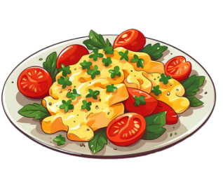
活用词汇
error /ˈerə(r)/ n.错误;差错
1.我写信是告诉你，我在你的标志上发现了一些错误。(应用文)
I am writing with the intention of telling you the discovered some errors on your signs.
2. 然而，在妈妈的鼓励和悉心指导下，经过一系列的尝试和错误，我学会了番茄炒鸡蛋。(2023 年高考全国乙卷应用文之学会一项新技能)
However, under the encouragement and careful instruction of my mother, I learnt Fried Egg with Tomato after going through a series of trials and errors.
3.话语卡在他的喉咙里，沉重地充满了真相的分量。但他强迫它们出来，承认自己的错误。这是一个困难的时刻，却又是解放的，因为在承认自己的错误时，他找到了纠正错误的力量。"(续写)
The words stuck in his throat, heavy with the weight of truth. But he forced them out, admitting his mistake. It was a difficult moment, yet liberating, for in acknowledging his error, he found the strength to make things right."

Slide 59

Thankyou

