Slide 1


感恩遇见，相互成就，本课件资料仅供您个人参考、教学使用，严禁自行在网络传播，违者依知识产权法追究法律责任。
更多教学资源请关注
公众号：溯恩英语
知识产权声明

Slide 2

表格数据分析类应用文
—查漏补缺 助力高考

Slide 3


Accumulation
graph/chart/table泛指表格
bar chart柱状图
pie chart饼状图
line chart折线图
引入表格主题
Contrary to ...,(和...相反)
According to the chart,...（根据表格）
As can be seen from the chart,...（如表所示...）
A accounts for ...percent and B be ...percent respectively.(A 和B分别占......)
As is shown/demostrated/exhibited in the graph/chart， ... （如表所示...）
The graph provides some data regarding... （该图为我们提供了有关……数据。）
The graph illustrates/reveals/suggests/implies/indicates/showcases/demonstrates... （表格说明/显示...）
According to the survey conducted in our school, ...percent of A ...while B...percent...根据我校进行的调查，A占百分之几，而B占百分之几。

Slide 4

Accumulation
描述具体数据
精确数值 accounts for...percent /reaches/makes up ...percent...占百分之几而...达到...
大约数值 approximately/roughly/nearly ...percent
刚好高于或低于Just over/under
最高值 peaks at ...percent ；tops the list with ...percent
最低值 fall to ...percent
占比分布over half less than a third

Slide 5

Accumulation
数据比较句型
Unlike A , B （与A不同，B...）
While A...., only B....
While 60% chose online courses, only 25% preferred offline lectures.有 60% 的人选择了在线课程，而只有 25% 的人更喜欢线下讲座。
Compared with A, B
Compared with boys (45%), girls showed higher participation (65%).与男生（45%）相比，女生的参与度更高（65%）。
A is significantly higher/lower than B（A明显高于/低于B）
There is a sharp contrast between A and B（A与B形成鲜明对比）
Both A and B account for X%（A和B均占X%）
Similarly, A and B are close（A与B数据接近）
A shares a similar proportion with B（A与B占比相似）

Slide 6

Accumulation
评论结果
The consequence is surprising because there is an increasing number of ...At the same time, it is also not optimistic for ... ( 其结果令人惊讶，因为越来越多的……与此同时，这也不容乐观……)
The data reflects the rising awareness of ..., which .... (这些数据表明人们对......的认识在不断提高，而且......)
The result undoubtedly depressed us. Not only does it show us the lack of awareness of ..., but renders us a glimpse of the challenges about .... (这一结果无疑让我们感到沮丧。它不仅表明我们对......缺乏足够的认识，还让我们看到了关于......所面临的种种挑战。)
What is apparent is that ... (很明显可以得出这样的结论：...)
To sum up, the data shows that... are nearly half to half, which may not be a good situation. ( 总的来说，数据表明，...和...比例几乎各占一半，这种情况可能并不理想。)
As can be seen from the chart/graph/figures, great changes have taken place in...(从图/数字中可以看出，...发生了巨大变化。)
The data/statistics/figures lead us to the conclusion that……(这些数据资料令我们得出结论……)

Slide 7
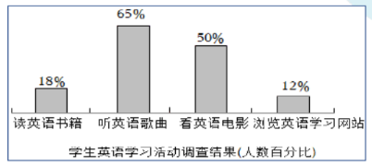
一、（2022年高考英语全国乙卷）
学校英文报正在开展以“Learning English Beyond the Classroom”为题的讨论。请使用图表中的调查结果写一篇短文投稿, 内容包括:
1. 学习活动状况描述;
2. 简单评论; 3. 你的建议。
注意：
1.词数100左右；2.短文的题目和首句已为你写好。
Learning English Beyond the Classroom
Nowadays, with the growing popularity of smartphones and computers, an increasing number of students are choosing to learn English beyond the classroom in various ways.

Slide 8
One Possible Version
Translation
Learning English Beyond the Classroom
Nowadays, with the growing popularity of smartphones and computers, an increasing number of students are choosing to learn English beyond the classroom in various ways.
As is shown in the chart，it is apprent that the percentage of students who choose listening to English songs and watching English movies is respectively 65% and 50%. However, those choosing reading English books and visiting English learning websites only account for 18% and 12% .
From my perspective,prioritizing efficient approaches like reading English books and visiting English learning websites proves more sustainable. Not only do they build a systematic knowledge framework but also cultivate critical thinking skills, which are often overlooked in entertainment-based learning.
课堂之外的英语学习
如今，随着智能手机和电脑的日益普及，越来越多的学生正通过多种途径在课堂之外学习英语。
显而易见，选择听英文歌曲和看英文电影的学生比例分别高达65%和50%；然而，选择阅读英文书籍和访问英语学习网站的学生仅占18%和12%。
在我看来，优先选择阅读英文书籍和访问英语学习网站等高效方法更具可持续性。它们既能构建系统的知识体系，又能培养批判性思维能力——而这些能力在娱乐化学习中常被忽视。

Slide 9
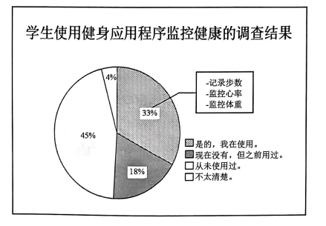
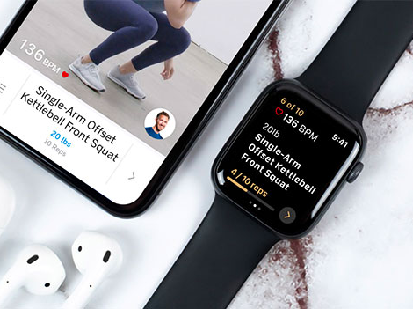
二、（绍兴高二第二学期期末统测）
学校英文报正在开展以“Using Fitness Apps to Monitor Health”为题的调查。请你根据下图调查数据写一篇短文投稿, 内容包括:
1. 描述数据;
2. 简单评论;
3. 提出建议。

Slide 10
One Possible Version
Translation
Using Fitness Apps to Monitor Health
Recently, a survey themed “ Using Fitness Apps to Monitor Health” has been conducted on our campus，which reflects the varying attitudes towards fitness apps. (背景介绍+数据主题介绍)
As is shown in the chart, one-third of our peers are using this high-tech approach to record their footsteps, monitor their heart rate and body weight. However, 18 percent have tried but no longer continue their use, while 45 percent have never explored these tools, and 4 percent are totally unaware of them. What is apparent is that we haven't yet fully realized the benefits of these multi-functional tools. （数据分析+评论）
To cope with this situation, we are supposed to probe into （深入探究）the functions of the smart fitness apps and stick to their exercise guidelines. Subsequently, we can embrace a brighter future with good health conditions. Just give it a try and live a healthier life!(建议+期展望/呼吁)
近期，我校开展了一项以"使用健身APP监测健康"为主题的调查，反映出学生对健身应用态度不一。
如图所示，三分之一的同学正使用这一高科技手段记录步数、监测心率和体重。然而，18%的人尝试后不再继续使用，45%从未探索过这些工具，另有4%对其完全不了解。显而易见，我们尚未充分认识到这些多功能工具的优势。
为应对此现状，我们应深入探究智能健身应用的功能，并坚持遵循其运动指导。如此，方能在健康的加持下拥抱更光明的未来。行动起来，尝试改变，拥抱更健康的生活吧！

Slide 11
三、
你校开展了“高中生了解人工智能的渠道”调查，结果如图。请写一篇短文给校英文报专栏 “Tech Horizon”投稿，要点如下：
1.描述调查结果；
2.你的渠道及理由。
School Learning
(12%)
Media Platforms
(65%)
Popular Science Books(23%)

Slide 12
One Possible Version
Translation
Recently, a survey themed “How high school students learn about AI” has been conducted on our campus.As is demostrated in the graph，65 percent use media platforms like news apps,23 percent read popular science books, while only 12 percent learn in class.
As for me, popular science books definitely served as the best way to learn about AI. To begin with,they provide reliable and detailed information, ensuring accuracy and a solid theoretical foundation. Plus,Books often include practical applications, helping us grasp concepts systematically.Also, reading promotes critical thinking, allowing learners to question and analyze AI’s impact. Compared to the fast-paced nature of media platforms, pupular science books offer depth and clarity that are essential for mastering complex topics.
Let’s embrace efficient methods to better learn about technology!
我们学校的调查显示了高中生了解人工智能的途径：65%通过新闻应用等媒体平台学习，23%阅读科普书籍，仅有12%在课堂上学习。
我个人认为科普书籍是理解AI的最佳方式。它们提供可靠详尽的资讯，确保信息准确并建立扎实理论基础。书籍常包含实际应用案例，帮助我们系统化掌握概念。更重要的是，阅读能培养批判性思维，让学习者能质疑分析人工智能的影响。相较于媒体平台的快节奏与碎片化特性，科普书籍提供的深度与清晰度对掌握复杂知识至关重要。
让我们拥抱高效的学习方式，更好地理解科技发展！

Slide 13
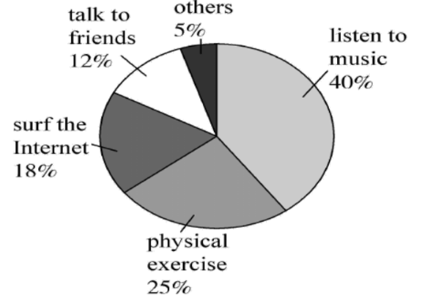
四、
你校高三英文社团就“What is the most effective way to ease stress?”这一话题进行了一次调查，请根据下面的调查结果写一篇调查报告，内容包括:
1. 简述调查结果;
2. 分析原因;
3. 发表个人看法。
The Most Effective Way to Ease Stress

Slide 14
One Possible Version
Translation
With the development of society, more and more people often feel stressed in their lives. Therefore, a survey themed “What is the most effective way to ease stress?” has been conducted by the English club, which reveals that students have a variety of ways to ease their stress.
As is shown in the chart, 40% of the students choose to listen to music, while 25% of them prefer to do physical exercise to make themselves relaxed. Meanwhile, 18% of the students tend to surf the Internet. By comparison, there are 12% who are fond of talking to friends and 5% choosing other activities to help relieve stress.
From my perspective,prioritizing healthy approaches like music or exercise proves more sustainable, which refresh both our mind and body, turning stress relief into a stepping stone toward holistic well-being.
随着社会发展，越来越多人常感生活压力。根据饼状图显示，学生有多种缓解压力的方式。
如图所示，40%的学生选择听音乐，25%倾向于通过体育锻炼放松身心。同时，18%的学生习惯上网冲浪。相较之下，12%的学生喜欢与朋友交谈，另有5%选择其他活动缓解压力。
在我看来，优先采用诸如音乐或运动这类有益健康的活动方式会更具可持续性，它们能让我们的心灵和身体都得到放松，将缓解压力转化为实现全面健康的垫脚石。

Slide 15

Thank you!

