Slide 1


感恩遇见，相互成就，本课件资料仅供您个人参考、教学使用，严禁自行在网络传播，违者依知识产权法追究法律责任。
更多教学资源请关注
公众号：溯恩英语
知识产权声明

Slide 2

劳动话题应用文
热点回顾 助力高考
“Without labor, nothing prospers." — Sophocles

Slide 3
01 Definition of Labor
02 Significance of Labor
03 Labor Activities
04 Labor Scenes
05 Reflections & Gains
06 Labor Education
07 Practices

Slide 4
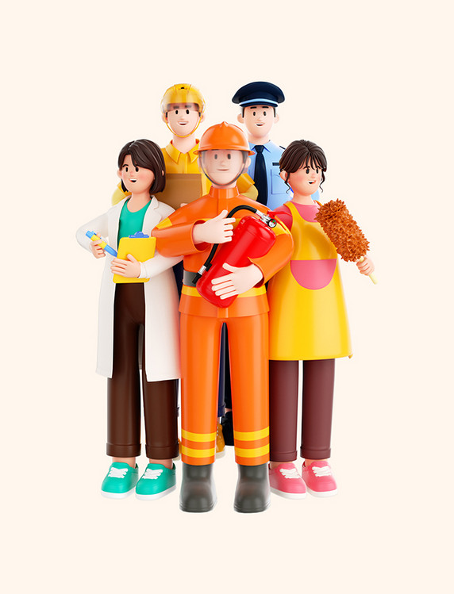
01 劳动的定义 Definition of Labor
Labor involves work requiring physical or mental effort. Purposeful human activity aimed at creating value The indispensable engine transforming raw potential into tangible reality Far more than sweat; the very act of creation itself | 劳动需要付出体力或脑力努力 旨在创造价值的有目的的人类活动 将原始潜力转化为现实成果不可或缺的引擎 远不止汗水；是创造行为本身

Slide 5
02 劳动的意义 Significance of Labor
Personal Development (个人发展)
塑造品格（耐心、团队合作、韧性）
培养美德：毅力、自力更生
锻炼技能与责任感
Shapes character (patience, teamwork, resilience)
Cultivates virtues: perseverance, self-reliance
Builds skills & fosters responsibility
Social Value (社会价值)
Lifeblood of societal prosperity: creates wealth & drives progress
Forges bonds of cooperation and social respect
Constructs the foundation of human progress
社会繁荣的命脉：创造财富、推动进步
建立合作纽带与社会尊重
构筑人类进步基石
Knowledge & Wisdom (知识与智慧)
Source of practical wisdom & problem-solving abilities
Deepens understanding through practice
实用智慧与解决问题能力的源泉
通过实践深化认知

Slide 6
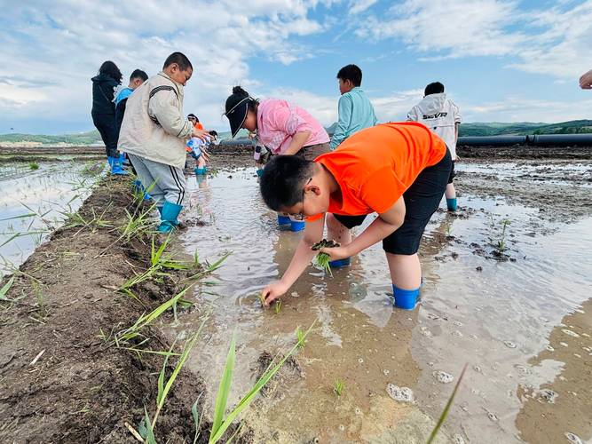
03 劳动实践活动
Labor Activities
On Campus (校内): Restore rooftop gardens/plant vegetables Maintain greenery (weeding/watering) Clean classrooms & organize resources Manage recycling programs Assist in cafeteria service Off Campus (校外): Volunteer at community centers/food banks Experience farming (planting/harvesting/feeding animals) Participate in tree planting or street cleaning Vocational practice (cafés/bookstores/museums) Social research (interviewing workers) | 修复屋顶花园/种植蔬菜 维护绿化（除草/浇水） 清洁教室、整理资源 组织回收项目 协助食堂服务 在社区中心/食物银行做志愿者 务农体验（种植/收割/喂养动物） 参与植树或街道清洁 职业实践（咖啡店/书店/博物馆） 社会调研（采访劳动者）

Slide 7

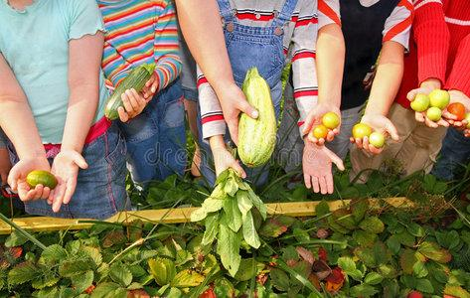
04 劳动场景/过程描写
Labor Scenes
Equip with tools (gardening/seedlings) Divide into groups for planting crops Steps: dig soil → plant seeds → water Rice planting in muddy paddies with farmers' guidance Harvest vegetables with blistered hands | 配备工具（园艺工具/秧苗） 分组种植农作物 步骤：翻土 → 播种 → 浇水 在农民指导下于泥泞水田插秧 满手水泡地收割蔬菜

Slide 8
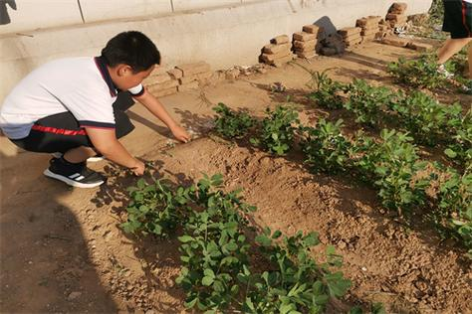
05劳动收获 Reflections & Gains
Fulfillment in transforming barren land. Deepen respect for farmers & agricultural work. Learned collaboration/perseverance. Gain practical skills & understanding of rural life. Earned profound satisfaction through self-reliance. | 见证荒地蜕变的成就感。 深化对农民及农业劳动的尊重。 领悟协作与坚持的价值。 掌握实践技能，理解乡村生活。 通过自力更生获得深刻满足感。

Slide 9

06 劳动教育建议
Labor Education Suggestions
1. Integrate mandatory hands-on courses (gardening/cooking). 2. Partner with factories/farms for apprenticeships. 3. Track skills via digital labor portfolios. 4. Launch student-managed gardens/workshops. 5. Make community service a credited curriculum component. | 1. 开设必修实践课（种植/烹饪）。 2. 与工厂/农场合作学徒项目。 3. 建立数字劳动档案追踪技能。 4. 设立学生自主管理的校园花园/工坊。 5. 将社区服务纳入学分课程体系。

Slide 10
07 Practices

Slide 11
一、（2025.5镇海中学高考模拟考）
古希腊诗人Sophocles曾说过，“Without labor, nothing prospers(繁荣).” 假如你是李华，向你校英文报Opinion专栏写一封投稿，内容包括：
1．对这句名言的理解；
2．结合实际说明劳动的重要性；
3．提出促进劳动教育的建议。
Notes:
Sophocles’ timeless wisdom, "Without labor, nothing prospers," illuminates a fundamental truth.
“没有劳动，便没有繁荣”‌是古希腊悲剧作家Sophocles的名言，强调劳动对人类文明和社会发展的根本性作用。

Slide 12
Official Version
Labor: The Foundation of Growth and Prosperity
Sophocles’ words, “Without labor, nothing prospers,” ring deeply true and serve as a guiding principle in understanding the essence of progress and achievement. Labor is not merely a means of production but a powerful catalyst for growth on multiple levels.
Labor’s significance isn’t confined to grand, abstract concepts. Instead, it’s deeply personal and practical. At our school, labor shapes character. When my class restored our neglected rooftop garden last semester, we transformed cracked soil into thriving vegetable beds. Through blistered hands and muddy uniforms, we learned patience and teamwork. Similarly, volunteering at a community recycling center taught me how sorting waste contributes to sustainable living—a lesson no textbook could match.
To strengthen labor education, we can take several steps. Integrate weekly hands-on campus maintenance sessions into the schedule, enabling students to take responsibility for their school environment. Partner with local farms for seasonal planting projects, so students learn farming and value hard work. Launch “Skill Swap” fairs where students exchange skills like pottery or coding. Labor education shouldn't be isolated but a perspective for all learning, cultivating well-rounded students.
劳动：成长与繁荣的基石
索福克勒斯的名言“没有劳动，一切都无法繁荣”意义深远，是理解进步与成就本质的指导原则。劳动不仅仅是一种生产手段，更是在多个层面促进成长的强大催化剂。
劳动的重要性并非局限于宏大、抽象的概念之中。相反，它具有深刻的个人意义和实用性。在我们的学校里，劳动塑造了学生的品格。上学期，我们班修复了被遗忘的屋顶花园，将破裂的土壤变成了生机勃勃的蔬菜地。通过磨破的手掌和沾满泥土的校服，我们学会了耐心和团队合作。同样，在社区回收中心的志愿服务让我明白了垃圾分类对可持续生活的贡献——这是一堂任何教科书都无法比拟的课程。
为了加强劳动教育，我们可以采取一些措施。将每周的校园维护实践课程纳入日程安排，让学生负责学校的环境。与当地的农场合作开展季节性的种植项目，让学生了解农业并重视努力工作。举办“技能交换”活动，让学生交换诸如陶艺或编程等技能。劳动教育不应被孤立对待，而应成为所有学习的一个重要视角，以培养全面发展的人才。

Slide 13
二、
假定你是李华，上周六你们班在学校闲置的空地上开展蔬菜种植活动。请给你的英国朋友Chris写一封邮件分享这次经历，内容包括：
1．活动经历；
2．你的感想。

Slide 14
二、
Official Version
Dear Chris,
How are you doing? Guess what? Last Saturday,we planted vegetables on a patch of vacant land at school.I'm eager to share its details with you.
Early in the morning, we gathered at the site, equipped with gardening tools, seedlings, and seeds. We then divided into groups, each responsible for planting different types of vegetables.While digging the soil, planting the seeds, and watering them are hard work, we were still all enjoyed the process. It was really fulfilling to see the once barren land turn into a promising garden by the end of the day! This experience taught me a lot about gardening and the importance of collaboration.
Have you ever participated in a similar activity? I would love to hear about it.
Best regards,
Li Hua
亲爱的Chris：
你好吗？上周六我们班我们在学校的一片空地上种植了蔬菜。我很想和你分享一下细节。
清晨，我们带着园艺工具、菜苗和种子聚集到现场。随后我们分成小组，每组负责种植不同种类的蔬菜。松土、播种、浇水都很辛苦，但大家都乐在其中。看到曾经荒芜的土地在一天结束时变成充满生机的菜园，实在令人满足！这次经历让我学到了许多园艺知识，也明白了协作的重要性。
你参加过类似的活动吗？我很想听听你的故事。
李华

Slide 15
三、
假定你是李华，暑期你参加了学校组织的为期一周的“下乡学农活动”，请你给校英文报写一篇短文，分享你印象深刻的一项活动，内容包括：
1．活动介绍；
2．你的感想。

Slide 16
三、
Official Version
A Memorable Rural Farming Experience
During the summer vacation, I had the opportunity to participate in a week-long rural farming activity organized by our school.
One of the most memorable activities was rice planting, where we were taught the traditional method of planting rice seedlings in the paddies. Initially, it was challenging as the muddy water made it difficult to move, but with the guidance of local farmers, we gradually got the hang of it. The experience was both physically demanding and immensely rewarding.
This activity not only allowed me to appreciate the hard work of farmers but also taught me the value of perseverance and teamwork. It was an unforgettable experience that deepened my understanding of rural life and agricultural practices.
一次难忘的乡村农耕体验
暑假期间，我有幸参加了学校组织的一周期乡村农耕活动。
最难忘的环节是插秧——农民伯伯在稻田里教我们传统的水稻种植方法。起初，泥泞的水田让人寸步难行，但在当地农人的指导下，我们逐渐掌握了技巧。这次体验既充满体力挑战，又带来巨大的精神满足。
此次活动不仅让我体会到农人的艰辛，更领悟到坚持与协作的价值。这段难忘的经历深化了我对乡村生活和农耕实践的认知。

Slide 17
四、
上周，你班开展了以“体验农耕文化，培养劳动精神”（Experience Farming Culture, Cultivate Labor spirit）为主题的劳动教育实践活动。请为班级英语园地写一篇报道，内容包括：
1．时间地点；
2．活动内容；
3. 你的感想。

Slide 18
四、
Official Version
Last Saturday, our class organized an uplifting practical activity in labor education on a local farm, whose theme was"Experience Farming Culture, Cultivate Labor Spirit".
During it, we experienced traditional farming culture firsthand. We engaged in various activities such as planting crops, harvesting vegetables and feeding farm animals. Under the guidance of the farmers and teachers, we learned about agricultural processes and the tremendous hard work that goes into farming.
This hands-on experience was incredibly rewarding. It deepened not only my respect for agricultural work but my understanding of the value of labor .Moreover, it taught me practical skills and the importance of teamwork.
上周六，我们班在当地的农场开展了一次有益的劳动教育实践活动，主题是“体验农耕文化，培养劳动精神”。
在活动中，我们亲身体验了传统的农耕文化。我们参与了诸如种植作物、收获蔬菜和喂养农场动物等各种活动。在农民和老师的指导下，我们了解了农业流程以及从事农业所付出的巨大努力。
这种亲身实践的经历非常有意义。它不仅加深了我对农业工作的尊重，也让我更加理解劳动的价值。此外，它还教会了我实用技能以及团队合作的重要性。

Slide 19
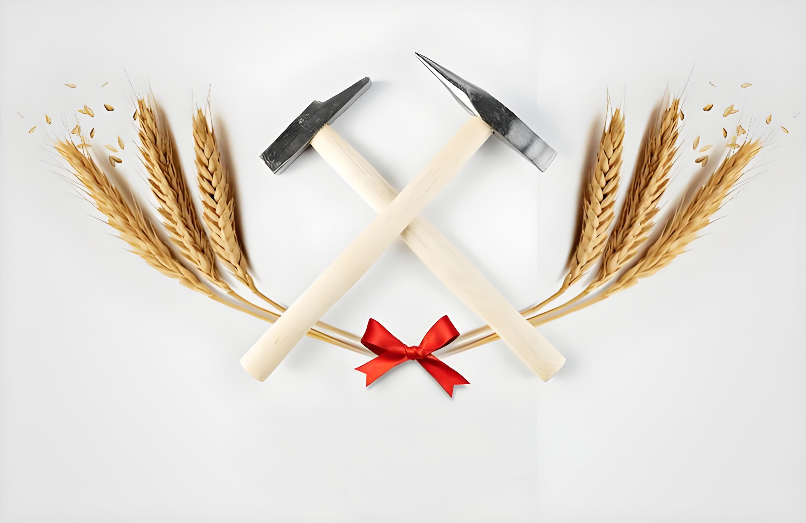
Thank you!

