Slide 1


感恩遇见，相互成就，本课件资料仅供您个人参考、教学使用，严禁自行在网络传播，违者依知识产权法追究法律责任。
更多教学资源请关注
公众号：溯恩英语
知识产权声明

Slide 2



2025年6月高考备考
靶向高考，读后续写雷霆一击
浙江省常山一中
吴俊峰

Slide 3

1
读后续写思维模式路径优化
—— 马斯洛需要层次理论；
准确读题和可视化快速构思；
语义连贯标词扩展法
Part

Slide 4

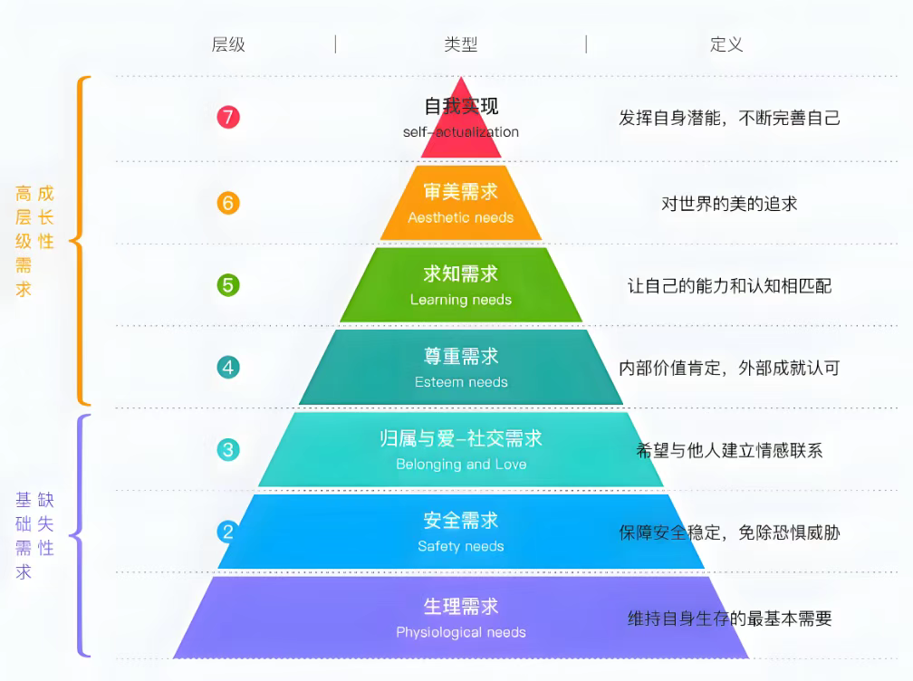
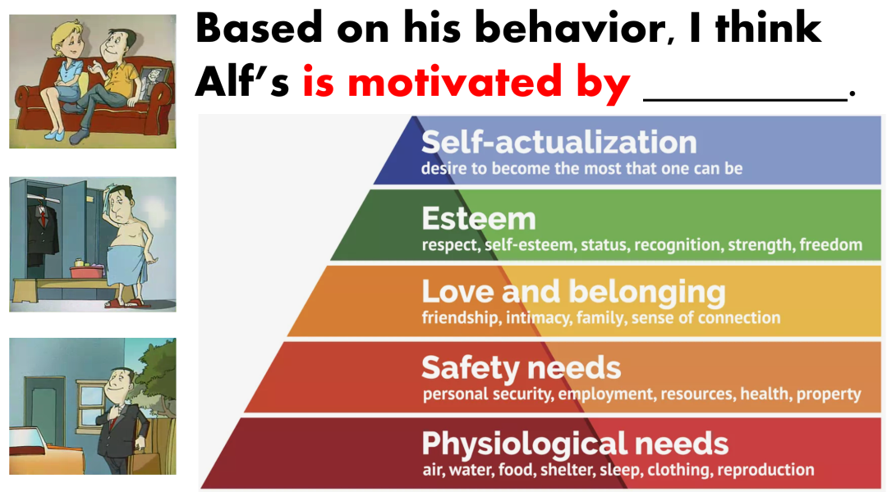
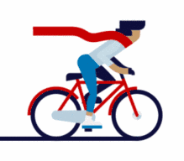
读后续写思维模式路径优化——用“马斯洛需要层次理论”解决多重矛盾
Notes:
词汇与结构知识
正式语篇结构知识
内容/世界背景知识
自动识别技能
综合与评价策略
元认知知识与技能监控

Slide 5
用“马斯洛需要层次理论”——解决高级需求矛盾，升华主题
The essence of a short story’s development is to meet main characters’ Needs with Solutions
短故事发展的本质是主角通过解决问题来满足需求。
improving the ability of interpersonal communication and learning to establish good relationships with others.
social growth
better express emotion and enhance the maturity of emotions
emotional growth
cognitive growth
a bettter understanding of oneself
Notes:
词汇与结构知识
正式语篇结构知识
内容/世界背景知识
自动识别技能
综合与评价策略
元认知知识与技能监控

Slide 6
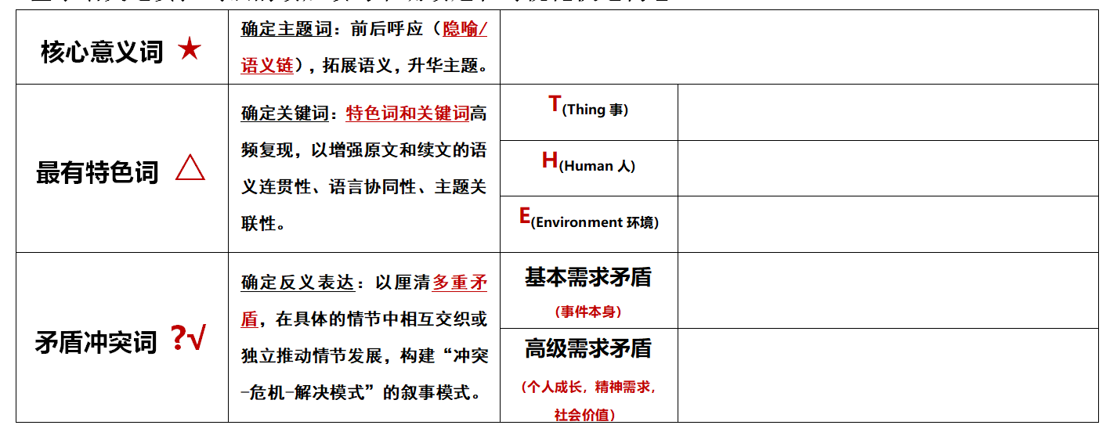
读后续写思维模式路径优化——准确读题和可视化快速构思
Notes:
词汇与结构知识
正式语篇结构知识
内容/世界背景知识
自动识别技能
综合与评价策略
元认知知识与技能监控

Slide 7
2
2025高考押题
—— 社区行善+网络创意/劳动实践
Part

Slide 8



2025高考押题——社区行善^{+网络创意/劳动实践}
1.utilize live streaming; stream live on television / on the Web; live-streamed; video-sharing platform
2. stage a community fundraising
3.The tale / video is fueled by social media
4.spread virally; a runaway hit; shine a spotlight on
5.post an update, which was virally shared more than 30,000 times
6.you can cast your vote on its web page where the comment section has been filled with campaigning for their favorites so far.
7.Uploaded on YouTube/ Douyin, the video started racking
up hundreds of thousands of views.
1.利用直播；在电视上/ 网上直播；现场直播的；视频分享平台
2.举办社区筹款活动
3.这个故事/视频被社交媒体疯传。
4.疯传；迅速走红热播 ；成为公众关注的焦点
5.发布了一个更新帖，被迅速转发了三万多次
6.你可以在网页上投上你的一票，在网页上评论区已经充满了为他们最喜欢的(胖熊)造势活动。
7.视频上传到YouTube/抖音上，点击量达到了数十万。
突破思维瓶颈，内化关键能力，做实高分细节
Notes:
词汇与结构知识
正式语篇结构知识
内容/世界背景知识
自动识别技能
综合与评价策略
元认知知识与技能监控

Slide 9
2025高考押题——社区行善^{+网络创意/劳动实践}
8.It went viral immediately. Just within hours, hundreds of likes and funny comments appeared, showing their enthusiasm. Constant streams of curious people even came by to take photos with us and my prized pumpkin. Jason was really excited and Mom was glad that her video should become such a hit and thus grew even crazier about shooting videos.
9. We also set up an online crowdfunding page to raise donations.
10.stage a community fundraising called...
11.It nudged me to show kindness or reach out to someone in need even there was no apparent reason. Sometimes, a few minutes of our time can mean the world to someone else, and perhaps, in our own small way, we can all be someone's “angel”.
8.这条消息立即走红。仅仅在几个小时内，就有数百个点赞和有趣的评论出现，显示出他们的热情。好奇的人们络绎不绝地过来和我们以及我心爱的南瓜合影留念。Jason很兴奋，妈妈也很高兴她的视频能这么火，也因此对拍摄视频更加狂热了。（2021.01浙江高考“南瓜卡头”）
9.我们还建立一个在线众筹页面来筹集捐款。
10.发起一场社区筹款活动，叫做……
11.它促使我表现出善意，或者向有需要的人伸出援手，即使没有明显的理由。有时候，我们几分钟的时间对别人来说意味着整个世界，也许，在我们自己的小方面，我们都可以成为别人的“天使”。
Notes:
词汇与结构知识
正式语篇结构知识
内容/世界背景知识
自动识别技能
综合与评价策略
元认知知识与技能监控

Slide 10
2025高考押题——社区行善^{+网络创意/劳动实践}
12.You were the angel I needed. God heard my prayer and sent you at just the right time.
13.The Paws Home took on an electric look. In the breeze danced the dazzling streamers. On the tables lay the donated pet supplies, baked goods and art works eager to be auctioned. On the stage stayed the excited pet animals eager to show talents. In the neighborhood shuttled Jack and Grace among the crowd in the warm sunshine. （4个完全倒装句）
14. their plight echoing in my thoughts(独立主格结构)
15. I even reached out to a nearby charity organization, explaining her situation and pleading for their help. The response was overwhelming.
12.你是我需要的天使。上帝听了我的祷告，就在合宜的时候差遣你来。
13.“熊掌之家”呈现火爆的样子。耀眼的彩带在微风中舞动。桌子上摆放着捐赠的宠物用品、烘焙食品和急于拍卖的艺术品。在舞台上，兴奋的宠物们渴望展示自己的才华。在附近，杰克和格蕾丝在温暖的阳光下穿梭在人群中。
14. 他们的困境在我的脑海中回响
15.我甚至联系了附近的一个慈善组织，解释了她的情况，并请求他们的帮助。反响强烈。
Notes:
词汇与结构知识
正式语篇结构知识
内容/世界背景知识
自动识别技能
综合与评价策略
元认知知识与技能监控

Slide 11
2025高考押题——社区行善^{+网络创意/劳动实践}
16.“Thank you for restoring our faith in humanity. Your kindness has given us strength to keep going.” her voice filled with gratitude.
17. Observing the positive transformation in her bestowed upon me a sense of gratification and strengthed my belief in the power of kindness and community backing.
18.Seeing the lot, an uneven, bare and abandoned place with unraveled grass, they tapped others' shoulders, which inspired everyone powerfully. The scorching sun baking people's face, they paved the grass, and moved the concrete. Beads of sweats blurring vision, they were still brimful of energy. These uncommon dreamer breathed new life into a common lot. Ultimately, a regulation soccer fieid was built.
16. “谢谢你恢复了我们对人性的信心。你的善良给了我们继续前进的力量。” 她的声音里充满了感激。
17.看到她身上的积极转变，我感到一种满足感，并加强我对善良和社区支持的力量的信念。
18.看到这块地，一片凹凸不平、光秃秃、荒无人烟、杂草丛生的地方，他们拍了拍别人的肩膀，这有力地鼓舞了每个人。烈日炙烤着人们的脸，他们铺了草，搬了混凝土。汗珠模糊了视线，但他们仍然精力充沛。这些不平凡的梦想家给平凡的生活注入了新的活力。最终，一个规范的足球场建成了。
Notes:
词汇与结构知识
正式语篇结构知识
内容/世界背景知识
自动识别技能
综合与评价策略
元认知知识与技能监控

Slide 12
3
考前回看2025届高三做过的语篇
—— 以语篇为依托，
以素养为立意，
重视学生思维的运用与创新
Part

Slide 13

考前必看语篇-1—— 生本课堂^{+鼓励学生想象力和创造力}
Mary was the art teacher for primary school students. On this particular day, she was guiding them through the process of drawing a scenic landscape. Akila yawned (打哈欠), clearly disinterested — drawing wasn’t her thing. A small group of students gathered around Tina, laughing at her unusual drawing: a sun sporting sunglasses and trees topped with ice cream cones.
Mary instructed Tina firmly but with unease, “Draw it the way I showed you.” As the lesson continued, doubt crept into Mary’s mind. Had the joy of creativity been overshadowed by the pressure to fit in? She scanned the room, observing her students’ faces — some concentrated, others uncertain. Akila’s disinterest was clear, and Tina’s imaginative drawing had been met with ridicule instead of praise.
After class, Mary sat down with Tina, her tone softening. “Why did you draw the sun with sunglasses and the trees with ice creams?” she asked gently.
Tina’s eyes sparkled with a touch of rebellion (叛逆). “I love ice cream, and I thought the sun would look cool with sunglasses. Why do we always have to draw like everyone else?”
Mary paused, her thoughts racing. Tina’s drawings weren’t just curious —— they were a window into a world where imagination ruled, where rules could be bent into delightful chaos. Was she, by enforcing a rigid style, killing that very creativity?
The next morning, Mary walked into the classroom with a renewed sense of purpose. She placed a large sheet of paper in front of the class and announced a new project: they would create a collective (集体的) artwork titled “Our Dream World” with no rules. They were free to use colors, shapes, and patterns however they wished.
At first, the students hesitated, unsure of this newfound freedom. Akila leaned back, skeptical of what seemed like another pointless exercise. But Tina, her creativity no longer restricted, eagerly grabbed her crayons and began to draw with abandon. Then, Maya joined in. And then Michael…
As the students worked, Mary observed them with curiosity.
Mary stood back and surveyed the creation.
找准语义链形成逻辑链
本文两条语义链，形成矛盾冲突：pressure to fit in → rules→ enforcing a rigid style → killing→ rules → restricted ；以及unusual drawing →creativity→imaginative → however they wished→ freedom→with abandon
对孩子两张不同的教学法的描述，同时也产生不同的情绪价值disinterested → joy→ delightful chaos → ridicule instead of praise → rebellion 。
基于以上语义链的分析，可以促成逻辑的合情合理产生，精准而快速地深度解读文意和理解作者写作意图。
同时抓住核心词“Our Dream World”统领全文，主题升华——“我们理想世界的What-How-Why?”.
—— 以2024年11月浙江杭州一模为例
Notes:
词汇与结构知识
正式语篇结构知识
内容/世界背景知识
自动识别技能
综合与评价策略
元认知知识与技能监控

Slide 14
考前必看语篇-1—— 生本课堂^{+鼓励学生想象力和创造力}
Mary was the art teacher for primary school students. On this particular day, she was guiding them through the process of drawing a scenic landscape. Akila yawned (打哈欠), clearly disinterested — drawing wasn’t her thing. A small group of students gathered around Tina, laughing at her unusual drawing: a sun sporting sunglasses and trees topped with ice cream cones.
Mary instructed Tina firmly but with unease, “Draw it the way I showed you.” As the lesson continued, doubt crept into Mary’s mind. Had the joy of creativity been overshadowed by the pressure to fit in? She scanned the room, observing her students’ faces — some concentrated, others uncertain. Akila’s disinterest was clear, and Tina’s imaginative drawing had been met with ridicule instead of praise.
After class, Mary sat down with Tina, her tone softening. “Why did you draw the sun with sunglasses and the trees with ice creams?” she asked gently.
Tina’s eyes sparkled with a touch of rebellion (叛逆). “I love ice cream, and I thought the sun would look cool with sunglasses. Why do we always have to draw like everyone else?”
Mary paused, her thoughts racing. Tina’s drawings weren’t just curious —— they were a window into a world where imagination ruled, where rules could be bent into delightful chaos. Was she, by enforcing a rigid style, killing that very creativity?
The next morning, Mary walked into the classroom with a renewed sense of purpose. She placed a large sheet of paper in front of the class and announced a new project: they would create a collective (集体的) artwork titled “Our Dream World” with no rules. They were free to use colors, shapes, and patterns however they wished.
At first, the students hesitated, unsure of this newfound freedom. Akila leaned back, skeptical of what seemed like another pointless exercise. But Tina, her creativity no longer restricted, eagerly grabbed her crayons and began to draw with abandon. Then, Maya joined in. And then Michael…
As the students worked, Mary observed them with curiosity.
Mary stood back and surveyed the creation.
As the students worked, Mary observed them with curiosity. She noticed how Akila, initially disinterested, had quietly chosen vibrant colors and was now blending them together to create a swirling sky filled with fantastical creatures that flew over a stone castle. Meanwhile, Tina was enthusiastically adding playful details to her section of the paper—a whimsical garden where flowers wore hats and creatures rested on the ice cream-topped trees. Mary felt a wave of relief wash over her. The room was alive with chatter and laughter, as Akila and Tina frequently exchanged ideas and inspired one another. Akila even leaned over to admire Tina's ice cream trees and said, "That is mind-blowing!" It was wonderful to see them cooperate, their initial differences melting away in the warmth of shared creativity.
Mary stood back and surveyed the creation. The enormous canvas had transformed into a magnificent portrayal of each student's imagination, forming a breathtaking landscape that reflected their individuality yet spoke to their collective spirit. Mary felt a sense of pride swell within her, she realized that in letting go of rigid structures, her students gave their painting an unrealistic but dream-like quality. Akila, Tina, and the rest of the class had not only embraced their own creative paths but had also nurtured each other's ideas. They were thrilled, "It was the best painting ever! We should definitely hang it on the wall!" Inspired by the moment, Mary decided to host an exhibition of their dream world, inviting parents and other classes to admire the beauty of imagination unleashed in her classroom.
—— 以2024年11月浙江杭州一模为例
Notes:
词汇与结构知识
正式语篇结构知识
内容/世界背景知识
自动识别技能
综合与评价策略
元认知知识与技能监控

Slide 15
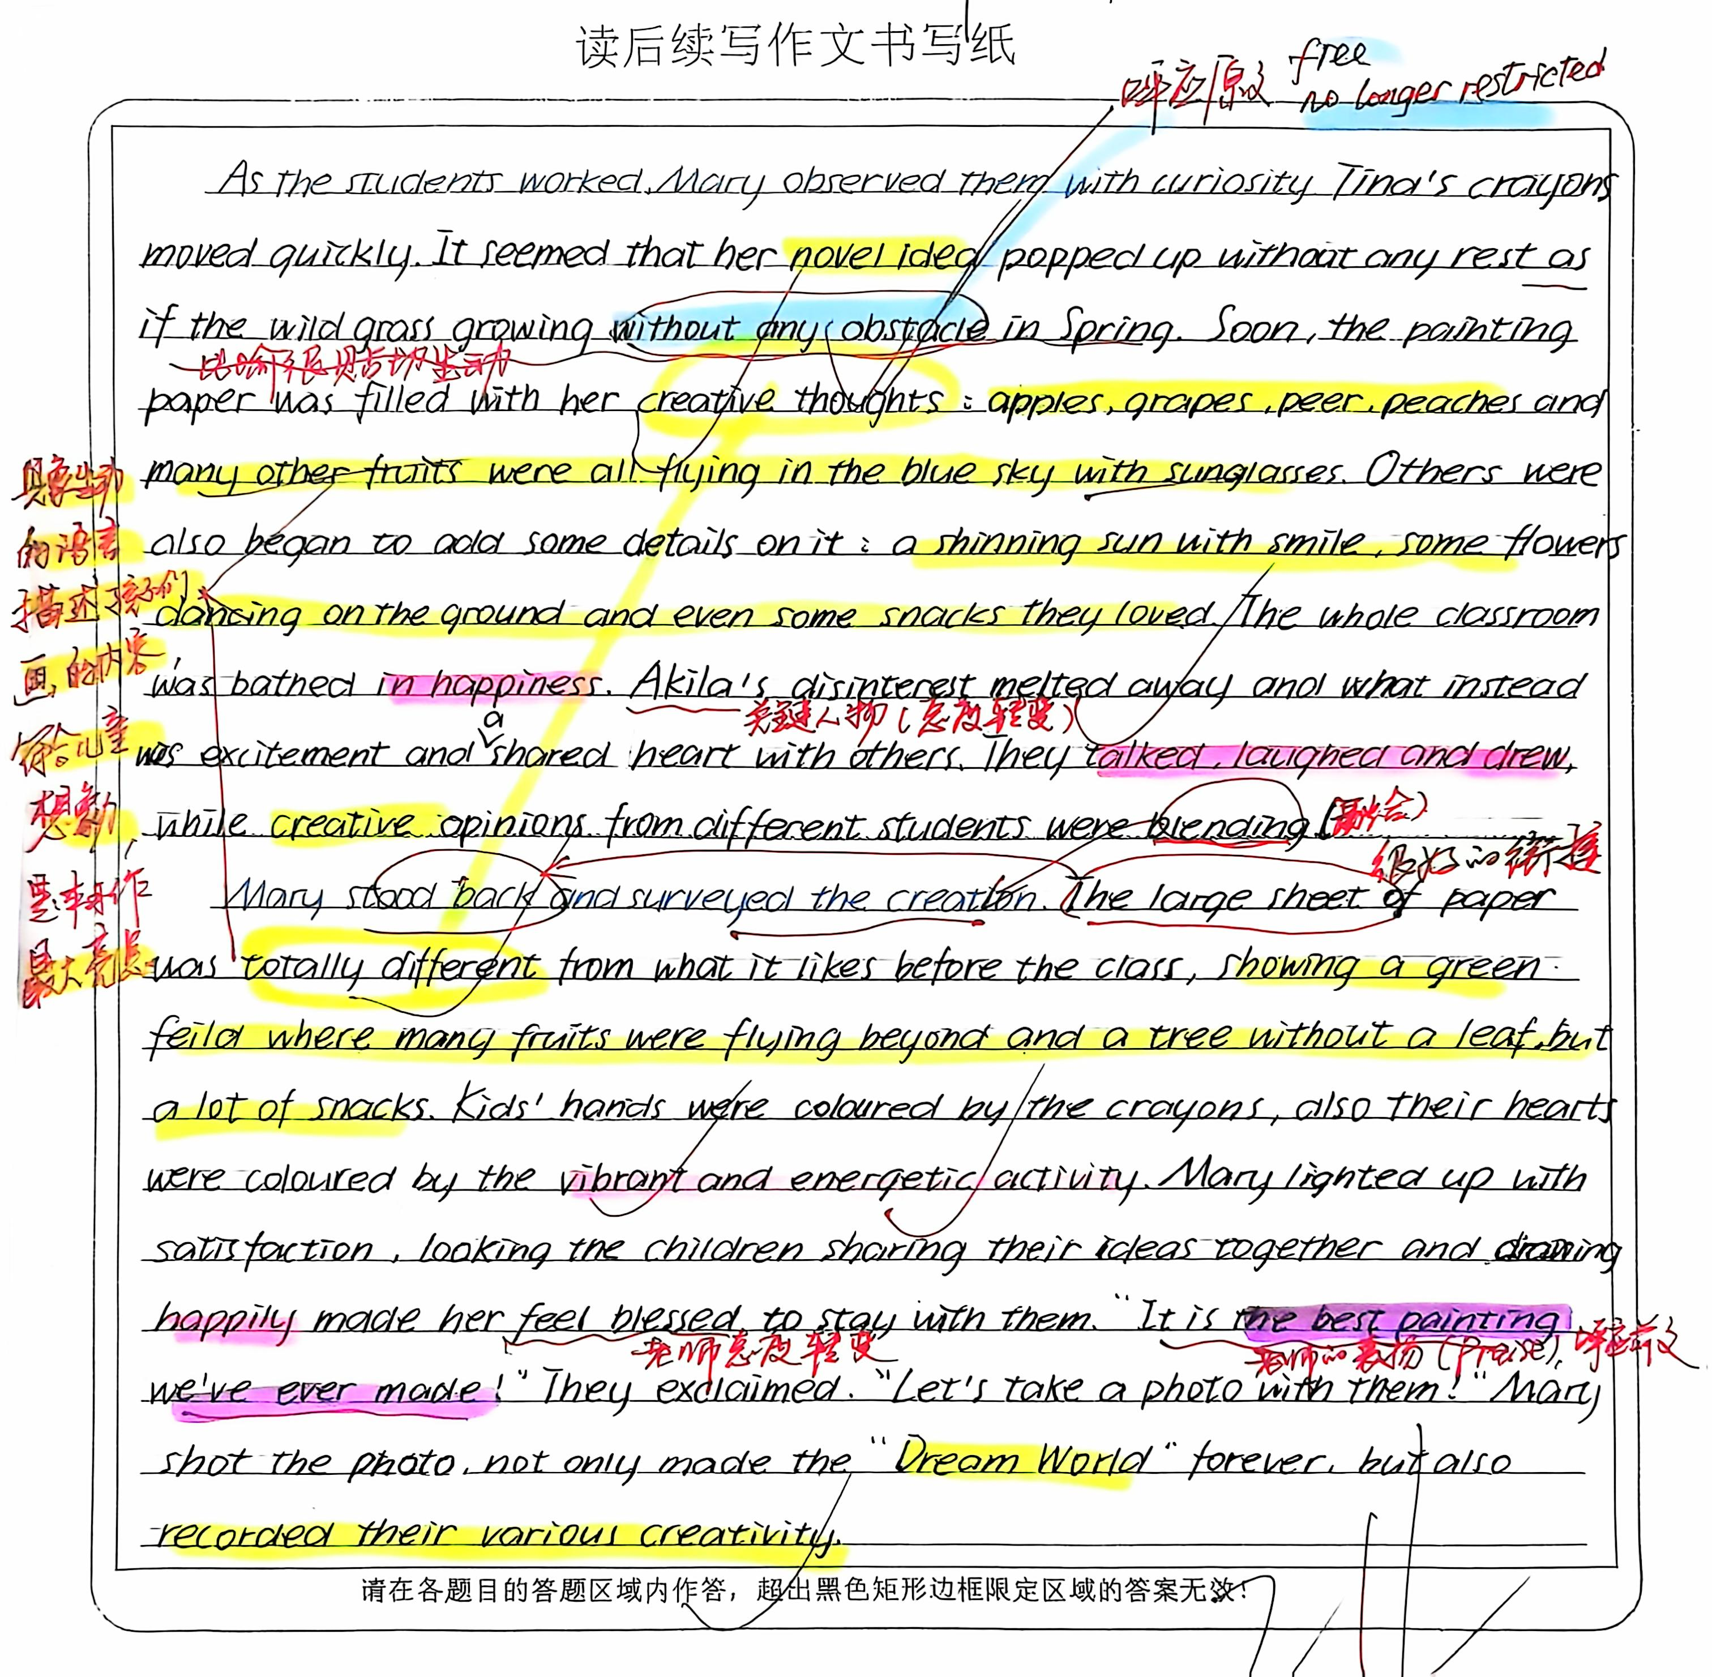
考前必看语篇-1——生本课堂^{+鼓励学生想象力和创造力}
提升续文中
扩展逻辑语义关系的能力
该习作紧扣关键词，创造性使用 “novel ideas→ as if the wild grass growing without any abstacle in spring →vibrant and energetic activity” 凸显孩子们的创造力。本习作最精彩之处在续文能与原文共情，具象生动的语言描述孩子们画画的内容，充满想象力和童趣。
习作多次重复关键词 creative / creativity, 突出主题词 Dream World 体现批判性思维。
在情感态度上渲染 happiness →disinterested melt away→excitment →happily →laughed→ the best painting we’ve ever made 与原文写作意图高度
契合和协同。
突破思维瓶颈，内化关键能力，做实高分细节
—— 以2024年11月浙江杭州一模为例
Notes:
词汇与结构知识
正式语篇结构知识
内容/世界背景知识
自动识别技能
综合与评价策略
元认知知识与技能监控

Slide 16
考前必看语篇-2—— A random act of kindness^{+make all the difference}
My day started just like all the other days for the past 15 years where I get up, make some coffee, shower, get dressed, and leave for the train station at precisely 7:35 A.M. to arrive at work by 8:30. While on the train, I would always choose a seat away from the crowd so I could read the newspaper in peace and quiet. At work, I am always burdened with questions from co-workers, suppliers, telephone calls, and then those dreaded meetings, so the last thing I need is some stranger to sit beside me and start small talk. I don’t know why, but for some reason, when I got on the train today, it was unusually full. With hesitation, I sat down in the only seat available beside a middle-aged man who had his head down and seemed to be lost in his thoughts. I was glad that he didn’t notice when I sat next to him as he just continued to look down towards the floor. Shortly after the train left for my 30-minute ride downtown, I found myself wondering what this man was thinking about. What could be so important that he didn’t even see me sitting next to him? I tried to forget about it and started to read my paper. However, for some strange reason, this “inner voice” kept prompting me to talk to this man. I tried to ignore the “voice” as there was no way I was starting a conversation with a complete stranger. As you probably guessed, I eventually broke down and came up with an excuse to ask him a question. When he raised his head and turned his eyes toward me, I could see that he must have been really upset as he had red eyes and still had some tears rolling down the side of his face, despite his feeble attempt to wipe them away. I can’t describe the sadness I felt seeing someone in so much pain. We talked for about 20 minutes, and in the end, he seemed to be doing better. As we were leaving the train, he thanked me heartily for being an “angel” by taking the time to talk. I never did find out what was making his heart so heavy with pain, but I was glad I listened to the “voice” that day.
Paragraph1: Several weeks later, Ifound an envelope on my desk with the word “Angel” written on it.
Paragraph2: Deeply touched yet still shaken, Isat there holding the letter,feeling lucky that Ifollowed my inner voice.
Several weeks later, I found an envelope on my desk with only the word “Angel” written on it. Curious and slightly puzzled, I opened it and found a heartfelt letter from the man I had met on the train that day. In his letter, he thanked me for taking the time to talk to him when he was at his lowest. He shared that he had been facing overwhelming personal struggles and had even considered ending his life that very day. My simple act of reaching out, he wrote, had reminded him that there were still people who cared, and it gave him the strength to keep going. The letter closed with words that touched me deeply: “You were the angel I needed. God heard my prayer and sent you at just the right time.” Deeply touched yet still shaken, I sat there holding the letter,feeling lucky that I followed my inner voice.I had almost ignored that “inner voice” urging me to speak to him, but now I understood why I hadn’t. It was a small act, but it was indeed a calling of my inner kindness, which had made a significant difference in his life. From that day on, I promised myself to always listen to that quiet voice within, especially when it nudged me to show kindness or reach out to someone in need even there was no apparent reason. Sometimes, a few minutes of our time can mean the world to someone else, and perhaps, in our own small way, we can all be someone’s “angel.”
—— 浙江省新阵地教育联盟 2025 届第二次联考
Notes:
词汇与结构知识
正式语篇结构知识
内容/世界背景知识
自动识别技能
综合与评价策略
元认知知识与技能监控

Slide 17
考前必看语篇-3—— 永不言弃^{+认真训练，步步为营}
My day started just like all the other days for the past 15 years where I get up, make some coffee, shower, get dressed, and leave for the train station at precisely 7:35 A.M. to arrive at work by 8:30. While on the train, I would always choose a seat away from the crowd so I could read the newspaper in peace and quiet. At work, I am always burdened with questions from co-workers, suppliers, telephone calls, and then those dreaded meetings, so the last thing I need is some stranger to sit beside me and start small talk. I don’t know why, but for some reason, when I got on the train today, it was unusually full. With hesitation, I sat down in the only seat available beside a middle-aged man who had his head down and seemed to be lost in his thoughts. I was glad that he didn’t notice when I sat next to him as he just continued to look down towards the floor. Shortly after the train left for my 30-minute ride downtown, I found myself wondering what this man was thinking about. What could be so important that he didn’t even see me sitting next to him? I tried to forget about it and started to read my paper. However, for some strange reason, this “inner voice” kept prompting me to talk to this man. I tried to ignore the “voice” as there was no way I was starting a conversation with a complete stranger. As you probably guessed, I eventually broke down and came up with an excuse to ask him a question. When he raised his head and turned his eyes toward me, I could see that he must have been really upset as he had red eyes and still had some tears rolling down the side of his face, despite his feeble attempt to wipe them away. I can’t describe the sadness I felt seeing someone in so much pain. We talked for about 20 minutes, and in the end, he seemed to be doing better. As we were leaving the train, he thanked me heartily for being an “angel” by taking the time to talk. I never did find out what was making his heart so heavy with pain, but I was glad I listened to the “voice” that day.
Paragraph1: Several weeks later, Ifound an envelope on my desk with the word “Angel” written on it.
Paragraph2: Deeply touched yet still shaken, Isat there holding the letter,feeling lucky that Ifollowed my inner voice.
Several weeks later, I found an envelope on my desk with only the word “Angel” written on it. Curious and slightly puzzled, I opened it and found a heartfelt letter from the man I had met on the train that day. In his letter, he thanked me for taking the time to talk to him when he was at his lowest. He shared that he had been facing overwhelming personal struggles and had even considered ending his life that very day. My simple act of reaching out, he wrote, had reminded him that there were still people who cared, and it gave him the strength to keep going. The letter closed with words that touched me deeply: “You were the angel I needed. God heard my prayer and sent you at just the right time.” Deeply touched yet still shaken, I sat there holding the letter,feeling lucky that I followed my inner voice.I had almost ignored that “inner voice” urging me to speak to him, but now I understood why I hadn’t. It was a small act, but it was indeed a calling of my inner kindness, which had made a significant difference in his life. From that day on, I promised myself to always listen to that quiet voice within, especially when it nudged me to show kindness or reach out to someone in need even there was no apparent reason. Sometimes, a few minutes of our time can mean the world to someone else, and perhaps, in our own small way, we can all be someone’s “angel.”
—— 2024学年第二学期浙江省七彩阳光新高考研究联盟返校联考
Notes:
词汇与结构知识
正式语篇结构知识
内容/世界背景知识
自动识别技能
综合与评价策略
元认知知识与技能监控

Slide 18
考前必看语篇-4—— 马斯洛高层次需求^{精神需求+社会价值}
The Popsicle Kids A nearly empty box of Popsicles (棒冰) in the freezer, left from a grandchild’s visit, caught my attention. Initially, I wanted to throw it away, but my wife suggested we give the remaining Popsicles to the neighborhood children. Her suggestion changed our life and led us to a future full of “Popsicle Kids.” My wife and I, retired on Social Security, live in an apartment complex. After careers in sales and nursing, our daily concerns revolved around aches, pains, and dinner. We often wondered what good we were to the world. That changed dramatically after we gave away the first Popsicle. Minutes after watching a neighbor boy, a second grader, walk away with an icy treat, our doorbell rang. An adorable blond girl, about six, smiled sweetly, “Is it true you’re giving away Popsicles?” With the box empty, we returned to our concerns. Early the next morning, the doorbell rang repeatedly. Standing on our porch were the four children from the previous day. They vocalized their wants, chanting (有节奏地喊), “We want Popsicles! We want Popsicles!” Looking into their eager young faces, I wondered, “What have I started?” Sensing a victory, they nodded eagerly when I explained the rules: ring the bell once, one Popsicle per day, and share something good about their day. But their thin shoulders bent downwards in disappointment when I mentioned they had to give something in return. I came to the rescue, suggesting they share something positive about their day, like what they learned at school or helping another student. Over time, new rules were added: “Ladies first,” “Don’t interrupt,” and “Properly get rid of the sticks.” On holidays, they expressed their understanding of why the day was celebrated. Over the years, about fifty youngsters visited. Some became part of my life, like the four kids who joined me on the steps one spring to read “Where the Red Fern Grows.” We discussed catching crawfish, loving pets, and family relationships. This simple act of sharing Popsicles transformed our life, bringing joy and meaning to both the children and ourselves. Paragraph1:
One night, another boy appeared at the door, saying “I don’t want a Popsicle; I just need to talk.” Paragraph2: I’ve sensed it’s more than Popsicles that bring these kids to our door.
One night, another boy appeared at the door, saying "I don t want a Popsicle; I just need to talk.” His voiced trembled slightly, and his eyes darted nervously to the ground. After hesitating for a moment, he looked up and shared his story-recently his parents had been fighting constantly, and he didn't know where to turn. As he spoke, his eyes welled up with tears. I pulled him in my arms, offering quiet words of reassurance. Slowly, I felt he relaxed, his shoulders no longer so tense “Whenever you need, you can always come to us,”I crouched down, comforting. “Yes, come and have a Popsicle, good boy;” added my wife, handing him the treat. With a faint smile, he took it and left .
I’ve sensed it’s more than Popsicles that bring these kids to our door. Sometimes, they’re more eager to share that they are not understanding an assignment or that they’re being bullied. Over time, a new rule was added:“actively explore hidden worries”—failed tests reset, lost friendships restored, assurances of growing up refreshed. Our living room became a sanctuary where Popsicle sticks piled like tiny monuments to trust.The “Popsicle Kids” have given me a new sense of purpose. We’ve dried tears, broken up fights and hopefully been another source of love in their lives. And, just maybe, we’ve helped establish some positive attitudes they can use throughout their lives. It seemed like we, the old couple, gave out treats to the neighborhood kids, but in truth, it was those “Popsicle Kids” who brought companionship, love and joy to our otherwise dull retirement life. What we receive from these kids is worth far more than the cost of a few treats.
——2025届3月全国天域名校协作体高三英语试题
Notes:
词汇与结构知识
正式语篇结构知识
内容/世界背景知识
自动识别技能
综合与评价策略
元认知知识与技能监控

Slide 19
考前必看语篇-5—— 牺牲自我 ^{成就他人+伟大友情}
Johnny, a 17-year-old from Whitehorse, had been competing in Cross-Country Skiing for five years. For many young athletes like him in Whitehorse, Yukon, the Yukon Cross-Country SkiChampionships were more than just a competition. It was their dream. A year ago, Johnny qualified for the Championships and successfully won a medal. After the competition, Johnny was eager to share his experience with Hayden, his teammate and best friend. Hayden had narrowly missed qualifying for the Championships. Johnny had watched his friend train tirelessly, push himself to the limit, and always keep his big smile. Johnny knew how much the Championships meant to Hayden. Johnny handed Hayden some colorful pins. “These are pins I traded with athletes from all overYukon,” Johnny said with a smile, “I want you to have them, so you can feel a part of the event too.” Hayden was touched, “Thanks, Johnny. This means a lot.” “Next time,” Johnny continued, “I hope you can also experience the event. I know you' ll make it.” Hayden nodded, “I’ ll work even harder for that.” This year's Yukon Cross-Country Ski Championships would be held in a month. Coach Nick guided the team through daily tough training and the team made significant progress in their skating,cornering, and downhill techniques. Meanwhile, they enhanced their endurance and balance. BothJohnny and Hayden met the Championship standards. Given Johnny's rich competitive experience,Coach Nick once again qualified Johnny for this year's event and Hayden was selected as an alternate(替补). The qualification for the competition excited Johnny, but there was always an idea staying in his mind. Johnny knew his friend had been wanting to go to the Championships for several years. This was the last chance for both of them to attend the Championships, as they would age out of the competition after this year. The thought became clear in his mind, strong and steady. Paragraph1 : The next day, Johnny went to see the coach.
Paragraph 2: Hayden accepted the precious chance to compete in the Championships.
The next day, Johnny went to see the coach.Knocking firmly at the door of coach’s office, Johnny stepped inside and cut straight to the point:“Hayden deserves my spot.”The coach frowned, citing Johnny’s seniority and years of effort. But Johnny persisted, voice steady.“This isn’t about me. It’s about giving Hayden the chance he earned, a chance to make his childhood dream come true.”A long silence followed. Coach Nick seemed to be considering it, still hesitant about the shift. Before Coach Nick had time to say another word, Johnny reminded him how hard Hayden trained, adding that Hayden was the best in terms of endurance and balance. Finally, Coach Nick nodded.“Then tell Hayden he’s in.” No sooner had Nick finished the sentence than Johnney zoomed off to share the news with Hayden. Hayden accepted the precious chance to compete in the Championships. Resolved to win the Championships, Hayden trained even harder in the following few days. On the other hand, Johnney shared all his experience thoroughly and selflessly. At the championships, he channeled every ounce of that resolve. On the track, Hayden exploded from the starting block, displaying his perfect techniques in skating cornering and down hilling. Johnny cheered from the sidelines as Hayden rounded the final bend, neck-and-neck with the defending champion. In a heart-stopping lunge, Hayden crossed the finish line first, the crowd erupting. On their way home, Hayden handed Jonny some colorful pins, at the sight of which Johnny beamed. His sacrifice had forged something greater—a freindship bond (_{定从}no medal could outweigh).
——2025届山东省青岛一模
Notes:
词汇与结构知识
正式语篇结构知识
内容/世界背景知识
自动识别技能
综合与评价策略
元认知知识与技能监控

Slide 20
考前必看语篇-6 —— 战胜自我 ^{情绪价值+赋能成长}
Growing up, I was always shy and unconfident in myself. Aside from my parents, I felt others found my shyness difficult to accept. It used to be something that affected my life in the most negative way possible. It made me unable to talk in any setting in which I felt uncomfortable. This means that I wasn’t even able to speak in class, chat with my friends, order my own food, etc. At the 5th grade, my parents moved to a neighbouring city because of the job relocation and I changed schools. I found myself in a new classroom with a new teacher, whom we called Ms. S, surrounded by 30 new faces. This was fairly terrifying. And so when I was asked to stand up and introduce myself, I was trembling. Still then, I was labelled as “shy and quiet”. I didn’t have a lot of friends, only spoke in class if I really had to, kept everything to myself, avoided public events, and panicked badly at the thought of oral presentations in class. This haunted (萦绕) me until one day, Ms. S announced in class that each of us was going to be singing a solo in front of the class. I’d had no idea that this was going to happen. When it was my turn, she called me up to the front, instructed the piano player to begin and I very unwillingly sang “Cuckoo, cuckoo, pray what do you do…” in a barely audible, high-pitched voice, with the rest of silent children staring up at me. Ms. S stood next to the piano, saying, “Louder! Louder!” But I didn’t know how to project my voice; I couldn’t make it any louder. I was really upset at it. I cried for a few hours. I suspected my childhood shyness was largely unsupported in the new school. This even made me not want to go to school. Paragraph1 :After school, Ms. S asked me to go into her office.
Paragraph2 : I took her word for it and something shifted for me.
After school, Ms. S asked me to go into her office. Dragging myself to her office, I had thousands of butterflies in my stomach.“What if Ms. S flies off the handle? What if she blames me for failing her expectation?” These thoughts kept haunting my mind like ghosts. As it turned out, not only was I allowed to make up for my poor performance, but Ms. S was the first person other than my parents to accept my shyness. Ms. S placed her hand gently on my shoulder and said in a most soothing voice, “Amy, it’s OK that you are shy and quiet. In fact, everyone suffers stage fright when they sing a solo, me included. But I find your voice really unique and sweet, which shows you have great potential in singing. Just throw your shyness and self-doubt to the back of your mind. You will soon fit into this new school.” I took her word for it and something shifted for me. No longer did I feel myself was unsupported, unseen and unacknowledged. Instead, I felt, for the first time in my life, that I was supported, accepted and valued. Soon, my reluctance to go to school evaporated and I began to participate in public events, do oral presentations and even sing a solo in front of the class, my voice audible and pleasant. In fact, the more I opened up, the more distant my shyness became, and the wider my social circle expanded. Witnessing my dramatic transformation, Mr. S beamed the most radiant smile and kept thumping up at me. Were there_{（省略if的虚拟句+倒装）} any magic power that enabled me to walk out of my shell of shyness_{(比喻)}, it must be Ms. S’s supportive words and inclusive acceptance_{（回扣前文）} that worked this wonder.如果说有什么神奇的力量能让我走出害羞的外壳，那一定是S女士支持的话语和包容的接受创造了这个奇迹。
——2025届3月江苏南通二模
Notes:
词汇与结构知识
正式语篇结构知识
内容/世界背景知识
自动识别技能
综合与评价策略
元认知知识与技能监控

Slide 21
考前必看语篇-7 —— 批判质疑 ^{坚持真理+挑战标准化答案}
Mr. Whiteside was more than a regular teacher; he belonged to those rare educators who truly loved teaching. His joy spread through his smile as he stood by the geometry blackboard, showing his passion for plane geometry (平面几何). I was a quiet, shy student who rarely spoke up- never causing trouble or drawing attention, Yet in his class, plane geometry unexpectedly became my favorite subject. Through his lively teaching, the clear logic of geometric principles quietly awakened interest in my usually silent heart. Toward the end of the year, Mr. Whiteside wanted to check our knowledge of geometry and gave us 25 true/false questions- a nationally standardized test. The test presented each problem with a conclusion shown. If we could prove the result using rules we learnt in math class, the answer was true. If it couldn't be proved, it was false. I quickly finished 24 problems. However, number 17 seemed to be a great challenge. I knew deep down that I had the ability to prove its truth, but the exact approach was not immediately obvious. Finally, I spent 30 minutes working on that proof until it was completed. Satisfied, I marked the question true and handed in the completed test. The following day, when the results came back, my score was an impressive 96, signaling a solid grasp of the subject. However, to my surprise and disappointment, number 17 was marked as incorrect. It was a blow to my confidence, but I couldn't ignore the efforts I had put into that problem. I clearly remembered that I had racked my brain to cover my page with related lines, figures and formulas until the proof was there at last. When Mr. Whiteside asked if there were any questions, for the first time, gathering all my courage, I raised my hand and spoke up, “The correct answer to number 17 is true!” Instead of arguing that this was a nationally standardized test, Mr. Whiteside did the most powerful thing I have ever seen a teacher do. Paragraph1: Nodding smilingly, he held out his chalk to me in front of the class.
Paragraph2: From that day in his geometry class, something changed.
Nodding smilingly,he held out his chalk to me in front of the class. Hesitantly, I walked to the blackboard to show my proof to the class. My hands trembled slightly as I sketched the geometric figures with chalk, but Mr. Whiteside's reassuring smile gave me the confidence to continue. My voice grew steadier as I connected related lines, cited formulas, and explained each step logically. The classroom fell silent except for the rhythmic tapping of chalk. When I finished, Mr. Whiteside studied the board intently, his eyes tracing every line. Suddenly, he clapped—a sharp, triumphant sound—and declared, "Flawless!" The class erupted in applause. From that day in his geometry class, something changed. I started participating more in class discussions and became more willing to share my ideas with others. Mr. Whiteside's trust in my reasoning had ignited a quiet confidence that surpassed geometry, transforming my shyness into thoughtful participation. Looking back, I realized true education isn't about standardized answers, but about nurturing courage to think, question, and prove the truth. Mr. Whiteside didn't just teach geometry; he taught me how to make silence speak and doubts shine. His impact on my life has been immeasurable, and I will forever be grateful for the lesson he taught me that day.真正的教育不是标准化的答案，而是培养思考、质疑和证明真理的勇气。怀特塞德不仅教几何；他教我如何让沉默说话，让怀疑闪耀。他对我生活的影响是无法估量的，我将永远感激他那天教给我的那一课。
——2025年4月稽阳联考
Notes:
词汇与结构知识
正式语篇结构知识
内容/世界背景知识
自动识别技能
综合与评价策略
元认知知识与技能监控

Slide 22
考前必看语篇-8 —— 数字时代的手工艺传承 ^{工匠精神+讲好传统故事}
（与原文协同性最好的范文，文学性强，主题突出，续文中的原文词汇复现率最高的一篇好文）
The old workshop door creaked open. Clara walked in quietly. Her shoes stepped on wood shavings (刨花) that sparkled in the sunlight. Through the dusty windows, the morning light shone on Grandfather’s rough hands. He was gluing a maple chair leg. The wall calendar still showed January. Its yellowed pages were curling, just like dry leaves. An open order book lay on the desk. February’s page was empty. There had been no new orders since mid-January. Clara held her breath and recorded Grandfather with her phone. She focused on his quick hands as he measured angles with a metal ruler. “This might help him,” she thought, eager to show how skilled he was. However, when she posted the video online, negative comments flooded in. “Old ways for a dying business! ” “No wonder the business is failing!” Saddened, Clara deleted the video quickly. A spider crawled over the empty order book. Its blank pages showed not many people wanted handmade things these days. “Want to see my treasure?” Grandpa’s voice broke the silence. He opened a leather album filled with pencil sketches (草图) like library chairs from 1958 and park benches from 1962. A faded photo slipped out: a smiling boy missing two teeth was grinning at the camera, holding a curved (弯曲的) spoon proudly. “Timmy, my former student,” Grandfather smiled, touching the curve of the spoon in the photo. “Now he designs furniture for tall buildings. Last month’s newspaper had an article about his curved stairs. It was inspired by this very spoon.” He tapped the photo, adding, “Machines make things fast, but hands remember stories.” Clara looked at the photo—the curved spoon, Timmy’s smile, and Grandpa’s young handwriting on the back: Timmy’s first repair, age 7. Beside her, fresh wood shavings were shining. “Stories must be told,” Clara murmured, taking out her phone again. This time, she aimed to share not just the work, but the story behind it. Paragraph1：The next morning, Clara uploaded a new video. Paragraph2：A week later, Timmy, now a famous furniture designer, walked in the workshop.
The next morning, Clara uploaded a new video. This time, her camera swept across the leather album's sketches of Timmy's curved spoon and lingered on a yellowed newspaper clipping featuring his iconic stairs. As Grandfather narrated their story, she zoomed in on his hands - rough yet steady - shaping a piece of wood into art. The video ended with his voice, “Hands remember stories machines forget.” By noon, comments exploded, “Hands of a legend!” “Need this magic in my home!” Shares of the video skyrocketed. Amid the flood of praise, Clara spotted a message,“I'm coming to see you soon, Master - back to where the magic began!” Her eyes widened at Timmy’s profile picture which just matched the same grin from that faded photo. A week later, Timmy, now a famous furniture designer, walked in the workshop. He embraced Grandfather, tears glistening.“Your spoon taught me curves have souls,” he said, placing the curved spoon on the desk. Together, they designed a signature chair — Timmy sketching modern lines on his tablet while Grandfather penciling his classic curves. Clara captured the moment: their four hands shaping a maple chair leg together, mirroring the one Grandfather had glued a week before. When Timmy posted the video, orders poured in: new chairs with curved legs, and even wooden benches for the town park. Wood shavings danced in the sunlight as the traditional handmade workshop came back to life, the order book’s empty February page now filled with March’s growing demands.
——2025年4月宁波二模
Notes:
词汇与结构知识
正式语篇结构知识
内容/世界背景知识
自动识别技能
综合与评价策略
元认知知识与技能监控

Slide 23
考前必看语篇-9 —— 理性对待输赢 ^{宽广胸襟+享受过程}
The crowd roared as I took off from the starting line in The Big Race. Through the cheers, I heard Mom shouting, “Run, Sammy, run!” I knew without looking that she was smiling from ear to ear and clapping her hands for me. I kept my eyes straight ahead, running as fast as I could. “Run, run, run,” I chanted to myself in my mind as I passed my friend Justin. I saw Justin's red face out of the corner of my eye and wondered if my own face was that red too. “Run, run, run.” I was on fire, passing Sarah, leaving her in my dust. The coach was waiting for me at the finish line, holding the medal for the fastest runner in kindergarten. I would wear that blue and white ribbon around my neck when we go out for ice cream to celebrate and then hang it in my room. Last night I took the collection maps off my wall, leaving it ready for my shiny new medal. I couldn't wait to see it every day when I woke up. Dad was there in the crowd also and would pick me up and put me on his shoulders to carry me around. “My son!” He would tell the other fathers, “My son won the race!” I was going to win! Faster than Sarah, I came up behind Mikey, giving my legs that extra burst of energy to pass him by. The winner, Sammy! All that running in the park was worth it! Just as I heard the roar of the crowd welcoming me to the finish line, I saw a blur out of the corner of my eye. What? There was Justin with his tomato cheeks running as fast as humanly possible, huffing and puffing like he was going to blow the house down. And then he was in front of me. I was behind tomato-face Justin. Crossing the finish line, I heard the voice over the loudspeaker say, “Congratulations to the winner, Justin!” Congratulations to Justin? Congratulations to Justin.
Paragraph 1: I stood there frozen as Justin was handed his medal.
Paragraph 2: Suddenly, strong hands lifted me onto Dad's shoulders.
I stood there frozen as Justin was handed his medal. All my hopes of winning shattered in an instant. The once - excited cheers of the crowd now seemed like a mockery. I felt a lump in my throat, and my eyes welled up with bitter tears of failure. Mom’s encouraging shouts from before gradually fading from my ears, I was devoured by an overwhelming sense of disappointment and frustration. I looked down at my feet, feeling like a complete failure. How could I have let tomato red Justin beat me at the last moment? All my daydreams about wearing the medal, going for ice-cream, and having Dad show me off to the other fathers evaporated. Instead, an overwhelming sense of loss and frustration hung over my head like a suffocating dark cloud. Suddenly, strong hands lifted me onto Dad’s shoulders. “My son,” Dad said proudly, “you are still my hero. You ran so hard out there!” Mom joined, beaming the most radiant smile. “Sammy, the effort you put in is what matters most. You trained so diligently, and that’s amazing.” Their words gradually lifted the suffocating dark cloud. In that fleeting moment, I realized my failure, however humiliating and unexpected, should be embraced with dignity and rationality. Meanwhile, others’ success, however jealous and unacceptable you might feel, should be congratulated with sincerity. Plus, the unreserved love and unwavering support from my parents were far more precious than any medal. Enlightened by these positive thoughts, I joined the crowd’s celebration for Justin's victory. 我的失败，无论多么羞辱和意外，都应该用尊严和理性来接受。与此同时，别人的成功，无论你感到多么嫉妒和不可接受，都应该真诚地祝贺。此外，父母毫无保留的爱和坚定的支持远比任何奖牌都珍贵。受到这些积极想法的启发，我加入了庆祝贾斯汀胜利的人群。
——2025 年 4 月杭州二模
Notes:
词汇与结构知识
正式语篇结构知识
内容/世界背景知识
自动识别技能
综合与评价策略
元认知知识与技能监控

Slide 24



2025年6月高考备考
奇迹总在拼搏之后；
成功蕴于进取之中。

