Slide 1



感恩遇见，相互成就，本课件资料仅供您个人参考、教学使用，严禁自行在网络传播，违者依知识产权法追究法律责任。
更多教学资源请关注
公众号：溯恩英语
知识产权声明

Slide 2



2025年6月 全国新高考I卷应用文讲评
—— 以PEEL写作逻辑法为基础
义乌市青岩书院 普薇薇

Slide 3
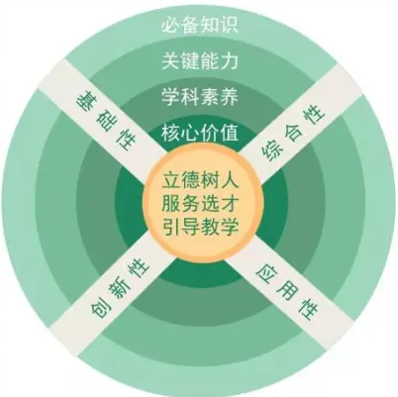
I. 知己知彼，有的放矢
to the point
subject-oriented
express accurately
express effectively
高考评价体系
What
How
Does your writing include all the required points?
Do you write with a clear yet tight structure?
Do you apply diverse expressions and sentence patterns?
Does your writing reflect your qualities?
Does your writing reflect your logical and critical thinking?
Why

Slide 4


II. 审题
假设你是李华，你班的英语报要增设一个栏目，外教Jenny提出“Fun at my school"和“Guess who l am”两个选项供大家选择，请给Jenny写一封邮件，内容包括：
(1)你的选择；
(2)说明理由。
注意：
1.写作词数应为80个左右；
2.请按如下格式在答题卡的相应位置作答。
1. 体裁：
2. 人称：
3. 时态
4. 语气：
5. 要点：
6. 结构：
书信
mainly 1st. & 3rd.
present+ future
polite& sincere
（建议/推荐+观点）
Greeting+ Choice+ Reasons+ Expectation
Para.1: Greetings+ Writing Purpose
Para.2: Reasons
(Points+ Supporting Details)
Para.3: Expectation

Slide 5
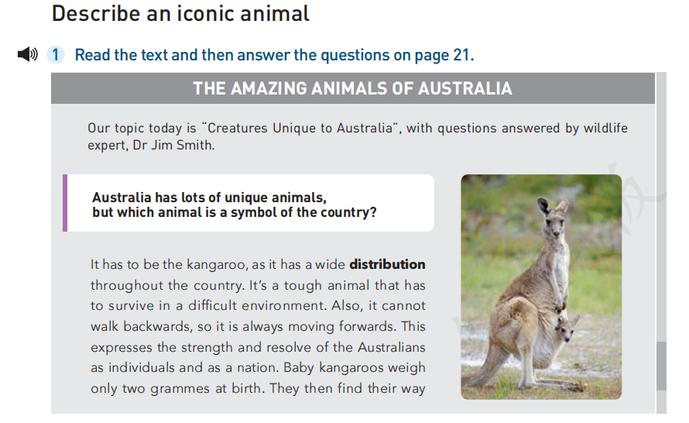
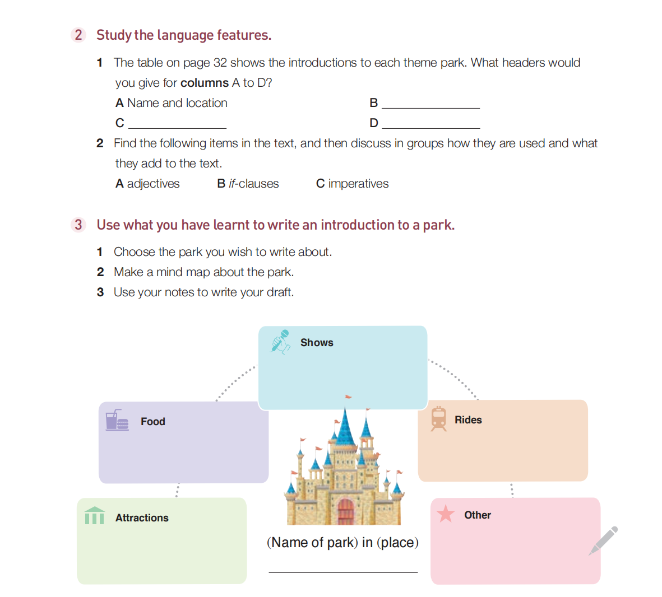
III. 核心词汇、表达及句式梳理
Sentence Patterns of Choices/ Opinions
Word Bank
I prefer ... to....
Between the given two choices, ... is my preference.
Compared with..., I would like to propose/ recommend ...
I am firmly convinced that...
There is compelling evidence to suggest that...
It is my considered opinion that...
The facts clearly indicate that...
It might be worth considering...
专栏
版块
特色内容
提议
选择
偏好
推荐
column (n.)
section (n.)
feature (n.& v.)
proposal (n.) - propose(v.)
choice/option (n.) - choose/ opt (v.)
preference (n.) - prefer (v.)
recommendation (n.)-recommend(v.)
Linking Words
to begin with
In addition; Plus; Better still/yet, Morover
Since/ As; Given that; Therefore/ Thus
For example/ instance; Such as; Like
Not to mention...
Will these make a good writing?
How to state your opinion effectively?

Slide 6

IV. Recall What We learnt&PEEL Your Writing
To state our opinions effectively, we need:
Point:
Evidence:
Explain:
Link:
State the opinion with a topic sentence
Support the point with evidence and expamples like facts, numbers, research findings and quotes.
Provide more details to support the points
A closing statement
or Link to the broader value
A clear yet tight structure!
Learn& Apply

Slide 7






V. 理由要点分析
FUN
AT SCHOOOL
your turn to PEEL:
GUESS
WHO I AM
!
?
Subjects:
make the newspaper more lively and positive (point)
cover diverse topics, such as sports events, talent shows, festivals and funny incidents (evidence)
arouse the readers’ curiosity
add a touch of mystery to the papers
value Everyone's Voice
Newspaper
add spices to students campus life
deepen the understandings among peers and of teachers
practice readers critical thinking
bring relief into our busy school lives (point)
help relieve stress with humor and happiness
anticipate each issue(explain)
PEEL our points:
Topic Sentence
Evidence& Explain
Link
Readers
spread joy (point)
remind us of the wonderful experiences we share as a school community (explain)
motivate students to express themselves and share their achievements and hobbies
promote self-awareness and confidence
Contributers
inspire students’ descriptive and creative writing to share the fun
inspire students’ descriptive and creative writing to stimulate fun
teacher
(Greater Value)
create a positive atmosphere
encourage students to engage more actively in school activities
help to build a stronger sense of community and friendship among students
encourage understanding and appreciation
promote connection
school

Slide 8
VI. 参考范文
Teacher’s Version
Dear Jenny,
Greetings!(交际性) I am writing to share my preference for the new column in our class English newspaper. "Fun at my school" is believed to be a fantastic addition!(写作目的+要点1选择 主题句)
With few limitation, it can covers a wide range of topics like festivals, club activities and funny incidents, which would be a good reflection of students’ diverse life.(理由1举例主题优势) Plus, since it highlights the joyful moments and positive experiences we have on campus, it will definitely make the newspaper more lively and encouraging. Either the plant adoption or the graffiti wall, everyone gets something to talk about. (理由2 解释&举例 报纸+撰稿人+读者)Not to mention the sharing would help advance our language skills and enhance the sense of community.(理由3 语言提升+学校更大价值)
Thank you for considering my input. Look forward to your reply!(礼貌用语+期待)
Best regards,
Li Hua
Dear Jenny,
Hope this mail finds you well!(交际性) Regarding the new column for our class English newspaper, I think “Guess Who I am” is the one can’t be missed.(背景+要点1选择 主题句)
The moment I saw the theme, my curiosity was aroused. It adds a touch of fun and mystery to the newspaper. Therefore, this column can significantly promote active participation. (理由1举例说明主题吸引力)Better yet, the guessing game can be both educational and entertaining. It’s a good opportunity for students to strengthen language skills in descriptive writing and creative thinking in an interactive way.(理由2解释 学习及思维提升) As everyone learns more about their peers, teachers, and notable figures around, it helps to bridge gaps and build stronger relationships on campus. (理由3 学校 更大价值)
Isn’t it an ideal choice? Looking forward to hearing your thoughts.(反问强调观点+期待)
Best regards,
Li Hua

Slide 9
VII. 高考真题举一反三
2406全国卷I 假定你是李华，上周五你们班在公园上了一堂美术课。请你给英国朋友Chris写一封邮件分享这次经历，内容包括：(1)你完成的作品；(2)你的感想
2306全国卷I 假定你是李华，外教Ryan准备将学生随机分为两人一组，让大家课后练习口语，你认为这样分组存在问题。请你给外教写一封邮件，内容包括： (1) 说明问题；(2) 提出建议
2501浙江 你将参加英语课上的一分钟演讲活动。请你针对部分同学在校园内用手机拍摄短视频的现象写一篇演讲稿。内容包括：(1)陈述看法；(2)提出建议。
2401浙江 请你写一篇短文向校英文报“Sports and Health”栏目投稿，向同学们推荐一项适合课间开展的运动, 内容包括：(1)介绍这项运动; (2)说明推荐理由。
2301浙江 上周末你参加了校学生会组织的“认识我们身边的植物”活动。请为校英文报写篇报道，内容包括：1. 活动的过程；(2)收获与感想。
Pair Work:
1.Each one choose a practical writing practice and PEEL together;
2. Turn to AI’s advice and draft your writing
3. Exchange the writings and give your peer; your comments and suggestions.
Structure the points logically and organize the writing effectively!

