Slide 1


感恩遇见，相互成就，本课件资料仅供您个人参考、教学使用，严禁自行在网络传播，违者依知识产权法追究法律责任。
更多教学资源请关注
公众号：溯恩英语
知识产权声明

Slide 2
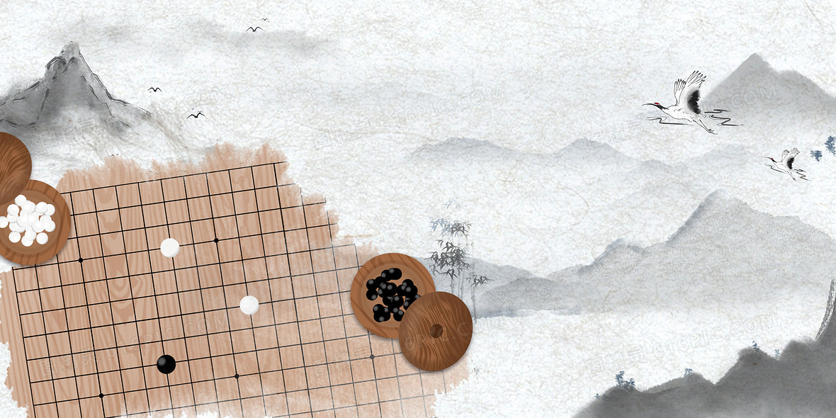
2025年全国高考I卷 语法填空 分析
北师大嘉兴附中 吴晨华

Slide 3
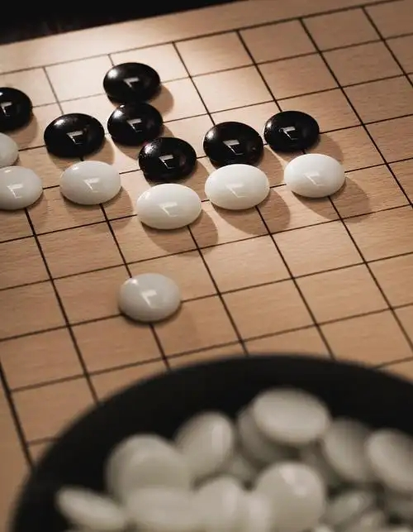
Par1 试题评析

Slide 4
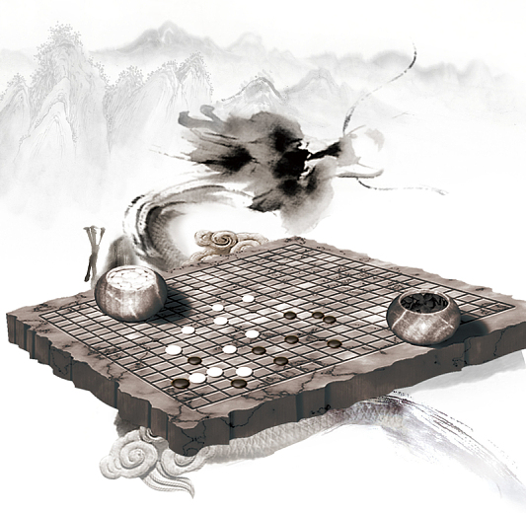
考生回忆版
An exhibition at the Jiushi Art Museum in Shanghai is featuring artwork inspired by Go, one of the oldest board games in the world, ___56_____originated in China more than 4,000 years ago.
Go, or weiqi in Chinese, is one of ___57_____ earliest binary-based(二进制)games. The movements of the black and white pieces reflect the basic ideas of Eastern philosophy, according to Tu Ningning, curator of the exhibition.
“The exhibition brings together Go culture, cutting-edge technology and contemporary art,” says Tu. “We hope ___58____ (present) the rather abstract Go game and AI in a visual context, and initiate dialogues with minimalism art, conceptual art and expressionism.”
“Each move should serve a long-term purpose. You try to lead the opponent into your trap and force them to follow your ____59______(guide) till they lose,” explains Wang Wei, a Go player among the visitors to the exhibition.
“The players’ personalities __60______ (reveal) during the game, and one’s weaknesses are exposed to the opponent,” she adds. “A decent winner always ____61______(try) to outplay the opponent ___62_____ no more than one or two points as a gesture of modesty and respect for the other side.”
Tu says it was the balance between the black and white pieces, beauty in the ____63_____(strategy) placement of the pieces, ___63____ the energy flow following each move that inspired artists to create oil paintings, sculptures, ____64_____(digital) generated graphics and silk-screen prints for the showcase.

Slide 5
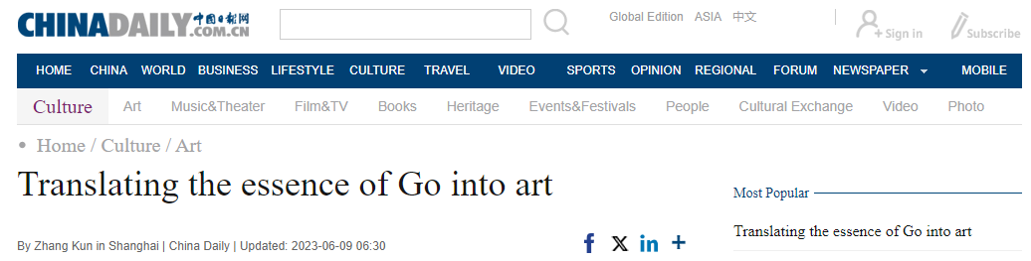
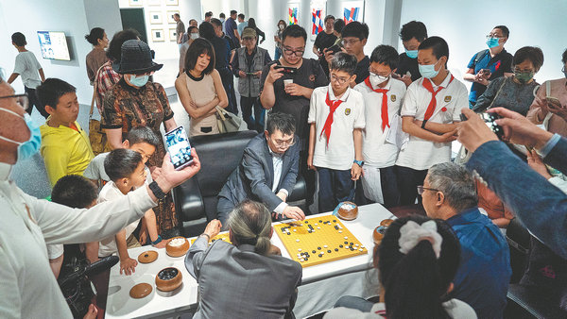
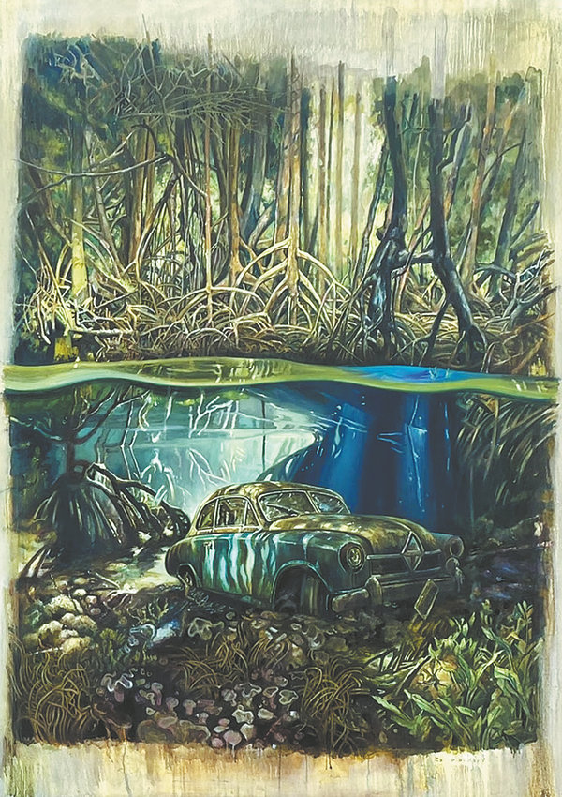
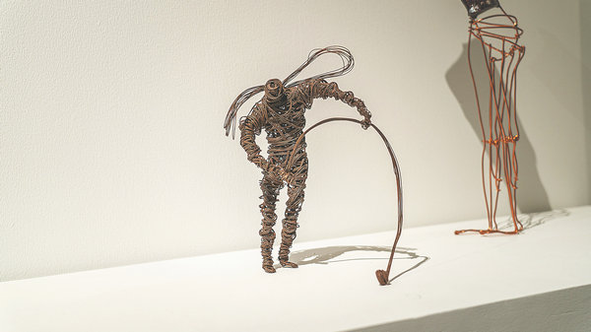
题源分析
An exhibition at the Jiushi Art Museum in Shanghai is featuring artwork inspired by Go, one of the oldest board games in the world, which originated in China more than 4,000 years ago.
The Game Art Vs Go Culture: 2023 China-Netherlands-Japan Invitation Exhibition in Shanghai, which started on May 31 and will run until July 21, is showcasing 41 artworks by 17 artists.
Presented by the Shanghai International Culture Association, the exhibition is one of the many events the organization is hosting that is related to the interactions between different cultures.
The idea of the exhibition was derived from the historical Go game between South Korean Go master Lee Se-dol and AlphaGo, the artificial intelligence Go player developed by Google's Deep-Mind. In March 2016, the two competed in five games, with AlphaGo losing one game.
Go, or weiqi in Chinese, is one of the earliest binary-based games. The movements of the black and white pieces reflect the basic ideas of Eastern philosophy, according to Tu Ningning, curator of the exhibition.
"The exhibition brings together Go culture, cutting-edge technology and contemporary art," says Tu. "We hope to present the rather abstract Go game and AI in a visual context, and initiate dialogues with minimalism art, conceptual art and expressionism.“
In a Go game, each player places a piece on the point of intersection of any two lines on the checkered board marked with 19 vertical and 19 horizontal lines. When a player encloses vacant points with boundaries made using their own pieces, they "conquer" that part of the board.
"Go is a game of algorithms. Each move should serve a long-term purpose. You try to lead the opponent into your trap and force them to follow your guidance till they lose," explains Wang Wei, a Go player among the visitors to the exhibition.
"The players' personalities are revealed during the game, and one's weaknesses are exposed to the opponent," she adds. "A decent winner always tries to outplay the opponent by no more than one or two points as a gesture of modesty and respect for the other side.“
Tu says it was the balance between the black and white pieces, beauty in the strategic placement of the pieces, and the energy flow following each move that inspired artists to create oil paintings, sculptures, digitally generated graphics and silk-screen prints for the showcase.
"I'm fascinated with the fact that the seemingly casual drop of a piece can overturn the whole game of Go. It is the same with art. A spontaneous stroke can change the outlook of the painting," says Zhang Fangbai, one of the artists involved in the exhibition. "You can achieve great rhythm and a sense of melody with free strokes of the brush, which you can also find in the game of Go. I think they both belong to the world of Taoism."
IF YOU GO
Game Art Vs Go Culture: 2023 China-Netherlands-Japan Invitation Exhibition in Shanghai
10 am-6 pm, May 31-July 21
Jiushi Art Museum, 6F, 27 Zhongshan Dong Yilu, Huangpu district, Shanghai
http://www.chinadaily.com.cn/a/202306/09/WS64824f27a31033ad3f7bb3dc.html

Slide 6
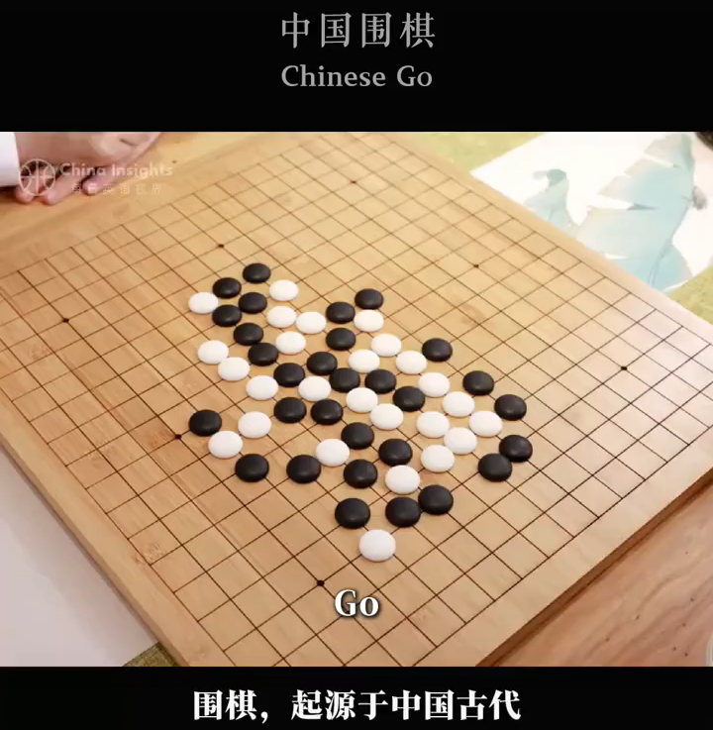
背景知识拓展
This is not a game,
it's a feeling and experience,
it's an art, a science,
a sport, a craft.
It's a dance that keeps you on
your toes constantly changing,
a way of life,
it's the challenge,
and you're for it.
GO!

Slide 7
试题评析
本试题是一篇关于上海久事美术馆举办围棋主题艺术展的报道。该展巧妙融合传统文化、人工智能与当代艺术，是中国传统文化中的哲思与智慧同现代科技结合的全新呈现。有助于增强考生对中华优秀传统文化的认同，塑造良好文化品格。（引自教育部教育考试院）
该语篇以 “围棋主题艺术展” 为线索，通过引入展览→解读围棋文化→阐述策展理念→棋手体验→艺术创作灵感的逻辑链条展开。
语法填空考点覆盖从句、冠词、非谓语动词、词性转换等基础语法，同时渗透对语境逻辑的理解。

Slide 8
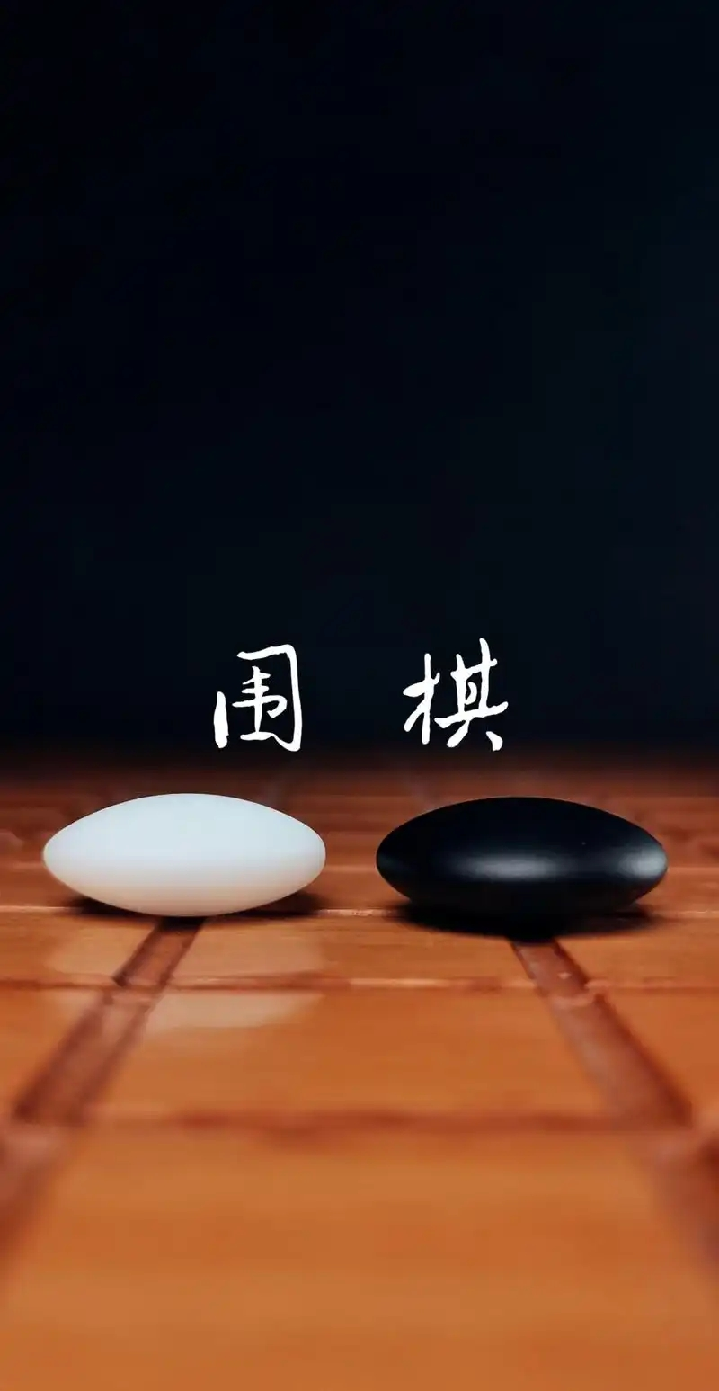
GO
weiqi
Par2 解题思路

Slide 9
解题步骤①寻找主干
An exhibition at the Jiushi Art Museum in Shanghai is featuring artwork inspired by Go, one of the oldest board games in the world, ___56_____originated in China more than 4,000 years ago.
Go, or weiqi in Chinese, is one of ___57_____ earliest binary-based(二进制)games. The movements of the black and white pieces reflect the basic ideas of Eastern philosophy, according to Tu Ningning, curator of the exhibition.
“The exhibition brings together Go culture, cutting-edge technology and contemporary art,” says Tu. “We hope _____58______ (present) the rather abstract Go game and AI in a visual context, and initiate dialogues with minimalism art, conceptual art and expressionism.”
“Each move should serve a long-term purpose. You try to lead the opponent into your trap and force them to follow your ____59______(guide) till they lose,” explains Wang Wei, a Go player among the visitors to the exhibition.
“The players’ personalities ______60______ (reveal) during the game, and one’s weaknesses are exposed to the opponent,” she adds. “A decent winner always ____61______(try) to outplay the opponent ___62_____ no more than one or two points as a gesture of modesty and respect for the other side.”
Tu says it was the balance between the black and white pieces, beauty in the ____63_____(strategy) placement of the pieces, ___63____ the energy flow following each move that inspired artists to create oil paintings, sculptures, ____64_____(digital) generated graphics and silk-screen prints for the showcase.

Slide 10
解题步骤②逐题分析
An exhibition at the Jiushi Art Museum in Shanghai is featuring artwork inspired by Go, one of the oldest board games in the world, ___56_____originated in China more than 4,000 years ago.
Go, or weiqi in Chinese, is one of ___57_____ earliest binary-based(二进制)games. The movements of the black and white pieces reflect the basic ideas of Eastern philosophy, according to Tu Ningning, curator of the exhibition.
“The exhibition brings together Go culture, cutting-edge technology and contemporary art,” says Tu. “We hope _____58______ (present) the rather abstract Go game and AI in a visual context, and initiate dialogues with minimalism art, conceptual art and expressionism.”
“Each move should serve a long-term purpose. You try to lead the opponent into your trap and force them to follow your ____59______(guide) till they lose,” explains Wang Wei, a Go player among the visitors to the exhibition.
“The players’ personalities ______60______ (reveal) during the game, and one’s weaknesses are exposed to the opponent,” she adds. “A decent winner always ____61______(try) to outplay the opponent ___62_____ no more than one or two points as a gesture of modesty and respect for the other side.”
Tu says it was the balance between the black and white pieces, beauty in the ____63_____(strategy) placement of the pieces, ___63____ the energy flow following each move that inspired artists to create oil paintings, sculptures, ____64_____(digital) generated graphics and silk-screen prints for the showcase.
56. which
从属连词、非限制性定语从句
57. the
定冠词、最高级
58. to present
hope后接不定式，“希望做某事”
59. guidance
名词，“指导”
60. are revealed
谓语动词、被动关系、主语为复数
61. tries
谓语动词、主动关系、主语为单数
62. by
介词，“胜过了…分”
63. strategic
形容词，修饰名词
64. and
并列连词
65. digitally
副词，修饰形容词

Slide 11
解题步骤③重点突破
长难句1
An exhibition at the Jiushi Art Museum in Shanghai is featuring artwork inspired by Go, one of the oldest board games in the world, ___56_____originated in China more than 4,000 years ago.
分析
该句有5个表示地点、时间的状语，即at the Jiushi Art Museum, in Shanghai, in the world, in China, more than 4000 years ago。其中2个状语作为干扰项易影响学生对句子主干的判断，即An exhibition is featuring artwork.
inspired by Go作为后置定语修饰artwork, 并以one of the oldest board games in the world为同位语，解释Go.
难点：考生需要判断originated在本句中所作的成分，即与inspired为并列关系的非谓语，还是从句中的谓语。
破解：根据originate用法——originate in sp., 及根据句意——“game”与“originate”搭配，可判定此处缺从属连词，为非限制定语从句的关系代词，故填which。
启发：排除干扰信息，确定句子成分，思考搭配关系

Slide 12
解题步骤③重点突破
长难句2
“We hope _____58______ (present) the rather abstract Go game and AI in a visual context, and initiate dialogues with minimalism art, conceptual art and expressionism.”
分析
该句主谓结构为We hope，其中hope为不及物动词，后接to do不定式作状语，表希望的动作或状态‌。
难点：句中出现大量不熟悉的词，如rather, minimalism art, conceptual art, expressionism，虽不影响答案填写，但易影响阅读理解、造成阅读障碍。
破解：方法1 present在此处为及物动词，思考作谓语还是非谓语，在判定为非谓语后，从doing/done/to do中思考、选择
方法 2 关注“and”，“initiate”与“present”呈并列关系，故此处为to present… and (to) initiate…
启发：不受不影响作答的生词干扰，关注句中语境逻辑（and）。
本题考点关联：
You try to lead the opponent into your trap and force them to follow your __59____(guide) till they lose.
The players’ personalities _60_ (reveal) during the game, and one’s weaknesses are exposed to the opponent.
Tu says it was the balance between the black and white pieces, beauty in the __63__(strategy) placement of the pieces, __63__ the energy flow following each move that inspired artists to create oil paintings, sculptures, __64___(digital) generated graphics and silk-screen prints for the showcase.
and

Slide 13
解题步骤③重点突破
长难句3
“A decent winner always ____61______(try) to outplay the opponent ___62_____ no more than one or two points as a gesture of modesty and respect for the other side.”
分析
难点：本句考点密集且重复考查了谓语动词。此外，考生对“decent”“outplay”词义不熟悉、对围棋文化不了解，影响62题中介词的正确填写。
破解：61题 本句除outplay为动词外，仅剩try为动词，即try应为谓语，从时态、语态、主谓一致三个角度判定答案为tries。此处须注意always中的“s”对谓语单复数的干扰。
62题 outplay: to play much better than sb you are competing against。类似的词汇为：outweigh/ outperform/ outnumber/ outlive/ outdo/ outwit等。outplay sb. by…中“by”表示胜过了…。
启发：了解中国的围棋文化，关注词的构造和词缀的含义。

Slide 14
解题步骤③重点突破
长难句4
Tu says it was the balance between the black and white pieces, beauty in the ____63_____(strategy) placement of the pieces, ___63____ the energy flow following each move that inspired artists to create oil paintings, sculptures, ____64_____(digital) generated graphics and silk-screen prints for the showcase.
分析
该句为全文最长单句，主谓结构为Tu says，其后跟了it was…that…的宾语从句，其中，the balance/ beauty/ the energy flow后均有限定，如介词短语和非谓语。
难点：本句结构较复杂，含多重从句，考点密集。
破解：63/64题 可以并列结构为突破口，the balance/ beauty/ the energy三者并列，故63题为and；oil paintings/ sculptures/ graphics/ prints四者为并列，故64题为digitally，即生成的方式为“数字地” ，意为“数字生成的图形” 。
启发：逐层分析句子结构、关注句中语境逻辑（and） 。

Slide 15
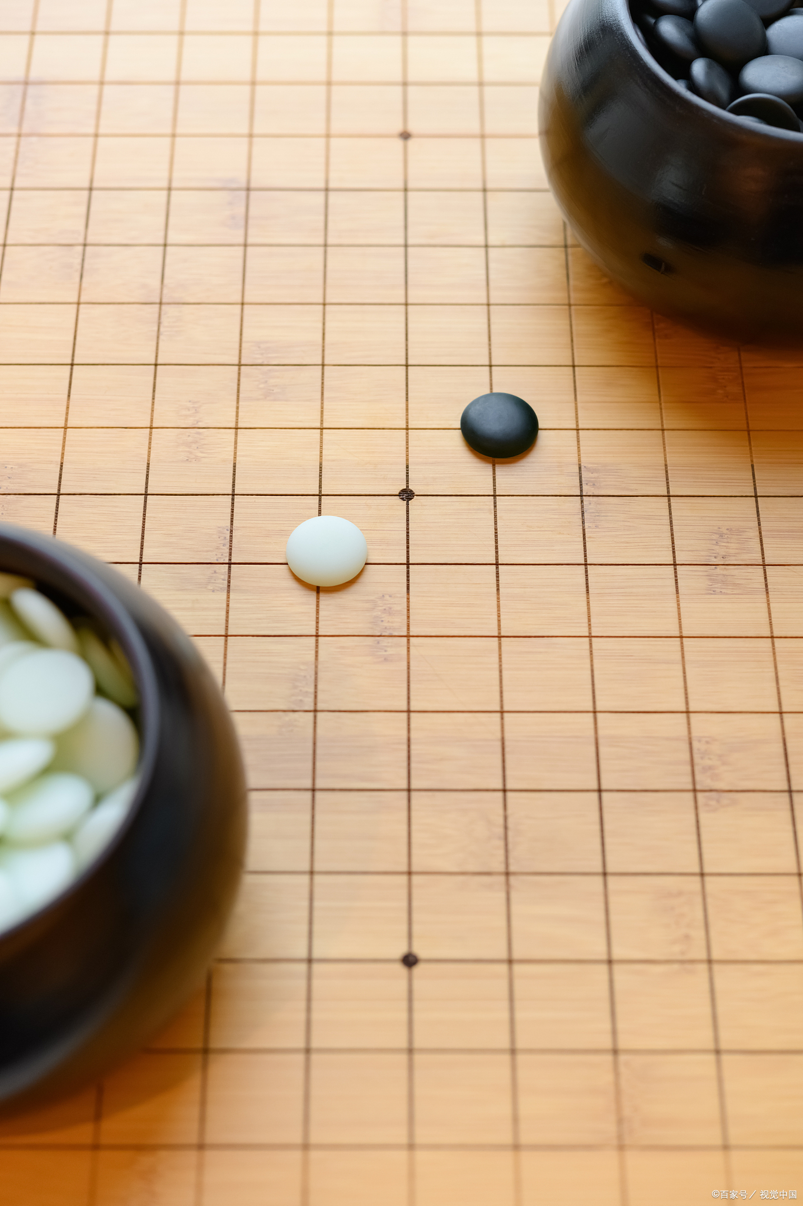
Par3 考点分析

Slide 16
考点分析
考点 | 考察点 | 题目
动词 | 谓语：语态、主谓一致 | 60、61
 | 非谓语：不定式 | 58
名词 | 词性转换 | 59
形容词 | 词性转换 | 63、65
 | 最高级搭配 | 57
连词 | 并列连词：and | 64
 | 从属连词：非限制性定语从句 | 56
介词 | 非固定搭配 | 62
冠词 | 定冠词：最高级搭配 | 57
试题难度阶梯设计科学合理：
动词类考点覆盖三大核心维度
词性转化聚焦形态变化能力
长难句分析关注句内语境逻辑
介词类考点融入文化语境和功能性应用

Slide 17
三年新高考1卷语法填空考点对比分析
 | 2023新高考1卷 |  | 2024新高考1卷 |  | 2025新高考1卷
题号 | 答案 | 考点 | 答案 | 考点 | 答案 | 考点
56 | tasty | 词性转换n.→adj. | engineering | 词性转换v.→adj. | which | 从属连词
57 | to bite | 不定式 | functional | 词性转换n.→adj. | the | 定冠词
58 | or | 并列连词 | to give | 不定式 | to present | 不定式
59 | recognized | 词性转换v.→adj. | closed | 非谓语 | guidance | 词性转换v.→n.
60 | by | 介词 | walks | 谓语 | are revealed | 谓语
61 | to be lifted | 不定式 | the | 定冠词 | tries | 谓语
62 | their | 物主代词 | favorites | 名词 | by | 介词
63 | a | 不定冠词 | as | 介词 | strategic | 词性转换n.→adj.
64 | rarely | 词性转化adj.→v. | which/that | 从属连词 | and | 并列连词
65 | wanting | 非谓语 | richness | 词性转化adj.→n. | digitally | 词性转换adj.→adv.
考点分析
词性变换均有3题
介词均来源于语境推断，而非固定搭配，弱化纯记忆性知识考查
打破必考非谓语（ing/done）的惯例，关注动词不定式及谓语动词考查
并列连词考查增多，并有多个考题的解题需要利用“and”分析句内语境逻辑

Slide 18
解题及备考启发
启发一 关注介词的灵活使用
（2023.6新高考1卷）
There you will find them prepared differently- more dumpling and less soup, and the wrappers are pressed 55 hand rather than rolled.
（2024.6新高考1卷）
The Glasshouse stands ____63____ a great achievement in contemporary design, to house the plants of the southwestern part of China at the end of a path retracing (追溯) the steps along the Silk Route ____64____ brought the plants from their native habitat in Asia to come to define much of the _____65_____ (rich) of gardening in England.
（2025.6新高考1卷）
A decent winner always ____61______(try) to outplay the opponent ___62_____ no more than one or two points as a gesture of modesty and respect for the other side.
基于句意理解和文本逻辑，分析所缺介词，注意固定搭配带来的干扰。

Slide 19
解题及备考启发
启发二 关注词性转化和积累
（2023.6新高考1卷）
Shanghai may be the 54 (recognize) home of the soup dumplings but food historians will actually point you to the neighboring canal town of Nanxiang as Xiao long hao’s birthplace.
（2024.6新高考1卷）
The latest ____56____ (engineer) techniques are applied to create this protective ____57____ (function) structure that is also beautiful.
The Glasshouse stands ____63____ a great achievement in contemporary design, to house the plants of the southwestern part of China at the end of a path retracing (追溯) the steps along the Silk Route ____64____ brought the plants from their native habitat in Asia to come to define much of the _____65_____ (rich) of gardening in England.
（2025.6新高考1卷）
Tu says it was the balance between the black and white pieces, beauty in the ____63_____(strategy) placement of the pieces, …
词性转化难度增加，日常学习须多加积累和练习

Slide 20
解题及备考启发
启发三 关注不定式的搭配
（2023.6新高考1卷）
To eat one, you have to decide whether 52_____ (bite) a small hole in it first, releasing the stream and risking a spill (溢出), 53.______ to put the whole dumpling in your mouth, letting the hot soup explode on your tongue.
Nanxiang aside, the best Xiao long bao have a fine skin, allowing them 56._____ (lift) out of the steamer basket without allowing them tearing or spilling any of 57.____ (they) contents.
（2024.6新高考1卷）
These sepals open on warm days ____58____ (give) the inside plants sunshine and fresh air. In cold weather, the structure stays ____59____ (close) to protect the plants.
（2025.6新高考1卷）
We hope _____58______ (present) the rather abstract Go game and AI in a visual context, and initiate dialogues with minimalism art, conceptual art and expressionism
不定式考查主要涉及作目的状语、与动词的固定搭配、上下文的语境逻辑等

Slide 21
解题及备考启发
启发四 强化句内逻辑分析，关注并列连词
（2023.6新高考1卷）
those amazing constructions of delicate dumpling wrappers, encasing hot, 51.____ (taste) soup and sweet, fresh meat
To eat one, you have to decide whether 52_____ (bite) a small hole in it first, releasing the stream and risking a spill (溢出), 53.______ to put the whole dumpling in your mouth, letting the hot soup explode on your tongue.
the wrappers are pressed 55._______ hand rather than rolled
（2025.6新高考1卷）
You try to lead the opponent into your trap and force them to follow your __59____(guide) till they lose.
The players’ personalities _60_ (reveal) during the game, and one’s weaknesses are exposed to the opponent.
Tu says it was the balance between the black and white pieces, beauty in the __63__(strategy) placement of the pieces, __63__ the energy flow following each move that inspired artists to create oil paintings, sculptures, __64___(digital) generated graphics and silk-screen prints for the showcase.
连词不再局限从属连词；并列连词可帮助分析句内逻辑，助力相关解题

Slide 22
Thanks for your attention！

