Slide 1


感恩遇见，相互成就，本课件资料仅供您个人参考、教学使用，严禁自行在网络传播，违者依知识产权法追究法律责任。
更多教学资源请关注
公众号：溯恩英语
知识产权声明

Slide 2

The World
May 16th-31st, 2025

Slide 3

1. Half of Young People Wish the Internet Did Not Exist
半数年轻人希望互联网不存在

Slide 4
Text Completion
The Guardian (May 20 2025 P10)
Almost half of young people would rather live in a world ______ the internet does not exist, a survey found. The research reveals that nearly 70% of 16- to 21-year-olds feel worse about themselves after spending time on social media. Half would support a “digital curfew” that would restrict their access ___ certain apps and sites past 10pm, while 46% said they would rather be young in a world without the internet. Twenty-six percent of respondents spent four or more hours a day on social media, while 42% admitted lying to their parents and guardians about what they do online. While online, 42% said they had lied about their age, 40% admitted to having a decoy or “burner” account and 27% said they pretended to be a different person __________ (complete).
The technology secretary, Peter Kyle, has hinted that the government was weighing up the __________ (possible) of making cut-off times mandatory for apps such as TikTok and Instagram. Rani Govender, the policy manager for child safety online at the NSPCC, said the curfews alone could not stop ________ (expose) to harmful materials. She added that the primary focus for companies and the government ____ (be) to ensure children use “much safer and less addictive sites”.
The study ________ (survey) 1,293 young people and found that 27% of respondents have shared their location online with strangers. In the same survey, 74% said they had spent more time online as a result of the pandemic, while 68% said they felt the time they spent online was detrimental to their mental health. Andy Burrows, ____ chief executive of the Molly Rose Foundation, said it was “clear that young people are aware of the risks online and what’s more they want action from tech companies to protect them”. He said algorithms can provide content which “can quickly spiral and take young people down rabbit holes of harmful and __________ (disstress) material”. New laws were “urgently required to finally embed a safe-by-design approach to regulation that puts the needs of children and society ahead of _____ of big tech”, he said.
where
to
completely
possibility
exposure
was
surveyed
the
distressing
those

Slide 5
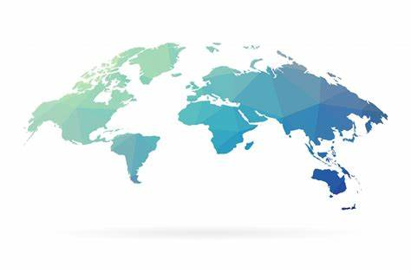
Reading Comprehension
1. Which of the following statements is TRUE according to the survey data?
A. Over 50% of young people admitted hiding their true selves online.
B. 74% of respondents said they had shared their location with strangers.
C. 42% of respondents spend more than four hours daily on social media.
D. Nearly half of young people would prefer growing up in an internet-free world.
DETAIL
2. What does Rani Govender imply about “digital curfews” in the article?
A. They will effectively block harmful online content for kids.
B. They are insufficient to fully protect children from online risks.
C. The government should focus on banning addictive apps completely.
D. Tech companies have already prioritized children’s safety in app design.
INFERENCE

Slide 6
Vocabulary
1. decoy: a person or thing used to lure others into a trap or to distract attention 诱饵;诱惑物;用作诱饵的人
He was booked on a flight leaving that day, but that was just a decoy.
他订了那天起飞的航班，但那不过是个诱饵。
2. rabbit hole: a complex or confusing situation or process that is difficult to escape from, often likened to a labyrinthine hole that a rabbit might dig
（探究的）复杂问题，深坑，无底洞；
Once you start exploring this rabbit hole, it’s hard to stop.
一旦你开始探索这个无底洞，就很难停下来。
Translation
他用诱饵分散了敌人的注意力。
He used a decoy to distract the enemy.
Translation
互联网可能是一个信息的无底洞。
The internet can be a rabbit hole of information.

Slide 7
Translation
The technology secretary, Peter Kyle, has hinted that the government was weighing up the possiblility of making cut-off times mandatory for apps such as TikTok and Instagram. Rani Govender, the policy manager for child safety online at the NSPCC, said the curfews alone could not stop exposure to harmful materials.
英国技术大臣Peter Kyle暗示，政府正在考虑强制对TikTok和Instagram等应用实施断网时间。全国防止虐待儿童协会(NSPCC)儿童在线安全政策经理Rani Govender表示，仅靠使用宵禁并不能阻止儿童接触有害内容。
He said algorithms can provide content which “can quickly spiral and take young people down rabbit holes of harmful and disstressing material”. New laws were “urgently required to finally embed a safe-by-design approach to regulation that puts the needs of children and society ahead of those of big tech”, he said.
他指出，算法推荐的内容“可能迅速失控，将年轻人引入有害和令人痛苦的深渊”。他表示，英国“亟需出台新法规”，从而“最终将安全设计原则纳入监管框架，优先保障儿童和社会需求，而非大型科技公司的利益”。

Slide 8
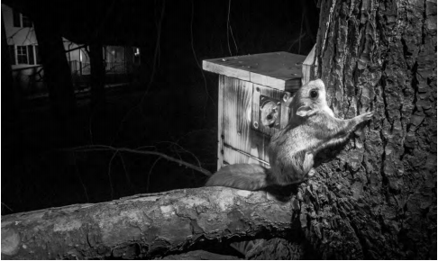
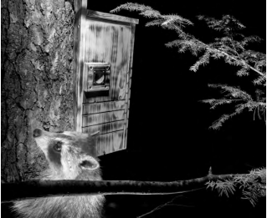
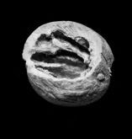
2. These Invisible ‘Wild Neighbors’ Need Our Help
“野生邻居”需要我们的帮助

Slide 9
Text Completion
The Washington Post (May 27, 2025 A13)
A hickory nut, opened with such precision it could belong in the Museum of Modern Art, lay at _____ base of a towering, dead eastern hemlock. That nut, its delicate grooves unmistakably carved by a flying squirrel, was a clue and an __________ (invite) to look through a doorway into a secret world.
The elusive, acrobatic lives of flying squirrels — North America’s only gliding mammal — range across the Northeastern United States, including in urban areas such as New York City and D.C. But the animals remain __________ (practice) invisible to us. Not because they are rare but because we aren’t looking.
Mostly silent and nocturnal, they glide like sprites through the canopy, planting seeds, spreading mycelium and keeping ecosystems alive ___ ways we are only beginning to understand.
Yet, when people do encounter flying squirrels in my area of New York’s Catskill Mountains, the animals are often dismissed as pesky attic invaders, and their magic ____________ (downgrade) to mere nuisance. Flying squirrels, like so many overlooked species, depend on dead and dying trees, ______ (call) snags, for survival. We humans cut down “messy” deadwood and, as a result, remove critical habitat. When we clear their homes, the fliers don’t disappear; they adapt. That’s _____ flying squirrels often end up in attics, ________ (seek) warmth and shelter. What others call a nuisance is actually survival in response to human encroachment.
While it’s easy to feel _________ (power) in the face of climate disasters and willful habitat destruction, conservation doesn’t have to start with grand gestures. It can start with something simple, such as pausing _______ (notice) the wild neighbors we share space with, whether in a forest, a city park or just a tree outside a window.
the
invitation
practically
in
is downgraded
called
why
seeking
powerless
to notice

Slide 10
Reading Comprehension
1.Why are flying squirrels described as "practically invisible" to people?
A. They are extremely rare in North America.
B. They are not not valued by humans.
C. They only live in remote, untouched forests.
D. They blend in perfectly with tree bark.
DETAIL
2. What is the main idea of the passage?
A. Flying squirrels are destructive pests in human attics.
B. Dead trees are unnecessary and should be cleared.
C. Flying squirrels require urgent captive breeding programs.
D. Simple observation of flying squirrels can be a form of conservation.
INFERENCE

Slide 11
Vocabulary
1. elusive: difficult to find, define, or achieve 难找的；难以解释的；难以达到的
Eric, as elusive as ever, was nowhere to be found.
埃里克总是这样神出鬼没，哪儿也找不着。
2. nuisance: a thing, person or situation that is annoying or causes trouble or problems 麻烦事；讨厌的人（或东西）
I don’t want to be a nuisance so tell me if you want to be alone.
我不想讨人嫌，你要是想一个人待着就说一声。
Translation
翻译时设法把握住原文中难以捉摸的风韵。
Try to catch the elusive charm of the original in translation.
Translation
明天不得不回去，真烦人。
It’s a nuisance having to go back tomorrow.

Slide 12
Translation
The elusive, acrobatic lives of flying squirrels — North America’s only gliding mammal — range across the Northeastern United States, including in urban areas such as New York City and D.C. But the animals remain practically invisible to us.
飞行松鼠这种神秘而敏捷的动物——北美仅有的会滑翔的哺乳动物——其活动范围遍及美国东北部地区，包括纽约市和华盛顿特区等城市区域。但这些动物对我们来说几乎完全看不见。
When we clear their homes, the fliers don’t disappear; they adapt. That’s why flying squirrels often end up in attics, seeking warmth and shelter. What others call a nuisance is actually survival in response to human encroachment.
当我们清理它们的栖息地时，这些飞鼠并不会消失；它们会适应环境。这就是为什么飞鼠常常会出现在阁楼里，它们在那里寻求温暖和庇护。而其他人眼中所谓的“麻烦”，实际上却是它们为了应对人类的侵扰而采取的生存策略。

Slide 13
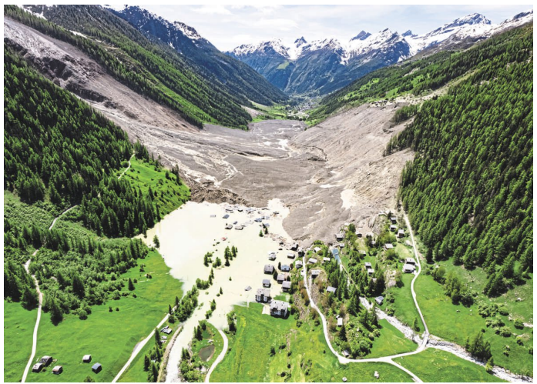
3. Glacier collapse buries nearly all of Swiss Alpine village
瑞士冰川坍塌致村庄毁灭
The village of Blatten after the avalanche, triggered by the collapse of the Birch Glacier. The debris also blocked a river, causing flooding.

Slide 14
Text Completion
The Washington Post（May 30, 2025 A10)
For days, the inhabitants of Blatten, a village in the Swiss Alps, had been warned by geologists that ___ unstable glacier high above their homes could collapse.
____ Wednesday afternoon, days after residents were evacuated, the glacier broke up under the weight of overlying rocks, _______ (bury) the village under some 3 million cubic meters of ice, rock and mud. Authorities said one person is missing but have not reported any confirmed casualties. The trail of debris – which officials said stretched more than a mile – blocked the river ___________ flows through the village, flooding the few surviving _________ (structure).
“We have lost our village,” Blatten Mayor Matthias Bellawald said at an __________ (emotion) news conference Wednesday evening, describing the __________ (destroy) as extensive. He appealed for help to rebuild the village. Stéphane Ganzer, a councillor for the province of Valais, told Swiss media that the cascade of rubble buried about 90 percent of the village. Authorities suspect that the collapse __________ (cause) by high-altitude snowmelt, but its precise trigger is unclear.
A 64-year-old resident, believed to have been in the area at the time of the collapse, is still missing, police said. In a statement Wednesday afternoon, police said they _____________ (develop) a thermal drone and sent rescue specialists _______ (find) him.
an
On
burying
that / which
structures
emotional
destruction
was caused
had deployed
to find

Slide 15
Vocabulary
1. debris: pieces of wood, metal, brick, etc. that are left after sth has been destroyed残骸；碎片；破片
Emergency teams are still clearing the debris from the plane crash. 各抢救小组仍在清理失事飞机的残骸。
2. cascade: a large number of things falling or coming quickly at the same time倾泻（或涌出）的东西
He crashed to the ground in a cascade of oil cans.
他随着一连串的油桶跌落坠地。
Translation
一些人遭飞溅的碎片致死。
A number of people were killed by flying debris.
Translation
一头金色的秀发如瀑布般垂落在他的背上。
A cascade of golden hair fell down his back.

Slide 16
Translation
For days, the inhabitants of Blatten, a village in the Swiss Alps, had been warned by geologists that an unstable glacier high above their homes could collapse.
数日来，瑞士阿尔卑斯山布拉滕村的居民一直收到地质学家的警告，称他们头顶上方有一座不稳定的冰川可能会崩塌。
Stéphane Ganzer, a councillor for the province of Valais, told Swiss media that the cascade of rubble buried about 90 percent of the village. Authorities suspect that the collapse was caused by high-altitude snowmelt, but its precise trigger is unclear.
瓦莱州议员斯特凡·甘泽尔对瑞士媒体表示，滚落的碎石掩埋了约 90% 的村庄。当局怀疑此次坍塌是由高山积雪融化引发的，但其确切诱因尚不清楚。

Slide 17
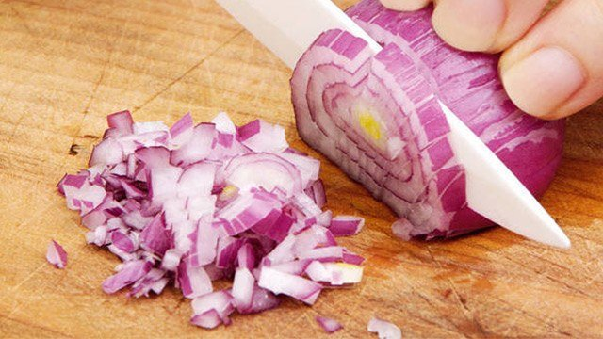
4. The secret to chopping onions without crying
切洋葱不流泪的秘密

Slide 18
Reading Comprehension
New Scientist（May 24, 2025 P11)
If you find yourself crying when chopping onions, physicists have found a possible solution – but chefs probably aren’t going to like it.When onions are cut open, they spray a mixture of sulphur-rich compounds into the air, one of which is syn-propanethial-S-oxide, a chemical that triggers the nerves in the eye responsible for tears.
Sunghwan Jung at Cornell University in New York state and his team used a high-speed camera to analyse the spray made when brown onions are cut with blades of varying thickness and at different speeds. Using a mounted guillotine consisting of a thin steel blade released from above, Jung and his team sliced a quarter of an onion that had been coated in black spray paint, which helped them track how the onion deformed, and watched the spray with a high-speed camera. They also used an electron microscope to measure the width of the blade tip, which varied between 5 and 200 micrometres, and changed the height of the blade to adjust the cutting speed, ranging from around 0.4 to 2 metres per second.
The researchers found that sharp blades produced fewer, slower droplets with less energy. When an onion is cut with a dull knife, the blade causes the onion skin to bend, storing elastic energy and building up pressure inside the onion. As a result, when the skin erupts, it does so more explosively, causing some particles to reach speeds of up to 40 metres per second.
A blunt knife can produce as much as 40 times as many droplets as a sharp one, while the fastest speeds produced four times as many particles as the lowest cutting speeds, the team found. Therefore, sharp knives and slow cuts should result in less of the irritating chemicals getting into your eyes – but Jung and his colleagues didn’t put this to the test. They declined to discuss the research with New Scientist.
“Whether it’s really going to change much in the kitchen, it’s not obvious to me it’s going to be particularly useful,” says Anne Juel at the University of Manchester, UK.

Slide 19
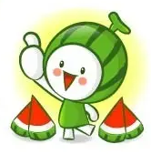
Reading Comprehension
1. What does the underlined word “explosively” mean in Paragraph 3? .
A. slowly and gently
B. suddenly and violently
C. silently and invisibly
D. repeatedly and predictably
VOCABULARY
2. What can be inferred about using a blunt knife to cut onions?
A. It reduces the amount of chemicals released.
B. It causes more droplets to spray at higher speeds.
C. It is the preferred method for professional chefs.
D. It prevents the onion skin from bending.
INFERENCE
3. Which of the following is the best title for the text?
A. The Health Risks of Cooking with Onions
B. How to Choose the Perfect Kitchen Knife
C. The Physics Behind Tear-Free Onion Chopping
D. A History of Onion-Related Scientific Studies"
GIST

Slide 20
Vocabulary
1. elastic: able to stretch and return to its original size and shape有弹性的
Beat it until the dough is slightly elastic. 反复捶打，直到面团略有弹性。
2. blunt: without a sharp edge or point不锋利的；钝的
The police said he had been hit with a blunt instrument.
警方说他遭到了钝器袭击。
Translation
这个新球的弹性非常好。
The new ball was perfectly elastic.
Translation
你们得把所有钝的刀磨一磨了。
You need to sharpen all your blunt knives.

Slide 21
Translation
When onions are cut open, they spray a mixture of sulphur-rich compounds into the air, one of which is syn-propanethial-S-oxide, a chemical that triggers the nerves in the eye responsible for tears.
当洋葱被切开时，其内部会释放出一种富含硫的化合物混合物，其中有一种名为“赛普拉尼索-硫-氧化物”的化学物质，这种物质会刺激眼睛中负责产生泪水的神经。
When an onion is cut with a dull knife, the blade causes the onion skin to bend, storing elastic energy and building up pressure inside the onion. As a result, when the skin erupts, it does so more explosively, causing some particles to reach speeds of up to 40 metres per second.
如果用钝刀切洋葱，刀刃会使洋葱皮发生弯曲，从而储存弹性能量，并在洋葱内部积聚压力。因此，当洋葱皮破裂时，其破裂过程会更加剧烈，一些粒子的速度甚至能达到每秒 40 米。

Slide 22

5. BBC News 05/22/2025

Slide 23

Dictation
The United Nations says it’s been unable to ________ any aid in Gaza since Israel eased its blockade on Monday. A UN spokesman said the _______ that had entered the territory so far had not yet reached warehouses and delivery points.
The European Union has said it’ll review ___ with Israel because of the war in Gaza. Israel has condemned the decision, ________ Brussels of completely misunderstanding the situation.
Donald Trump has set out plans for a multi-billion-dollar missile defence system called the Golden Dome. The US president said it would be able to intercept attacks _________________.
An international report says nearly half a billion teenagers worldwide will be overweight or _____ by the end of the decade. The review in the Lancet journal says weight gain and mental health problems are becoming the main dangers facing __________, rather than alcohol or tobacco.
England will be the first country to start __________ people against the sexually transmitted infection gonorrhoea. It’s the same jab currently given to babies for meningitis B. The two diseases are caused by similar bacteria.
The United Nations says the Dominican Republic deported nearly 1,000 pregnant or breastfeeding women to neighboring Haiti last month. The UN said the practice _______ international standards.
Japan’s agriculture minister has resigned after he joked that he never had to buy rice because he’s so often handed the food as a gift. Taku Eto’s comments caused anger because many consumers have been facing ___________.
hand out
supplies
ties
accusing
launched from space
obese
adolescents
vaccinating
violated
rising prices

Slide 24
Vocabulary
1. blockade: an act or means of sealing off a place to prevent goods or people from entering or leaving 封锁；阻塞
Striking lorry drivers agreed to lift their blockades of main roads.
罢工的卡车司机们同意解除对主干道的封堵。
2. jab: an injection of something into your blood to prevent illness
注射；接种；预防针
I got a jab in my arm for the flu vaccine.
我在胳膊上打了一针流感疫苗。
Translation
目前还不清楚谁会真正执行这项封锁任务。
It’s not yet clear who will actually enforce the blockade.
Translation
护士给我打了一针快针，我甚至都没感觉到。
The nurse gave me a quick jab and I didn’t even feel it.

Slide 25
Translation
The United Nations says it’s been unable to hand out any aid in Gaza since Israel eased its blockade on Monday. A UN spokesman said the supplies that had entered the territory so far had not yet reached warehouses and delivery points.
联合国表示，自周一以色列放宽封锁以来，该机构一直未能在加沙地带实施任何援助物资分发工作。一位联合国发言人指出，迄今进入该地区的援助物资尚未送达仓库和分发站点。
An international report says nearly half a billion teenagers worldwide will be overweight or obese by the end of the decade. The review in the Lancet journal says weight gain and mental health problems are becoming the main dangers facing adolescents, rather than alcohol or tobacco.
一份国际报告称，到本年代末，全球将有近5亿青少年面临超重或肥胖问题。《柳叶刀》杂志发表的这篇评论文章指出，体重增加和心理健康问题正在取代酒精或烟草，成为青少年面临的主要危险。

