Slide 1


感恩遇见，相互成就，本课件资料仅供您个人参考、教学使用，严禁自行在网络传播，违者依知识产权法追究法律责任。
更多教学资源请关注
公众号：溯恩英语
知识产权声明

Slide 2

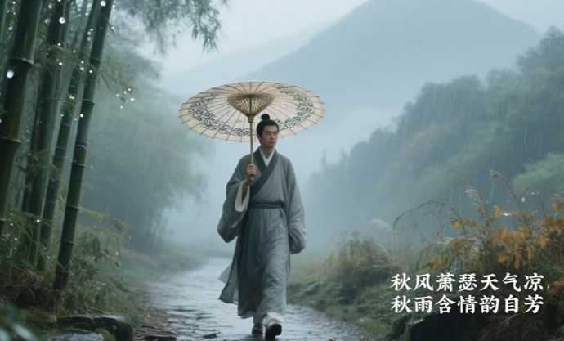
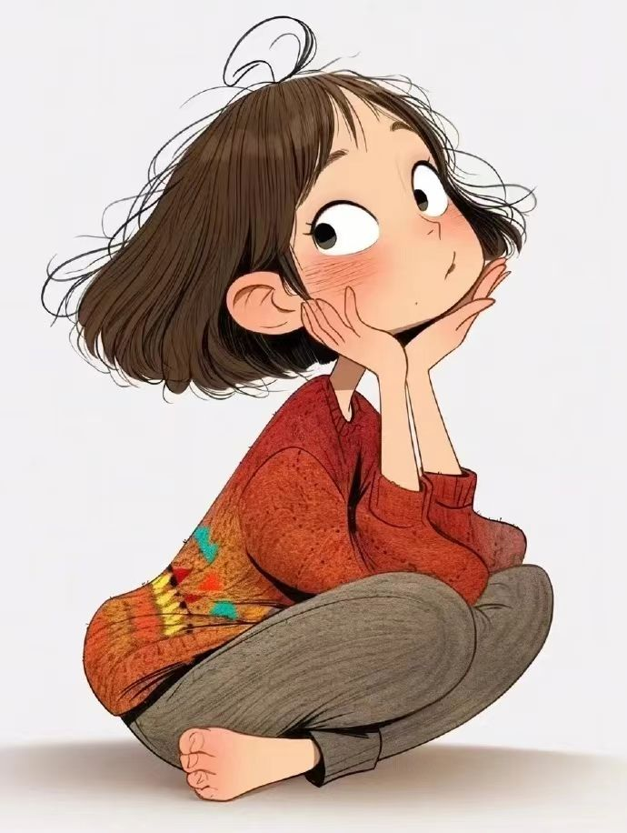
四步法解读后续写
—以2025年全国高考英语二卷读后续写为例
礼泉县教育局教研室 高小聪

Slide 3

Contents：
PART 01
找六要素，了解大意
PART 02
审提示语，预测下文
enriching
PART 03
深挖主题，贯通读写
PART 04
斟词酌句，连句成文

Slide 4
Learning Objectives：
At the end of the class, the students will be able to
1.generate a coherent 150-word narrative continuation using the
provided prompts and appropriate language (Language Ability).
2. understand and convey how sharing name meanings fosters
cultural confidence and bridges understanding (Cultural Awareness).
3. analyze themes and predict logical developments to integrate into their continuation (Thinking quality).
apply the "Four-Step Method" to plan, draft, and revise their continuation writing (Learning Capacity).

Slide 5
细读文章及要求，完成下面任务。
Tip：Underline the key information in the original text.
第二节（满分25分）
阅读下面材料，根据其内容和所给段落开头语续写两段，使之构成一篇完整的短文。
“What is your name? ” is a question most frequently asked when people meet for the first time. But for me, it was the first challenge I encountered as an international student in Ireland.
The pronunciation system of the Chinese language is quite different from that of English. For native speakers of English, some Chinese words are rather difficult to pronounce. My given name Qiuyu（秋雨）, for instance, happened to be a great challenge for many of them. Every time I gave a self-introduction, I had to explain how to pronounce my name at least five times, yet they still could not say it the way I did.
Once in a lecture, the professor tried repeating my name after me over and over in front of thirty classmates. I really did not know whether I should continue correcting him or simply drop the matter. I feared that my classmates might grow tired of my efforts or even lose patience with me. After all, I did care about how others would think of me. I realized that if I didn't stop, the entire lecture would be ruined. “It's okay, professor,” I shrugged （耸肩）. The awkward moment ended with the class erupting into laughter. I forced a smile, unsure how to respond further.
After that incident, I stopped acting as a “Chinese teacher. ” Instead of correcting others when they were struggling to pronounce my name, I just smiled and nodded approvingly. This approach spared me the discomfort of having to over-explain. However, I soon found that by doing so, I might be losing something more important: the opportunity to share a small part of my cultural identity.
注意：（1）续写词数应为150个左右；（2）请按如下格式在答题卡的相应位置作答。
In a class discussion, I was invited to explain the meaning of my name. ...
Many of my classmates got interested and came up to me after class. ...

Slide 6
Part1.找六要素，了解大意
Main Character: The narrator ("I"), Qiuyu (秋雨) an international student from __________.
China
Who
Other Characters: Native English speakers in __________ (general), a professor, classmates (specifically mentioned in the class discussion).
Main idea:
Ireland
As an international student in Ireland, I, the author faced the __________that others had difficulty pronouncing his/her Chinese name ,Qiuyu. After an awkward ____________in a lecture, the author chose not
__________(correct) people any more, but later realized this might mean losing the chance to share part of his/her ________________.
When
During her time as an international student in Ireland
challenge
Where
A university __________ hall, Ireland
lecture
The difficulty native English speakers have ___________ the narrator's Chinese name, Qiuyu, led to my awkwardness , frustration and ____________ .
pronouncing
experience
What
discomfort
to correct
The fundamental difference between Chinese and English pronunciation systems makes "Qiuyu" ___________ for native English speakers.
Why
challenging
Cultural differences create a communication________ around my name; An awkward public incident_______ the protagonist to change behaviors;Passive strategy ________ surface issues but _________ a deeper identity crisis;The protagonist stands at a crossroads regarding whether __________(assert) cultural identity.
barrier
forces
cultural identity
resolves
How
triggers
to assert

Slide 7
Hint1. In a class discussion, I was invited to explain the meaning of my name.
By sharing the meaning/ ____________of my name—its natural symbolism and the Chinese culture _________ by Qiuyu. I noticed their expressions changing from confusion to curiosity and then to pleassure/_________ .
significance
carried
Part2.审提示语，
预测下文
interest
Hint2. Many of my classmates got interested and came up to me after class.
“Your name— I must learn it properly!” exclaimed a boy who often _______________ my name , eyes sparkling with playful urgency. “It’s so ____ to say!”.
mispronounced
fun
Theme1. Sharing the cultural meaning of one's name demonstrates cultural ___________, serving as a _______ for cross-cultural communication while strengthening personal cultural _________ .
confidence
bridge
identity
Theme2. Overcoming initial cultural discomfort/_________by sharing the meaning of her Chinese name _________understanding and ___________ meaningful connections with classmates.
Part3. 深挖主题，
贯通读写
shock
bridged
fostered
Theme3. Sharing the meaning of one’s Chinese name fostered cultural understanding and _____________ among her classmates.
appreciation

Slide 8
Part4. 斟词酌句，连句成文
教师下水作文1
In a class discussion, I was invited to explain the meaning of my name. Nervous 1___________ I was, I still narrated the 2_________(mean) of my name with gentle clarity,“Qiuyu means autumn rain. As a famous agricultural proverb 3______(go) , rain on the Start of Autumn brings a bountiful harvest(立秋有雨样样收), which reflects its nourishing 4_______(affect) on crop filling and ripening. Therefore, “Qiuyu” 5 ___________(symbol) harvest and hope for life. My parents gave me the name, wishing that I could lead a rich and 6____________(purpose) life like that in autumn. Understand?” Unexpectedly, thunderous applause suddenly 7______(fill) the classroom and the professor cast an 8__________(approve) glance in my direction— a moment the discomfort of over-explanation disappeared.
Many of my classmates got interested and came up to me after class. “Your name— I must learn it 9_________(proper) !” exclaimed a boy who often 10_______________(pronounce) my name before, eyes 11_________(spark) with playful urgency. “It’s so fun to say!”. With slow enunciation, I guided him through each syllable of“Qiu-yu”. Soon a small chorus of voices 12______(rise) as other students echoed the sounds playfully. At that time,I realized that a name is more than a 13_________(phone) symbol; it serves as a 14_______ for cross-cultural communication, embodying the significance of cultural 15____________(confident) and effective and further strengthening her my own sense of cultural identity. (高小聪）
as/though
meaning
goes
effect
symbolizes
purposeful
filled
approving
properly
mispronounced
sparkling
rose
phonetic
bridge
confidence

Slide 9
Part4. 斟词酌句，连句成文
教师下水作文2
During a class discussion, I was invited to explain the meaning of my name. The thought of potential mispronunciations filled me with 1__________(frustrate) and nervousness, rooting me to the spot, speechless. 2_________, seeing the teacher's kind smile and classmates' 3_________(curiosity) eyes, I plucked up my courage, stepped forward, and 4______(take) a deep breath. "Qiu symbolizes autumn—the season of 5________(harvest)," I explained, "and Yu means rain, which 6__________(nourish) the earth and brings abundance to the season." As understanding dawned on my classmates, I added that my parents chose this name to represent precious rain that nourishes the crops. Everyone listened 7___________(attentive) , filling me with unexpected warmth.
Many of my classmates got interested and came up to me after class. Interested classmates 8____________(approach) me, their faces 9___________(brim) with curiosity. "That's so poetic, like a scene from a Chinese painting!" one burst out. Hearing this, I felt a surge of 10_______(proud) in my culture and realized that, as an exchange student, sharing Chinese culture was why I was here . When they asked me to teach the 11______________ (pronounce) and share more Chinese stories, I patiently repeated my name and 12____________(elaborate) with examples . Soon, eager attempts and joyful 13_________(laugh) filled the air. Watching my classmates' passionate 14_______(effort), I felt my earlier anxiety melt away, 15_________(replace) by a profound sense of cross-cultural connection. (马星星）
frustration
However
curious
took
harvest
nourishes
attentively
approached
brimming
pride
pronunciation
elaborated
laughter
efforts
replaced

Slide 10
Part4. 斟词酌句，连句成文
官方范文:
In a class discussion, I was invited to explain the meaning of my name. Standing up, I felt a mix of nervousness and 1__________(excite). “My name, Qiuyu, combines the characters for autumn and rain in Chinese,” I began, my voice steady. “Autumn represents harvest and 2_________(mature), while rain symbolizes 3____________(nourish) and growth. Together, they embody a time of abundance and 4_________(renew).” As I spoke, I noticed the rapt attention of my classmates, their eyes 5__________(reflect)curiosity and respect. It was a moment of connection, a bridge 6______ (build) between cultures through the simple act of sharing my name.
Many of my classmates got interested and came up to me after class. They 7___________(surround) me, their questions 8________(pour) out like a stream. “What other names have beautiful meanings in Chinese?” “Can you teach us 9______to write our names in Chinese characters?” I smiled, feeling a warmth 10________ (spread) through me. I took out a piece of paper and began to sketch out characters, explaining each stroke and its 11____________(significant). Through this interaction, I realized that by embracing my cultural identity, I was not only preserving my heritage but also 12___________(enrich) the lives of those around me. It was a small yet meaningful step towards fostering cultural understanding and appreciation.
excitement
maturity
nourishment
renewal
reflecting
built
surrounded
pouring
how
spread
significance
enriching

Slide 11
Conclusion
我们要有经常讲的自信: 制度自信、文化自信。所有的自信它应该反映在我们的一言一行、一举一动、一颦一笑，以及我们的追求、我们的行动、我们的理想之中。
—彭凯平

