Slide 1



感恩遇见，相互成就，本课件资料仅供您个人参考、教学使用，严禁自行在网络传播，违者依知识产权法追究法律责任。
更多教学资源请关注
公众号：溯恩英语
知识产权声明

Slide 2




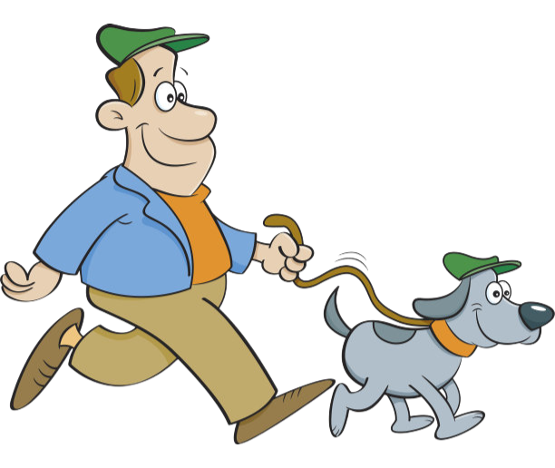

拉波夫叙事在读后续写中的妙用
2025年6月续写真题：道歉的力量
杭州二中树兰高级中学 郭合英

Slide 3

本节课带领学生借助拉波夫叙事理论剖析文本，从叙事结构的点题、定向、进展、评价、结局和回应6个维度梳理原文脉络，探究作者的创作意图。同时，引导学生明确续写需展开的关键要素，通过合理规划续写内容的布局与构思，确保续写部分逻辑严密、内容充实且衔接自然，与原文形成高度协同的叙事整体。

Slide 4
1. 了解故事梗概
2. 拉波夫叙事介绍
Learning objectives
3. 拉波夫叙事应用
4. 作品赏析

Slide 5


1
1. 了解故事梗概

Slide 6
使某事井然有序；
将某事安排妥当
My wife and I wanted to share our new home with family and friends by hosting a small gathering in the early summer. She had prepared lots of snacks, while my job was to have the backyard in order.
There was plenty of space for the kids to run and play. There was just one thing I hadn’t counted on: my brother chose to bring his dog Toby, a 50-pound ball of fire. Though friendly, he could easily knock over my niece’s small boys and my six-month-old granddaughter. So, when my brother showed up, I asked him to watch Toby and keep him outside.
My plan was working out just fine. Toby was using up his energy by running back and forth in the backyard and giving the kids plenty of room. Unexpectedly, after supper, the weather changed. It started to rain and everyone went indoors.
It was an awkward moment. I didn't want Toby to be running around in the house, and my brother wasn’t happy with driving home with a wet dog. Eventually, my brother decided to leave rather than force the issue.
sth.
预料到；考虑到；想到
（喻）精力充沛、充满激情的人
撞倒
出现，到场
进展顺利
来来回回
对…… 高兴；
对…… 感到满意
强行解决问题；
迫使事情有个结果

Slide 7
根本没机会；
不可能；想都别想
A few days passed, and I hadn’t heard anything from my brother. I texted him and expressed wishes for him to come out again. His reply came as a surprise—a shock, actually: “Not a chance.” Clearly, he was unhappy over the way we had parted. After all, I had left him little choice. Well, he'll get over it, I reasoned.
Two months passed. My wife suggested I get in touch with my brother, but I resisted, thinking he should call first. However, my conscience (良心) kept bothering me. I tried to put myself in my brother’s shoes. He was facing health issues, and his wife of thirty-five years had passed away a few months earlier. Toby was his constant companion, the one who kept him going.
注意:
(1) 续写词数应为150左右；
(2) 请按如下格式在答题纸相应位置作答。
I realized it was me who was at fault.
With the biscuits my wife had made, I arrived at my brother's door.
从（挫折、失望等）中恢复过来
与某人取得联系
换位思考；
设身处地为他人着想
去世
one’s
oneself
使某人坚持下去
sb.

Slide 8
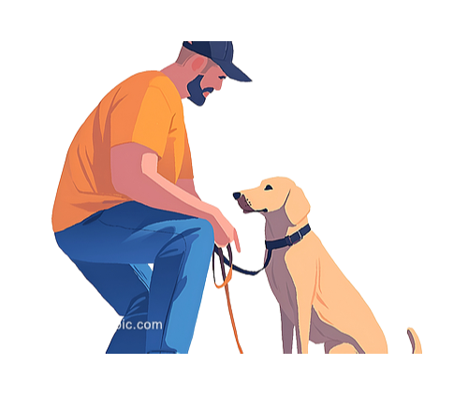
语法填空
In early summer，I and my wife held a small gathering in my new home
1 (share) it with family and friends. My wife prepared snacks, and I tidied the backyard for kids. 2 , my brother brought Toby, a 50-pound
3 (energy) dog, which might knock over children. When it rained, everyone went inside, but I asked my brother to keep Toby outside. My brother left 4 (angry). After days of no contact, I texted, but my brother responded with “Not a chance”. Two months later, I realized my brother, 5 had health problems and 6 (lose) his wife recently, relied on Toby 7 his constant companion. Guilty, I put himself in 8 (brother)shoes, understanding Toby’s role in keeping him 9 (go). The story shows a conflict 10 (cause) by a dog and the importance of understanding in fixing relationships.
to share
However
energetic
angrily
who
had lost
as
brother’s
going
caused

Slide 9
1
2. 拉波夫叙事介绍

Slide 10
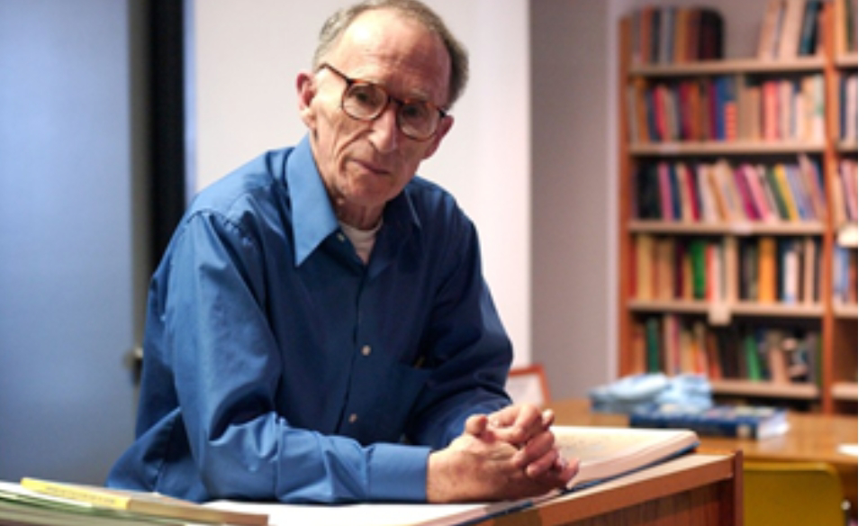
拉波夫提出一个完整的叙事结构，包含以下六个部分：
点题(Abstract)
指向(Orientation)
进展(Complicating Actions)
评议(Evaluation)
结局(Resolution)
回应(Coda)
拉波夫，社会语言学主要创始人，宾夕法尼亚大学语言学教授
他认为“一个完整的叙事模式以点题和指向开始，以进展为主体，用评议烘托气氛，以结局结束情节，最后用回应将读者拉回现实” 。(Labov, 1972)
美国语言学家拉波夫

Slide 11
是故事发生的经过，指随着故事的发展，各种矛盾冲突的出现。
评议
指矛盾冲突被化解或问题得到解决。
指作者或故事的中人物对事件的看法、态度和心理，以及对故事的起因、结果以及过程中事件要点的评议。
Evaluation
进展
结局
Complicating Actions
Resolution
是故事对读者的启迪或意义，其作用是点明主旨、升华主题。它将读者拉回现实，是连接故事和现实的纽带。
Labov’s
Narrative
Structure
是作者对故事的时间、地点、人物、事件做出交待。
Orientation
Coda
回应
指向
Abstract
即故事大意，是对文章的高度概括，通常出现在文章的首段。如果是有标题的文章，标题即点题。
点题

Slide 12
1
3. 拉波夫叙事的应用

Slide 13
点题（Abstract）
My wife and I wanted to share our new home with family and friends by hosting a small gathering in the early summer.
作用：能让学生俯瞰原文，迅速激发
他们的阅读兴趣和好奇心。
家庭聚会
指向(Orientation)
My wife and I wanted to share our new home with family and friends by hosting a small gathering in the early summer. She had prepared lots of snacks, while my job was to have the backyard in order.
There was plenty of space for the kids to run and play. There was just one thing I hadn’t counted on: my brother chose to bring his dog Toby, a 50-pound ball of fire. Though friendly, he could easily knock over my niece’s small boys and my six-month-old granddaughter. So, when my brother showed up, I asked him to watch Toby and keep him outside.
时间
地点
人物
背景
in the early summer
in the backyard and indoors
my wife , I , my brother
the preparation for the gathering and the potential problems caused by my brother bringing his dog

Slide 14



进展(Complicating Actions)
以冲突为主线
，层层推进
人与动物的冲突
Toby, a 50-pound ball of fire
人际冲突
Toby的活力与家庭孩子安全的冲突
内心冲突
he could easily knock over my niece’s small boys and my six-month-old granddaughter.
留白与伏笔的冲突

Slide 15
进展(Complicating Actions)
矛盾的本质是“规则”
与“情感”的碰撞
以冲突为主线
，层层推进
导火索
不欢而散
人与动物的冲突
I didn’t want Toby to be running around in the house.
my brother wasn’t happy with driving home with a wet dog
人际冲突
I texted him and expressed
wishes for him to come out again.
Unexpectedly, after supper, the weather changed. It started to rain and everyone went indoors.
内心冲突
持续发酵
His reply came as a surprise—a shock, actually: “Not a chance.”.
留白与伏笔的冲突

Slide 16
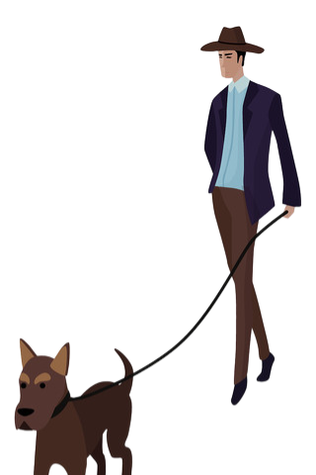
进展(Complicating Actions)
以冲突为主线
，层层推进
My wife suggested I get in touch with my brother, but I resisted, thinking he should call first.
人与动物的冲突
人际冲突
内心冲突
my conscience kept bothering me.
展现了人性的固执与愧疚
留白与伏笔的冲突

Slide 17
进展(Complicating Actions)
此句既是伏笔也隐含留白
以冲突为主线
，层层推进
作为伏笔：“我” 的 “自负” 与弟弟的强硬拒绝（“Not a chance”）形成情节反差，暗示人物关系的潜在裂痕，为后文和解的必要性做铺垫。
人与动物的冲突
he’ll get over it
人际冲突
Not a chance
作为留白：“我” 写下这句话时，未揭示弟弟的真实处境 (如丧妻、健康问题、对狗的情感依赖)，这种信息的 “留白”，营造了信息差，制造情节张力，增强后期共情。
内心冲突
留白与伏笔的冲突

Slide 18
评议(Evaluation)
情感递进的层次感
share our new home with family and friends
could easily knock over children
Not a chance
think he should call first
put myself in my brother’s shoes
it was me who was at fault
聚会的
期待
对狗的担忧
兄弟间的矛盾
骨子里的倔强
开始自我反思
准备主动认错

Slide 19

结局(Resolution)
I realized it was me who was at fault.
功能定位：评价 (Evaluation) + 解决 (Resolution) 的过渡
评价(Evaluation)：通过主人公的自我反思(“realized it was me who was at fault”)，揭示冲突的根源(自我过错)，完成对事件的主观评判，强化叙事的情感逻辑。
With the biscuits my wife had made, I arrived at my brother’s door.
解决(Resolution)的铺垫：认知层面的 “认错” 是后续行动的前提，推动叙事从 “冲突持续” 转向 “和解可能”。

Slide 20
结局(Resolution)
With the biscuits my wife had made, I arrived at my brother’s door.
功能定位：解决(Resolution)的核心行动
具体行动化解冲突：携带妻子制作的饼干（象征和解的媒介）登门，以实际行为弥补过错，符合拉波夫理论“(Resolution) 需通过行动终结矛盾” 的要求。
细节的象征意义：“biscuits” 作为日常食品，既可以人食也可以狗食，赋予和解场景的真实感；“my wife had made” 隐含家庭支持的意象，强化 “修复关系” 的合理性。

Slide 21
结局(Resolution)
I realized it was me who was at fault.
场景1：可从情节入手，写回忆兄弟离开时的黯然伤神；也可从情感入手，写兄弟妻子去世之后，狗成了兄弟的精神寄托，也可写我的后悔。
场景2：妻子出场，承上启下。（原文最后一段是妻子建议我应该主动联系兄弟,其次第二段的给出句提到了带着妻子做的饼干）
With the biscuits my wife had made, I arrived at my brother’s door.

Slide 22
结局(Resolution)
“my wife had made”呼应和映射作用：既与前文“妻子准备聚会零食”形成呼应，又暗示主人公的和解行为不仅是个人意愿，也包含家庭支持（妻子的支持与配合），弱化冲突中的个人对立，强化 “关系修复” 的集体性。
“biscuits”媒介作用：饼干作为日常食品，具有 “家庭温暖”“和解诚意” 的隐喻，避免直接道歉的生硬感。
I realized it was me who was at fault.
With the biscuits my wife had made, I arrived at my brother’s door.
思考 “biscuits my wife had made” 在句中的作用？
矛盾闭环结局：“解铃还须系铃人”，矛盾因犬而起，破冰之策亦当以犬为媒—让引发冲突的核心要素成为和解的情感纽带，方能实现续写与原文的叙事逻辑闭环。这种首尾呼应的设计，既遵循 “问题原点即解决支点”的创作逻辑，又能通过宠物元素的二次激活，使情节转折更具合理性与情感张力，最终达成文本内核的高度协同。

Slide 23

回应(Coda)
I realized it was me who was at fault.
With the biscuits my wife had made, I arrived at my brother’s door.
原文以“家庭聚会的矛盾”为切入点，用质朴的语言勾勒出人与物、人与人之间的各种冲突，其亮点在于通过细节铺垫实现情感转折，让“规则冲突”自然转向“情感联结”，最终落脚“共情”的主题。所以，在续写时若能紧扣上述关键点，将哥哥的情感需求(Toby的陪伴意义)与主人公的反思结合，便能自然推动情节走向温暖的和解。

Slide 24
1
4. 作品赏析

Slide 25
读后续写是否促学外语，主要看有无语言协同效应发生，即学生是否在续写中运用读物中出现的词语。（2019年5月王初明《读后续写何以有效促学》）
1. 原文词句的协同
续写时，尽可能多用原文语言，做到高协同
2. 原文句式的协同

Slide 26
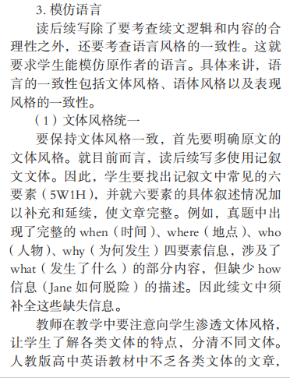
读后续写除了要考查续文逻辑和内容的合理性之外，还要考查语言风格的一致性。这就要求学生能模仿原作者的语言。具体来讲，语言的一致性包括文体风格、语体风格以及表现风格的一致性。
--谢丹《从高考读后续写题型看高中英语读写教学》2017年11月
文本不同，语言风格就不同

Slide 27
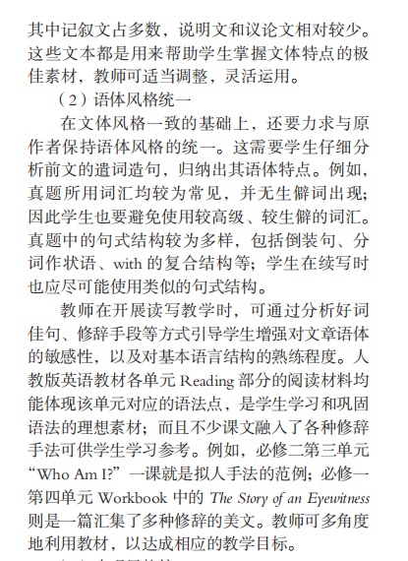
这需要学生仔细分析前文的遣词造句，归纳出其语体特点。真题所用词汇均较为常见，并无生僻词出现；因此学生也要避免使用较高级、较生僻的词汇。真题中的句式结构较为多样，包括倒装句、分词作状语、with 的复合结构等；学生在续写时也应尽可能使用类似的句式结构。

Slide 28
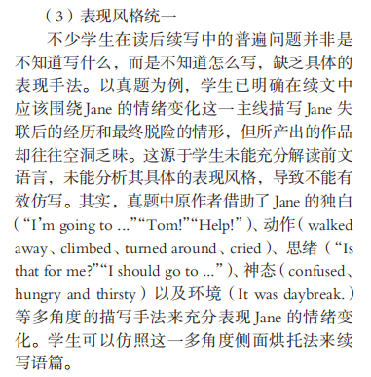
学生未能充分解读前文语言，未能分析其具体的表现风格，导致不能有
效仿写
故而，行文构思之初，需以文本细读为舟，深度解析原文的语言特质与行文肌理。通过捕捉其独特的用词偏好、句式节奏及核心意象，精准锚定可延续的关键词句，方能在续写时实现语言风格与叙事逻辑的无缝衔接，确保续写篇章与原文血脉相连，浑然一体。

Slide 29
黄底为1星词，蓝底为2星词，红底为非标词，未标为初中词汇
My wife and I wanted to share our new home with family and friends by hosting a small gathering in the early summer. She had prepared lots of snacks, while my job was to have the backyard in order.
There was plenty of space for the kids to run and play. There was just one thing I hadn’t counted on: my brother chose to bring his dog Toby, a 50-pound ball of fire. Though friendly, he could easily knock over my niece’s small boys and my six-month-old granddaughter. So, when my brother showed up, I asked him to watch Toby and keep him outside.
My plan was working out just fine. Toby was using up his energy by running back and forth in the backyard and giving the kids plenty of room. Unexpectedly, after supper, the weather changed. It started to rain and everyone went indoors.
It was an awkward moment. I didn't want Toby to be running around in the house, and my brother wasn't happy with driving home with a wet dog. Eventually, my brother decided to leave rather than force the issue.

Slide 30
黄底为1星词，蓝底为2星词，红底为非标词，未标为初中词汇
My wife and I wanted to share our new home with family and friends by hosting a small gathering in the early summer. She had prepared lots of snacks, while my job was to have the backyard in order.
There was plenty of space for the kids to run and play. There was just one thing I hadn’t counted on: my brother chose to bring his dog Toby, a 50-pound ball of fire. Though friendly, he could easily knock over my niece’s small boys and my six-month-old granddaughter. So, when my brother showed up, I asked him to watch Toby and keep him outside.
My plan was working out just fine. Toby was using up his energy by running back and forth in the backyard and giving the kids plenty of room. Unexpectedly, after supper, the weather changed. It started to rain and everyone went indoors.
It was an awkward moment. I didn't want Toby to be running around in the house, and my brother wasn't happy with driving home with a wet dog. Eventually, my brother decided to leave rather than force the issue.

Slide 31
A few days passed, and I hadn't heard anything from my brother. I texted him and expressed wishes for him to come out again. His reply came as a surprise—a shock, actually: “Not a chance.” Clearly, he was unhappy over the way we had parted. After all, I had left him little choice. Well, he'll get over it, I reasoned.
Two months passed. My wife suggested I get in touch with my brother, but I resisted, thinking he should call first. However, my conscience (良心) kept bothering me. I tried to put myself in my brother's shoes. He was facing health issues, and his wife of thirty-five years had passed away a few months earlier. Toby was his constant companion, the one who kept him going.
注意:
(1) 续写词数应为150左右；
(2) 请按如下格式在答题纸相应位置作答。
I realized it was me who was at fault.
With the biscuits my wife had made, I arrived at my brother's door.

Slide 32
词汇占比 |  |  | 特点归纳
初中词 | 295词 | 约占比95%
1星词 | 9词 | 约占比3%
2星词 | 4词 | 约占比1%
非标词 | 3词 （1个标汉语， 2个未标汉语） | 约占0.96比%
原文词数 | 311词 （不含给出句） | 第一段给出句9词，第二段给出句13词，共333词。
高比例基础词汇决定了语言的“质朴平实”，1星词和2星词多为情感或动作类关键词，在基础词汇框架中精准勾勒心理活动与场景动态，避免语言过于平淡。续写时需紧扣这一词汇特征，确保语言风格的高度协同。

Slide 33
整篇文章以初中词汇为主，无非标词
黄底为1星词，蓝底为2星词，红底为非标词，未标为初中词汇
划线词为原文语言的产出
I realized it was me who was at fault. I sat by the window, staring at the gentle rain outside, which reminded me of that rainy day on the gathering day. The rhythmic sound of raindrops hitting the glass seemed to mirror the restlessness in my heart. I’d been so focused on protecting my family that I’d overlooked my brother’s great loss. Struggling with health issues and having lost his wife recently, he depended on Toby not just as a pet, but as his support in loneliness. When I reflected, my wife approached with a box of heart-shaped biscuits. “These were freshly baked,” she said softly, “maybe they’ll say what words can’t.” Her suggestion touched me deeply—I needed to bridge the gap not just with apologies, but with understanding.
With the biscuits my wife had made, I arrived at my brother’s door. When he answered it, his eyes flashed with surprise, still shadowed by the “Not a chance” from our last encounter. But Toby bounded forward, tail swinging wildly, his front feet rested on my shoulder as if to beg for peace. I bent down to softly touch his ears, then took out a biscuit. Surprisingly, Toby gently took it in his mouth and ran back to my brother. As his dog’s uncontained joy washed over him, my brother’s “Not a chance” disappeared like sugar in tea. I stepped closer for a bear hug, and he laughed—half-choked, half-relieved. As we sat chatting, Toby lay at our feet like a silent peacemaker, which shows the most broken bonds are fixed by the simplest acts of love.

Slide 34
原创作品
以狗为媒的和解
以雨景开篇,既与原文故事背景形成呼应，又能烘托出主人公内心的不安与反思，使场景过渡自然。
I realized it was me who was at fault. I sat by the window, staring at the gentle rain outside, which reminded me of that rainy day on the gathering day. The rhythmic sound of raindrops hitting the glass seemed to mirror the restlessness in my heart. I’d been so focused on protecting my family that I’d overlooked my brother’s great loss. Struggling with health issues and having lost his wife recently, he depended on Toby not just as a pet, but as his support in loneliness. When I reflected, my wife approached with a box of heart-shaped biscuits. “These were freshly baked,” she said softly, “maybe they’ll say what words can’t.” Her suggestion touched me deeply—I needed to bridge the gap not just with apologies, but with understanding.
With the biscuits my wife had made, I arrived at my brother’s door. When he answered it, his eyes flashed with surprise, still shadowed by the “Not a chance” from our last encounter. But Toby bounded forward, tail swinging wildly, his front feet rested on my shoulder as if to beg for peace. I bent down to softly touch his ears, then took out a biscuit. Surprisingly, Toby gently took it in his mouth and ran back to my brother. As his dog’s uncontained joy washed over him, my brother’s “Not a chance” disappeared like sugar in tea. I stepped closer for a bear hug, and he laughed—half-choked, half-relieved. As we sat chatting, Toby lay at our feet like a silent peacemaker, which shows the most broken bonds are fixed by the simplest acts of love.
妻子的出场承上启下，自然地推动故事发展，助推我将反思转化为行动的契机，使得前往哥哥家送饼干的行为顺理成章。
“我” 的内心反思
Toby 的热情反应（“bounded forward”“tail swinging wildly”）打破了登门时的尴尬氛围，为后续兄弟对话铺垫了缓和的基调。 Toby 的亲昵举动（“rested on my shoulder”）象征着 “敌意消解”，暗示矛盾将迎刃而解，推动情节从 “隔阂” 转向 “和解”。
“我” 准备主动出击，化干戈为玉帛。
点明主旨，表明兄弟间破碎的关系通过送饼干、狗狗的互动等简单的爱意举动得以修复。
呼应原文矛盾：矛盾因狗而起，结尾因狗而欢

Slide 35


