Slide 1


感恩遇见，相互成就，本课件资料仅供您个人参考、教学使用，严禁自行在网络传播，违者依知识产权法追究法律责任。
更多教学资源请关注
公众号：溯恩英语
知识产权声明

Slide 2


Slide 3



新高考思维优化——精通词义延伸方式和过程
5.①主题句本身会包含核心话题和决定语篇发展方向的控制性信息，主要陈述部分则需要将控制性信息进行语义延展，为支撑主题句服务。
②利用关键词重复来突出并强化主旨。核心关键词存在复现的关系，围绕同一主题前后呼应，形成词汇链和语义链，使文本语际间实现语义上的衔接和连贯。
③利用语义场保证主题和语义传递取得统一（信息流flow的桥梁通道）。 阅读过程中要善于扫描同词/同话题词，建构语义场，搭建信息流flow的通道。尤其注意paraphrase(释文，改述，换说)的地方往往是题眼。
“哒哒哒--达达”信息搭桥法
Notes:
联系 系统 真实挑战
应用 迁移
大概念不是法则，从左到右，先算个位后算十位，从低位到高位。 乘除法规则运算：先分后合
最核心的是什么？
基于知识技能 高于知识技能 的思想 理念 认识 准则
自主学习能力
选择不同的工具进行测量，能够准确表示。高楼 大树 不能测量可以选择参照物估测。
真实的 挑战性
教室的高 楼房的高
大概念可以是各种形式的体现：一个词、一个短语、一个句子或者一个问题
站位很高，长远的目标，指向学生核心素养，抓住大概念，抓住基本问题，实现预期结果和目标

Slide 4



A篇阅读理解满分秒杀策略
1. 快速打开A篇阅读理解的方式：
①快速读取文章标题/主题句/文章主旨大意（一般在第一段）
②浏览文章的框架结构/语篇组织（达成宏观把握，方便定位信息）
③题干关键词快速回到原文定位信息源（题目=阅读提纲）
2. 先做直接辨认型：
单点直接信息题（带问题寻读跳读---获取文本信息--选项对号入座）
3. 再做间接辨认型：
多点信息题（多点信息群---注重对特定细节的筛选、类比、综合，加工转换--正确释义）
突破思维瓶颈，内化关键能力，做实高分细节
Notes:
词汇与结构知识
正式语篇结构知识
内容/世界背景知识
自动识别技能
综合与评价策略
元认知知识与技能监控

Slide 5
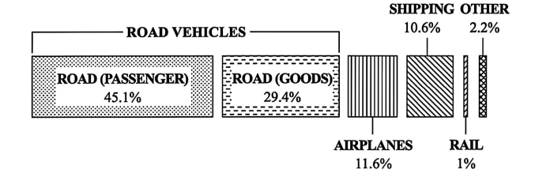
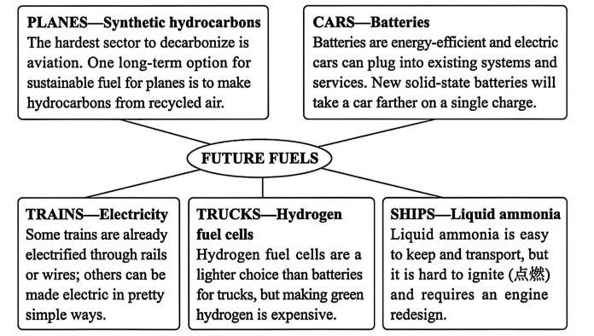

2025年6月全国高考Ⅰ卷A篇 阅读理解满分突破思维策略
The greening of planes, trains and automobiles Moving goods and people around the world is responsible for a large part of global CO₂ emissions (排放). As the world races to decarbonize everything, it faces particular problems with transportation — which accounts for about a quarter of our energy-related greenhouse gas emissions. Here's the breakdown of the emissions in 2018 for different modes of transport.
The fuels for transport need to be not just green, cheap and powerful, but also lightweight and safe enough to be carried around. Each mode of transport has its specific fuel needs. Much is still to be settled, but here are some of the solutions to get us going green.
This energy transition (变革) is global, and the amount of renewable energy the world will need is “a little bit mind-blowing,” says mechanical engineer Keith Wipke at the National Renewable Energy Laboratory. It's estimated that the global demand for electricity could more than double by 2050. Fortunately, analyses suggest that renewables are up to the task. “We need to speed up the development of green energy, and it will all get used,"says Wipke.
21.What percentage of global transport emissions did road vehicles account for in 2018? A.11.6%. B.45.1%.
C.74.5%. D.86.1%.
22.Which mode of transport can go green comparatively easily? A.Planes. B.Trucks.
C.Trains. D.Ships.
23.What does Wipke suggest regarding energy transition? A.Limiting fuel consumption.
B.Putting more effort into renewables. C.Improving energy efficiency.
D.Making electricity more affordable.
微观结构的逻辑分析
段际的逻辑连贯
语篇结构快定位，信息采集巧加工
1.快速读标题，获取文章主旨大意: 不同交通方式的绿色燃料。
2.题干关键词快速回到原文定位信息源：
① 题目=阅读提纲；
② 题目→形成问题链：排放占比 → 相对易实现绿色化的交通方式 → 绿色能源变革的建议。

Slide 6

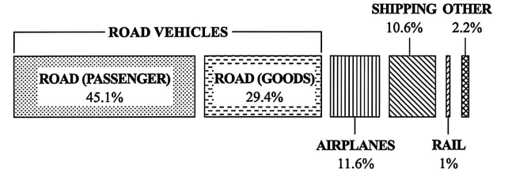

2025年6月全国高考Ⅰ卷A篇 阅读理解满分突破思维策略
The greening of planes, trains and automobiles Moving goods and people around the world is responsible for a large part of global CO₂ emissions (排放). As the world races to decarbonize everything, it faces particular problems with transportation — which accounts for about a quarter of our energy-related greenhouse gas emissions. Here's the breakdown of the emissions in 2018 for different modes of transport.
21.What percentage of global transport emissions did road vehicles account for in 2018? A.11.6%. B.45.1%.
C.74.5%. D.86.1%.
微观结构的逻辑分析
强化敏感捕捉关键信息的意识与能力
21题抓题干关键词 road vehicles
然后在图表中找到ROAD VEHICLES信息，关注数字及计算，根据PASSENGER 45.1% _{(道路(客运)45.1%)}以及GOODS 29.4% _{(道路(货运)29.4%)}可知，道路车辆总占比为45.1% + 29.4% = 74.5%，即道路车辆在2018年全球交通排放中占比74.5%

Slide 7

2025年6月全国高考Ⅰ卷A篇 阅读理解满分突破思维策略
The fuels for transport need to be not just green, cheap and powerful, but also lightweight and safe enough to be carried around. Each mode of transport has its specific fuel needs. Much is still to be settled, but here are some of the solutions to get us going green.
22.Which mode of transport can go green comparatively easily? A.Planes. B.Trucks.
C.Trains. D.Ships.
微观结构的逻辑分析
敏感捕捉关键信息，快速整合加工信息
1.具备敏感捕捉关键信息的意识与能力是秒杀的基础。要快速加工和整合信息：结构化、层次化、要点化、简洁化，完整化、逻辑化。
2.善于捕捉一些意义相同、相似、相反的词，形成语义链，建构逻辑链：从反义表达hardest sector，expensive，it is hard to ignite，快速排除ABD选项，再建构语义链already electrified--pretty simple ways，秒杀正确答案C选项。

Slide 8


2025年6月全国高考Ⅰ卷A篇 阅读理解满分突破思维策略
The greening of planes, trains and automobiles ...
The fuels for transport need to be not just green, cheap and powerful, but also lightweight and safe enough to be carried around. Each mode of transport has its specific fuel needs. Much is still to be settled, but here are some of the solutions to get us going green.
This energy transition (变革) is global, and the amount of renewable energy the world will need is “a little bit mind-blowing,” says mechanical engineer Keith Wipke at the National Renewable Energy Laboratory. It's estimated that the global demand for electricity could more than double by 2050. Fortunately, analyses suggest that renewables are up to the task. “We need to speed up the development of green energy, and it will all get used,"says Wipke.
23.What does Wipke suggest regarding energy transition? A.Limiting fuel consumption.
B.Putting more effort into renewables. C.Improving energy efficiency.
D.Making electricity more affordable.
微观结构的逻辑分析
建构语义场，秒杀正确答案
1.核心词的概念要明确： 本段energy transition 指renewable energy=green energy。选项ACD的核心词概念不对等。
段际的逻辑连贯
2.善于捕捉意义相同、相似的词，联系在一起，形成语义链和高阶逻辑思维。 more than double -- speed up the development --all get used与B选项的Putting more effort同义信息匹配。
警惕“范围（概念）不清”的逻辑错误
D选项干扰性极强，以局部代替整体，即Electricity来混淆renewable energy 的概念，本篇中Synthetic hydrocarbons，Batteries，Electricity，Hydrogen fuel cells，Liquid ammonia只是renewable energy 的一种。 所以阅读过程中，要特别注意关键名词的概念内涵与外延。

Slide 9



A篇语料整理： 语义场建构；改述释义；高频课外单词语境记忆
9.手工制作珠宝 10. 无需注册。 先到先得。 | = altruistic_{利他主义的，无私的} /selfless behavior
1.随着全世界竞相努力实现全面脱碳，
2.以下是2018年不同交通方式的排放细目。
3.非常令人兴奋的
会胜任这项任务
固态电池
相对容易地
4.践行环保 / 节能/ 可再生能源
1.As the world races to decarbonize everything, 构词法：前缀“de-”(表示“去除、减少”) 2.Here’s the breakdown of the emissions in 2018 for different modes of transport. (熟词生义)细目列表; 细目分类 3. mind-blowing be up to the task solid-state batteries comparatively easily 4.go green /energy-efficient / renewable energy =renewables
高频课外单词语境记忆
mind-blowing _{合成词的理解，体现知识迁移}
同话题语义场词汇：培养学生的眼力，善于捕捉一些意义相同、相似的词

Slide 10
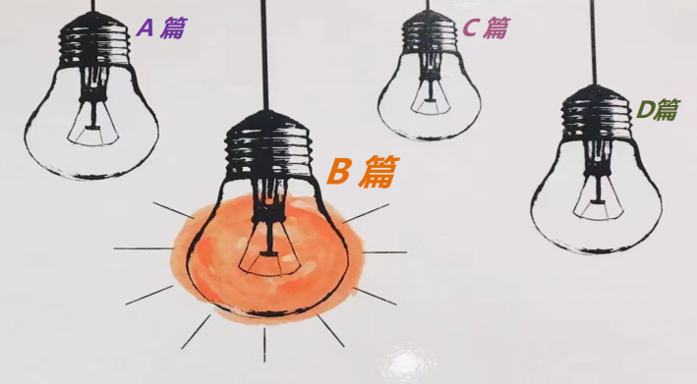
B篇阅读理解满分秒杀策略
1.B篇阅读要强化“作者意识”：
B篇阅读，多为体现立德树人，语言表现力强的记叙文，常常以细腻的语言呈现一个暖心或是励志的故事，考生需强化“作者意识_{含命题者}”，体验不同情感，感受正确的人生观和价值观。
作为阅读者，唯有站在作者的立场上，试着从作者的角度_{（命题人的角度多半也是作者的角度）}出发，去揣测、想象、推敲作者要表达的真实意图，把握人物特征，才能秒懂语言组织之道，才能洞悉文本内涵之妙，并快速精准答题。
Notes:
词汇与结构知识
正式语篇结构知识
内容/世界背景知识
自动识别技能
综合与评价策略
元认知知识与技能监控

Slide 11
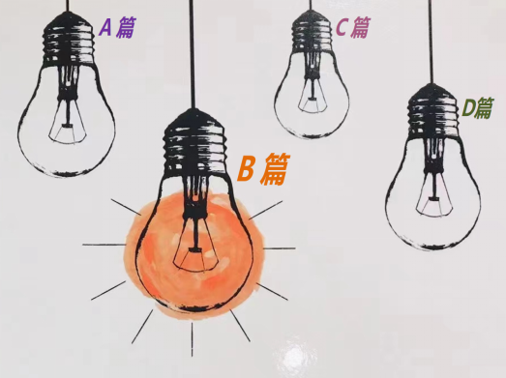
B篇阅读理解满分秒杀策略
2.快速从尾段获取评议，精准读懂文章：
快速从尾段获取人物、情节、情感的主题信息到位。
根据拉波夫叙事模式， B篇记叙文的尾段通常包括评议、结局、回应。 评议是叙事者或故事中人物对事件的看法和态度；结局是故事的完结；回应是故事与现实生活的纽带，用来点明主旨，升华主题。
直接从尾段阅读能快速激发直觉的情感体验，把握文脉走向，预测全文大意，找准文本的情感契合点。情感体验是一种全方位、全历程、全情境的整体性体验，通过后文尾段初步体验（基本可以解决 第27题），再依据试题题干指引，构建语义场，深化文本主题的感悟，分析作者所表达的思想情感，领悟作者的立意。
Notes:
词汇与结构知识
正式语篇结构知识
内容/世界背景知识
自动识别技能
综合与评价策略
元认知知识与技能监控

Slide 12


2025年6月全国高考Ⅰ卷B篇 阅读理解满分突破思维策略
In my ninth-grade writing class last year, I met a cowboy who saved his town, a strict father who demanded his son earn straight A’s, and a modern-day Juliet who died of heartbreak after her parents rejected the love of her young life. More than once, I found myself wondering just how my students, who’d created these people, knew their subjects so well.
But things were different for their first essay, which was about the question: “Why is writing important?” Most of the essays filled less than one page, and few contained a sentence that could be interpreted as a thesis (论点) statement. I was shocked. Then I realized that the problem was the question itself. They could have written pages on the necessity of computers, but writing, in and of itself, simply didn’t strike them as important. This would have to change.
As a new unit started, I asked everyone to write a persuasive piece on a health-related topic of their choice. This time they found the exercise much more interesting. For the next two assignments, a personal-narrative unit followed by a creative-writing workshop, I only required that the piece meet the specifications of its genre (体裁) and that it contain a thesis. The results were staggering. The students took on diverse topics and turned in stories, 10 to 20 pages each, with characters that broadened my view and touched my heart.
I walked into class believing that writing is important as a means of communication. However, my students demonstrated something more important to me. When the final bell rang in June, I walked away with a yearbook full of messages about writing’s most powerful significance — the ability to connect people, to put us in another’s skin, to teach us what it means to be human.
26.What does the underlined word “staggering”in paragraph 3 mean?
A.Mixed. B.Amazing.
C.Similar. D.Disturbing.
27.What does the author's experience show?
A.Teaching is learning. B.Still waters run deep.
C.Knowledge is power. D.Practice makes perfect.
微观结构的逻辑分析
快速从尾段获取人物、情节、情感到位
直接从尾段阅读能快速激发直觉的情感体验，把握文脉走向，了解全文大意，找准文本的情感契合点。
本篇以夹叙夹议的方式，启发考生运用批判性思维和辩证思维深人思考文章主题和思想内涵，理清两条叙事主线：学生进步和我的收获。
快速锁定27题A选项“Teaching is learning _{(教学相长)}”符合第3段broadened my view and touched my heart和第4段 my students demonstrated something more important to me的信息推断和归纳。
根据构建语义链，形成逻辑链，第26题“The results were...”应是“显著的，惊人的”。
段际的逻辑连贯

Slide 13



2025年6月全国高考Ⅰ卷B篇 阅读理解满分突破思维策略
In my ninth-grade writing class last year, I met a cowboy who saved his town, a strict father who demanded his son earn straight A’s, and a modern-day Juliet who died of heartbreak after her parents rejected the love of her young life. More than once, I found myself wondering just how my students, who’d created these people, knew their subjects so well.
But things were different for their first essay, which was about the question: “Why is writing important?” Most of the essays filled less than one page, and few contained a sentence that could be interpreted as a thesis (论点) statement. I was shocked. Then I realized that the problem was the question itself. They could have written pages on the necessity of computers, but writing, in and of itself, simply didn’t strike them as important. This would have to change.
As a new unit started, I asked everyone to write a persuasive piece on a health-related topic of their choice. This time they found the exercise much more interesting. For the next two assignments, a personal-narrative unit followed by a creative-writing workshop, I only required that the piece meet the specifications of its genre (体裁) and that it contain a thesis. The results were staggering. The students took on diverse topics and turned in stories, 10 to 20 pages each, with characters that broadened my view and touched my heart.
I walked into class believing that writing is important as a means of communication. However, my students demonstrated something more important to me. When the final bell rang in June, I walked away with a yearbook full of messages about writing’s most powerful significance — the ability to connect people, to put us in another’s skin, to teach us what it means to be human.
24.Who are the people mentioned at the beginning of paragraph 1?
A.Ninth graders. B.Students' parents.
C.Modern writers. D.Fictional characters.
25.Why did the students perform poorly in writing their first essay?
A.They were not given enough time.
B.They had a very limited vocabulary.
C.They misunderstood the question.
D.They had little interest in the topic.
微观结构的逻辑分析
24题考查归纳和迁移的高阶思维
these people= their subjects是对前文的归纳；created these people是结合语境，迁移理解为“写作中创造出来的虚构人物，即Fictional characters”
25题：警惕“张冠李戴/ 偷梁换柱”的逻辑错误
段际的逻辑连贯
C选项极具干扰性，与原文高度相似，一半是一半非，似是而非。命题者用核心词“the question”挖坑布陷阱；与此同时，命题者会在不易引人注意的地方换了一两个词汇造成句意的改变；或者把一个事物的特征说成是另一个事物的特征；或者把他人的观点说成是作者的观点。如本题C选项的 misunderstood是对文本的曲解。
正确答案通常是对原文信息的同义改写，其全部信息一定都能从文中找到依据和逻辑关联。D选项的They had little interest = writing simply didn't strike them as important； the topic = the question: “Why is writing important?”
依据统一语境_{(如本题中的the question)，}寻找词义
延伸方式和过程，善于扫描同义词/同话题词：
本文就“写作的重要性和意义？”建构语义链, 形成逻辑链，writing simply didn't strike
them as important→change→much
more interesting，D选项吻合语义。

Slide 14
B篇语料整理： 语义场建构；改述释义；高频课外单词语境记忆
9.手工制作珠宝 10. 无需注册。 先到先得。 | = altruistic_{利他主义的，无私的} /selfless behavior
5.被解释为主题语句
6.就其本身而言，写作对他们来说根本不算是一件重要的事情。
7.结果令人震惊。
8.设身处地为某人着想
9.虚构的人物角色/ 合乎规格/ 最终收获一本年刊
10.教学相长/静水流深;大智若愚
5.be interpreted as a thesis statement /ɪnˈtɜːprət/ 解释，说明；口译；把……理解为；演绎 6.Writing, in and of itself, simply didn’t strike them as important. 给（某人以……）印象；让（某人）觉得 7.The results were staggering. 8. put sb in another’s skin =put oneself in someone else's shoes 9. fictional characters meet the specifications _{/ˌspesɪfɪˈkeɪʃn/ 规格，规范} walk away with a yearbook 10. Teaching is learning. / Still waters run deep.
stagger_{摇摇晃晃地走，蹒跚的}一词多义
拓展多种表达和思维方式

Slide 15

CD篇阅读理解高分突破思维策略
1. 用有限的词汇 获取 最有用信息
用有限的时间 获取 最精准答案
CD篇是纸老虎，战略上藐视，勇于四两拨千斤把握主线；
战术上重视，善于语篇解构和语义建构
2. 科学打开阅读理解的方式：
① 找到主题句/文章主旨大意（一般在第一段）
② 了解文章的框架结构/语篇组织（what/ why/ how/ whether, 也是思维的切入口）
③ 做题与看文章同步交替进行（题目=阅读提纲）
3. C、D篇：
①科学研究类说明文往往第一段呈现研究发现或结论（文章主旨）
● ②路标词，带出作者真正写作意图：However, but, in fact, actually；
studys find out (研究发现/表明…)
4. 先做 单点信息题（猜词，态度、段落或文章主旨）
再做 多点信息题（细节理解；文章主旨）
Notes:
词汇与结构知识
正式语篇结构知识
内容/世界背景知识
自动识别技能
综合与评价策略
元认知知识与技能监控

Slide 16

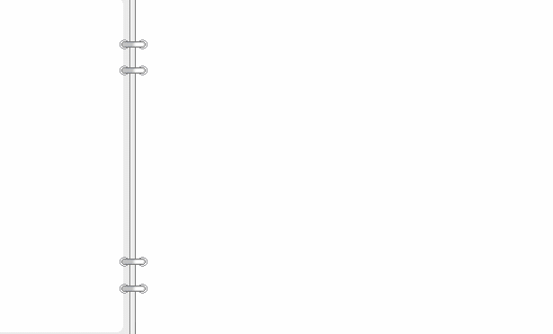
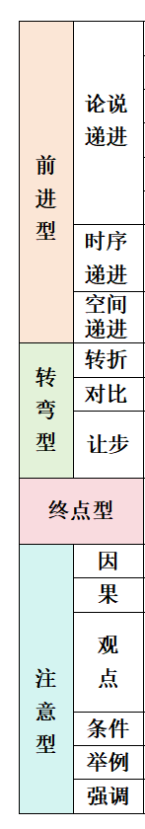
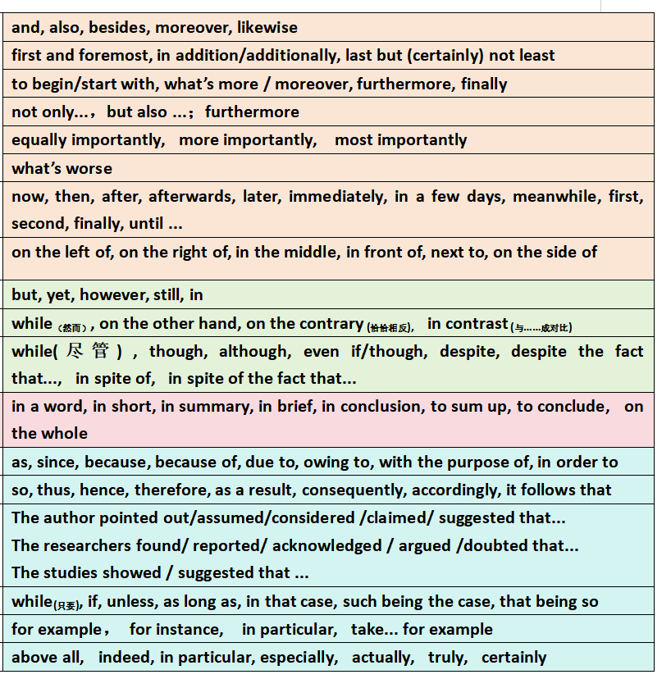

四类路标词：
彰显逻辑，快速解构

Slide 17

2025年6月全国高考Ⅰ卷C篇 阅读理解满分突破思维策略
——语篇解构
What phenomenon
While safety improvements might have been made to our streets in recent years, transport studies also show declines in pedestrian (行人) mobility, especially among young children. Many parents say there’s too much traffic on the roads for their children to walk safely to school, so they pack them into the car instead.
Dutch authors Thalia Verkade and Marco te Br mmelstroet are bothered by facts like these. In their new book Movement: How to Take Back Our Streets and Transform Our Lives, they call for a rethink of our streets and the role they play in our lives.
Life on city streets started to change decades ago. Whole neighbourhoods were destroyed to make way for new road networks and kids had to play elsewhere. Some communities fought back. Most famously, a Canadian journalist who had moved her family to Manhattan in the early 1950s led a campaign to stop the destruction of her local park. Describing her alarm at its proposed replacement with an expressway, Jane Jacobs called on her mayor (市长) to champion “New York as a decent place to live, and not just rush through.” Similar campaigns occurred in Australia in the late 1960s and 1970s as well.
Although these campaigns were widespread, the reality is that the majority of the western cities were completely redesigned around the needs of the motor car. The number of cars on roads has been increasing rapidly. In Australia we now have over twenty million cars for just over twenty-six million people, among the highest rate of car ownership in the world.
We invest a lot in roads that help us rush through, but we fail to account for the true costs. Do we really recognise what it costs us as a society when children can’t move safely around our communities? The authors of Movement have it right: it’s time to think differently about that street outside your front door.
28. What phenomenon does the author point out in paragraph 1?
29. What were the Canadian journalist and other campaigners trying to do?
30. What can be inferred about the campaigns in Australia in the late 1960s and 1970s?
31. What can be a suitable title for the text?
路标词
微观结构的逻辑分析
How+ rethink
How
利用路标词厘清语篇框架结构：
有助于快速解构语篇宏观模式，有效彰显作者的写作思路，带出作者真正写作意图： studies show...，the reality is that...，but...。
抓住关键词复现，确定篇章结构:
运用语篇分析手段，从语境、信息、结构等层面分析文本，理清文本内在的错综复杂的关系。在快速浏览中抓住关键词复现与呼应 rethink →think differently，本篇区分于传统的单一的“问题解决”模式，属于“问题+解决+失败反思”模式，What phenomenon---How---What reality---Why fail + think differently。聚焦主题 streets and the role they play in our lives，“反思街道功能，重视城市宜居性”。考查学生批判性思维。
段际的逻辑连贯
路标词
What reality
路标词
Why fail + think differently

Slide 18
2025年6月全国高考Ⅰ卷C篇 阅读理解满分突破思维策略
While safety improvements might have been made to our streets in recent years, transport studies also show declines in pedestrian (行人) mobility, especially among young children. Many parents say there’s too much traffic on the roads for their children to walk safely to school, so they pack them into the car instead.
Dutch authors Thalia Verkade and Marco te Br mmelstroet are bothered by facts like these. In their new book Movement: How to Take Back Our Streets and Transform Our Lives, they call for a rethink of our streets and the role they play in our lives.
Life on city streets started to change decades ago. Whole neighbourhoods were destroyed to make way for new road networks and kids had to play elsewhere. Some communities fought back. Most famously, a Canadian journalist who had moved her family to Manhattan in the early 1950s led a campaign to stop the destruction of her local park. Describing her alarm at its proposed replacement with an expressway, Jane Jacobs called on her mayor (市长) to champion “New York as a decent place to live, and not just rush through.” Similar campaigns occurred in Australia in the late 1960s and 1970s as well.
Although these campaigns were widespread, the reality is that the majority of the western cities were completely redesigned around the needs of the motor car. The number of cars on roads has been increasing rapidly. In Australia we now have over twenty million cars for just over twenty-six million people, among the highest rate of car ownership in the world.
We invest a lot in roads that help us rush through, but we fail to account for the true costs. Do we really recognise what it costs us as a society when children can’t move safely around our communities? The authors of Movement have it right: it’s time to think differently about that street outside your front door.
28. What phenomenon does the author point out in paragraph 1?
A. Cars often get stuck on the road.
B. Traffic accidents occur frequently.
C. People walk less and drive more.
D. Pedestrians fail to follow the rules.
29. What were the Canadian journalist and other campaigners trying to do?
A Keep their cities livable.
B. Promote cultural diversity.
C. Help the needy families.
D. Make expressways accessible.
30. What can be inferred about the campaigns in Australia in the late 1960s and 1970s?
A. They boosted the sales of cars.
B. They turned out largely ineffective.
C. They won government support.
D. They advocated building new parks.
快速paraphrase同义信息匹配
段际的逻辑连贯
paraphrase(释义，改述，换说)的地方往往是秒杀正确答案的突破点：a decent place to live = livable。不能理解decent意思的考生，也可借助上文语境 stop the destruction of her local park，并利用排除法，找到正确选项A.
路标词
路标词
从段际逻辑关系搭建信息流flow通道
30题的定位词在第3段，但信息重点在第4段，尤其是路标词 the reality暗含作者真正写作意图，around the needs of the motor car--cars on roads has been increasing--the highest rate of car ownership形成语义链，整合信息流flow通道，得出“事与愿违，收效甚微”，即ineffective的结论。

Slide 19

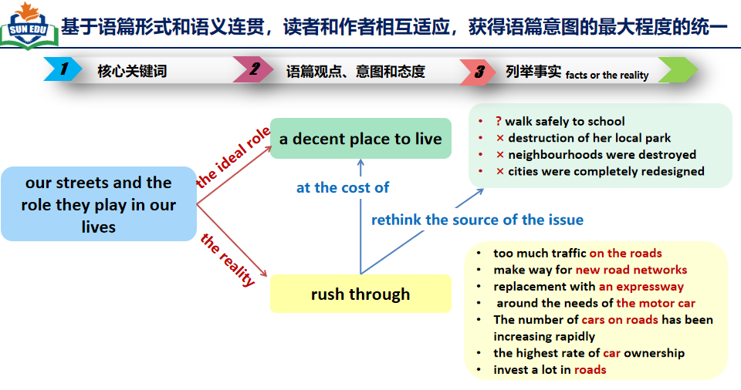


2025年6月全国高考Ⅰ卷C篇 阅读理解满分突破思维策略
While safety improvements might have been made to our streets in recent years, transport studies also show declines in pedestrian (行人) mobility, especially among young children. Many parents say there’s too much traffic on the roads for their children to walk safely to school, so they pack them into the car instead.
Dutch authors Thalia Verkade and Marco te Br mmelstroet are bothered by facts like these. In their new book Movement: How to Take Back Our Streets and Transform Our Lives, they call for a rethink of our streets and the role they play in our lives.
Life on city streets started to change decades ago. Whole neighbourhoods were destroyed to make way for new road networks and kids had to play elsewhere. Some communities fought back. Most famously, a Canadian journalist who had moved her family to Manhattan in the early 1950s led a campaign to stop the destruction of her local park. Describing her alarm at its proposed replacement with an expressway, Jane Jacobs called on her mayor (市长) to champion “New York as a decent place to live, and not just rush through.” Similar campaigns occurred in Australia in the late 1960s and 1970s as well.
Although these campaigns were widespread, the reality is that the majority of the western cities were completely redesigned around the needs of the motor car. The number of cars on roads has been increasing rapidly. In Australia we now have over twenty million cars for just over twenty-six million people, among the highest rate of car ownership in the world.
We invest a lot in roads that help us rush through, but we fail to account for the true costs. Do we really recognise what it costs us as a society when children can’t move safely around our communities? The authors of Movement have it right: it’s time to think differently about that street outside your front door.
31. What can be a suitable title for the text?
A. Why the Rush? B. What’s Next?
C. Where to Stay? D. Who to Blame?
微观结构的逻辑分析
标题蕴含文章要义和内核，
凝练语篇价值和特色:
★
★
标题是主题语境的浓缩，根据文章中核心
词汇streets and the role以及它的下义词a decent place to live和rush through，列举大量事实说明“过度的公路和汽车 = the Rush _{快速通行}”，其代价是“街道功能和城市宜居性的丢失”，呼吁重新思考_{think differently} 问题根源和街道功能。(见思维导图)
★
警惕“推理过度，主观臆断”逻辑错误：
D选项有干扰性，命题人根据原文信息“大量的
街道功能和城市宜居性的丢失的事实”，做了一种貌似合理的推理，让考生掉入陷阱“Blame”，是没有基于事实与逻辑的推理过度，文章里没有问责，而是呼吁重新思考根源the Rush，并提出质疑Why?
务必确保所选答案确有出处，必然能在原文中
找到依据的，符合原意，切不可轻信感觉或仅凭常理或按自己主观意愿判断 。
★

Slide 20

基于语篇形式和语义连贯，读者和作者相互适应，获得语篇意图的最大程度的统一
1
2
核心关键词
语篇观点、意图和态度
3
列举事实 _{facts or the reality}
? walk safely to school
× destruction of her local park
× neighbourhoods were destroyed
× cities were completely redesigned
a decent place to live
the ideal role
our streets and the role they play in our lives
at the cost of
rethink the source of the issue
the reality
too much traffic on the roads
make way for new road networks
replacement with an expressway
around the needs of the motor car
The number of cars on roads has been increasing rapidly
the highest rate of car ownership
invest a lot in roads
rush through
从某种意义上讲，解读语篇连贯性是读者对语篇已有信息进行
解构和重构，从语篇连贯性角度探究阅读理解的解题方法和高阶思维的形成过程，可以增强解题过程的理据性和明见性，如：1.语篇主题连贯性；2.自然段内部的连贯性；3.词汇衔接连贯；4.语义连贯与小句关系；5.段落间的连贯性；6.语篇心理连贯；7.语篇缺省信息连贯。

Slide 21
C篇语料整理： 语义场建构；改述释义；高频课外单词语境记忆
9.手工制作珠宝 10. 无需注册。 先到先得。 | = altruistic_{利他主义的，无私的} /selfless behavior
11.行人出行流动性的下降
12.对当地公园拟被改建为高速公路深感忧虑
13.一个宜居的地方
14.给…让路;为…让出位置
15.没有考虑到真正的成本
约占据我们与能源有关的温室气体排放的四分之一
11.declines in pedestrian mobility
12.alarm at local park’s proposed replacement with an expressway
13. a decent_{/ˈdiːsnt/像样的；得体的，合宜的} place to live
= livable = habitable
14.make way for
15.fail to account for the true costs
account for about a quarter of our energy-related greenhouse gas emissions
改述释义，学习多种表达和思维方式
account for的一词多义

Slide 22
2025年6月全国高考Ⅰ卷D篇 阅读理解满分突破思维策略
——语篇解构
★
Microplastics have become a common source of pollution across the Earth — they have settled in the deep sea and on the Himalayas, stuck inside volcanic rocks, filled the stomachs of seabirds and even fallen in fresh Antarctic snow. They are even appearing inside humans.
Now, new research suggests that a simple, cheap measure may significantly reduce the level of microplastics in water from your tap (水龙头): boiling and filtering (过滤) it. In a study published Wednesday in Environmental Science & Technology Letters, researchers from China found that boiling tap water for just five minutes — then filtering it after it cools — could remove at least 80 percent of its microplastics.
Crucially, this process relies on the water containing enough calcium carbonate (碳酸钙) to trap the plastics. In the study, boiling hard water containing 300 milligrams of calcium carbonate led to an almost 90 percent drop in plastics. But in samples with less than 60 milligrams of calcium carbonate, boiling reduced the level of plastics by just 25 percent. Additionally, the research didn’t include all types of plastics. The team focused only on three common types — polystyrene, polyethylene and polypropylene — and they didn’t study other chemicals previously found in water such as vinyl chloride.
Still, the findings show a potential path forward for reducing microplastic exposure — a task that’s becoming increasingly difficult. Even bottled water, scientists found earlier this year, contains 10 to 1,000 times more microplastics than originally thought.
Scientists are still trying to determine how harmful microplastics are — but what they do know has raised concerns. The new study suggests boiling tap water could be a tool to limit intake. “The way they demonstrated how microplastics were trapped through the boiling process was nice,” Caroline Gauchotte-Lindsay, an environmental engineer of the University of Glasgow in Scotland who was not involved in the research, tells New Scientist. “We should be looking into upgrading drinking water treatment plants so they remove microplastics.”
32. How does the author present the issue in the first paragraph?
33. What determines the effectiveness of trapping microplastics in water?
34. What does the author try to illustrate by mentioning bottled water in paragraph 4?
35. What is Gauchotte-Lindsay’s suggestion about?
Present the issue：_{Microplastics}
微观结构的逻辑分析
路标词
★
★
Propose a solution: _{boiling and filtering}
路标词
厘清语篇框架结构
Crucial factor: _{calcium carbonate}
快速了解本文的框架结构是解题关键：第一段呈现问题：微塑料污染普遍性，捕捉核心词Microplastic；第二段提出方法，煮沸和过滤自来水；第三段关键因素，碳酸钙含量；第四段实际挑战，日益困难；第五段未来前景，升级饮用水处理厂，符合“问题-解决” _{(Problem-solution pattern)} 的篇章模式，搭建了信息流flow的通道。
定位宏观信息，提炼主旨与篇章结构，有利于对信息理解的全面性和思维的深刻性。
路标词
Actual challenge: _{increasingly difficult}
Future prospect: _{upgrading plants}
★

Slide 23

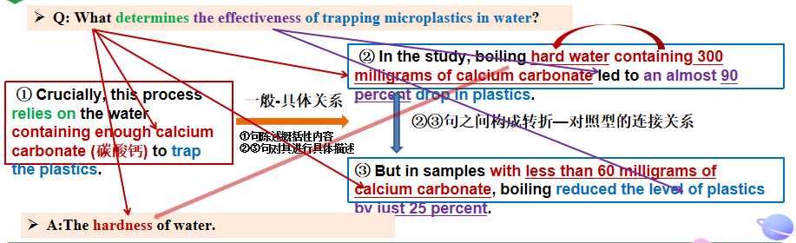

2025年6月全国高考Ⅰ卷D篇 阅读理解满分突破思维策略
Microplastics have become a common source of pollution across the Earth — they have settled in the deep sea and on the Himalayas, stuck inside volcanic rocks, filled the stomachs of seabirds and even fallen in fresh Antarctic snow. They are even appearing inside humans.
Now, new research suggests that a simple, cheap measure may significantly reduce the level of microplastics in water from your tap (水龙头): boiling and filtering (过滤) it. In a study published Wednesday in Environmental Science & Technology Letters, researchers from China found that boiling tap water for just five minutes — then filtering it after it cools — could remove at least 80 percent of its microplastics.
Crucially, this process relies on the water containing enough calcium carbonate (碳酸钙) to trap the plastics. In the study, boiling hard water containing 300 milligrams of calcium carbonate led to an almost 90 percent drop in plastics. But in samples with less than 60 milligrams of calcium carbonate, boiling reduced the level of plastics by just 25 percent. Additionally, the research didn’t include all types of plastics. The team focused only on three common types — polystyrene, polyethylene and polypropylene — and they didn’t study other chemicals previously found in water such as vinyl chloride.
Still, the findings show a potential path forward for reducing microplastic exposure — a task that’s becoming increasingly difficult. Even bottled water, scientists found earlier this year, contains 10 to 1,000 times more microplastics than originally thought.
Scientists are still trying to determine how harmful microplastics are — but what they do know has raised concerns. The new study suggests boiling tap water could be a tool to limit intake. “The way they demonstrated how microplastics were trapped through the boiling process was nice,” Caroline Gauchotte-Lindsay, an environmental engineer of the University of Glasgow in Scotland who was not involved in the research, tells New Scientist. “We should be looking into upgrading drinking water treatment plants so they remove microplastics.”
32. How does the author present the issue in the first paragraph?
A. By quoting an expert. B. By defining a concept.
C. By giving examples. D. By providing statistics.
33. What determines the effectiveness of trapping microplastics in water?
A. The hardness of water.
B. The length of cooling time.
C. The frequency of filtering.
D. The type of plastic in water.
微观结构的逻辑分析
考查对逻辑关系的分析能力
通过列举微塑料存在于......等具体例子，属于举例说明_{（giving examples）}说明其污染的普遍性 Microplastics have become a common source of pollution across the Earth 。关注段首句后的破折号，起进一步解释说明的作用。
33题：利用小句的逻辑-语义关系，进行合理判析推理：
段际的逻辑连贯
小句关系是语篇连贯性的基础，是指小句间的语义关系和逻辑关系，主要有次序关系、范围关系、一般-具体关系、层次关系、对照关系、问题-解决方法关系、依靠关系、假设-真实关系、扩展关系(程晓堂、王琦，2004)。对词语含义的推测需要学生根据词汇所在的上下文语境，剖析小句之间的关系，从而在语境中理解词汇意义。
阅读过程是解构的过程，需要培养学生分析句内、句际、段落间及其与主题的逻辑关系，推断文字表达的语义，进而解决阅读理解问题，发展逻辑思维。高考试题中分析与推断类试题可通过剖析语篇衔接手段和小句关系所表达的意义来解答。
语义连贯分析概念成分上的照应性
本题难点在于“水的硬度hardness”即“碳酸钙含量”的概念成分上的照应性。小句关系
是逻辑-语义连贯的重要形式， the water containing enough calcium carbonate 与下句
hard water containing ...是同质性话题。

Slide 24

构建语义链和语义场，分析语篇衔接手段和小句关系所表达的意义，激活认知
Q: What determines the effectiveness of trapping microplastics in water?
② In the study, boiling hard water containing 300 milligrams of calcium carbonate led to an almost 90 percent drop in plastics.
① Crucially, this process relies on the water containing enough calcium carbonate (碳酸钙) to trap the plastics.
一般-具体关系
②③句之间构成转折—对照型的连接关系
①句陈述概括性内容
②③句对其进行具体描述
③ But in samples with less than 60 milligrams of calcium carbonate, boiling reduced the level of plastics by just 25 percent.
A: The hardness of water.
段际的逻辑连贯
②③句之间构成转折—对照型的连接关系，煮沸硬水(含300毫克碳酸钙)可减少近 90%的微塑料，而煮沸低碳酸钙含量的水仅减少25%的微塑料。由此可知，碳酸钙含量直接决定去除微塑料的有效性。
通过词汇衔接①句 enough calcium carbonate 与②句hard water_{硬水} containing 300 milligrams of calcium carbonate_{高碳酸钙含量}的同义词复现与③句in samples with less than 60 milligrams of calcium carbonate反义词复现，我们可以建立“hard water硬水” 即 “碳酸钙含量高”的概念成分上的照应性，利用命题发展的索引性(即能从语篇中发现命题发展的线索，信息的关联)，找到A选项的关键词专业性较强的术语“hardness”。
解答此类专业性强的题目令考生非常头痛，我们一定要自信地根据上下文语境，构建语义链和语义场，分析语篇衔接手段和小句关系所表达的意义，语用推理上的顺应性，进而推断语义，激活语篇信息在心智上形成跨专业知识的统一认知。

Slide 25

2025年6月全国高考Ⅰ卷D篇 阅读理解满分突破思维策略
Microplastics have become a common source of pollution across the Earth — they have settled in the deep sea and on the Himalayas, stuck inside volcanic rocks, filled the stomachs of seabirds and even fallen in fresh Antarctic snow. They are even appearing inside humans.
Now, new research suggests that a simple, cheap measure may significantly reduce the level of microplastics in water from your tap (水龙头): boiling and filtering (过滤) it. In a study published Wednesday in Environmental Science & Technology Letters, researchers from China found that boiling tap water for just five minutes — then filtering it after it cools — could remove at least 80 percent of its microplastics.
Crucially, this process relies on the water containing enough calcium carbonate (碳酸钙) to trap the plastics. In the study, boiling hard water containing 300 milligrams of calcium carbonate led to an almost 90 percent drop in plastics. But in samples with less than 60 milligrams of calcium carbonate, boiling reduced the level of plastics by just 25 percent. Additionally, the research didn’t include all types of plastics. The team focused only on three common types — polystyrene, polyethylene and polypropylene — and they didn’t study other chemicals previously found in water such as vinyl chloride.
Still, the findings show a potential path forward for reducing microplastic exposure — a task that’s becoming increasingly difficult. Even bottled water, scientists found earlier this year, contains 10 to 1,000 times more microplastics than originally thought.
Scientists are still trying to determine how harmful microplastics are — but what they do know has raised concerns. The new study suggests boiling tap water could be a tool to limit intake. “The way they demonstrated how microplastics were trapped through the boiling process was nice,” Caroline Gauchotte-Lindsay, an environmental engineer of the University of Glasgow in Scotland who was not involved in the research, tells New Scientist. “We should be looking into upgrading drinking water treatment plants so they remove microplastics.”
34. What does the author try to illustrate by mentioning bottled water in paragraph 4?
A. The importance of plastic recycling.
B. The severity of the microplastic problem.
C. The danger in overusing pure water.
D. The difficulty in treating polluted water.
警惕“偷换概念”逻辑错误：
微观结构的逻辑分析
D选项有干扰性，difficulty与原文意义相符。但命题人利用treating polluted water偷换了microplastic problem的概念。从逻辑推理角度犯了“偷换概念，偷梁换柱”的错误，偷换概念包含：
1.表述范围过泛、过偏、过窄或与过远：treating polluted water范围太大，本文及本段的中心词是microplastic problem。
2.偷换中心词，中心词不全：有的干扰选项中虽然涉及文章里反复出现的信息，包含其中一个中心词，但其他的信息却是命题人编造出来的，并未涵盖另一个中心词，此类选项无法充当文章主旨。
解题技巧提示：阅读中我们要从整体上感知，准确寻找出原文中与选项对应的语句，找出语句含有的意义，提取与答案相关的信息。。
精通词义延伸方式和过程
考生要深谙词义延伸方式和过程：本段转折到“尽管找到减少微塑料接触的潜在途径”，但实际是一项日益困难的任务，引出该观点和核心关键词“increasingly difficult”。
与后句形成一般-具体的小句关系，作者甚至举出大家都认为是安全的饮用水bottled water的例子，利用数据事实 “ 10 to 1,000 times more microplastics than originally thought”证明上句的观点，说明问题严重（severity）。increasingly difficult---10 to 1,000 times more microplastics--- severity 存在复现的关系形成词汇链和语义链。
段际的逻辑连贯
路标词

Slide 26

2025年6月全国Ⅰ卷D篇 阅读理解满分突破思维策略——最有争议性的B or D?
Microplastics have become a common source of pollution across the Earth — they have settled in the deep sea and on the Himalayas, stuck inside volcanic rocks, filled the stomachs of seabirds and even fallen in fresh Antarctic snow. They are even appearing inside humans.
Now, new research suggests that a simple, cheap measure may significantly reduce the level of microplastics in water from your tap (水龙头): boiling and filtering (过滤) it. In a study published Wednesday in Environmental Science & Technology Letters, researchers from China found that boiling tap water for just five minutes — then filtering it after it cools — could remove at least 80 percent of its microplastics.
Crucially, this process relies on the water containing enough calcium carbonate (碳酸钙) to trap the plastics. In the study, boiling hard water containing 300 milligrams of calcium carbonate led to an almost 90 percent drop in plastics. But in samples with less than 60 milligrams of calcium carbonate, boiling reduced the level of plastics by just 25 percent. Additionally, the research didn’t include all types of plastics. The team focused only on three common types — polystyrene, polyethylene and polypropylene — and they didn’t study other chemicals previously found in water such as vinyl chloride.
Still, the findings show a potential path forward for reducing microplastic exposure — a task that’s becoming increasingly difficult. Even bottled water, scientists found earlier this year, contains 10 to 1,000 times more microplastics than originally thought.
Scientists are still trying to determine how harmful microplastics are — but what they do know has raised concerns. The new study suggests boiling tap water could be a tool to limit intake. “The way they demonstrated how microplastics were trapped through the boiling process was nice,” Caroline Gauchotte-Lindsay, an environmental engineer of the University of Glasgow in Scotland who was not involved in the research, tells New Scientist. “We should be looking into upgrading drinking water treatment plants so they remove microplastics.”
35. What is Gauchotte-Lindsay’s suggestion about?
A Choice of new research methods.
B. Possible direction for further study.
C. Need to involve more researchers.
D. Potential application of the findings.
微观结构的逻辑分析
1.从语篇组织宏观结构上考虑
英语语篇通常属于演绎型的直线型思维模式，第二段提出方法，亮观点“ a simple, cheap measure” 并形成一条语义链贯穿全文“--a potential path-- a tool to limit intake--The way was nice”，对“小方法解决大问题”一直是肯定态度。
结尾不是对开头的简单重复，而是对前面内容的总结或补充。本篇前文_{（第二段）}已经有立论，尾段借用专家Caroline的观点，作进一步客观评价_{（was nice，与前文呼应）}和补充。
Caroline并非在杂志Environmental Science & Technology Letters上针对“研究”本身，而是在杂志 New Scientist 作进一步肯定认同_{（was nice）}并在此基础上补充意见，目的是推广该技术。

Slide 27
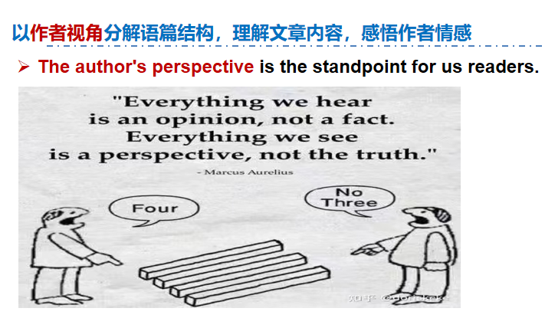

2025年6月全国Ⅰ卷D篇 阅读理解满分突破思维策略——最有争议性的B or D?
Microplastics have become a common source of pollution across the Earth — they have settled in the deep sea and on the Himalayas, stuck inside volcanic rocks, filled the stomachs of seabirds and even fallen in fresh Antarctic snow. They are even appearing inside humans.
Now, new research suggests that a simple, cheap measure may significantly reduce the level of microplastics in water from your tap (水龙头): boiling and filtering (过滤) it. In a study published Wednesday in Environmental Science & Technology Letters, researchers from China found that boiling tap water for just five minutes — then filtering it after it cools — could remove at least 80 percent of its microplastics.
Crucially, this process relies on the water containing enough calcium carbonate (碳酸钙) to trap the plastics. In the study, boiling hard water containing 300 milligrams of calcium carbonate led to an almost 90 percent drop in plastics. But in samples with less than 60 milligrams of calcium carbonate, boiling reduced the level of plastics by just 25 percent. Additionally, the research didn’t include all types of plastics. The team focused only on three common types — polystyrene, polyethylene and polypropylene — and they didn’t study other chemicals previously found in water such as vinyl chloride.
Still, the findings show a potential path forward for reducing microplastic exposure — a task that’s becoming increasingly difficult. Even bottled water, scientists found earlier this year, contains 10 to 1,000 times more microplastics than originally thought.
Scientists are still trying to determine how harmful microplastics are — but what they do know has raised concerns. The new study suggests boiling tap water could be a tool to limit intake. “The way they demonstrated how microplastics were trapped through the boiling process was nice,” Caroline Gauchotte-Lindsay, an environmental engineer of the University of Glasgow in Scotland who was not involved in the research, tells New Scientist. “We should be looking into upgrading drinking water treatment plants so they remove microplastics.”
35. What is Gauchotte-Lindsay’s suggestion about?
A Choice of new research methods.
B. Possible direction for further study.
C. Need to involve more researchers.
D. Potential application of the findings.
微观结构的逻辑分析
2.从作者视角上考虑_{(关注人称代词)}
从 作者立场，用了“ your tap”，说明该方法研究仅限于“读者家里或办公室”。
Caroline Gauchotte-Lindsay的身份是工程师和非参与研究的人员，其观点立场 they demonstrated...，不适宜针对研究本身谈Possible direction for further study，而是基于We should...视角谈该研究发现对整个社会的效益，建议将该研究发现由“家里或办公室”应用到更大场景“饮用水处理
厂的升级改造”之中，更好
服务人类社会。

Slide 28
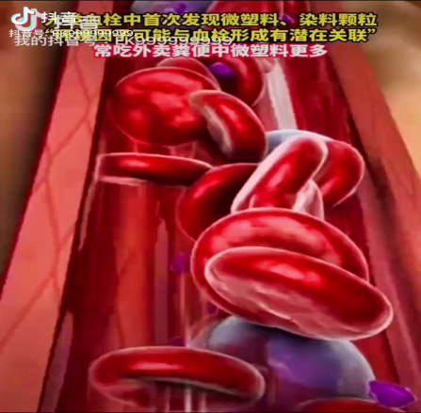
D篇语料整理： 语义场建构；改述释义；高频课外单词语境记忆
9.手工制作珠宝 10. 无需注册。 先到先得。 | = altruistic_{利他主义的，无私的} /selfless behavior
16. drinking water treatment plants
17. The way they demonstrated how_{引导宾语从句} microplastics were trapped through the boiling process_{定语从句} was nice.
18. crucially/ previously/ originally
19. hardness
severity
intake
upgrade
新课程标准对阅读理解之词义理解的要求：
1.一词多义或熟词生义：词义并非完全等同词典中所标注的汉语意思，其在不同的语境中会有所不同。根据上下文正确理解灵活变化的词义，才算是真正初步具备了一定的阅读理解能力。
2.派生词：根据构词法知识，已知的词根、前缀或后缀来猜测新词的意义。
3.知识迁移，合成词的理解：合成词是由两个或多个单词组合而成的新词，通常结合语境去开放性理解合成词的综合意义。
16.饮用水处理厂
17.他们展示的微塑料是如何通过煮沸过程被捕获的方式很好。
18.关键地/ 先前/ 起初
19.硬度 /严重(性)/ 摄入量 / 升级

Slide 29
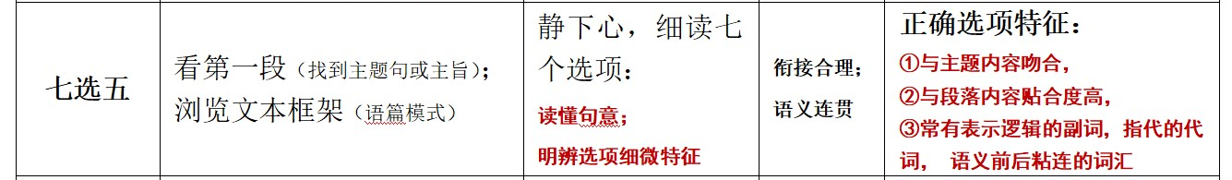

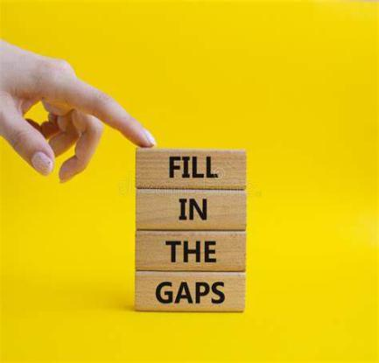



“七选五”思维模式路径优化——宏观结构+微观语义+逻辑推理
1
分析语篇结构，标识选项特征
2
跳序定位答案，熟练抽丝剥茧
3
聚焦语义连贯，紧扣主旨意义
阅读理解“七选五”题型主要考查考生对文章的整体内容和结构以及上下文逻辑意义的理解和掌握。该阅读题型的实质是句子填空，让学生将句子空白补充完整，“形投意合”，使语篇内容合情，逻辑合理，行文合法，既考查考生对文章整体内容的理解能力，又考查考生对语篇结构的分析能力以及通过上下文的表述来进行逻辑思考和推理的能力。
七选五题型的答案牵一发而动全身，需步步为营，抽丝剥茧，精细操作，“形投意合”，选出粘连度高的正确选项。
Notes:
词汇与结构知识
正式语篇结构知识
内容/世界背景知识
自动识别技能
综合与评价策略
元认知知识与技能监控

Slide 30

确定文章主旨
浏览文本框架
2025年6月全国高考Ⅰ卷七选五满分突破思维策略：
An Unsung Hero Need a break between classes or just a quick pick-me-up in the morning? The College Cafe has just that, and more. _____36_____ Catherine Murphy, a cafe worker in a green shirt and black hat, makes sure that each customer gets exactly what they order. She goes back and forth between machines to make the drinks. _____37_____ As the customer grabs the drink from her hand, she smiles and says, “Hello, how is your day?” Even when the line is getting longer, she doesn’t let it get in the way of her genuine conversations. Murphy gets up at a quarter to five and drives thirty minutes every day to get to work on time. _____38_____ “I do so because I like to make coffee for the students. I know they need it in the morning,” Murphy said. Being a mother and wife has helped her become the woman she is. She believes she is here to serve. One thing Murphy may not know is that her smile is contagious (有感染力) and can be the difference in a student having a much better day than they were having before seeing her. Joanna Wright, a senior political science major, loves coffee and goes to the cafe at least six days a week. _____39_____ “Catherine always has a huge smile on her face, which always puts me in a cheerful mood,” Wright said. “I enjoy working in the cafe,” Murphy said. _____40_____ She has every intention of staying and continuing doing what she loves.
微观结构的逻辑分析
段际的逻辑连贯
A. The cafe closes at 9 pm every day. B. She has two children aged eight and four. C. Sometimes she arrives early to serve the students early. D. After finishing an order, she calls out the name on the cup. E. Not only does this cafe serve up drinks, it also serves up smiles. F. Going to the cafe starts her day off good and gets her ready for class. G. She has served here for 17 years and can’t imagine working anywhere else.
根据标题“无名英雄”，确定文章主旨，快速扫描符合标题的人物特征词，形成语义链smile--enjoy--love。
根据观点和结构一致的原则，锚定第40题的G答案，凸显平凡岗位的坚守，与主题呼应。
运用衔接连贯理论，词汇衔接达到语义连贯，锚定36题E选项smiles粘连度高，形投意合。

Slide 31

标识选项特征，细微能见知著
多点支撑锁定选项
形投意合确保满分
01
看选项句式：问句（找答句）、祈使句（表建议）、否定句（找肯定关联），时态差异
Features are
clues
02
看选项逻辑词：因果、解释、转折、并列、递进、概括
看选项粘连性：连接（and, and then, but, because, so, or）、替代（one, ones, the same, do so, so, not）、省略、照应（人称代词, 指示代词, 限定词, 比较异同same, similar, equal, likewise, different, other, else, otherwise, in contrast）
03
04
看选项核心概念：文章主题词和段落主题词构成的语义链、语义场
05
看选项情感色彩：情态动词、形容词、副词、动词和名词

Slide 32



2025年6月全国高考Ⅰ卷七选五满分突破思维策略：
明辨选项细微特征
空处前后衔接连贯
Catherine Murphy, a cafe worker in a green shirt and black hat, makes sure that each customer gets exactly what they order. She goes back and forth between machines to make the drinks. _____37_____ As the customer grabs the drink from her hand, she smiles and says, “Hello, how is your day?” Even when the line is getting longer, she doesn’t let it get in the way of her genuine conversations.
①Murphy gets up at a quarter to five and drives thirty minutes every day to get to work on time. _②____38_____ “③I do so because I like to make coffee for the students. I know they need it in the morning,” Murphy said. Being a mother and wife has helped her become the woman she is. She believes she is here to serve.
One thing Murphy may not know is that her smile is contagious (有感染力) and can be the difference in a student having a much better day than they were having before seeing her. Joanna Wright, a senior political science major, loves coffee and goes to the cafe at least six days a week. _____39_____ “Catherine always has a huge smile on her face, which always puts me in a cheerful mood,” Wright said.
微观结构的逻辑分析
语义链构成逻辑链：make the drinks-- finishing an order--calls out the name-- grabs the drink 构成了一条完整的语义链和动作链。
D. After finishing an order, she calls out the name on the cup.
利用小句的逻辑-语义关系，进行合理判析推理：①②句范围关系，every day与Sometimes 形成词汇衔接； ②③因果关系， do so because ...展现其想学生所想的敬业精神
C. Sometimes she arrives early to serve the students early.
段际的逻辑连贯
关注选项中代词的照应关系：通过F选项gets her ready for class中的her应该指学生，迅速锁定和定位信息 Joanna Wright, a senior political science major。
F. Going to the cafe starts her day off good and gets her ready for class.

Slide 33
七选五语料整理： 语义场建构；改述释义；高频课外单词语境记忆
9.手工制作珠宝 10. 无需注册。 先到先得。 | = altruistic_{利他主义的，无私的} /selfless behavior
20.一位无名英雄
n.提神的东西;
使人兴奋的东西
21. 妨碍到她真诚的交流
22. 开启美好的一天
一心想做某事
20. an unsung hero
pick-me-up
21. get in the way of her genuine conversations
22. start the day off good
have every intention of doing sth

Slide 34


