Slide 1


感恩遇见，相互成就，本课件资料仅供您个人参考、教学使用，严禁自行在网络传播，违者依知识产权法追究法律责任。
更多教学资源请关注
公众号：溯恩英语
知识产权声明

Slide 2
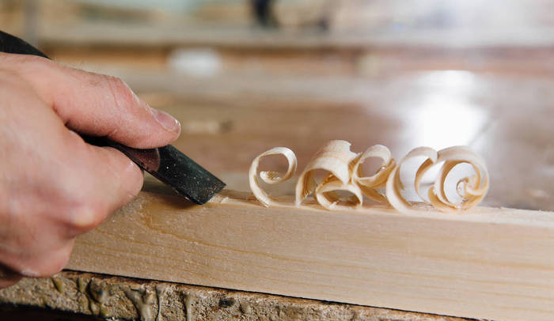
Continuation writing
How to help traditional handicrafts survive and thrive?

Slide 3
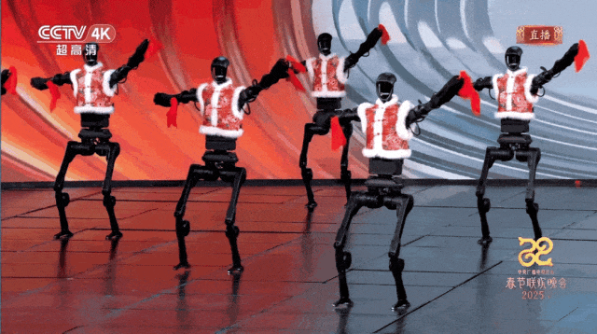
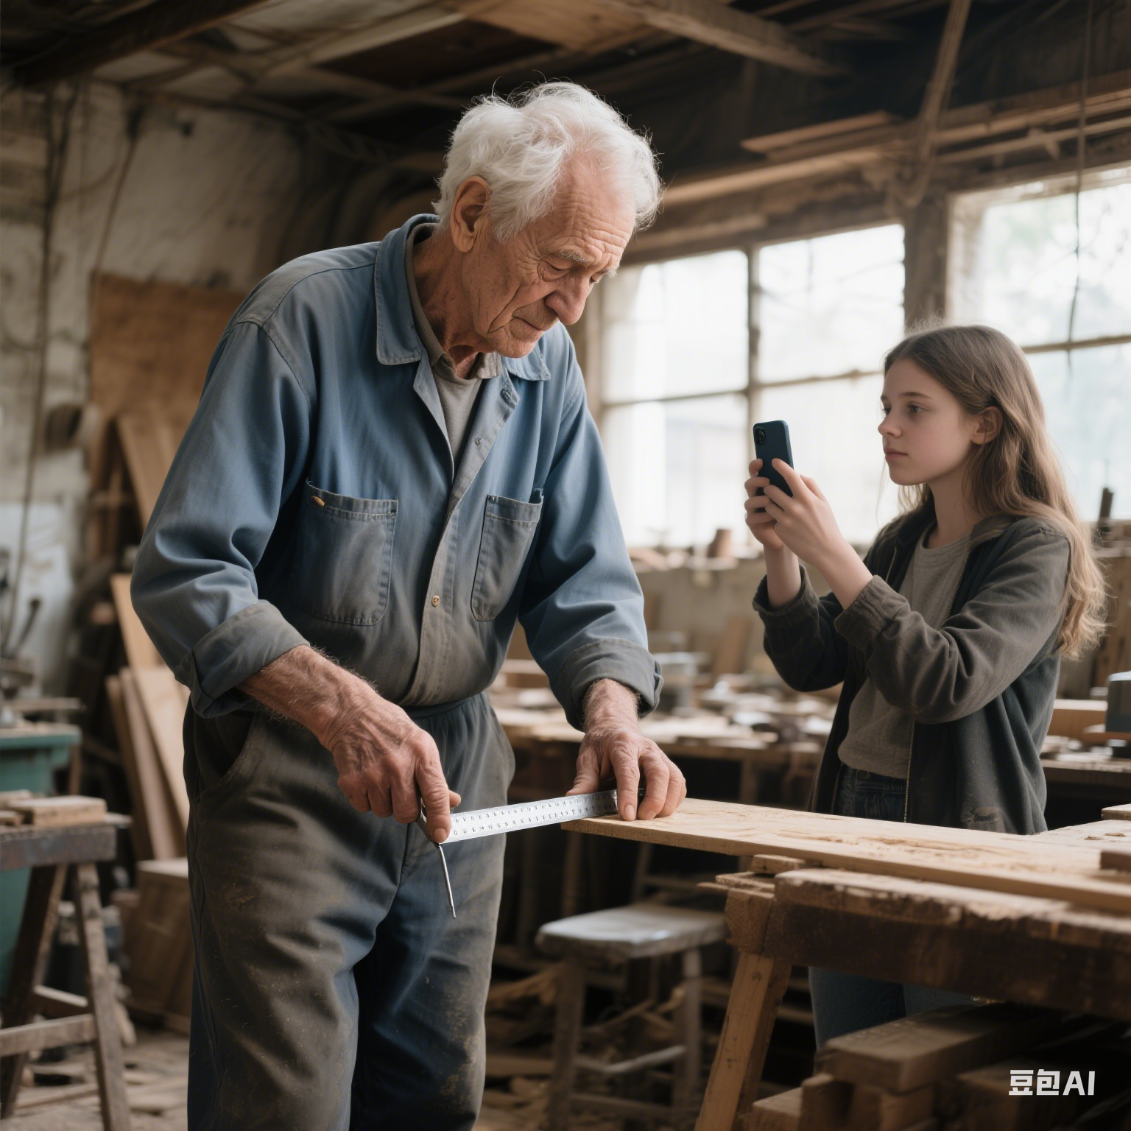
Can we use technology to help traditional handicrafts survive?
A Yangge folk dance, ________(perform) by robots during the Spring Festival Gala of the Year of the Snake on Tuesday has wowed users of some overseas social media, as the performance, ______(use) an innovative approach, blended cultural heritage with cutting-edge technology.
performed
using

Slide 4

Story mountain
Name:
Occupation:
Masterpiece:
Inspiration:
Relationship:
climax
Did she get positive feedback?
How did she respond?
What did she notice and realise?
resolution
conflict
rising action
falling action
My questions：
1.
2.
3.
Who?
When ?
Where?
What?
Why?
exposition
ending

Slide 5
Exposition
Para 1-2
who
when
where
what
Clara & Clara’s Grandfather
a(n) __________________craftsman
skilful/skilled/adept
in January
in the workshop
Clara recorded how Grandpa glued a maple
chair leg.
Why?
She focused on his quick hands as he measured angles with a metal ruler.

Slide 6
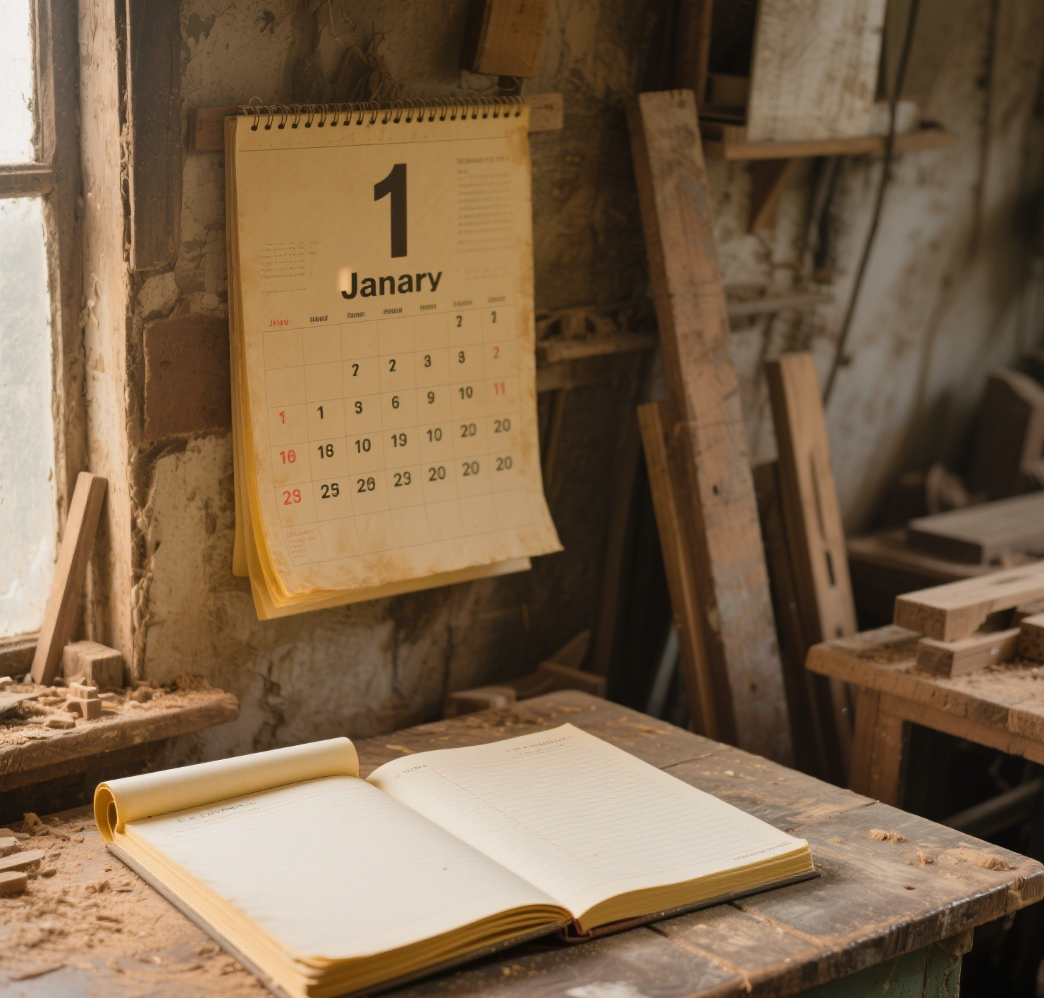
Exposition
Para 1-2
Is the business booming or struggling?
yellowed and curling pages, like dry leaves
dusty
windows
empty
February’s page

Slide 7
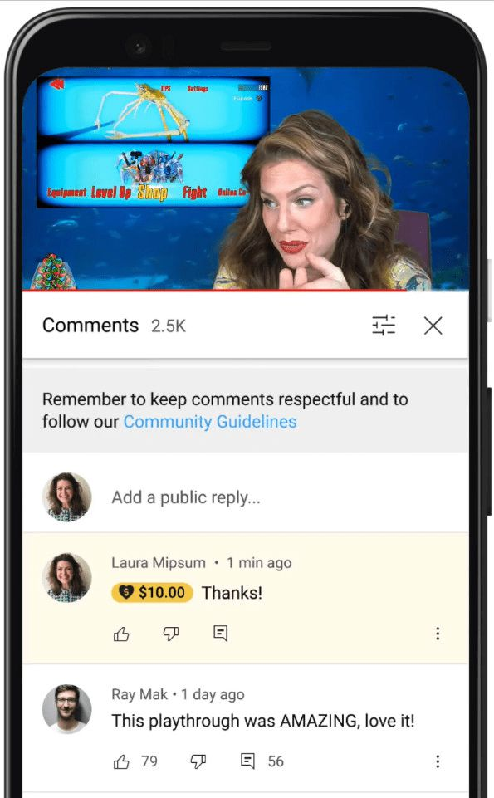
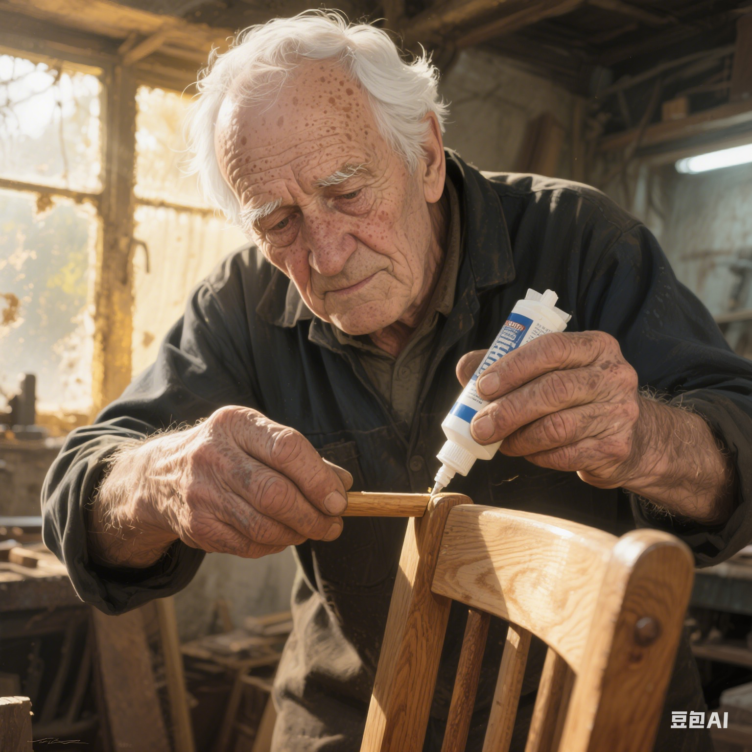
Conflict
Para 3
Did she get positive feedback?
Negative comments flooded in.
How did she respond?
Saddened
________, she deleted the video ______.
quickly
What did she notice? What did she realise?
Old ways for a dying
business!
traditional handicrafts
VS
modern technology
No wonder the
business is dying!

Slide 8
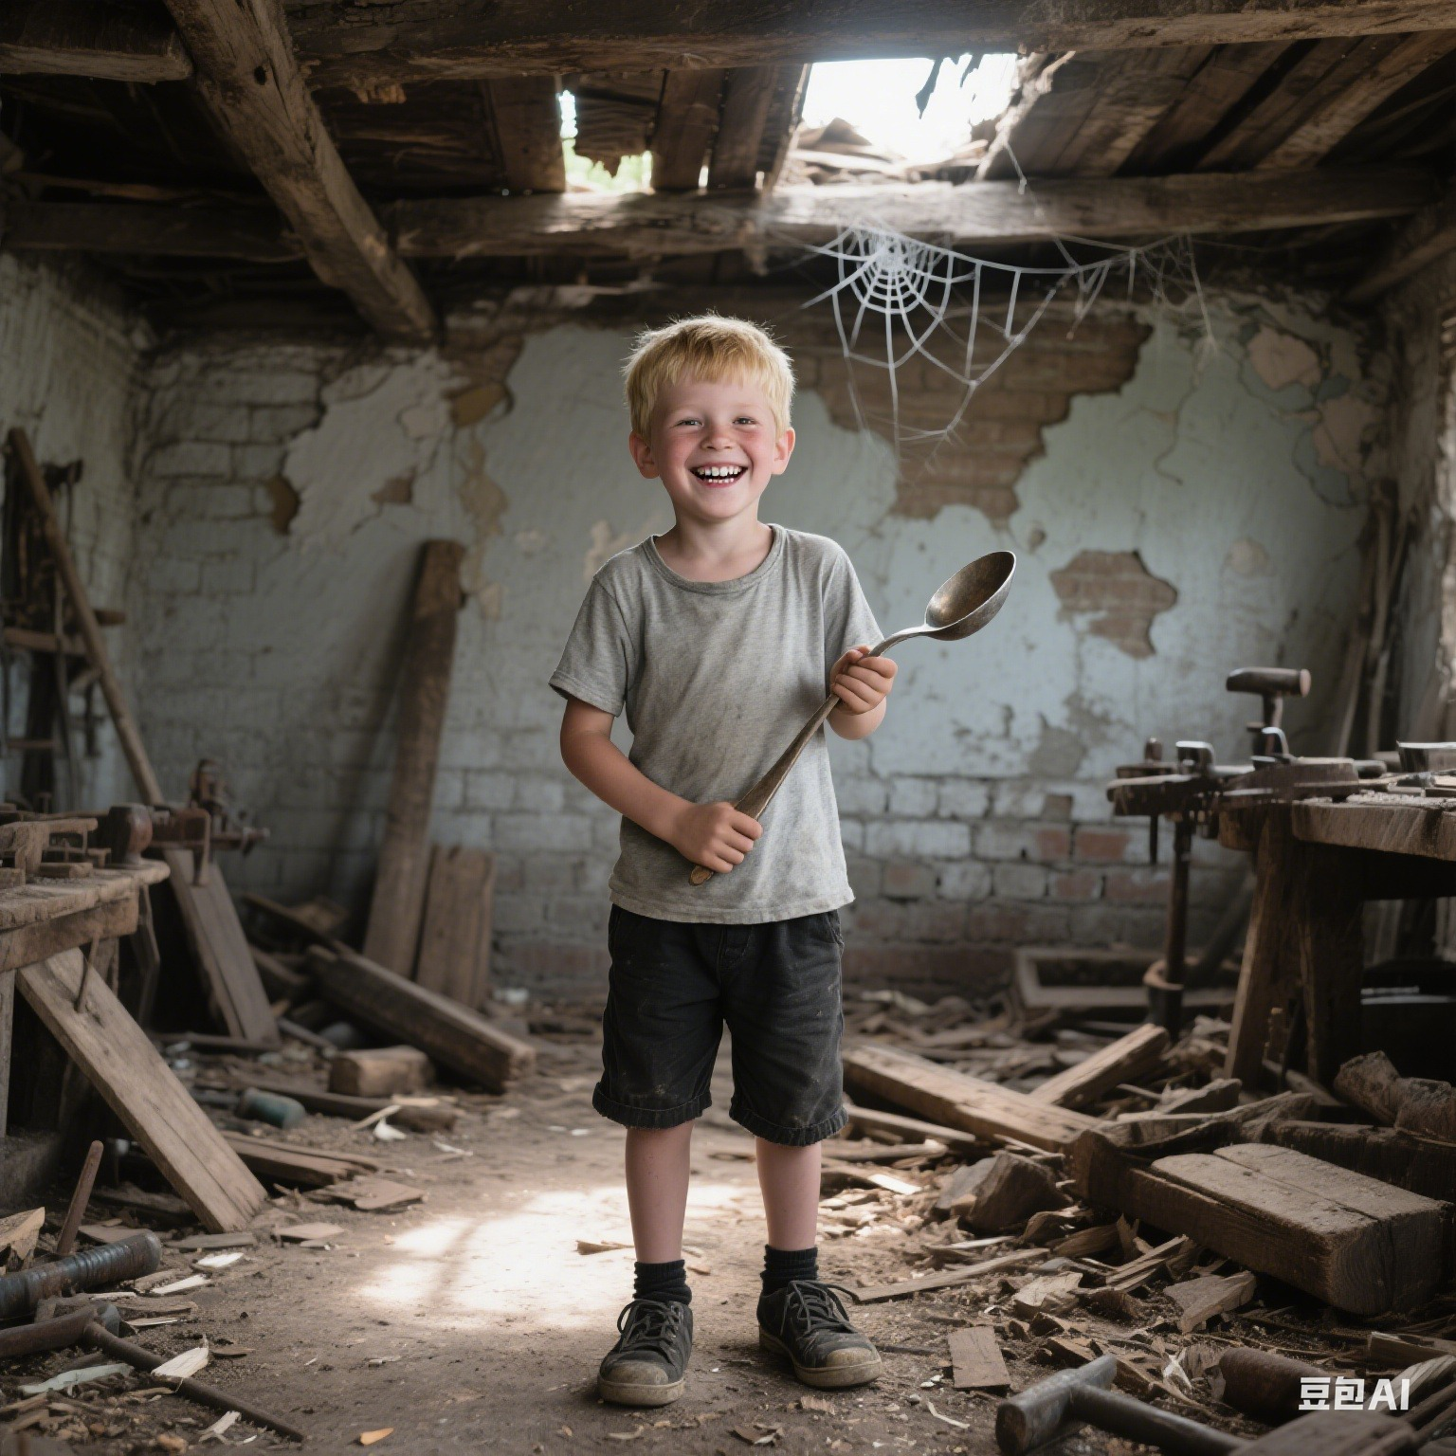
Climax
Para 4-6
How did Grandpa comment on the photo?
Name
Occupation
Masterpiece
Inspiration
Relationship
Timmy
a furniture designer
curved chairs
a curved spoon
a former student
efficiency VS humanity
Machines make things fast VS Hands remember stories
What did Clara notice? What did she realise?
Beside her, fresh wood shavings were shining. She aimed to share not just the work, but the story behind it.

Slide 9
Resolution
Discuss in groups and raise questions
Para 7: The next morning, Clara uploaded a new video.
1. What was the new video about?
2. Did the video get positive feedback?
3. What were those positive/negative comments about?
4. How did Clara and Grandpa respond to the feedback?
5. Why did Timmy walk in the workshop?
...
Para 8: A week later, Timmy, now a famous furniture designer, walked in the workshop.
What
is
the
missing
plot
?

Slide 10

Scene 1
What could Clara show in the new video?
She aimed to share not just the work, but the story behind it.
Grandpa’s quick yet rough hands
a leather album
a faded photo
Timmy’s curved spoon
How to use your language to make
the video and traditional handicrafts alive?

Slide 11
Scene 1
How to describe the video?
focus on Clara’s camera
Make sure details echo.
This time, her camera ___________(扫过）the leather album, ________________(停留在/聚焦）Timmy’s curved spoon, and ___________(拉近放大）Grandpa’s hands--rough yet steady--shaping a piece of wood into art.
swept across
lingered/focused on
zoomed in on
action chains
focus on Grandpa
In the new video, Grandpa _____(坐在）at the workbench, _______(擦光）a curved spoon,and ________(讲述）the story behind it--Timmy’s first repair.
sat
polished
narrated

Slide 12
Polish Scene 1
Tip 1:活用副介非谓，让语言妙趣横生。
In the new video, seated at the workbench, Grandpa ______________________________(精心地/技术娴熟地/温柔地/有爱地） polished a curved spoon, narrating the story behind it __________________________ ______________________________________________（以低沉亲切的声音/带着一个温柔的微笑/就像一个经验丰富的讲故事者）.
delicately/skillfully/tenderly/lovingly
in a low but warm voice/with a gentle smile/like a seasoned storyteller
What if I want to add hands?

Slide 13
Polish Scene 1
postures
gestures
facial expressions
eye contact
body language
thoughts
speech
action scene
In the new video, seated at the workbench, Grandpa lovingly polished a curved spoon with rough hands, narrating the story behind it in a low but warm voice.
What if I want to add wood shavings?
posture&speech
In the new video, seated at the workbench, Grandpa lovingly polished a curved spoon with his rough hands, narrating the story behind it in a low but warm voice,___________________________________________
________(眼睛里闪烁着喜悦的光芒/脸上洋溢着笑容）.
his eyes sparkling with joy/with a smile spreading across his face
Tip 2: 巧用复合独立，使画面动态频呈。

Slide 14
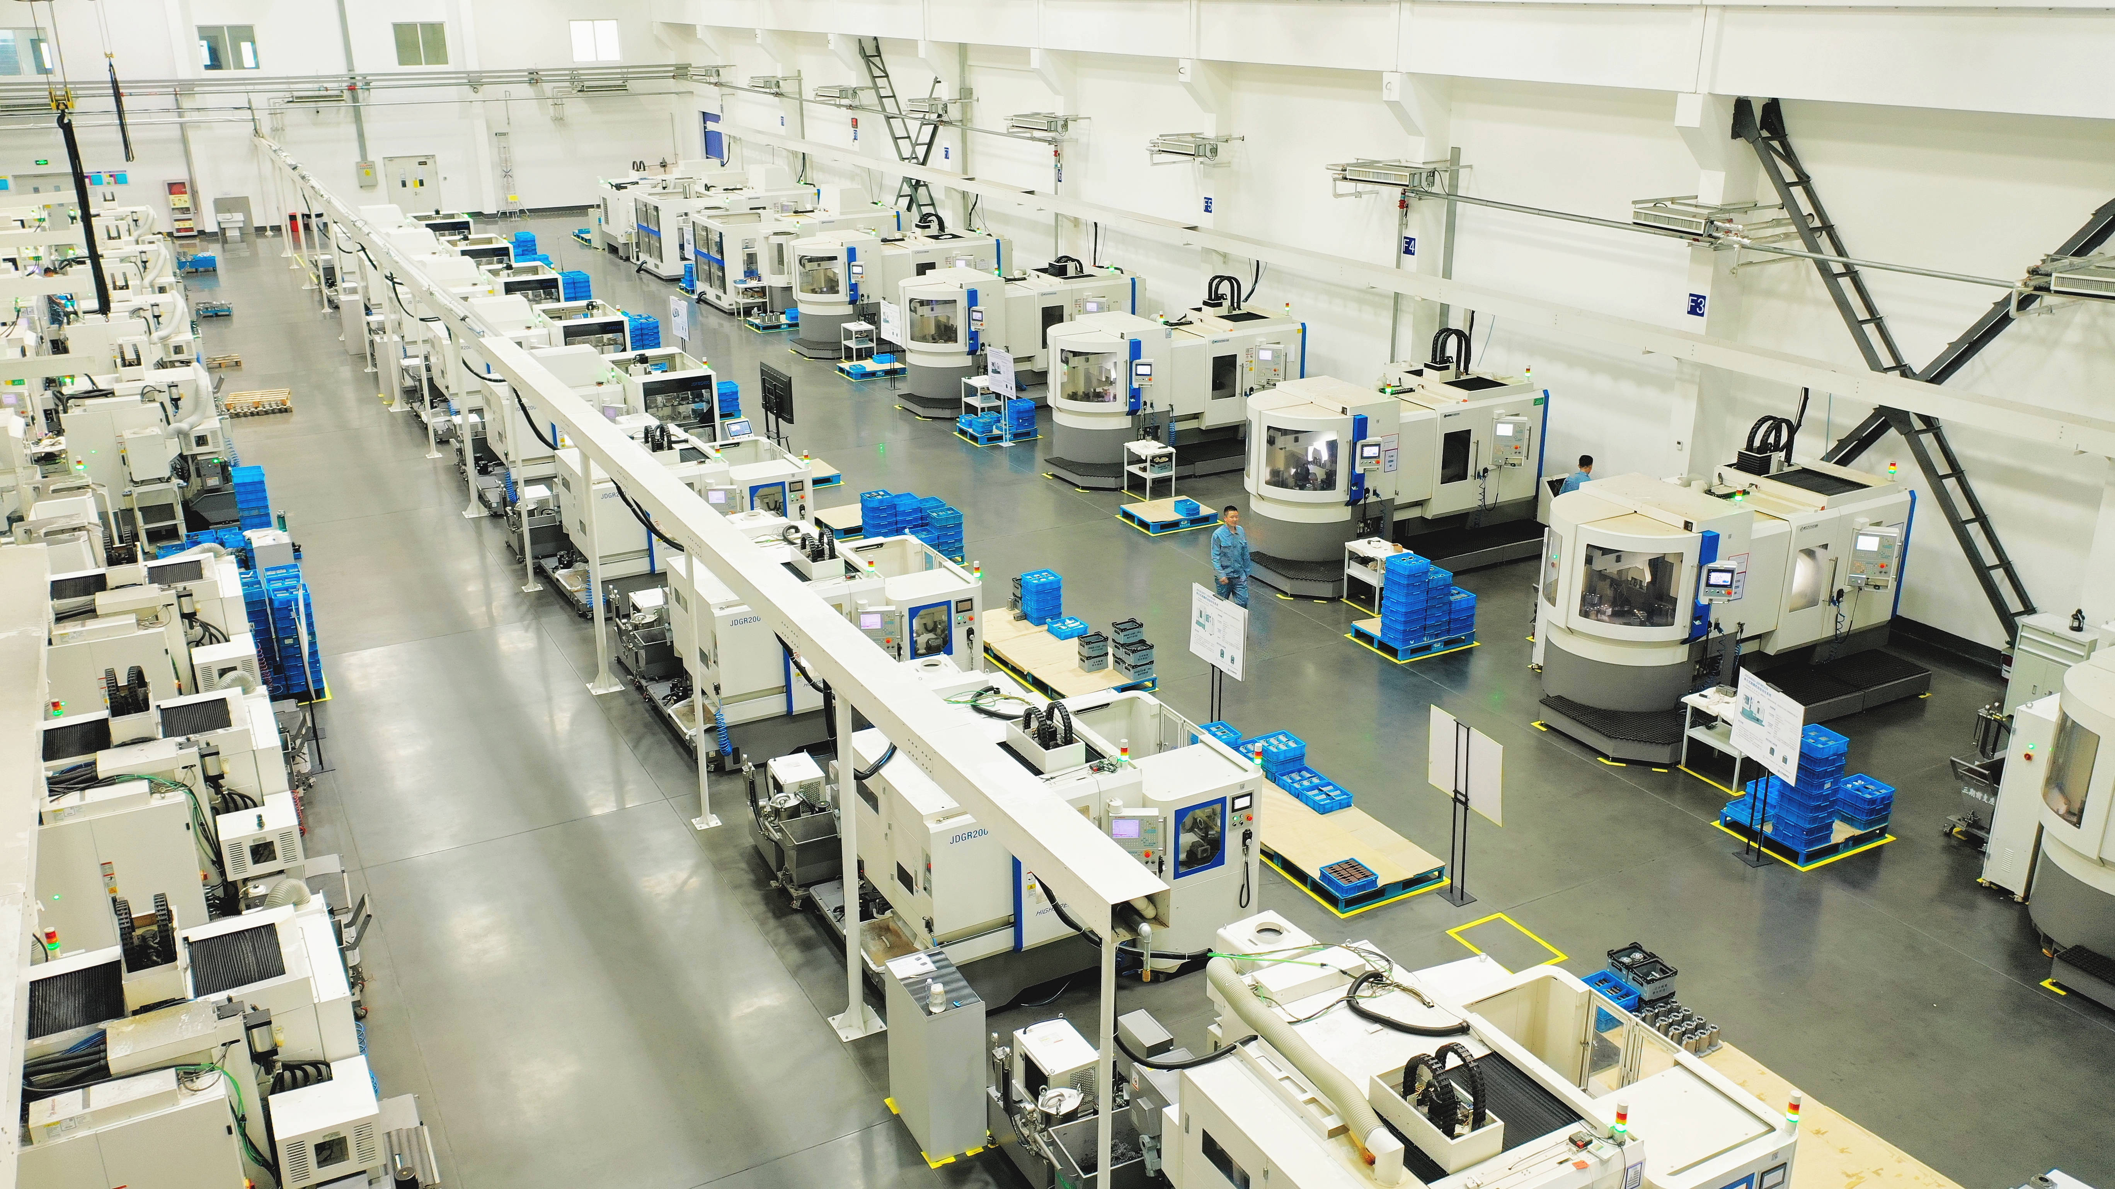
Assignment
Finish writing para 7 and polish it.
Machines make things flawless, while hands make them alive.

