Slide 1


感恩遇见，相互成就，本课件资料仅供您个人参考、教学使用，严禁自行在网络传播，违者依知识产权法追究法律责任。
更多教学资源请关注
公众号：溯恩英语
知识产权声明

Slide 2

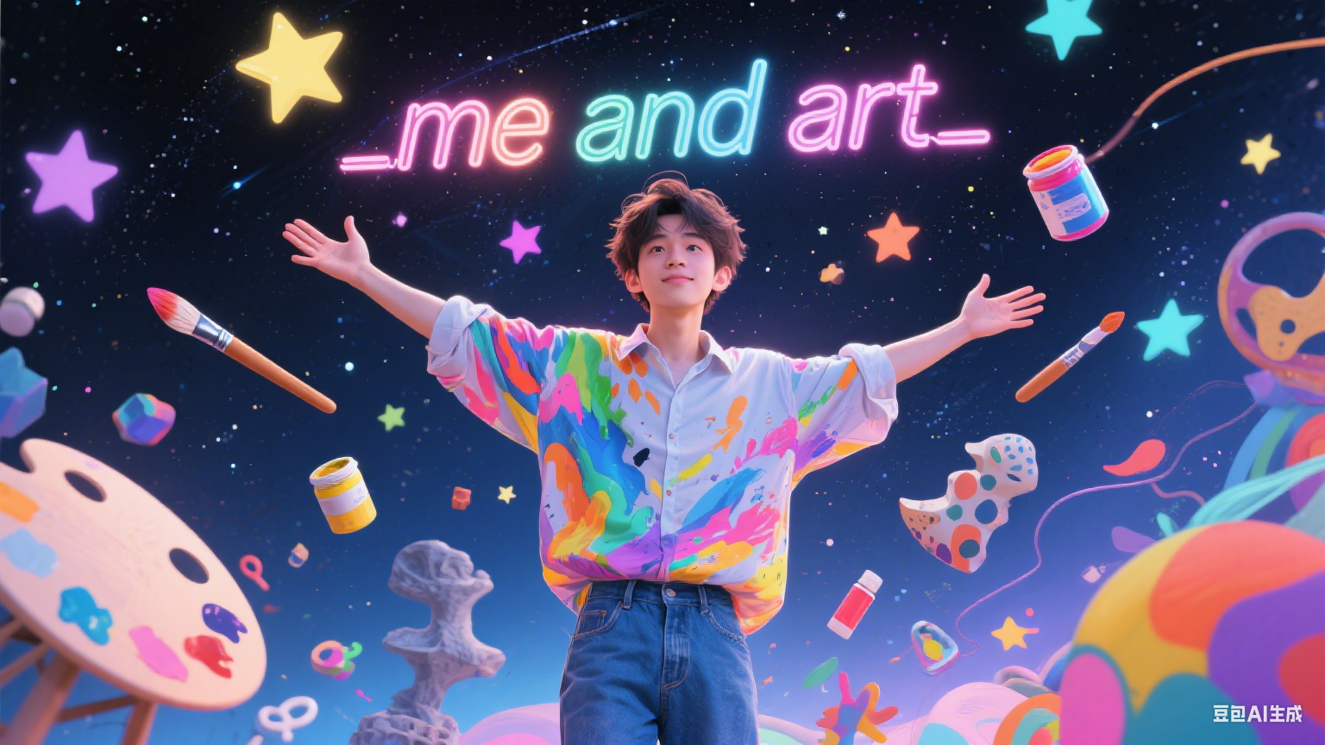
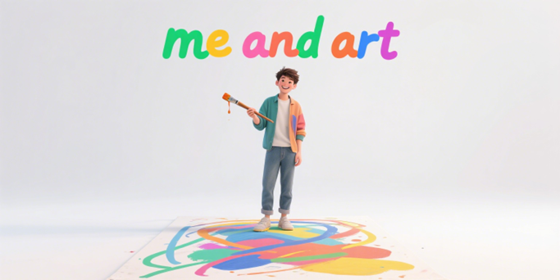
202506杭州市高二杭州市质量检测应用文
Me and Art
2025
关注： 要点的自然衔接
Judyliu

Slide 3

5步审题法+要点的自然衔接
高考应用文中的
要点衔接
投稿+夹叙夹议
202506杭州市高二年级质检
假定你是李华，你校英文报正举行 “Me & Art” 为主题的征文活动。请你写一篇短文投稿，介绍你的一项艺术爱好，内容包括：
1 你的艺术成长经历；
2 该爱好对你的影响。
1 文体：短文投稿
2 时态：一般过去时+一般现在时
3 主题：“Me & Art”
4 要点分层：
P1：开门见山点题
P2：艺术成长经历
P3：爱好的影响
5 语气：正式、客观且积极，
短文投稿不是书信，无需呼语和落款

Slide 4
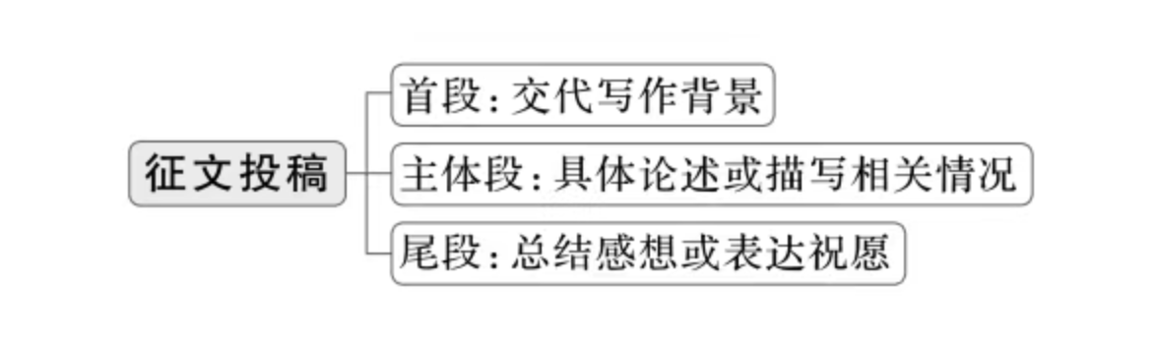
征文投稿是作者将自己的作品按照一定的要求投递到相关平台或机构，以供评审、发表或参与活动的行为。通常包括三部分内容：
1. 征文的主题与要求；
2. 投稿的时间、地点及对象；
3. 投稿的注意事项。
征文投稿要求内容符合主题、格式规范、语言流畅，投稿信息准确无误，多以记叙类短文投稿和说明议论类短文投稿为主。

Slide 5
Art 的范畴分类
1. 视觉艺术（Visual Arts）
定义：通过视觉媒介呈现的艺术形式，注重空间与造型表达。
绘画（Painting）：水彩、油画、素描
雕塑（Sculpture）：黏土雕塑、木雕
设计（Design）：插画、服装设计、建筑设计
数字艺术（Digital Art）：板绘、3D 建模、动画
2. 表演艺术（Performing Arts）
定义：通过身体动作、声音等现场演绎的艺术形式，强调即时性与互动性。
舞蹈（Dance）：芭蕾、街舞、民族舞
音乐（Music）：器乐演奏（小提琴 / 钢琴）、声乐
戏剧（Drama）：话剧、音乐剧、即兴表演
3. 文学艺术（Literary Arts）
定义：以语言文字为媒介，塑造形象、表达思想的艺术形式。
诗歌（Poetry）：现代诗、俳句
散文（Prose）：随笔、创意写作
剧本（Playwriting）：短剧创作、影视脚本
4. 实用艺术（Practical Arts）
定义：兼具功能性与审美性的艺术形式，融合实用与创意。
手工艺（Crafts）：陶艺、刺绣、纸艺
烹饪艺术（Culinary Art）：创意摆盘、甜点设计
园艺（Gardening）：景观设计、花卉造型
5. 跨媒介艺术（Interdisciplinary Art）
定义：融合多种艺术形式的创新表达，打破传统边界。
装置艺术（Installation Art）：空间场景与材料结合
行为艺术（Performance Art）：身体动作与观念表达
多媒体艺术（Multimedia Art）：声光电与影像融合
体育和运动不是艺术！！！

Slide 6
P 1:开门见山点题
倒装句强调艺术重要性
如果没有艺术，我的生活将是一张等待上色的空白画布。在所有艺术形式中，拉小提琴就是那道在我的人生旅程中绘出最鲜艳色彩的笔触。
Were it not for art, my life would be a blank canvas waiting to be colored. Among all forms, playing the violin has been the brushstroke that paints the most vivid hues on my journey.
虚拟语气突出艺术不可或缺
我无法想象没有艺术，我的生活会是什么样子。其中，舞蹈已成为我，指引我走过成长的每一个篇章。
I can't imagine what my life would be like without art. Among them, dancing guides me through every chapter of growth.

Slide 7
P 1:开门见山点题
倒装句
从未有一项爱好像绘画这样深刻地影响着我。
Never has a pursuit influenced me as deeply as painting has.
虚拟语气 + 明喻
艺术就像人生海洋中的一座灯塔，如果我没有邂逅陶艺的魅力，或许仍在漂泊。
Art is like a lighthouse in the ocean of life, and had I not encountered the magic of pottery, I might still be lost.

Slide 8
P2 ：艺术成长经历
学生问题：成长经历和影响没有逻辑关系
写作技巧 | 具体方法 | 示例（以绘画为例） | 对后文 “艺术影响” 的铺垫作用
按时间线串联关键节点 | 以时间为轴，选取童年、少年、青年等不同阶段的标志性事件 | 童年：用蜡笔临摹卡通画； 少年：参加美术培训班学习素描； 青年：在市级绘画比赛中突破创作瓶颈 | 按阶段展现成长，自然衔接各阶段艺术带来的能力提升、性格塑造等影响
融入具体事件与细节 | 通过动作、场景、感官等细节增强画面感 | 第一次握水彩笔时指尖打滑； 老师用铅笔在画纸上示范排线的沙沙声； 美术馆中某幅油画的厚重颜料触感 | 细节凸显学习过程的真实感，对应后文艺术培养的观察力、专注力等品质
强调情感与心理变化 | 记录好奇、热爱、迷茫、坚定等情感转变 | 初期因自由创作感到兴奋→长期练习静物画产生倦怠→完成主题创作后重拾热情 | 情感起伏为后文艺术作为情感寄托、精神支柱等影响提供依据
设置 “伏笔式” 情节 | 提前安排与后文影响相关的情节 | 反复修改毕业创作的构图，花费 20 小时调整光影 | 为后文阐述艺术培养耐心、毅力，以及解决问题的思维方式做铺垫
突出关键人物与环境影响 | 加入老师指导、家人支持或环境熏陶等内容 | 爷爷赠送的第一套画笔； 美术老师鼓励尝试抽象画风格 | 体现外部因素的作用，自然过渡到艺术对人际关系、审美观念的影响

Slide 9
Connecting Key Nodes by Timeline（按时间线串联关键节点）
小学时，我加入书法社团，开始用毛笔练习基础楷书，一开始手抖得厉害。初中时，我参加市级书法比赛，可作品有问题，比如笔画不匀、结构不好。高中时，经过多年练习 —— 每天花几小时练每一笔 —— 我在省级比赛获奖，突破了创作瓶颈。
In primary school, I joined the calligraphy club and started practicing basic regular script with a brush. At first, my hand shook a lot. In junior high, I took part in a city - level calligraphy competition. But my work had problems, like uneven strokes and bad structure. In senior high, after years of practice—spending hours each day on every stroke—I won an award in a provincial competition, breaking through my creative block.

Slide 10
Including Specific Events and Details（融入具体事件与细节）
我还记得第一次握毛笔的情景。手一抖，墨水在宣纸上流得到处都是，弄得一团糟。书法课上，老师纠正我的握笔姿势 —— 把拇指和食指放对位置，帮我的手腕顺畅移动。有一次参观书法展，一幅佳作惊到我了：墨色的浓淡，像首无声的诗，让我感受到书法的深刻之美。
I still remember my first time holding a writing brush. My hand shook so much that the ink spread all over the rice paper, making a mess. In a calligraphy class, my teacher corrected my grip—putting my thumb and index finger in the right place and helping my wrist move smoothly. Once, when visiting a calligraphy show, a great work shocked me: the thick and thin ink, like a silent poem, made me feel the deep beauty of calligraphy.

Slide 11
Emphasizing Emotional and Mental Changes（强调情感与心理变化）
一开始，书法只是因为好奇 —— 我喜欢毛笔能把墨变成艺术。但练了几个月重复的基本笔画后，我烦了，想放弃。不过，当我终于写出一幅能表达我心情的作品，比如一个充满活力、生动的 “春” 字时，我的热情又回来了。现在，书法不只是爱好，更是我生活的一部分，能让我平静，给我灵感。
At first, calligraphy was just out of curiosity—I liked how a brush could turn ink into art. But after months of repeating basic strokes, I got bored and wanted to quit. However, when I finally made a piece that showed my feelings, like a lively “spring” character full of energy, my passion came back. Now, calligraphy is not just a hobby, but part of my life, calming me and giving me inspiration.

Slide 12
Setting “Foreshadowing” Plots（设置 “伏笔式” 情节）
有一次，为完成学校活动的书法作品，我改了十多次布局，花了一周时间调整字间距和笔画节奏。这种不放弃的经历，后来让我面对数学难题时也有耐心 —— 就像打磨书法作品一样，我学会把大挑战拆成小步骤。
Once, to finish a calligraphy work for a school event, I changed the composition over ten times, adjusting the space between characters and the rhythm of strokes for a whole week. This experience of not giving up later helped me be patient with difficult math problems—just like perfecting calligraphy, I learned to break big challenges into small steps.

Slide 13
Highlighting Key Figures and Environmental Influences（突出关键人物与环境影响）
我爷爷喜欢书法，他给了我第一套毛笔和砚台。他的书房满是书法卷轴，对童年的我来说就像个奇妙天地。我的书法老师刘老师，总鼓励我尝试不同风格，比如奔放的草书，拓宽了我的艺术视野。他们的支持让我明白，艺术不只是个人创作，也是人与人交流的一种方式。
My grandpa, who loves calligraphy, gave me my first set of brushes and inkstones. His study, full of calligraphy scrolls, was like a wonderland for my childhood. My calligraphy teacher, Mrs. Liu, always encouraged me to try different styles, like wild cursive script, which opened up my artistic view. Their support made me realize that art is not just personal creation, but also a way to connect people.

Slide 14
P3 ：爱好的影响
耐心与专注
长期练习书法时，一笔一划都需要耐心打磨。这种耐心慢慢渗透到学习和生活里，面对复杂的数学题，我不再着急忙慌，而是像写书法一样，静下心拆分步骤；背长篇课文时，也能逐句攻克，专注让效率提高了不少。
During the long - term calligraphy practice, every single stroke requires patient polishing. This patience gradually seeps into my study and life. When facing complex math problems, I no longer panic. Instead, just like doing calligraphy, I calm down and break them into steps. When reciting long texts, I can also tackle them sentence by sentence. Concentration has greatly improved my efficiency.

Slide 15
P3 ：爱好的影响
审美提升与文化感悟
看的优秀书法作品多了，我对美有了新理解。从墨色浓淡变化，到字体结构搭配，能发现藏在笔画里的韵味。而且，书法背后连着中国传统文化，写 “福” 字时，能想到古人对幸福的期盼；临摹经典，仿佛在和历史对话，这让我更懂也更热爱传统文化。
After seeing many excellent calligraphy works, I have a new understanding of beauty. From the changes in ink shades to the matching of character structures, I can discover the charm hidden in the strokes. Moreover, calligraphy is connected to traditional Chinese culture. When writing the character “Fu” (good fortune), I can think of the ancients’ hope for happiness. When copying classics, it’s like having a conversation with history. This makes me understand and love traditional culture more.

Slide 16
P3 ：爱好的影响
抗挫力与心态调整
书法创作中，总有写不好的时候，一幅作品改几十遍是常事。但每次克服这些挫折，心态就更强大。现在遇到生活里的难题，像考试失利、和同学闹矛盾，我能想起书法练习时的坚持，告诉自己慢慢来，办法总比困难多，心态越来越积极了。
In calligraphy creation, there are always times when I can’t write well. It’s common to revise a piece dozens of times. But every time I overcome these setbacks, my mindset becomes stronger. Now, when facing difficulties in life, such as failing an exam or having conflicts with classmates, I can recall the persistence during calligraphy practice. I tell myself to take it easy, for there are always more solutions than difficulties. My mindset is getting more and more positive.

Slide 17
P3 ：爱好的影响
人际交往与传承意识
因为书法，我认识了同样爱好的朋友，一起交流、参加活动，拓宽了社交圈。而且，受爷爷和老师影响，我也想把书法分享出去，教同学写简单的字体，给外国朋友介绍书法故事，希望让更多人感受这份艺术魅力，传承传统文化。
Because of calligraphy, I’ve met friends with the same hobby. We communicate and participate in activities together, broadening my social circle. Also, influenced by my grandpa and teacher, I want to share calligraphy. I teach classmates to write simple characters and introduce calligraphy stories to foreign friends. I hope more people can feel the charm of this art and pass on traditional culture.

Slide 18
下水作文
高考应用文中要点衔接
Without art, my life would be a blank sheet of rice paper waiting to be inscribed. Among all art forms, calligraphy is the brushstroke that paints the most vivid hues in my life journey.
In primary school, I joined the calligraphy club and started practicing basic regular script with a brush. At first, my hand shook a lot. In junior high, I took part in a city - level calligraphy competition. But my work had problems, like uneven strokes and bad structure. In senior high, after years of practice—spending hours each day on every stroke—I won an award in a provincial competition, breaking through my creative block.
In calligraphy creation, there are always times when I can’t write well. It’s common to revise a piece dozens of times. But every time I overcome these setbacks, my mindset becomes stronger. Now, when facing difficulties in life, such as failing an exam or having conflicts with classmates, I can recall the persistence during calligraphy practice. I tell myself to take it easy, for there are always more solutions than difficulties. My mindset is getting more and more positive.

Slide 19
参考范文
高考应用文中要点衔接
I’m Li Hua, and my passion for painting began in childhood. At six, I was captivated by vibrant colors and shapes in picture books, inspiring me to pick up a brush. My parents enrolled me in art classes, where I explored techniques and found joy in creating. Over time, painting became my way to express emotions and ideas.
Painting positively impacts my studies and life. It sharpens my focus, helping me tackle academic challenges with patience. During stressful times, sketching calms my mind, boosting my mood and creativity. Sharing my artwork with friends strengthens our bonds. Painting not only enriches my life but also teaches me to find beauty in everyday moments, making me a happier, more balanced person.

Slide 20
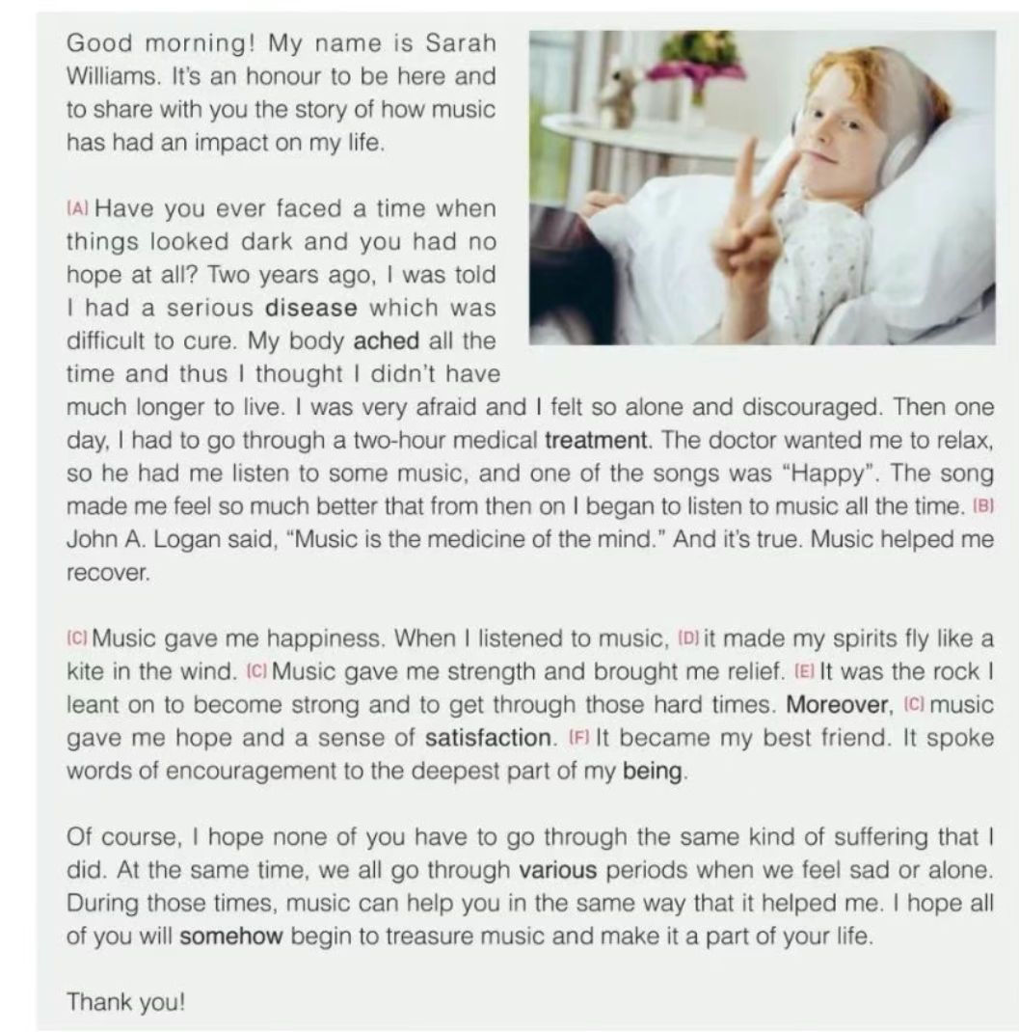
同类型拓展1
2024学年第二学期浙江省名校协作体试题高三年级英语试题
假定你是李华，你将参加你校举办的 “Music and Me” 主题英语演讲比赛，请撰写一份演讲稿，
内容包括：
(1)分享你和音乐的故事；
(2)音乐对你的影响。
Hello, everyone! _____________________________________________________________________________________________________________________That's all. Thank you!

Slide 21
参考范文
Hello everyone!
My name is Li Hua, and today I'm thrilled to share with you my journey of "Music and Me".
From a tender age, music has been my soul's companion, whispering stories of joy and sorrow through melodies. It was the piano's gentle notes that first captivated my heart, leading me to explore a world of harmonies and rhythms.
Music has shaped me in more ways than one. It's been my sanctuary, healing my wounds and igniting my passions. Through its magic, I've learned empathy, resilience, and the art of expressing the inexpressible.
Thank you for letting me share this harmonious bond between music and me.
That's all. Thank you!

Slide 22
同类型拓展2
体育运动是校园生活中的重要组成部分。假定你是李华，你校英文网站的体育栏目正在征集稿件，请你以“Sports and I”为题，写一篇投稿。要点：1. 你对体育运动的理解；2. 个人运动的经历和感受；3. 呼吁大家热爱运动和生活。
Sports are of great importance for us. They can help us build up our body and become refreshed.
Basketball is my favourite sport, which is full of fun and challenge. Of all the matches I’ve experienced, my first basketball match in senior high school is the most unforgettable. Our rival was a skillful team with several champion titles. It turned out as expected, we fell behind most of the time. However, although there were difficulties, each of us spared no efforts and we played as a team. Our hard work finally paid off. We managed to win 3 scores at the final moment!
Basketball enriches my spare time, both physically and mentally. I love this game! Let’s all love sports and life.

