Slide 1

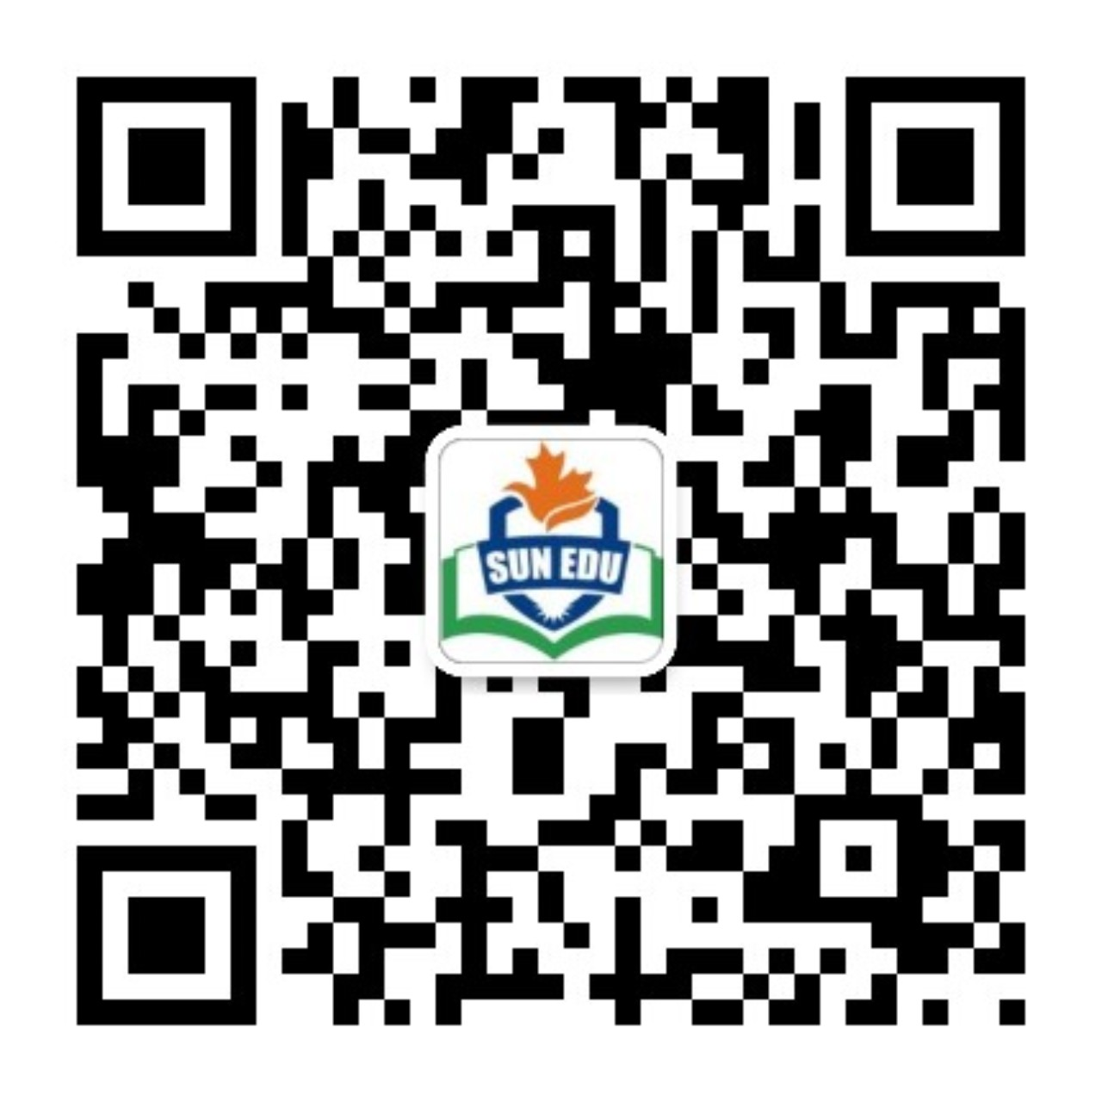
感恩遇见，相互成就，本课件资料仅供您个人参考、教学使用，严禁自行在网络传播，违者依知识产权法追究法律责任。
更多教学资源请关注
公众号：溯恩英语
知识产权声明

Slide 2


Follow-up:
Your Article on Canadian Sports
－2025年高考全国Ⅱ卷应用文分析
礼泉县教育局教研室 高小聪

Slide 3
Contents：
01
析透情境
02
立稳框架
03
铸造语料
04
动笔成文
05
四元评价
06
迁移运用

Slide 4
Learning Objectives：
At the end of the class, the students will be able to:
1.Compose an English email of approximately 80 words using functional language. (Language Ability)
2.Make your langauge friendly but professional, which fits the target writer Chris. (Cultural Awareness)
3.Make sure your writing is well-organized with smooth transitions.
(Thinking Quality)
4.Apply the "ask + remind" pattern to other types of writing, like an inquiry letter（咨询信） or a reminder for a late article（催稿信）
(Learning Capacity)

Slide 5
Ⅰ.析透情境
Human and Society
(coordinate and communicate)
Theme
第一节（满分15分）
假定你是校英文报编辑李华，外教Chris上个月答应写一篇介绍加拿大体育运动的文章。请给 Chris写一封邮件，内容包括：
（1）询问进展；（2）提醒交稿时间。
注意：
（1）写作词数应为80个左右；
（2）请按如下格式在答题卡的相应位置作答。
Text
type
Letter of inquiry +
Follow-up letter
Li Hua, Editor of the
School English Newspaper
Writer
Target
Readers
like Chris, foreign teachers,
featured Writer （特邀作者）
Prons
The 1st, 2nd, 3rd prons
Simple Past Tense; Simple Present Tense; Simple Future Tense;
Tenses
① Inquire about progress
② Remind Chris of the submission
deadline
Dear Chris,
________________________________________________________________________ Best wishes,
Li Hua
Key
points
Mood
Polite; Friendly; Professional;

Slide 6
Ⅱ.立稳框架
Dear Chris,
①Brief greeting
②Reference prior agreement (Canadian sports article agreed last month.)
Starting：
Stating purpose
+Building connection
Letter of
Inquiry
Body:
Inquiry on Progress
+Offer of Support
①Politely ask about the progress
② Actively offer help
③Reminding Chris of the Deadline
Ending:
Appreciation
+ Open Communication
①Acknowledge contribution
②Feel free to reach out
Best wishes,
Lihua

Slide 7
Ⅲ.铸造语料
① Hope you're doing well.
② Hope everything is going well with you these days.
③ I hope this email finds you well.
④How are things going with you recently?
⑤Warm greetings from the school newspaper team!
⑥Trust this message finds you in good spirits.
⑦I hope you’re having a productive week.
Brief
greeting：
①Could you give me a quick update on how it's going?
②I was wondering how the article is coming along.
③Would you mind letting me know about the progress?
④How is the article progressing?
⑤Could you kindly update me on the status of your article about
Canadian sports?
⑥May I ask how far along you are with the article?
⑦Have you had a chance to make progress on the sports feature?
Asking about progress:

Slide 8
Ⅲ.铸造语料
①Please don't hesitate to reach out if you need any help or information.
②Please let me know if there's anything I can assist you with.
③Feel free to contact me if you have any questions.
④I’d be glad to assist with research or fact-checking.
⑤Should you encounter writer’s block, I can share some references.
⑥If photos or data would help, I can compile them for you.
⑦Please feel free to ask if you need any background materials.
Offering
Help:
①Just a friendly reminder that the final deadline for submission is [Date].
②We hope to finalize the next edition soon, so we'd appreciate it if you
could submit the article by [Date].
③Could you please ensure the article is submitted by [Date]?
④To meet our publishing schedule, we need the article by [Date].
⑤Just a gentle reminder: the final submission is due by July 7th.
⑥May we request the article no later than 5 PM this Friday?
⑦We’d appreciate receiving your draft by end of day Thursday.
Reminding Sb.of the Deadline:

Slide 9
Ⅳ.动笔成文
第一节（满分15分）
假定你是校英文报编辑李华，外教Chris上个月答应写一篇介绍加拿大体育运动的文章。请给 Chris写一封邮件，内容包括：
（1）询问进展；（2）提醒交稿时间。
注意：
（1）写作词数应为80个左右；
（2）请按如下格式在答题卡的相应位置作答。
Dear Chris,
__________________________________________________________________________________________________________________________________
Best wishes,
Li Hua

Slide 10
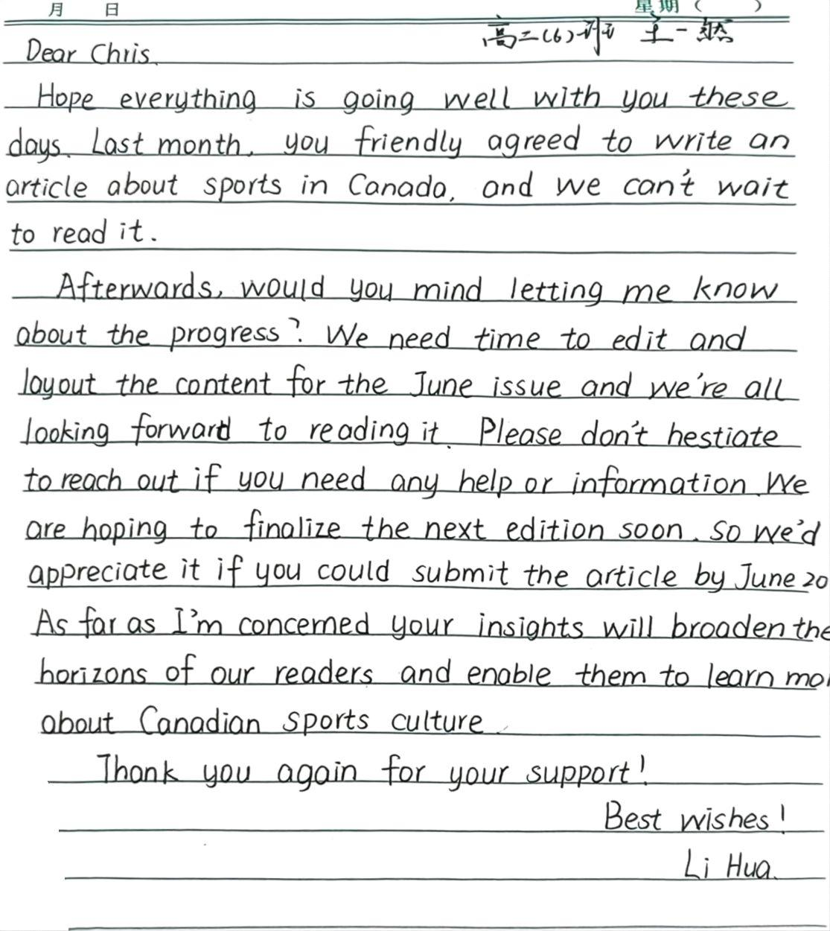
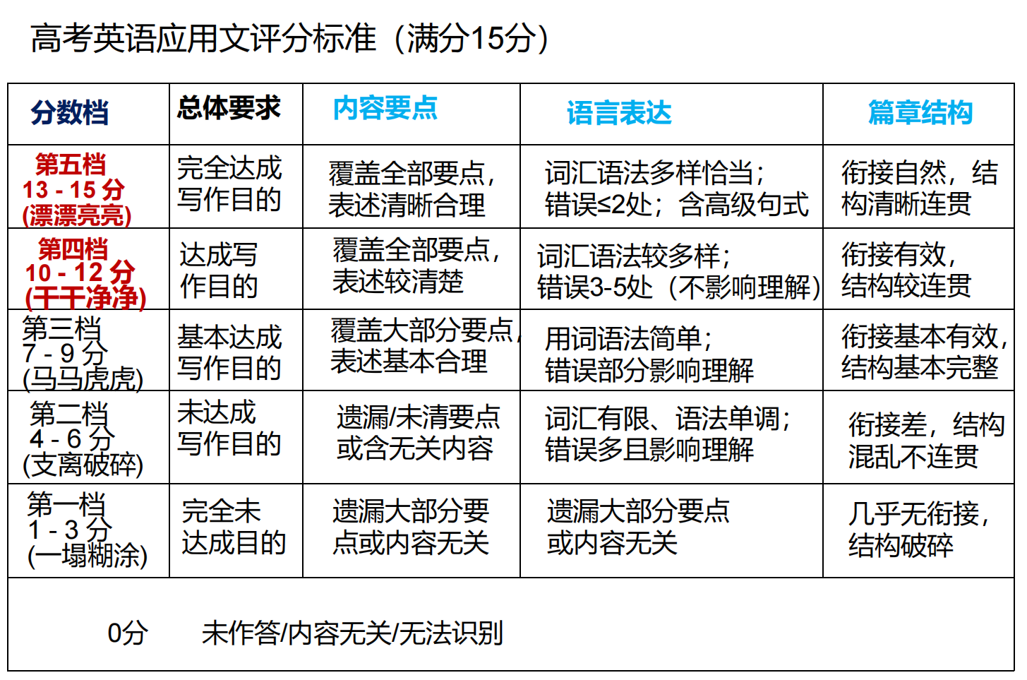
Ⅴ.三元评价

Slide 11
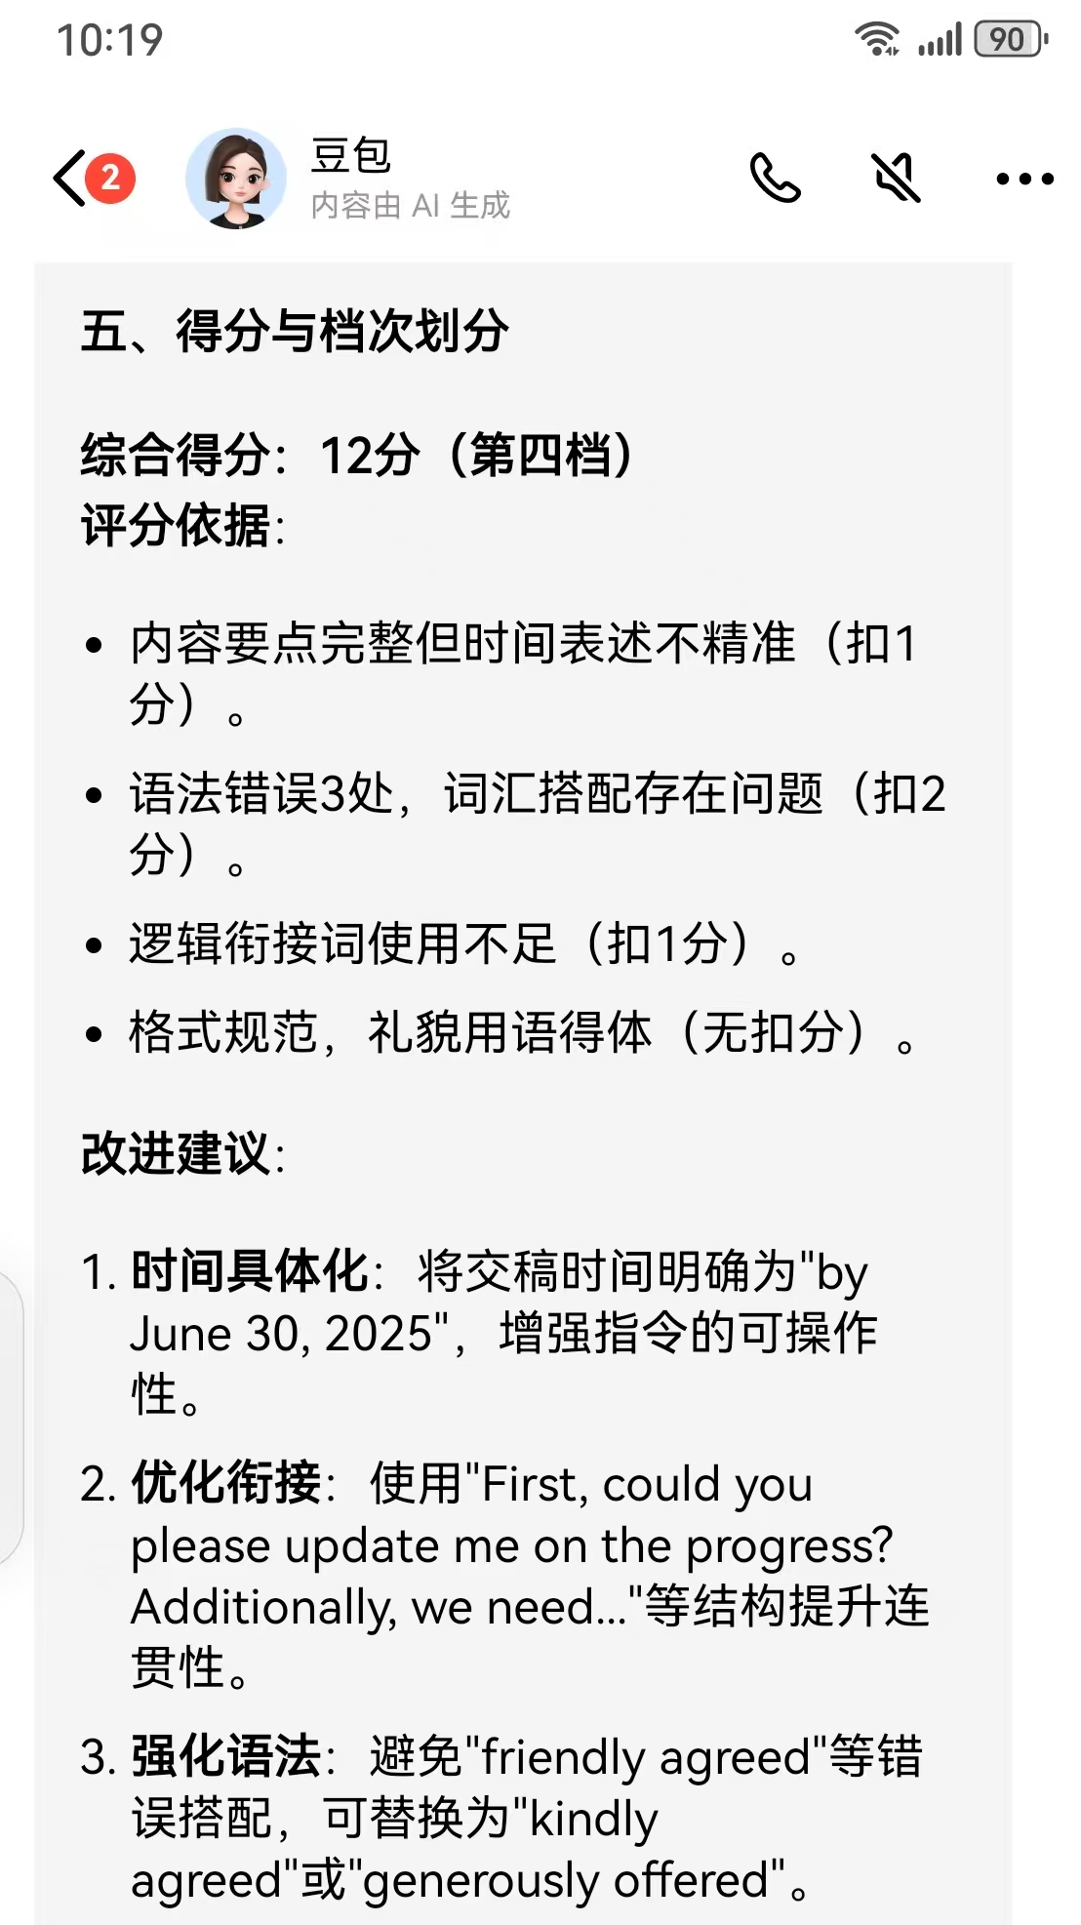
Ⅴ.四元评价
一然自评：（第四档：12分）
任务完成度高（询问文章进度、提醒截稿日期），语言表达准确、礼貌得体，结构清晰。建议：提升词汇多样性和上下文连贯性。
同伴互评：（第四档 10 - 12 分 ）
覆盖任务要点且表述清，语言有多样尝试但存小瑕疵,如 are hoping，篇章衔接自然、结构清晰，修正小错误可冲击第五档 。
教师评价：（第四档：11.5分）
要点覆盖完整、语言基础扎实、格式规范。
建议：针对 “高级句式运用” 和 “情境化交际策略”进行专项突破。

Slide 12
Ⅴ.四元评价
优点：
内容要点：完整覆盖 “询问进展、提醒交稿时间” 核心任务，额外补充对文章作用的期待，内容充实 。
语言表达：尝试多样表达，如 “Hope everything is going well...”“As far as I'm concerned...” ，语言礼貌得体，格式规范 。
篇章结构：开头寒暄、中间表意、结尾致谢祝福，结构清晰，衔接自然 。
不足：
内容细节：交稿时间表述不精准，仅说 “by June 20” ，未明确年份，可操作性弱 。
语言表达：“friendly agreed” 词汇搭配错误；词汇语法多样但精准度不够，小瑕疵拉低质量 。
篇章衔接：逻辑衔接词使用单一，若增添 “First”“Additionally” 等，连贯性可进一步提升 。

Slide 13
Ⅴ.四元评价
Improve
Dear Chris,
Hope everything is going well with you these days. Last month, you 1 ______ (kind) agreed to write an article about sports in Canada, and we can't wait to read it.
2 _____ could you please 3________(update) me on the progress? We need time to edit and layout the content for the June issue and we're all looking forward to reading it. 4____________(addition) , please don't hesitate to reach out if you need any help or information. We 5______ to finalize the next edition soon, so we'd appreciate it if you could submit the article by June 30, 2025. As far as I'm concerned, your insights will broaden the horizons of our readers and enable them to learn more about Canadian sports culture.
Thank you again for your support!
Best wishes!
kindly
First
update
Additionally
hope

Slide 14
Ⅳ.磨逻辑
官方范文：
Dear Chris,
Hope this email finds you well! Last month, you kindly agreed to write an article about sports in Canada, and we’re all looking forward to 1_______(read) it.
I’m writing to politely inquire about the 2_________(progress) of the article. Would you mind letting me know 3______ it’s going? Also, could I remind you that the deadline for submission is this Friday, June 14th? Your insights into 4_________(Canada) sports will surely enrich our readers’ understanding of global sports culture, which will be of 5________(benefit) to us.
Thank you again for your support!
Best wishes,
Li Hua
reading
progress
how
Canadian
benefit

Slide 15
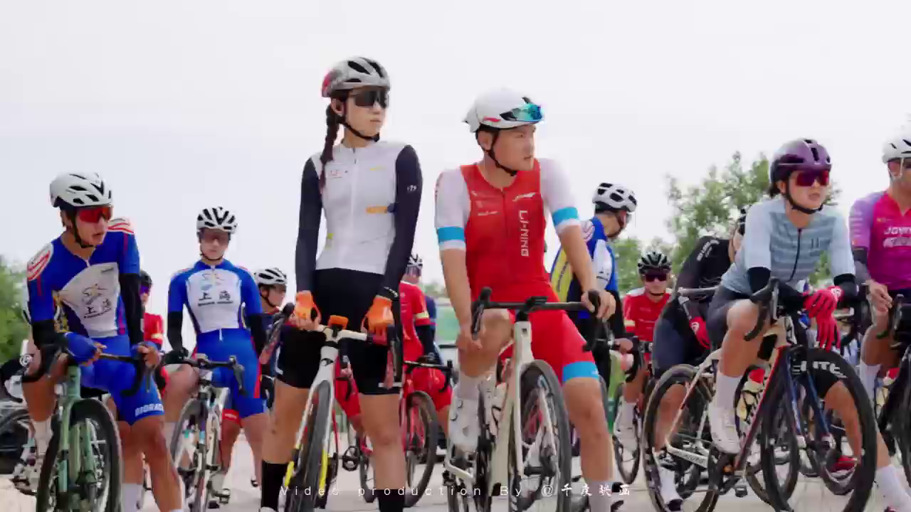
Ⅵ.迁移运用
What sports event had taken place in Liquan County?

Slide 16
Ⅵ.迁移运用
假设你是交换生Chris，校英文报编辑。李华（Li Hua）承诺撰写一篇介绍2025年"东恒盛杯"中国公路自行车联赛第五站（陕西礼泉站）的文章。请给他写一封邮件，内容包括：(1) 礼貌询问稿件进展；(2) 提醒交稿时间。
注意：(1) 词数约80词；(2) 按以下格式在答题卡作答：
提示：
2025年“东恒盛杯”中国公路自行车联赛第五站（陕西礼泉站）
the 2025 "Dong Hengsheng Cup" China Road Cycling League (Liquan Station)
Dear Li Hua,
________________________________________________________________________________
_________________________________________________________________________________
Best wishes,
Chris

Slide 17
Sample writing:
Dear Li Hua,
I hope this email finds you 1_____(good) ! As 2 ____ editor of our school’s English newspaper, I 3____________ (write) to check on the progress of your article about the 2025 "Dong Hengsheng Cup" China Road Cycling League (Liquan Station, June 11–15).
Our readers are eager 4_________ (read) your insights on how the event 5________(blend) competitive cycling with local cultural highlights—particularly its 6____________(connect) to the Tang Dynasty heritage. Could you let me know how the draft 7___________ along? To ensure smooth publication, please 8_________(submit）the final version by this Friday, July 4. This 9___________(allow) sufficient time for editing and layout adjustments.
Thank you for 10_________ (capture) this vibrant sports-cultural event through your writing!
Best regards,
Chris
well
an
am writing
to read
blended
connections
is coming
submit
will allow
capturing

Slide 18
Conclusion:
星光不问赶路人，时光不负有心人。希望你的成绩会照亮整个夏天，然后带着你的期许，去见从未见过的风景。
Starlight doesn’t ask of travelers on the way;
Time rewards those who persist day by day.
May your achievements light up your summer days,
Then lead you on with hopes and dreams ablaze,
To see the wonders beyond familiar gaze.

