Slide 1



感恩遇见，相互成就，本课件资料仅供您个人参考、教学使用，严禁自行在网络传播，违者依知识产权法追究法律责任。
更多教学资源请关注
公众号：溯恩英语
知识产权声明

Slide 2


活用教材词汇，靶向高考写作
M2U2单词拓展
Wildlife Protection

Slide 3

活用词汇
poster /ˈpəʊstə(r)/ n.海报
1. 学生们设计了一张色彩鲜艳的海报来宣传学校的慈善活动。(应用文)
The students designed a colorful poster to promote the school's charity event.
2.走廊里的环保海报鼓励大家进行垃圾分类。(应用文)
Environmental posters in the hallway encouraged recycling.
3.他的电影海报收藏几乎贴满了房间的每一寸墙壁。(续写)
His movie poster collection covers almost every inch of his room.

Slide 4
活用词汇
poster /ˈpəʊstə(r)/ n.海报
1. 学生们设计了一张色彩鲜艳的海报来宣传学校的慈善活动。(应用文)
The students designed a colorful poster to promote the school's charity event.
2.走廊里的环保海报鼓励大家进行垃圾分类。(应用文)
Environmental posters in the hallway encouraged recycling.
3.他的电影海报收藏几乎贴满了房间的每一寸墙壁。(续写)
His movie poster collection covers almost every inch of his room.

Slide 5
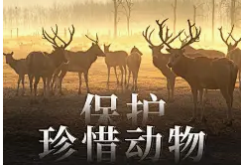

活用词汇
illegal /ɪˈli:gl/ adj.不合法的;非法的
illegally /ɪ'li:ɡəlɪ/ adv.不合法地;非法地
1. 在许多国家，捕猎濒危动物是非法的。(应用文)
Hunting endangered animals is illegal in many countries.
2.他把车非法停在消防栓前，被开了罚单。(续写)
He parked his car illegally in front of the fire hydrant and got a ticket.

Slide 6

活用词汇
hunt /hʌnt/ vt.&vi.打猎;搜寻;追捕
hunter /ˈhʌntə(r)/ n.猎人
1. 我到处都搜遍了，就是找不到它。(续写)
I've hunted everywhere but I can't find it.
2. 受这种特殊求职方式的启发，他们想出了一个主意，通过准备简历和练习面试，帮助更多有技能的无家可归者找到工作。(续写)
Inspired by this special way of job-hunting, they came up with the idea of helping more homeless people with skills to find a job through preparing resumes and practicing interviews.

Slide 7
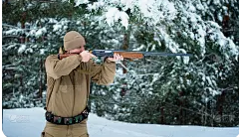
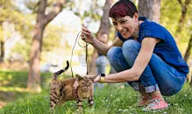
活用词汇
hunt /hʌnt/ vt.&vi.打猎;搜寻;追捕
hunter /ˈhʌntə(r)/ n.猎人
3.他对冒险和狩猎很感兴趣。(续写)
He was very interested in adventure and hunting.
4. 他意识到动物不仅仅是宠物或猎物，它们还是他的朋友和伙伴。(续写)
He realized that animals were not just pets or creatures to be hunted, but they were his friends and companions.

Slide 8

活用词汇
immediately /ɪˈmi:diətli/ adv.立刻
1.他将要住院三个月，使得我立即赶去看他。(2022浙江卷1月续写)
His going to stay in hospital for three months urged me to visit him immediately.
2.他立即扑倒在地。(续写)
He immediately flung himself to the floor.
3.她刚走开我就想起了她的名字。(续写)
Immediately she'd gone, I remembered her name.

Slide 9

活用词汇
immediately /ɪˈmi:diətli/ adv.立刻
4.他匆匆下了车，紧接着后悔没有带上手机。(续写)
Hurrying out of the vehicle, he immediately regretted not having his phone.
5.她立刻戴上，然后站在镜子前，转着圈，欣赏着她的样子。(续写)
She put it on immediately and stood in front of the mirror, twirling and admiring the way it looked on her.

Slide 10
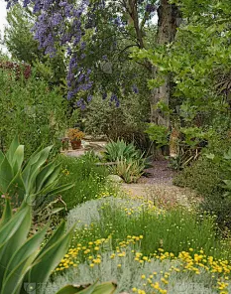

活用词汇
species /ˈspi:ʃi:z/ n.物种
1.通过此次实践活动，我不仅深入了解了不同植物及其特性，还充分认识到校园内植物种类的丰富性与多样性。(2023浙江应用文“认识我身边的植物”活动)
Through this event, I not only enjoyed learning about different plants and their characteristics, but also came to realize the abundance and diversity of the plant species on our campus.
2. 如果世界上存在一种神奇的力量，那一定是超越所有物种界限的普遍之爱与互惠精神，正如我所崇敬的蜂鸟所象征的意义一般。(续写)
Were there magic power existing in this world, it must be the universal love and reciprocity that surpassed beyond any species, as is the case with my sacred hummingbird and me.

Slide 11

活用词汇
on earth /ɒn ɜ:θ/ (疑问词后表强调)究竟;到底
1.“这太蠢了，杰米。”她皱着眉头说道，“我们到底在这儿干什么？”然而，杰米却笑得灿烂，稳稳地扶着自行车，让她上去。(续写)
"This is stupid, Jamie" she scowled, "What on earth are we doing here? Jamie, however, beamed brightly and held the bicycle steady for her to climb on.
2.在那一刻，我站在原地，手中握着那张十美元的钞票，陷入了短暂的困惑。我犹豫不决，既不确定应该购买什么商品，也不知道究竟买给谁。(续写)
For a few moments I just stood there，confused，holding that ten­dollar bill，wondering what to buy and who on earth to buy it for.

Slide 12

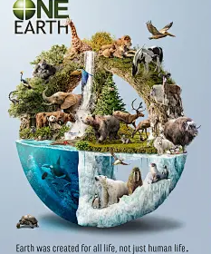
活用词汇
die out /daɪ aʊt/ 灭亡;逐渐消失
1.随着生存环境的持续恶化，许多物种正面临逐渐灭绝的风险。(应用文)
With the living environment becoming worse and worse, many species are gradually dying out.

Slide 13
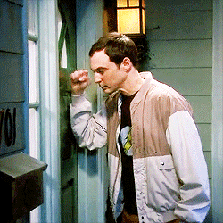
活用词汇
alarming /əˈlɑ:mɪŋ/ adj.惊人的;使人惊恐的
alarm /əˈlɑ:m/ vt.使惊恐;使害怕 n.恐慌
1. “你都干了些什么？”埃利惊恐地喊道。(续写)
‘What have you done?’ Ellie cried in alarm .
2.那天夜里他没有回家，我越来越感到恐慌。(续写)
I felt a growing sense of alarm when he did not return that night.
3.我敲打所有的门让大家警觉。(续写)
I hammered on all the doors to raise the alarm .
4.半夜里一辆汽车的警报器突然响了起来。(续写)
A car alarm went off in the middle of the night (= started ringing).

Slide 14
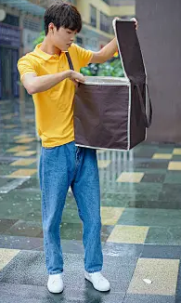
活用词汇
alarming /əˈlɑ:mɪŋ/ adj.惊人的;使人惊恐的
alarm /əˈlɑ:m/ vt.使惊恐;使害怕 n.恐慌
5.她一想到独自旅行的情景就害怕。(续写)
She was alarmed at the prospect of travelling alone.
6.就在阿瑟拿起第一个箱子准备离开时，他突然听到了一声悠长的警报声。(续写)
Just as Arthur picked up the first suitcase and started walking，he heard the long loud noise of an alarm.
7.现在，空气中弥漫着警报声，同时伴随着人们从四面八方奔跑时发出的呼喊声。 (续写)
Now the air was filled with the sound of the alarm and the shouts of people running from all directions.

Slide 15

活用词汇
rate /reɪt/ n.速度;(比)率 vt.划分等级
rating /ˈreɪtɪŋ/ n.等级;级别
1.我对此感到困惑，因为这是我仅基于收视率数据作出的决定。(续写)
Confused, I simply based my decision on the ratings.
2.我们查阅了十佳餐厅的评级，并选择了一家进行体验。(续写)
We found a rating of the Top Ten Restaurants, and went into one of them.
3.有趣的是，相同的评级对不同的消费者可能有不同的影响。(应用文)
Interestingly, the same rating may have different influences on different consumers.

Slide 16

活用词汇
extinct /ɪkˈstɪŋkt/ adj.已灭绝的
extinction /ɪkˈstɪŋkʃn/ n.灭绝
1. 尽管全球保护行动不断推进，生物多样性的急剧丧失仍将无数物种推向灭绝边缘。(应用文)
Despite global conservation efforts, the rapid loss of biodiversity continues to push countless species toward the brink of extinction.
2. 若不是数十年严格的保护计划，曾濒临灭绝的大熊猫可能已完全消失。(应用文)
Were it not for decades of conservation programs, the giant panda, once teetering on the edge of extinction, might have vanished entirely.

Slide 17
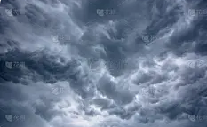
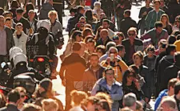
活用词汇
mass /mæs/ adj.大量的;广泛的 n.大量
1. 远远地看去，那座山是黑魆魆一片。(续写)
The hill appeared as a black mass in the distance.
2. 天空中乌云密布。(续写)
The sky was full of dark masses of clouds.
3. 天边乌云密布。(续写)
Dark clouds massed on the horizon.
4. 我在人群里挤来挤去，挤到了出口处。(续写)
I struggled through the mass of people to the exit.

Slide 18
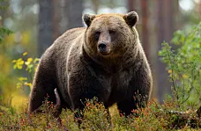
活用词汇
habitat /ˈhæbɪtæt/ n.(动植物)生活环境;栖息地
1.令人担忧的是,许多熊的栖息地正在被破坏。(应用文)
What is worrying is that many habitats of bears are being destroyed.

Slide 19
活用词汇
habitat /ˈhæbɪtæt/ n.(动植物)生活环境;栖息地
1.令人担忧的是,许多熊的栖息地正在被破坏。(应用文)
What is worrying is that many habitats of bears are being destroyed.

Slide 20

活用词汇
aware /əˈweə(r)/ adj.知道;发觉;有…意识的
aware of /əˈweə(r) əv/ 意识到;知道
1.她悄悄离开，没有让他发觉。(续写)
She slipped away without him being aware of it.
2.他们突然意识到有些人在瞧着他们。(续写)
They suddenly became aware of people looking at them.
3.我察觉到她在发抖。(续写)
I was aware that she was trembling.
4.在周末，我们把它们送给附近的居民，以唤起他们循环使用和保护地球的意识。(续写)
At the weekend, we sent them to the people living nearby to arouse their awareness of recycling and protecting the earth.

Slide 21
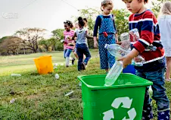
活用词汇
aware /əˈweə(r)/ adj.知道;发觉;有…意识的
aware of /əˈweə(r) əv/ 意识到;知道
5. 这项运动成功地使人们意识到正确洗手的重要性。(应用文)
The campaign has successfully made people aware of the importance of washing hands properly.
6. 在那段时间里，日益增强的环保意识使它触手可及。(2021年全国乙卷)
During that time, increasing environmental awareness made it desirable.

Slide 22

活用词汇
endanger /ɪnˈdeɪndʒə(r)/ vt.使遭受危险;危害
1.随着濒危物种日的临近，我写信呼吁大家保护野生动物和植物。(应用文)
With Endangered Species Day approaching, I'm writing to appeal to all of you to protect wild ammals and plants.

Slide 23
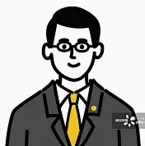
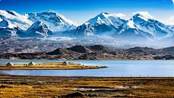
活用词汇
average /ˈævərɪdʒ/ n.平均数 adj.平均的
on average /ɒn ˈævərɪdʒ/ 平均
1.我最尊敬的人是我的语文老师，他中等身材，戴着一副眼镜。( 2020年全国卷Ⅰ满分作文)
The person I respect most is my Chinese teacher, who is of average height and wears a pair of glasses.
2. 在这项研究中，191名平均年龄为50岁的女性参加了自行车运动测试，直到她们感到疲惫。（2022·浙江卷1月）
For the study, 191 women with an average age of 50 took a bicycle exercise test until they were tired out.
3. 青藏高原是世界上最高的高原，平均海拔超过4000米。(应用文)
The Qinghai-Tibet Plateau is the world's highest plateau, averaging over 4,000 metres above sea level.

Slide 24
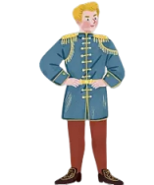

活用词汇
prince /prɪns/ n.王子;王孙;亲王
1.在他生命的最初十年里，维克多是家务活小王子。(续写)
For the initial ten years of his life, Victor was the prince of the household.
2. 得知她在剧中扮演的公主角色被替换了，她很沮丧，感觉自己就像一艘被抛弃的船，漂浮在绝望的海洋，努力寻找希望。(续写)
Discouraged by the news that her role as the princess in the play was replaced, she felt like an abandoned boat floating in a sea of despair, struggling to find hope.

Slide 25

活用词汇
make progress /meɪk ˈprəʊgres/ 取得进步
1. 作为父亲，他不仅关心我的生活，还激励我树立远大目标并为之努力奋斗。若没有他的鼓励，我不可能取得如此大的进步。(续写)
As a father, not only does he care about my life, but also inspires me to set a high objective and strive for it. But for his encouragement, I couldn't have made so much progress.
2.代表那些想在英语上取得进步的人，我真诚地邀请你在周五晚上7点接受采访。（2022新高考全国卷）
On behalf of those who feel like making progress in English, I sincerely invite you to give an interview at 7：00 pm on Friday.
3.由于您出色的工作，我们每个人的英语都有了很大的进步，其中最好的是我们掌握了有效的学习方法。(2020年浙江卷)
Owing to your excellent work, every one of us has made great progress in English, the best of which is that we have grasped effective learning methods.

Slide 26
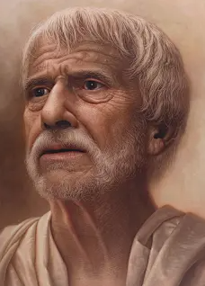
concern /kənˈsɜ:n/ vt.涉及;让……担忧
concerned /kənˈsɜ:nd/ adj.担心的;关切的
concerned about /kənˈsɜ:nd əˈbaʊt/ 对…关切的;为…担忧的
活用词汇
1.狂怒不安的熊步步逼近，我们紧张担心的情绪转变成了恐惧与绝望。(续写)
With the raging bear approaching, our tension and concern gave way to fear and despair.
2.让我担心的是我们对事态的变化缺乏准备。(续写)
What concerns me is our lack of preparation for the change.
3. 担忧的表情使他额头上出现皱纹。(续写)
A look of concern furrowed his brow.
4.总统对这个问题深感担忧。(续写)
The President is deeply concerned about this issue.

Slide 27

concern /kənˈsɜ:n/ vt.涉及;让……担忧
concerned /kənˈsɜ:nd/ adj.担心的;关切的
concerned about /kənˈsɜ:nd əˈbaʊt/ 对…关切的;为…担忧的
活用词汇
5.如果我们都能去关心其他有需求的人,这个世界就会成为更加美好的生存之地。(续写)
If we could show concern for others in need, the world would be a better place to live in.
6. 就我而言，学生应该多听多说来发展他们的沟通技巧。(2022全国乙卷)
As far as I am concerned, students should do more listening and speaking so that they can develop their communication skills.
7.如果你有任何关于中文的问题，我非常愿意帮助你，做一名活雷锋。(续写)
Should you have any questions concerning Chinese, I am more than willing to help you by being a living Lei Feng.

Slide 28

活用词汇
living /ˈlɪvɪŋ/ adj.居住的;活的 n.生活
1.只有保护好环境，才能真正拥有更好的生活条件。(应用文)
Better living conditions can really be reached on condition that the environment is well protected.
2.活雷锋是一个继承雷锋精神，在当今社会做他曾经做过的事情的人。(2023年天津卷)
A living Lei Feng is a person who inherits the spirit of Lei Feng and does what he used to do in the present society.
3.众所周知，浪费意味着自杀。人们普遍认为我们急需资源，然而我们仍在浪费生活物资，这似乎相当荒谬。(续写)
As we all know, wasting means suicide. It’s generally accepted that we are in desperate need of resources, while we are still wasting living materials, which seems quite ridiculous.

Slide 29

活用词汇
adapt /əˈdæpt/ vi.适应 vt.使适应;使适合
adapt to /əˈdæpt tə/ 适应
1.我写信是想请您指导一部短剧，它是根据我们的一篇课文改编的。(2020全国卷Ⅲ)
I'm writing to ask for your guidance on a short play, which is adapted from one of our texts.
2. 我不仅要适应美国的生活方式，还要帮助他们更好地了解中国文化。(续写)
Not only will I adapt myself to the American lifestyle， but I will also help them understand the Chinese culture better.
3.在我们国家英国留学多年，我想你在这里一定拥有良好的英语知识和很好的适应能力。(2021年天津卷)
After years of study abroad in our country here in Britain, I think you must have had a good knowledge of English and good adaptation here.

Slide 30

活用词汇
adapt /əˈdæpt/ vi.适应 vt.使适应;使适合
adapt to /əˈdæpt tə/ 适应
4.幸运的是，他成功适应了新的学校生活，并且很快就交到了新朋友。(续写)
Luckily, he managed to adapt to his new school life and soon made new friends.
5.另一方面，良好的听力和口语能力将对你适应课堂有很大的帮助，这样你就能理解老师的话和指示。(2021年6月上海卷)
For another, good listening and speaking ability will be of great help for you to adapt yourself in class so that you can understand the teachers’ words and instructions.

Slide 31

活用词汇
measure /ˈmeʒə(r)/ n.措施;方法 vt.测量;度量
1. 因此，是我们采取措施保护海洋的时候了。(2022年全国甲卷)
Therefore, it is high time that we took measures to protect the oceans.
2.衡量成功与否不在于有多少金钱，而在于如何理解人生真正的意义。(应用文)
Success is not measured by how much money you have but by how you understand the true meaning of life.
3. 为了人们的健康和幸福，应当采取措施控制和预防污染，每个人都应当为此做出贡献。(应用文)
For the sake of people's health and happiness, measures should be taken to control and prevent pollution and everyone should make a contribution to it.

Slide 32

活用词汇
authority /ɔ:ˈθɒrəti/ n.官方;当权;权威
1.诚邀您参加2024全球教育论坛。您在教学方法上的权威将影响全球教育发展。请分享创新观点，但需以明确数据和研究为支撑。(应用文)
We sincerely invite you to join the 2024 Education Forum. Your authority in teaching methods will help shape global education. Please share creative ideas, but support them with clear data and research.
2. 如果人工智能有权管理交通系统，事故可能减少，但人类工作会消失。(应用文)
If AI had the authority to control traffic systems, accidents might decrease, but human jobs could disappear.

Slide 33
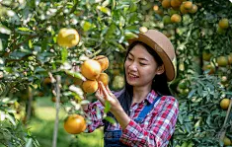
活用词汇
pressure /ˈpreʃə(r)/ n.压力;要求
1. 为了缓解学习压力，上周末我和同学们一起去新兴农场摘橙子。 (2020年全国卷Ⅱ)
In order to release the pressure resulting from our study, I went to Xinxing Farm to pick some oranges together with my classmates last weekend.
2.他的心脏感觉像是要从胸膛里爆炸出来，局势的压力太大，难以承受。(续写)
"His heart felt like it was going to burst out of his chest, the pressure of the situation too immense to bear."
3.黑暗从四面八方逼近，是一种令人窒息的绝望斗篷，使希望之光变得暗淡。(续写)
The darkness pressed in from all sides, a suffocating shroud of despair that dimmed the light of hope.

Slide 34
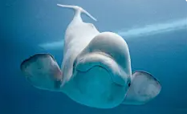
活用词汇
whale /weɪl/ n.鲸
1.当船驶向辽阔的海洋时，伊什梅尔的脑海中充满了关于白鲸的故事。(续写)
As the ship sailed into the vast ocean, Ishmael's mind raced with the tales of the white whale.
2. 正如《白鲸》中的以实玛利面对巨大的白鲸时感到敬畏和恐惧，当她凝视黑暗时，她也感到了类似的恐惧。(续写)
Just as Ishmael in 'Moby Dick' faced the great white whale with a mix of awe and terror, she too felt a similar dread as she stared into the darkness.

Slide 35
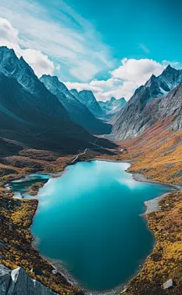
活用词汇
reserve /rɪˈzɜ:v/ n.(动植物)保护区;储藏(量)
1.九寨沟国家公园是位于四川省北部的一个自然保护区。最令人印象深刻的是其众多的多级瀑布和色彩斑斓的湖泊。(2021年天津)
Jiuzhaigou National Park is a nature reserve in the north of Sichuan Province. What is the most impressive is its many multi-level waterfalls and colorful lakes.
2. 病愈后，这位富有创造力的人来到了为他保留的大房子里。(续写)
After recovering from his illness, the creative man went to the big house reserved for him.

Slide 36
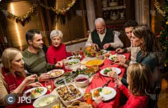
活用词汇
plain /pleɪn/ n.平原 adj.简单明了的
1. 她满脸不耐烦。(续写)
She made her annoyance plain.
2.他个子很高，穿着朴素。(续写)
He was very tall and plainly dressed.
3. 复活节晚餐很简单，但全家人都对它的美味满意。(续写)
The Easter dinner was plain and simple but the whole family was quite contented with its delicacy.

Slide 37

活用词汇
make out /meɪk aʊt/ 看清;听清;分清
1. 雨越下越大，透过大雨我努力辨认那边模糊的人影。(续写)
Peeking through the mounting rain, I struggled to make out the vague figure over there.
2.她眯起眼睛阅读标签上的小字，眼睛努力辨认那些文字。(续写)
She squinted to read the tiny print on the label, her eyes straining to make out the words.

Slide 38
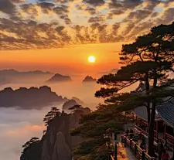
活用词汇
observe /əbˈzɜ:v/ vt.观察(到);注视;遵守
1. 在泰山之巅，人们兴奋地观看太阳从海上升起。(续写)
On the top of Mountain Tai, people excitedly observed the sun rising from the sea.
2. 这对双胞胎近仔细观察他们的父亲做三明治。(2021全国卷Ⅰ)
The twins observed their father make some sandwiches closely.
3. 为迎接即将到来的国际志愿者日，我们呼吁大家积极参与以“互助互爱”为主题的志愿者活动。(续写)
To observe the upcoming International Volunteer Day, we are appealing to all of you for the active participation of a volunteer campaign themed “ mutual assistance and care”.

Slide 39

活用词汇
beauty /ˈbju:ti/ n.美;美人;美好的东西
1. 首先是美化校园活动。(应用文)
It’ ll commence with beautifying campus activities.
2. 杭州被誉为人间天堂，拥有众多历史悠久的名胜古迹，从令人心旷神怡的西湖到古朴宁静的灵隐寺，您可在此尽情领略其永恒的自然之美与信仰之魅。(应用文)
Hangzhou, hailed as the paradise on earth, boasts a galaxy of historically reputed sites, ranging from the bracing West Lake to the antiquely serene LingYin Temple, where you could fully immerse in its timeless charm of beauty and faith behind.

Slide 40

活用词汇
remind /rɪˈmaɪnd/ vt.提醒;使想起
1. 你说这样的话，使我想起了你的父亲。(续写)
You remind me of your father when you say that.
2. 这股气味使我想起了法国。(续写)
That smell reminds me of France.
3. 这张海报提醒我们必须立即采取措施保护濒危生物。(应用文)
The poster reminds us that we must take immediate measures to protect endangered creatures.
=The poster reminds us to take immediate measures to protect endangered creatures.

Slide 41

活用词汇
remind /rɪˈmaɪnd/ vt.提醒;使想起
4. 春节是中国最重要的传统节日之一,它总是让我们想到家庭的团聚。(应用文)
The Spring Festival is one of the most important traditional festivals in China, which always reminds us of the family reunion.
5. 世界海洋日是强调海洋重要性并提醒人们保护海洋的日子。(2022年全国甲卷)
World Oceans Day is a day to stress the importance of oceans and remind people to protect them.

Slide 42
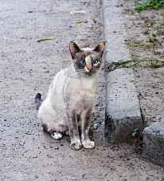
活用词汇
fur /fɜ:(r)/ n.毛(皮);毛皮衣服
1.令他们吃惊的是，意识到危险已经消失了，毛茸茸的巨人停止了追赶，回到小溪里，抱起她的孩子，紧紧地抱着它。(续写)
To their surprise, realizing the danger was away, the furry giant stopped chasing and returned to the stream, picking up her baby, and holding it in arms tightly.
2. 这只瘦猫的毛发上满是污渍，凌乱不堪，显得十分邋遢。(续写)
The skinny cat looked ragged with its dirty-spotted and messy fur.

Slide 43
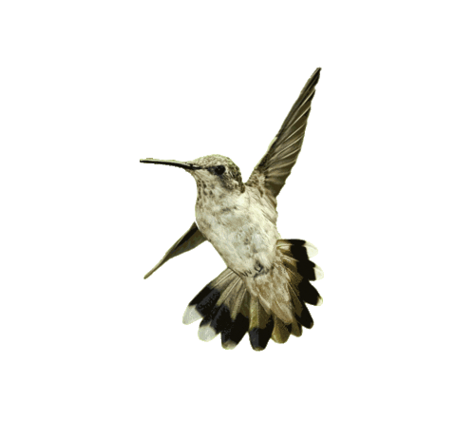
活用词汇
sacred /ˈseɪkrɪd/ adj.神圣的;受尊敬的
1. 倘若这世上真有神奇的力量存在，那一定是超越物种的博爱与互惠，就像我与我那神圣的蜂鸟一样。(2023年浙江英语)
Were there magic power existing in this world, it must be the universal love and reciprocity that surpassed beyond any species, as is the case with my sacred hummingbird and me.

Slide 44

活用词汇
shoot /ʃu:t/ vr.&vi.射杀;射伤;发射
1. 飞机掠过天空。(续写)
A plane shot across the sky.
2. 他猛地伸出手去抓她。(续写)
His hand shot out to grab her.
3.火不断从房顶蹿上来。(续写)
Flames were shooting up through the roof.
4.她一靠近，那个老妇人的手就猛地伸了出来。(续写)
As soon as she got close, the old woman's hand shot out.
5.背部的一阵剧痛(续写)
a shooting pain in the back

Slide 45

活用词汇
shoot /ʃu:t/ vr.&vi.射杀;射伤;发射
6.疼痛顺着她的胳膊窜了上来。(续写)
The pain shot up her arm.
7.她很生气，瞪了他一眼。(续写)
She shot an angry glance at him.

Slide 46

活用词汇
profit /ˈprɒfɪt/ n.利润;利益
1. 在我看来，经济发展给我们带来的坏处无疑已经超过了它的好处。(续写)
From my perspective, the disadvantages which economic development brings us have already undoubtedly outweighed its profits.
2. 我们曾经信任过他，可仅仅一个星期后，他就为了赚钱把贝尔修女出卖了！(续写)
We had trusted him, and just a week later he was selling Sister Belle away to make a profit!

Slide 47
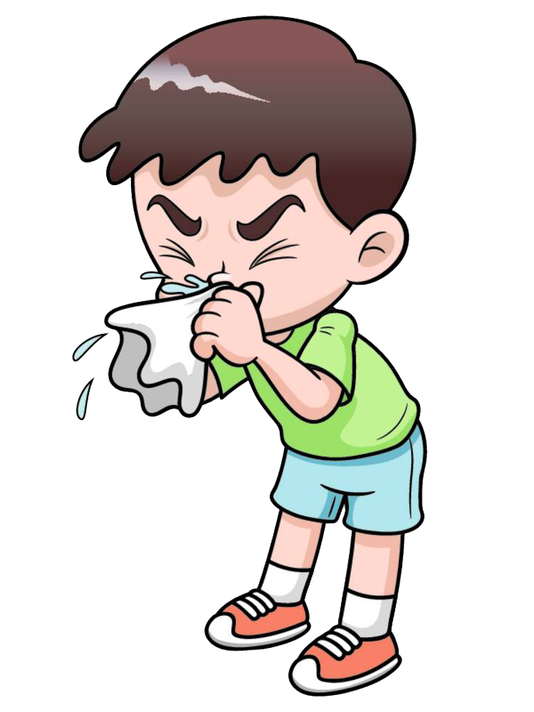

活用词汇
day and night /deɪ ənd naɪt/ 日日夜夜;夜以继日
1. 我一直在咳嗽。(续写)
I've been coughing day and night.
2. 感动得流下了眼泪，我决心要用心学习钢琴，对奶奶的回忆激励着我日夜练习。(续写)
Moved to tears, I determined to learn piano by heart and my memory of grandma motivated me to practice day and night.

Slide 48

活用词汇
attack /əˈtæk/ n.,vi.&vt.攻击;抨击
1. 他计划在暑假学习功夫，以便能够在受到攻击时自卫。(续写)
He planned to learn kung fu in the summer holidays so that he can defend himself against being attacked．
2. 67岁生日后的第四天，他心脏病发作。(续写)
Four days after his sixty-seventh birthday, he had a heart attack.
3. 他的父亲喜欢在野外生火做饭，讲述如何应对诸如熊的攻击和蜜蜂叮咬等危险的故事。(续写)
His father liked cooking over an open air, telling stories about how to survive things like bear attacks and bites of bees.
4.突然紧张不安(续写)
an attack of nerves

Slide 49

活用词汇
effective /ɪˈfektɪv/ adj.有效的;生效的
1.你可以向你的父母或老师求助，他们会帮助你选择合适的策略来有效地应对压力。(续写)
You can turn to your parents or teachers, who will help you choose the appropriate strategies to cope with your stress effectively.
2.在经验丰富的老师的指导下，我们改编了课本中的戏剧，分配角色给演员，并设计舞台，营造出适宜的灯光和音响效果。(续写)
Under the guidance of experienced teachers, we adapted plays from our textbooks, cast parts to actors, and designed the stage, creating suitable light and sound effects.

Slide 50
活用词汇
recover /rɪˈkʌvə(r)/ vi.恢复;康复 vt.找回;寻回
1.我真诚地希望你能尽快恢复信心，并且爱上英语。(应用文)
I sincerely hope you can recover confidence as soon as possible and fall in love with English.
2. 尽管他在车祸中受伤严重，但最终他康复了。(续写)
Even though he was seriously hurt in the car accident，he finally recovered from it.
=Even though he was seriously hurt in the car accident， he finally made a recovery from it.

Slide 51

活用词汇
remove /rɪˈmu:v/ vt.去除;移开;脱去
1. 感受大家的热情与赞赏，亨利不再感到紧张焦虑，变得更加自信。(续写)
Everyone’s enthusiasm and admiration removed Henry’s nervousness and anxiety, enhancing his confidence.
2. 去除沉重的负担，学生们才可以保持良好的心理健康。(应用文)
With their heavy burden removed, students can keep sound mental health.
3. 杰克慢慢地走近狐狸，轻轻地拔掉了它爪子上的刺。(续写)
Jack slowly approached the fox and gently removed the thorn from its paw.

Slide 52

活用词汇
remove /rɪˈmu:v/ vt.去除;移开;脱去
4. 直到我试图把头抽出来时，我才意识到出去可不像进来那么容易。(续写)
It was only when I tried to remove my head that I realized getting out was going to be less straightforward than getting in.
5. 我清理掉了覆盖在她头上和翅膀上的黏糊糊的蜘蛛网。(续写)
I removed the sticky spiderwebs that covered her head and wings.

Slide 53

活用词汇
intend /ɪnˈtend/ vi.&vt.打算;计划;想要
1. 我们学校组织了一场五公里的越野跑比赛，目的是增强我们的体力和脑力(应用文)。
Our school organized a five-kilometer cross-country running race with the intention of improving our physical and mental strength.
2. 我们都参加了这次比赛,该比赛的目的是鼓励我们经常锻炼。(应用文)
We all participate in the race intended to encourage us to exercise regularly.
3. 我们的《谈话》节目旨在与学生分享英语学习的方法和经验。（2022年全国卷Ⅰ）
Our program, “Talk and Talk”， is intended to share English learning methods and experience with students.

Slide 54

活用词汇
threat /θret/ n.威胁
threaten /ˈθretn/ vt.威胁;危及
1. 暴风雨即将来临。(续写)
A storm was threatening.
2. 狗狗大声吼叫，站在他和蛇之间，毛发竖起，眼睛盯着威胁。蛇被狗狗的勇气吓退了，蜿蜒地离开了。(续写)
With a fierce bark, the dog stood between him and the serpent, its fur bristled and eyes fixed on the threat. The snake, intimidated by the dog's courage, slithered away.
3. 交通问题是个棘手的问题。它不仅影响我们的日常生活，而且可能威胁到人们的生命。(应用文)
The traffic issue is a hard nut to crack. It not only affects our everyday life, but may also threaten people’s lives.

Slide 55
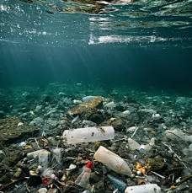
活用词汇
harmony /ˈhɑ:məni/ n.和谐;融洽
1.我正在欣赏漂亮的湖，这时与美景不协调的一幕映入了我的眼帘。(续写)
I was appreciating the beautiful lake when a scene that didn’t go with its harmony came into my eyes.
2. 众所周知，交友有助于我们建立良好的人际关系，也有利于构建和谐社会。(应用文)
As we all know, making friends can help us establish good interpersonal relationships, and build a harmonious society.
3. 没有他们，人们就无法享受和谐，国家就会陷入混乱。(续写)
Without them, people could not enjoy harmony or the country would be in chaos.

Slide 56

活用词汇
goods /gʊdz/ n.商品;货物
1. 因此，他倒了下来，递给我$15，说：“我提前交货了，你把货物送到这对夫妇的家里。”(续写)
Therefore, he fell down and handed me $15, saying, ‘I have taken an advance for this delivery, and you deliver the goods to the couple’s home.’
2. 他们询问搬运工送货上门的费用。(续写)
They asked the porter about the charges for delivering their goods to their home.
3. 我冲进去抢货。(续写)
I rushed inside and grabbed the goods.

Slide 57
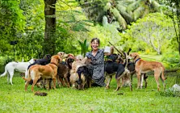
活用词汇
creature /ˈkri:tʃə(r)/ n.生物;动物
1.看到这只声音甜美、充满感激之情的动物，我不禁感到一阵宽慰和敬畏。我知道，当我钻进车里开车离开时，我将永远珍惜我们共同的回忆。(续写)
I couldn't help but feel a surge of relief and awe at the sight of this sound and grateful creature, and I knew that I would always cherish the memories we shared as I climbed into my car and drove away.
2. 我从不厌倦重复这些话，动物是最忠诚、最可爱的生物。(续写)
I never grow tired of repeating this—animals are the most devoted and loving creatures.
3. 有很长一段时间，这个小生命头转到来转去地盯着我的眼睛看。
(2023年浙江卷读后续写)
For a very long moment, this tiny creature looked into my eyes, turning her head from side to side.

Slide 58
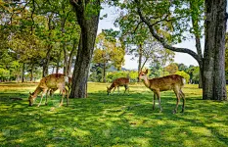
活用词汇
deer /dɪə(r)/ n.鹿
1. 一天，杰克在森林里闲逛时，偶然发现一群鹿在一片空地上安静地吃草。(续写)
One day, while wandering through the forest, Jack chanced upon a group of deer eating grass peacefully in a clearing.
2. 然后我看到一只小鹿宝宝躺在地上，显然又渴又热，费力地抬起头来舔我儿子手中的水。(续写)
And then I saw a tiny baby deer lying on the ground，obviously suffering from thirst and heat，lift its head with great effort to lap up the water in my boy’s hands.

Slide 59
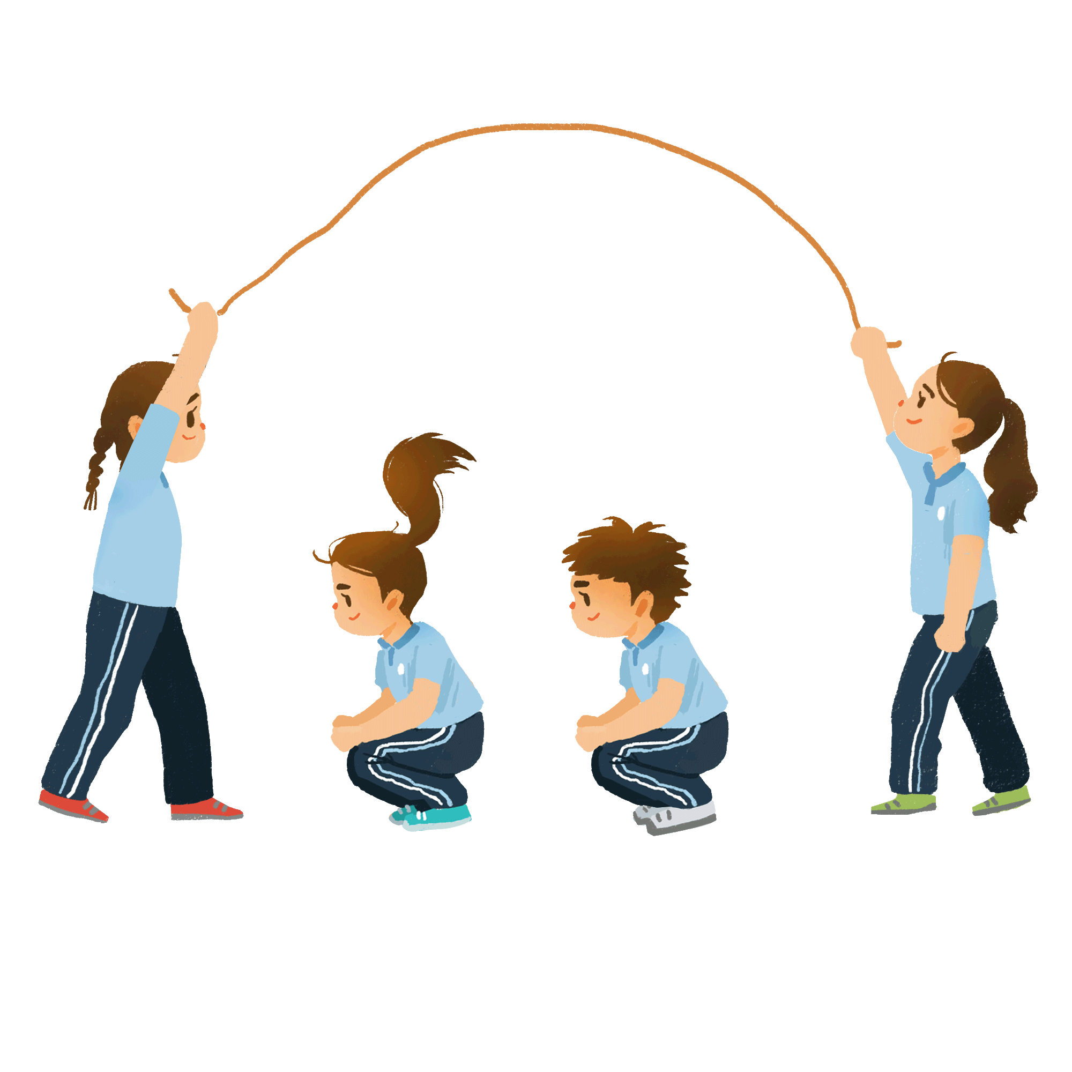
活用词汇
reduce /rɪˈdju:s/ vt.减少
1. 他们的批评使她流下了眼泪。(续写)
She was reduced to tears by their criticisms.
2. 此外，人们认为，如果那些经常开车上下班的人能够真正参与拼车计划的话，那么道路上行驶的车辆数量将会大幅减少。(续写)
Furthermore, it is thought that if those who frequently drive to work actually took part in a car pooling scheme, then the number of vehicles on the road would be dramatically reduced.
3. 为了解决这个日益严重的问题，学校应该减轻学生的学业负担，增加户外活动的时间。(续写)
To tackle the growing problem, schools should reduce the academic burden of students and increase the time of outdoor activities.

Slide 60

due /dju:/ adj.由于;因为
due to /dju: tə/ 由于;因为
活用词汇
1. 由于与环境保护相关的旅行以及探险旅行越来越受欢迎，如今各类旅行项目都被归入了生态旅游这一类别。(应用文)
Due to the growing popularity of environmentally-related and adventure travel, various types of trips are now being classified as ecotourism.
2. 由于技术的快速发展，在线学习变得越来越流行。(应用文)
Due to the rapid development of technology, online learning has become more and more popular.
3. 许多家长仍然限制电子阅读，主要是因为担心他们孩子的健康。(应用文)
Many parents still limit electronic reading, mainly due to concerns about their children's health.

Slide 61
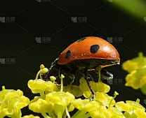
活用词汇
insect /ˈɪnsekt/ n.昆虫
1. 刹那间，万物都突然寂静无声，鸟儿不再歌唱，树叶不再沙沙作响，昆虫也停止了欢唱。一种寂静的感觉悄悄向我袭来。(续写)
In an instant, everything suddenly gone quiet.Birds didn't chirp, leaves didn't rustle and insects didn't sing. A feeling of stillness crept up on me.
2. 由于害怕昆虫，又时刻警惕着暴风雨的来临，他一直待在家里。(续写)
Terrified of insects and always on alert for a storm rolling in, he remained housebound.

Slide 62

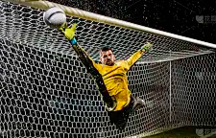
活用词汇
net /net/ n.网 adj.净得的;纯的
1. 网上种类繁多的商品可以毫不费力地进行比较，也很容易选择。(应用文)
The large varieties of goods on the net are effortlessly comparable and easy to choose.
2. 当球飞向球网的上面时，他屏住呼吸，用力击球。(续写)
He struck the ball hard and held his breath as it flew toward the upper corner of the net.

Slide 63

活用词汇
search for /sɜ:tʃ fə(r)/ 搜索;查找
1.她的眼睛在房间里来回扫视，急切地四处寻找着逃离眼下不断加剧的恐慌的办法。(续写)
Her eyes darted around the room, a frantic search for an escape from the mounting panic.
2.值得一提的是，学生们全天都能使用性能良好的电脑和平板，以便于他们能够查找信息。(应用文)
What is worth mentioning is the well-performing computers and tablets accessible to students throughout the day, allowing students to search for information conveniently.

Slide 64

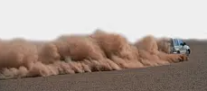
stir /stɜ:(r)/ vt.激发;搅动
活用词汇
1. 她搅了搅茶。(续写)
She stirred her tea.
2. 微风吹动着树枝。(续写)
A slight breeze was stirring the branches.
3. 响声把我从睡梦中惊醒。(续写)
A noise stirred me from sleep.
4. 他那悲惨的故事打动了她。(续写)
She was stirred by his sad story.
5.她心里渐渐生出了内疚感。(续写)
A feeling of guilt began to stir in her.
6. 风吹起大量尘土。(续写)
The wind stirred up a lot of dust.

Slide 65

活用词汇
emotion /ɪˈməʊʃn/ n.感情;情感;情绪
1.他情绪失去了控制。(续写)
He lost control of his emotions.
2. 他们对这个消息表现出复杂的感情。(续写)
They expressed mixed emotions at the news.
3. 群情激奋。(续写)
Emotions are running high (= people are feeling very excited, angry, etc.) .
4. 玛丽激动得不能自持。(续写)
Mary was overcome with emotion.
5. 我的研究告诉我，那些情绪消极的人有着对秩序和敏感度的内在情感需求。(续写)
My research told me that people with negativity have an emotional need for order and sensitivity.
6. 感觉就像你的衣服在情感上与某人联系在一起。(续写)
It feels like you are emotionally connecting someone in your clothes.

Slide 66

活用词汇
skin /skɪn/ n.皮;皮肤
1. 经过治疗恢复后，医生告诉他，接下来的 6 个月内不能做整形手术，因为皮肤需要这么长时间才能停止收缩和起皱。(续写)
After he recovered from the treatments, the doctors told him they would not do plastic surgery for 6 months because it takes that long for the skin to stop shrinking and wrinkling.
2. 他太瘦了，以至于其他孩子过去常拿他开玩笑说，刮风会把他吹走。(续写)
He was so skinny that the other kids used to joke about him getting blown away when it was windy.

Slide 67
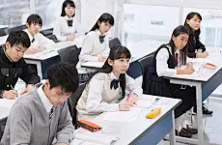
活用词汇
unusual /ʌnˈju:ʒuəl/ adj.特别的;不寻常的
1. 期末考试结束后，教室异常安静，学生们焦急地等待着考试结果。(续写)
After the final exam, the classroom was unusually quiet as students anxiously awaited the results.
2. 这就是为什么没有一个孩子认为大卫决定加入越野队是不寻常的。(续写)
That was why none of the children thought it unusual that David had decided to join the cross-country team.

Slide 68
Thank you

