Slide 1


感恩遇见，相互成就，本课件资料仅供您个人参考、教学使用，严禁自行在网络传播，违者依知识产权法追究法律责任。
更多教学资源请关注
公众号：溯恩英语
知识产权声明

Slide 2



Book1 Unit1
Expanding your world
Teenage Life around the World

Slide 3

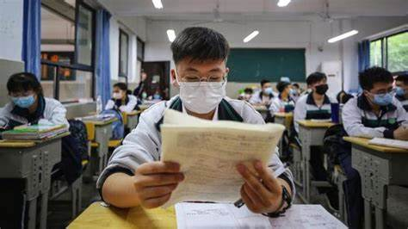
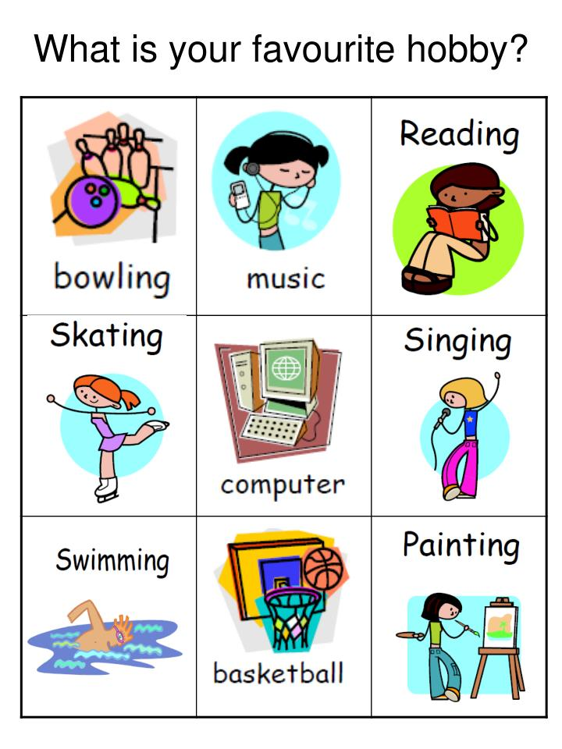

Your life
What is your school life like?
How do you feel?
What is your hobby?
I like/enjoy _____ because_________.
What do you want to do in the future?
I want to _________ because ______________.

Slide 4
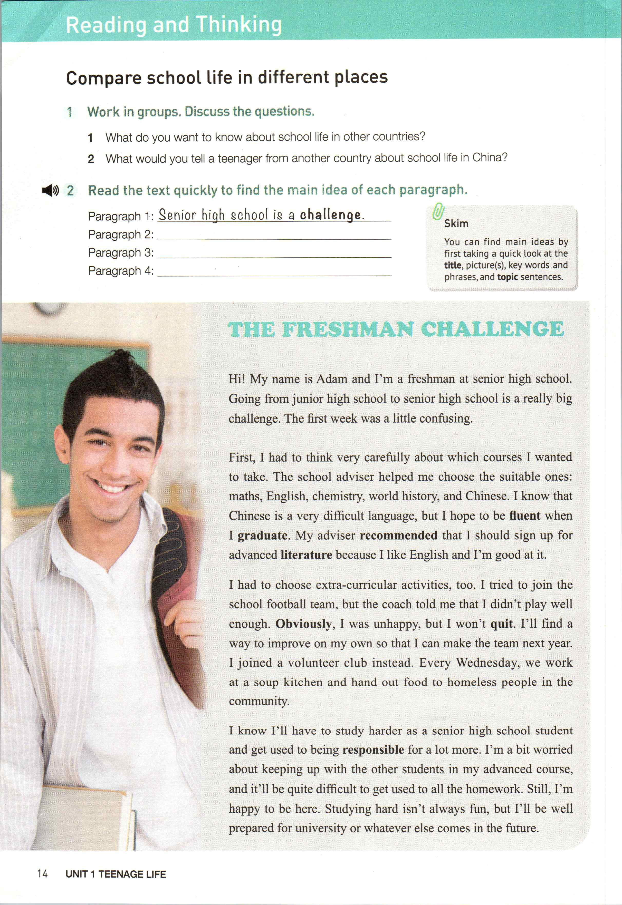
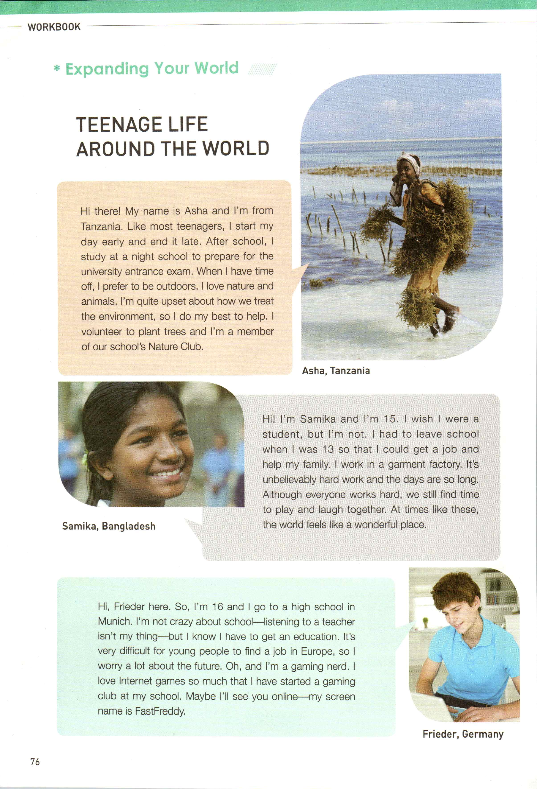
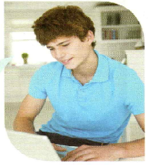
Hi, my name is Adam, from America
Notes:
Teenage life around the world Scan the text quickly who & where What is their teenage life like? What is their school life like? What is their hobby? How do you feel about their work?

Slide 5
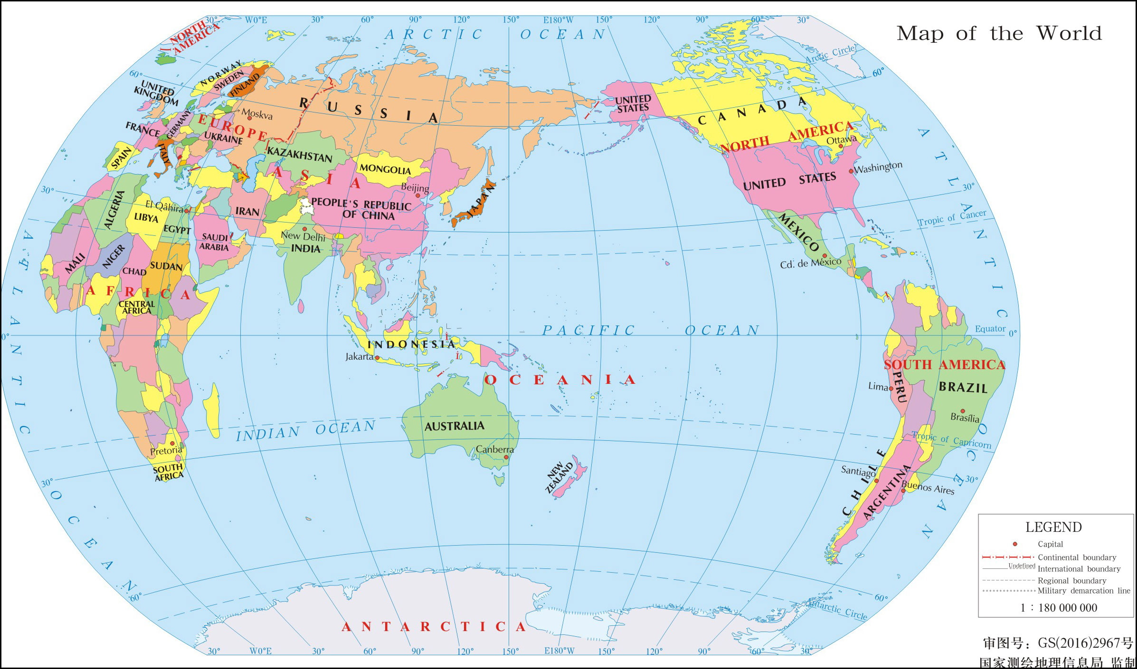

Hi, Frieder here. from Germany
Hi, my name is Adam, from America
Hi, I’m Samika, from Bangladesh
Teenage Life around the World
Hi there! My name is Asha, from Tanzania.
What do you want to learn from the text?
Raise questions start with“wh-”
Notes:
What is there teenage life like? To be more detailed. Teenage life- What is their school life like? What is their hobby? What do they do after class? What is their dream? Read the text and try to figure out which aspects are mentioned

Slide 6


What kind of person do you think Asha is?
Asha, Tanzania
Hi there!My name is Asha and I'm from Tanzania. Like most teenagers, I start my day early and end it late. After school, I study at a night school to prepare for the university entrance exam. When I have time off, I prefer to be outdoors. I love nature and animals. I'm quite upset about how we treat the environment, so I do my best to help. I volunteer to plant trees and I'm a member of our school's Nature Club.
School life
hardworking
Hobby
caring
After-class activities
active
Notes:
School life/ hobby ( What kind of person do you think Asha is? ) Quality 板书

Slide 7
Frieder
Samika
Asha
*love nature & animals
Hobby
School
life
After-class activities
*start early and end late
*study at night school
Try to find out which aspects(方面）are mentioned when introducing Samika and Frieder?
*join a nature club

Slide 8
Hi, Frieder here. So, I'm 16 and I go to a high school in Munich. I'm not crazy about school—listening to a teacher isn't my thing—but I know I have to get an education. It's very difficult for young people to find a job in Europe, so l worry a lot about the future. Oh, and I'm a gaming nerd. I love Internet games so much that I have started a gaming club at my school. Maybe I'll see you online-my screen name is FastFreddy.
Hi! I'm Samika and I'm 15. I wish I were a student, but I'm not. I had to leave school when I was 13 so that I could get a job and help my family. I work in a garment factory. It's unbelievably hard work and the days are so long. Although everyone works hard, we still find time to play and laugh together. At times like these，the world feels like a wonderful place.

Slide 9
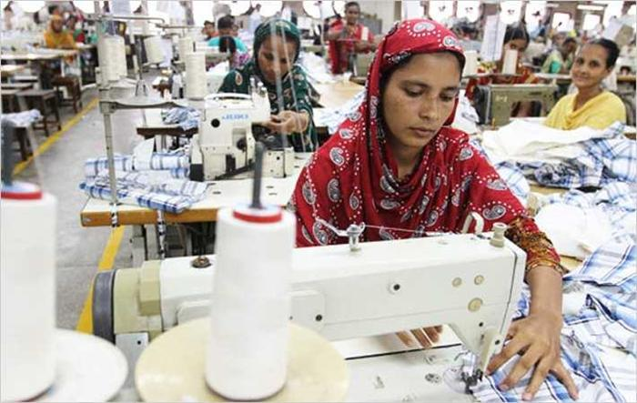

What kind of person do you think Samika is?
Samika, Bangladesh
Hi! I'm Samika and I'm 15. I wish I were a student, but I'm not. I had to leave school when I was 13 so that I could get a job and help my family. I work in a garment factory. It's unbelievably hard work and the days are so long. Although everyone works hard, we still find time to play and laugh together. At times like these，the world feels like a wonderful place.
Life
responsible
Job
positive
Notes:
unblievably hard work and so long (unbelievably so 表现了工作的时间如此之长，。。）

Slide 10

What is Frieder’s attitude to study?
Frieder, Germany
Hi, Frieder here. So, I'm 16 and I go to a high school in Munich. I'm not crazy about school—listening to a teacher isn't my thing—but I know I have to get an education. It's very difficult for young people to find a job in Europe, so l worry a lot about the future. Oh, and I'm a gaming nerd. I love Internet games so much that I have started a gaming club at my school. Maybe I'll see you online-my screen name is FastFreddy.
School life
It is a must though he is not crazy about school.
Hobby
Notes:
对未来工作的担忧。。。

Slide 11

Hobby
School life
Frieder
* be a gaming nerd
* start a game club
* not crazy about school
Samika
Life
* leave school in 13
Job
Asha
* work in a garmont factory
*love nature & animals
Hobby
School
life
After-class activities
*start early and end late
*study at night school
Discussion:
What can we learn from them?
*join a nature club

Slide 12

Asha, Tanzania
Hi there!My name is Asha and I'm from Tanzania. Like most teenagers, I start my day early and end it late. After school, I study at a night school to prepare for the university entrance exam. When I have time off, I prefer to be outdoors. I love nature and animals. I'm quite upset about how we treat the environment, so I do my best to help. I volunteer to plant trees and I'm a member of our school's Nature Club.
care for nature
Notes:
School life/ hobby ( What kind of person do you think Asha is? ) Quality 板书

Slide 13
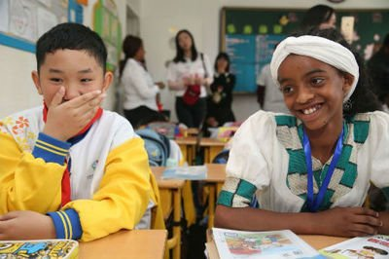
Samika, Bangladesh
Hi! I'm Samika and I'm 15. I wish I were a student, but I'm not. I had to leave school when I was 13 so that I could get a job and help my family. I work in a garment factory. It's unbelievably hard work and the days are so long. Although everyone works hard, we still find time to play and laugh together. At times like these，the world feels like a wonderful place.
cherish（珍惜） school life
hold a positive attitude to life
Notes:
unblievably hard work and so long (unbelievably so 表现了工作的时间如此之长，。。）If I were... I wish I were a student... If you were her, what would you do? Study hard because it is really hard for her to get a chance to study.

Slide 14

Frieder, Germany
Hi, Frieder here. So, I'm 16 and I go to a high school in Munich. I'm not crazy about school—listening to a teacher isn't my thing—but I know I have to get an education. It's very difficult for young people to find a job in Europe, so l worry a lot about the future. Oh, and I'm a gaming nerd. I love Internet games so much that I have started a gaming club at my school. Maybe I'll see you online-my screen name is FastFreddy.
know the importance of education
Notes:
对未来工作的担忧。。。

Slide 15

Hi, Frieder here. from Germany
Hi, I’m ..., from China
Hi, my name is Adam, from America
Hi, I’m Samika, from Bangladesh
What is your teenage life like?
How do you plan your own teenage life in the years that follow?
Hi there! My name is Asha, from Tanzania.
Notes:
What is there teenage life like?

Slide 16


Try to tell teenagers from another country about your teenage life in China. How do you plan your own teenage life in the years that follow?
Hi, there! My name is _______ and I’m from China. Like most teenagers, _______________________(School life) ___________________. ( Hobby)
_________________________________________________.(After-class activities)
I want to ____________________(your goal/plan in the years that follow) because _____________(reasons why you set that goal)

Slide 17
Hi, there! My name is _______ and I’m from China. Like most teenagers, ______________(School life)I love _____________________________. ( Hobby)
_________________________________________________.(After-class activities)
_________________(your goal/plan in the years that follow) because___________
(reasons why you set that goal)
Sentence pattern for reference
1) school life
Like most teenagers, I start my day...and end it ...
I study... to prepare for the university entrance exam.
2) hobby
When I have time off, I prefer to...
I love... so much that...
3)after-class activities
I volunteer to... and I’m a member...
4)attitude
Although ..., we still find time to play and laugh together.
At times like these, the world feels like a wonderful place.
It's very difficult for ...to do...

Slide 18
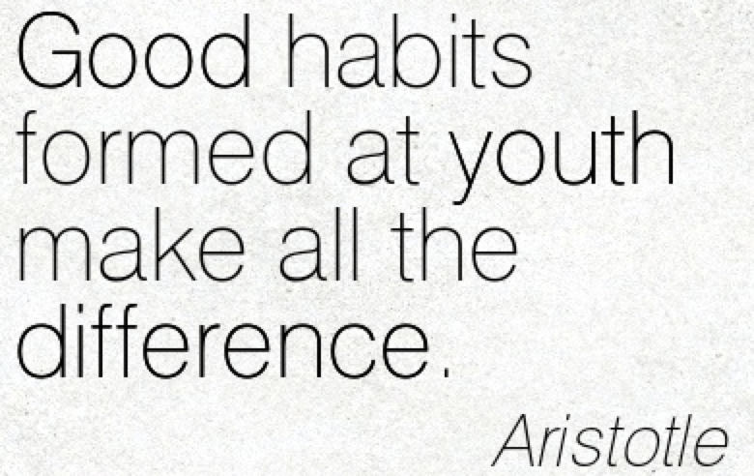
Homework
1. Finish your passage.
2. Browse the website https://www.wikihow.com/Have-a-Successful-Teenage-Life

Slide 19

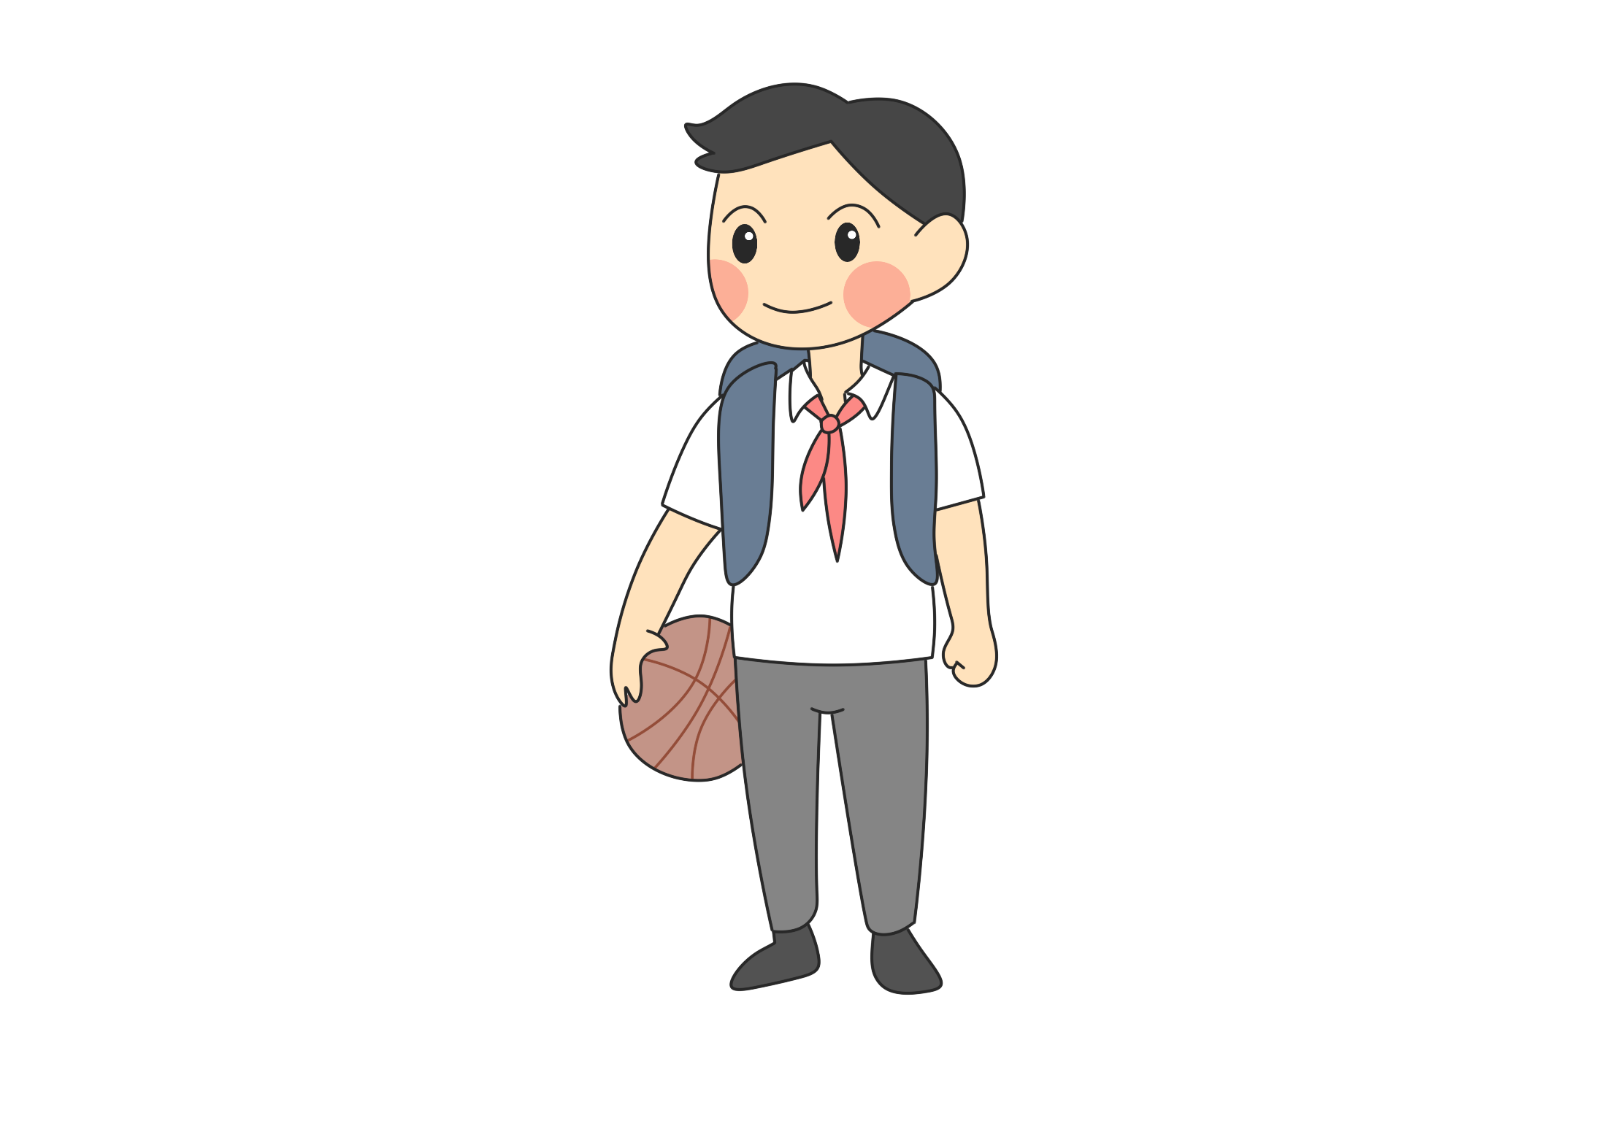
Thank you!

Slide 20
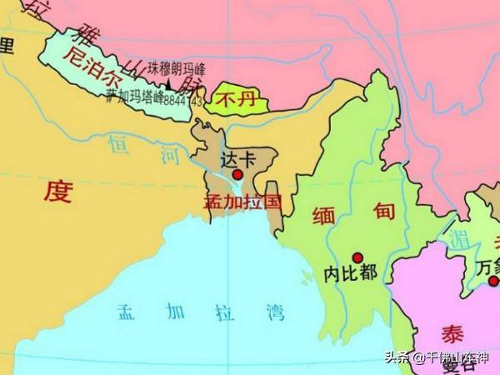
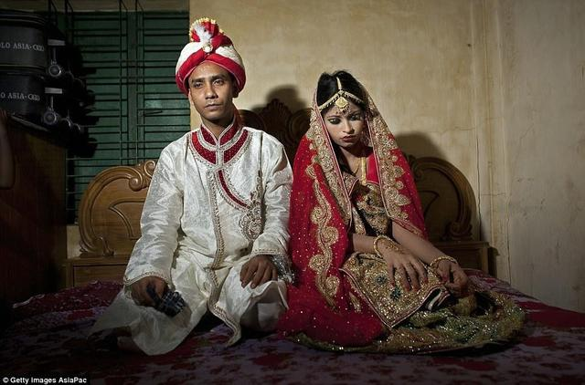
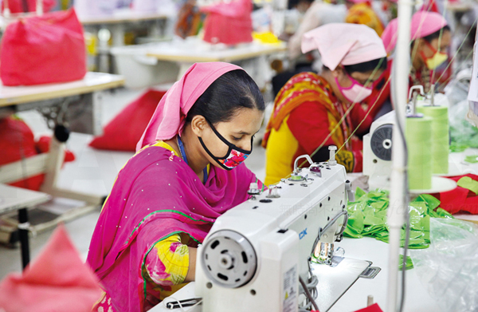
Bangladesh, South Asia
It is among the world’s poorest countries. Less then 50% of Bangladeshi young people attend secondary school(中学). By the time they are in their late teens they are already married and working.

