Slide 1


感恩遇见，相互成就，本课件资料仅供您个人参考、教学使用，严禁自行在网络传播，违者依知识产权法追究法律责任。
更多教学资源请关注
公众号：溯恩英语
知识产权声明

Slide 2

南京照相馆
Dead to Rights
See the film
挖掘高考英语知识点：
应用文写作
Judyliu

Slide 3

“Dead to Rights”
电影标题里的习语
南京大屠
1 Nanjing Massacre：/ˈmæsəkə(r)/
2 Rape of Nanjing
“Dead to Rights” 意译手法，英语习语。精准地概括并体现了电影的核心主题。Dead to rights是一个司法和犯罪领域的专业术语，它通常以catch/have somebody dead to rights的搭配形式出现，意思相当于“铁证如山，证据确凿”。

Slide 4

学英语高考知识点：听力 南京大屠杀历史背景
In December 1 the Japanese imperial army invaded Nanjing and unleashed hell on earth(将人间变成了地狱.) Over 300,000 Chinese 2 and prisoners of war slaughtered in just six weeks, not in battle, but in cold 3. Women were raped, tortured， 4 murdered Children were thrown into 5 . Elderly people were buried 6 Pregnant women cut open with bayonets(被刺刀剖开腹部). Entire families 7. This wasn't war. This was a crime against 8 . And the worst part? The Japanese laughed. They took photos. They turned murder into 9. To this day, some 10 it ever happened. But we remember because silence is 11. We speak for those whose voices were forever silenced. We 12 the lives lost, the families destroyed. We demand truth. We demand accountability(问责). Nanjing is not just a city, it is a wound that still 13 . Remember Nanjing, remember the 14 truth. Never forget. Never forgive, never 15 .

Slide 5
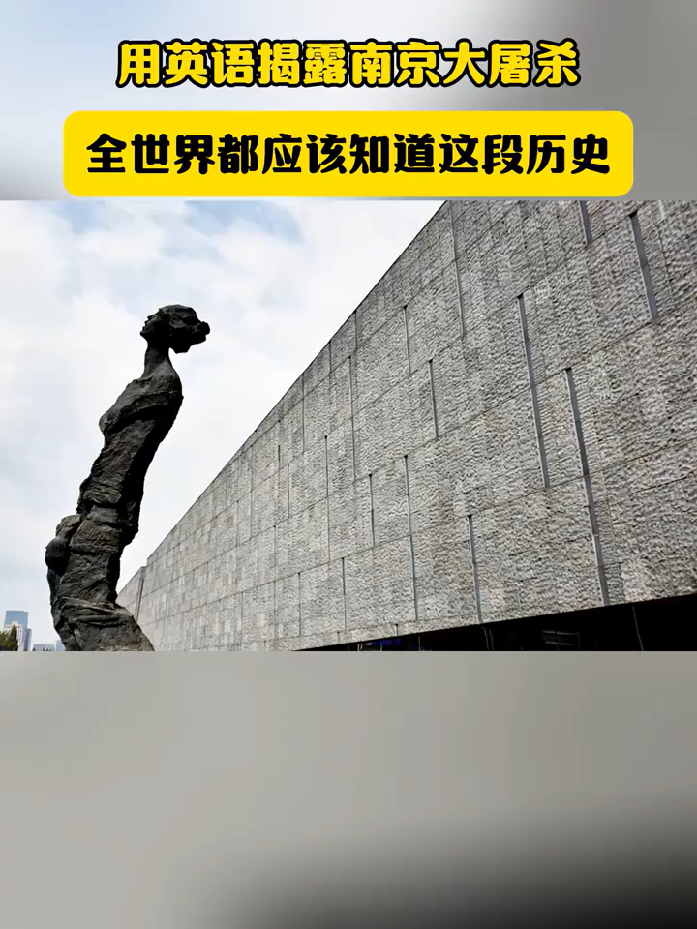
学英语高考知识点：听力 ：南京大屠杀历史背景
In December 1937 the Japanese imperial army invaded Nanjing and unleashed hell on earth.将人间变成了地狱。Over 300,000 Chinese civilians and prisoners of war slaughtered in just six weeks, not in battle, but in cold blood. Women were raped, tortured，murdered .Children were thrown into flames. Elderly people were buried alive. Pregnant women cut open with bayonets被刺刀剖开腹部. Entire families erased. This wasn't war. This was a crime against humanity. And the worst part? The Japanese laughed. They took photos. They turned murder into sport. To this day, some deny it ever happened. But we remember because silence is betrayal. We speak for those whose voices were forever silenced. We mourn the lives lost, the families destroyed. We demand truth. We demand accountability. Nanjing is not just a city, it is a wound that still bleeds. Remember Nanjing, remember the truth. Never forget. Never forgive, never again.

Slide 6
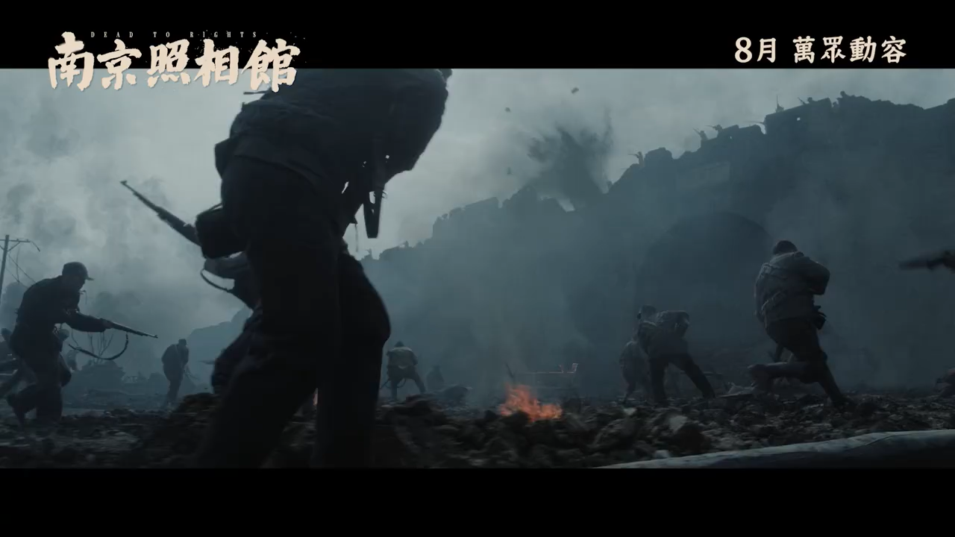
电影主要内容：预告片
《南京照相馆》 (Dead to Rights)
大好河山，寸土不让。
Every piece of territory shall not be surrendered.

Slide 7
语法填空：电影主要内容
Dead to Rights, a film set during the Nanjing Massacre, 1 （earn） over 400 million yuan in its first three days since its release on Friday. The film dominated daily charts and set the best opening-day record for 2 war film in the summer season over the past three years.
3 (mark) the 80th anniversary of the victory in the Chinese People's War of Resistance Against Japanese Aggression (1931-45), the film revisits one of the most barbaric episodes of World War II through the perspective of a group of unsung 4 (hero).
The Nanjing Massacre occurred 5 Japanese troops captured Nanjing on Dec 13, 1937. Over the course of six weeks, they slaughtered around 300,000 Chinese civilians and 6 (unarm) soldiers.
Set against the Nanjing Massacre, the film follows a group of civilians 7 (shelter) in a photo studio.
Forced to develop a Japanese military photographer‘s film to survive, they 8 （accident） uncover photographic proof of the atrocities. Initially focused 9 on mere survival, they ultimately risk everything 10 (preserve) the evidence and expose the war crimes.

Slide 8

语法填空：电影主要内容
Dead to Rights, a film set during the Nanjing Massacre, 1 has earned over 400 million yuan in its first three days since its release on Friday. The film dominated daily charts and set the best opening-day record for 2 a war film in the summer season over the past three years.
3 Marking the 80th anniversary of the victory in the Chinese People's War of Resistance Against Japanese Aggression (1931-45), the film revisits one of the most barbaric episodes of World War II through the perspective of a group of unsung 4 heroes.
The Nanjing Massacre occurred 5 when Japanese troops captured Nanjing on Dec 13, 1937. Over the course of six weeks, they slaughtered around 300,000 Chinese civilians and 6 unarmed soldiers.
Set against the Nanjing Massacre, the film follows a group of civilians 7 sheltering in a photo studio.
Forced to develop a Japanese military photographer's film to survive, they 8 accidentally uncover photographic proof of the atrocities. Initially focused 9 on mere survival, they ultimately risk everything 10 to preserve the evidence and expose the war crimes.

Slide 9
假定你是李华，看完《Dead to Rights》后深受触动，想推荐给好友Peter。请写一封信，说明推荐理由。
（参考方向：结合电影主要内容，历史意义、震撼场景，呼吁铭记历史）
应用文写作：书信
第一段：开门见山说明写信目的（推荐电影《Dead to Rights》），简述观影后的整体感受（震撼、触动）。
关键词：recommend, moving, Nanjing Massacre
核心短语：highly recommend, be deeply touched by, historical significance
第二段：具体说明推荐理由 —— 电影还原 1937 年南京历史，展现平民守护真相的勇气，场景震撼（如保护底片的情节）。
关键词：historical background, courage, truth, shocking scenes
核心短语：show the history of, risk one’s life to do, remind us of
第三段：呼吁好友观看，强调铭记历史的意义，邀请看完后交流感受。
关键词：watch, remember history, discuss
核心短语：it’s worth watching, never forget, have a talk

Slide 10
应用文写作：书信
Dear Peter,
I’m writing to highly recommend a movie called Dead to Rights, which left me deeply touched after I watched it last week. As a historical war drama, it carries great significance that I think you shouldn’t miss.
Set in Nanjing in 1937, the film tells the story of a group of ordinary Chinese civilians who hide in a small photo studio during the Japanese army’s occupation of the city. What strikes me most is how a local postal worker, forced to develop films for a Japanese military photographer, discovers horrifying evidence of large-scale violence against unarmed people. Along with others, he risks his life to protect the negatives, determined to let the world know the truth. The scenes, though shocking, are so powerful that they vividly remind us of the cruelty of the Nanjing Massacre.
It’s definitely worth watching, not just for its moving plot but also because it makes us realize how important it is to remember history. Let’s plan to watch it together soon, and I’m sure we’ll have a lot to talk about afterward.
Yours,
li Hua

Slide 11
学校将组织观看《Dead to Rights》，请你以学生会名义写一则通知，告知观影时间（本周六下午 2 点）、地点（学校礼堂）及意义。
（参考方向：电影主要内容，铭记历史、珍惜和平，提醒准时参加）
应用文写作：通知
第一段：明确通知主题（组织观看《Dead to Rights》），告知时间（本周六下午 2 点）和地点（学校礼堂）。
关键词：notice, organize, time, place
核心短语：be glad to inform, take place, at the school hall
第二段：说明观影意义 —— 了解南京历史，铭记战争伤痛，珍惜和平。
关键词：significance, history, peace, remember
核心短语：help us learn about, remind us to cherish, avoid tragedies
第三段：提醒准时参加，保持秩序。
关键词：attend on time, order
核心短语：please be present, keep quiet, don’t be late

Slide 12
应用文写作：通知
Notice
The Students’ Union is pleased to inform you that a special screening of the historical drama Dead to Rights will be held this Saturday. Scheduled to start at 2 p.m. sharp, the film will be played in the school hall, where seating will be arranged in advance for all attendees.
Set in Nanjing in 1937, the film vividly depicts the struggles of ordinary Chinese civilians during the city’s darkest days, as they risk their lives to preserve evidence of historical truths. By watching it, we can gain a deeper understanding of the suffering endured by our ancestors and reflect on the value of peace—lessons that are vital for every young person. This is more than just a movie; it is a chance to connect with our history.
We kindly request that you arrive 10 minutes early to avoid delays and maintain silence throughout the screening to ensure a respectful atmosphere for all. Your participation will not only enrich your knowledge but also help keep the memory of history alive.
Don’t miss this meaningful opportunity.

Slide 13
假如你是李华，看完电影后，你想发起 “铭记历史，传承真相” 的校园倡议。请写一封倡议信，号召同学行动。
（参考方向：呼吁了解历史、传播真相，以实际行动致敬先烈）
应用文写作：倡议信
第一段：引出倡议背景（观看《Dead to Rights》后深受触动），点明倡议主题（铭记历史，传承真相）。
关键词：initiative, moved, remember history, spread truth
核心短语：be inspired by, call on, take action
第二段：具体呼吁行动 —— 主动了解南京大屠杀历史，向他人讲述真相，尊重先烈。
关键词：learn, spread, respect martyrs
核心短语：learn more about, tell the truth to, in memory of
第三段：强调行动意义（避免历史重演，让真相永存），鼓励大家共同参与。
关键词：meaning, repeat, last forever
核心短语：prevent from, work together, make a difference

Slide 14
应用文写作：倡议信
Dear schoolmates,
Having watched Dead to Rights, I was profoundly stirred by its raw portrayal of history—a film that doesn’t just tell a story, but screams the truth we must never let fade. Thus, I earnestly call on every one of us to embrace the mission of “remembering history and passing on the truth.”
To honor the souls lost in the Nanjing Massacre, let us dig deeper into this chapter: flip through historical records, explore documentaries, or visit memorials. These acts are not mere learning; they are tributes to the innocent lives cut short and the brave souls who risked everything to preserve evidence, just like the characters in the film. Moreover, let’s take every chance to share these truths—with peers, family, or even online—so that the darkness of 1937 is never buried under silence.
History repeats only when we choose to forget. Our collective efforts, no matter how small, can weave a shield against ignorance. Let’s vow to be guardians of truth: to study, to speak, to act. Together, we can ensure that the sacrifices of the past light the way for a future that cherishes peace.
Join this cause—for memory, for justice, for us all.

Slide 15
语料积累
三、动词（Verbs）
recommend 推荐
touch 触动（be deeply touched 深受触动）
protect 保护
risk 冒…… 风险（risk one’s life 冒生命危险）
remind 提醒（remind sb. of 使某人想起）
cherish 珍惜
inherit 传承
spread 传播
respect 敬重
memorize 铭记
prevent 阻止
call on 呼吁
organize 组织
present 出席（be present 到场）
preserve 保存（preserve history 留存历史）
一、名词（Nouns）
historical significance 历史意义
atrocity 暴行
massacre 大屠杀
civilian 平民
negative 底片（电影中特指记录暴行的胶片）
studio 工作室（文中指照相馆）
courage 勇气
martyr 烈士
peace 和平
truth 真相
memory 记忆
documentaries 纪录片
initiative 倡议
二、形容词（Adjectives）
historical 历史的
shocking 令人震撼的
meaningful 有意义的
profound 深刻的
unforgettable 难忘的
precious 珍贵的
painful 痛苦的
brave 勇敢的
solemn 庄严的
sincere 真诚的
significant 重要的
vivid 生动的

Slide 16
铭记历史，勿忘国耻。Remember history and don't forget national humiliation.
前事不忘，后事之师。The remembrance of the past is the teacher of the future.
我们可以原谅，但绝不能忘记。We can forgive, but we must never forget.
历史不会因时代变迁而改变，事实也不会因巧舌抵赖而消失。History will not be changed with the course of time, and facts will never fade away due to repudiation from the artful tongue.
铭记历史，不是为了延续仇恨，而是为了唤起对和平的向往和坚守。Remembering history is not to prolong hatred but to inspire the longing for and perseverance in peace.
南京大屠杀是人类历史上最丑陋的事件之一，充斥着人性的邪恶。The Nanjing Massacre is among the ugliest incidents in world history, full of human depravity.
只有每个人都珍惜和维护和平，铭记战争的惨痛教训，和平才有希望。Only if everyone cherishes and safeguards peace, and only if everyone remembers the bitter lessons of war, can there be hope for peace.
历史如果淡忘，必将重演。If history is forgotten, it will repeat itself.
缅怀先烈，吾辈自强。Cherish the memory of martyrs and strive for self - improvement for our generation.

Slide 17


铭记历史，勿忘国耻。
Remember history and don't forget national humiliation.
前事不忘，后事之师。
The remembrance of the past is the teacher of the future.
我们可以原谅，但绝不能忘记。
We can forgive, but we must never forget.
历史不会因时代变迁而改变，事实也不会因巧舌抵赖而消失。
History will not be changed with the course of time, and facts will never fade away due to repudiation from the artful tongue.
铭记历史，不是为了延续仇恨，而是为了唤起对和平的向往和坚守。
Remembering history is not to prolong hatred but to inspire the longing for and perseverance in peace.
只有每个人都珍惜和维护和平，铭记战争的惨痛教训，和平才有希望。
Only if everyone cherishes and safeguards peace, and only if everyone remembers the bitter lessons of war, can there be hope for peace.
历史如果淡忘，必将重演。
If history is forgotten, it will repeat itself.
缅怀先烈，吾辈自强。
Cherish the memory of martyrs and strive for self - improvement for our generation.

Slide 18
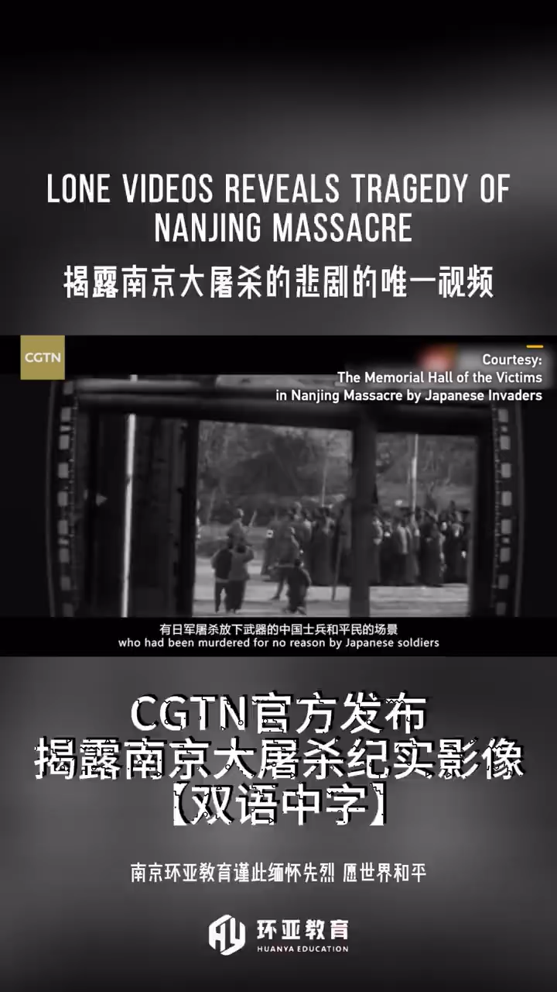
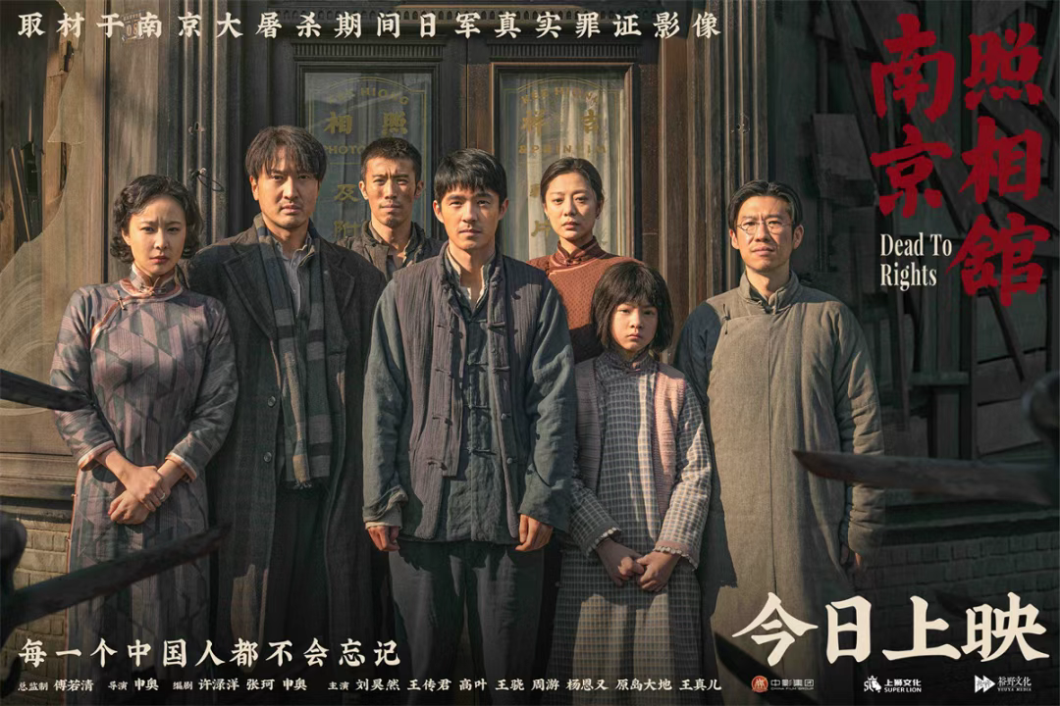
课后语言拓展

