Slide 1



感恩遇见，相互成就，本课件资料仅供您个人参考、教学使用，严禁自行在网络传播，违者依知识产权法追究法律责任。
更多教学资源请关注
公众号：溯恩英语
知识产权声明

Slide 2
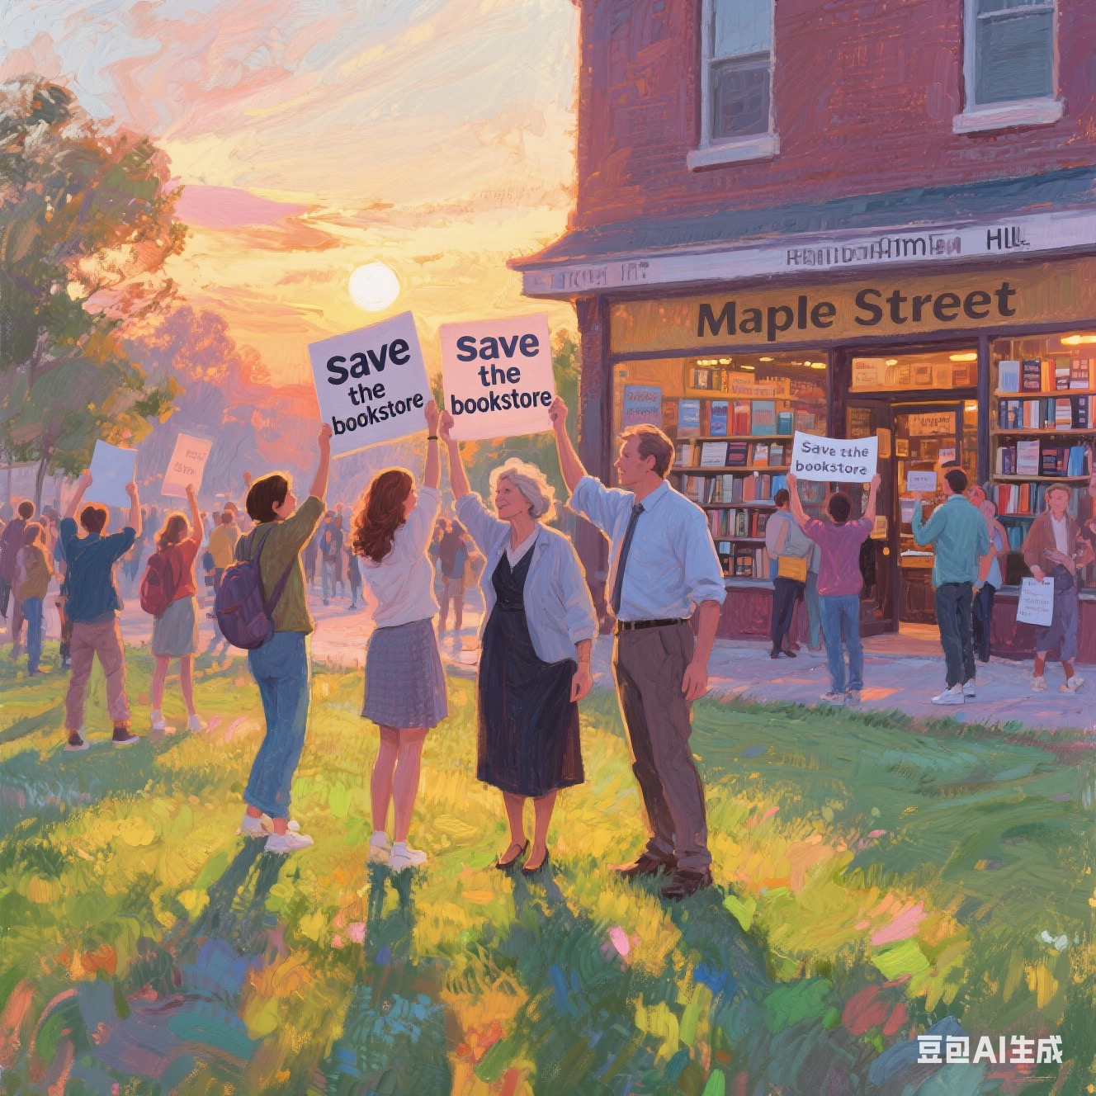
枫树街书店之保卫战
---人与社会之社区互助
--2025-8 江浙高中发展体
郑素红

Slide 3
读原文:
The old bookstore on Maple Street had been Mr. Hale’s life work. For forty years, he’d stacked its shelves with weathered novels, dog-eared poetry collections, and rare first editions, each with a story he could recite by heart. But last month, the bank had sent a notice — rising rents and falling sales meant the store would close by the end of the week.
Lila, a regular since she was a kid, couldn’t bear the thought. She’d grown up here, hiding in the back corner with a book while her mom worked next door. Now a college student home for summer, she’d started a “Save the Bookstore” campaign: a petition, a GoFundMe page, even hand-painted signs taped to lampposts. But donations trickled in, and the petition barely had a hundred signatures.
“This isn’t just a store,” Lila said to Mr. Hale one afternoon, gesturing to the creaky wooden floors and the smell of old paper. He smiled sadly, polishing a leather-bound Dickens. “It’s where Mrs. Carter met her late husband — they bonded over a shared love for Hemingway. Where Tommy, the shy kid from down the street, found the courage to join the debate team after reading To Kill a Mockingbird.”

Slide 4
Lila’s throat tightened. She knew those stories too. She’d left her own mark here: a faded drawing of a cat tucked inside The Secret Garden, a note scrawled in the margin of Pride and Prejudice (“Mr. Darcy is overrated!”) when she was twelve.
On the penultimate day, Lila arrived to find Mr. Hale packing boxes. “I’m sorry, kiddo,” he said, his voice rough. “We tried.” She noticed a dusty box labeled “Memorabilia” in the corner — newspaper clippings from the store’ s opening, a photo of Mr. Hale as a young man, and a stack of handwritten letters.
Curious, she pulled one out. It was dated 1998, from a girl named Clara: “Your store kept me going when my dad left. I’ll never forget the day you let me take Anne of Green Gables home even though I couldn’t pay — said ‘stories should be free to heal.’” Lila froze. Clara was her mom’s name.
Before she could ask, the bell above the door jingled. A woman in a business suit stepped in, scanning the shelves. “I’m from the real estate company,” she said, holding out a clipboard. “We need the keys by Friday.”
Mr. Hale’s shoulders slumped. Lila grabbed the letter, her heart racing. “Wait — this store matters. To all of us.” The woman raised an eyebrow. “Prove it.”
注意：1.续写词数应为150左右；2.请按如下格式在答题卡的相应位置作答。
Paragraph 1: Lila sprinted out the door, the letter clutched in her hand.
Paragraph 2: By sunset, the bookstore’s front lawn was crowded.

Slide 5
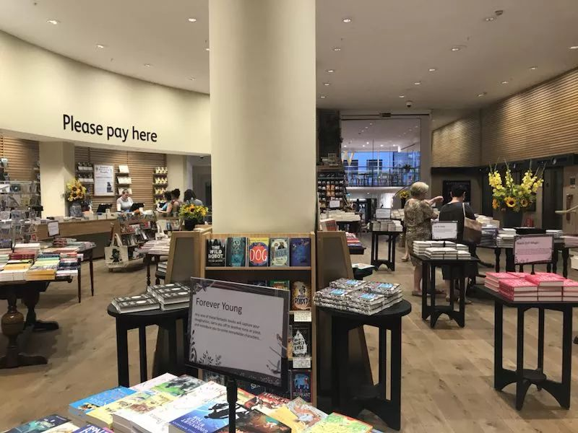
Read for information
Major roles: Lila
Minor roles : Lila’s mother, Mrs. Carter, Tommy , Mr. Hale & the real estate agent
2. narrative perspective: third-person
3. time： summer
place： bookstore ;
event: Lila tried to do something to save the bookstore.
6. Analyze
conflicts
Conflict : the bookstore would close
Solution: prove the bookstore matters to all and get money to cover its rising rents or increase its sales.

Slide 6


5.
story
line
Climax
A real estate agent in business suit came to request the key by Friday. Lila had to do something to prove the bookstore matters to all.
On the penultimate day, Lila noticed a dusty box labeled “Memorabilia” in the corner — lots of treasures including a stack of handwritten letters. She
found a letter written by her mom.
Para1: Lila sprinted out the door, the letter clutched in her hand.
Lila came back from college during summer and start a campaign to save it but it did little work.
Para2: By sunset, the bookstore’s front lawn was crowded.
Mr Hale’s bookstore on Maple Street would close due to rising rents and falling sales.
background
Ending
Beginning

Slide 7
Read for clues and echoes
hidden clues | echoes
The old bookstore on Maple Street had been Mr. Hale’s life work. For forty years, he’d stacked its shelves with weathered novels, dog-eared poetry collections, and rare first editions, each with a story he could recite by heart. But last month, the bank had sent a notice — rising rents and falling sales meant the store would close by the end of the week. | 1. The store would stay and continue to heal its readers as a tiny haven. 2. Lila handed her a new petition with thousands of signatures and a print - a significantly increased GoFundMe total, which was enough to cover the rising rents.

Slide 8
hidden clues | echoes
The old bookstore on Maple Street had been Mr. Hale’s life work. For forty years, he’d stacked its shelves with weathered novels, dog-eared poetry collections, and rare first editions, each with a story he could recite by heart. …… Now a college student home for summer, she’d started a “Save the Bookstore” campaign: a petition, a GoFundMe page, even hand-painted signs taped to lampposts. But donations trickled in, and the petition barely had a hundred signatures. | 3. Lila’s “Save the Bookstore ”campaign paid off. 4. People, young and old, gathered; some held hand- painted signs, others carried dog-eared books. 5. Meanwhile, with the post online going viral, donations flooded in. 6. Lila handed the real-estate agent a new petition with thousands of signatures and a screenshot showing the constantly increasing GoFundMe total.

Slide 9
Read for clues and echoes
hidden clues | echoes
“This isn’t just a store,” Lila said to Mr. Hale one afternoon, gesturing to the creaky wooden floors and the smell of old paper. He smiled sadly, polishing a leather-bound Dickens. “It’s where Mrs. Carter met her late husband — they bonded over a shared love for Hemingway. Where Tommy, the shy kid from down the street, found the courage to join the debate team after reading To Kill a Mockingbird.” | 7. Mrs. Carter , teary – eyed, recounted her romance from a shared love for Hemingway. What struck people’s heartstring was that Tommy emotionally shared how the bookstore had changed his life.

Slide 10
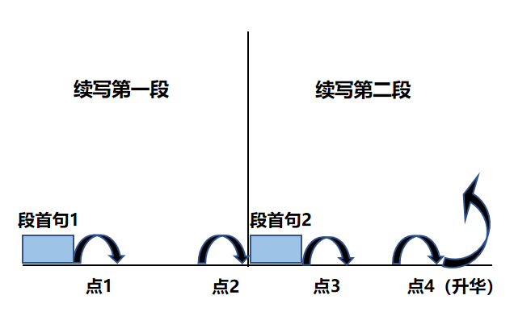
Plot Continuation
点1：位于续写第一段段首，流畅衔接前面的故事（常与原文最后一段呼应）和第一段段首语；
点2：位于续写第一段段尾，流畅衔接第二段段首句；
点3：位于续写第二段段首，续写衔接第二段段首语；
点4：文章结尾升华，给予读者正能量，揭示和强调主题。

Slide 11
Plot the continuation story
Para1: Lila sprinted out the door, the letter clutched in her hand.
Para2: By sunset, the bookstore’s front lawn was crowded.
Link1: Who would read the letter? What feeling?
Body: What idea did Lila come up with? Or What did Lila do with the letter?
Link2: What did Lila do to save the bookstore? How?
Link3: Who came to the bookstore? How did they feel?
Body: What did they do? How did the real estate agent react?
Ending: ① What would become of the bookstore? How did Mr. Hale feel?
② What lesson did the story teach Lila or readers?

Slide 12
Plot the continuation story
Para1: Lila sprinted out the door, the letter clutched in her hand.
Para2: By sunset, the bookstore’s front lawn was crowded.
Link1: Who would read the letter? What feeling?
Body: What idea did Lila come up with? Or What did Lila do with the letter?
Link2: What did Lila do to save the bookstore? How?
Link3: Who came to the bookstore? How did they feel?
Body: What did they do? How did the real estate agent react?
Ending: ① What would become of the bookstore? How did Mr. Hale feel?
② What lesson did the story teach Lila or readers?

Slide 13
心理描写
神态描写
动作描写
外貌描写
环境描写
对话描写
语言
无灵主语
动作链
分词作状语
With 复合结构
独立主格
从句
倒装句
虚拟语气
强调句
长短句结合
考生构思情节的同时，要考虑合适的语言句式以及修辞

Slide 14
Design link1
Para1: Lila sprinted out the door, the letter clutched in her hand.
Link1A: (呼应所给首句动作sprinted out 以及呼应 the letter 的写信人） Panting and Puffing, // Heart racing, she burst into her mother's café next door, thrusting the yellowed paper at Clara.
Link1B: （呼应所给首句主语Lila以及动作）She dashed to the café next door where her mom worked.” Mom, look what I found!” she gasped, urging her mother to read the yellowed letter.

Slide 15
Design link2
Para1: Lila sprinted out the door, the letter clutched in her hand.
Para2： Anita studied the drawing carefully.
Link2 A: (呼应第二段所给句首句，暗示首段结尾应该是越来越多的人知晓现在书店的危机) People deeply connected with the old bookstore on Maple Street shared their stories and conveyed a message--Maple Street would never close!"
Link2 B: (呼应原文第一段的最后一句以及Lila 发起的拯救书店运动） Knowing the terrible fate of the bookstore, more and more people joined in Lila’s Save the Bookstore Campaign.

Slide 16
Design link3
Para2: By sunset, the bookstore’s front lawn was crowded.
Link3A: (呼应所给首句 的时间 sunset 以及the front lawn was crowded ） Bathed in the sunset glow, enthusiastic customers from far and near held hand-painted signs Save the Bookstore.
Link3B: (呼应the front lawn was crowded ,点明到场的人们所作所为） People, young and old, gathered; some held hand- painted signs, others carried dog-eared books.

Slide 17
Design link3
Para2: By sunset, the bookstore’s front lawn was crowded.
Link3A: (呼应所给首句 的时间 sunset 以及the front lawn was crowded ） Bathed in the sunset glow, enthusiastic customers from far and near held hand-painted signs Save the Bookstore.
Link3B: (呼应the front lawn was crowded ,点明到场的人们所作所为） People, young and old, gathered; some held hand- painted signs, others carried dog-eared books.

Slide 18
Design ending
Para2: By sunset, the bookstore’s front lawn was crowded.
Ending A: (呼应书店的美好的结局) Cheers erupted. Moved to tears, Mr. Hale hugged Lila tightly, his voice thick with emotion: "Books do heal readers—and now they defend my bookstore!"
Ending B: (点赞拯救书店运动的发起者Lila) Hearing the brilliant news, the crowd cheered. Casting a grateful look at Lila, Mr. Hale gave her a thumbs-up for what Lila did for the bookstore.
Ending C: (小故事感悟出来的大道理) The Save the bookstore campaign paid off and served as reminder to Lila that many hands make work light. // unity is strength.

Slide 19
习作 version 1
Para1: Lila sprinted out the door, the letter clutched in her hand.
Panting and Puffing, // Heart racing, she burst into her mother's café next door, thrusting the yellowed paper at Clara. Confused, Clara scanned the letter, her fingers trembling over the familiar handwriting. Tears blurred her vision as memories flooded back. Thinking of the critical situation of the bookstore, Lila grabbed her phone immediately, snapped the letter repeatedly and typed rapidly. Her post exploded/ went viral online: " Anne of Green Gables healed Clara, my mom 27 years ago. Now the bookstore needs saving!" Within minutes, numerous messages and comments flooded in—Tommy shared how To Kill a Mockingbird changed his life; Mrs. Carter posted wedding photos taken outside the store. People deeply connected with the old bookstore on Maple Street shared their stories and conveyed a message--Maple Street would never close!" (129)

Slide 20
Para2: By sunset, the bookstore’s front lawn was crowded.
People, young and old, gathered; some held hand- painted signs, others carried dog-eared books. Mrs. Carter , teary – eyed, recounted her romance from a shared love for Hemingway. What struck people’s heartstring was that Tommy emotionally shared how the bookstore had changed his life. The real - estate agent ‘s jaw almost dropped. Lila handed her a new petition with thousands of signatures and a print - a significantly increased GoFundMe total, which was enough to cover the rising rents. which was enough to cover the rising rents. Feeling awkward, the agent stuttered, “You- you’ve proven it. This bookstore will stay.” Hearing the brilliant news, the crowd cheered. Casting a grateful look at Lila, Mr. Hale gave her a thumbs-up for what Lila did for the bookstore. (127)
Ending2： Relieved, Mr. Hale exchanged a meaningful look with Lila, convinced that his bookstore would continue to heal its readers as a tiny haven.
Ending3： The Save the bookstore campaign paid off and served as reminder to Lila that many hands make work light. // unity is strength.

Slide 21
习作version 2
Para1: Lila sprinted out the door, the letter clutched in her hand.
She dashed to the café next door where her mom worked.” Mom, look what I found!” she gasped, urging her mother to read the yellowed letter. Clara’s eyes went moist as she read. She whispered that Mr. Hale gave her hope and helped her pull through the toughest time with the magic book Anne of Green Gables. All of a sudden, a brilliant idea struck Lila. Inspired by her mom’s story, she set out to contact Tommy, now a reputable lawyer, Mrs. Carter, who still visited the bookstore regularly and many others whose lives had been changed by Mr. Hale’s bookstore. Knowing the terrible fate of the bookstore, more and more people joined in Lila’s Save the Bookstore Campaign. (119)

Slide 22
Para2: By sunset, the bookstore’s front lawn was crowded.
Bathed in the sunset glow, enthusiastic customers from far and near held signs Save the Bookstore. Mrs. Carter stood arm-in-arm with Tommy, who held his dog-eared copy of To Kill a Mockingbird aloft. Clara supported Mr. Hale, who stared in disbelief at the crowd. Watching with tearful eyes, the real estate agent was convinced this store mattered a lot to its community." Seeing the close bond between the store and its readers, the agent choked. Her phone rang suddenly. She slid open her phone, listened intently and then turned to the crowd, her stern expression softening. "A generous donor/ The local government/ The community center will cover the rising rents." Cheers erupted. Moved to tears, Mr. Hale hugged Lila tightly, his voice thick with emotion: "Books do heal readers—and now they defend my bookstore!" (129 words)

Slide 23
社会关系类
该故事模型涉及人际交往、社区服务、团队合作、家庭关系、友情维护、职场竞争等方面，是目前高考出现最频繁的话题之一。这类读后续写题隶属于“人与自我”“人与社会”两大主题语境，内容丰富多样。 “人与自我，人与社会”在读后续写文本中又会交错在一起，在社会中成就个人成长。

Slide 24
社会关系类真题 ：
1. 2025年6月新高考I 卷 兄弟情深 （亲情之兄弟情）
2.2024年6月新高考I卷 维也纳之约 （ 陌生人之间诚信互助）
3.2022年6月浙江卷 我的志愿者经历 （友善互助，让世界更美好）
4.2020年6月新高考I卷 帮穷人家的孩子挣钱 （友善互助，让世界更美好）
5.2022年1月浙江卷 学渣与学霸合作 （学校生活，互相学习，成就成长）
6.2021年6月新高考I卷 双胞胎为母亲做惊喜早餐 （家庭生活，亲情与爱）
7.2021年6月浙江卷 我打工赚钱补贴家用 （家庭生活，亲情与爱）
8.2021年1月浙江卷 万圣节趣事之南瓜卡头 （ 家庭生活趣事，喜悦美好）
9.2017年11月 浙江卷 和健忘妈妈一起旅行的经历 （家庭生活趣事，善良）

Slide 25
Proverbs:
Divided, we fall. United, we stand.
分裂，我们就会失败。 团结起来，我们屹立不倒。
2. Unity is strength. 团结就是力量。
3. Many hands make work light. 众人拾柴火焰高。

