Slide 1


感恩遇见，相互成就，本课件资料仅供您个人参考、教学使用，严禁自行在网络传播，违者依知识产权法追究法律责任。
更多教学资源请关注
公众号：溯恩英语
知识产权声明

Slide 2
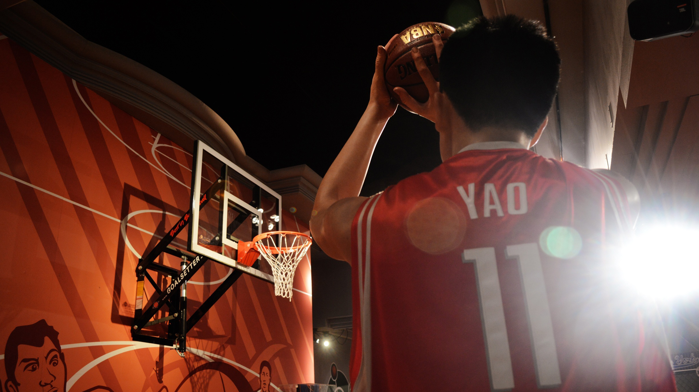
Beginning lesson for Continuation Writing
A Short
Basketball Player
Ms. Zhu

Slide 3
Learn the concept of continuation writing
《普通高等学校招生全国统一考试英语学科考试说明》对读后续写的界定是：要求考生根据材料内容、所给段落开头和关键信息，将其发展成一篇150词左右的与给定材料有逻辑衔接、情节和结构完整的短文(教育部考试中心，2015)。
阅读 + 写作

Slide 4
Learn the criteria
[高考读后续写评价标准]
第五档（21-25)
创造了丰富、合理的内容，富有逻辑性，续写完整，与原文情境融洽度高。
使用了多样并且恰当的词汇和语法结构，可能有个别小错，但不影响理解。
有效地使用了语句间衔接手段，全文结构清晰，意义连贯。
第四档（16 -20）
创造了比较丰富、合理的内容，比较有逻辑性，续写完整，与原文情境融洽度较高。
使用了比较多样并且恰当的词汇和语法结构，可能有些许错误，但不影响理解。
比较有效地使用了语句间衔接手段，全文结构比较清晰，意义比较连贯。
第三档（11 -15）
创造了基本合理的内容，有一定逻辑性，续写基本完整，与原文情境相关。
使用了简单的词汇和语法结构，有一些错误或不恰当的地方，但基本不影响理解。
基本有效地使用了语句间衔接手段，全文结构基本清晰，意义基本连贯。
第二档（6 -10）
内容和逻辑上有一些重大问题，续写不够完整，与原文情境有一定程度脱节。
所使用的词汇有限，语法结构单调，错误较多，影响理解。
未能有效地使用语句间衔接手段，全文结构不够清晰，意义不够连贯。
第一档（1-5）
内容和逻辑上有较多重大问题，或有部分内容抄自原文，续写不完整，与原文情节基本脱节。
所使用的词汇有限，语法结构单调，错误很多，严重影响理解。
几乎没有使用语句间衔接手段，全文结构不清晰，意义不连贯。
需完整
内容
有逻辑
有融合
丰富
词法
完整
恰当
连贯
衔接
清晰
不要浪费笔墨
照抄原文

Slide 5
读后续写分步走
Step 1
原文解读
人物关系
情节线与情感线
Step 2
写前框架
情节衔接
问题解决
Step 3
整体写作
句法应用
内容完整
线索、伏笔
主题挖掘
情感带入
主要矛盾/冲突
衔接设置
融合检验

Slide 6
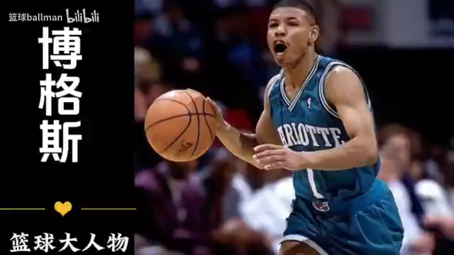

Slide 7
Read the given material
Step 1 Focus on the basic elements
①Tony and I were in our school basketball team, the Lions. We loved basketball and were both huge fans of the NBA. When we weren’t playing on the court(球场), we were watching a game on TV. My favourite player was LeBron James while Tony’s was Tyrone Bogues.
②Bogues was only 1.6 metres tall, which made him the shortest player ever in the NBA. Guess what? Tony was only 1.6 metres tall, too! Tony knew that being shorter than other players meant that he had to practise more. During all those hours of doing jump shots(跳投) on his own, he used Bogues as his inspiration. Tony once said, “If Bogues could make it, why not me?”
③But our coach was not so sure. Tony had to try out many times just for making the team. He was still usually on the bench(场边休息区), being just a replacement. Everyone knew Tony had real skills, and was someone who worked really hard and had a strong desire to play for the team. However, Tony didn’t get a chance.
④This week, the Lions were playing with our main competitors, the Bears, a team whose record this season had been perfect. They hadn’t lost a single game(丢一场比赛).
⑤The last quarter began, and my team was behind by 10 points. Suddenly, a player and I crashed into(碰撞) each other. Pain raced through my body. My knee hurt badly. “I don’t think I can play anymore, coach,” I said quietly as the doctor put an ice pack on my knee.
⑥“No way,” the coach replied sharply(尖声叫道). “We’ve got no more players!”
Who
（major character（s）?
What
was the relationship among them?
What
did the hero want to be?
What
challenge(s) did he face? Why?
How did he feel then?

Slide 8
Read the given material
Step 1 Focus on the basic elements
①Tony and I were in our school basketball team, the Lions. We loved basketball and were both huge fans of the NBA. When we weren’t playing on the court, we were watching a game on TV. My favourite player was LeBron James while Tony’s was Tyrone Bogues.
②Bogues was only 1.6 metres tall, which made him the shortest player ever in the NBA. Guess what? Tony was only 1.6 metres tall, too! Tony knew that being shorter than other players meant that he had to practise more. During all those hours of doing jump shots on his own, he used Bogues as his inspiration. Tony once said, “If Bogues could make it, why not me?”
③But our coach was not so sure. Tony had to try out many times just for making the team. He was still usually on the bench(场边休息区), being just a replacement. Everyone knew Tony had real skills, and was someone who worked really hard and had a strong desire to play for the team. However, Tony didn’t get a chance.
④This week, the Lions were playing with our main competitors, the Bears, a team whose record this season had been perfect. They hadn’t lost a single game.
⑤The last quarter began, and my team was behind by 10 points. Suddenly, a player and I crashed into each other. Pain raced through my body. My knee hurt badly. “I don’t think I can play anymore, coach,” I said quietly as the doctor put an ice pack on my knee.
⑥“No way,” the coach replied sharply. “We’ve got no more players!”
Who
（major character（s）?

Slide 9
Read the given material
Step 1 Focus on the basic elements
Tony
His favorite player was Bogues, 1.6 meters tall.
Tony was only 1.6 meters tall.
He knew he had to practice more.
Bogues was his inspiration.
Tony wants to be a “Bogues”.
Tony
wanted
to
be
a
“Bogues”.
①Tony and I were in our school basketball team, the Lions. We loved basketball and were both huge fans of the NBA. When we weren’t playing on the court, we were watching a game on TV. My favourite player was LeBron James while Tony’s was Tyrone Bogues.
②Bogues was only 1.6 metres tall, which made him the shortest player ever in the NBA. Guess what? Tony was only 1.6 metres tall, too! Tony knew that being shorter than other players meant that he had to practise more. During all those hours of doing jump shots on his own, he used Bogues as his inspiration. Tony once said, “If Bogues could make it, why not me?”
③But our coach was not so sure. Tony had to try out many times just for making the team. He was still usually on the bench(场边休息区), being just a replacement. Everyone knew Tony had real skills, and was someone who worked really hard and had a strong desire to play for the team. However, Tony didn’t get a chance.
④This week, the Lions were playing with our main competitors, the Bears, a team whose record this season had been perfect. They hadn’t lost a single game.
⑤The last quarter began, and my team was behind by 10 points. Suddenly, a player and I crashed into each other. Pain raced through my body. My knee hurt badly. “I don’t think I can play anymore, coach,” I said quietly as the doctor put an ice pack on my knee.
⑥“No way,” the coach replied sharply. “We’ve got no more players!”
①Tony and I were in our school basketball team, the Lions. We loved basketball and were both huge fans of the NBA. When we weren’t playing on the court, we were watching a game on TV. My favourite player was LeBron James while Tony’s was Tyrone Bogues.
②Bogues was only 1.6 metres tall, which made him the shortest player ever in the NBA. Guess what? Tony was only 1.6 metres tall, too! Tony knew that being shorter than other players meant that he had to practise more. During all those hours of doing jump shots on his own, he used Bogues as his inspiration. Tony once said, “If Bogues could make it, why not me?”
③But our coach was not so sure. Tony had to try out many times just for making the team. He was still usually on the bench(场边休息区), being just a replacement. Everyone knew Tony had real skills, and was someone who worked really hard and had a strong desire to play for the team. However, Tony didn’t get a chance.
④This week, the Lions were playing with our main competitors, the Bears, a team whose record this season had been perfect. They hadn’t lost a single game.
⑤The last quarter began, and my team was behind by 10 points. Suddenly, a player and I crashed into each other. Pain raced through my body. My knee hurt badly. “I don’t think I can play anymore, coach,” I said quietly as the doctor put an ice pack on my knee.
⑥“No way,” the coach replied sharply. “We’ve got no more players!”

Slide 10
Read the given material
Step 1 Focus on the basic elements
①Tony and I were in our school basketball team, the Lions. We loved basketball and were both huge fans of the NBA. When we weren’t playing on the court, we were watching a game on TV. My favourite player was LeBron James while Tony’s was Tyrone Bogues.
②Bogues was only 1.6 metres tall, which made him the shortest player ever in the NBA. Guess what? Tony was only 1.6 metres tall, too! Tony knew that being shorter than other players meant that he had to practise more. During all those hours of doing jump shots on his own, he used Bogues as his inspiration. Tony once said, “If Bogues could make it, why not me?”
③But our coach was not so sure. Tony had to try out many times just for making the team. He was still usually on the bench(场边休息区), being just a replacement. Everyone knew Tony had real skills, and was someone who worked really hard and had a strong desire to play for the team. However, Tony didn’t get a chance.
④This week, the Lions were playing with our main competitors, the Bears, a team whose record this season had been perfect. They hadn’t lost a single game.
⑤The last quarter began, and my team was behind by 10 points. Suddenly, a player and I crashed into each other. Pain raced through my body. My knee hurt badly. “I don’t think I can play anymore, coach,” I said quietly as the doctor put an ice pack on my knee.
⑥“No way,” the coach replied sharply. “We’ve got no more players!”
①Tony and I were in our school basketball team, the Lions. We loved basketball and were both huge fans of the NBA. When we weren’t playing on the court, we were watching a game on TV. My favourite player was LeBron James while Tony’s was Tyrone Bogues.
②Bogues was only 1.6 metres tall, which made him the shortest player ever in the NBA. Guess what? Tony was only 1.6 metres tall, too! Tony knew that being shorter than other players meant that he had to practise more. During all those hours of doing jump shots on his own, he used Bogues as his inspiration. Tony once said, “If Bogues could make it, why not me?”
③But our coach was not so sure. Tony had to try out many times just for making the team. He was still usually on the bench(场边休息区), being just a replacement. Everyone knew Tony had real skills, and was someone who worked really hard and had a strong desire to play for the team. However, Tony didn’t get a chance.
④This week, the Lions were playing with our main competitors, the Bears, a team whose record this season had been perfect. They hadn’t lost a single game.
⑤The last quarter began, and my team was behind by 10 points. Suddenly, a player and I crashed into each other. Pain raced through my body. My knee hurt badly. “I don’t think I can play anymore, coach,” I said quietly as the doctor put an ice pack on my knee.
⑥“No way,” the coach replied sharply. “We’ve got no more players!”
What
Challenge(s) did he face?
Although Tony has real skills, he still worked very hard, longing for a chance to play for the team. , .

Slide 11
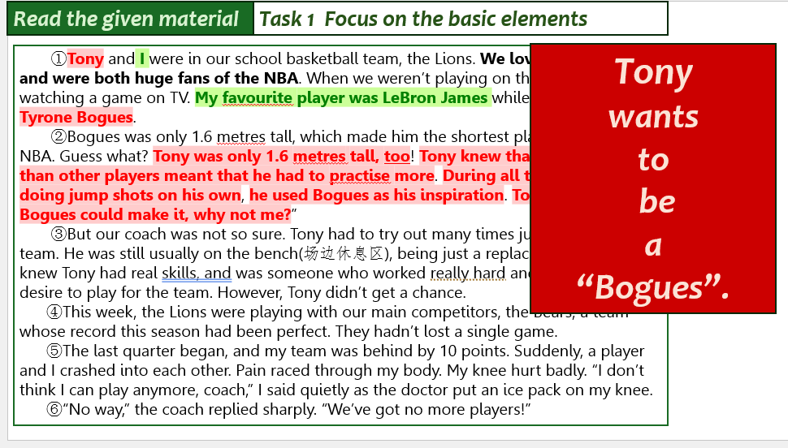
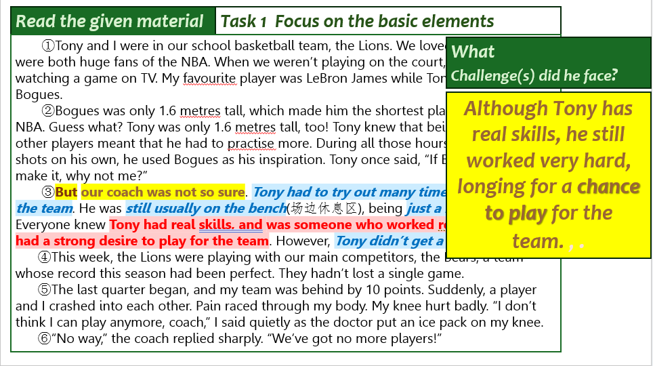
Read the given material
Step 2 Focus on the conflict/challenge/difficulty…
If there was a chance, Tony would probably a “Bogues”.
Could Tony seize the chance to become a “Bogues” ?
④This week, the Lions were playing with our main competitors, the Bears, a team whose record this season had been perfect. They hadn’t lost a single game.
⑤The last quarter began, and my team was behind by 10 points. Suddenly, a player and I crashed into each other. Pain raced through my body. My knee hurt badly. “I don’t think I can play anymore, coach,” I said quietly as the doctor put an ice pack on my knee.
⑥“No way,” the coach replied sharply. “We’ve got no more players!”
④This week, the Lions were playing with our main competitors, the Bears, a team whose record this season had been perfect. They hadn’t lost a single game.
⑤The last quarter began, and my team was behind by 10 points. Suddenly, a player and I crashed into each other. Pain raced through my body. My knee hurt badly. “I don’t think I can play anymore, coach,” I said quietly as the doctor put an ice pack on my knee.
⑥“No way,” the coach replied sharply. “We’ve got no more players!”

Slide 12
Read for writing
Step 3 Predict the ending based on the given material.
Q. Could Tony seize the chance to become a “Bogues” ?
②Bogues was only 1.6 metres tall, which made him the shortest player ever in the NBA. Guess what? Tony was only 1.6 metres tall, too! Tony knew that being shorter than other players meant that he had to practise more. During all those hours of doing jump shots on his own, he used Bogues as his inspiration. Tony once said, “If Bogues could make it, why not me?”
③But our coach was not so sure. Tony had to try out many times just for making the team. He was still usually on the bench(场边休息区), being just a replacement. Everyone knew Tony had real skills, and was someone who worked really hard and had a strong desire to play for the team. However, Tony didn’t get a chance.
④This week, the Lions were playing with our main competitors, the Bears, a team whose record this season had been perfect. They hadn’t lost a single game.
⑤The last quarter began, and my team was behind by 10 points. Suddenly, a player and I crashed into each other. Pain raced through my body. My knee hurt badly. “I don’t think I can play anymore, coach,” I said quietly as the doctor put an ice pack on my knee.
⑥“No way,” the coach replied sharply. “We’ve got no more players!”
Tony was only 1.6 meters tall.
Tony was just a replacement.
Tony had real skills and worked really hard.
Tony used Bogues as his inspiration.
Tony’s real skills + Bogues’ inspiration
The Bears hadn’t lost a single game.
My team was behind by 10 points.
Tony would seize the chance to become a “Bogues”.

Slide 13
Read for writing
Step 4 Outline the continuation para.
Tony would seize the chance to become a “Bogues”. How?
Continuation para. “What about Tony?” someone suggested.
S1. 衔接
S2. 人物互动
S3. 主角展示
S4. 故事结局
S5. 主题呈现
Q1. To whom? What was his/her response?
Scene 1. The coach felt a little bit hesitated but without other choice.
Scene 2. Tony couldn’t hold his excitement and actively accept the challenge as well as promised to behave well.
Q2. Would Tony follow the coach’s requirement? How did he feel then?
Scent 3. Tony, inspired by “Bogues”, played like a real “Bogues”(skills + inspiration+determination).
Q3. How did Tony help his team beat the Bear?
Tony seized the chance to and proved to others he was a “Bogues”, winning the coach’s recognition and more chances.
Chances/opportunities are for those who never give up their dreams.

Slide 14
Writing
Step 5 detailed writing (actions + emotions)
Scene 1. The coach felt a little bit hesitated but without other choice.
Sentence patterns
非谓语前缀+ 主句+非限制性定语从句后缀
Only/On no account/ In no case + 状语(从句) + 部分倒装
With /find + O + Oc.
It is/ was + …+ that 强调句式
There be 句式
What impressed/inspired/ touched … sb. most was that…
无灵主语
1. 看了看只有1.6米的Tony，教练还是不太想要他顶替我的位置。可是，也别无他法，只能招手让Tony 上场。
Looking at Tony, 1.6 meters tall, the coach still couldn’t make up his mind to ask him to take the place of me. However, without other choices, he had to give in, waving at Tony to play.

Slide 15
Writing
Step 5 detailed writing
Scene 2. Tony couldn’t hold his excitement and actively accept the challenge as well as promised to behave well.
2. 听到教练让他上场，Tony 感到无比惊讶并异常兴奋，这可是他梦寐以求的机会啊。来不及多想，Tony 朝教练点了点头，并向他表示他一定会好好表现的。
Sentence patterns
非谓语前缀+ 主句+非限制性定语从句后缀
Only/On no account/ In no case + 状语(从句) + 部分倒装
With /find + O + Oc.
It is/ was + …+ that 强调句式
There be 句式
What impressed/inspired/ touched … sb. most was that…
无灵主语
Tony felt extremely surprised and thrilled when hearing the news that the coach asked him to play, which was the very chance that he was dreaming. Without a second thought, Tony nodded to the coach and promised/,promising that he would not let him down.
A mixed sense of excitement surprise seized him when Tony heard that the coach asked him to take the place of me/play as a real basketball player, which was the chance that he was dreaming. Not thinking twice, Tony nodded his head and promised not to let him down.

Slide 16
Writing
Step 5 detailed writing
Scent 3. Tony, inspired by “Bogues”, played like a real “Bogues”(skills + determination).
3. 让我们动容有印象深刻的是 Tony ，被Bogues 鼓舞着的，就像Bogues 一样在场上灵活，不到10分钟的时间就帮我们拿下10分，并在最后一刻让我们反超the Bears 2分。
Sentence patterns
非谓语前缀+ 主句+非限制性定语从句后缀
Only/On no account/ In no case + 状语(从句) + 部分倒装
With /find + O + Oc.
It is/ was + …+ that 强调句式
There be 句式
What impressed/inspired/ touched … sb. most was that…
无灵主语
What touched/impressed us most was that Tony, inspired by Bogues, was playing the ball like Bogues on the ground flexibly, and helped us score 10 points within 10m and surpass the Bears by 2 points on the final occasion.

Slide 17
Writing
Step 5 detailed writing
Tony seized the chance to and proved to others he was a “Bogues”, winning the coach’s recognition and more chances.
Chances/opportunities are for those who never give up their dreams.
Sentence patterns
非谓语前缀+ 主句+非限制性定语从句后缀
Only/On no account/ In no case + 状语(从句) + 部分倒装
With /find + O + Oc.
It is/ was + …+ that 强调句式
There be 句式
What impressed/inspired/ touched … sb. most was that…
无灵主语
4&5 我们绝不曾想到我们对会打败the Bears, 兴奋的呼唤向潮水般涌向Tony。也因为这次机会，Tony 赢得了教练的认可，证明了他也能像Bogues 一样。也是在那个时候我才明白，机会是给那些不轻易放弃的人。
On no account had we ever thought we could beat the Bears, yells of thrill and appreciation surrouding Tony. It was because of the chance that Tony won the coach’s recognition and proved himself that he could play like Bogues. Only at that time did I realize that chances/opportunities are for those who never give up their dreams.

Slide 18
Writing
Step 6 combination
Continuation para. “What about Tony?” someone suggested. Looking at Tony, 1.6 meters tall, the coach still couldn’t make up his mind to ask him to take the place of me. However, without other choices, he had to give in, waving at Tony to play. A mixed sense of excitement surprise seized him when Tony heard that the coach asked him to take the place of me/play as a real basketball player, which was the chance that he was dreaming. Not thinking twice, Tony nodded his head and promised not to let him down. What touched/impressed us most was that Tony, inspired by Bogues, was playing the ball like Bogues on the ground flexibly, and helped us score 10 points within 10m and surpass the Bears by 2 points on the final occasion. On no account had we ever thought we could beat the Bears, yells of thrill and appreciation surrouding Tony. It was because of the chance that Tony won the coach’s recognition and proved himself that he could play like Bogues. Only at that time did I realize that chances/opportunities are for those who never give up their dreams.

Slide 19


