Slide 1


感恩遇见，相互成就，本课件资料仅供您个人参考、教学使用，严禁自行在网络传播，违者依知识产权法追究法律责任。
更多教学资源请关注
公众号：溯恩英语
知识产权声明

Slide 2

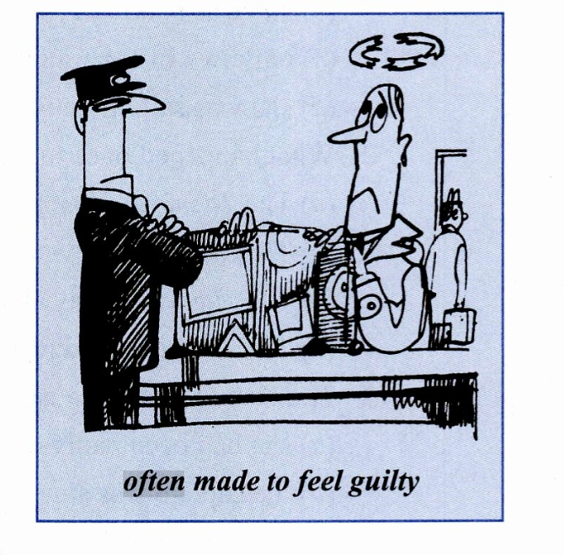



新概念3
Lesson 11 Not guilty
Shirley

Slide 3









PART One
Target vocabulary

Slide 4
Match each word with the best meaning.
A.A person who illegally transports goods or people, typically across borders. B. Showing willingness to allow the existence of opinions or behavior that one does not necessarily agree with; accepting. C. to tell customs officers that you are carrying goods on which you should pay tax
D. Having become tough or unfeeling, especially due to experience; experienced or cynical /ˈsɪnɪkəl/. E. Relating to a job that requires special education or training; skilled or expert in a particular field. F. To leap or spring suddenly, often to seize or attack something. G. Causing fear, horror, or dread; very bad or unpleasant. H. A pleasant-smelling liquid or substance, typically used to give a pleasant scent to the body or space. I. In a manner that involves mocking or expressing contempt, often by saying the opposite of what is meant. J. Not subject to a rule or obligation; freed from a requirement or duty. K. To remove something by turning it in the opposite direction to tighten it, often referring to a cap or lid. L. One of the two openings in the nose through which air is inhaled and exhaled. M. Assertive/əˈsɜːrtɪv/ in offering one’s services or opinions, often in an intrusive or meddlesome way. N. A tax that you pay on things that you buy, especially those that you bring into a country
______tolerant
______ declare
______ hardened
______ professional
______ smuggler
______ officious
______ dreadful
______ pounce
______ perfume
______ sarcastically
______ exempt
______ duty
______ unscrew
______ nostril
B
C
D
E
A
M
G
F
H
I
J
N
K
L

Slide 5
PART Two
Reading the passage

Slide 6
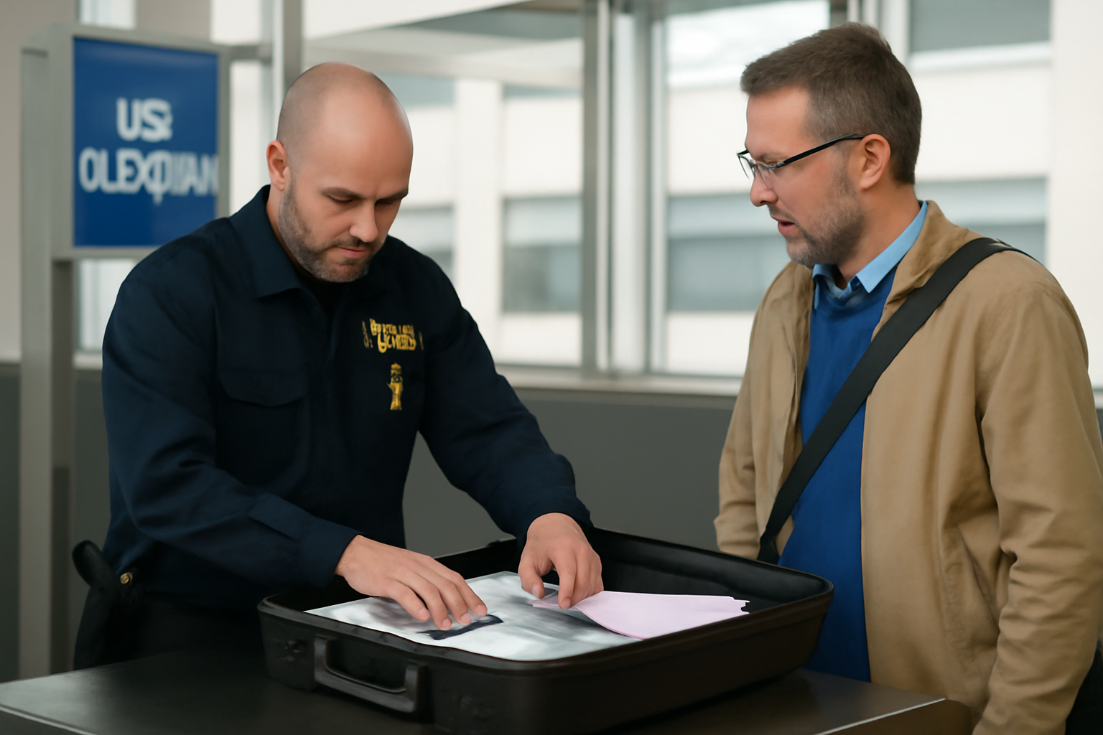
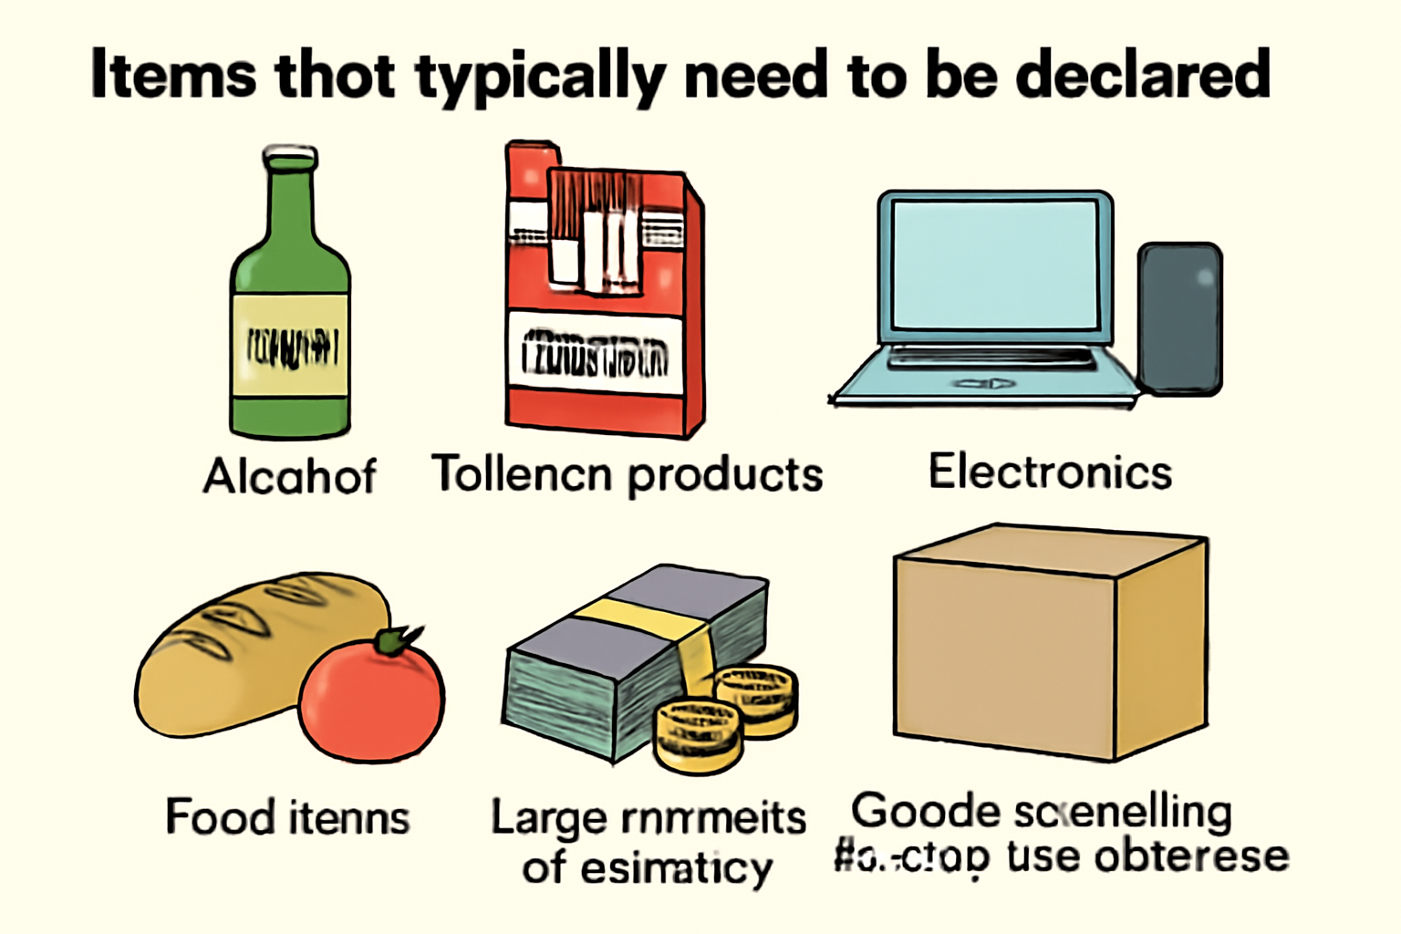
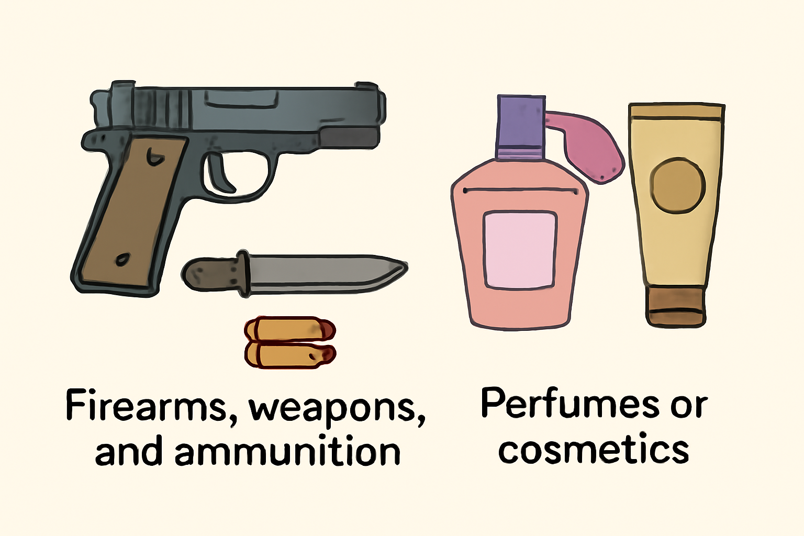
Which items need to be declared at customs?
Alcohol
Tobacco products
Electronics
Gifts or souvenirs
Currency or financial instruments
Medicines or health supplements
Firearms, weapons, and ammunition 弹药
Perfumes or cosmetics

Slide 7
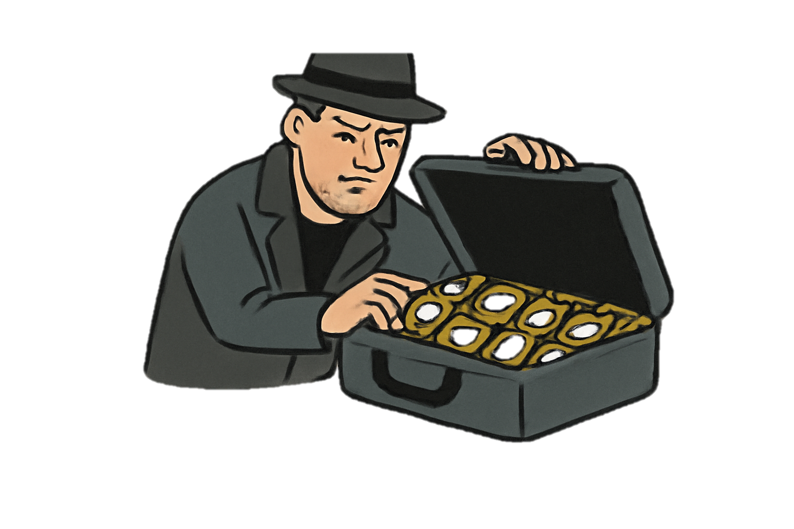
It
______ is through its illegal transportation of goods across national borders that smuggling poses a severe global challenge. By evading（evade-escape） customs regulations, smugglers not only cause significant revenue ______ (lose) for governments but also undermine（逐渐削弱） legal businesses.
What makes smuggling particularly dangerous is its association with ____________ (organize) crime networks. The transportation of illicit /ɪˈlɪsɪt/(illegal) goods, ______ (include) narcotics/nɑːrˈkɑːtɪk/ (麻醉剂) and arms, frequently leads to heightened social ________(stable) and public health emergencies. Additionally, illegal wildlife trade disrupts ecological balance, while human trafficking is a grave offense __________ fundamental human rights. (traffic-trafficked（非法）进行…交易，做…买卖. panic-panicked )
Historically, smuggling operations _______________(evolve) in sophistication, taking advantage of globalization and technological advances. Consequently, it is imperative that nations strengthen cross-border cooperation and implement ______ (rigor) enforcement measures.
______ international cooperation is enhanced, this threat will continue to grow. Among the potential solutions to this complex issue ______ (lie) the need for a coordinated international response.
loss
organized
including
instability
on/against
have evolved
rigorous
Unless
lies
smuggler

Slide 8
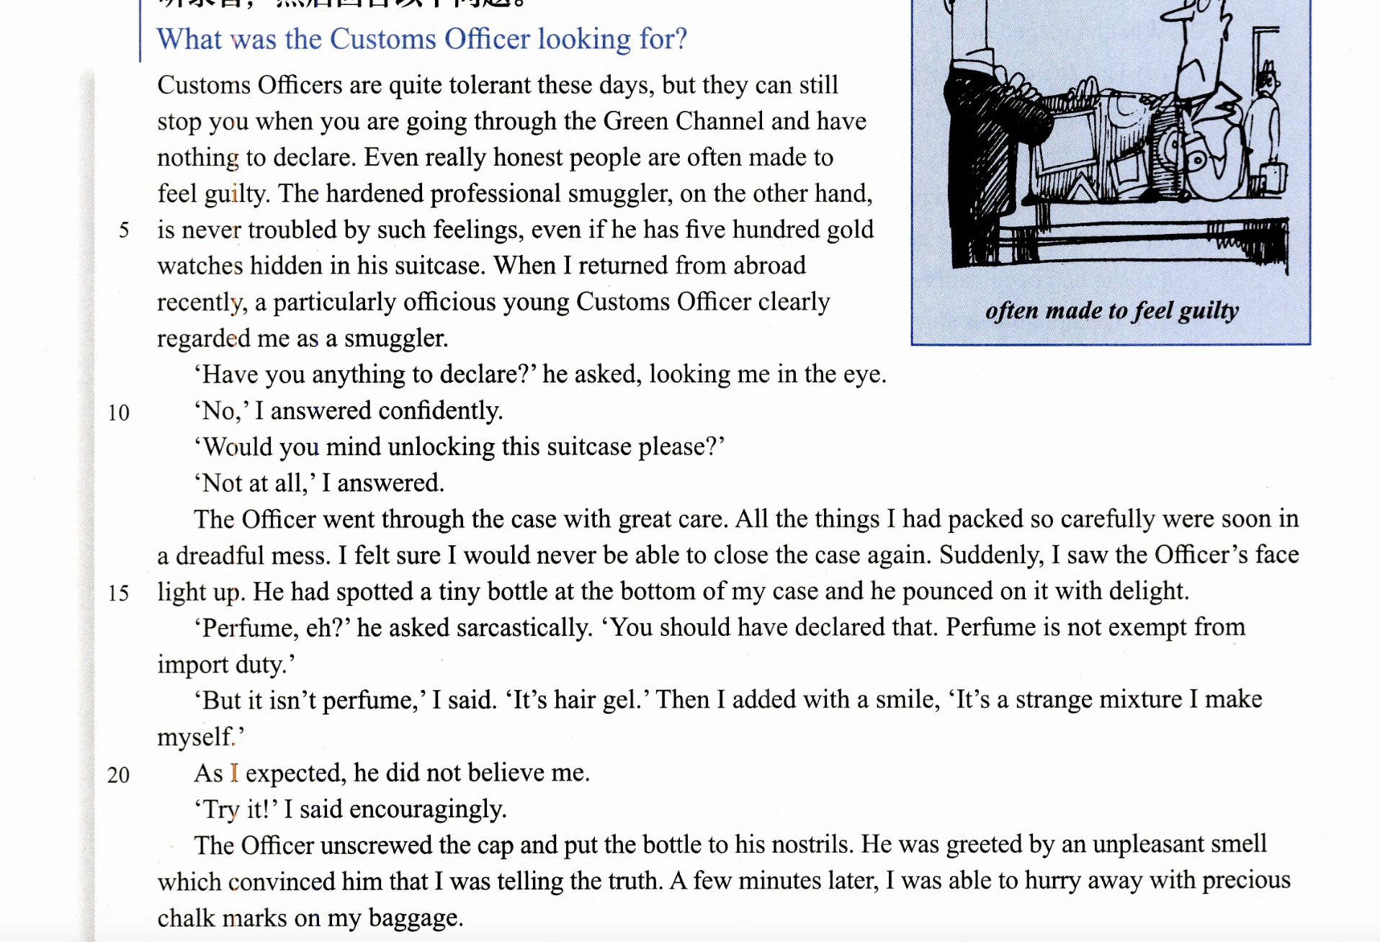

Slide 9
PART Three
Reading comprehension

Slide 10
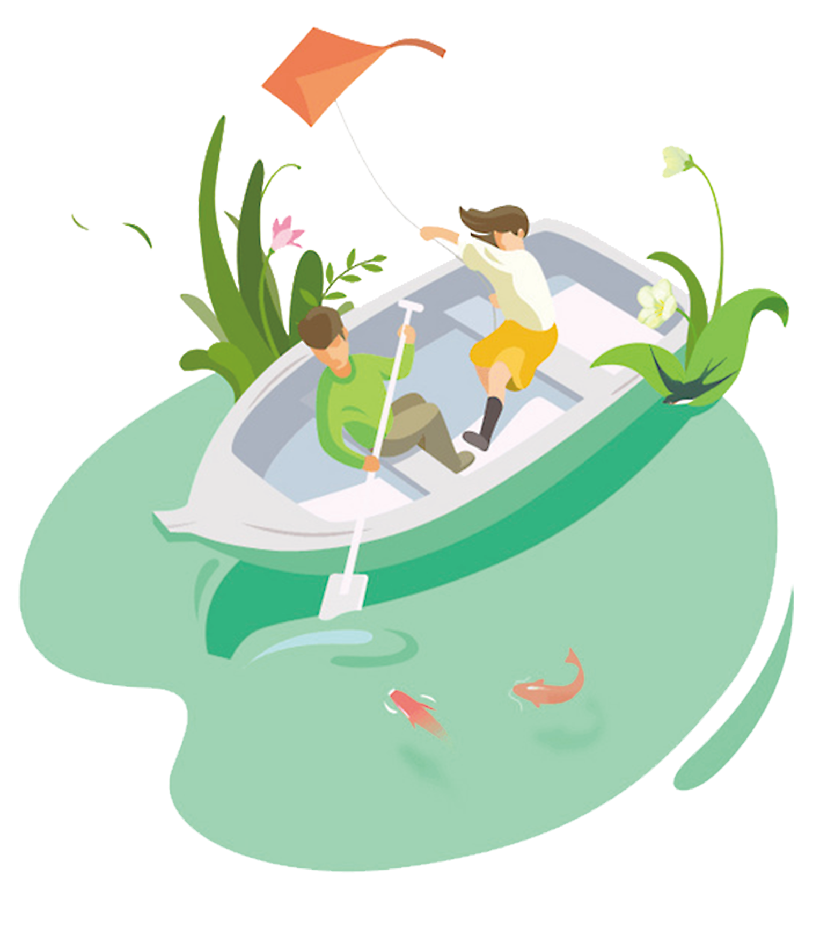
1 What makes really honest people feel guilty when going through Customs?
(a) Having five hundred gold watches hidden in their suitcases.
(b) The particularly officious way Customs Officers always ask questions.
(c) The fact that they are treated as potential smugglers.
(d) Carrying things which are not exempt from import duty.
2 What made the Customs Officer's face light up?
(a) Knowing how difficult it would be for the writer to close his case.
(b) Seeing the bottle of hair gel which he could charge duty on.
(c) The idea of having found something which should have been declared.
(d) Discovering an unopened bottle of perfume at the botom of the case.
3 The writer was in a hurry to get away because
(a) he had grown impatient at having taken so long to get through Customs
(b) he was anxious to get away from the unpleasant smell
(c) he was afraid he might still be stopped for smuggling
(d) he was trying to escape with precious chalk marks

Slide 11
PART Four
Structure imitation

Slide 12
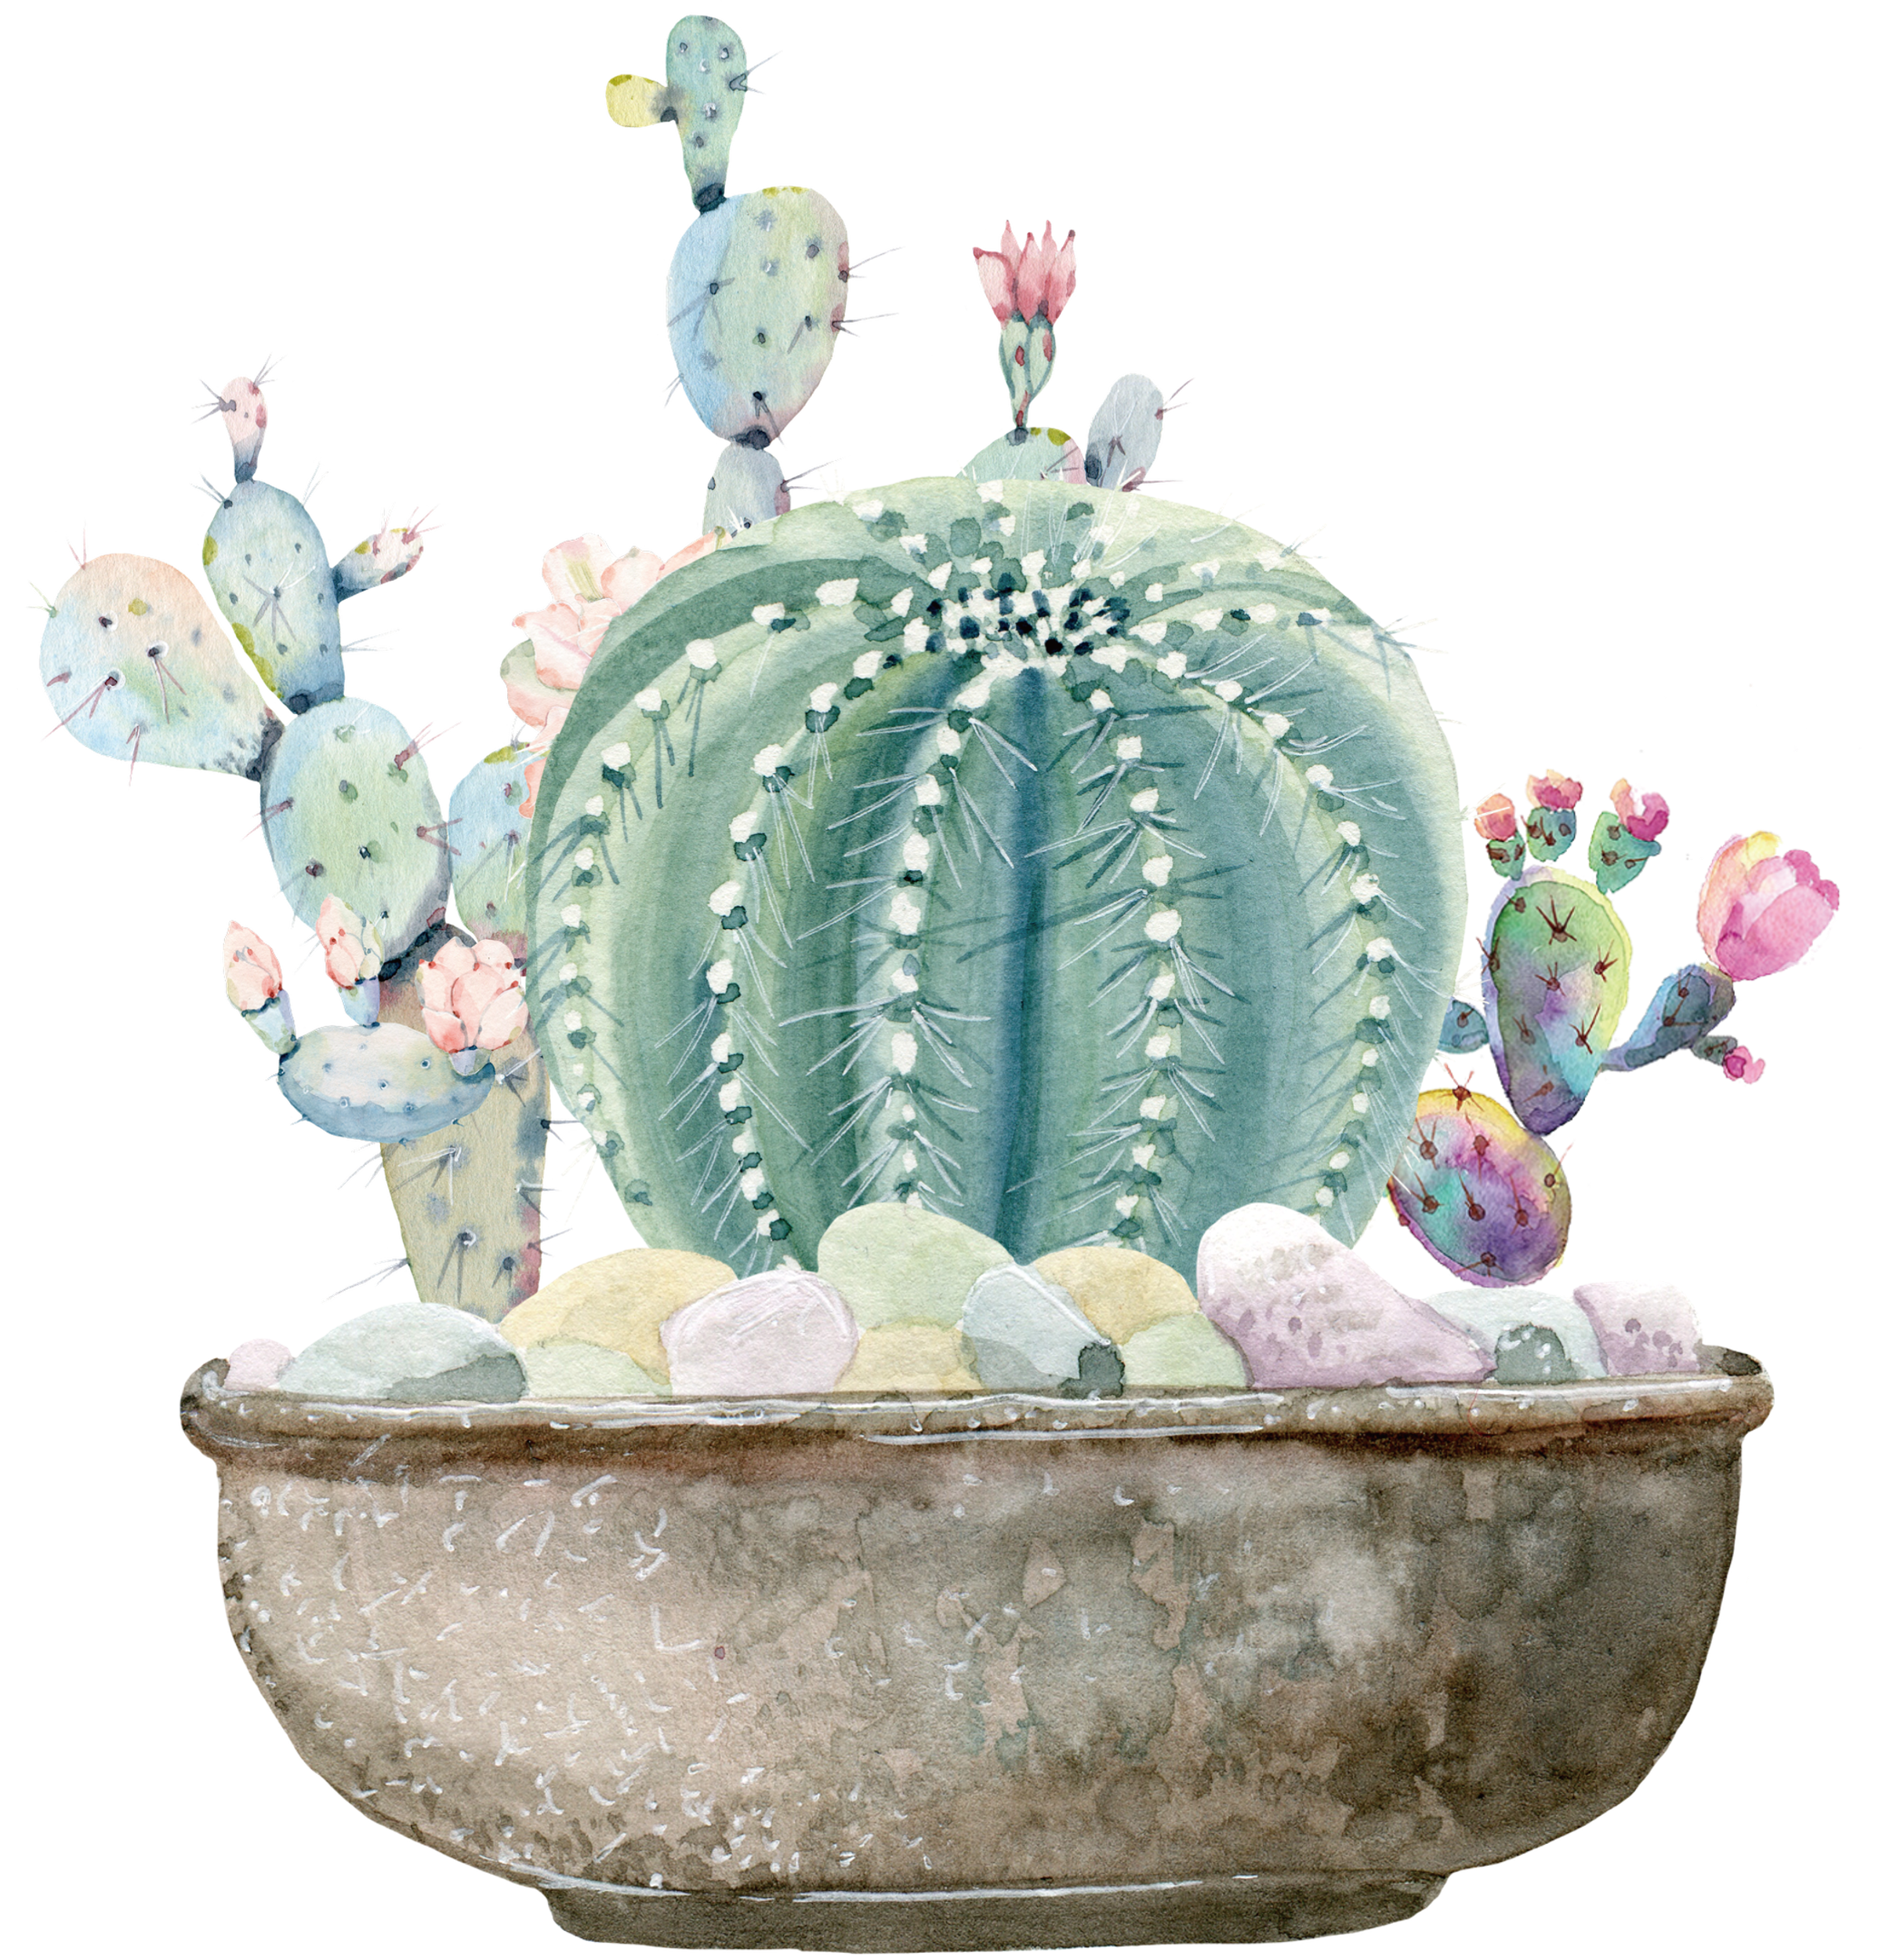
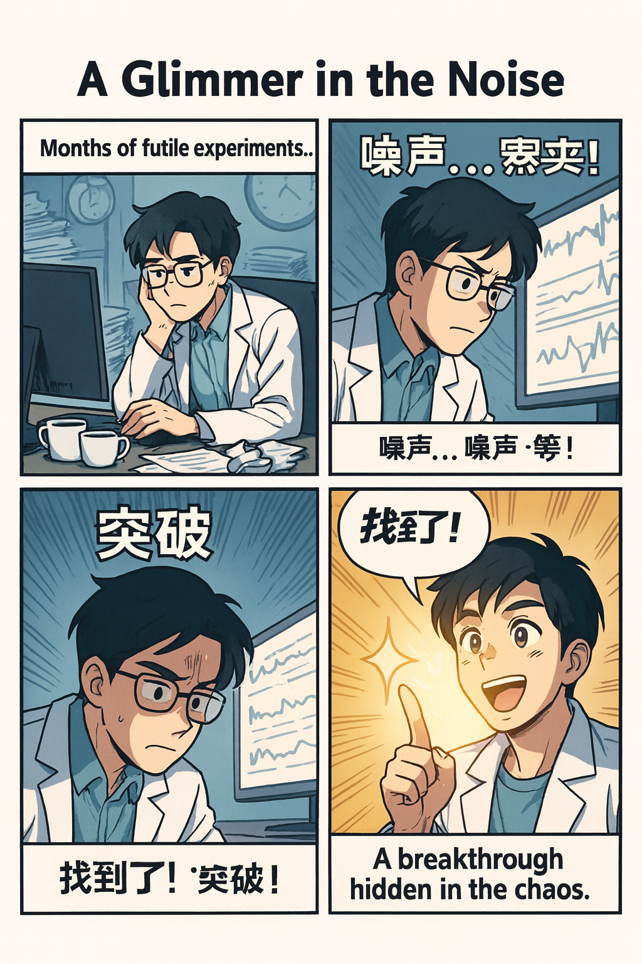
1. Suddenly, I saw the Officer's face light up. He had spotted a tiny bottle...
1) The young scientist’s face lit up as he spotted a glimmer of hope amidst months of futile /ˈfjuːtaɪl/（ pointless 徒劳的） experiments, a breakthrough hidden within the chaotic（ /keɪˈɒtɪk/ 混乱的） data.
这位年轻的科学家看到一丝希望的曙光时，脸上露出了笑容。在经历了数月毫无进展的实验之后，他从混乱的数据中发现了突破的迹象。
2) 她那张饱经风霜的脸瞬间亮了起来，如同黑暗地貌上的第一道曙光，因为她看到了地平线上的救援船。
Her careworn/ weather-beaten face lit up like the first crack of dawn over a dark landscape as she spotted the rescue boat on the horizon.
3）祖母的脸庞骤然焕发光彩，当她看见那个名字在屏幕上跳动（pulse），一段沉睡已久的记忆如被划燃的火柴般骤然苏醒。
Grandmother’s face lit up as she spotted the name pulsing on the screen, a long-dormant recollection flaring like a struck match.（strike –struck-struck）

Slide 13
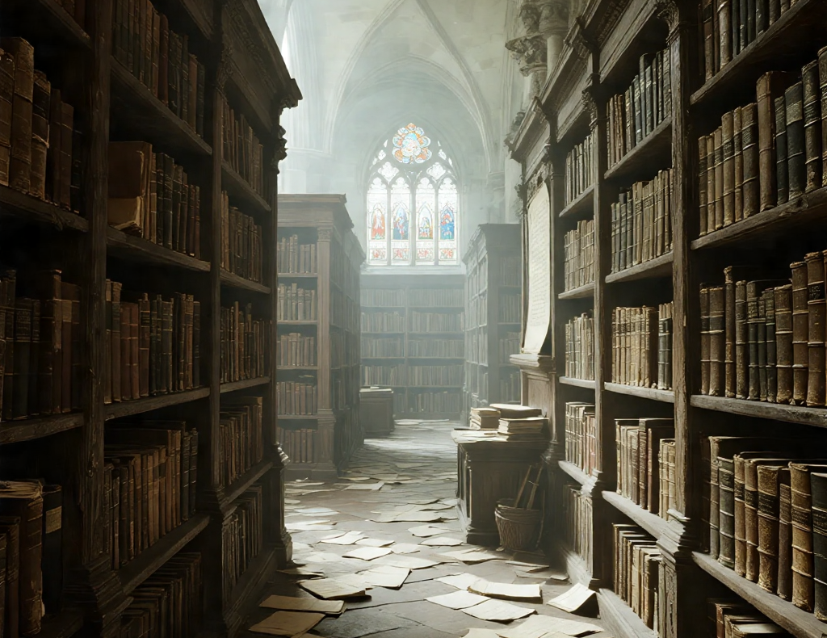
2.He was greeted by an unpleasant smell which convinced him that I was telling the truth. （嗅觉）
1）Upon entering the ancient library, we were greeted by the palpable scent of ageing paper and dust, a aroma that instantly convinced us that we were in a place that transcended time.
踏入这座古老的图书馆，陈纸与尘埃那股清晰可感的气息迎面而来，这股气味立刻让我们确信自己置身于一个超越时间的所在。
be greeted by：中性偏消极，表示“迎接他的是...”，常与嗅觉、景象搭配。
be assailed by：（强烈）表示“受到...的猛烈冲击”，强调突然性和不可抗拒性，常用于气味、声音、光线。
He was assailed by the sincere, desperate edge in her voice, leaving him in no doubt that her story was true.
她声音里真诚而又绝望的语调如浪般袭来，使他确信她说的都是真的。

Slide 14

五感——to show not tell
Her notebook bloomed with marginalia /ˌmɑːdʒɪˈneɪlɪə/（ (书、手稿、信的)边注）—arrowed lines, tiny stars, a thin river of blue ink. 她的笔记本盛开着旁批——箭头、小星星、一道细细的蓝墨河。
1）. [光源] + /cast/threw/ a glare（强烈刺眼的光）；limned/trace lambent gleam（微光）/halo（光环；光晕）/ effulgence（灿烂；光辉）/ argent/ˈɑːrdʒənt/ sheen（银亮光泽） over/around [物体]
光源：the scorching sun（酷热的阳光）, the low, aureate /ˈɔːriət/（golden） sun, argent /ˈɑːdʒənt/ （silver）moonlight, gaslight, streetlamps/headlight beam / the stained-glass window（ 彩色玻璃窗）/the projector
Moonlight cast a lambent /ˈlæmbənt/(柔和而光亮的) gleam around the bell tower. 月色在钟楼周围洒下轻柔的微光。
The lighthouse beam cast a cold, argent sheen over the breakers. 灯塔的光束将一层冰冷的银辉撒在拍岸的浪头上。
The stained-glass window cast a jeweled aureole over the benches. 彩绘玻璃把宝石般的圣环光晕投在长椅上。

Slide 15
五感——to show not tell
2） [颜色/明暗] + ran in muted tones, with a [光线名词] silhouetting [主体].
光线：an aureole /ˈɔːriəʊl/（光环） of backlight（背光的圣环）/a halo of candlelight/
a moonlit corona（月色光冠）/an alpenglow /ˈælpənˌɡləʊ/（朝霞）wash（山岚晚照的晕光）/the afterglow（余晖）/a lambency of gaslight（煤气灯的柔辉）/a silvered rim of light（镀银般的光缘）/a gilt（镀金；金色涂层）rim of light（鎏金般光缘）/a penumbral/pɪˈnʌmbrəl/（日月半影的；界限不明的）halo（半影光晕）/ an opaline sheen（乳白珠光）
The square ran in muted sepias, with an aureole of backlight silhouetting the statue.
广场一片柔和的赭褐色，背光的光晕把雕像勾成剪影。
The stage ran in muted amber, with an opaline sheen silhouetting the violinist.
舞台铺着柔和的琥珀色，一层乳白的珠光把小提琴手勾成剪影。
Slate gray and dusty blue ran in muted tones across the evening sky, with the last amber gleam of the sunset silhouetting Tom as he tilted his head upward, his eyes tracing the fading arc of Ed's rocket.
灰蓝与尘褐在暮色中交织成柔和的色调，夕阳最后一抹琥珀色的微光勾勒出汤姆仰首的剪影——他正凝望着埃德的火箭在天际划出的渐逝弧线。

Slide 16
五感——to show not tell
Sound
1) From/Behind/Above + 地点, [声音名词] + 动词 (rolled / drummed / hissed / rose …) through/over [空间].
地点：the rafters（屋梁）/ the treeline（林缘）/ the alley（小巷）
声音名词：a susurration（沙沙低语）/ a thrum（低沉律动）/ a murmur / a clatter（哗啦声；嘈杂的谈笑声；咔嗒声）/ a peal / a clangor / a patter
动词：rolled / spilled / swelled / gathered / skittered / ricocheted / reverberated
空间：through the valley / the tiled corridor（铺有瓷砖的走廊）; over the square / the water / the rooftops
Behind the curtain, a nervous rustle gathered and spilled across the auditorium. 帷幕后不安的窸窣声聚起，又泻向整个礼堂。
From the quay, a peal of horns rolled through the morning fog. 码头那头汽笛洪响，在晨雾里缓缓推移。

Slide 17
五感——to show not tell
1) The air was permeated with…/ redolent /ˈredələnt/ of…, (质感/强度). 房间充满…
2) A (whiff/hint/tang) of (气味) drifted/wafted from (来源). 一缕（…）从（…）飘来。
3) The air was thick/stuffed with (气味); it (hung/lingered/clung) in my nostrils. 空气里充满（…）；它在鼻腔里（萦绕/停留/缠着不散）。
味道： aroma / fragrance / bouquet（香气，常见于花/茶/酒）smell of bread/tea/soap, notes of citrus/ˈsɪtrəs/柑橘 /vanilla /vəˈnɪlə/香草, a hint/whiff （一股）of mint（薄荷；薄荷糖）/redolent of pine/sea salt（带有…的气息，正式）/petrichor（雨后土壤清香）/ ozone（雷雨后“电离”味）
负向： reek/stink of smoke/fish（冲鼻恶臭） acrid（刺激呛人）/ rancid（油脂酸败）/ musty（霉陈）/ rank（强烈难闻）/metallic tang（金属味）/ sour sweat（酸汗味）
强度：faint / subtle / distinct / overpowering / heady（醺人）/ cloying（腻甜） 温度：warm / cool / smoky / briny（咸湿） / resinous（松脂感） / yeasty（发酵香）
一缕雨后土香从花园飘来，仿佛泥土在呼吸。
A whiff of petrichor drifted in from the garden, as if the soil were breathing.
房间里弥漫着潮湿衣物和陈旧空气的臭味，压抑得让人窒息。
The room reeked of damp clothes and stale air, suffocating in its heaviness.

Slide 18
五感——to show not tell
flavor（味道，尤指食物独特的风味）; savor（滋味，常指慢慢品味）;aftertaste（余味，回味）; palate /ˈpælət/ （味觉；口味）;tang（强烈的味道，多为辛辣/酸味）; piquancy（辛辣；刺激性味道） bitterness / sweetness / saltiness / sourness / spiciness（五味细分）
短语：be rich in flavor（味道浓郁）；leave a lingering aftertaste（留下挥之不去的余味）
appeal to one’s palate（迎合某人的口味）；savor every bite / sip（细细品味每一口）
be infused with a hint of …（带有一丝……的味道）；explode with flavors（味道在口中迸发）；carry a tang of …（带有一股……的味道）
这碗汤带着一丝淡淡的姜味，既温暖又清新。
The soup was infused with a delicate hint of ginger, warming yet refreshing.
这杯红酒留下橡木与浆果的余味，微妙却令人难忘。
The wine left a lingering aftertaste of oak and berries, subtle yet memorable.
这种药的味道很苦，久久地留在我的舌头上不肯消散。
The medicine carried a bitter tang that clung stubbornly to my tongue.

Slide 19
五感——to show not tell
texture（质地，触感）sensation（感觉，感官体验）roughness / smoothness / softness（粗糙/光滑/柔软）firmness（坚实）moisture / dampness（潮湿）warmth / chill（温暖 / 冷意）
tingle（刺痛感，轻微颤动感）prickle（刺痒感，针刺感）
be rough to the touch（摸起来很粗糙）have a velvety texture（有天鹅绒般的触感）send a shiver down one’s spine（让人脊背发凉）make one’s skin crawl（让人起鸡皮疙瘩）be damp with sweat（因出汗而潮湿）tingle with excitement / fear（因兴奋/害怕而颤动）be numb to the cold（对寒冷麻木）
The blanket had a velvety softness, wrapping me in gentle warmth.
那条毯子有着天鹅绒般的柔软，将我包裹在温柔的暖意中。
The morning breeze brushed lightly against my skin, cool but refreshing.
清晨的微风轻轻拂过我的皮肤，凉爽却令人精神振奋。
A prickling sensation crept across my skin, as if unseen eyes were watching me.
一股刺痒感爬上我的皮肤，仿佛有双看不见的眼睛在注视着我。
My fingers tingled as I touched the icy water, sharp but awakening.
我的手指碰到冰冷的水时刺痛颤抖，锐利却令人清醒。

Slide 20
PART Five
Story telling

Slide 21
Story-telling
1. Customs Officers—Tolerant--Green Channel--Nothing to declare
2. Officious young officer—Declare--Unlock suitcase--Search carefully
3. Dreadful mess--Pounced on the bottle—Perfume--Sarcastic remark
4. Exempt from import duty--Hair-oil—Encouraging--Unscrewed the cap
5. Nostrils--Unpleasant smell—Convinced--Precious chalk-marks--Baggage

Slide 22
PART Six
Summary writing

Slide 23
Answer the following questions with complete sentences.
1. Did the writer have anything to declare or not? 2. What did the Customs Officer make him do? 3. Did the Customs Officer search the case carefully or not? 4. What did he find? 5. What did he think was in the bottle? 6. What did the writer tell him the bottle contained? 7. Who had made it? 8. Did the Customs Officer believe him or not? 9. What did the writer encourage the Officer to do? 10.What convinced the Officer that the writer was telling the truth? 11. Did the Officer let the writer pass through the Customs or not?

Slide 24
Did the writer have anything to declare or not? No, he did not have anything to declare.
What did the Customs Officer make him do? The Officer made him unlock and open the suitcase.
The writer was going through the Green Channel at Customs, claiming that he had nothing to declare.
3. Did the Customs Officer search the case carefully or not? Yes, the Officer searched the case carefully.
4. What did he find? He found a tiny bottle at the bottom of the case.
5. What did he think was in the bottle? The Officer thought the bottle contained perfume.
The Officer carefully searched the suitcase, causing a dreadful mess, and eventually found a tiny bottle at the bottom of the case, assuming it contained perfume.

Slide 25
6. What did the writer tell him the bottle contained? The writer told him the bottle contained hair-oil.
7. Who had made it? The writer had made it himself.
The writer explained that the bottle contained hair-oil, which he had made himself. However, the Officer did not believe him at first.
8. Did the Customs Officer believe him or not? No, the Officer did not believe him at first.
9. What did the writer encourage the Officer to do? The writer encouraged the Officer to try it.
The writer encouraged the Officer to try the substance, and the Officer unscrewed the cap and smelled it.
10. What convinced the Officer that the writer was telling the truth? The unpleasant smell of the substance convinced the Officer.
11. Did the Officer let the writer pass through the Customs or not? Yes, the Officer let the writer pass through.
The unpleasant smell convinced the Officer that the writer was telling the truth, and he allowed him to pass through Customs, marking his baggage for clearance.

Slide 26
Possible version 1:
The writer was going through the Green Channel at Customs, claiming that he had nothing to declare. The Officer carefully searched the suitcase, causing a dreadful mess, and eventually found a tiny bottle at the bottom of the case, assuming it contained perfume. The writer explained that the bottle contained hair-oil, which he had made himself. However, the Officer did not believe him at first. The writer encouraged the Officer to try the substance, and the Officer unscrewed the cap and smelled it. The unpleasant smell convinced the Officer that the writer was telling the truth, and he allowed him to pass through Customs, marking his baggage for clearance.
Possible version 2: Though the writer had nothing to declare, the Customs Officer made him unlock his case. Searching the case carefully, the officer found it small bottle, which he thought was perfume. The writer told the Customs Officer that hair gel, which he had made himself. As the Officer did not believe this, the writer encouraged him to try it. The unpleasant smell convinced him the writer was telling the truth, so he let him pass through Customs.

Slide 27
PART Seven
Occasion describing

Slide 28
Composition
Imagine that a man tries to smuggle something valuable through the Customs. Expand the following into a paragraph of about 150 words.
When the Customs Officer _________________________________ the man said that he had nothing to declare. The Officer asked the man to _________________________________ Although the case contained only _________________________________ and _________________________________ it was very heavy. This made the Officer suspicious, so he_________________________________The case was soon empty and when the Officer _________________________________ he found that _________________________________ The Officer examined the case carefully and saw that _________________________________ He _________________________________ and removed the bottom part of the case which contained _________________________________ While the Officer was looking at _________________________________ the man tried to _________________________________ For a moment, the man disappeared among _________________________________ but he was soon _________________________________ and placed under arrest.

Slide 29
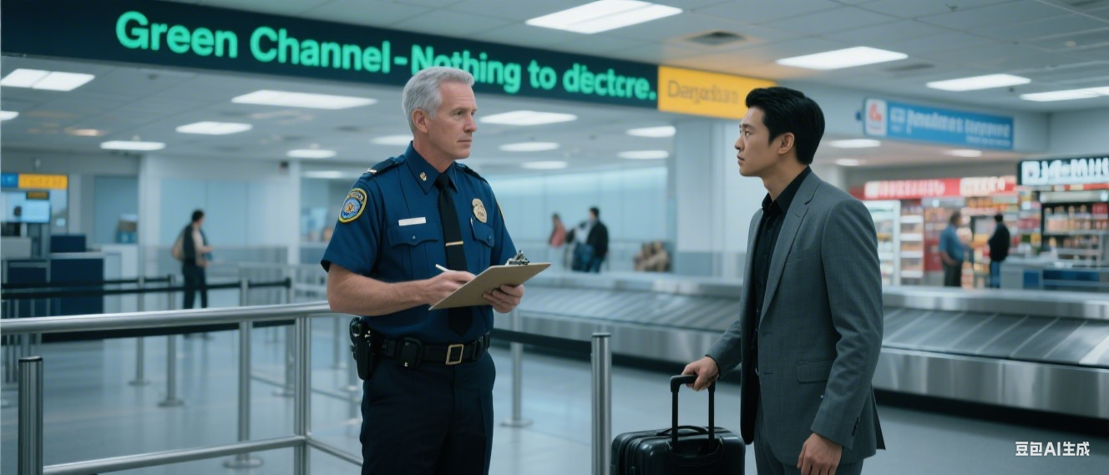
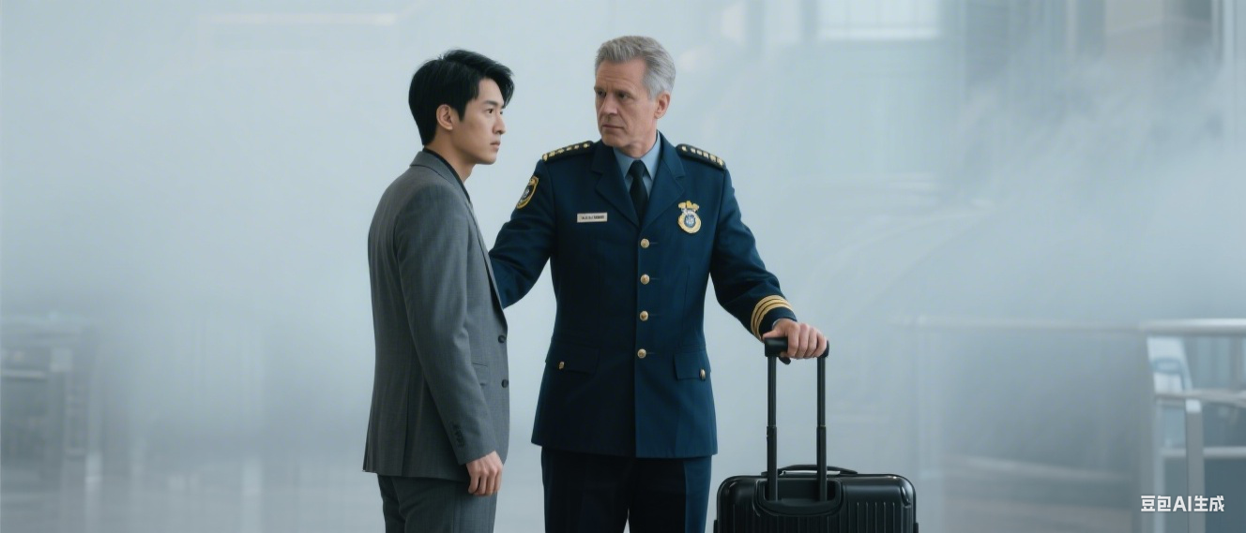
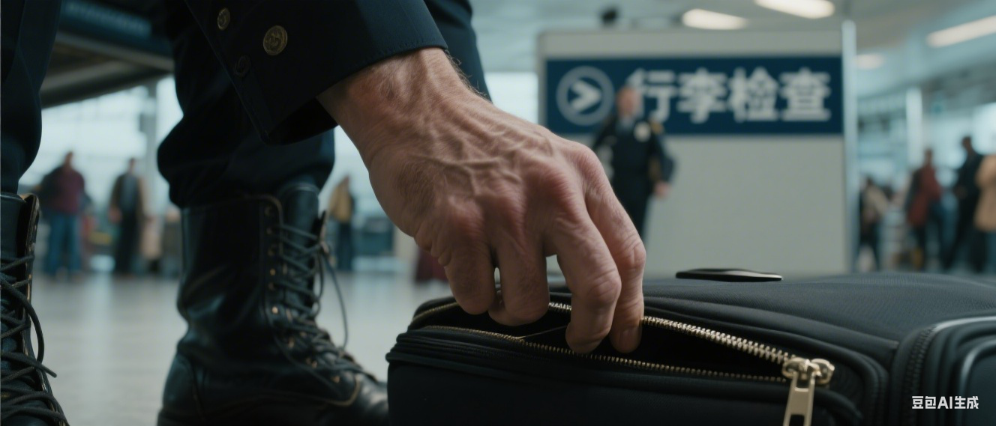
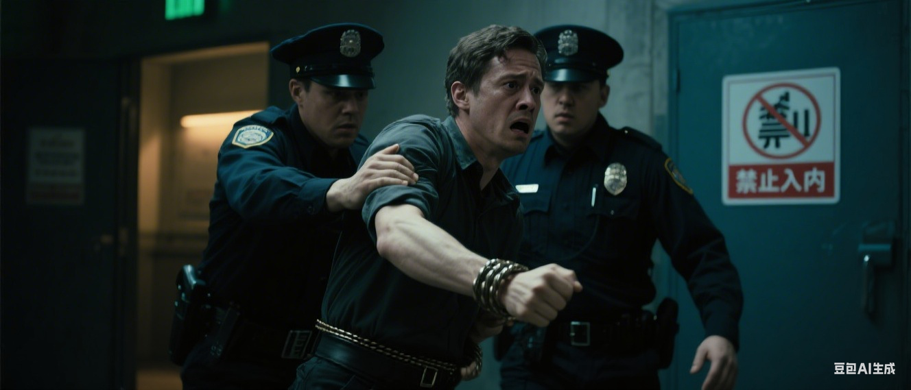
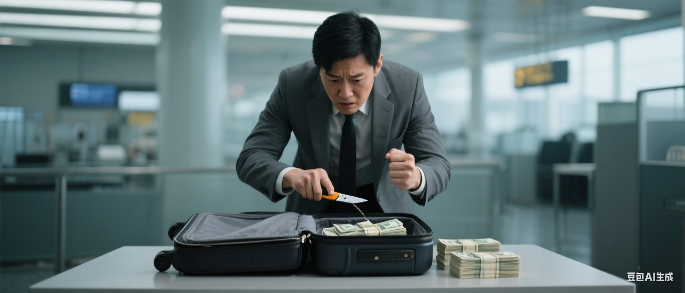
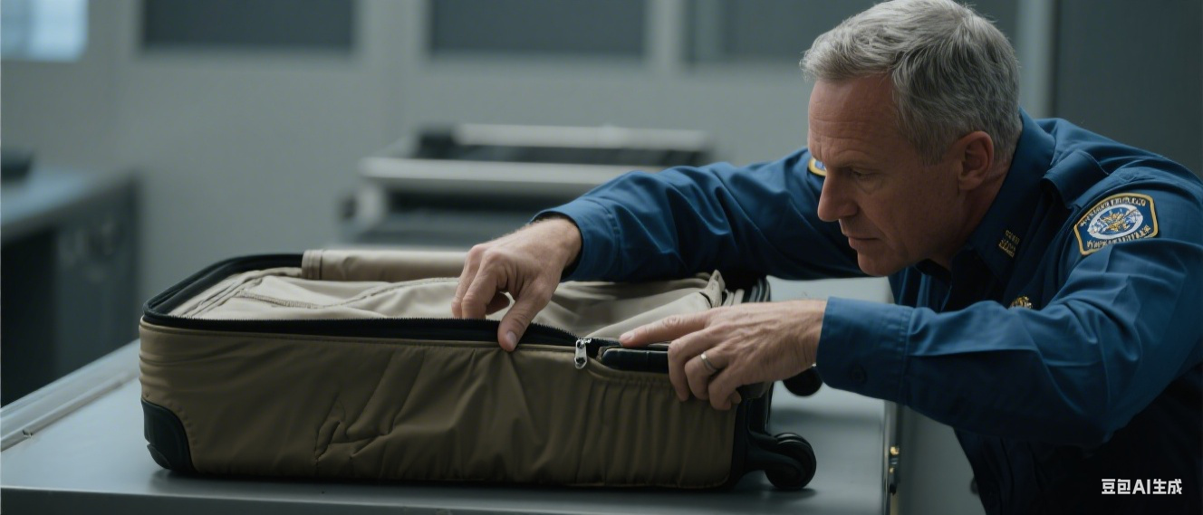
When the Customs Officer ... the man said that he had nothing to declare. The Officer asked the man to ...Although the case contained only ... and ... it was very heavy. This made the Officer suspicious, so he ... The case was soon empty and when the Officer ... he found that ... The Officer examined the case carefully and saw that ... He ... and removed the bottom part of the case which contained ... While the Officer was looking at ... the man tried to ... For a moment, the man disappeared among ... but he was soon ... and placed under arrest.
加入五感

Slide 30
When the Customs Officer approached the man at the Green Channel, he said he had nothing to declare.
The Officer asked him to open his suitcase, and as the man hesitated, a faint, unsettling smell of cologne lingered in the air.
Although the case contained only clothing and toiletries / ˈtɔɪlətriːz/ 洗漱用品, it felt unusually heavy.
This made the officer suspicious, so he decided to check it completely.
The case was soon empty and when the officer examined the case carefully and saw that the lining seemed loose and out of place.
He ran his fingers along the seams, feeling the smoothness of the fabric before detecting a subtle bulge beneath it, and removed the bottom part of the case which contained several neatly stacked bundles of cash, their crisp edges cold and firm to the touch.
While the Officer was looking at the hidden stash, the man tried to slip away quickly, his footsteps muffled by the crowd, his heart racing with fear.
For a moment, the man disappeared among the bustling travelers, but he was soon caught by the Officer, his wrist firmly gripped, and placed under arrest.

Slide 31
PART Eight
Story development

Slide 33
Para.1 As I finally zipped up my suitcase and prepared to leave, a sudden thought crossed my mind.
Para.2 As I walked through the crowded airport terminal, I couldn’t help but chuckle at how absurd the whole situation had been.

Slide 34
Para.1 As I finally zipped up my suitcase and prepared to leave, a sudden thought crossed my mind. I had narrowly avoided trouble with something as trivial as hair-oil. The Officer stood silently for a moment, still holding the bottle in his hand, the faint smell of the hair-oil lingering in the air. He seemed unsure whether to apologize for his initial suspicion or simply move on. "Next time, be sure to declare everything," he said with a slight grin, his voice laced with a mix of amusement and mild reproach. His eyes met mine, and for a brief moment, I saw an almost reluctant acknowledgment of the situation. With that, I nodded and quickly made my way toward the exit, feeling a sense of relief wash over me, the clattering sounds of the busy terminal now sounding faintly in the distance.
Para.2 As I walked through the crowded airport terminal, I couldn’t help but chuckle at how absurd the whole situation had been. I couldn’t help but chuckle at how absurd the whole situation had been. The memory of the Officer’s skeptical expression and the awkward moment of him sniffing the bottle stayed with me, as vivid as if it had just happened. It made me realize how easy it is for misunderstandings to arise, especially when it comes to Customs. The soft hum of the airport's fluorescent lights overhead, along with the bustling footsteps around me, reminded me how ordinary the experience seemed in comparison to how intense it had felt in the moment. Still, I was grateful for the experience—it was a reminder that even the smallest details could cause an uproar. With a deep breath, I left the Customs area behind, ready to continue my journey, this time a little more aware of what might lie ahead.

Slide 35
PART Nine
Vocabulary reinforcement

Slide 36
Word Bank
guiltily
guilty —— adv
feel guilty about (doing) sth. 对（做）某事感到内疚
be guilty of (sth./doing sth.) 犯有...罪；对...负有责任
The defendant decided to plead guilty to avoid a longer sentence.
被告决定认罪（plead guilty），以避免受到更长的刑期处罚。
2. tolerant /ˈtɒlərənt/ (adj.) 容忍的；宽容的——v 容忍 —— n忍受，容忍
A healthy society should be tolerant ____different opinions and _______(belief).
be tolerant of/towards sb./sth. 对某人/某事宽容
She refused to tolerate ______________( call) a liar.
tolerate doing sth.（容忍做某事）
3. declare /dɪˈkleə(r)/ (v.) 宣布；声明；申报——n声明，表白；
The government has declared war _____ illiteracy.
政府已宣布要扫除文盲。 declare war on/against（向...）宣战
declare sth. to customs 向海关申报某物
She declared her intentions emphatically /ɪmˈfætɪkli/, confidently, and unflinchingly.
她坚定、自信、毫不退缩地表明了她的意图。emphatically，强调地，有力地
tolerate
tolerance
of
beliefs
being called
declaration
on

Slide 37

4. hardened /ˈhɑːdnd/ (adj.) (因经历过很多艰苦而)铁石心肠的; 麻木不仁的
The hardened criminal showed no remorse for his actions.
这个冷酷无情的罪犯对自己的行为毫无悔意（remorse-adj remorseful-adv remorsefully）。
She was hardened to the harsh criticism and never let it affect her self-esteem.
她已经对严厉的批评变得麻木，从不让它影响自己的自尊心。
5. professional /prəˈfeʃənl/ (adj. & n.) 职业的；专业的；专业人士
反义词：业余的；业余爱好者；生手，外行
She is proficient in data analysis and statistical modeling.
她在数据分析和统计建模方面很熟练。
He is expert in/at conflict resolution and negotiation tactics.
他在冲突解决和谈判策略方面是专家。
He is preeminent in the field of theoretical physics, recognized for his groundbreaking research.
他在理论物理领域处于领先地位，以其开创性的研究而闻名。
The renowned scientist demonstrated unparalleled expertise in climate modeling, which was pivotal in shaping global environmental policies.
这位著名科学家展示了在气候建模方面无与伦比的专业知识，这对全球环境政策的形成起到了关键作用。
amateur

Slide 38
6. officious /əˈfɪʃəs/ (adj.) - self-important - arrogant
爱发号施令的；多管闲事的（贬义）
an officious manner 一副官僚做派
official 公务的；公职的；公事的；要员；官员；高级职员
professional 职业的，专业的；专业人员，专业人士 Professionalism [不可数]：职业素养
representative 典型的，有代表性的；代表
contemporary 当代的，现代的；同时代的人；同龄人，同辈
commercial 商业的；营利的；广告； Commercialism [不可数]：商业主义
classic 典型的，有代表性的；经典作品，杰作
individual 单独的，个别的；个人，个体；与众不同的人，有个性的人
local 当地的，地方的；局部的；当地人，本地人
advocate 提倡，主张，支持；拥护者，提倡者
witness 目击，亲眼看见；目击者；证人
contract 签订合同，收缩；合同
academic 学术的；（cn）学者
basic 基础的 ；基础知识
go / get back to basics 回归本原；返璞归真
Nurtured carefully, the business can once again get back to basics.
只要用心经营，公司可以重回正轨。

Slide 39
special 特别的 ；特价品/特别节目 specialty [可数]：专长
creative 有创意的 ；创意工作者 creativity [不可数]：创造力
creation [不可数] 创造 [可数] 作品；创作
essential 必需的 ; 必需品 essential [不可数]：本质（哲学）
original 原始的 ; 原作 . originality [不可数]：原创性
According to evaluation by the Palace Museum in Beijing, his jiyouhuang pieces are better than the Qing Dynasty ________ (original) in quality.
Throughout history, some of the _________ (origin) customs have changed, but the spirit of the festival-the spirit of family-has largely been kept.
________________ (original) it was a bedroom, but we turned it into a study.
He lacks ____________ (basic).
originals
original
Originally
basics

Slide 40

7. dreadful /ˈdredfl/ (adj.) 糟糕透顶的；可怕的
The presentation was dreadful, lacking both coherence and depth, leaving the audience uninterested and disengaged.
演讲极其糟糕，既没有连贯性，也没有深度，导致观众兴趣缺缺，心不在焉。
The news of the disaster hit him like a dreadful storm, overwhelming his senses and leaving him paralyzed/ˈperəlaɪzd/（使瘫痪，使麻痹）with fear. （比喻）
灾难的消息如同一场可怕的风暴袭来，压倒了他的感官，使他恐惧得无法动弹。
The dreadful silence in the room seemed to choke every breath, as if it were a living thing feeding on their anxiety.（拟人）
房间里那可怕的寂静似乎扼住了每一次呼吸，仿佛它是一个活生生的存在，吞噬着他们的焦虑。
The dreadful noise echoed through the hall, it shrieked, it groaned, it moaned, filling every corner with terror.（排比）
那可怕的噪音在大厅里回荡，它尖叫着，呻吟着，哀号着，充满了每个角落的恐惧。
How could anyone endure such a dreadful betrayal, where trust is shattered and hearts are torn apart?（反问）
谁能忍受如此可怕的背叛，信任被摧毁，心灵被撕裂？

Slide 41
dread v 畏惧，担心；n 害怕，畏惧；令人生畏的人，可怕的事物
The dread whispered in his ear, its icy fingers creeping up his spine as he approached the door."
恐惧在他耳边低语，它冰冷的手指沿着他的脊背爬升，当他接近那扇门时。
The dread of facing the final exam was so overwhelming that it felt as though the entire weight of the world was on his shoulders."
面对期末考试的恐惧如此压倒，以至于他觉得整个世界的重担压在了他肩上。
He dreaded the coming storm, the endless questions, the overwhelming responsibility."
他畏惧即将到来的暴风雨，无休止的质疑，无法承受的责任。
The joyous anticipation of the holiday was quickly overshadowed by the dread of the looming deadline.
假期的愉悦期待很快就被临近截止日期的恐惧所掩盖。
8. pounce /paʊns/ (v.) 猛扑；突然抓住
pounce on/upon sb./sth. 猛扑；突袭 /迅速采取行动，抓住机会（通常指人）
The fox pounced with stealth and speed, its red fur blending into the underbrush（= undergrowth下层灌木丛） as it snatched（grab） up the small bird.
狐狸以隐秘和迅速的方式扑向目标，红色的皮毛与灌木丛融为一体，快速抓住了那只小鸟。

Slide 42
The cheetah /ˈtʃiːtə/（猎豹） pounced like a coiled /ˈkɔːɪld/（ 盘绕的）spring, its powerful legs propelling it forward in a blur of speed.
猎豹像弹簧一样迅猛扑向猎物，强大的后腿使它在一瞬间加速，速度如闪电般快速。
The hawk pounced with deadly accuracy, its talons /ˈtælən/（猛禽的爪）piercing the air as it swooped down on the helpless rabbit.
鹰以致命的精准扑向猎物，利爪划破空气，俯冲下来抓住了毫无反抗能力的兔子。
swoop v 俯冲；突然袭击；（尤指鸟）猛扑
9. perfume /ˈpɜːfjuːm/ (n.) 香水；香气
wear perfume
喷香水（注意动词用 wear，不用 spray）
10. sar·cas·ti·cal·ly /sɑːˈkæstɪkli/ (adv.) 讽刺地；挖苦地—— adj. sarcastic
ironical 讽刺的；言辞中含有反语
It was ironical that the fire station burned down.
satirical 通过幽默、夸张或讽刺来批评社会、政治或人类愚蠢的行为。
The satirical cartoon mocked the government's handling of the crisis.
cynical 愤世嫉俗的
His cynical view of politics made him uninterested in voting.
derisive-mocking- contemptuous /kənˈtemptʃuəs/ - scornful-sneering 嘲讽的、嘲笑的、轻蔑的

Slide 43
11. exempt /ɪɡˈzempt/ (adj. & v.) 被免除的；免除
Employees with certain health conditions are exempt from the company's mandatory health screenings.
有特定健康状况的员工被豁免参加公司强制性的健康检查。（screening 熟词生义n筛查）
be exempt from sth. 被免除...
The law exempts people with disabilities from paying certain taxes.
exempt sb .from sth. 免除某人的...
这是一个非常正式的词，常与 tax（税）, duty（责任、关税）, rules（规则）等词搭配。
12. duty /ˈdjuːti/ (n.) 责任；职责；关税
on/off duty 值班/下班
it is sb's duty to do sth. 做某事是某人的责任
import/export/excise/consumption duties 进/出口关税/消费税
一词多义的高频考点！具体语境中判断是“责任”还是“关税”。
distribution channel 分销渠道
13. gel /dʒel/ (n. & v.) 凝胶；发胶；成形，变明确
Ideas were beginning to gel in my mind.
各种想法在我头脑里逐渐明朗起来。

Slide 44
As the project unfolded, the initial rough ideas gelled into a sophisticated design, ready to be implemented.
随着项目的展开，最初的粗略想法逐渐整合成了一个精致的设计，准备实施。
gel into 变成，发展为（通常指的是经过整合后形成某个清晰的形态或结果）
The new team members quickly gelled together, working seamlessly to meet the project deadline.
新加入的团队成员迅速融合在一起，无缝合作以满足项目截止日期。
14. unscrew /ˌʌnˈskruː/ (v.) 拧开；旋开；拧下…的螺丝
unscrew the lid/cap 拧开盖子/瓶盖
unscrew a bolt 拧开螺栓
Screw the bolt tight. 把螺栓拧紧。
I screwed up the letter and threw it into the fire.
~ sth up (into sth)~ sth (up) into sthto squeeze sth, especially a piece of paper, into a tight ball把（纸等）揉成一团
screw up-mess up slang 搞糟；搅乱；弄坏
unravel the complicated knot 解开绳子上复杂的结
unwind with a good book 放松
unzipped his jacket 拉开拉链
unleashed a storm of protest 引发了一场抗议

Slide 45
17. nostril /ˈnɒstrəl/ (n.) 鼻孔
the smell stung his nostrils 气味刺鼻（文学性表达）
flare your nostrils （生气或情绪激动时）鼻孔张大
The horse backed away, its nostrils flaring with fear. 马向后惊退，吓得鼻翼扇动。
The acrid stench of burning wood filled his nostrils, each breath a reminder of the destruction that had claimed his village."
刺鼻的烧木气味充满了他的鼻孔，每一次呼吸都提醒着他曾吞噬他村庄的毁灭。
不仅增强了感官细节，还通过气味的象征作用，使环境描写与人物的情感联系起来，突显了灾难带来的深刻影响。
Her nostrils flared with indignation /ˌɪndɪɡˈneɪʃn/ as she listened to the lies he spoke, a silent protest that spoke louder than words.
她的鼻孔因愤怒而张开，听着他说的谎言，这是一种无声的抗议，比言语更为有力。

Slide 46
用词汇正确形式填空
tolerate, unscrew, declare, professional, officious, dreadful, sarcastically
Her __________________ conduct at the meeting, constantly interrupting and correcting others, was a clear sign of her __________________.
After the scandal, the CEO was forced to make a public __________________ that he was innocent, but few believed him.
A true __________________ knows that __________________ is not just about skill, but also about integrity.
Oh, what a perfectly wonderful mess you've made," she said, her voice dripping with __________________.
The lid was rusted shut; it was completely immovable. I needed a tool to _______________ it.
The prospect of growing old fills me with _______. For me, the loneliness was ________.
This sort of behaviour will not _____________.
officious
officiousness
declaration
professional
professionalism
sarcasm
unscrew
dread
dreadful
be tolerated

Slide 47
feel guilty about, be guilty of, tolerant of, pounce on, be exempt from, begin to gel
The investigative committee was formed to determine whether the official could _______________ misconduct in office, a finding that would end his career.
The defense lawyer argued that his client, having acted in a moment of pure panic, should ________________ the most severe charges due to mitigating（ alleviate） circumstances.
The veteran journalist had a knack for ______________________ a single, seemingly insignificant detail in a press release and building a major story around it.
Seeing the old photograph made him ______________________ never visiting his grandfather more often before he passed away, a regret that lingered for years.
The complex plot of the novel only ______________________ in the final chapters, where all the scattered narrative threads finally coalesce into a coherent whole.
The community, once divided, is finally _____________a shared vision for its future, though consensus remains fragile.
knack
~ (of/for sth)~ (of/for doing sth)a special skill or ability that you have naturally or can learn（天生的或学会的）技能，本领
co·alescev. /ˌkəʊəˈles/ ~ (into/with sth) ( formal ) to come together to form one larger group, substance, etc.合并；联合；结合
be guilty of
be exempt from
pouncing on
guilty about
begin to gel
tolerant of

Slide 48



















Thank you！

