Slide 1


感恩遇见，相互成就，本课件资料仅供您个人参考、教学使用，严禁自行在网络传播，违者依知识产权法追究法律责任。
更多教学资源请关注
公众号：溯恩英语
知识产权声明

Slide 2
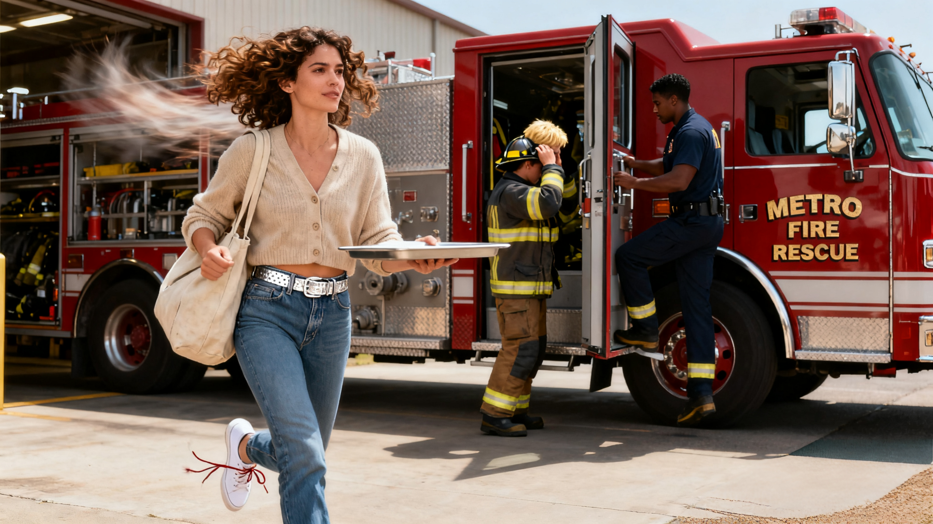
The Unfinished Lunch
2025-2026武汉高三九月调研考试读后续写

Slide 3
阅读下面材料，根据其内容和所给段落开头语续写两段，使之构成一篇完整的短文。
It was a typical busy noon at the downtown fast-food spot. The smell of sizzling patties and crispy fries lingered(弥漫)in the air, and the place was packed with folks rushing to grab a quick meal. I'd just gotten off a long morning at work, and my stomach was empty as I finally reached the front of the line and got my order—a burger, fries, and a cold drink.
As I set the tray(托盘)down on a small table by the window, I glanced over and saw two firefighters in the corner. Their uniforms were heavy with faint spots, like they'd just stepped away from a smoky scene, and their boots still held a hint of damp from the morning dew. They stood in the back of the line, shoulders relaxed but eyes tired.
I was just about to pick up my burger—the cheese melted perfectly—when a loud, sharp siren(警报)cut through the noise of the restaurant. The two firefighters froze for half a second, and then moved. No hesitation, no exchange of words—just muscle memory. One grabbed his helmet off the nearby counter, the other adjusted his radio on his shoulder, and they turned toward the door, their steps quickening. I watched them go, and my fork paused mid-air.
My empty stomach served as a quiet reminder of how long I'd waited for this meal. I'd stood in that line for 15 minutes, my feet aching from the morning's work. Giving them my lunch meant I would have to wait again—maybe another line, maybe my break slipping away faster. I bit my lip, staring at the tray. Then I thought of their uniforms, the spots, the way they'd act upon hearing the siren like it was a call they couldn’t ignore. They didn’t get to pause for a meal when emergencies hit. They'd probably go hours without eating, running from one call to the next.

Slide 4
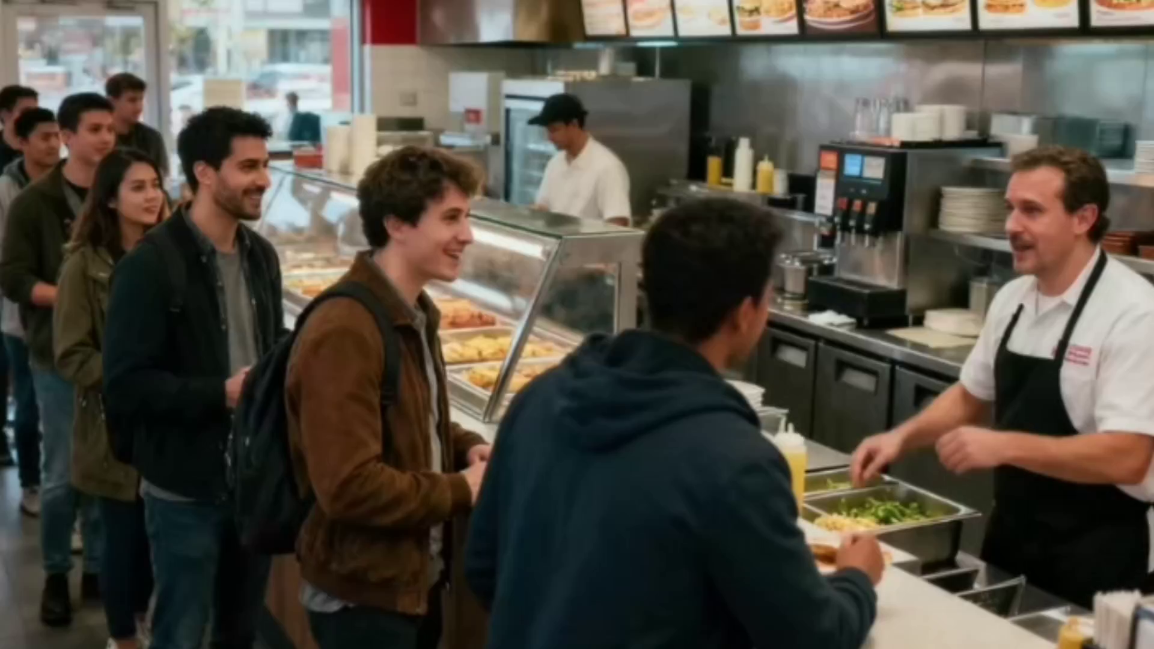

Slide 5
continuation writing
Para 1.
My hesitation melted away.
Para 2.
I went back to the counter;only to find the manager was waiting for me.
注意：
1.所续写短文的词数应为150左右；
2.续写部分分为两段，每段的开头语已为你写好.

Slide 6
Step 1
Reading
01
Elements of a Narrative Essay
Descriptive Details

Slide 7
Task 1 Skim the text and find out 5w1h
Time point: A weekday noon.
when
where
who
what
why
时间背景：这正是人们午餐休息、最为忙碌和匆忙的时刻。这个时间点选择得非常巧妙，因为它突出了每个人（包括叙述者和消防员）时间的紧迫性，为后面的矛盾冲突埋下伏笔。
Time context: This is exactly the time when people are on their lunch break, at their busiest and most rushed. The choice of this time is very skillful because it highlights the time urgency for everyone (including the narrator and the firefighters), foreshadowing the upcoming conflict.

Slide 8
Task 1 Skim the text and find out 5w1h
Specific location:
A downtown fast-food restaurant.
when
where
who
what
why
环境氛围：故事通过细节描写生动地再现了快餐店的典型环境：空气中弥漫着油炸食物的香味，店内人头攒动，人们行色匆匆。
Atmosphere: The story vividly recreates the typical environment of a fast-food restaurant through detailed descriptions: the air is filled with the smell of fried food, the place is crowded with people coming and going in a hurry.

Slide 9
Task 1 Skim the text and find out 5w1h
1.“我”：Very hungry, tired, and eager to enjoy a hard-earned meal. 非常饥饿、疲惫，渴望享受一顿来之不易的午餐。
2. 两位消防员：They have just finished a mission (evident from the stains on their uniforms and damp boots), exhausted but always on standby. Their silence and "muscle memory" actions reflect the professionalism and sacrifice inherent in their profession. 刚结束一次任务（制服上的污渍和湿靴子），疲惫不堪，但时刻保持待命状态。他们的沉默和“肌肉记忆”般的行动体现了其职业的专业性和牺牲精神。
3. 经理：He represents "community goodwill" and the idea that "good deeds are rewarded." His appearance resolves the external conflict (the narrator losing her lunch) and reinforces the story’s warm theme, completing a cycle of kindness. 观察力敏锐、富有同情心和感激之心。他是“社区善意”和“好人有好报”的体现者。他的出现解决了故事的外部矛盾（叙述者失去午餐），并强化了故事的温暖主题，让善行形成了一个完整的闭环。
Characters:
Narrator (“I”):An ordinary office worker who has just finished a busy morning.
Two Firefighters:Municipal emergency personnel.
The Manager:The person in charge of the fast-food restaurant.
when
where
who
what
why

Slide 10
Task 1 Skim the text and find out 5w1h
Contradiction (矛盾):
The core contradiction of the story is the internal conflict between the narrator's self-interest and the needs of others.
External manifestation: The hungry "I" wants to enjoy her meal vs. the possibly even hungrier firefighters who must perform their duties without time to eat.
when
where
who
what
why
故事的核心矛盾是叙述者内心的自我需求与他人需求之间的冲突。
外部表现：饥饿的“我”想要享用午餐 vs. 可能更饥饿的消防员需要执行任务而没空吃饭。
Deeper implications（深层内涵）：
Personal comfort vs. Selfless dedication: The narrator's personal right and comfort in waiting for her meal contrast with the firefighters' selfless sacrifice of their basic needs for the safety of others.
个人舒适 vs. 无私奉献：叙述者等待午餐的个人权利和舒适，与消防员为他人安全而牺牲个人基本需求的无私奉献形成对比。

Slide 11
Task 1 Skim the text and find out 5w1h
Theme (主题):
The theme of the story is the kindness, gratitude, and reciprocation among ordinary people in daily life, as well as the warmth of community spirit.
The transmission and cycle of goodwill: The story depicts a complete cycle of kindness: firefighters serve the community → the narrator is moved and shows kindness to them (giving her lunch) → the manager is moved and reciprocates kindness to the narrator (providing a new meal for free). This shows that goodwill is infectious and transmissible.
when
where
who
what
why
故事的主题是日常生活中平凡人的善良、感恩与回馈，以及社区精神的温暖。
善行的传递与循环：故事描绘了一个完整的善意循环：消防员为社区服务 → 叙述者被感动并向消防员表达善意（赠送午餐） → 经理被感动并向叙述者回馈善意（免费提供新午餐）。这表明善行具有感染力和传递性。

Slide 12

情节搭建的主要行为动作句式 (驱动故事发展的骨架):
1. 建立场景与状态的句式 (Setting the Scene)
"The smell... lingered in the air, and the place was packed with folks..."
功能： 使用感官动词 (lingered) 和状态描述 (was packed)，营造出忙碌、充满烟火气的具体氛围。
"Their uniforms were heavy with faint spots... and their boots still held a hint of damp..."
功能： 详细描述消防员的疲惫状态，为后文他们的奉献精神埋下伏笔，激发读者同情。
"They stood in the back of the line, shoulders relaxed but eyes tired."
功能： Stood 是一个状态动作，而 shoulders relaxed but eyes tired 这个独立主格结构进行了精准的对比刻画，生动地建立了人物形象。
细节描写

Slide 13
情节搭建的主要行为动作句式 (驱动故事发展的骨架):
1. 建立场景与状态的句式 (Setting the Scene)
"The smell... lingered in the air, and the place was packed with folks..."
功能： 使用感官动词 (lingered) 和状态描述 (was packed)，营造出忙碌、充满烟火气的具体氛围。
"Their uniforms were heavy with faint spots... and their boots still held a hint of damp..."
功能： 详细描述消防员的疲惫状态，为后文他们的奉献精神埋下伏笔，激发读者同情。
"They stood in the back of the line, shoulders relaxed but eyes tired."
功能： Stood 是一个状态动作，而 shoulders relaxed but eyes tired 这个独立主格结构进行了精准的对比刻画，生动地建立了人物形象。
细节描写

Slide 14
情节搭建的主要行为动作句式 (驱动故事发展的骨架):
2. 推动情节发展的动作句式 (Driving the Plot Forward)
"The two firefighters froze for half a second, and then moved."
功能： Froze (瞬间动作) 和 moved (后续动作) 的连续使用，精准描绘了人物从震惊到做出专业反应的瞬间。
"One grabbed his helmet off the nearby counter, the other adjusted his radio on his shoulder, and they turned toward the door, their steps quickening."
功能： 这是典型的连续动作句式。三个并列的动词短语 (grabbed..., adjusted..., turned...) 像电影镜头一样快速切换，最后用独立主格 (their steps quickening) 收尾，生动地再现了消防员训练有素、一气呵成的紧急出动场面，极大地增强了画面的动态感和紧迫感。这是情节发展的核心驱动力。
细节描写

Slide 15
情绪线--人物动作状态描写、情绪分析
1. 阶段一：疲惫的渴望 (Opening - Fatigue & Longing)
"my stomach was empty"（我）；"shoulders relaxed but eyes tired" - 消防员
• 情绪分析：这个对比强烈的细节不仅描述了消防员的状态，也 subtly (微妙地) 为叙述者后来的共情埋下了种子。读者和叙述者都能感受到他们平静外表下的疲惫。
2. 外部的震惊与职业的触动 (Inciting Incident - Shock & Awe）
• "No hesitation, no exchange of words—just muscle memory." (没有犹豫，没有交换言语——只是肌肉记忆。)
• 情绪分析： 这是情绪转变的关键。叙述者的情绪从看热闹的震惊，迅速转化为对这种绝对专业、绝对果断的敬佩 (awe) 和惊叹。
细节描写

Slide 16
情绪线--人物动作状态描写、情绪分析
3. 内心的挣扎与共情 (Rising Action - Inner Conflict & Empathy)
• 动作描写"my fork paused mid-air" (我的叉子停在了半空中)
•情绪分析： 这是全文的情绪支点和最精彩的动作细节。一个简单的肢体动作 paused，极其传神地外化了内心的震动、犹豫和思考的开始。外在动作的停止，标志着内在情绪斗争的正式开始。
4. 坚定的决心与升华的释然 (Climax & Resolution - Determination & Elevated Resolution)
• 动作描写："My hesitation melted away." (我的犹豫消失了。)
• 情绪分析： melted away 这个比喻非常巧妙，形容犹豫像冰块一样消融，体现出一种突然的、彻底的释然和清晰。情绪瞬间变得坚定。
细节描写

Slide 17
Step 2 Plot Construction
情节搭建
02

Slide 18
Task 3: Find some clues that can be used
段落 | 关键线索 | 续写中可体现为
第一段 | 消防员迅速离开 steps quickening | “我”的动作要快：冲出去、呼喊
 | 消防员疲惫但敬业eyes tired; muscle memory | 他们的反应：短暂惊讶、疲惫的微笑、简短感谢
第二段 | 餐厅繁忙 packed with folks | 经理在场并目睹一切的理由
 | “我”的饥饿与不愿等待 empty stomach；feet aching | “我”回柜台时预期的负面情绪（与后续形成反差）
 | 无直接线索，需推断 | 经理的赞赏和慷慨行为（免费食物），完成善意循环
 | 生理饥饿与情感满足 | 结尾强调心理满足感，食物变得更有意义

Slide 19
Task 2 Analyze the given text by this model
After a fierce internal conflict between her own hunger and the firefighters' greater sacrifice, she decided to offer them her lunch.
Climax
What will happen after the climax？
A sudden alarm triggered the firefighters' instinctive, hurried departure, causing the narrator to pause mid-meal.
Build-up
Resolution
STORY
MOUNTAIN
The narrator, exhausted and hungry, finally got her lunch in a crowded fast-food restaurant and noticed two tired firefighters.
Opening
Ending

Slide 20
Task 4 : Raise some questions
Para 1. My hesitation melted away.
1. How does the protagonist catch up with the departing firefighters? What are her specific actions?
2. What are the specific reactions of the firefighters (facial expression, words, actions) when the protagonist offers them her lunch?
3. How is this exchange completed against the backdrop of the wailing siren? What is the atmosphere like?
消防员步伐加快 (their steps quickening)，引擎可能已启动。她需要快速行动——是抓起整个托盘冲出去，还是快速把食物包起来？
他们很疲惫但专业 (eyes tired, no exchange of words)。反应可能是短暂的惊讶，随后是一个疲惫而真诚的微笑，并可能有一句简短的感谢。
警报声 (loud, sharp siren) 制造了紧迫感。对话可能很短，被警报声淹没，但情感交流是真切的。

Slide 21
Task 4 : Raise some questions
Para 2. I went back to the counter;only to find the manager was waitingfor me.
1. Why is the manager waiting there? What did he see?
2. What does the manager say to the protagonist? What is his attitude and tone?
3. How does the manager reward the protagonist's kind act? How does this ending elevate the theme?
餐厅很忙，经理可能在巡视。他很可能目睹了主角冲出去给消防员送食物的全过程。
经理的角色是社区善意的代表。他的语气应该是赞赏的、温暖的，可能表示他看到主角的行为很感动。
最直接的方式是提供一份新的免费食物 (on the house)。这完成了“善意的循环”，表明善行会得到认可和回报，强化了社区互爱的主题。

Slide 22
Step 3
Lexical and Syntactic Chunk Accumulation
语料句式积累
03

Slide 23
一、语块积累 (Lexical Chunks)
linger in the air 弥漫在空气中
packed with folks 挤满了人
cut through the noise 划破了噪音
get off work 下班
shoulders relaxed but eyes tired 肩膀放松但眼神疲惫
freeze for half a second 僵住了半秒钟
No hesitation, no exchange of words 没有犹豫，没有交换言语)
muscle memory 肌肉记忆
steps quicken 步伐加快
pause mid-air 停在半空中
hesitation melted away 犹豫消失了

Slide 24
二、 高级句式 (Advanced Structures)
1. 并列与平行结构 (Parallelism)
• "No hesitation, no exchange of words—just muscle memory."
◦ 分析： 两个否定短语平行并列，后用破折号引出强有力的肯定结论。节奏短促，铿锵有力，强调了消防员反应的迅速和本能。
2. 独立主格结构 (Absolute Phrase)
• "...they turned toward the door, their steps quickening."
◦ 分析：their steps quickening 是一个经典的独立主格结构（名词 + 非谓语动词）。它用来修饰主句，描述主语“他们”转身时的伴随状态（步伐加快），使句子信息量更丰富，画面更具动感。
3. 复合句与状语从句 (Complex Sentences & Adverbial Clauses)
"I'd just gotten off a long morning at work, and my stomach was empty as I finally reached the front of the line..."
分析： 这是一个由 and 连接的并列复合句，后半句又包含一个由 as 引导的时间状语从句。多层次的从句结构清晰地交代了背景、状态和时间的先后关系。

Slide 25
Step 4
Reference Model Essay and Appraisal
参考范文及评析
04

Slide 26
Paragraph 1: My hesitation melted away. My hands were a little shaky, but I walked over to them quickly, catching up just as they reached the door. "Wait!"I shouted. They turned, surprised, their helmets still in their hands.“Here,”I said, holding out the tray.“You need this more than I do. I'm not in a rush —but you are.”They thanked me repeatedly and took the lunch. I stood by the door, watching them run toward the fire truck, their uniforms fading into the distance, a sense of relief lingering in my chest.
第一段： 我的犹豫瞬间消失了。我的双手有些颤抖，但我快步走向他们，在他们刚到门口时追上了。“等一下！”我喊道。他们转过身，面露惊讶，手中还拿着头盔。“这个给你们，”我说着，递出托盘，“你们比我更需要。我不赶时间——但你们赶。”他们连连道谢，接过了午餐。我站在门边，望着他们跑向消防车的背影，他们的制服逐渐消失在远方，一种释然之感在我心中久久盘旋。
第二段： 我走回柜台，却发现经理正在等我。“你刚才的做法真的很暖心，”她笑着说道。当我伸手掏钱包想再买一个汉堡时，她摇了摇头：“这样的善意不该没有回报。”一股暖流席卷了我，泪水几乎模糊了视线。我端着新餐点回到座位，咬下一口——这比我很久以来吃过的任何东西都更美味。那天，我不仅仅喂饱了两个人。我更成为了一个善意循环的一部分——这种循环让这个繁忙、凌乱的世界变得温柔了一些。
Paragraph 2: I went back to the counter, only to find the manager waiting for me.“That was really nice of you,"she said with a grin. When I reached for my wallet to pay for a new burger, she shook her head.“Kindness like that shouldn't go unrewarded. "A wave of warmth washed over me, and tears nearly blurred my vision. Sitting back down with my fresh meal, I took a bite —and it tasted better than anything I'd had in a long time. That day, I didn’t just feed two people. I became part of a circle of kindness—the kind that makes this busy, messy world feel a little softer.

Slide 27
一、情节设计分析 (Plot Design Analysis)
1. 衔接自然 (Seamless Connection):
◦ 首句 My hesitation melted away 直接对应原文最后的内心斗争，承上启下，转折流畅。
◦ 动作 walked over to them quickly, catching up just as they reached the door 时间点抓得恰到好处，制造了轻微的紧张感，仿佛再晚一秒就来不及了，使故事节奏紧凑。
2. 对话简练有力 (Concise and Powerful Dialogue):
◦ 对话 "You need this more than I do. I'm not in a rush —but you are." 直接回应了原文中的矛盾（自己的等待 vs 对方的紧急），不仅解释了行为动机，更体现了叙述者对消防员工作的深刻理解，一句话就升华了行为的意义。
3. 结局闭环与升华 (Closed Loop and Elevated Ending):
◦ 经理的出现和奖励构成了一个完美的“善意循环”（circle of kindness），解决了叙述者失去午餐的现实问题，符合“好人有好报”的普世价值观，让读者感到慰藉和满足。
◦ 没有停留在“获得免费午餐”这一表面，而是通过最后一句 I became part of a circle of kindness将个人行为置于更广阔的层面，使情节主题得到升华。

Slide 28
二、主题深化技巧 (Theme Deepening Techniques)
续写部分通过具体的情节和细腻的感受，将原文的主题从“个人善举”深化为“社群善意”与“世界的美好”。
1. “循环”概念的引入 (Introduction of the "Circle" Concept):
◦ a circle of kindness 是点题之笔。这个比喻生动地描绘了善意的传递性：
■ 消防员： 服务社群（善意1）■ 叙述者： 感激并帮助消防员（善意2）■ 经理： 赞赏并奖励叙述者（善意3）这个循环表明，善意可以流动和扩大，从而强化了整个故事温暖的核心主题。
2. 情感落点的提升 (Elevation of the Emotional Endpoint):
◦ 结尾 makes this busy, messy world feel a little softer 将一顿快餐的体验，提升到了改变世界感受的高度。它传递了一个充满希望的信念：即使世界繁忙混乱，但个人的微小善行却能为其增添一丝柔软和温情。这使得故事的结局不仅仅是“皆大欢喜”，更是“发人深省，内心温暖”。

Slide 29
三、心理描写亮点 (Highlights of Psychological Description)
续写的心理描写并非直白倾诉，而是融于动作、感官和比喻之中，非常高级和动人。
1. 通过身体反应表达复杂情绪 (Expressing Complex Emotions through Physical Reactions):
◦ My hands were a little shaky： “手微微颤抖”精准描绘了做出决定后的紧张激动和不确定，真实可信。
◦ tears nearly blurred my vision： “泪水模糊了视线”远比“我很感动”更有力量。
◦ a sense of relief lingering in my chest： “释然之感在胸中徘徊” – relief 一词表明做完决定并付诸行动后，内心的纠结和压力得以释放，是一种轻松而满足的状态。
2. 通过感官体验隐喻心理变化 (Metaphoring Psychological Changes through Sensory Experiences):
◦ it tasted better than anything I'd had in a long time： “味道比很久以来的任何食物都好” 这是最精彩的心理描写。它隐喻着：因善意而获得的回报，在精神上的愉悦远胜于物质上的满足。
3. 内心独白点明主旨 (Inner Monologue to Highlight the Theme):
◦ 最后的思考 I didn’t just feed two people. I became part of a circle of kindness... 是画龙点睛的内心独白。它清晰地展示了叙述者对自己行为意义的深刻认知和反思，成功地将整个故事的心理历程推向了最高点——自我实现。

Slide 30
Chain of Love
The "Chain of Love" shows how kindness grows when shared—even small acts can inspire others to pay it forward. As Mother Teresa said, “I can cast a stone across the waters to create many ripples.” We are all part of this chain. Martin Luther King Jr. reminded us that we are “tied in a single garment of destiny.” By lifting others up, we also nurture ourselves and build a more compassionate world. It starts with one choice: to choose empathy over indifference. Gandhi’s call to “be the change you wish to see” is a practical guide to strengthening this eternal chain.
“爱之链”表明，善意在分享时会不断增长——即便是微小的举动也能激励他人传递善意。正如特蕾莎修女所说：“我虽独身一人，却也能投石入水，激起万千涟漪。”我们都是这链条中的一环。马丁·路德·金曾提醒我们，我们“同穿一件命运之衣”。通过助人向上，我们也在滋养自己，共同建立一个更有同理心的世界。这一切始于一个选择：以关怀代替冷漠。甘地呼吁“欲变世界，先变其身”，这正是巩固这条永恒链条的实践真谛。

