Slide 1


感恩遇见，相互成就，本课件资料仅供您个人参考、教学使用，严禁自行在网络传播，违者依知识产权法追究法律责任。
更多教学资源请关注
公众号：溯恩英语
知识产权声明

Slide 2
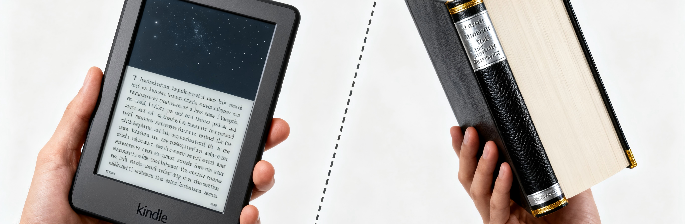

Whether the Library Should Buy E-books ?
—2025~2026学年度武汉市部分学校高三年级九月调研考试

Slide 3
Aspect
Key Points
Analyze
Genre
Reader
Writing Puporse
Content
Tense
Person
Tone
Speech
你校正在开展“学校图书馆是否应该购买电子书刊”的讨论。请你写一篇发言稿，在英语课堂作课前分享。 内容包括:
(1) 表达看法；
(2) 说明理由。
The teacher and classmates in an English class
To express and justify a chosen position
To stimulate thought and contribute to the class discussion
States an opinion and lists reasons（such as convenience, updates, eco-friendliness, and diversity）
Simple Present Tense (main)
Good morning,everyone!
I, we,you
Formal and polite, persuasive yet friendly

Slide 4

Construct
Greeting(Given)+background information
Opening
State your position clearly
express opinion
Body
reasons for your choice
?
benefits/drawbacks
Closing
Summarize/anticipate+appreciate

Slide 5

Practice
Greeting(Given)+background information
Opening
State your position clearly
Version 1
Good morning,everyone! On the issue of whether the library should buy e-books and e-magazines, my firm belief is that the library has a responsibility to modernize its collection.(表语从句)
Version 2
Good morning,every one! When it comes to whether the library should buy e-books and e-magazines, I firmly believe that integrating/embracing digital resources is a crucial strategic move for the library's future.（宾语从句，doing作主语）
Version 3
Good morning,everyone! Our school is talking about whether the library should buy e-books and e-magazines. From my perspective, I don’t support this idea.

Slide 6






Brainstorm
Who will be beneficial from the e-books?
What are the benefits for each group?
01
Students
Convenience, Speed, Free Access, Ease of Use, Eye Protection, Learning Effectiveness方便、快捷、免费、易用、保护视力、学习效果
Library
Budget, Space, Management Efficiency, Preservation, Loan Processes预算、空间、管理效率、书籍保存、借阅流程
02
Librarians
Long-term Investment Value, Modern Image of the School, Resource Sustainability长期投资的价值、学校的现代化形象、资源的可持续性
03
School
04
Society & Environment
Environmental Protection, Social Equity (Ensuring Access for All Students)环保、社会公平（确保所有学生都能访问）

Slide 7




Brainstorm
What are the drawbacks for each group?
01
Students
Require personal devices需要自有设备
Cause eye strain导致眼睛疲劳
Create distractions容易分散注意力
Library
02
Librarians
Need to learn new skills需要学习新技能
Increase long-term expenses增加长期开支
Require infrastructure upgrades需要升级基础设施
Depend on external platforms依赖外部平台
03
School

Slide 8
Practice
Closing
Summarize/anticipate+appreciate
Version 1
I truly believe this small change will make our campus reading better. That’s all. Thanks for listening!
Version 2
In conclusion, I am convinced that printed books still work better for most of us students. Thanks for listening!
Version 3
In short/To conclude/Utimately, adding e-books prepares our library and students for a promising digital future.Thanks for listening!

Slide 9

Official Writing One
Good morning, everyone. I’m greatly honored to share my thoughts on the topic.“Should the school library buy e-books and e-magazines?” Personally, I’m quite excited about this plan. Digital e-books can cover textbooks, English novels, and popular magazines, fitting different students’ needs. Not only do they save space in the library, but also offer convenient access to us. Moreover, they usually come with interactive features like audio and video, making reading more engaging.
I truly believe this small change will make our campus reading better. That’s all. Thanks for listening!
大家早上好。我很荣幸能就“学校图书馆是否应该购买电子书和电子杂志？”这一话题分享我的看法。个人而言，我对这个计划感到非常兴奋。数字电子书可以涵盖教科书、英文小说和流行杂志，满足不同学生的需求。它们不仅节省图书馆空间，还为我们提供了便捷的获取方式。此外，它们通常还带有音频和视频等互动功能，使阅读更加引人入胜。
我真心相信这一小小的改变会让我们的校园阅读变得更好。谢谢聆听！

Slide 10
Official Writing Two
Good morning, everyone! Our school is talking about whether the library should buy e-books and e-magazines. From my perspective, I don’t support this idea.
First, reading e-books, which requires looking at screens for long periods of time, will definitely does harm to our eyes. Besides, the use of e-books needs a campus network, which can be unstable sometimes, leading to difficulty in reading them. If it stops working, we can’t read e-books at all — but printed books are still accessible.
In conclusion, I am convinced that printed books still work better for most of us students. Thanks for listening!
大家早上好！我们学校正在讨论图书馆是否应该购买电子书和电子杂志。就我个人而言，我不支持这个想法。
首先，阅读电子书需要长时间盯着屏幕，这肯定会对我们的眼睛造成伤害。此外，使用电子书需要校园网络，而网络有时可能不稳定，导致阅读困难。如果网络中断，我们根本无法阅读电子书——但纸质书仍然可以阅读。
总之，我相信纸质书对我们大多数学生来说仍然更实用。谢谢聆听！

Slide 11
Sample Writing
Good morning,every one! When it comes to whether the library should buy e-books and e-magazines, I firmly believe that integrating/embracing digital resources is a crucial strategic move for the library's future.
To begin with, it enables us to gain instant access to a vast digital collection,allowing us to study anytime anywhere, thereby significantly enhancing learning efficiency. Furthermore,teachers benefit from the real-time updated academic resources, enabling them to incorporate the latest research findings into their teaching materials.
To conclude,adding e-books prepares our library and students for a promising digital future.Thanks for listening!
大家早上好！关于图书馆是否应该购买电子书和电子杂志的问题，我坚信引入数字资源是图书馆未来发展的关键战略举措。
首先，数字资源使我们能够即时获取海量电子馆藏，让我们可以随时随地进行学习，从而显著提高学习效率。此外，教师也能从实时更新的学术资源中受益，能够将最新研究成果融入教学内容。
总之，引进电子书将为我们的图书馆和学生迎接充满希望的数字化未来做好准备。谢谢聆听！

Slide 12
Accumulate
In Favor of E-Books:
Digital resources integration
Crucial strategic move
Instant access to vast digital collection
Study anytime anywhere
Enhance learning efficiency
Real-time updated academic resources
Incorporate latest research findings
Prepare for digital future
Interactive features (audio/video)
Make reading more engaging
Save space in library
Convenient access
Fit different needs
Make campus reading better
Against E-Books:
Harm to eyes
Look at screens for long periods
Unstable campus network
支持电子书：
数字资源整合
关键战略举措
即时获取海量数字馆藏
随时随地学习
提升学习效率
实时更新的学术资源
融入最新研究成果
迎接数字化未来
交互功能（音频/视频）
使阅读更有吸引力
节省图书馆空间
便捷访问
满足不同需求
改善校园阅读
反对电子书：
伤害眼睛
长时间看屏幕
不稳定的校园网络

Slide 13
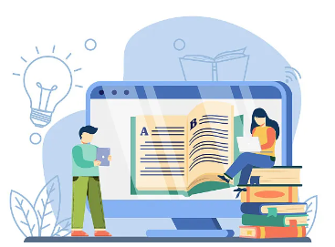
Homework
(2025.3广州一模)
学校英语俱乐部计划在“世界读书日”举行英文演讲比赛，主题是“实体书店是否会消失？”请你写一篇英文演讲稿，内容包括：
1.你的看法；
2.你的理由。

Slide 14
Sample Writing
Will Physical Bookstores Disappear?
Good morning,every one! In this digital-dominated era,thriving as online reading seems, I believe that physical bookstores are far from extinction.
Physical bookstores offer immersive experience that digital platforms cannot replicate. Imagine that you flip/leaf through the pages with faint smell of paper and ink, all the worry will vanish into thin air.Meanwhile, as a social and cultural space, the physical bookstore is a paradise for bookworms.It features multiple activities, like author signings, reading salons and book clubs, hence collecting the like-minded to exchange unique insights.Moreover, its aesthetic and emotional appeal cannot be overlooked.It will evoke a sense of nostalgia, reminding us of the timeless joy with a book in our hands.
Physical bookstores are not merely places to buy books; they are cultural sanctuaries, community hubs, and irreplaceable treasures in our digital world.With the exceptional charm, physical bookstores are here to stay.
实体书店是否会消失
在这个数字主导的时代，尽管在线阅读看似蓬勃发展，但我认为实体书店远不会消失。
实体书店能提供一种沉浸式的体验，这是数字平台无法复制的。想象一下，你翻动着散发着淡淡纸墨香的书页，所有的烦恼都会烟消云散。与此同时，作为一个社交和文化空间，实体书店是书虫们的天堂。这里会举办多种活动，比如作家签名会、读书沙龙和读书俱乐部等，因此志同道合的人聚集在一起，交流独到的见解。此外，实体书店的美学价值和情感吸引力也不容小觑。它会唤起怀旧感，让我们想起手捧一本书时的喜悦。
实体书店不仅仅是买书的地方，它们是文化圣地，社区中心，也是我们数字世界中不可替代的珍宝。凭借其独特的魅力，实体书店将会一直存在下去。

Slide 15

Thank you!

