Slide 1



感恩遇见，相互成就，本课件资料仅供您个人参考、教学使用，严禁自行在网络传播，违者依知识产权法追究法律责任。
更多教学资源请关注
公众号：溯恩英语
知识产权声明

Slide 2


活用教材词汇，靶向高考写作
B3U1单词拓展
Festivals And Celebrations

Slide 3
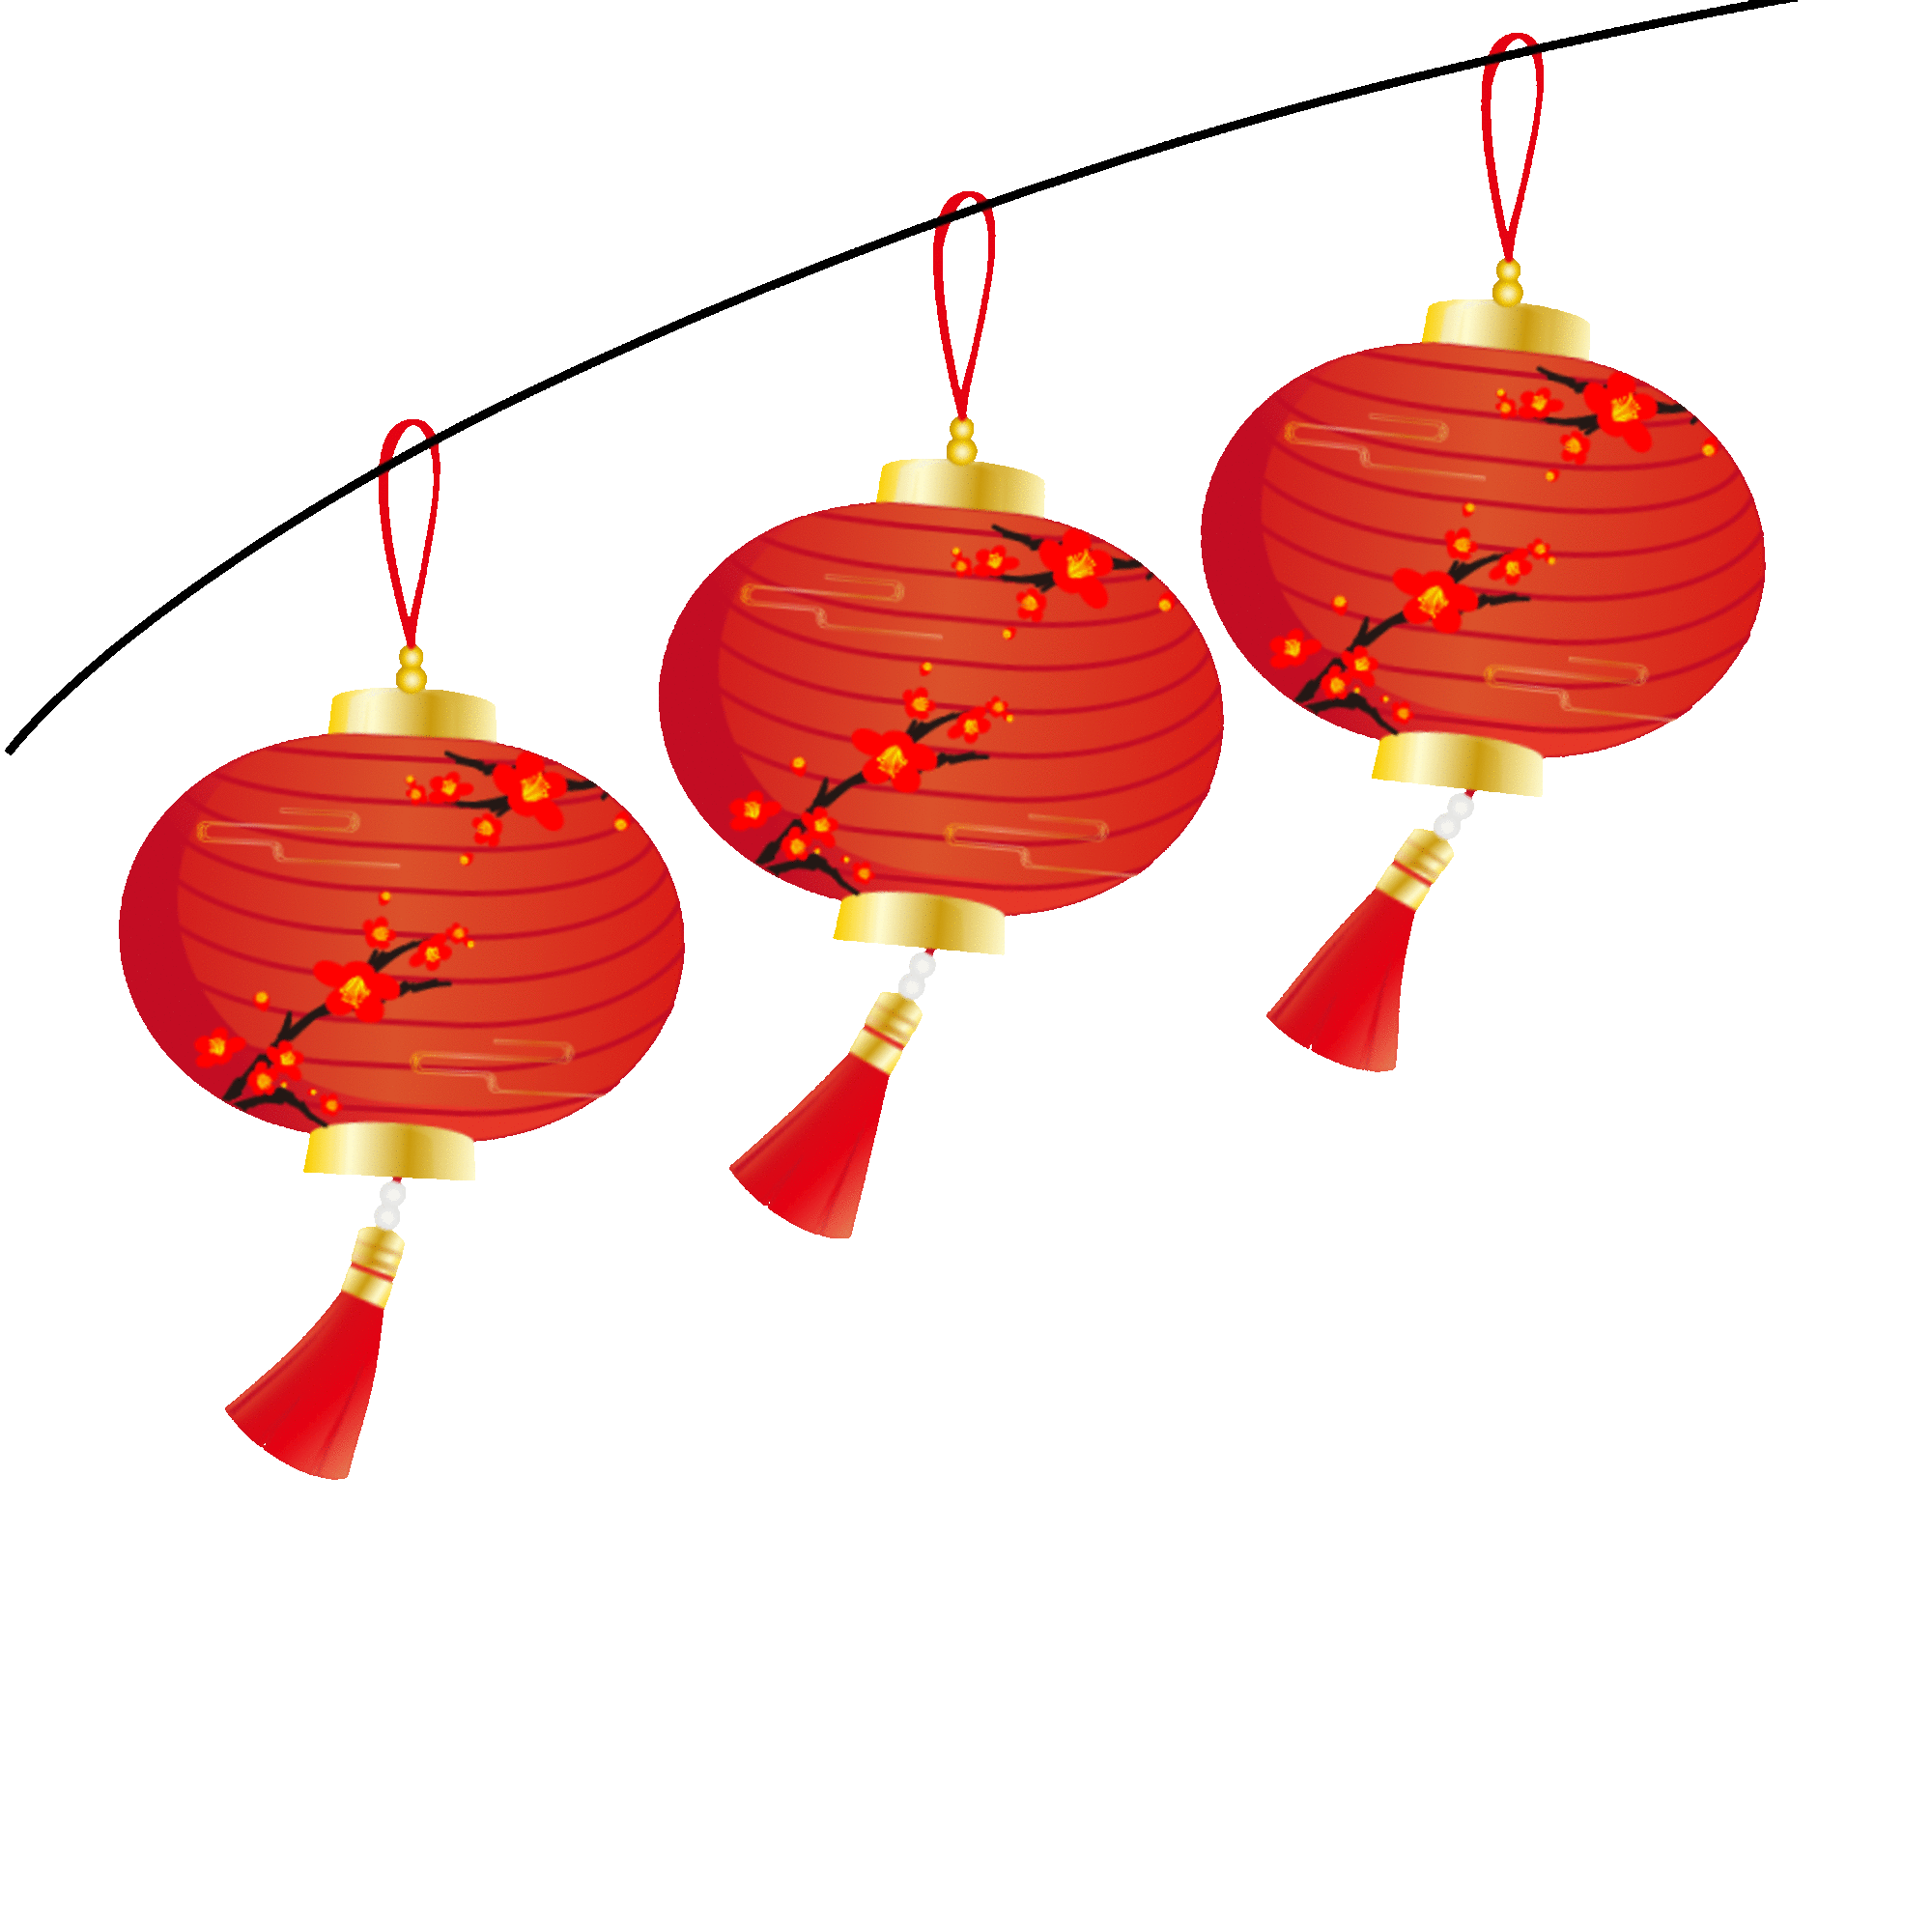
活用词汇
lantern /ˈlæntən/ n.灯笼;提灯
1. 在春节期间，人们用红灯笼和春联装饰房子，呈现出节日的气氛。(应用文)
During the Spring Festival, red lanterns and Spring Festival couplets are used to decorate a house, presenting a festive atmosphere.
2.晚饭后，我们去公园欣赏美丽的灯笼，这是元宵节的亮点所在。两条巨龙灯特别引人注目，我们情不自禁地拍照。(应用文)
After the dinner, we went to the park to appreciate the beautiful lanterns, the highlight of this Lantern Festival. Two huge dragon lanterns especially caught our eyes and we couldn't help flashing our cameras.

Slide 4

活用词汇
carnival /ˈkɑ:nɪvl/ n.狂欢节;嘉年华
1. 大街上有舞龙、舞狮和其他一些狂欢活动，而中央电视台举办的盛大的春节联欢晚会是你不能错过的。(应用文)
In the street appear the dragon and lion dance and some other carnival activities,while the grand Spring Festival Gala held by CCTV is what you can’t miss.

Slide 5
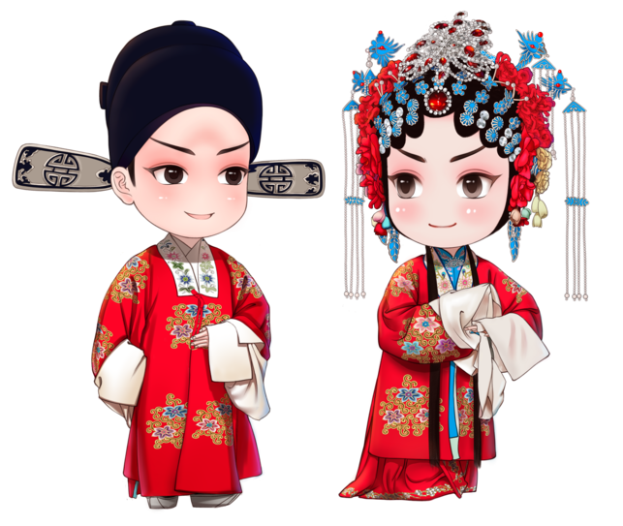

活用词汇
costume /ˈkɒstju:m/ n.(某地或某时期)服装;戏装
1. 多德勒·巴格想起了他妈妈有一次万圣节穿过的旧蜜蜂服装。(续写)
Doodlebug recalled the old bee costume that his Mom wore for Halloween once.
2. 在我看来，最吸引人的部分是那些华丽的服装和妆容。(应用文之推荐中国戏曲鉴赏 (Appreciation of Chinese Opera))课)
The most attractive part, in my opinion, is the fancy costumes and makeup.

Slide 6
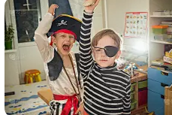
活用词汇
dress ... up /dres ʌp/ 穿上盛装;装扮
1.她给孩子们穿上了最漂亮的衣服。(续写)
She dressed the children in their best clothes.
2. 她一向全身黑色装束。(续写)
She always dressed entirely in black.
3. 这些男孩子都装扮成了海盗。(续写)
The boys were all dressed up as pirates.

Slide 7
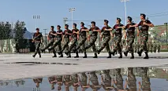
活用词汇
march /mɑ:tʃ/ vi.&n.行进;前进;示威游行
1. 她毅然走过来，要我向她道歉。(续写)
She marched over to me and demanded an apology.
2.士兵在政府大楼外面来回练习队列行进。(续写)
Soldiers were marching up and down outside the government buildings.

Slide 8

活用词汇
congratulation /kənˌgrætʃuˈleɪʃn/ n.祝贺;恭喜
congratulate /kənˈgrætʃuleɪt/ vt.向(某人)道贺;感到自豪
1. 演出结束后不久，我的家人来到后台祝贺我。(续写)
Soon after the show, my family came backstage to congratulate me.
2. 她向他虚情假意地微微一笑表示祝贺。(续写)
She flashed him a false smile of congratulation.
3. 我衷心地祝贺你在英语演讲赛中获得第一名。( 应用文写作之祝贺信)
I’d like to offer my sincere congratulationto you on your winning the first place in the English Speech Competition.

Slide 9

活用词汇
congratulation /kənˌgrætʃuˈleɪʃn/ n.祝贺;恭喜
congratulate /kənˈgrætʃuleɪt/ vt.向(某人)道贺;感到自豪
4. 首先，我对你在演讲比赛中取得的成功表示衷心的祝贺。(应用文写作之祝贺信)
Firstly，I express my sincere congratulations on your success in the speech contest.
=To begin with， I congratulate you sincerely on your success in the speech contest.

Slide 10
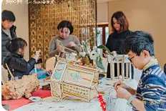
活用词汇
riddle /ˈrɪdl/ n.谜语;神秘事件
1.人们聚在一起欣赏五彩斑斓的灯笼，猜灯谜。(应用文)
People get together to enjoy colorful lanterns and play riddle games.
2. 接下来，我们将专注于设计灯笼以及创作英语谜语。(应用文)
As for the next step, we will focus on designing lanterns and making English
riddles.

Slide 11

活用词汇
ceremony /ˈserəməni/ n.典礼;仪式
1. 在过去的三年里，我的高中经历了许多丰富多彩的活动，其中成人礼尤其令人难以忘怀。(应用文之“An Unforgettable Activity in High School”主题征文活动)
My high school has witnessed many colorful activities in the past 3 years, among which the coming-of- age ceremony is especially unforgettable.
2. 在婚礼上，她遇到了一位举止得体的男士。(续写)
At the wedding ceremony, she met the man with good manners.

Slide 12

活用词汇
after all /ˈɑ:ftə(r) ɔ:l/ 毕竟;别忘了
1. 批评者认为太空探索代价高昂，但人类无法放弃对宇宙的好奇——我们终究是天生的探索者。(应用文)
Critics argue that space exploration is costly, yet humanity cannot abandon its curiosity about the universe; we are, after all, natural explorers.
2. 有人称人工智能威胁人类就业，但历史提醒我们：技术革命终究会创造新机遇。(应用文写作之申请信)
Some claim artificial intelligence threatens human jobs, but history reminds us that technological revolutions, after all, have always created new opportunities.

Slide 13
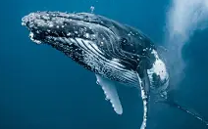
活用词汇
range /reɪndʒ/ n.一系列;范围 vi.包括
1. 坦率地说，课堂之外学习英语的方法有很多，但重要的是找到一个最适合你的方法。（2022年全国乙卷）
Frankly speaking, there are a wide range of ways to learn English beyond the class, but it is important to find one that suits you best.
2. 那里的活动种类繁多，从观赏鲸鱼到徒步旅行都有，而且住宿设施也致力于对自然环境的影响降到最低。(2021年全国乙卷)
Activities there range from whale watching to hiking and accommodations aim to have a low impact on the natural environment.

Slide 14
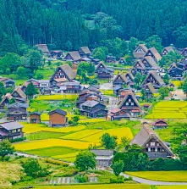
活用词汇
origin /ˈɒrɪdʒɪn/ n.起源;起因;出身
1. 如今，当我走过一丛鲜花或一棵枝繁叶茂的树木时，我能够真正领略到其美丽之处以及它的生长环境。(应用文)
Now, as I walk past a shrub of flowers or a leafy tree, I can genuinely appreciate its beauty and origin.
2. 作为其中的一位参与者，我被这些精美的艺术品以及创作者的独特创意深深吸引住了。(应用文)
As one of the participants, I was really spellbound by these elegant artworks and the originality of their creators.
3. 我们诚邀所有学生提交展现家乡独特文化、迷人风景和鲜明特色的原创照片及文字作品。(应用文)
We invite all students to submit original photos and texts showcasing the unique cultures, scenic beauty, and distinctive characteristics of their hometowns.

Slide 15
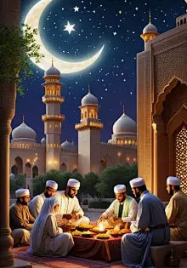
活用词汇
religion /rɪˈlɪdʒən/ n.宗教;宗教信仰
religious /rɪˈlɪdʒəs/ adj.宗教的;笃信宗教的
1. 历史课上，我们探讨了古代宗教如何塑造早期文明的法律与传统。(应用文)
In our history class, we discussed how ancient religions shaped early civilizations’ laws and traditions.
2.校图书馆有关于不同宗教的书籍，帮助学生理解文化多样性。(应用文)
The school library has books about different religions, which helps students understand cultural diversity.
3.学校尊重所有宗教节日，允许学生分享排灯节或圣诞节等传统。(应用文)
Our school respects all religious festivals, allowing students to share traditions like Diwali or Christmas.

Slide 16

活用词汇
figure /ˈfɪgə(r)/ n.人物;数字;身材 vt.认为
1. 她一向体态秀美。(续写)
She's always had a good figure.
2. 只有通过均衡的饮食和规律的锻炼，你才能既保持体形又保持健康。(应用文)
Only by means of balanced diets and regular exercise can you keep your figure and stay healthy.
3. 那个可怕的身影消失在森林后,汤姆的心狂跳不止，一路跑回了家。(续写)
The terrible figure disappeared into the forest, after which Tom ran all the way home, his heart wildly beating.

Slide 17

活用词汇
charm /tʃɑ:m/ n.魅力;迷人的特征;咒语
1. 他具有不可否认的魅力。(续写)
He had undeniable charm.
2.他有一副迷人的微笑。(续写)
He was gifted with a charming smile.

Slide 18
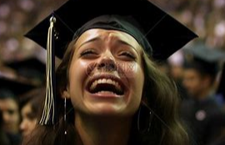
活用词汇
joy /dʒɔɪ/ n.高兴;喜悦
joyful /ˈdʒɔɪfl/ adj.高兴的;快乐的
1. 使他感到非常高兴的是她接受了。(续写)
To his great joy, she accepted.
2. 孩子们欣喜若狂。(续写)
The children are wild with joy.
3. 我欢欣鼓舞，流下了快乐的泪水。(续写)
I exulted and wept for joy.

Slide 19
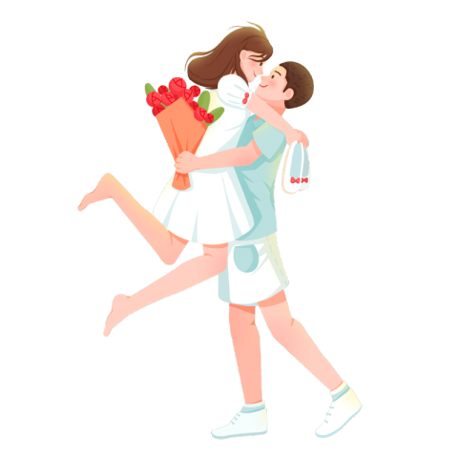
活用词汇
gratitude /ˈgrætɪtju:d/ n.感激之情;感谢
1. 他向他们笑了笑表示谢意。(续写)
He smiled at them with gratitude.
2. 她的双臂紧紧搂住他的脖子，充满感激。(续写)
Her arms tightened about his neck in gratitude.

Slide 20
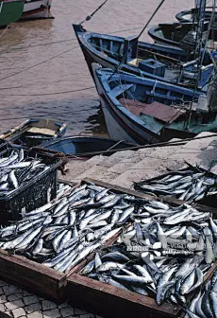
活用词汇
harvest /ˈhɑ:vɪst/ n.收获季节;收获 v.收割
1. 中秋节源于古代农耕文化，传统上为庆祝丰收表达感恩。(应用文)
The Mid-Autumn Festival, rooted in ancient farming culture, traditionally celebrates gratitude for a bountiful harvest.
2.过度捕捞已严重消耗海洋资源，迫使某些物种濒临灭绝。(应用文)
Overfishing has severely harvested marine resources, pushing some species toward extinction.

Slide 21
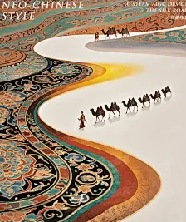
活用词汇
agricultural /ˌæɡrɪ'kʌltʃərəl/ adj.农业(劳动/生产)
agriculture /ˈægrɪkʌltʃə(r)/ n.农业;农艺
1. 现代农业日益依赖无人机和人工智能监测作物生长，大幅提升生产力。(应用文)
Modern agriculture increasingly relies on drones and AI to monitor crop growth, significantly boosting productivity.
2.农业无人机不仅节省人力成本，还能通过精准灌溉减少水资源浪费(应用文)
。
Agricultural drones not only save labor costs but also reduce water waste through precise irrigation.
3. 丝绸之路不仅是贸易路线，更是古代文明间农业技术交流的桥梁。(应用文)
The Silk Road was not only a trade route but also a bridge for exchanging agricultural techniques between ancient civilizations.

Slide 22
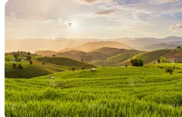
活用词汇
crop /krɒp/ n.庄稼;作物;一季的收成
1. 他有一头浓黑鬈曲的短发。(续写)
He had a thick crop of black curly hair.
2. 河谷里种满了庄稼。(续写)
The river valley is intensively cropped.

Slide 23
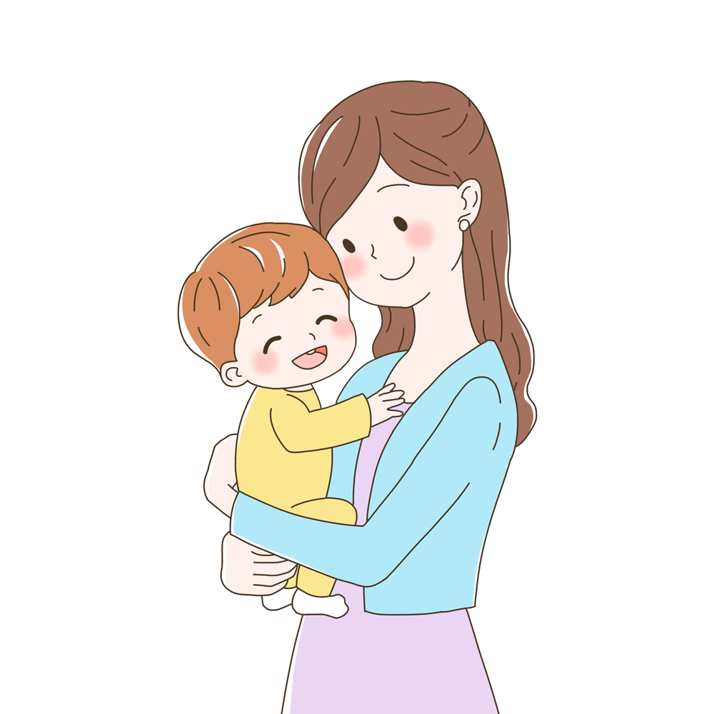
活用词汇
gather /ˈgæðə(r)/ vi.聚集;集合 vt.聚集;搜集
1. 她提起裙摆就跑。(续写)
She gathered up her skirts and ran.
2. 她把孩子拉过来紧紧抱在怀里。(续写)
She gathered the child in her arms and held him close.
3. 他把她拉到身边。(续写)
He gathered her to him.
4. 我坐下片刻积蓄力量。(续写)
I sat down for a moment to gather my strength.
5. 门打开时她还勉强要自己集中精神。(续写)
She was still trying to gather her thoughts together when the door opened.
6. 幸运的是，这短暂的拖延给了他喘息的时间。(续写)
Fortunately the short delay gave him time to gather himself.

Slide 24
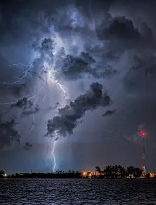
活用词汇
gather /ˈgæðə(r)/ vi.聚集;集合 vt.聚集;搜集
7. 很快就聚集起了一群人。(续写)
A crowd soon gathered.
8.孩子们被聚集在一间屋子里。(续写)
The kids were gathered together in one room.
9. 卡车加快了速度。(续写)
The truck gathered speed.
10. 暴风雨乌云正在聚集。(续写)
The storm clouds were gathering.
11. 他用披风把身子裹紧。(续写)
He gathered his cloak around him.

Slide 25

活用词汇
grateful /ˈgreɪtfl/ adj.感激的;表示感谢的
1. 凯特感激地对他笑了笑。(续写)
Kate gave him a grateful smile.
2. 他感激地点了点头。(续写)
He nodded gratefully.

Slide 26

活用词汇
feature /ˈfi:tʃə(r)/ vt.以…为特色 n.特色
1. 她容貌中最引人注目的是她的双眼。(续写)
Her eyes are her most striking feature .
2.学校文化节将以传统舞蹈为特色，旨在提升对非物质文化遗产的认知。(应用文)
The school’s cultural festival will feature traditional dances, aiming to promote awareness of intangible heritage.
3. 辩论赛将聚焦人工智能伦理话题，鼓励学生批判性思考。(应用文)
The debate competition will feature topics on AI ethics, encouraging critical thinking among students.

Slide 27

活用词汇
decorate /ˈdekəreɪt/ vt.装饰;装潢
1. 他们用花和气球装饰了房间。(续写)
They decorated the room with flowers and balloons.
2. 春联、窗花等传统春节装饰品承载着辞旧迎新的深刻文化寓意。(应用文)
Traditional Spring Festival decorations like red couplets and paper-cuttings carry profound cultural meanings of hope and renewal.
3. 为庆祝中秋节，教室挂满手工纸灯笼，营造出温暖的文化氛围。(续写)
The classroom was decorated with handmade paper lanterns for the Mid-Autumn Festival, creating a warm cultural atmosphere.

Slide 28

活用词汇
church /tʃɜ:tʃ/ n.(基督教的)教堂;礼拜堂
1. 沐浴在金色的晨曦中，教堂静静矗立在山顶，钟声在山谷回荡，仿佛在低语几个世纪未曾诉说的故事。(续写)
Bathed in the golden glow of dawn, the church stood silently at the hilltop, its bell echoing across the valley, as if whispering centuries of untold stories.
2.若非志愿者们努力保护这座历史悠久的教堂，这一文化瑰宝恐已湮没于尘埃。(续写)
Had it not been for the volunteers' efforts to protect the historic church, this cultural treasure would have faded into oblivion.

Slide 29

活用词汇
significant /sɪgˈnɪfɪkənt/ adj.有重大意义的;显著的
1. 你的工作有了显著改进。(应用文)
Your work has shown a significant improvement.
2. 设立世界海洋日是为了让人们意识到保护海洋是很重要的。(2022年全国甲卷)
World Oceans Day was set up to make people aware that protecting the oceans is very significant/is of great significance.
3. 我认为在学校锻炼身体很重要，因此我们学生必须积极、按时上体育课。(应用文)
I attach great significance to working out at school， so we students must have PE classes actively and punctually.

Slide 30

活用词汇
fade /feɪd/ vi.&vt.逐渐消失;(使)褪色
fade away /feɪd əˈweɪ/ 逐渐消失;(身体)变得虚弱
1. 天上的颜色都退去了。(续写)
All colour had faded from the sky.
2. 窗帘已经给晒退了色。(续写)
The curtains had faded in the sun.
3. 笑声逐渐消逝。(续写)
The laughter faded away.
4. 她的笑容逐渐消失。(续写)
Her smile faded.
5. 所有的记忆，曾与我很近，都变得模糊。(续写)
And all of the memories, so close to me, just fade away.
6. 在那一瞬间，一天的工作忧虑都消逝了。(续写)
In that instant, the worries of my day at work fade away.

Slide 31
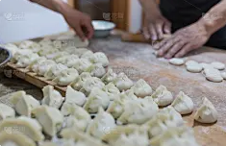
活用词汇
typical /ˈtɪpɪkl/ adj.典型的;有代表性的
1. 你知道，每个节日都有自己的典型食品，端午节也不例外。吃粽子，一种由竹叶包的蒸熟的大米，是你不能错过的。(应用文)
You know, every festival has its own typical food, and the Dragon Boat Festival is no exception. Eating zongzi, boiled rice wrapped by bamboo leaves, is what you can’t miss.
2. 另外，你们将有机会学习如何包饺子，这是一个典型的中国习俗，我相信你们一定会从中感受到快乐。(应用文)
In addition, you will have a chance to learn how to make dumplings, which is a typical Chinese custom, where I believe you are sure to have great fun.

Slide 32

活用词汇
evil /ˈi:vl/ adj.邪恶的;有害的 n.邪恶
1. 传统上，中国结被人们认为能够驱邪并具有辟邪的魔力，被视为吉祥的象征。(应用文)
Traditionally, Chinese knots are expected to drive off evil spirits and act as lucky charms.
2. 他努力保护弱者和无权者，凭借自己的智慧和勇气与邪恶势力进行斗争。(续写)
He manages to protect the weak and the powerless, fighting against the evil with his wisdom and bravery.
3. 当她念出这些台词时，她感觉自己仿佛进入了女巫的角色之中，仿佛这个角色已经占据了她的身体，她不再只是在表演，而是完全成为了那个邪恶的女巫。(续写)
As she spoke the lines, she felt herself slip into the role of the witch, as if the character had taken over her body, and she was no longer just acting but completely becoming the evil witch.

Slide 33

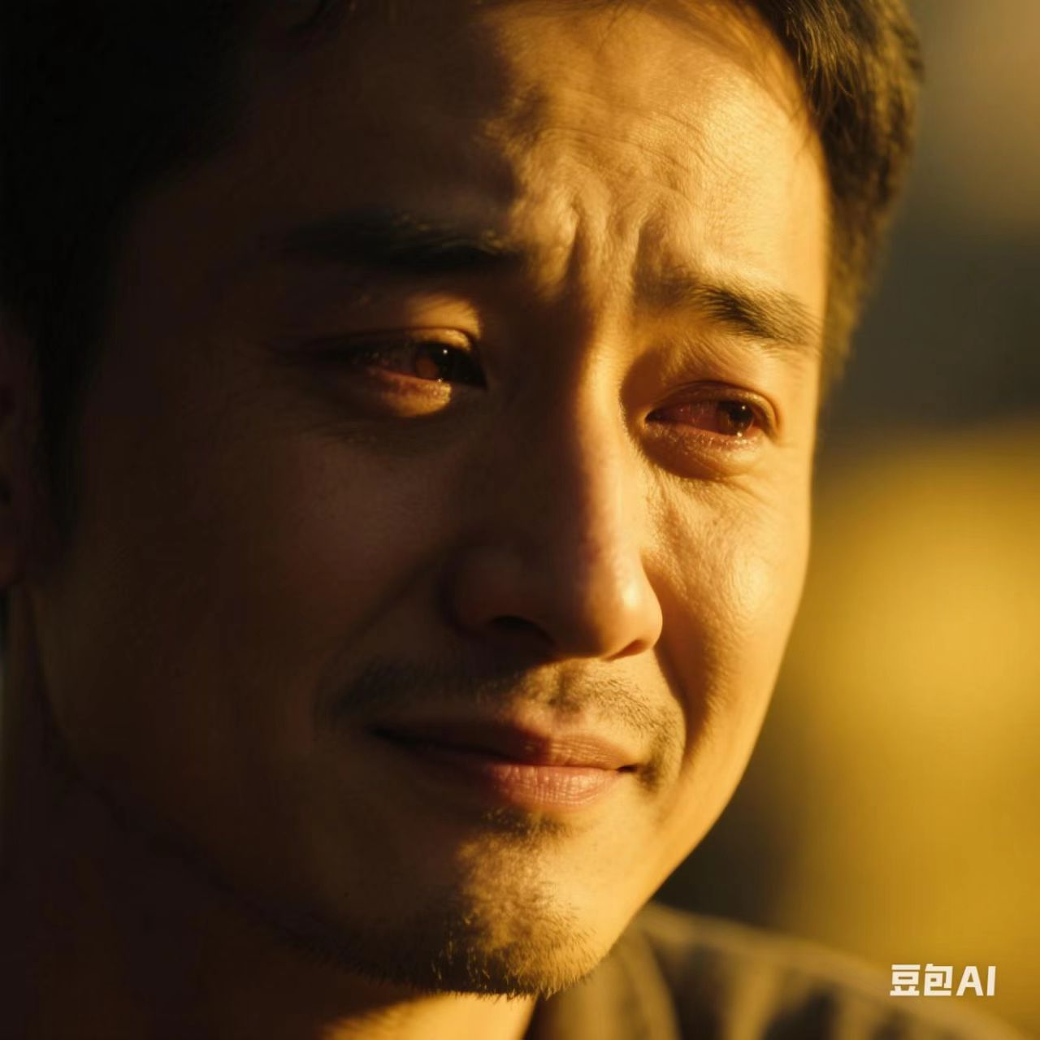
活用词汇
in spite of /ɪn spaɪt əv/ 不管;尽管
1. 尽管表面看似镇静，我内心却非常慌乱。(续写)
In spite of my outward calm I was very shaken.
2. 尽管他很失望，他还是勉强露出一丝淡淡的微笑。(续写)
In spite of his disappointment, he managed a weak smile.

Slide 34

活用词汇
commercial /kəˈmɜ:ʃl/ adj.商业(化)的
1. 如果没有这些外来务工人员的辛勤付出，上海不可能成为这样一个商业中心和金融中心。(应用文)
Shanghai couldn't have been such a commercial hub and financial center but for the sweat these migrant workers have shed.

Slide 35

活用词汇
take advantage of /teɪk ədˈvɑ:ntɪdʒ əv/ 利用;欺骗; 占…的便宜
1. 利用空闲时间骑自行车对我们的健康和环境都有很大的好处。(应用文写作之环境保护)
Taking advantage of free time to ride a bike is of great benefit to our health as well as the environment.
2. 我想借此机会向您表示衷心的感谢，感谢您的帮助。(应用文写作之感谢信)
I would like to take advantage of this chance to express my thanks for your help.

Slide 36
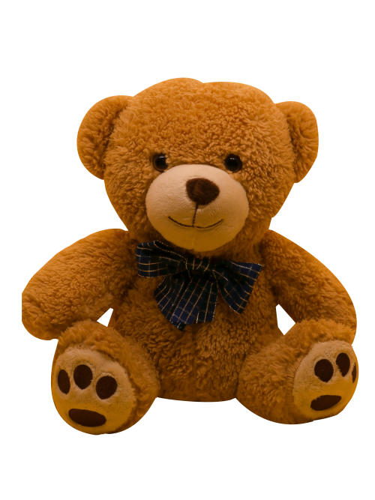
活用词汇
medium /ˈmi:diəm/ n.媒介;手段 adj.中等的
the media /ðə ˈmi:diə/ 大众传播媒介
1. 预计在未来几年，中国经济将保持中速增长，因此在电影产业的投资以及优质电影的数量方面都有可能增加。(应用文)
China’s economy is expected to grow at a medium speed in the coming years, so an increase is possible in the investment in the movie industry and the number of quality movies.
2. 阳光是一只中等大小的棕色泰迪熊，脸上挂着温暖的微笑。(续写)
Sunshine is a medium-sized, brown teddy bear with a warm smile stitched onto its face.
3. 于是保罗决定通过社交媒体来查找其主人的信息。(续写)
Then Paul decided to tum to social media to identify its owner.

Slide 37
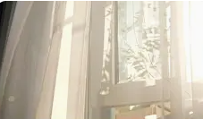
活用词汇
reflect /rɪˈflekt/ vt.显示;反映;反射
1. 他的脸映照在镜子里。(续写)
His face was reflected in the mirror.
2. 她在他的眼中看到了自己的样子。(续写)
She could see herself reflected in his eyes.
3. 窗户反射着午后明媚的阳光。(续写)
The windows reflected the bright afternoon sunlight.
4. 经过几天的认真思考，她决定回信。(续写)
After days of reflection she decided to write back.
5. 听到我的话，他垂下了头，陷入沉思之中。(续写)
At my words, he hung his head, lost in deep reflection.

Slide 38

活用词汇
belief /bɪˈli:f/ n.信仰;信心;信任
1. 他说的话难以置信。(续写)
What he said is beyond belief.
2. 尚克利粗犷的脸上掠过一副完全不信任的表情。(续写)
A look of pure disbelief crossed Shankly's rugged face.
3. 他摇头表示不信。(续写)
He shook his head in disbelief.
4. 她既惊愕又难以置信地盯着他。(续写)
She gazed at him in horrified disbelief.

Slide 39

活用词汇
faith /feɪθ/ n.宗教信仰;信任;相信
1. 她朋友的善意使她恢复了对人性的信心。(续写)
Her friend's kindness has restored her faith in human nature.
2. 她对人性的善良和天性的诚实有着不可动摇的信心。(续写)
She had an unshakable faith in human goodness and natural honesty.

Slide 40
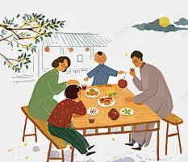
活用词汇
occasion /əˈkeɪʒn/ n.特别的事(或仪式、庆典)
1. 我曾见过他几次。(续写)
I've met him on several occasions.
2. 中秋节是一个家庭团聚的特殊时刻。(应用文)
The Mid-Autumn Festival is a special occasion for a family reunion.
3. 虽然在毕业之际我感到有点难过，但我还是要衷心感谢你对我英语学习的帮助。(应用文)
Although on the occasion of graduation, I feel a bit upset, I want to send my sincere gratitude for your kind help with my English learning.
4. 令我高兴的是，他似乎逐渐开始接纳我了，而且偶尔还会和我分享他的想法。(2022年浙江卷续写)
To my delight, he seemed to accept me little by little, and would occasionally share his ideas with me.

Slide 41

活用词汇
have sth. in common /həv ˈsʌmθɪŋ ɪn ˈkɒmən/(兴趣、想法等)相同
1. 若非我们拥有如此多的共同点，这次跨文化交流项目绝不可能弥合学生间的隔阂。(应用文)
Had it not been for the fact that we have so much in common, the cross-cultural exchange program would never have bridged the gap between the students.
2. 尽管看似截然不同，老画家与年轻科学家却有一个共同点：对未知永无止境的好奇，最终让他们缔结了意想不到的友谊。(续写)
Though they appeared to be polar opposites, the old painter and the young scientist had one thing in common: an insatiable curiosity about the unknown, which eventually drew them into an unlikely friendship.
3.人们很少意识到，他们推崇的传统手工艺与现代数字艺术有着超乎表象的共同点：皆源于创造力与耐心。(应用文)
Little do people realize that the traditional handicrafts and modern digital art they admire have more in common than meets the eye: both are born from creativity and patience.

Slide 42
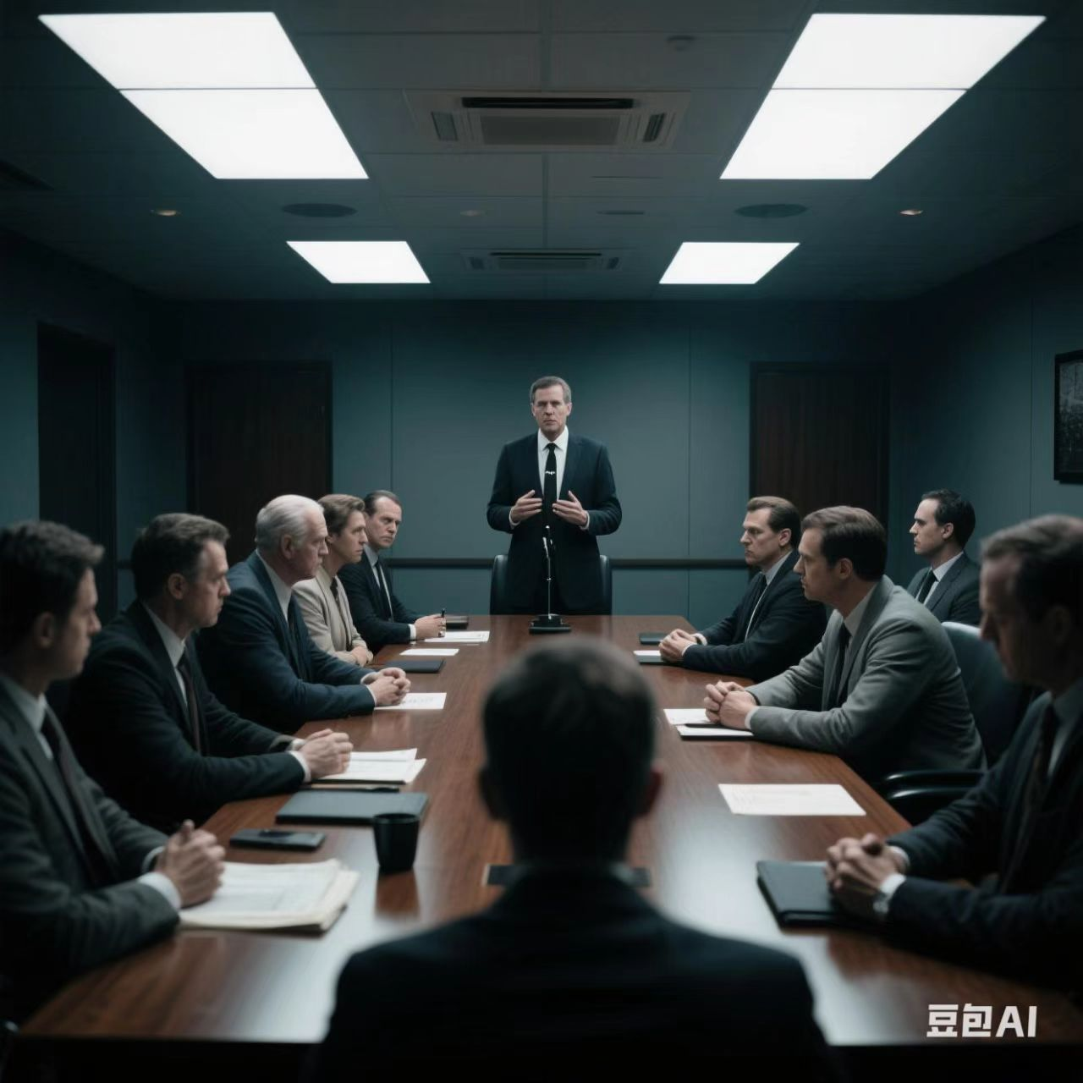
活用词汇
atmosphere /ˈætməsfɪə(r)/ n.气氛;氛围;(地球)大气层
1. 屋子里的气氛不对了。(续写)
The atmosphere at the house soured.
2. 气氛顿时紧张了起来。(续写)
The atmosphere crackled with tension.

Slide 43
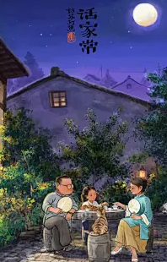
活用词汇
lunar /ˈlu:nə(r)/ adj.阴历的;月球的;月亮的
1. 那一晚的月亮在整个阴历月内看起来最亮。我们最喜爱的是一家人一起欣赏满月的时刻。(续写)
The moon that night looks the brightest in the whole lunar month. What we love most is the time when the whole family enjoy the full moon together.

Slide 44
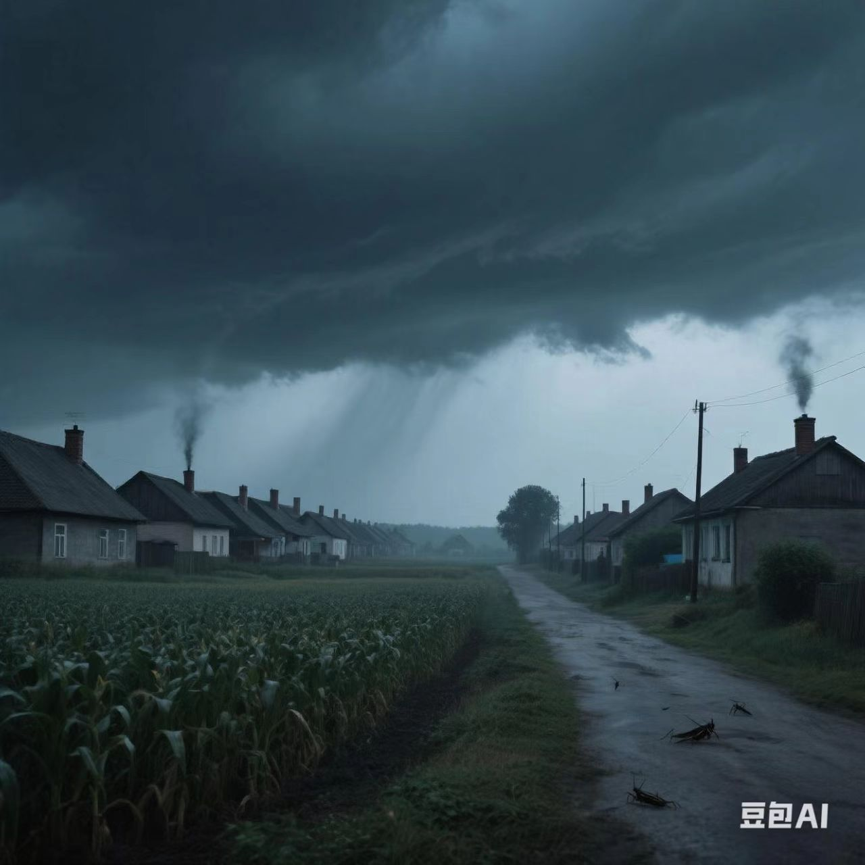
活用词汇
eve /i:v/ n.前夕;前一天
1. 春节前夕，社区中心将举办文化集市，展示传统手工艺和民俗表演，让居民沉浸在节日喜悦中。(应用文)
On the eve of the Spring Festival, the community center will host a cultural fair featuring traditional crafts and folk performances, offering residents a chance to immerse themselves in festive joy.
2. 除夕夜的年夜饭不仅能增进亲情，更承载着中华文化遗产的精髓。(应用文)
Not only does the family reunion dinner on the eve of Lunar New Year strengthen bonds, but it also carries the essence of Chinese cultural heritage.
3. 暴风雨前夕，村庄一片寂静，街道空无一人，窗户紧闭，仿佛在为即将到来的混乱屏息凝神。(续写)
The village lay quiet on the eve of the storm, its streets deserted and windows tightly shut, as if holding its breath for the impending chaos.

Slide 45
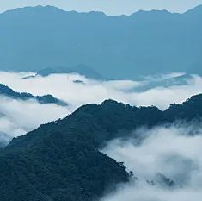

活用词汇
envelope /ˈenvələʊp/ n.信封;塑料封套
1. 森林那种美妙、馥郁的香气笼罩了我们。(续写)
That lovely, rich fragrant smell of the forest enveloped us.
2. 云雾笼罩着山顶。(续写)
Clouds enveloped the mountain tops.
3. 房里是一片黑暗。(续写)
And darkness enveloped the house.

Slide 46
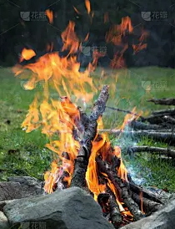
活用词汇
merry /ˈmeri/ adj.愉快的;高兴的
1. 她轻轻地哼着一首欢快的小曲儿。(续写)
She was humming a merry little tune.
2. 从房子里传出阵阵欢快的笑声。(续写)
From the house come bursts of merry laughter.
3. 篝火正在欢快地熊熊燃烧着。(续写)
The log fire was blazing merrily.
4. 克里斯开心地仰天大笑。(续写)
Chris threw back his head and laughed merrily.

Slide 47
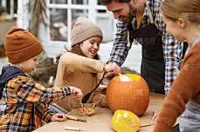
活用词汇
pumpkin /ˈpʌmpkɪn/ n.南瓜
1. 在万圣节雕刻南瓜是一项家庭传统活动。(续写)
Pumpkin carving at Halloween is a family tradition.
2. 现在我不太明白自己当初为何会认为把脑袋伸进南瓜里就能解决问题，但当时我觉得这么做确实很有道理。(2021年1月浙江卷)
I'm unsure now why I thought forcing my head inside the pumpkin would settle the matter, but it seemed to make perfect sense at the time.

Slide 48

活用词汇
pleased /pli:zd/ adj.高兴的;满意的
1. 她对考试成绩非常满意。(续写)
She was very pleased with her exam results.
2. 上司应该对你满意了。(续写)
The boss should be pleased with you.
3. 你觉得好些了，我真高兴。(续写)
I'm really pleased that you're feeling better.
4. 听到你的消息我很高兴。(续写)
I'm pleased to hear about your news.
5. 看他好像吃了一惊，她感到开心。(续写)
She had the pleasure of seeing him look surprised.

Slide 49

活用词汇
firework /ˈfaɪəwɜ:k/ n.烟花;[pl.]烟花表演
1.孩子们盼望着收到压岁钱，一起高兴地玩耍，兴奋地放烟火。(应用文)
The children are looking forward to receiving lucky money, playing happily with each other, and setting off fireworks excitedly.
2. 天空中绽放出绚烂的烟花，这一令人惊喜的景象将夜晚照得灯火辉煌。(续写)
The sky erupted in a cascade of fireworks, a spectacle of surprise that illuminated the night with its brilliance.
3. 春节前，人们会精心准备许多活动，比如包饺子和放烟花。(应用文)
Prior to the Spring Festival, lots of activities will be well-prepared, such as making dumplings and setting off fireworks.

Slide 50
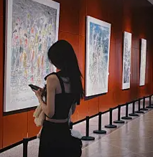
活用词汇
frank /fræŋk/ adj.坦率的;直率的
1. 那些谈话不留情面地坦率。
The talks had been brutally frank.
2. 要建立这样一种关系，父母应当成为孩子的朋友，而孩子则应当更加信任父母，并坦诚地表达自己的感受。(应用文)
To build a relationship of this kind, parents should become friends of their children while children ought to place more trust in their parents and give voice to their feelings frankly.
3. 坦白说，我没太听清她讲了什么，但还是点了点头，眼睛都没从屏幕上移开。(续写)
To be frank, I didn't quite catch what she said but still nodded, even without taking my eyes off the screen.
4. 坦白说，我一走进大厅，就被他们那些精彩绝伦的作品迷住了。(续写)
Frankly speaking, the moment I entered the hall, I was spellbound by their fantastic works.

Slide 51

活用词汇
go off /gəʊ ɒf/ 爆炸;走火;离开
1. 他听见警报器响了。(续写)
He heard the alarm go off.
2. 因为她的闹钟没响。(续写)
Because her alarm clock didn't go off.

Slide 52
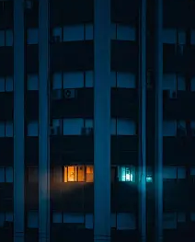
活用词汇
except for /ɪkˈsept fə(r)/ 除…之外
1. 当学生们给她送来圣诞礼物时，她感觉更糟了。礼物都是用漂亮的纸包着，系着漂亮的丝带，只有Teddy的礼物例外。(续写)
She felt even worse when her students brought her Christmas presents,wrapped in beautiful paper and tied with pretty ribbons, except for Teddy's.
2. 当我去取东西的时候，发现整栋楼都漆黑一片，只有一楼的一个窗户透出一丝光亮。(续写)
When I arrived to collect, I found the building was dark except for a single light in a ground floor window.

Slide 53
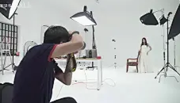
活用词汇
inner /ˈɪnə(r)/ adj.内部的;里面的;内心的
1. 我是一名摄影师，经营着一家位于市中心的摄影工作室。(续写)
I am a photographer running a studio in the inner city.
2. 为何不帮助学生们抒发内心的情感，让他们以积极向上的心态去迎接充满挑战但又充满希望的未来呢？(续写)
Why not help students voice inner feelings and have a good mood to embrace the tough yet bright future?
3. 通过一个人的内在品质来了解他是非常重要的。(续写)
It is important to know a person through his inner qualities.

Slide 54
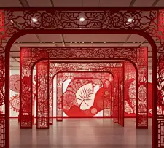
活用词汇
region /ˈri:dʒən/ n.地区;区域;地带
1. 此次展览以中国剪纸为主题，不仅展示了不同地区的各种剪纸作品，还向我们呈现了中国剪纸的历史与发展。(应用文)
Featuring Chinese paper-cutting, the exhibition not only shows a variety of paper-cuts in different regions, but also presents to us the history and development of paper-cutting in China.

Slide 55
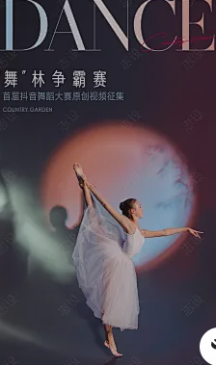
活用词汇
represent /ˌreprɪˈzent/ vt.象征;代表;相当于
1. 我非常高兴代表我们学校告诉你们有关即将到来的排球比赛的一些事宜。(应用文)
Representing our school, I'm glad to tell you something about the coming volleyball game.
2. 最后但同样重要的是，我非常荣幸代表我班参加上周举行的小组跳舞比赛。(应用文)
Last but not least, I feel it a great honour to represent my class to take part in the group dancing competition held last week.
3. 颐和园、紫禁城、长城等都是古代文明和古人智慧的代表。(2021年天津卷)
The Summer Palace, the Forbidden City, the Great Wall and so on are the representatives of ancient civilization and the wisdom of ancient folks.

Slide 56
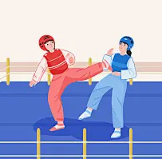
活用词汇
wrestling /ˈreslɪŋ/ n.摔跤运动
wrestle /ˈresl/ vi.&vt.摔跤;奋力对付
wrestler /ˈreslə(r)/ n.摔跤运动员
1. 本周末举行的摔跤比赛不仅展示力量，更弘扬永不言弃的精神，是激励青少年的绝佳平台。(应用文)
The wrestling competition, which will be held this weekend, not only showcases physical strength but also celebrates the unyielding spirit of perseverance, making it a perfect platform to inspire teenagers.
2. 摔跤手站在昏暗的赛场上，汗水从布满伤痕的肩膀滑落，双眼紧锁对手，仿佛搏斗的不仅是比赛，更是昔日失败的阴影。(续写)
The wrestler stood in the dimly lit arena, sweat dripping down his scarred shoulders, his eyes locked on the opponent as if wrestling not just a match, but the ghosts of his past failures.

Slide 57

活用词汇
set off /set ɒf/ 出发;动身;启程
1. 他们以不紧不慢的速度出发了。
They set off at a steady pace.
2. 你最好每天留出一些时间运动，一下以便保持精力充沛。(应用文)
You had better set aside some time every day for sports so that you can keep yourself energetic.
3. 相反的是，他在杰夫手上涂了一些药，然后开始帮他们收拾烂摊子。(2021年全国卷Ⅰ续写)
Instead, he applied some medicine to Jeff's hand, and then set out to help/set about helping them clean up the mess.

Slide 58
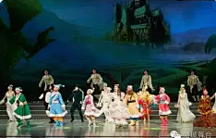
活用词汇
fancy /ˈfænsi/ adj.花哨的;精致的 v.想要
1. 虽然它并非一款华丽或昂贵的玩具，但它在我心中却占有着特殊的位置。我选择这款玩具车作为我的展品，是因为它承载着我快乐的童年回忆。(应用文)
Although it is not a fancy or expensive toy, it holds a special place in my heart. I chose this toy car as my exhibit because it represents my happy childhood memories.
2. 在了解了这些台词之后，学生们被鼓励穿上华丽的服装并结成对进行表演。(续写)
After learning about the lines, students were encouraged to put on the fancy costume and perform in pairs.

Slide 59
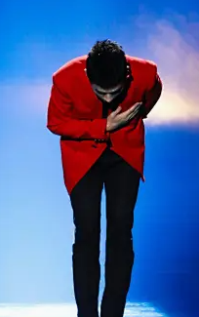
活用词汇
grace /greɪs/ n.优美;优雅;高雅
1. 他还描述了那些宏伟的花园，里面弥漫着异国花朵的芬芳气息，还有那优雅的喷泉缓缓流淌出的轻柔水流。(续写)
He also described magnificent gardens, full of the sweet scents of exotic flowers and the gentle thin stream of graceful fountains.
2. 他优雅地向观众鞠了一躬。(续写)
He gave a graceful bow to the audience.
3. 望着他们那洋溢着笑容的面庞，我领悟到运动会的意义并不仅仅在于胜负的得失，而在于建立友谊以及以优雅的姿态面对失败。(应用文)
Looking up at their smiling faces, I felt the meaning of a Sports Meet was not just about winning or losing, but about securing friendship and failing with grace.

Slide 60
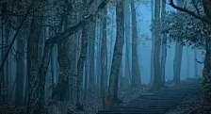
活用词汇
absolutely /ˈæbsəlu:tli/ adv.绝对地;完全地
1. “你错了。”她斩钉截铁地说。(续写)
‘You're wrong,’ she said with absolute certainty.
2. 我工作时需要绝对的安静。(续写)
I need absolute silence when I'm working.
3. 瞬间，一片漆黑笼罩了整个森林。(续写)
Immediately，an absolute darkness ruled the forest.

Slide 61

活用词汇
moment /ˈməʊmənt/ n.片刻;瞬间
1. 那一刻真是吓人。(续写)
It was a really scary moment.
2. 可怕的时刻终于来到了。(续写)
The dreaded moment had finally arrived.
3. 回首三年的校园时光，当我第一次在网上出售自己的画作，并将所得款项捐赠给山区的孩子们的那一刻，塑造了我成为一个更加成熟和有责任感的人。(应用文)
Looking back on my three years on campus, I found the moment, when I sold my first painting online and donated the money to the children in mountainous area, really shaped me into a more mature and responsible individual.

Slide 62
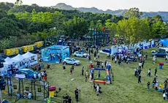
活用词汇
tent /tent/ n.帐篷
1. 在赛道的一侧为年轻的参赛者们准备了大型帐篷。(应用文)
Large tents were provided for the young competitors on one side of the track.
2. 尽管被分配到了离赛道最远的那一顶帐篷，我还是充分利用们学校的颜色装饰了帐篷，营造出了一个充满支持的氛围。(续写)
Despite being assigned the last tent that was furthest from the track, I made the best of the situation by decorating it with our school colors and creating a supportive atmosphere.

Slide 63
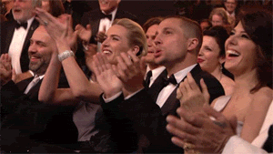
活用词汇
brief /bri:f/ adj.简洁的;简单的;短暂的
1. 他发出短暂的咯咯声。(续写)
He let out a brief cackle.
2. 当我们结束发言后，现场出现一阵短暂的寂静，随后大厅内爆发出热烈的掌声。(续写)
When we finished, there was a brief silence, and then the hall erupted into applause.

Slide 64
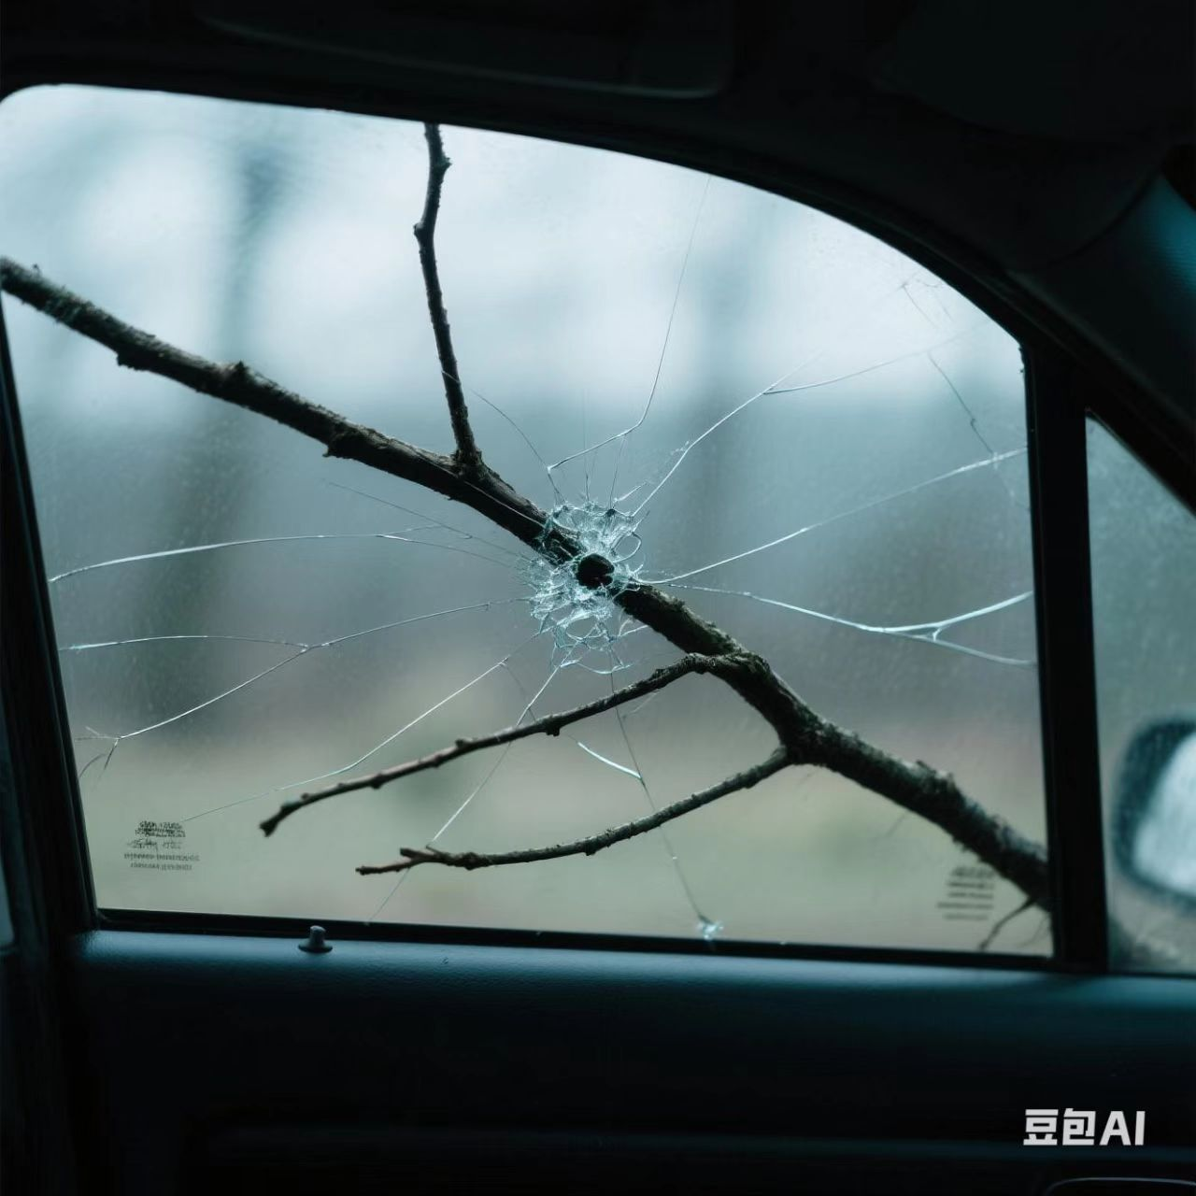
活用词汇
branch /brɑ:ntʃ/ n.树枝;分支;支流
1. 他从那棵树上砍下一根树枝。(续写)
He chopped a branch off the tree.
2. 一条树枝突然划过车窗。(续写)
A branch whipped across the car window.
3. 当我们回来时，就看到凯西的父亲和兄弟们在我们的院子里清理废墟，并用链锯锯断那棵倒下大树最粗的树枝，但是那时我们并不太了解他们。(续写)
When we returned, we saw Cathy's father and brothers in our yard, gathering debris and using a chain saw to cut the thickest branches of the fallen tree, though we barely knew them then.

Slide 65

活用词汇
wedding /ˈwedɪŋ/ n.婚礼;结婚庆典
1. 就像为我姐姐们的婚礼准备礼物一样，Grandma Lou也给珍妮送了一个梅森罐，罐里装满了五颜六色的种子，密密麻麻地排列着。(续写)
As she had for my older sisters'weddings, Grandma Lou gave Jenny a Mason jar, where lay the colorful seeds round and round.
2.十年后，泰迪邀请汤普森夫人作为新郎的母亲出席他的婚礼。(续写)
Ten years later, Teddy invited Mrs. Thompson to attend his wedding as groom's mother.

Slide 66
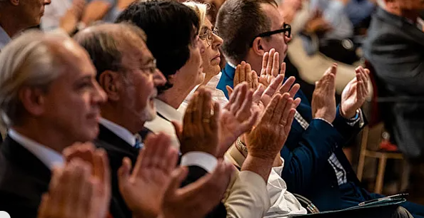
活用词汇
clap /klæp/ vt.鼓掌;拍手;击掌 n.鼓掌
1.掌声四溢，当大多数人都已停止鼓掌时，还有几双手仍在拍着。(续写)
The applause spilled out, with a few hands still clapping after others had stopped.
2. 观众又是喝彩又是鼓掌。(续写)
The audience cheered and clapped.
3. 她高兴地拍起手来。(续写)
She clapped her hands in delight.
4. 他拍手要大家安静下来。(续写)
He clapped his hands for silence.

Slide 67

活用词汇
respect /rɪˈspekt/ n.&vt.尊敬;尊重
1. 人们静默两分钟以示尊敬。(续写)
A two-minute silence was held as a mark of respect.
2. 他们之间产生了深切的相互尊重和理解。(续写)
A deep mutual respect and understanding developed between them.
3. 这种工作能让你珍惜自己挣来的钱，并尊重劳动人民。(应用文)
This was the sort of work that made you appreciate the dollars you earned and respect the laboring people.

Slide 68

活用词汇
horrible /ˈhɒrəbl/ adj.令人震惊的;恐怖的
1. 如果不是他及时的帮助，我没可能逃出这个可怕的泥沼。(续写)
Without his timely help, my chance to escape the horrible mire could have been zero.
2. 我感觉到很不愉快，她对我们说了谎。(续写)
I've got a horrible feeling she lied to us.
3. 这是一个多么可怕的夜晚啊！(续写)
What a horrible night it was!
4. 我们在那片阴森的森林里徘徊，不知道会遭遇什么可怕的事情，只盼着能找到回去的路。(续写)
We wandered in the scary forest and didn't know what horrible thing would happen to us，hoping to find the way back.

Slide 69

Thank You

