Slide 1


感恩遇见，相互成就，本课件资料仅供您个人参考、教学使用，严禁自行在网络传播，违者依知识产权法追究法律责任。
更多教学资源请关注
公众号：溯恩英语
知识产权声明

Slide 2

活用教材词汇，靶向高考写作
M5U1单词拓展
Science And Scientists

Slide 3

活用词汇
severe /sɪˈvɪə(r)/ a.极为恶劣的;十分严重的
1. 考虑到撞伤了路人，司机受到了严厉的惩罚，并感到非常沮丧。(续写)
Given that the driver injured the passer-by, he was severely punished and felt frustrated.
2. 没有感觉到严重的困境逼近，我走向惊恐的服务员，告诉他们放松点。(续写)
Sensing no severe dilemma approaching, I walked to the terrified waiters and
told them to take it easy.
3. 这里是急诊室，您儿子刚被送来，面部、颈部和手臂有严重烧伤。(续写)
This is the em ergency room calling and your son was just brought in with severe burns on his face, neck and arms.

Slide 4
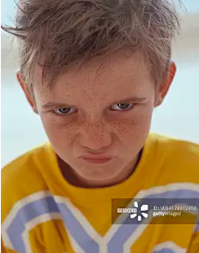
活用词汇
frustrated /frʌˈstreɪtɪd/ a.懊恼的;沮丧的;失意的
1. 似乎我永远也找不到丢失的钱包了，我既沮丧又失望。(续写)
It seemed that I couldn't find my lost wallet forever，frustrated and disappointed.
2. 看到他精心搭建的模型倒塌，一股挫败的愤怒席卷了他，他把散落的碎片踢得满房间都是。(续写)
Seeing his carefully built model collapse, a wave of frustrated anger washed over him, and he kicked the scattered pieces across the room.

Slide 5

活用词汇
contradictory /ˌkɒntrəˈdɪktəri/ a.相互矛盾的;对立的
1. 但我得到的信息丰富多样，甚至相互矛盾。(续写)
But the information I got was rich and varied, or even contradictory.
2. 在网上做研究时，批判性地评估信息来源至关重要，因为你经常会遇到相互矛盾的观点。(应用文)
When researching online, it's crucial to critically evaluate sources as you often encounter contradictory viewpoints.
3. 他的脑海里充满了矛盾的想法：是说真话冒着受罚的风险，还是保持沉默忍受内疚？(续写)
His mind was a whirlwind of contradictory thoughts: should he tell the truth and risk punishment, or keep silent and live with the guilt?

Slide 6

活用词汇
infection /ɪnˈfekʃn/ n.感染;传染
infect /ɪnˈfekt/ vt.使感染;传染
1.他的笑声具有感染力，像池塘中的涟漪一样传播着快乐。(续写)
His laughter was infectious, spreading joy like ripples in a pond.
2. 为防止感染传播，强烈建议勤洗手并在拥挤场所佩戴口罩。(续写)
To prevent the spread of infection, frequent handwashing and wearing masks in crowded places are highly recommended.
3. 也许是清晨散步时的新鲜空气，也许是杰瑞富有感染力的精神，但我父亲很快就变了一个人，充满了对生活新的热情。(续写)
Maybe it was the fresh air on early morning walks, or maybe it was Jerry's infectious spirit, but my father was soon a different man, filled with a renewed enthusiasm for life.
4. 不幸的是，昨天我意外感染了流感，这导致我发高烧，吃了不少苦头。(续写)
Unfortunately, yesterday I was unexpectedly infected with flu, which caused me to have a high fever and suffer a lot.

Slide 7

活用词汇
subscribe /səbˈskraɪb/ vi.认购(股份);定期订购
1. 我强烈建议你订阅《国家地理》杂志；它关于科学和自然的文章和照片确实非常出色。(应用文)
I highly recommend you subscribe to "National Geographic" magazine; its articles and photographs on science and nature are truly outstanding.
2. 许多科学家赞同气候变化主要由人类活动引起的理论。
(应用文)
Many scientists subscribe to the theory that climate change is primarily caused by human activities.

Slide 8

活用词汇
proof /pru:f/ n.证据;证明;检验
1. 此外，印刷内容通常经过严格的审查和校对，使其比电子版更准确、更权威。(应用文)
Moreover, print content often undergoes rigorous examination and proofreading, making it more accurate and authoritative than the electronic version.
2. 校园劳动节活动生动地证明了幸福生活源于体力劳动。(应用文)
The Campus Labor Day event serves as living proof that happy life stems from doing Physical Labor.
3. 格雷迪认为它们只是吓人，并且证明了贾里德是个奇怪的孩子。(续写)
Grady thought they were just scary and proof that Jared was a strange kid.

Slide 9
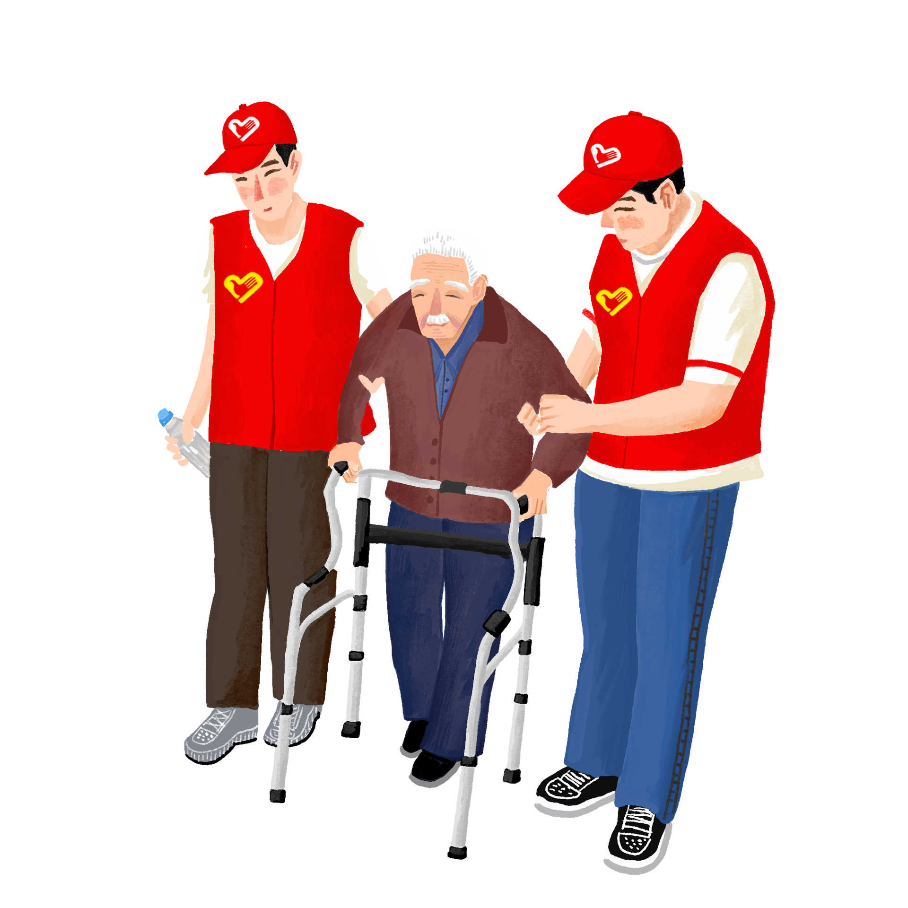
活用词汇
multiple /ˈmʌltɪpl/ a.数量多的;多种多样的
1. 他坐在一个睡袋上，面前整齐地摆放着多份简历，旁边还有一个牌子写着“需要工作和食物”。(续写)
He was sitting on a sleeping bag with multiple resumes neatly laid out, along with a sign that read “need work and food.”
2. 如果我不是在学习、担心成绩，就是在参加多种课外活动，或者试图为大学做准备。(应用文)
If I wasn't studying and worrying about my grades, I was taking part in multiple extra-curricular activities or attempting to make preparations for college.
3. 参加多种志愿活动拓宽了我的视野，丰富了我的高中生活。(应用文)
Participating in multiple volunteer activities has broadened my horizons and enriched my high school life.

Slide 10
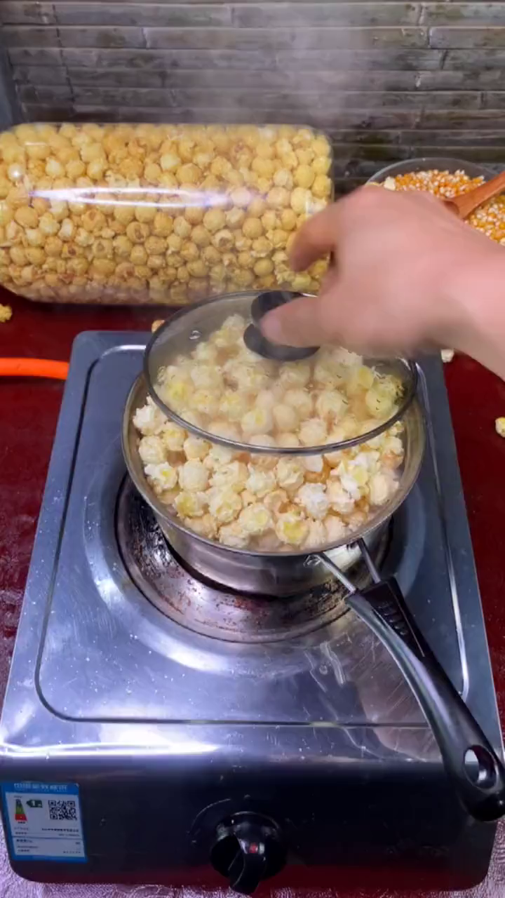
活用词汇
household /ˈhaʊshəʊld/ n.一家人;家庭
1. 我在一个珍视书籍的家庭中长大。(应用文)
I grew up in a household where books were cherished.
2. 在家里，我爸爸说：“工作是成长的一大步。我很高兴你将为家庭做贡献。”(续写)
At home, my dad said, “A job’s a big step to growing up. I’m glad you will be contributing to the household. ”
3. 然后梅雷迪思太太上网订购了一台家用爆米花机。(续写)
Then Mrs. Meredith searched the internet and ordered a household popcorn machine.

Slide 11
活用词汇
suspect /səˈspekt/ v.怀疑;疑有 n.犯罪嫌疑人
1. 我曾怀疑他偷了钱,但后来证明我错了。(续写)
I once suspected that he had stolen the money, but later it turned out that I was proved wrong.
2. 当他们走近时，他们看到了穿着一套新西装抱着美丽花朵的嫌疑人。(续写)
As they approached, they saw the suspect who wore a set of new suit hugging beautiful flowers.
3. 她把食物递给看门人，对看门人说了抱歉，说她不应该怀疑他们，就把他们当作小偷。(续写)
She passed the food on to the porter, and said sorry to the porter, saying that she shouldn’t suspect them, and took them as thieves.

Slide 12

活用词汇
blame /bleɪm/ vt.把…归咎于;责怪 n.责备
1. 不要总把自己的失败归咎于他人,你应该为失败承担责任。(续写)
Don’t always blame your own failure on others. You should take/bear the blame for failure.
2. 蒂姆被责备为演出失败负责,他悲伤得忍不住痛哭。(读后续写情感描写)
Blamed for the failure of the performance, Tim felt seized by a burst of sadness and couldn’t help crying bitterly.
3. 他害怕父亲会责怪他，并认为自己做得不够好。(续写)
He was afraid that his father would blame him and thought he didn't do well enough.

Slide 13

活用词汇
handle /ˈhændl/ n.把手;拉手 vt.处理;搬动
1. 为了应对/处理/解决/克服这些挑战，最重要的是高中生应专注于培养批判性思维、解决问题和创造力技能，这些是人工智能无法替代的。(应用文)
To tackle/handle/ address/cope with these challenges, what tops the list is that high school students should concentrate on cultivating critical thinking, problem-solving, and creativity skills, which are irreplaceable by AI.
2. 一天，我前往市中心参加面试，我在有轨电车上坐下，发现座位靠背处有一把漂亮的丝绸伞，银色的伞柄上装饰着金色的卷轴花纹，其中还刻着一个名字。(续写)
One day, I headed to the downtown for an interview, I sat down in the streetcar, and there against the seat was a beautiful silk umbrella with a silver handle decorated with gold scrolls, among which there was a name carved.

Slide 14
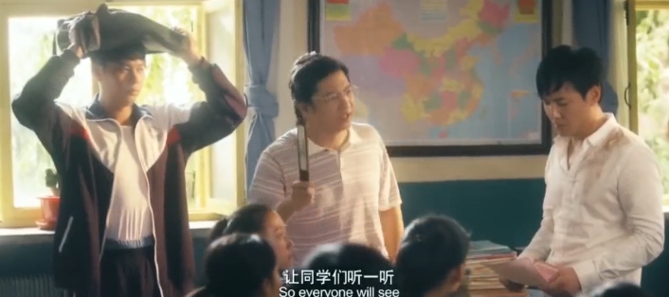
活用词汇
intervention /ˌɪntə'venʃn/ n.介入;出面;干涉
1. 经济危机期间，及时的政府干预对于稳定市场至关重要。(应用文)
Timely government intervention is essential to stabilize the market during economic crises.
2. 就在争论即将升级为打斗时，老师冷静的介入化解了紧张气氛。(续写)
Just as the argument was about to escalate into a fight, the teacher's calm intervention diffused the tension.

Slide 15

活用词汇
link /lɪŋk/ n.联系;纽带 vt.把…接起来
1. 毫无疑问,社会习俗在现在和过去之间起到了重要的纽带作用。(应用文)
Undoubtedly, social customs provide a vital link between the present and the past.
2. 这些组织已联合起来,准备办一场慈善音乐会。(应用文)
The organizations have linked up for a charity concert.
3.一个接一个，手拉手，这些素不相识的人走进海浪，彼此挽住手腕，决心不让任何人死在那片海滩上。(续写)
One by one，link by link，total strangers walked into the waves and grasped one another by the wrists，determined that no one would die on that beach．

Slide 16
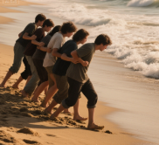
活用词汇
link /lɪŋk/ n.联系;纽带 vt.把…接起来
4. 冰冷的金属链环硌痛了他的身体一侧。(续写)
The cold metal links hurt his side.
5. 他们紧紧连在一起，双脚牢牢扎进沙子里，设法确保了自己的安全。
They stayed linked tightly and managed to ensure they were safe by making their feet firmly planted in the sand．

Slide 17
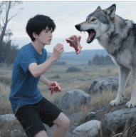
活用词汇
raw /rɔ:/ a.未煮的;生的;未经处理的
1. 有一次他吃了生海鸟生病后，就拒绝再吃任何东西了。(续写)
Once he got sick from eating raw seabirds，he refused to eat at all.
2. 麦克的一个朋友挑出一些生肉扔给了狼。(续写)
One of Mac’s friends picked out some raw meat and threw it to the wolf.
3. 食用生的或未煮熟的海鲜有食源性疾病的风险。(应用文)
Consuming raw or undercooked seafood carries a risk of foodborne illness.

Slide 18

活用词汇
pure /pjʊə(r)/ a.干净的;纯的;纯粹的
1. 关于要求，主题应与中国传统文化相关，你的演讲需在10分钟内完成，且必须纯用英语。(应用文)
As to requirements, the theme should be related to Chinese traditional culture and your speech 1s expected to be related within 10 minutes and purely in English.
2. 它们浓密的银灰色皮毛下有一层纯白的底毛，形成一种旗帜般的图案，在它们奔跑时会上下摆动。(续写)
Their thick, silver-gray fur has a pure white undercoat, making a kind of flag that moves up and down when they run.
3. 他们的心是纯净的，所以我们一起给凯蒂写了一封信，上面写着：“我们知道那是个不幸的意外。”(续写)
Their hearts are pure, so we wrote Katie a letter together, reading "We know it was an unfortunate accident.

Slide 19
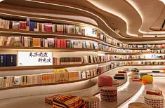
活用词汇
substantial /səbˈstænʃl/ a.大量的;价值巨大的
1. 我为这个项目投入了大量的精力和时间，进行了彻底的研究，并严格遵守了所有指导方针。(应用文)
I dedicated a substantial amount of effort and time to this project, conducting thorough research and strictly following all the guidelines.
2. 我们的筹款活动取得了巨大成功，筹集到的资金足以支持当地动物收容所一年的运作。(应用文)
Our fundraising event achieved substantial success, collecting enough money to support the local animal shelter for a year.
3. 经过大规模翻新后，旧图书馆变成了一个明亮现代的社区中心。(应用文)
After substantial renovations, the old library transformed into a bright and modern community center.

Slide 20

活用词汇
decrease /dɪˈkri:s/ n.减少;降低;减少量 v.减少
1. 由于人类活动，一些稀有动物的数目正在减少。(应用文)
Because of human activities, the number of some rare animals is on the decrease.
=Because of human activities, the number of some rare animals is decreasing.
2. 随着交通状况的改善,交通事故的数量在减少。(应用文)
With the traffic improving, the number of accidents is on the decrease.
3. 近两年新生人数从2 000减少到1 600人。(应用文)
The number of new students has decreased from 2,000 to 1,600 in recent two years.

Slide 21

活用词汇
thanks to /θæŋks tə/ 幸亏;由于
1. 多亏了马克的帮助，约翰设法在5:30到达了目的地。(续写)
Thanks to Mark's help, John managed to make it to the destination at 5:30.
2.多亏了辞职，我才能够将信心扩展到我生活的其他领域。(应用文)
Thanks to the quit，I am able to extend the confidence to other areas of my life.

Slide 22

活用词汇
statistic /stəˈtɪstɪk/ n.[pl.]统计数字;统计资料
1. 该项目要求每个团队提出一个假说，设计实验来验证该假说，进行统计分析并展示研究结果。(应用文)
The project required each team to develop a hypothesis, set up an experiment to test the hypothesis, do the statistical analysis and present the findings.
2. 最近的统计数据显示，参与在线学习平台的学生人数显著增加。(应用文)
Recent statistics show a significant increase in the number of students participating in online learning platforms.

Slide 23

活用词汇
transform /trænsˈfɔ:m/ vt.使改观 vi.改变;转变
1. 你的慷慨帮助和善意使我的第一次加拿大之行成为一个难忘的回忆。(应用文之感谢信)
Your generous help and kindness transformed my first Canada trip into an unforgettable memory.
2. 我充分意识到，是在国外的生活经历改变了我。(应用文)
I'm fully aware that it's the experience from my life abroad that has transformed me.
3. 时间让我们从婴孩变成大人,让我们的父母从大人变成老年人。(应用文)
Time will transform us from babies into adults and our parents from adults to old men.

Slide 24

活用词汇
thinking /ˈθɪŋkɪŋ/ n.思想;思维;见解
1. 当我把答案给他看时，老师表扬了我的独立思考能力。(应用文)
When I showed my answer to him, the teacher praised me for my independent thinking.
2. 它帮助我们养成英语思维和表达的习惯。(应用文)
It helps us form the habit of English thinking and expressing ourselves.
3. 此外，要求每位参与者在规定时间内提交一份读书报告，以增强他们的批判性思维能力和写作能力。(应用文)
In addition, every participant is required to submit a reading report within given time to enhance their critical thinking ability and writing capability.

Slide 25
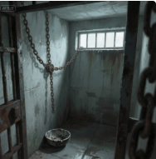
活用词汇
cell /sel/ n.细胞;小房间;单间牢房
1. 人体由数万亿个细胞组成，每个细胞执行特定的功能。(应用文)
The human body is composed of trillions of cells, each performing specialized functions.
2. 那个狭小的牢房又湿又冷，墙上高处只有一条狭窄的窗缝。(续写)
The tiny cell was damp and cold, with only a narrow slit of a window high up on the wall.

Slide 26
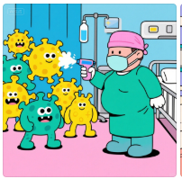
活用词汇
virus /ˈvaɪrəs/ n.病毒
1. 那时我们意识到我可能是从我们朋友那里感染了病毒。(续写)
That was when we realized that I might have caught the virus from our friend.
2. 她也尽量减少与我们孩子的接触，以防她携带病毒。(续写)
She also minimized her contact with our kids in case she was carrying the virus.
3. 尽管担心病毒的严重性，我知道我必须勇敢。(应用文)
Though worried about the seriousness of the virus, I knew I had to be brave.

Slide 27

活用词汇
finding /ˈfaɪndɪŋ/ n.发现;调查结果;判决
1. 我们的努力得到了回报，亨德森博士对我们出色的发现非常满意。(续写)
Our hard work paid off and Dr. Henderson’s was very satisfied with our wonderful findings.
2. 我在那个项目上投入了比以往更多的时间和精力，最终向全班展示了我们的发现，令人惊讶的是，这为我们赢得了优异的成绩！(应用文)
I poured more time and energy into that project than ever before, and finally presented our findings to the class, which surprisingly earned us an excellent grade!

Slide 28
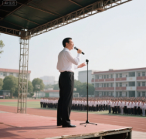
活用词汇
initial /ɪˈnɪʃl/ a.最初的;开始的;第一的
1. 接下来的几周见证了这个麻雀的变化，从一开始毫无生命力的双眼到现在的眼里充满好奇，从耷拉的翅膀到时不时的振翅。(续写)
The following weeks witnessed this sparrow’s progress/growth/changes, from initial lifeless eyes to eyes filled with curiosity, from drooping wings to occassional determined fluttering.
2. 按计划，今年的运动会最初将由我们校长的励志演讲开始，以激励我们积极参与。(应用文)
As scheduled, initially, this year's sports meeting will begin with our headmaster's inspring speech to motivate us to take part in it actively.

Slide 29

活用词汇
framework /ˈfreɪmwɜ:k/ n.框架;结构
1.在写论文之前，列一个提纲有助于为你的论点建立一个清晰的框架。(应用文)
Before writing the essay, it's helpful to create an outline to establish a clear framework for your arguments.
2.古建筑的骨架在暮色天空的映衬下显得格外突兀。(续写)
The skeletal framework of the ancient building stood starkly against the twilight sky.

Slide 30

活用词汇
solid /ˈsɒlɪd/ a.可靠的;固体的 n.固体
1. 我们的底座很稳固。四个个子较小的人爬到基座组成员的背上，站在他们的肩膀上。(续写)
Our base was solid. Four smaller men climbed onto the backs of the base group and stood on their shoulders.
2. 总而言之，您的课程，尤其是后两个模块，必将使我们学生能够辨别真假新闻，更高效地搜索信息，从而培养扎实的信息素养。没有这种素养，现代公民就无法适应未来社会。(应用文)
To sum up, your course, especially with the latter two modules, will definitely enable us students to distinguish between genuine and fake news, search for information more efficiently and thus develop solid information literacy, without which a modern citizen cannot get adapted to the future society.
3. 他是一个可靠的学生，学习成绩优异，领导能力强。(应用文)
He is a solid student with excellent academic performance and strong leadership skills.

Slide 31

活用词汇
cast /kɑ:st/ vt.投射;向…投以(视线等)
1. 太阳沉入地平线，向这一天投下温暖的告别。(续写)
The sun dipped below the horizon, casting a warm goodbye to the day.
2. 一个灿烂的微笑照亮了她的脸，投射出一种满足感的光芒，感染了所有看到它的人。(续写)
A radiant smile illuminated her face, casting a glow of contentment that was contagious to all who beheld it.
3. 恐惧就像一片笼罩在她头上的乌云，给她的每一步都投下了阴影。(续写)
Fear was a dark cloud that loomed over her, casting a shadow on her every step.
4. 第二天，当萨瑟夫人分配角色时，我迅速而坚定地举起了手。(续写)
The next day, when Mrs. Sather cast the characters, I lifted up my hand quickly and firmly.

Slide 32

活用词汇
shadow /ˈʃædəʊ/ n.阴影;影子;背光处
1. 她就在那里，坐在树影里擦着眼睛。(续写)
There she was, sitting in a tree shadow wiping her eyes.
2. 我们可以选择的主题包括书法、武术、皮影戏、剪纸等等。(应用文)
The themes we can choose include calligraphy, martial arts, shadow puppet plays, paper-cut and so on.
3. 他找到红土，与泥混合来添加阴影，然后拔了些草，把它变成一种颜料。(续写)
He found red dust and mixed it with mud to add shadow, then picked up some grass and turned it into some kind of paint.

Slide 33

活用词汇
shadow /ˈʃædəʊ/ n.阴影;影子;背光处
4. 聚光灯在我们身上投下长长的影子，随着我们在舞台上移动而闪烁。(续写)
The spotlight cast elongated shadows of our bodies, flickering as we moved across the stage.
5. 雷声不断震撼着天空，闪电瞬间照亮了商店，在我脑海中投下可怕的阴影。(续写)
Thunder continued to shake the sky and lightning illuminated the store for seconds, casting frightening shadows on my mind.

Slide 34

活用词汇
rainbow /ˈreɪnbəʊ/ n.彩虹
1. 对自己愚蠢的行为感到非常后悔，想着错过了彩虹，我又哭起来。(续写)
Remorseful for my simple-minded behavior, thinking about the missing rainbow, I burst into tears again.
2. 每次雨后，妈妈、托马斯和玛吉都会坐在前廊，守望着彩虹的出现。(续写)
Each time it did, Mama, Thomas, and Maggie would sit on the front porch and watch for a rainbow.

Slide 35

活用词汇
pour /pɔ:(r)/ vi.倒出;倾泻;斟(饮料)
1. 附近，顾客们正仔细翻阅着售卖文具、海报和其他畅销书主题礼物的货架。(续写)
Nearby, customers were pouring over shelves selling stationery, posters and other best-seller-themed gifts.
2. 邻居们正蜂拥而入。(续写)
​ Neighbors were pouring in.
3. 他把所有的卡片倒在地毯上，然后一张一张地摆放好。(续写)
He poured out all the cards on the carpet and placed them one by one.
4. 每当我感到低落或挫败时，我的小狗都会安静地陪伴着我，而我会向他倾诉我所有的内心想法。(续写)
Every time I felt down or defeated, my puppy would keep me company quietly and I would pour out all my inner thoughts to him.

Slide 36
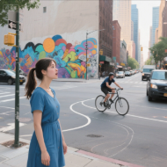
活用词汇
concrete /ˈkɒŋkri:t/ n.混凝土 a.混凝土制的
1.在这个喧嚣的城市中，在那钢筋混凝土的丛林里，她在日常中发现了艺术：自行车手轨迹的优雅弧线，行人的有节奏的舞蹈，以及装饰墙面的充满活力的街头艺术织锦。(续写)
In the bustling city, amidst the concrete jungle, she found art in the everyday: the graceful arc of a cyclist's path, the rhythmic dance of pedestrians, and the vibrant tapestry of street art that adorned the walls.
2. 我认为，为了保护我们的环境，政府必须采取更具体的措施。(应用文)
In my opinion, to protect our environment, the government must take even more concrete measures.

Slide 37

活用词汇
patriotic /ˌpeɪtriˈɒtɪk/ a.爱国的
1. 每当谈论起端午节，我都不禁想起屈原，他是中国历史上一位伟大的爱国诗人。他的诗一旦读起来就能激起人们的爱国热情。(应用文)
Whenever I talk about the Dragon Boat Festival, 1 can’t help thinking of Qu Yuan, a great patriotic poet in Chinese history. His poems, once read, can inspire people to have great passion for their country.

Slide 38

活用词汇
mechanical /məˈkænɪkl/ a.机械的;发动机的;机器的
mechanic /məˈkænɪk/ n.机械师;机械修理工
1. 面包师提供温暖的面包，机械师免费修理汽车，老年人得到大家的照顾。(续写)
The baker offered warm bread, the mechanic fixed cars for free, and the elderly were cared for by all.
2. 学校为机器人俱乐部购置了先进的机械设备，让学生们获得动手实践的工程经验。(应用文)
The school has invested in advanced mechanical equipment for the robotics club, allowing students to gain hands-on engineering experience.
3. 古老的钟楼发出一连串机械的咔哒声和呼呼声，它的指针缓缓移向午夜。(续写)
The old clock tower emitted a series of mechanical clicks and whirs, its hands slowly inching towards midnight.

Slide 39
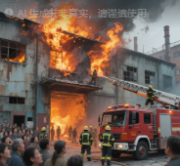
活用词汇
break out /breɪk aʊt/ (战争等)突然开始;爆发
1. 几秒钟的停顿后，掌声爆发了。(续写)
After a few seconds' pause, applause broke out.
2. 当突如其来的雷暴袭来时，恐慌在拥挤的市场上爆发了。(续写)
Panic broke out in the crowded marketplace when the unexpected thunderstorm struck.
3. 昨晚深夜，一场火灾在废弃工厂爆发，所幸没有人员伤亡报告。(续写)
A fire broke out in the abandoned factory late last night, but fortunately no injuries were reported.

Slide 40

活用词汇
defend /dɪˈfend/ vt.保卫;防守;辯解
1. 军队将不惜一切代价保卫祖国不受任何侵略。(续写)
The army will do whatever it takes to defend the motherland against any invasion.
2. 看到这只凶猛的狼,他像箭一样冲过去保护儿子。(读后续写肢体动作)
Seeing the fierce wolf, he rushed to defend/in defence of his son like an arrow.
3. 根据中国法律，律师被允许在法庭上为自己辩护。(续写)
The lawyers are allowed to defend themselves in court according to Chinese law.

Slide 41

活用词汇
assistant /əˈsɪstənt/ n.助理;助手
1. 幸运的是，格雷迪的父亲及时听到了喊来帮助他。(续写)
Fortunately, Grady’s father heard the shout in time to come to his assistance.
2. 如果您对活动有任何疑问或需要任何方面的协助，请随时与我们联系。(续写)
Please feel free to reach out if you have any questions or need assistance with anything related to the event.
3. 人工智能作为一种宝贵的学习助手，使学生能够根据个人需求进行个性化学习，并获得实时反馈和针对性指导，从而提升学习体验和成果。(应用文)
AI serves as a valuable learning assistant for students to perform personalized learning based on individual needs and gain real-time feedback and targeted guidance, thus enhancing learning experiences and outcomes.

Slide 42
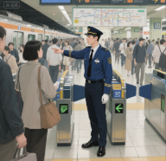
活用词汇
assistant /əˈsɪstənt/ n.助理;助手
4. 这次活动不仅增进了我们学生之间的友谊，还帮助我们培养了积极的人生态度。(应用文)
Not only did the activity strengthen the friendship among our students,but also it assisted us in building a positive attitude towards life.
5. 保罗，一位检票口引导员，正在值他的日常班。(续写)
Paul, a ticket gate line assistant, was working his usual shift.

Slide 43

活用词汇
in charge of /ɪn tʃɑ:dʒ əv/ 主管;掌管
1. 作为学生会主席，我被委派负责你在天津逗留期间的所有活动。(应用文写作之活动安排)(应用文)
As chairman of the Student Association， I was appointed to be in charge of/take charge of arranging all the activities during your stay in Tianjin.
2. 然而，父亲和哥哥只是耸耸肩，因为它被交给母亲负责了。(续写)
However, father and brother just shrugged because it was left in the charge of mother.
3. 赛场仿佛因他的怒火而搏动，空气中充满了几乎可以触摸到的电流般的紧张感。(续写)
The field seemed to pulse with his anger, the very air charged with an electric tension that was almost tangible.

Slide 44

活用词汇
in charge of /ɪn tʃɑ:dʒ əv/ 主管;掌管
4. 我咬紧牙关，鼓起全身力气，向前猛冲，竭尽全力保持领先，这样我们队才不会落后。(续写)
Gritting my teeth and mustering up all my strength, I charged forward, trying my utmost to keep ahead so that our team wouldn't fall behind.
5. 当背叛的事实逐渐被意识到时，房间里充满了一种明显的紧张气氛。(续写)
The room was charged with a palpable tension as the realization of the betrayal sunk in.

Slide 45
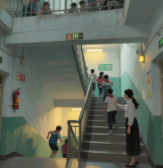
活用词汇
leadership /ˈli:dəʃɪp/ n.领导;领导地位;领导才能
1. 您的领导能力和组织能力确实令人钦佩。(应用文)
Your leadership and organizational skills are truly admirable.
2. 通过担任班长一职，我培养了强大的领导能力，例如激励同学和有效协调小组任务。(应用文)
Through my role as class monitor, I have developed strong leadership skills, such as motivating classmates and coordinating group tasks effectively.
3. 在她镇定的领导下，受惊的学生们迅速组织起来，有序地撤离了大楼。(续写)
​ Under her calm leadership, the frightened students quickly organized themselves and evacuated the building in an orderly manner.

Slide 46
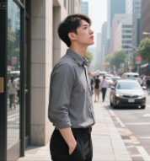
活用词汇
trace /treɪs/ vt.追溯;追踪 n.痕迹;遗迹
1. 他的眼中甚至没有一丝自怜。(续写)
There was not even a trace of self-pity in his eyes.
2. 他脸色舒缓，转身，离开了，没有一点踪迹。(续写)
Softening his face, he turned around and left without any trace.
3. 随着生活看到一丝阳光，肖恩变得越来越感激，但那些贫穷的日子不断提醒着他，还有像他一样生活在痛苦中、渴望食物的无家可归者。(续写)
With his life seeing a trace of sunlight, Shawn grew increasingly thankful, but the poor days constantly reminded him of homeless people living in misery and wanting for food like him.

Slide 47

活用词汇
outstanding /aʊtˈstændɪŋ/ a.优秀的;杰出的;明显的
1. 我渴望加入贵校社区，贡献我优异的学术成绩和对研究的热情。(应用文)
I am eager to join your university community and contribute my outstanding academic record and passion for research.
2. 通过这次经历，我认识到，我们越是承认我们遗产地的突出普遍价值，就越有可能以尊重的态度对待它们。(应用文)
Through this experience, I appreciate that the more we acknowledge the outstanding universal value of our heritage sites, the more likely we are to treat them with respect.
3. 它为你提供了一个展示你杰出英语能力的平台。(应用文)
It serves as a platform to demonstrate your outstanding English abilities.
4. 我非常喜欢这个项目，并努力付出，因此被授予“最优秀毕业生”称号。(应用文)
I really loved the program and worked hard and I was named the most outstanding graduate.

Slide 48
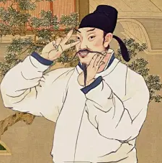
活用词汇
gifted /ˈgɪftɪd/ a.有天赋的;有天才的
1. 画作所描绘的壮丽景色和生动市井生活给我留下了深刻印象，我真的很欣赏那些有天赋的学生画家们的精彩作品。(应用文)
Impressed by the splendid scenery and the vivid civil life the paintings portrayed, I really appreciate the wonderful works by those gifted student painters.
2. 苏轼，中国宋朝一位才华横溢的学者，以其动人的诗歌和富有洞察力的散文而闻名。(应用文)
​​ Su Shi, a gifted scholar from China's Song Dynasty, was known for his moving poetry and insightful prose.
3. 她的音乐天赋在她只有一岁时就脱颖而出了。(续写)
Her musical gift stood out when she was only one year old.
4. 当他们答对时，通常会得到小礼物。(续写)
Small gifts are usually offered when they give the right answer.

Slide 49


活用词汇
come down /kʌm daʊn/ 患(病);染上(小病)
1. 自从我祖父染上了这种病，我们就轮流照顾他。(续写)
Since my grandfather came down with the disease, we have taken turns to care for him.
2. 很遗憾地通知您，我今天无法来上课，因为我发高烧了。(应用文)
​​ I regret to inform you that I will be unable to attend class today as I have come down with a high fever.
3. 他把新飞机抛向空中。它上升，下落，然后从地面上弹了起来。(续写)
He threw the new plane into the air. It went up, came down and bounced off the ground.

Slide 50

活用词汇
abstract /ˈæbstrækt/ a.抽象的 n.(文献等)摘要
1. 与许多抽象的目标相比，实际的目标能给我们带来更多勇气和信心，每当我们前进一步时。(应用文)
Compared with many abstract objectives, practical ones can bring us more courage and confidence whenever we make one step forward.
2. 理解抽象的数学概念通常需要借助具体的例子或图表进行可视化。(应用文)
Understanding abstract mathematical concepts often requires visualizing them with concrete examples or diagrams.
3. 他的思绪飘入抽象领域，凝视着星空，思索着存在的意义。(续写)
His thoughts drifted into the abstract, pondering the meaning of existence as he gazed at the starry sky.

Slide 51
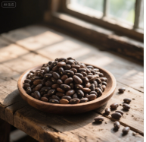
活用词汇
steady /ˈstedi/ a.稳定的;平稳的;稳步的
1. 然而，杰米灿烂地笑着，稳稳地扶住自行车让她爬上去。(续写)
Jamie, however, beamed brightly and held the bicycle steady for her to climb on.
2. 我的声音是克制而平稳的，听起来比我真实的感受要平静得多。(续写)
My voice was measured and steady, sounding far calmer than I really felt.
3. 充分与他讨论了我的想法并分享了见解，他起初漠不关心，但后来开始专心听我讲。我们的项目正在稳步推进。(续写)
​​ I fully discussed my ideas and shared my insights with him, who was once indifferent but later listened to me with close attention. We were making steady progress with our project.
4. 色调浓郁深沉如泥土般的豆子稳稳地支撑着底部。(续写)
Beans in rich, deep earth tones held the bottom steady.

Slide 52
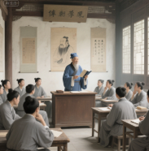
活用词汇
concept /ˈkɒnsept/ n.概念;观念
1. 此外，中国文化还包括民族历史中多样的文化思想和精神理念，主要由儒家、佛家和道家思想构成。(应用文)
Besides, Chinese culture also includes various cultural thoughts and spiritual concepts in the national history, which is mainly composed of Confucianism, Buddhism and Taoism.
2. 可持续发展的理念强调满足当代人的需求，同时不损害后代人满足其需求的能力。(应用文)
The concept of sustainable development emphasizes meeting present needs without compromising the ability of future generations to meet their own needs.
3.她关于社区花园的革命性概念，将那片空地变成了一个生机勃勃的绿色空间。(续写)
Her revolutionary concept for a community garden transformed the vacant lot into a thriving green space.

Slide 53
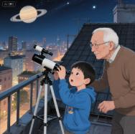
活用词汇
astronomer /əˈstrɒnəmə(r)/ n.天文学家
astronomy /əˈstrɒnəmi/ n.天文学
1. 伽利略·伽利莱，一位开创性的意大利天文学家，用他的望远镜做出了开创性的观测，挑战了当时盛行的宇宙观。(应用文)
Galileo Galilei, a pioneering Italian astronomer, made groundbreaking observations with his telescope that challenged prevailing views of the universe.
2. 那位天文学家花了无数个夜晚，通过强大的望远镜凝视星空，细致地记录着遥远恒星的移动。(续写)
The astronomer spent countless nights peering through the powerful telescope, meticulously recording the movements of distant stars.
3. 她对天文学毕生的热爱，始于她第一次通过祖父的小望远镜看到土星环的那一刻。(续写)
Her lifelong passion for astronomy began the moment she first saw Saturn's rings through her grandfather's small telescope.

Slide 54
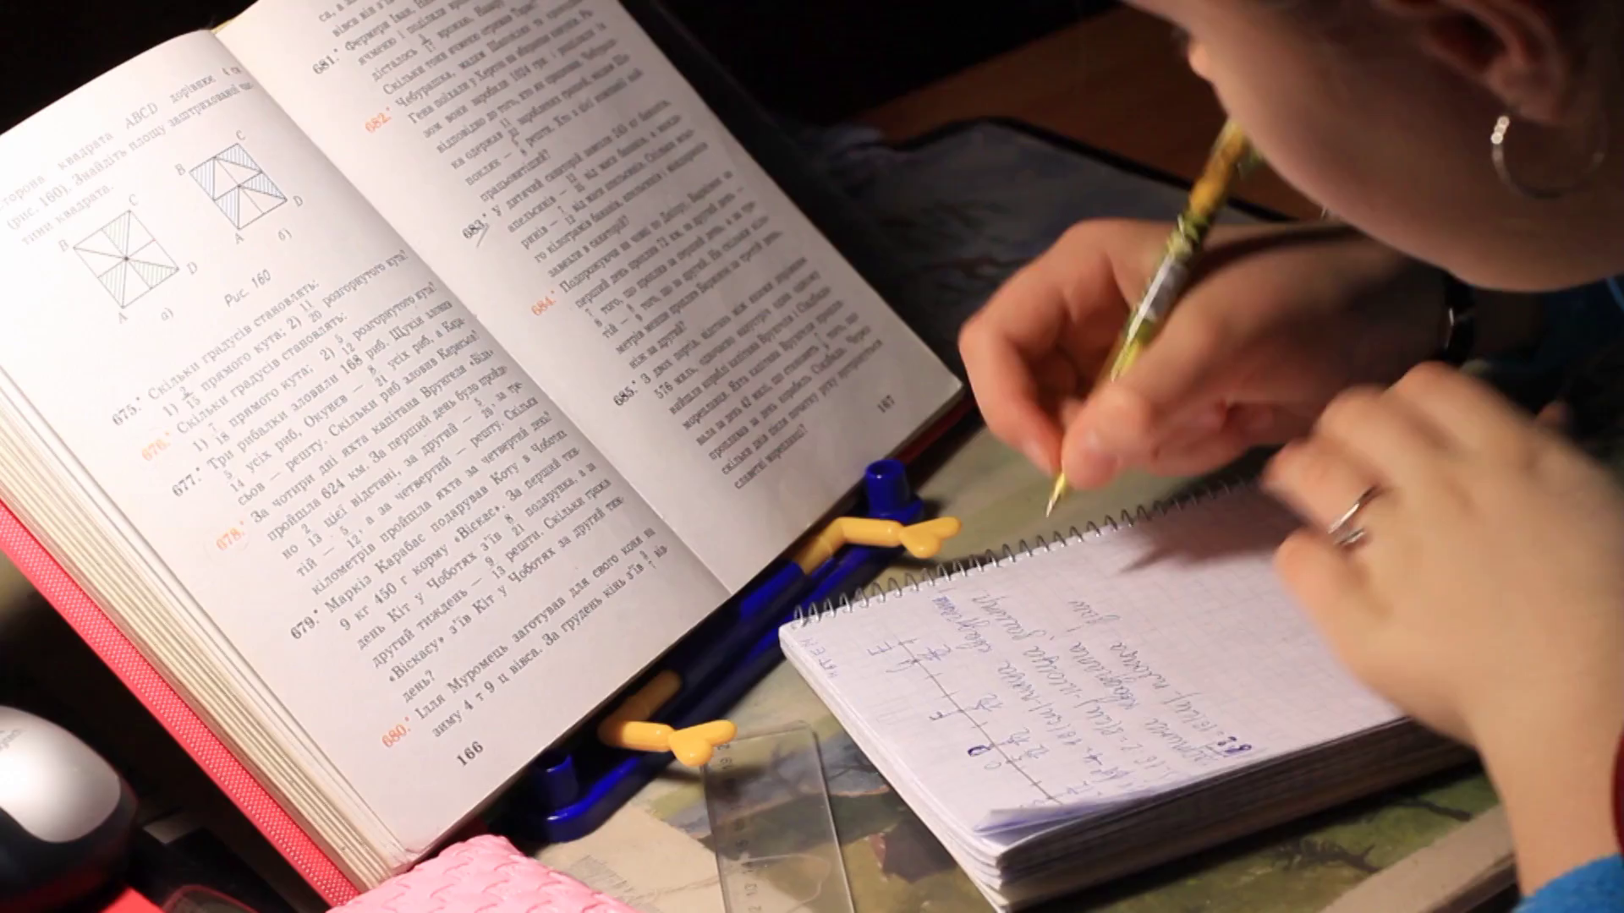

活用词汇
besides /bɪˈsaɪdz/ prep.除…外(还) ad.而且
1. 此外，向你的老师和同学寻求反馈可以提供宝贵的见解和改进建议。(应用文)
Besides, asking for feedback from your teachers and peers can provide valuable insights and suggestions for improvement.
2. 此外，出国旅行需要大量时间，而这些时间本可用于我的学习。(应用文)
Besides, travelling abroad takes much time, which will otherwise be used for my studies.
3. 此外，我们将拜访一些当地居民的家。(应用文)
Besides, we will call on some local residents at their homes.
4.此外，由于数字设备便于携带，人们可以随时随地通过数字设备享受阅读的乐趣。(应用文)
​​ Besides, with digital devices easy to carry around, people can enjoy the fun of reading anytime anywhere on digital devices.

Slide 55

活用词汇
brilliant /ˈbrɪliənt/ a.聪颖的;绝妙的;明亮的
1. 您关于改进项目结构的绝妙建议确实是无价的，直接促成了我们的成功。(应用文)
Your brilliant suggestion on improving the project structure was truly invaluable and led directly to our success.
2. 天空喷发出一连串的烟花，一个充满惊喜的景象，以其璀璨的光芒照亮了夜空。(续写)
The sky erupted in a cascade of fireworks, a spectacle of surprise that illuminated the night with its brilliance.
3. 更重要的是，多年的班长经历使我成为一名出色的组织者，这将极大地有助于维持活动秩序。(应用文)
What's more, years of being monitor makes me a brilliant organizer, which will help a lot to keep the activity in order.

Slide 56
Thank you

