Slide 1


感恩遇见，相互成就，本课件资料仅供您个人参考、教学使用，严禁自行在网络传播，违者依知识产权法追究法律责任。
更多教学资源请关注
公众号：溯恩英语
知识产权声明

Slide 2

The World
September 1st-15th, 2025

Slide 3
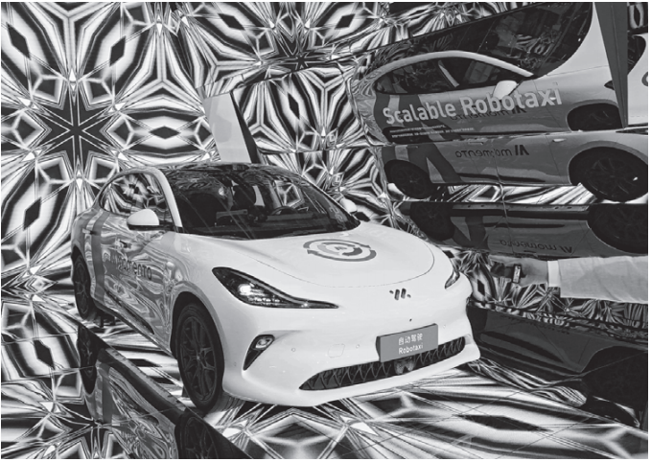
1. Uber and Self-Driving Firm Team Up
优步与自动驾驶公司联手合作

Slide 4
Text Completion
The Wall Street Journal (September 9, 2025 PB4)
Ride-hailing company Uber Technologies and Chinese autonomous-driving company Momenta are collaborating _________(test) autonomous vehicles in Germany next year.
The companies said in a joint statement Monday that Momenta’s advanced autonomous driving technology ______________ (integrate) with Uber’s global platform to provide robotaxi services.
The partnership will start testing in Munich next year with the goal of ___________ (expand) to other European cities, they said.
The collaboration comes ____ robotaxi companies around the world have been scaling up their fleet sizes, thanks to advanced autonomous driving technology and as countries become __________ (open) to testing the advanced technology.
“Testing L4 autonomous vehicles in Munich allows us to showcase _____ Momenta’s AI-driven Robotaxi technology can transform urban mobility, as ___new chapter in the region’s rich automotive heritage,” said Xudong Cao, chief executive of Momenta.
Momenta ________ (operate) a robotaxi service in Shanghai and has provided its autonomous driving technology to major automakers including German brands such as MercedesBenz, BMW and Audi.
Uber has been collaborating _____ robotaxi companies to explore autonomous driving services.
The ride-hailing app has partnered with Chinese robotaxi ___________(company) WeRide and Pony AI in the Middle East.
to test
will be integrated
expanding
as
more open
how
a
operates
with
companies

Slide 5
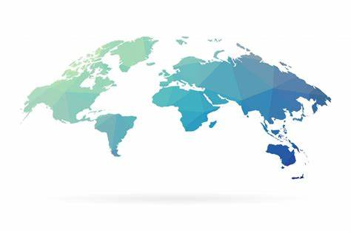
Reading Comprehension
1. What is true about the Uber-Momenta collaboration according to the passage?
A. Momenta's technology will be used for Uber's robotaxis in Germany.
B. The testing will begin in Munich and expand to other European cities.
C. Momenta currently operates robotaxi services only in Shanghai.
D. Uber has previously partnered with WeRide and Pony AI in Europe.
DETAIL
2. What is the main idea of the passage?
A. A partnership to test and expand autonomous ride-hailing services in Europe.
B. The superiority of Chinese autonomous driving technology over German brands.
C. The challenges of implementing L4 autonomous vehicles in urban areas.
D. Uber's strategy to replace all human drivers with autonomous technology.
GIST

Slide 6
Vocabulary
1. fleet: a group of planes, buses, taxis, etc. travelling together or owned by the same organization （同一机构或统一调度的）机群，车队
With its own fleet of trucks, the company delivers most orders overnight.
因为有自己的运输车队，该公司的大部分订货可以第二天就送到。
2. transform: to completely change the appearance or character of sth, especially so that it is better 使改变外观（或性质）；使改观；
A new colour scheme will transform your bedroom.
新的色彩调配将使你的卧室焕然一新。
Translation
一支极其强大的舰队集结在珍珠港。
An enormously powerful fleet was concentrated at Pearl Harbour.
Translation
那是能够彻底改变我一生的一件事。
It was an event that would transform my life.

Slide 7
Translation
The technology secretary, Peter Kyle, has hinted that the government was weighing up the possiblility of making cut-off times mandatory for apps such as TikTok and Instagram. Rani Govender, the policy manager for child safety online at the NSPCC, said the curfews alone could not stop exposure to harmful materials.
英国技术大臣Peter Kyle暗示，政府正在考虑强制对TikTok和Instagram等应用实施断网时间。全国防止虐待儿童协会(NSPCC)儿童在线安全政策经理Rani Govender表示，仅靠使用宵禁并不能阻止儿童接触有害内容。
He said algorithms can provide content which “can quickly spiral and take young people down rabbit holes of harmful and disstressing material”. New laws were “urgently required to finally embed a safe-by-design approach to regulation that puts the needs of children and society ahead of those of big tech”, he said.
他指出，算法推荐的内容“可能迅速失控，将年轻人引入有害和令人痛苦的深渊”。他表示，英国“亟需出台新法规”，从而“最终将安全设计原则纳入监管框架，优先保障儿童和社会需求，而非大型科技公司的利益”。

Slide 8
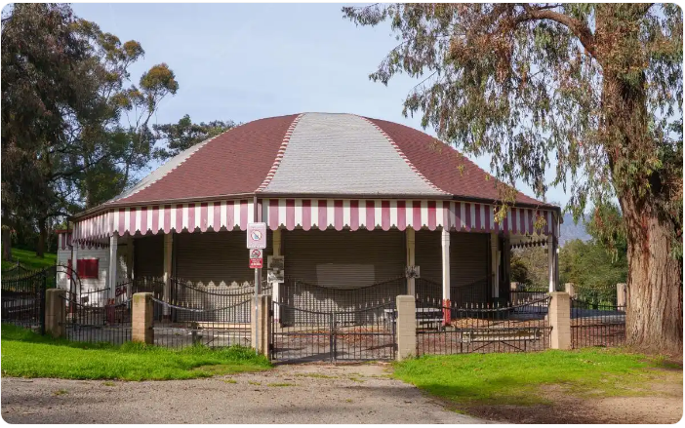
2. L.A. buys Griffith Park carousel, where Disney dreamed up theme park
洛杉矶市购得格里菲斯公园旋转木——马迪士尼构想主题公园的地方

Slide 9
Text Completion
Los Angeles Times (September 9, 2025 PB1,B5)
The Griffith Park carousel —— a “crown jewel” of the park, _____ Walt Disney first dreamed up Disneyland— is getting a new lease on life just in time for its 2026 centennial. The city of Los Angeles' Recreation and Parks Commission inked a million-dollar deal to buy ____ historic amusement ride late last month.
Its previous operator, Julio Gosdinski, _____ (die) suddenly near the height of the COVID-19 pandemic, ________ (leave) the amusement in limbo just as COVID restrictions were starting to ease.
After the parks commission agreement, the stable of hand-carved basswood and poplar horses will spin under city auspices, part of a broader restoration of the section of the park, which is slated _____________ (complete) ahead of the Olympic Games in 2028.
The carousel is one of the ______ (old) wooden merry-go-rounds in California and one of just a handful designed by the famous Spillman Engineering Corp. and its predecessor that remain ____ operation in the state. The current merry-go-round was built in 1926 and relocated to Griffith Park in the depths of the Great Depression in 1937.
“Walt Disney _________ (regular) frequented the Merry-Go-Round on Saturdays, watching his daughters ride around and daydreaming of one day creating his own theme park,” the city agreement said.
But the amusement will require significant repairs before it can reopen, documents show. According to the ____________ (department) proposal, the sellers had higher offers but wanted the merry-go-round to keep twirling in its longtime home.
No reopening date _________________ (announce).
where
the
died
leaving
to be completed
oldest
in
regularly
department’s
has been announced

Slide 10
Reading Comprehension
1. What is true about the Griffith Park carousel according to the passage?
A. It was designed by Walt Disney and built during the Great Depression.
B. It will be fully restored and reopened for the 2028 Olympic Games.
C. It is one of the few remaining operational Spillman-designed carousels in California.
D. It was purchased by the city despite receiving lower offers from other buyers.
DETAIL
2. What is the main focus of the passage?
A. The historical significance and future restoration of a landmark carousel.
B. Walt Disney’s personal connection to Griffith Park and its influence on Disneyland.
C. The impact of the COVID-19 pandemic on the operation of amusement rides.
D. The city’s efforts to revitalize Griffith Park in preparation for the 2028 Olympics.
GIST

Slide 11
Vocabulary
1. ink: to sign a document, especially a contract 签署，签订（合同等）
A formal contract is inked which is renewable annually.
签署的一份正式合同每年可续签一次。
2. limbo: a situation in which you are not certain what to do next, cannot take action, etc., （尤指因等待他人作决定）处于不定状态
His life seemed stuck in limbo; he could not go forward and he could not go back.
他的生活好像陷入了不知所措的境地，进退两难。
Translation
这个集团刚刚签订了一份1 000万元的协议。
The group has just inked a $10 million deal.
Translation
谈判自12月中旬已陷入了僵局。
The negotiations have been in limbo since mid-December.
.

Slide 12
Translation
After the parks commission agreement, the stable of hand-carved basswood and poplar horses will spin under city auspices, part of a broader restoration of the section of the park, which is slated to be completed ahead of the Olympic Games in 2028.
在公园管理委员会达成协议后，这批由手工雕刻的椴木和杨木制成的马匹将在市政府的支持下旋转起来，这是公园这一区域更广泛修复工作的一部分，预计将在 2028 年奥运会之前完工。
“Walt Disney regularly frequented the Merry-Go-Round on Saturdays, watching his daughters ride around and daydreaming of one day creating his own theme park,” the city agreement said.
该市协议称：“沃尔特·迪士尼经常在周六光顾旋转木马，看着女儿们一圈圈地骑着，梦想着有朝一日能创建自己的主题公园。”

Slide 13
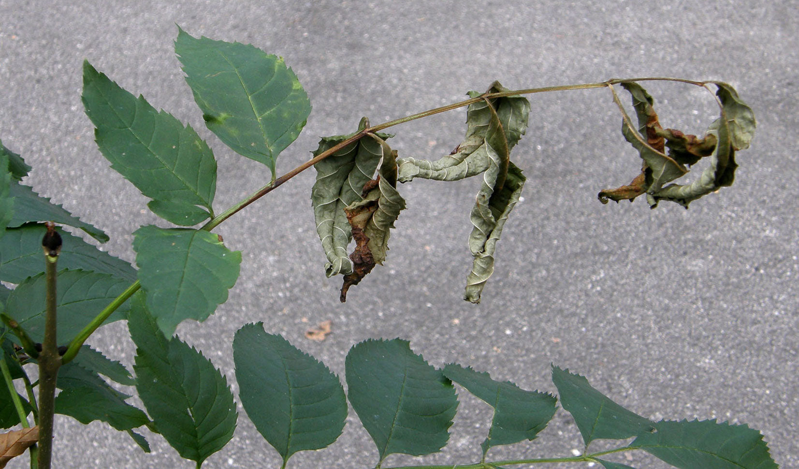
3. Ash trees fight back
白蜡树奋起反抗

Slide 14
Reading Comprehension
BBC Wildlife（September, 2025 P17)
With more than 150 million individual trees in Britain, the ash is a significant species in our woodlands. But for more than a decade it has been heavily impacted by ash dieback, a fungus that originated in Asia. It had been predicted that up to 85 percent of all UK ash trees will succumb to the disease – but now there are signs that ash is evolving resistance to the fungus. A study carried out by scientists at Kew Gardens and Queen Mary University of London has found subtle changes in the DNA of new generations of trees that may allow them to outwit it.
Richard Buggs, professor of evolutionary genomics at Queen Mary, says the findings suggest the ash will not – as once feared – go the way of the elm tree, which has all but disappeared from the British countryside as a result of Dutch elm disease. “Ash trees are showing a very different dynamic because they produce an abundance of seedlings upon which natural selection can act when they are still young,” he says. A single tree can produce 100,000 of its distinctive ash ‘keys’, sometimes called helicopter seeds, every other year.
The ash dieback fungus was first spotted in Europe about 30 years ago, and identified in Britain in 2012. Signs of the disease are orange-brown lesions where branches meet the trunk, dead shoots and branches, and black and wilting leaves.
Ash trees are regarded as a keystone species in woodland habitats. More than 950 species depend on them and it’s been estimated that the total cost of ash dieback to the UK economy in lost ecosystem services will be £15 billion over 100 years.

Slide 15

Reading Comprehension
1. The word “succumb” in paragraph 1 is closest in meaning to ________.
A. resist B. yield C. adapt D. contribute
INFERENCE
2. What is a key reason that ash trees might avoid the fate of elm trees?
A. They are treated with a new effective fungicide.
B. They produce a large number of seeds for natural selection.
C. They are being protected in special government reserves.
D. They have been completely removed from infected areas.
VOCABULARY
3. Which of the following is the best title for the text?
A. The Economic Crisis Caused by Tree Diseases
B. The Total Disappearance of British Elm Trees
C. A New Fungus Threatening European Woodlands
D. Hope for Ash Trees: Evolution Fights Back Against Disease
GIST

Slide 16
Vocabulary
1. succumb: to not be able to fight an attack, an illness, a temptation , etc.屈服；屈从；抵挡不住（攻击、疾病、诱惑等）
His career was cut short when he succumbed to cancer. 他的事业随着他死于癌症而中断。
2. outwit: to defeat sb/sth or gain an advantage over them by doing sth clever（智力上）超过，胜过
Somehow he always manages to outwit his opponents.
他反正总能设法智胜对手。
Translation
他最终为露西的魅力所倾倒，答应了她的请求。
He finally succumbed to Lucy’s charms and agreed to her request.
Translation
在这个故事里，狡猾的狐狸智胜了猎人。
In the story, the cunning fox outwits the hunters.

Slide 17
Translation
With more than 150 million individual trees in Britain, the ash is a significant species in our woodlands. But for more than a decade it has been heavily impacted by ash dieback, a fungus that originated in Asia.
在英国，有超过 1.5 亿棵白蜡树，这种树在我们的林地中占有重要地位。但近十年来，白蜡树一直深受白蜡枯萎病的严重影响，这种病菌源自亚洲。
Ash trees are regarded as a keystone species in woodland habitats. More than 950 species depend on them and it’s been estimated that the total cost of ash dieback to the UK economy in lost ecosystem services will be £15 billion over 100 years.
白蜡树在林地生态系统中被视为关键物种。超过 950 个物种依赖于它们。据估计，白蜡树疫病对英国经济造成的因生态系统服务丧失而产生的总损失将在 100 年内达到 150 亿英镑。

Slide 18

4. Households most likely to splash the cash on a holiday
最舍得为度假挥金如土的家庭

Slide 19
Text Completion
The Times（September 8, 2025 P13)
when
Holidays are the top priority for households ______ it comes to spending discretionary money, ahead of dining out and home renovations, a survey shows.
People were able to choose up to three spending priorities.The survey of 2,000 people, commissioned by Travel Counsellors and carried out by Census wide, ______ (find) that even 39 percent of those who saw themselves as “disciplined” savers and rarely treated themselves saw holidays as a priority.
When ______ (ask) about broader financial goals, 22 percent of people surveyed said their top ambition would be to have enough cash ________ (travel) the world while only 7 percent cited milestones such as weddings. Seventy-one percent of people surveyed, in June, _________ (take) a holiday in the past 12 months. Thirty-four percent of holidaymakers estimated they would spend more on holidays this year _____ last; 56 percent planned to spend about the same and 9 percent said they were looking to cut back.
While people questioned ________ (typical) spent between £501 and £1,000 on a single holiday booking in the past year, those _______ (earn) over £120,000 spent £9,501 to £10,000 on a single trip.
The most popular holiday luxuries ____ people enjoyed were local shopping and buying souvenirs, luxury _______________(accommodate), drinks at scenic sites and dining out at high-end restaurants, the survey found.
found
asked
to travel
had taken
than
typically
earning
that
accommodation

Slide 20
Vocabulary
1. discretionary: decided according to the judgement of a person in authority about what is necessary in each particular situation; not decided by rules自由决定的；酌情行事的；便宜行事的
Magistrates were given wider discretionary powers. 地方法官们被赋予了更广泛的酌情决定权。
2. commission: to officially ask sb to write, make or create sth or to do a task for you 正式委托
She has been commissioned to write a new national anthem.
她已接受谱写新国歌的委托。
Translation
这些加薪完全是酌情决定的。
These pay rises are purely discretionary.
Translation
出版商已委托人把这本书译成法语。
Publishers have commissioned a French translation of the book.

Slide 21
Translation
Holidays are the top priority for households when it comes to spending discretionary money, ahead of dining out and home renovations, a survey shows.
一项调查显示，在可自由支配的消费方面，度假是家庭的首要选择，排在外出就餐和家庭装修之前。
The most popular holiday luxuries that people enjoyed were local shopping and buying souvenirs, luxury accommodation, drinks at scenic sites and dining out at high-end restaurants, the survey found.
调查结果显示，人们最喜爱的度假休闲活动包括当地购物和购买纪念品、豪华住宿、景区内的饮品消费以及在高档餐厅用餐。

Slide 22

5. BBC News 09/12/2025

Slide 23

Dictation
Traditional diets are being __________ by ultra-processed foods, often high in sugar, starch, salt, unhealthy fats and __________. While undernutrition remains a significant problem in the under fives in many low and middle income countries, among school-age children and adolescents, one in 5 is ____________ and one in 10 is obese. UNICEF warns that the health impacts and economic costs are potentially ___________. It urges governments to take action, including on the labeling and marketing of food, as well as protecting any policy-making from _____________ by the ultra-processed food industry.
The army in Nepal says a nationwide curfew will be in force until Thursday morning to restore ______________ after violent anti-corruption protests that prompted the government to quit. Soldiers are patrolling the streets of Kathmandu and have set up roadblocks. The army says it’s arrested more than 20 people ______________ violence and looting. On Tuesday, demonstrators __________ numerous buildings, including the Parliament, the Supreme Court, and the Prime minister’s residence.
Two people have died in _______ that hit the Indonesian island of Bali following heavy rainfall. ________________ are still underway. The local authorities say the rain caused rivers in Denpasar to overflow. They added that the drainage system has been clogged with rubbish.
displaced
additives
overweight
enormous
interference
law and order
suspected of
set fire to
floods
Evacuation efforts

Slide 24
Vocabulary
1. drainage: the process by which water or liquid waste is drained from an area 排水过程
Proper drainage is essential for preventing waterlogging in agricultural fields. 适当的排水对于防止农田积水至关重要。
2. clog: to fill or cover something so that movement or activity is difficult 塞满，挤满
The streets were clogged with traffic.
街道上挤满了车辆。
Translation
该市改善了排水系统以应对强降雨。
The city improved its drainage system to handle heavy rainfall.
Translation
排水管被头发塞满了。
The drain is clogged with hair.

Slide 25
Translation
UNICEF warns that the health impacts and economic costs are potentially enormous. It urges governments to take action, including on the labeling and marketing of food, as well as protecting any policy-making from interference by the ultra-processed food industry.
联合国儿童基金会警告说，健康影响和经济成本可能是巨大的。它敦促各国政府采取行动，包括在食品标签和营销方面采取行动，并保护任何政策制定不受超加工食品行业的干扰。
Two people have died in floods that hit the Indonesian island of Bali following heavy rainfall. Evacuation efforts are still underway. The local authorities say the rain caused rivers in Denpasar to overflow. They added that the drainage system has been clogged with rubbish.
印尼巴厘岛因暴雨引发洪水，造成两人死亡。疏散工作仍在进行中。当地政府表示，大雨导致登巴萨的河流泛滥。他们补充说，排水系统已经被垃圾堵塞了。

