Slide 1


感恩遇见，相互成就，本课件资料仅供您个人参考、教学使用，严禁自行在网络传播，违者依知识产权法追究法律责任。
更多教学资源请关注
公众号：溯恩英语
知识产权声明

Slide 2

应用文写作思辨性思维训练：
议论文：“二选一 + 理由”类
从 “选得好” 到 “说得透”
刘艳

Slide 3
试卷名称 | 题目内容 | 题目特点
重庆市 2026 年 9 月调研测试卷 | 假定你是李华，你校计划举办一次英语周活动，外教 Mr. Smith 提出了两个方案：“English Song Competition” 和 “English Word Spelling Contest”，请你给他写一封邮件，内容包括：1. 你的选择；2. 说明理由。 | 1. 体裁为邮件，格式固定（含称呼、落款）；2. 核心任务 “二选一 + 多维理由”（英语周活动方案二选一）；3. 场景为校园活动建议，受众为外教（需兼顾英语表达实用性与礼貌性）；4. 词数要求 80 左右，需按指定格式作答。
青岛市 2025-2026 学年高三期初调研卷 | 假定你是李华，你校英语社团将举行 “Stories of China” 英语演讲比赛。交换生 Jenny 想从 “愚公移山” 和 “孔融让梨” 中选择一个参赛，特向你寻求建议。请你写一封邮件，内容包括：1. 你的建议；2. 说明理由。 | 1. 体裁为邮件，格式固定；2. 核心任务 “二选一 + 理由”（演讲比赛中国故事选题二选一）；3. 场景为演讲比赛建议，受众为交换生（需兼顾中国文化内涵与跨文化传播性）；4. 词数要求 80 左右，可适当补充细节。
雅礼中学 2026 届高三月考试卷（ | 假定你是李华，你校外教 David 打算带领学生创办每周英语视频播客，现在正在征求学生意见，需要从以下两个主题中选择一个作为播客的主题：“Emotional Outlets（解忧树洞）” 和 “Futuristic Vision（未来愿景）”。请你写一封邮件，内容包括：1. 你的选择；2. 你推荐的理由。 | 1. 体裁为邮件，格式固定；2. 核心任务 “二选一 + 理由”（英语播客主题二选一）；3. 场景为播客创办建议，受众为外教（需兼顾学生需求与播客持续价值）；4. 词数要求 80 左右，可适当补充细节。
2025 年 6 月高考全国卷（ | 假定你是李华，你班的英语报要增设一个栏目。外教 Jenny 提出 “Fun at my school” 和 “Guess who I am” 两个选项供大家选择。请给 Jenny 写一封邮件，内容包括：（1）你的选择；（2）说明理由。注意：1. 写作词数应为 80 左右；2. 按指定格式作答（开头已给出：Dear Jenny,I really like the idea of adding a new column to our English newspaper.） | 1. 体裁为邮件，格式固定（开头已预设）；2. 核心任务 “二选一 + 理由”（英语报栏目增设二选一）；3. 场景为班级报纸建议，受众为外教（需贴合报纸传播性与学生互动性）；4. 选项贴近学生生活，强调真实情境；5. 词数要求 80 左右，需按指定格式作答。
均为邮件体裁，有明确格式要求（称呼、落款，部分预设开头）；
2. 核心任务统一为 “二选一 + 说明理由”，需明确表态，拒绝模糊；
3. 场景均为校园 / 学习相关（活动、比赛、播客、报纸栏目），贴近学生日常；
4. 受众均为师长（外教 / 交换生），需贴合身份语气（礼貌、实用）

Slide 4
“选择 + 理由” 类应用文写作思路拆解
步骤 | 核心目标 | 操作方法 （以青岛卷 “选愚公移山” 为例）
1. 审题定位 | 明确 “选择对象 + 受众 + 场景” | 选择对象：愚公移山；受众：Jenny（交换生，对中国文化了解有限）；场景：英语演讲比赛（需易懂、有感染力）
2. 挖掘核心需求 | 找到 “选择” 与 “受众 / 场景” 的匹配点 | Jenny 的需求：能清晰用英语传达文化，让外国听众理解；演讲比赛需求：故事有冲突、有价值观输出→愚公移山 “坚持” 主题易传达
3. 多维拆解理由 | 从 “不同维度” 构建论据，避免单薄 | 维度 1：文化内涵（体现中国 “坚持不懈” 的精神，比 “礼仪” 更具普世价值）； 维度 2：演讲效果（故事有情节：移山挑战→子孙接力，易讲生动）； 维度 3：受众共鸣（外国人也懂 “克服困难”，比 “谦让” 更易共情）
4. 具象化支撑 | 每个理由加 “具体细节” | 维度 2 补充：“演讲时可描述‘愚公面对大山不放弃’的场景，

Slide 5
理由深化的 “4 大思维角度”
思维角度 | 核心逻辑 | 应用示例 （以雅礼卷 “选解忧树洞” 为例） | 效果对比 （学生原理由 vs 深化后）
1. 个人→集体 | 从 “个人受益” 延伸到 “他人 / 集体价值” | 原理由：“学生有压力，需要倾诉”；深化后：“不仅能帮有压力的学生倾诉（个人），还能让其他学生学会倾听（集体），营造班级温暖氛围” | 单薄（只说个人）→ 全面（个人 + 集体）
2. 短期→长期 | 从 “当下效果” 延伸到 “长期影响” | 原理由：“播客能让学生练英语”；深化后：“短期能练口语（当下），长期能培养‘用英语解决心理问题’的能力（未来），比‘聊未来’更实用” | 只看短期（如 “播客有趣”）→ 有深度（短期 + 长期）
3. 功能→情感 | 从 “表层功能” 延伸到 “深层情感 / 价值” | 原理由：“学生可以说自己的烦恼”；深化后：“不仅能让学生‘说出烦恼’（功能），还能让他们感受到‘被理解’（情感），缓解焦虑” | 只说功能（如 “能练英语”）→ 有温度（功能 + 情感）
4. 对比→优势 | 与 “另一选择” 对比，突出独特优势 | 原理由：“解忧树洞比未来愿景好”；深化后：“‘未来愿景’需要大量专业词汇（如 AI、space），学生易卡壳；而‘解忧树洞’用日常英语即可，参与门槛低，更易坚持” | 无对比（只说自己选的好）→ 说服力强（对比显优势）

Slide 6
重庆市 2026 年 9 月调研卷（选择 “English Song Competition”）
思维角度 | 中文具体理由（供学生梳理思路） | 英文翻译（供学生对照练习）
个人→ 集体 | 班里 80% 同学喜欢音乐，选择英语歌曲比赛能让内向同学通过合唱融入集体，避免有人因不敢单独参与而放弃。 | 80% of classmates like music; choosing the English Song Competition allows shy students to integrate into the group through chorus, preventing anyone from giving up for fear of participating alone.
短期→ 长期 | 活动当天学生能边唱《Yesterday》边记 “memory”“yesterday” 等歌词单词（短期）；长期能让学生觉得英语学习有趣，主动积累更多词汇。 | On the event day, students can memorize words like "memory" and "yesterday" from the song Yesterday while singing (short-term); in the long run, it makes students find English learning fun and take the initiative to accumulate more words.
功能→ 情感 | 唱歌能自然纠正发音（功能），学生完成小组表演后获得评委和同学的掌声，会产生 “我能学好英语” 的成就感（情感）。 | Singing can naturally correct pronunciation (function); after students finish their group performance and get applause from judges and classmates, they will feel a sense of accomplishment that "I can learn English well" (emotion).
对比→ 优势 | 另一选项 “英语拼写比赛” 需要死记硬背单词，基础弱的学生易受挫；而歌曲比赛边玩边学，所有学生都能参与。 | The other option "English Word Spelling Contest" requires rote memorization of words, which easily frustrates students with weak foundations; while the song competition allows learning while playing, so all students can participate.

Slide 7
青岛市 2025-2026 学年高三期初调研卷（选择 “愚公移山”）
思维角度 | 中文具体理由 | 英文
个人→ 集体 | Jenny（交换生）用英语讲 “愚公坚持挖山” 时，外国听众会联想到自己 “备考克服困难” 的经历，比听 “孔融让梨” 更容易产生共鸣。 | When Jenny (the exchange student) tells the story of "Yugong persisting in digging mountains" in English, foreign audiences will think of their own experience of "overcoming difficulties in exam preparation" and resonate more easily than listening to "Kong Rong Gives Up Pears".
短期→ 长期 | 短期来看，Jenny 能因故事线清晰（挖山→坚持）流畅完成演讲；长期能让外国同学记住中国 “不放弃” 的文化，愿意了解更多中国故事。 | In the short term, Jenny can finish the speech fluently because of the clear story line (digging mountains → persistence); in the long run, it helps foreign classmates remember China’s "never give up" culture and be willing to learn more Chinese stories.
功能→ 情感 | 愚公移山的故事不用复杂英语就能讲清楚（功能：易表达），结尾说 “This spirit helps me face English barriers”，能让听众感受到 “勇气” 的力量（情感）。 | The story of Yugong Moves Mountains can be told clearly without complex English (function: easy to express); ending with "This spirit helps me face English barriers" allows the audience to feel the power of "courage" (emotion).
对比→ 优势 | “孔融让梨” 需要额外解释 “为什么让梨是礼仪”，外国听众易困惑；愚公移山的 “坚持” 是全世界都懂的品质，不用多余背景说明。 | "Kong Rong Gives Up Pears" needs extra explanation of "why giving up pears is etiquette", which easily confuses foreign audiences; the "persistence" in Yugong Moves Mountains is a quality understood worldwide, requiring no extra background explanation.

Slide 8
雅礼中学 2026 届高三月考试卷（选择 “Emotional Outlets”）
思维角度 | 中文具体理由（供学生梳理思路） | 英文翻译（供学生对照练习）
个人→集体 | 有学生用英语说 “我担心作业太多”，其他同学会回复 “I can help you with math”，慢慢形成 “有人倾诉、有人帮忙” 的班级互助氛围。 | Some students say "I’m worried about too much homework" in English, and other classmates will reply "I can help you with math", gradually forming a class mutual assistance atmosphere of "someone to talk to and someone to help".
短期→长期 | 短期能帮学生用英语宣泄考试焦虑（如说 “I’m stressed about exams”）；长期能让学生从 “只会说情绪” 到 “说清情绪原因”，表达更精准。 | In the short term, it helps students vent exam anxiety in English (e.g., saying "I’m stressed about exams"); in the long run, it allows students to move from "only expressing emotions" to "explaining the reasons for emotions", making expressions more accurate.
功能→情感 | 学生用 “worried”“happy” 等日常英语聊烦恼（功能：练口语），听到同学说 “Me too” 时，会觉得 “不是只有我这样”，获得情感安慰（情感）。 | Students talk about troubles using daily English words like "worried" and "happy" (function: practice speaking); when they hear classmates say "Me too", they will feel "I’m not the only one like this" and get emotional comfort (emotion).
对比→优势 | “未来愿景” 播客需要说 “AI”“nanotechnology”（纳米技术）等难词，学生查词半天还不敢说；解忧树洞用简单词就能交流，没人会怕开口。 | The "Futuristic Vision" podcast requires difficult words like "AI" and "nanotechnology"; students spend a long time looking up words but still dare not speak. Emotional Outlets allows communication with simple words, so no one is afraid to speak.

Slide 9
2025 年 6 月高考全国卷（选择 “Fun at my school”）
思维角度 | 中文具体理由（供学生梳理思路） | 英文翻译（供学生对照练习）
个人→集体 | 学生分享 “社团烘焙活动” 时，会写 “我们卖了 50 块饼干，钱捐给慈善”，其他同学读了会想 “下次我也要投稿，分享自己的经历”，让报纸更受欢迎。 | When students share "club baking activities", they will write "We sold 50 cookies and donated the money to charity"; other classmates will think "I want to contribute next time" after reading, making the newspaper more popular.
短期→长期 | 短期能让英语报内容不单调（有故事、有细节）；长期学生为把趣事写生动，会主动加细节（从 “We played basketball” 到 “We won because Tom passed well”），写作能力自然提升。 | In the short term, it makes the English newspaper content not boring (with stories and details); in the long run, to make interesting stories vivid, students will take the initiative to add details (from "We played basketball" to "We won because Tom passed well"), so writing ability improves naturally.
功能→情感 | 这个栏目能记录春游、校庆等校园生活（功能：留素材）；毕业多年后学生翻看报纸，会想起 “原来我高中有这么多开心事”，留下温暖回忆（情感）。 | This column can record campus life like spring trips and school anniversaries (function: keep materials); many years after graduation, when students read the newspaper, they will remember "I had so many happy things in high school" and keep warm memories (emotion).
对比→优势 | Fun at my school 每月有新主题（义卖、运动会），学生永远有素材投稿。 | Fun at my school has new themes every month (charity sales, sports meets), so students always have materials to contribute.

Slide 10
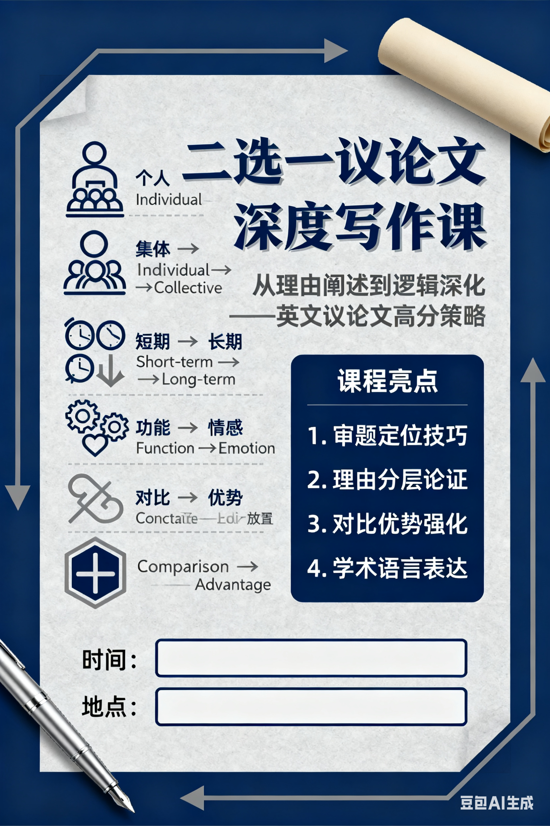
重庆市 2026 年 9 月调研测试卷：
假定你是李华，你校计划举办一次英语周活动，外教 Mr. Smith 提出了两个方案：“English Song Competition” 和 “English Word Spelling Contest”，请你给他写一封邮件，内容包括：1. 你的选择；2. 说明理由。
P1：背景+目的
我写这封邮件是想就英语周活动表达我的看法 —— 我强烈建议选择 “英语歌曲比赛”，因为它在很多方面更符合我们学生的需求。
I’m writing to share my opinion on the English Week activity—I strongly recommend choosing the "English Song Competition" because it fits our students’ needs better in many aspects.

Slide 11
P2：理由
唱英文歌不仅能帮我们练习语言技能，还能缓解学习压力。在忙碌的课程之后，准备歌曲比赛更像是一次轻松的休息，而非负担。比如，当我们唱《Take Me to Your Heart》或《Big Big World》这类熟悉的歌曲时，既能享受音乐，又能复习单词和句子，这让英语学习变得更愉快。
Singing English songs can not only help us practice language skills but also relieve our study pressure. After busy classes, preparing for the song competition feels like a relaxing break rather than a burden. For example, when we sing familiar songs like Take Me to Your Heart or Big Big World, we can enjoy the music while reviewing words and sentences, which makes English learning more pleasant.

Slide 12
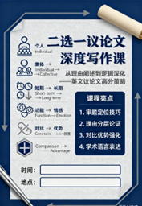
P2：理由
而且，歌曲比赛能为英语周营造热烈的氛围，这对产生长期影响很有帮助。短期来看，它能让每个学生发挥自己的优势 —— 即使是不擅长拼写的同学，也能通过唱歌展现自己。长期来看，它会激发学生对英语文化的兴趣：比赛结束后，我们很多人可能会主动去听更多英文歌或看英文音乐视频，这有助于提升我们的英语综合能力。
What’s more, the song competition can create a lively atmosphere for the English Week, which is good for a long-term impact. Short-termly, it allows every student to show their strengths—even those who are not good at spelling can shine by singing. Long-termly, it will arouse students’ interest in English culture: after the competition, many of us may take the initiative to listen to more English songs or watch English music videos, which helps improve our comprehensive English ability.

Slide 13
P2：理由
最后同样重要的是，和英语拼写比赛相比，歌曲比赛对不同英语水平的学生更具包容性。拼写比赛主要依赖死记硬背，这可能会让基础薄弱的同学感到气馁。但歌曲比赛形式灵活 —— 如果我们没信心，可以选简单的歌；如果想挑战，也可以选难度大的。这样一来，没人会觉得被排斥，更多学生都会愿意参与到英语周活动中来。
Last but not least, compared with the English Word Spelling Contest, the song competition is more inclusive for students with different English levels. The spelling contest mainly depends on rote memorization, which may make students with weak foundations feel discouraged. However, the song competition has flexible forms—we can choose easy songs if we’re not confident, or challenge difficult ones if we want. This way, no one will feel left out, and more students will be willing to join in the English Week activity.

Slide 14
P3：期待祝福
我真心希望这次活动能顺利开展，也感谢您抽出时间考虑我的建议。
I really hope this activity can come true, and thank you for taking the time to consider my suggestion.

Slide 15
下水作文
Dear Mr. Smith,
I’m writing to share my opinion on the English Week activity—I strongly recommend choosing the "English Song Competition" because it fits our students’ needs better in many aspects.
Singing English songs can not only help us practice language skills but also relieve our study pressure. After busy classes, preparing for the song competition feels like a relaxing break rather than a burden. What’s more, the song competition can create a lively atmosphere for the English Week, which is good for a long-term impact. Last but not least, compared with the English Word Spelling Contest, the song competition is more inclusive for students with different English levels. The spelling contest mainly depends on rote memorization, which may make students with weak foundations feel discouraged. However, the song competition has flexible forms.
I really hope this activity can come true, and thank you for taking the time to consider my suggestion.

Slide 16
参考范文
Dear Mr. Smith,
Thank you for proposing the two wonderful ideas for English Week. I would recommend the English Song Competition for the following reasons.
First, singing English songs is a fun way to improve pronunciation and vocabulary naturally. Many students enjoy music, so participation would be high. Second, this activity allows creative performances - solo, duets, or even group acts - making it more engaging than a traditional contest. Lastly, we can invite judges to give feedback on both language skills and stage presence, adding educational value.
I’m sure this event will be both fun and educational for everyone. Looking forward to hearing your thoughts.
Yours,
Li Hua

