Slide 1


感恩遇见，相互成就，本课件资料仅供您个人参考、教学使用，严禁自行在网络传播，违者依知识产权法追究法律责任。
更多教学资源请关注
公众号：溯恩英语
知识产权声明

Slide 2
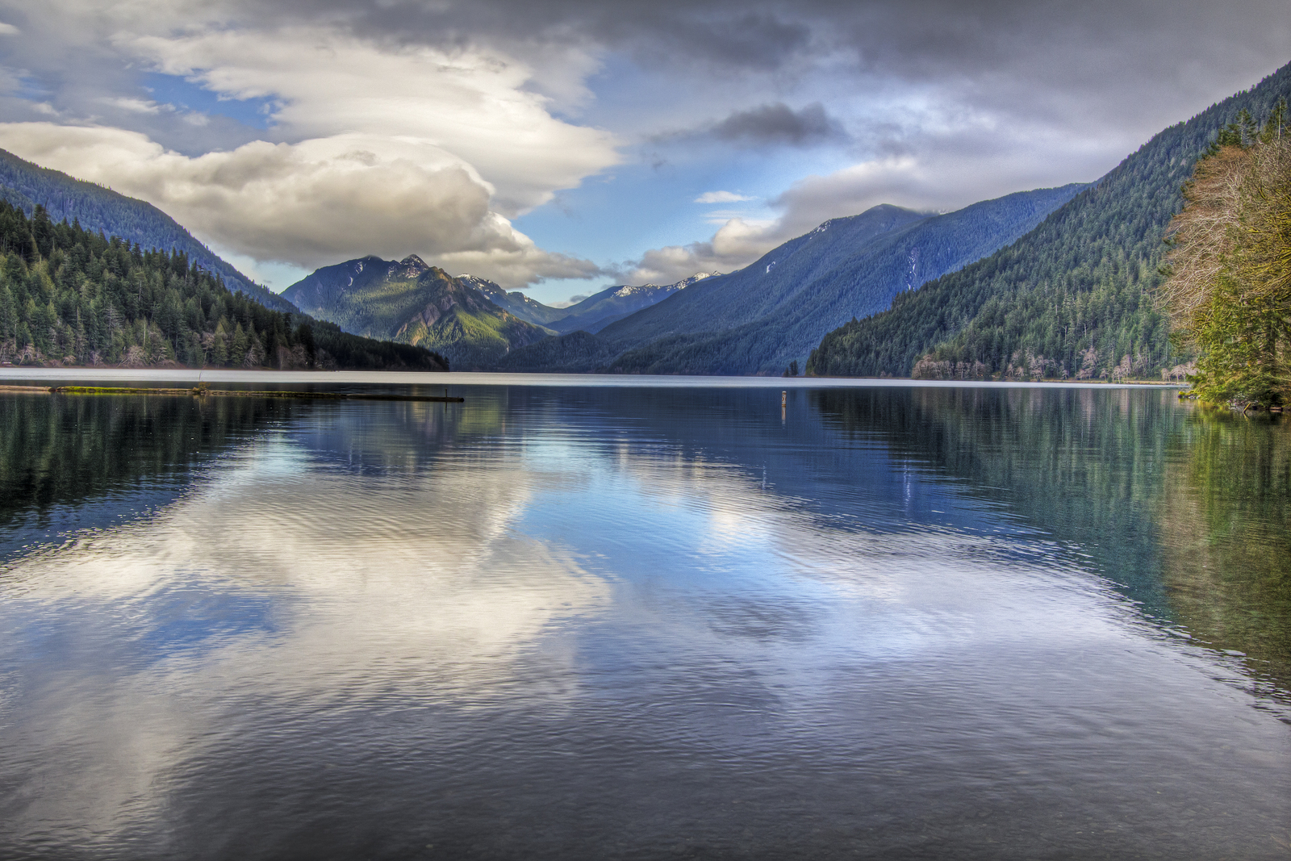
U3 Fascinating Parks (period4)
Using Language(1): Listening and Speaking
浙江省青田县中学 舒 影

Slide 3
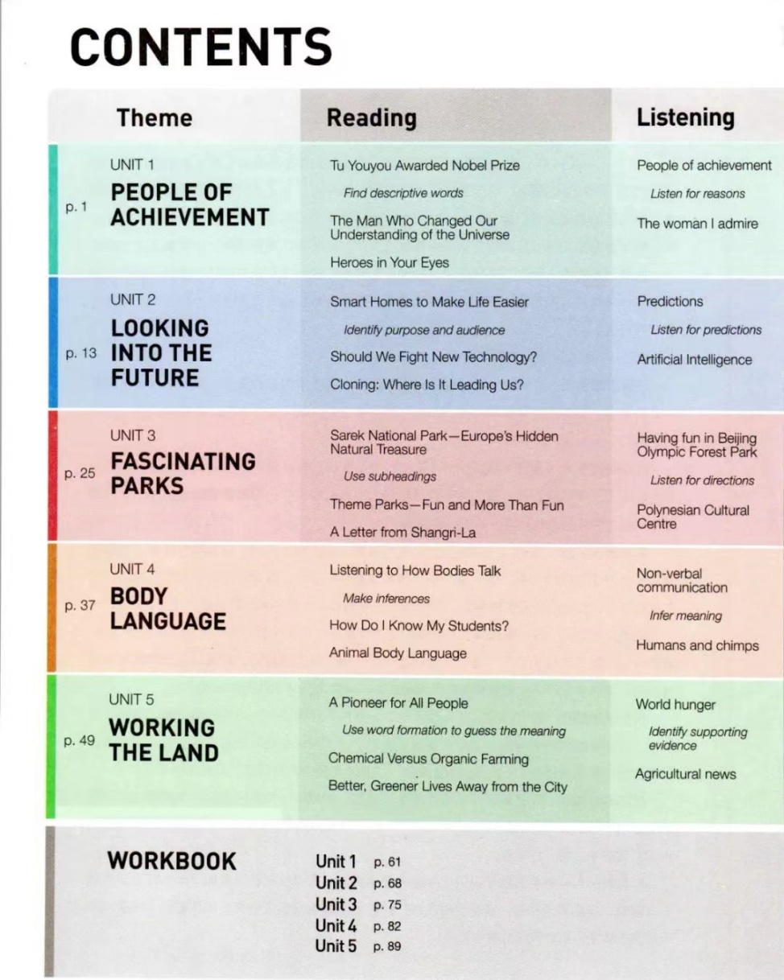
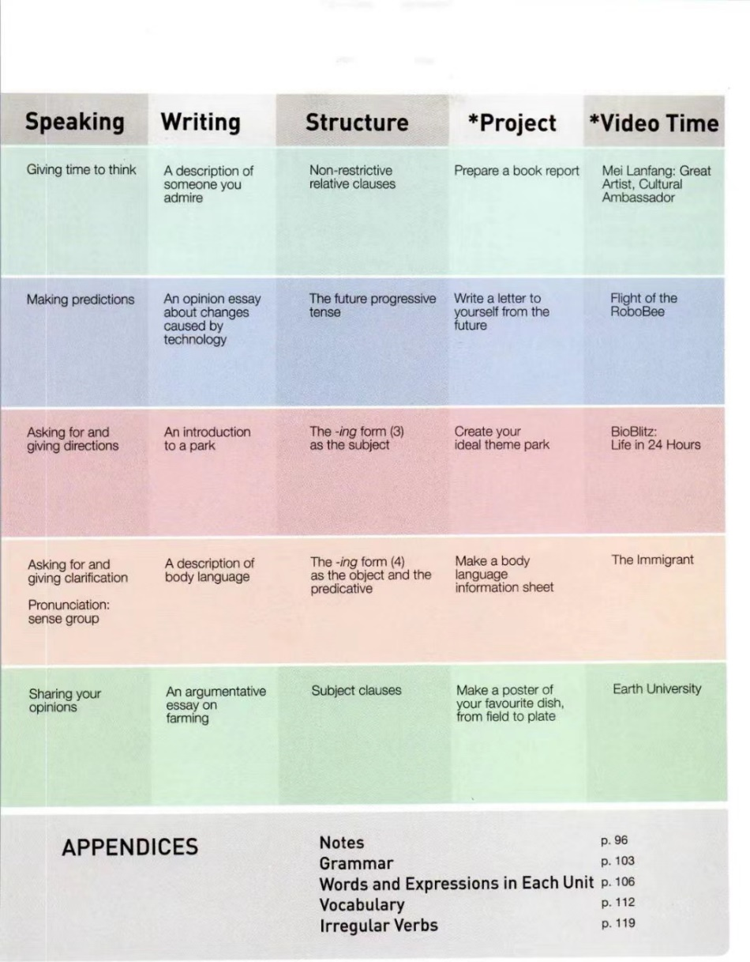
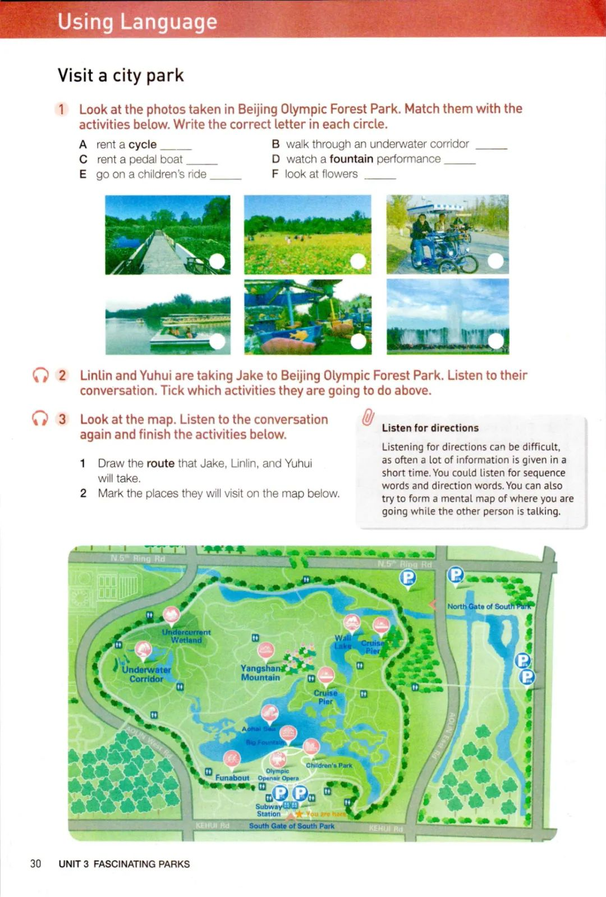

Slide 4
Learning objects
By the end of the class, you’ll be able to:
know what a city park is and what people can do there.
comprehend and grasp relevant information according to the key words of directions.
learn to read a map and draw the route of a trip on the map by listening to a conversation.
4. make up a conversation about asking for and giving directions.

Slide 5
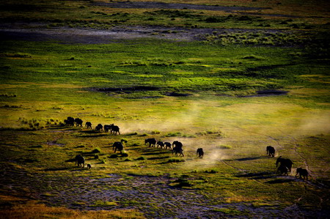
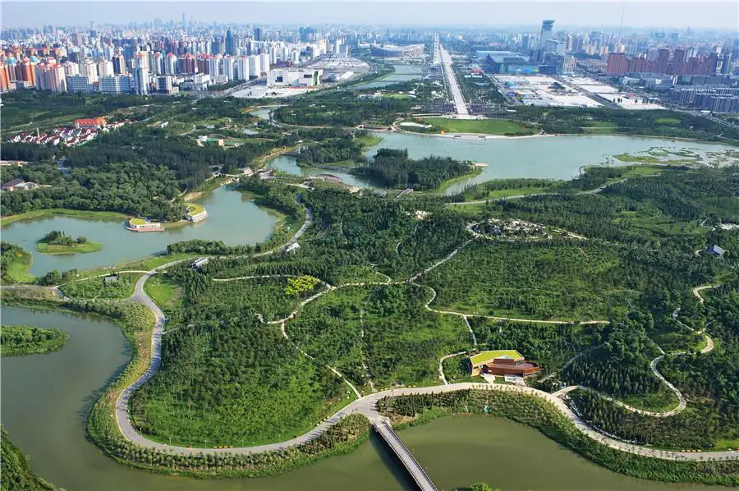

Lead-in
National Park
City Park
1. What’s the difference between a national park and a city park?
2. What can people do in a city park?

Slide 6
The Beijing Olympic Forest Park was built in 2008 to provide a place for athletes and coaches to relax during the Olympic Games. Located within easy walking distance north of the Bird's Nest Stadium, it was given to the city after the games, and it is now the largest of Beijing's city parks.

Slide 7
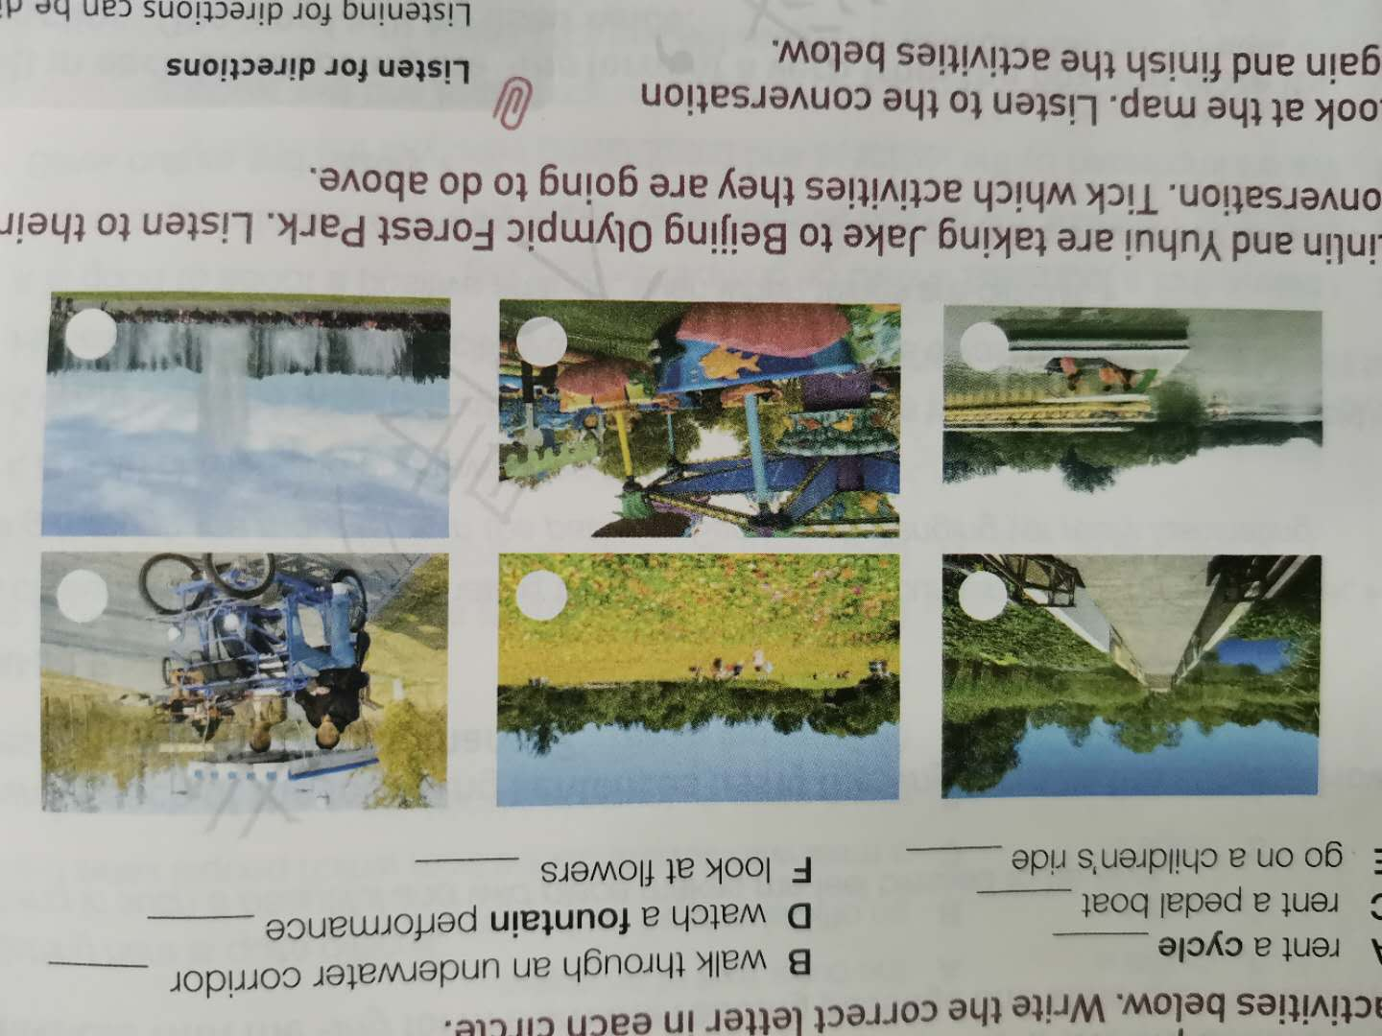
Pre-listening--Activity 1
Look at the photos taken in Beijing Olympic Forest Park. Match them with the activities below. Write the correct letter in each circle.
A rent a cycle B walk through an underwater corridor
C rent a pedal boat D watch a fountain performance
E go on a children’s ride F look at flowers

Slide 8
Pre-listening--Activity 1
Look at the photos taken in Beijing Olympic Forest Park. Match them with the activities below. Write the correct letter in each circle.
A rent a cycle B walk through an underwater corridor
C rent a pedal boat D watch a fountain performance
E go on a children’s ride F look at flowers
B
F
A
C
E
D

Slide 9

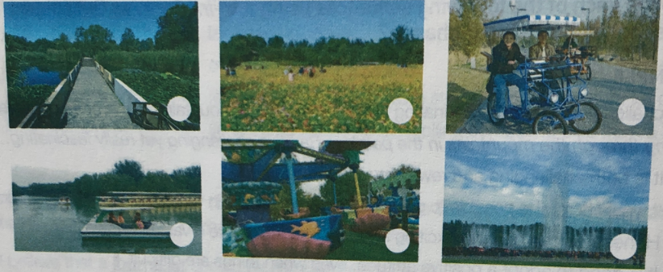
Listening--Activity2
Linlin and Yuhui are taking Jake to Beijing Olympic Forest Park. Listen to their conversation. Tick which activities they are going to do.




Slide 10

Listening--Activity3
Look at the map. Listen to the conversation and finish the activities below.
1. Draw the route that Jake, Linlin, and Yuhui will take.
2. Mark the places they will visit on the map.
Listen for directions
Listening for directions can be difficult, as often a lot of information is given in a short time. You could listen for sequence words (first, to begin with, then, after that, finally…) and direction words (go straight on, turn left, go across…).You can also try to form a mental map of where you are going while the other person is talking.

Slide 11
Direction Words
intersection
十字路口
go straight on
turn left
turn right
cross/go across
SCHOOL
SCHOOL
SCHOOL
SCHOOL
HOSPITAL
HOSPITAL
HOSPITAL
go past
opposite
next to
between

Slide 12
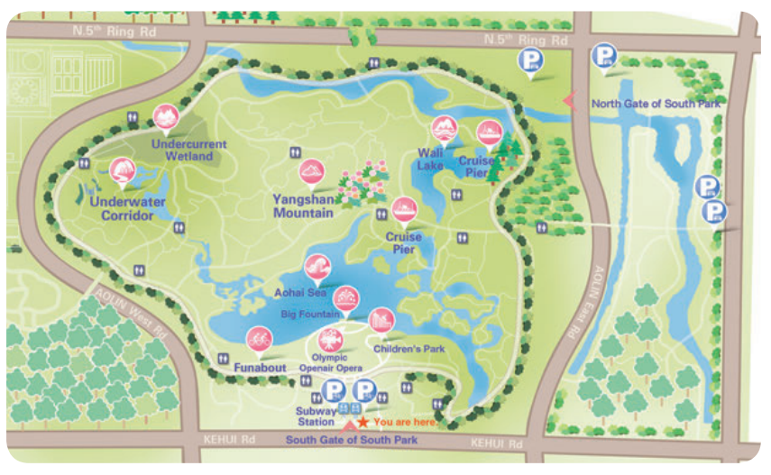

Read a Map
directions
main spots
main roads

Slide 13
1. Draw the route that Jake, Linlin, and Yuhui will take.
2. Mark the places they will visit on the map.

Slide 14
Sequence words & Direction words
From here, we should go north.
Then turn left and follow the main road until we reach the second path on the right.
Follow it for about three hundred metres until we come to an intersection with a washroom.
Then we turn right on the path.
Then we should turn left on another path.
After about 150 metres, we’ll be at the underwater wetland corridor.

Slide 15
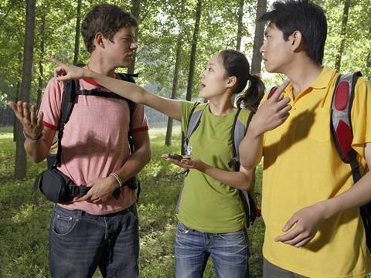
Speaking—Activity 4
Work in pairs. Role-play visiting the park. Take turns giving directions to different places in the park. Use the words and phrases of asking for and giving directions to help you.

Slide 16
Asking for and Giving directions
Asking for directions
Excuse/Pardon me.
How do I get to...?
Is ... nearby?
Is ... far from...?
How far is ...?
Is ...close to ...?
I was wondering if you could tell me how to find ....
Do you happen to know where...is?
Giving directions
It’s on the north/south/east/west side of the park.
It’s about... meters north of...
Go through...
Walk/Go along the river/path...
Follow the (main) path to...
When you see the..., you are close to ...
Go straight ahead (until you come to …).
Turn left at the second / next intersection.

Slide 17
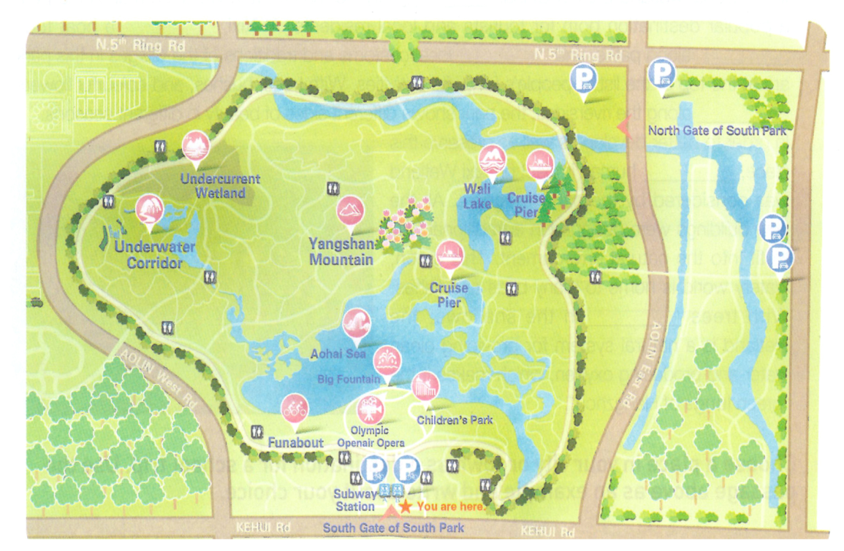
Speaking
Linlin, Yuhui and Jake are now at Underwater Corridor, how can they get to the next destination, Wali Lake? Make up a conversation with your partners (in groups of three) according to the map.
Notes:
Passagetiona

Slide 18
Homework
1. Review the expressions of asking for and giving directions.
2. Make up a conversation of asking for and giving directions according to the map in activity 3 (from Wali Lake back to the South Gate of South Park).

