Slide 1



感恩遇见，相互成就，本课件资料仅供您个人参考、教学使用，严禁自行在网络传播，违者依知识产权法追究法律责任。
更多教学资源请关注
公众号：溯恩英语
知识产权声明

Slide 2
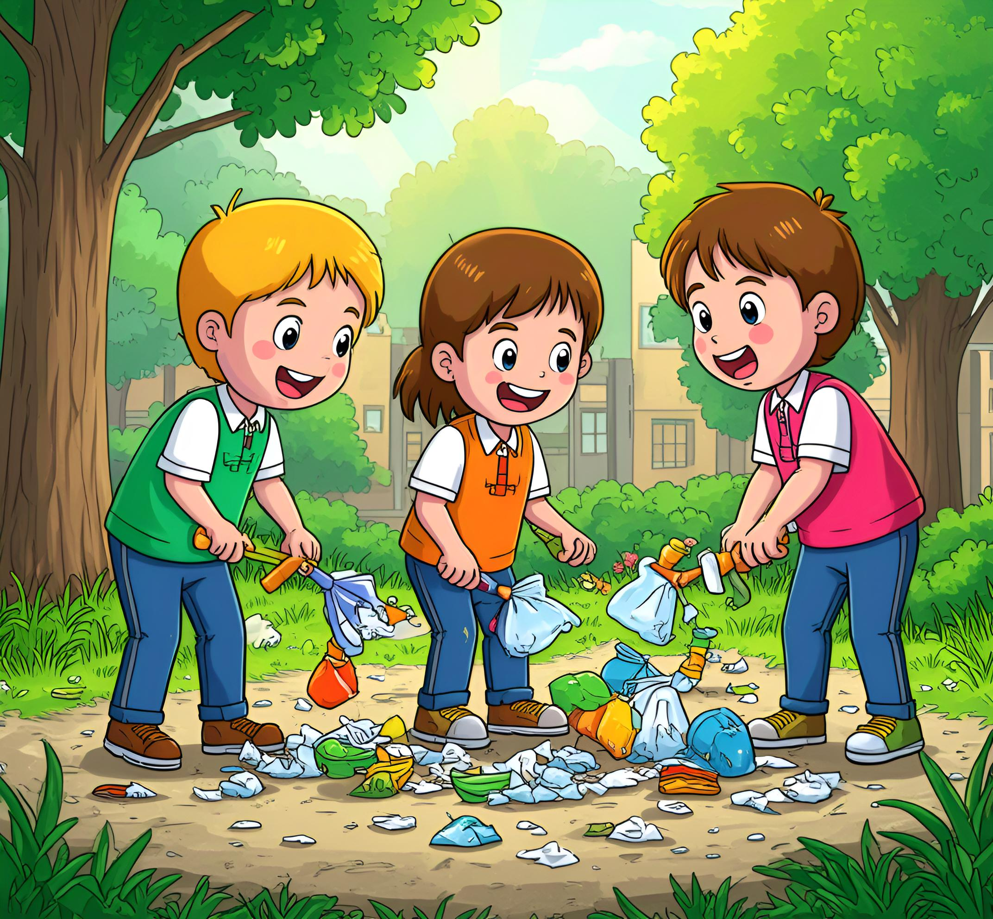
以细节为钥，启续写之思
——以2025年武汉二调读后续写“A Cleanup Squad”为例
广东 周文文

Slide 3
第二节（满分 25 分）阅读下面材料, 根据其内容和所给段落开头语续写两段, 使之构成一篇完整的短文。
As the school year wrapped up and the first days of summer vacation stretched out before them, Max, Ava, and Sam had a perfect day planned at their usual community park. This tidy little park was their go-to spot for unwinding and just enjoying some precious leisure time.
Max rushed ahead with a soccer ball under his arm, Ava and Sam trailing closely behind, full of energy. It was the kind of day that promised endless fun and carefree laughter. But as they stepped into the park, their heart sank. The once-beloved playground was now a chaotic mess of discarded trash -- candy wrappers stuck in the slide's metal bars, plastic bottles rolling in the wind, and chip bags lying underfoot.
“Look at this!” Ava shouted in disbelief as she pointed to the garbage near the swings. Max's face darkened with frustration. The three friends stood frozen, their eyes scanning the playground area. The once clean slides and swings were now buried under a layer of candy wrappers and plastic bottles. Ava cast a glanceat the walking trails, where garbage seemed to have taken over, with discarded bags and cans lying everywhere. Sam looked out at the grassy fields - a disaster. The park was vast, but every corner seemed to have been touched by the carelessness of others.
“Who would be so thoughtless?” Max whispered, shaking his head.
Sam kicked a plastic bottle in anger, sending it flying across the grass. “ It's not just thoughtless -it's disrespectful."
Ava sighed thoughtfully but suddenly her face lit up. “We can't just leave it like this. Why don't we do something about it? We can, say, form a Cleanup Squad(清洁小分队)…” she said, her voice soft but determined.
注意：1、续写词数应为 150 左右；2、请按照如下格式在答题卡的相应位置作答。
Max and Sam exchanged an excited glance. __________________________
Unexpectedly, other parkgoers joined in as they did the cleanup.__________________________

Slide 4
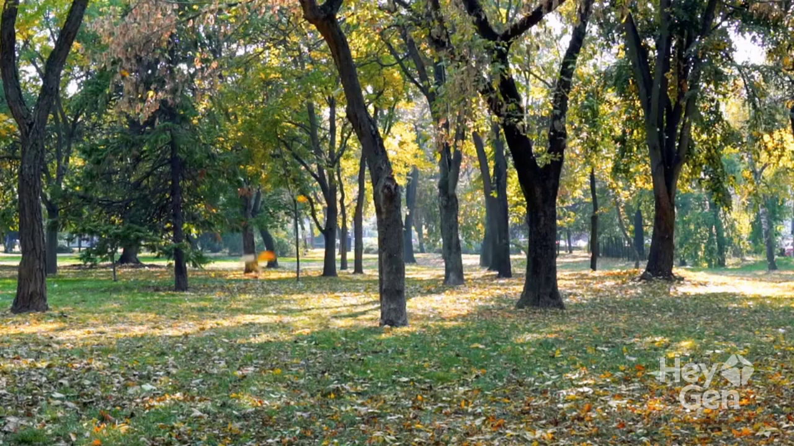
Story Recap Video

Slide 5
Step 1 Read for Understanding
Characters | Max, Ava, and Sam (three friends planning to spend the first day of summer vacation at their community park)
When | The first day of summer vacation, right after the school year ended.
Where | Their usual community park.
What | The three friends went to the park expecting a fun day, but found it littered with trash—candy wrappers, plastic bottles, chip bags, etc., all over the playground, trails, and fields.
Conflict/Problem | Their anticipated "perfect day" was disrupted by the park’s mess, and they had to decide whether and how to address the garbage.
Plot Line | Eagerness to enjoy the park → Disappointment and anger at the mess → Ava proposes forming a "Cleanup Squad" (a turning point)
Emotional Line | Excitement (heading to the park full of energy) → Disappointment/frustration (heart sank, Max’s face darkened) → Anger (Sam kicks a bottle, calls the act disrespectful) → Determination and hope (Ava’s soft but determined suggestion to take action)
Theme | Taking responsibility for environmental issues, the power of proactive action, and building a sense of community (foreshadowing others’ participation later)

Slide 6


Story Mountain Analysis
高潮（Climax）
A sudden idea: forming a team
发展（Rising action）
回落（Falling action）
Trash everywhere, feeling down
Para. 1 Conflict resolved
结局 (Resolution)
Three friends went to the park during summer vacation.
Para. 2 A satisfying conclusion
开端 (Exposition)

Slide 7
Step 2 Read for Language
1. wrapped up
2. stretched out
3. had a perfect day planned
4. go-to spot for unwinding
5. enjoyed some precious leisure time
6. rushed ahead
7. trailed closely behind
8. their heart sank
9. a chaotic mess of discarded trash
10. shouted in disbelief
11. Max's face darkened with frustration
12. stood frozen
13. scanned the playground area
14. cast a glance
15. in anger
16. her face lit up
17. her voice soft but determined
1. 结束；收尾
2. 展开；铺开
3. 计划了完美的一天
4. 放松的常去地方
5. 享受宝贵的休闲时光
6. 冲在前面
7. 紧跟在后面
8. 心情沉重；感到沮丧
9. 乱扔的垃圾造成的混乱局面
10. 难以置信地大喊
11. 马克斯因沮丧而脸色阴沉
12. 呆呆地站着
13. 扫视操场区域
14. 瞥一眼
15. 愤怒地
16. 她的脸上露出喜色
17. 她的声音轻柔但坚定

Slide 8
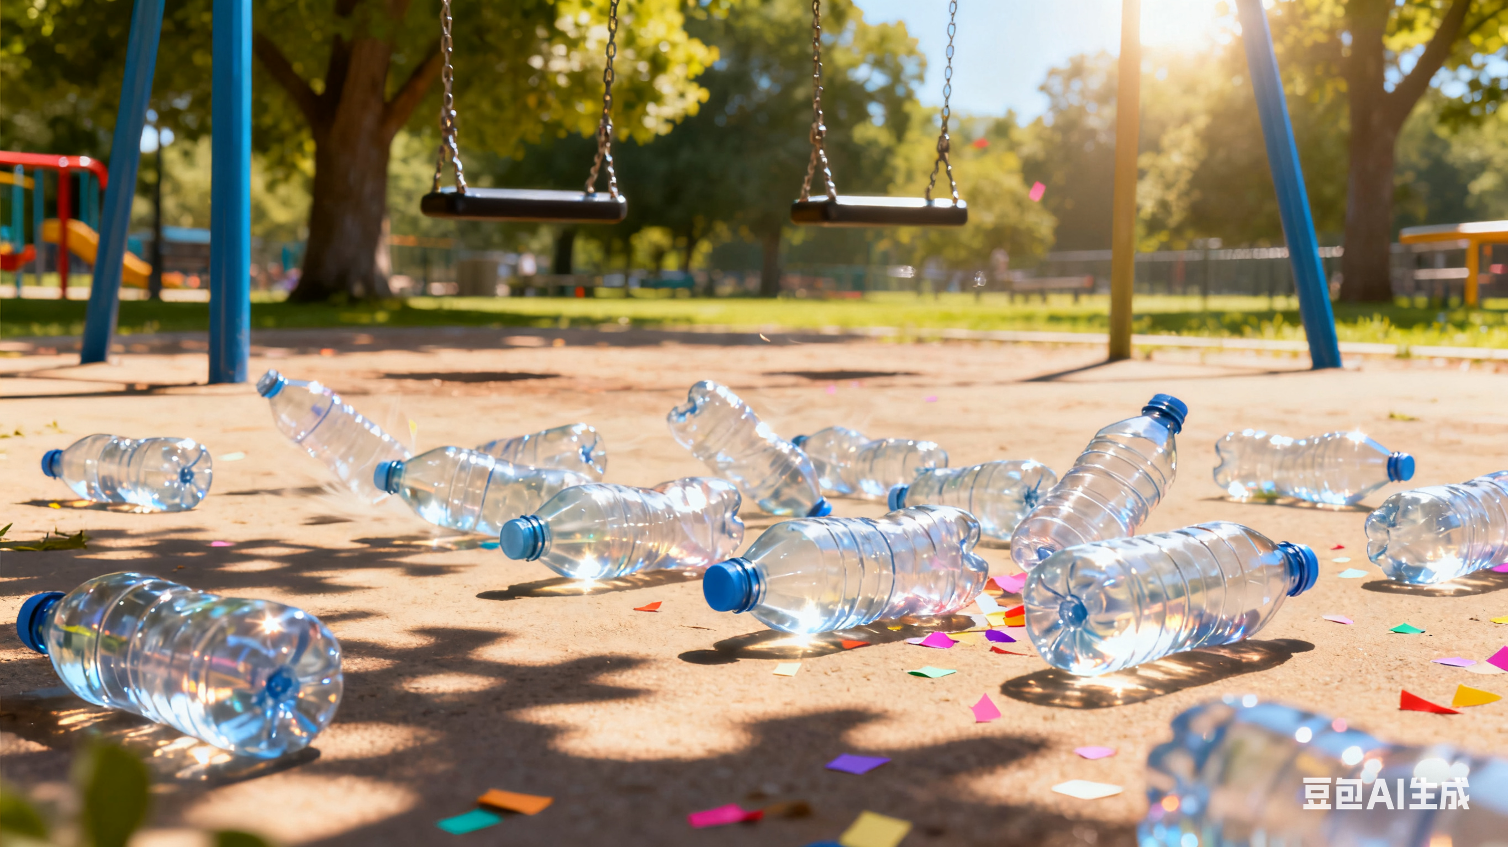
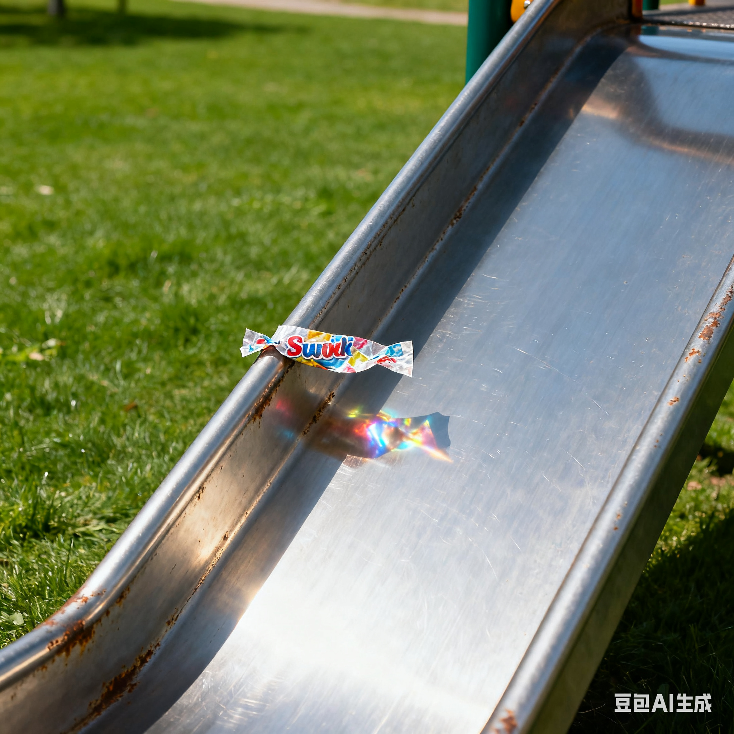
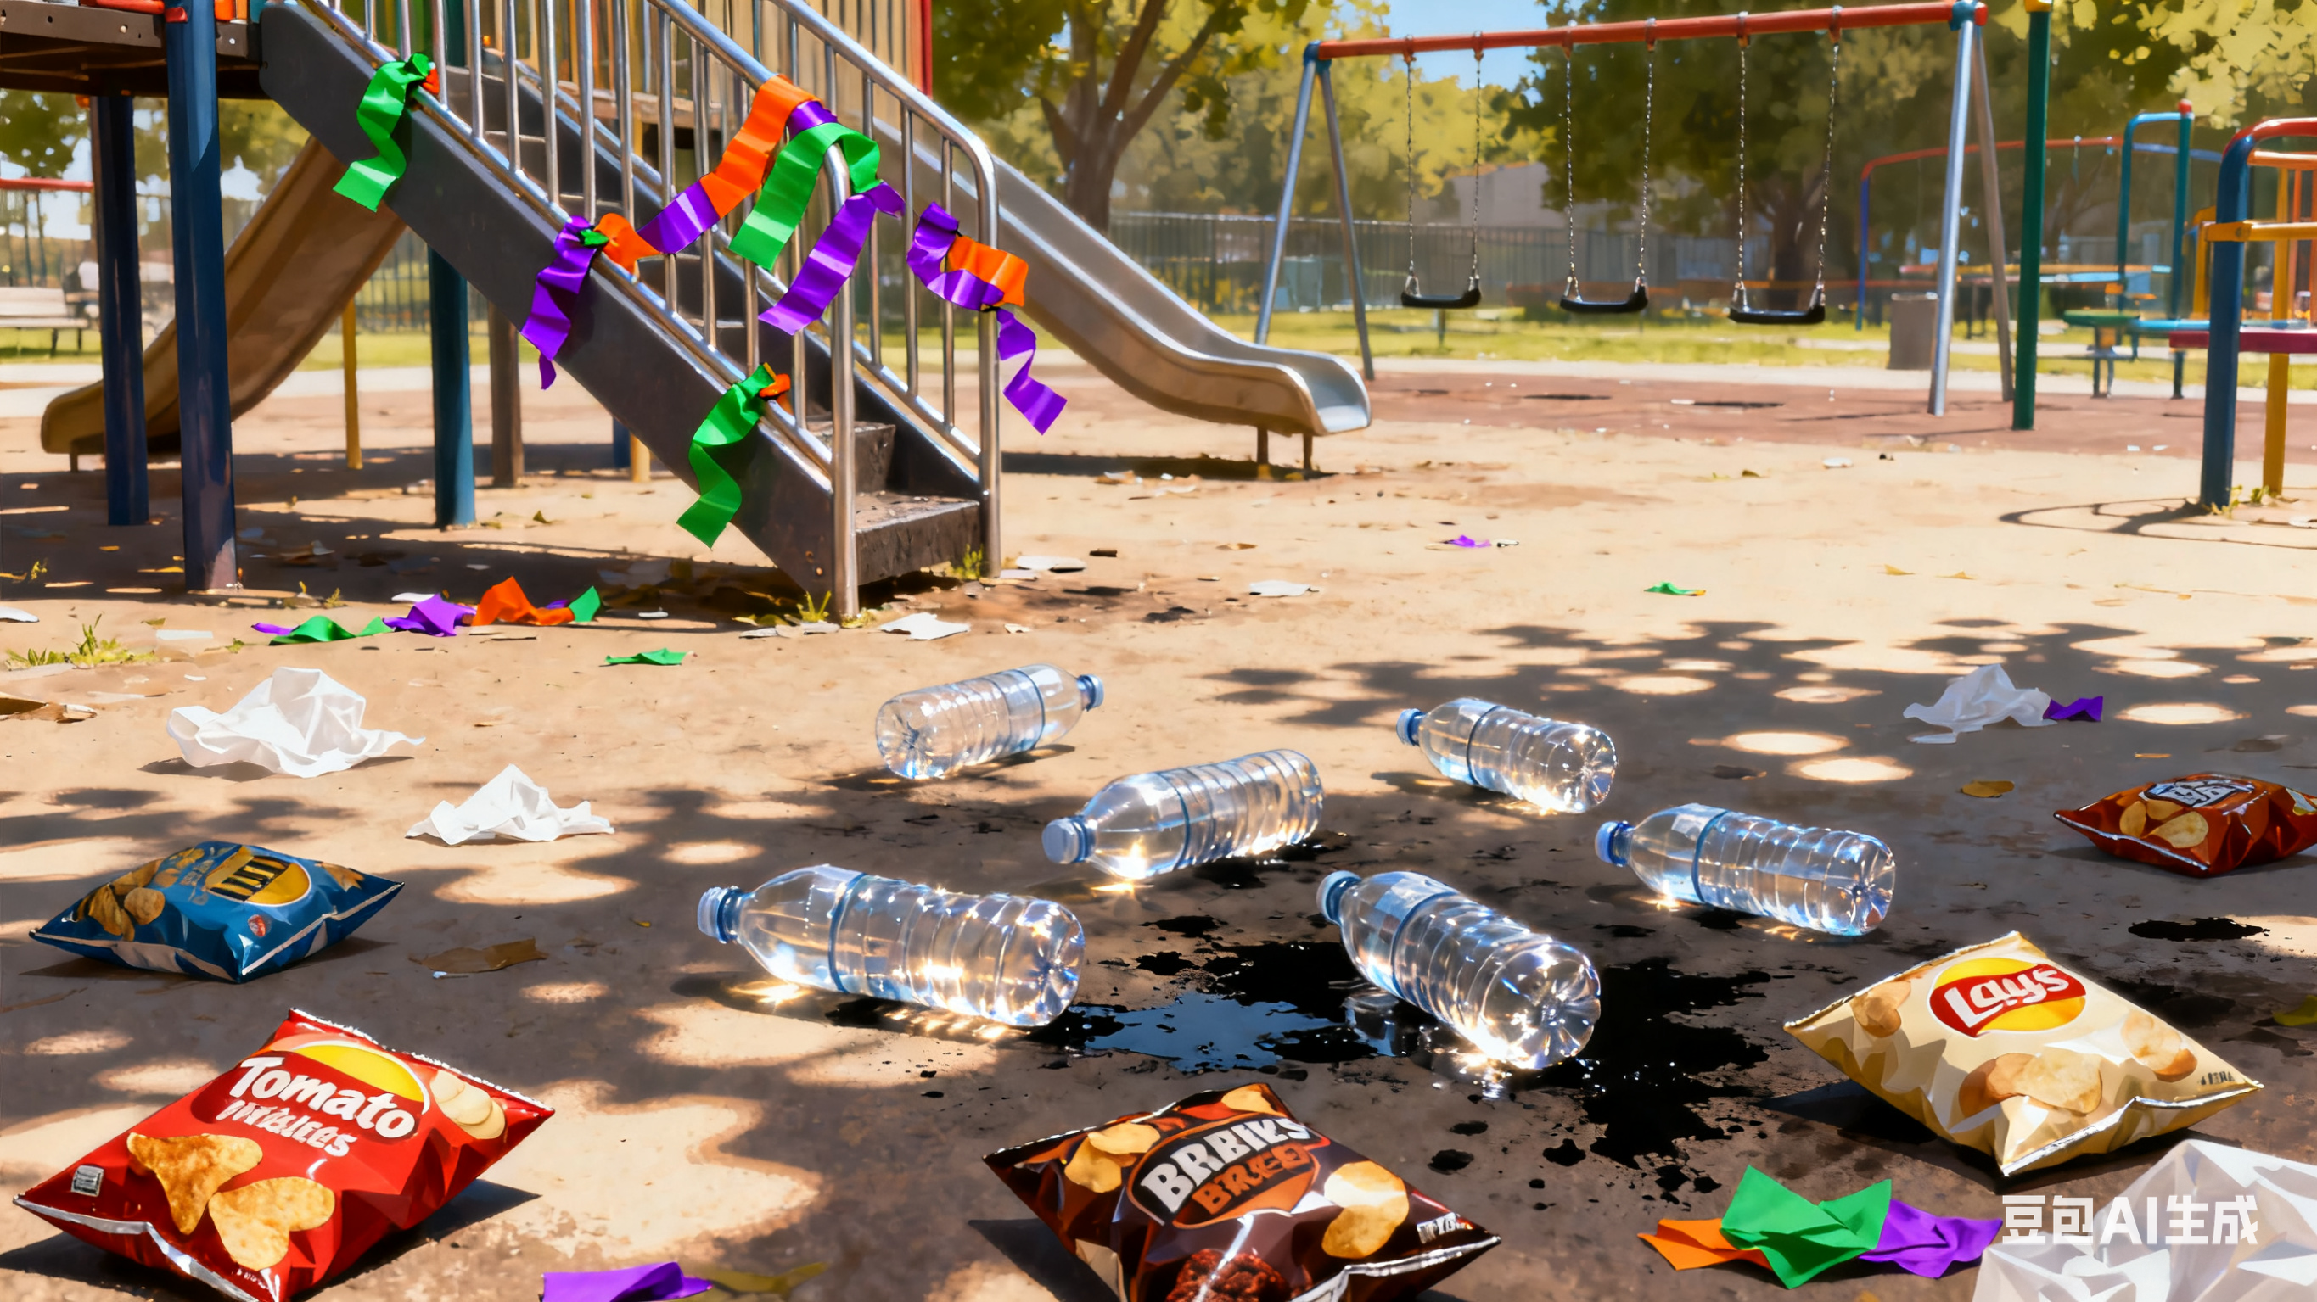
Step 2 Read for Language
The once-beloved playground was now a chaotic mess of discarded trash -- candy wrappers stuck in the slide's metal bars, plastic bottles rolling in the wind, and chip bags lying underfoot.
曾经备受喜爱的儿童游乐场，如今已是一片堆满乱扔垃圾的混乱景象 —— 滑梯的金属栏杆上卡着糖纸，塑料瓶在风中滚来滚去，脚下还散落着薯片袋。

Slide 9
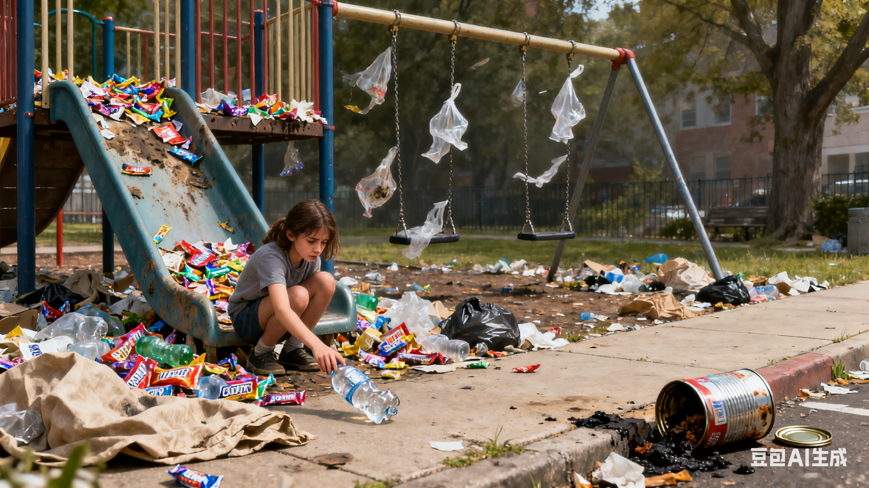
Step 2 Read for Language
The once clean slides and swings were now buried under a layer of candy wrappers and plastic bottles. Ava cast a glance at the walking trails, where garbage seemed to have taken over, with discarded bags and cans lying everywhere. Sam looked out at the grassy fields - a disaster.
曾经干净的滑梯与秋千，如今被一层糖纸和塑料瓶埋住了。艾娃瞥了眼步道，那里俨然成了垃圾的地盘，丢弃的袋子和易拉罐随处可见。萨姆望向草地 —— 一片狼藉。

Slide 10
Step 2 Read for Language
 | Details
see | This tidy little park; The once-beloved playground was now a chaotic mess of discarded trash — candy wrappers stuck in the slide's metal bars, plastic bottles rolling in the wind, and chip bags lying underfoot; The once clean slides and swings were now buried under a layer of candy wrappers and plastic bottles; Ava cast a glance at the walking trails, where garbage seemed to have taken over, with discarded bags and cans lying everywhere. Sam looked out at the grassy fields - a disaster.
do | Max rushed ahead with a soccer ball under his arm, Ava and Sam trailing closely behind; she pointed to the garbage near the swings; shaking his head; Sam kicked a plastic bottle; Ava sighed thoughtfully
feel | their heart sankin disbelief; Max's face darkened with frustrationin anger; but suddenly her face lit upher voice soft but determined
say/ hear | “Look at this!” Ava shouted“Who would be so thoughtless?” Max whispered“It's not just thoughtless - it's disrespectful.”“We can't just leave it like this. Why don't we do something about it? We can, say, form a Cleanup Squad…” she said

Slide 11
Step 2 Plot Construction
Para 1 Max and Sam exchanged an excited glance.
1. What decision did they make?
2. How did they clean up the park? How did they feel?
3. How did others react?
Para 2 Unexpectedly, other parkgoers joined in as they did the cleanup.
1. What did other volunteers do?
2. What was the result?
3. How did they feel? /What lesson did they learn?

Slide 12
Step 2 Plot Construction
Para 1 Max and Sam exchanged an excited glance.
1. They decided to take action.
2. They worked hard to clean up the park.
3. Their action attracted the attention of some parkgoers.
Para 2 Unexpectedly, other parkgoers joined in as they did the cleanup.
1. Volunteers work together to do the cleanup.
2. The park was cleaner.
3. They felt satisfied.

Slide 13
Expand details related to "five senses" : Within the established continuation framework, infer what the characters see, hear, say, do, think/feel based on the plot development. Add 5-8 multi-angle detailed descriptions reasonably in each paragraph to make the continuation more vivid.
Step 3 Add reasonable details
What would he/she see? （所见——环境、人物、活动场景描写）
What would he/she hear?（所闻——人物对话、声音）
What would he/she say?（所说——对话描写）
What would he/she do?（所做——具体动作+肢体动作描写）
How would/he she feel?（所感/所思——情感+神态细节描写、内心活动描写）

Slide 14
Appreciate the "Five-Sense" Details in the Model Essay
Unexpectedly, other park-goers joined in as they did the cleanup. A gentle breeze carried the sound of laughter as a young mom with her child picked up litter near the sandbox. The child's eyes sparkled with joy at the new adventure. Meanwhile, an elderly man, with a kind smile on his face, helped clear the walking trails. Even a group of teenagers, who had been playing basketball, joined in. They tossed aside their balls with enthusiasm. What they did was infectious, and soon the park was cleaner than ever. Max, Ava, and Sam realized that together, they could make a real difference. They stood back to admire their handiwork. The flowers seemed to sway in appreciation. “We are indeed a ‘Cleanup Squad’,” Ava declared, smiling, her eyes shining with pride, “And maybe we can do this every weekend!”

Slide 15
Appreciate the "Five-Sense" Details in the Model Essay
Max and Sam exchanged an excited glance. A bright spark of enthusiasm lit up their eyes, and a wide grin spread across Sam's face. “Great idea," Max said, his frustration replaced by determination. He took a deep breath, feeling the weight of the task ahead.The sun peeked through the clouds, as if eager to witness their plan. Max kicked the soccer ball into a corner and they gathered, quickly dividing the park into sections: Max took the playground area, his eyes scanning the mess with a newfound resolve. Ava focused on the walking trails, her brows furrowed in concentration. Sam, filled with anticipation, headed for the grassy fields. They raced home to grab gloves and trash bags, the wind whipping through their hair. Returning with a renewed sense of purpose, they got to work immediately. With each piece of trash collected, the park slowly regained its former charm. Their efforts soon caught the attention of other park-goers who watched curiously.

Slide 16
Appreciate the "Five-Sense" Details in the Model Essay
Unexpectedly, other park-goers joined in as they did the cleanup. A gentle breeze carried the sound of laughter as a young mom with her child picked up litter near the sandbox. The child's eyes sparkled with joy at the new adventure. Meanwhile, an elderly man, with a kind smile on his face, helped clear the walking trails. Even a group of teenagers, who had been playing basketball, joined in. They tossed aside their balls with enthusiasm. （不同人具体的参与方式——动作、环境、声音、神态、情感）What they did was infectious, and soon the park was cleaner than ever. （动作的结果）Max, Ava, and Sam realized that together, they could make a real difference. They stood back to admire their handiwork. The flowers seemed to sway in appreciation. “We are indeed a ‘Cleanup Squad’,” Ava declared, smiling, her eyes shining with pride, “And maybe we can do this every weekend!” （感想与收获——心理、环境、语言、神态）

Slide 17
Appreciate the "Five-Sense" Details in the Model Essay
Max and Sam exchanged an excited glance. A bright spark of enthusiasm lit up their eyes, and a wide grin spread across Sam's face. “Great idea," Max said, his frustration replaced by determination. He took a deep breath, feeling the weight of the task ahead. (同意决定——神态、语言、动作、情感/心理)The sun peeked through the clouds, as if eager to witness their plan.（环境烘托）Max kicked the soccer ball into a corner and they gathered, quickly dividing the park into sections: Max took the playground area, his eyes scanning the mess with a newfound resolve. Ava focused on the walking trails, her brows furrowed in concentration. Sam, filled with anticipation, headed for the grassy fields. They raced home to grab gloves and trash bags, the wind whipping through their hair. Returning with a renewed sense of purpose, they got to work immediately.（分工干活——动作描写+心理+神态+环境） With each piece of trash collected, the park slowly regained its former charm. （动作的结果）Their efforts soon caught the attention of other park-goers who watched curiously.（吸引他人注意，承上起下）

Slide 18
Version 1: What they did was infectious, and soon the park was cleaner than ever.
How to make the description more vivid and visual?
Let’s refer to the writing styles of the same content in more other model essays.

Slide 19
【参考范文2】
Max and Sam exchanged an excited glance. "That's a great idea, Ava!" Max exclaimed. Sam nodded in agreement, his eyes shining with determination. (表示同意——语言、神态、动作)Without hesitation, they quickly divided the tasks. Max ran to fetch some trash bags from his nearby home. Ava and Sam started collecting the larger pieces of garbage first, like the chip bags and plastic bottles. （具体工作与分工——动作描写）As they worked, Ava hummed a little tune, and the others joined in. Their laughter and songs filled the park, making the cleanup seem more like a fun game. （动作的影响——声音、情感）
Unexpectedly, other parkgoers joined in as they did the cleanup. An elderly couple, who were taking a stroll, saw what they were doing and decided to lend a hand. A group of kids playing nearby also came over, eager to help make the park clean again. （不同人的具体响应）With more people engaging in, the cleanup went much faster. Before long, the playground was clean once more. （动作的结果）The slides and swings sparkled in the sun, and the grassy fields were free of trash. （动作的结果——视觉）Max, Ava, and Sam looked at each other, beaming with pride. They realized that with everyone's effort, they could make a difference and keep their beloved park beautiful. （结尾——动作、情感、心理）

Slide 20
Version 1: What they did was infectious, and soon the park was cleaner than ever.
Compare and Conclude
Version 2: Before long, the playground was clean once more. The slides and swings sparkled in the sun, and the grassy fields were free of trash.
Version 3: In less than an hour, the park was transformed: the slides shone, the grass was clear, and the swings were free of garbage.
Tip: Make the description more vivid by supplementing it with visual detailed descriptions.通过补充视觉上的细节描写使续写更生动

Slide 21
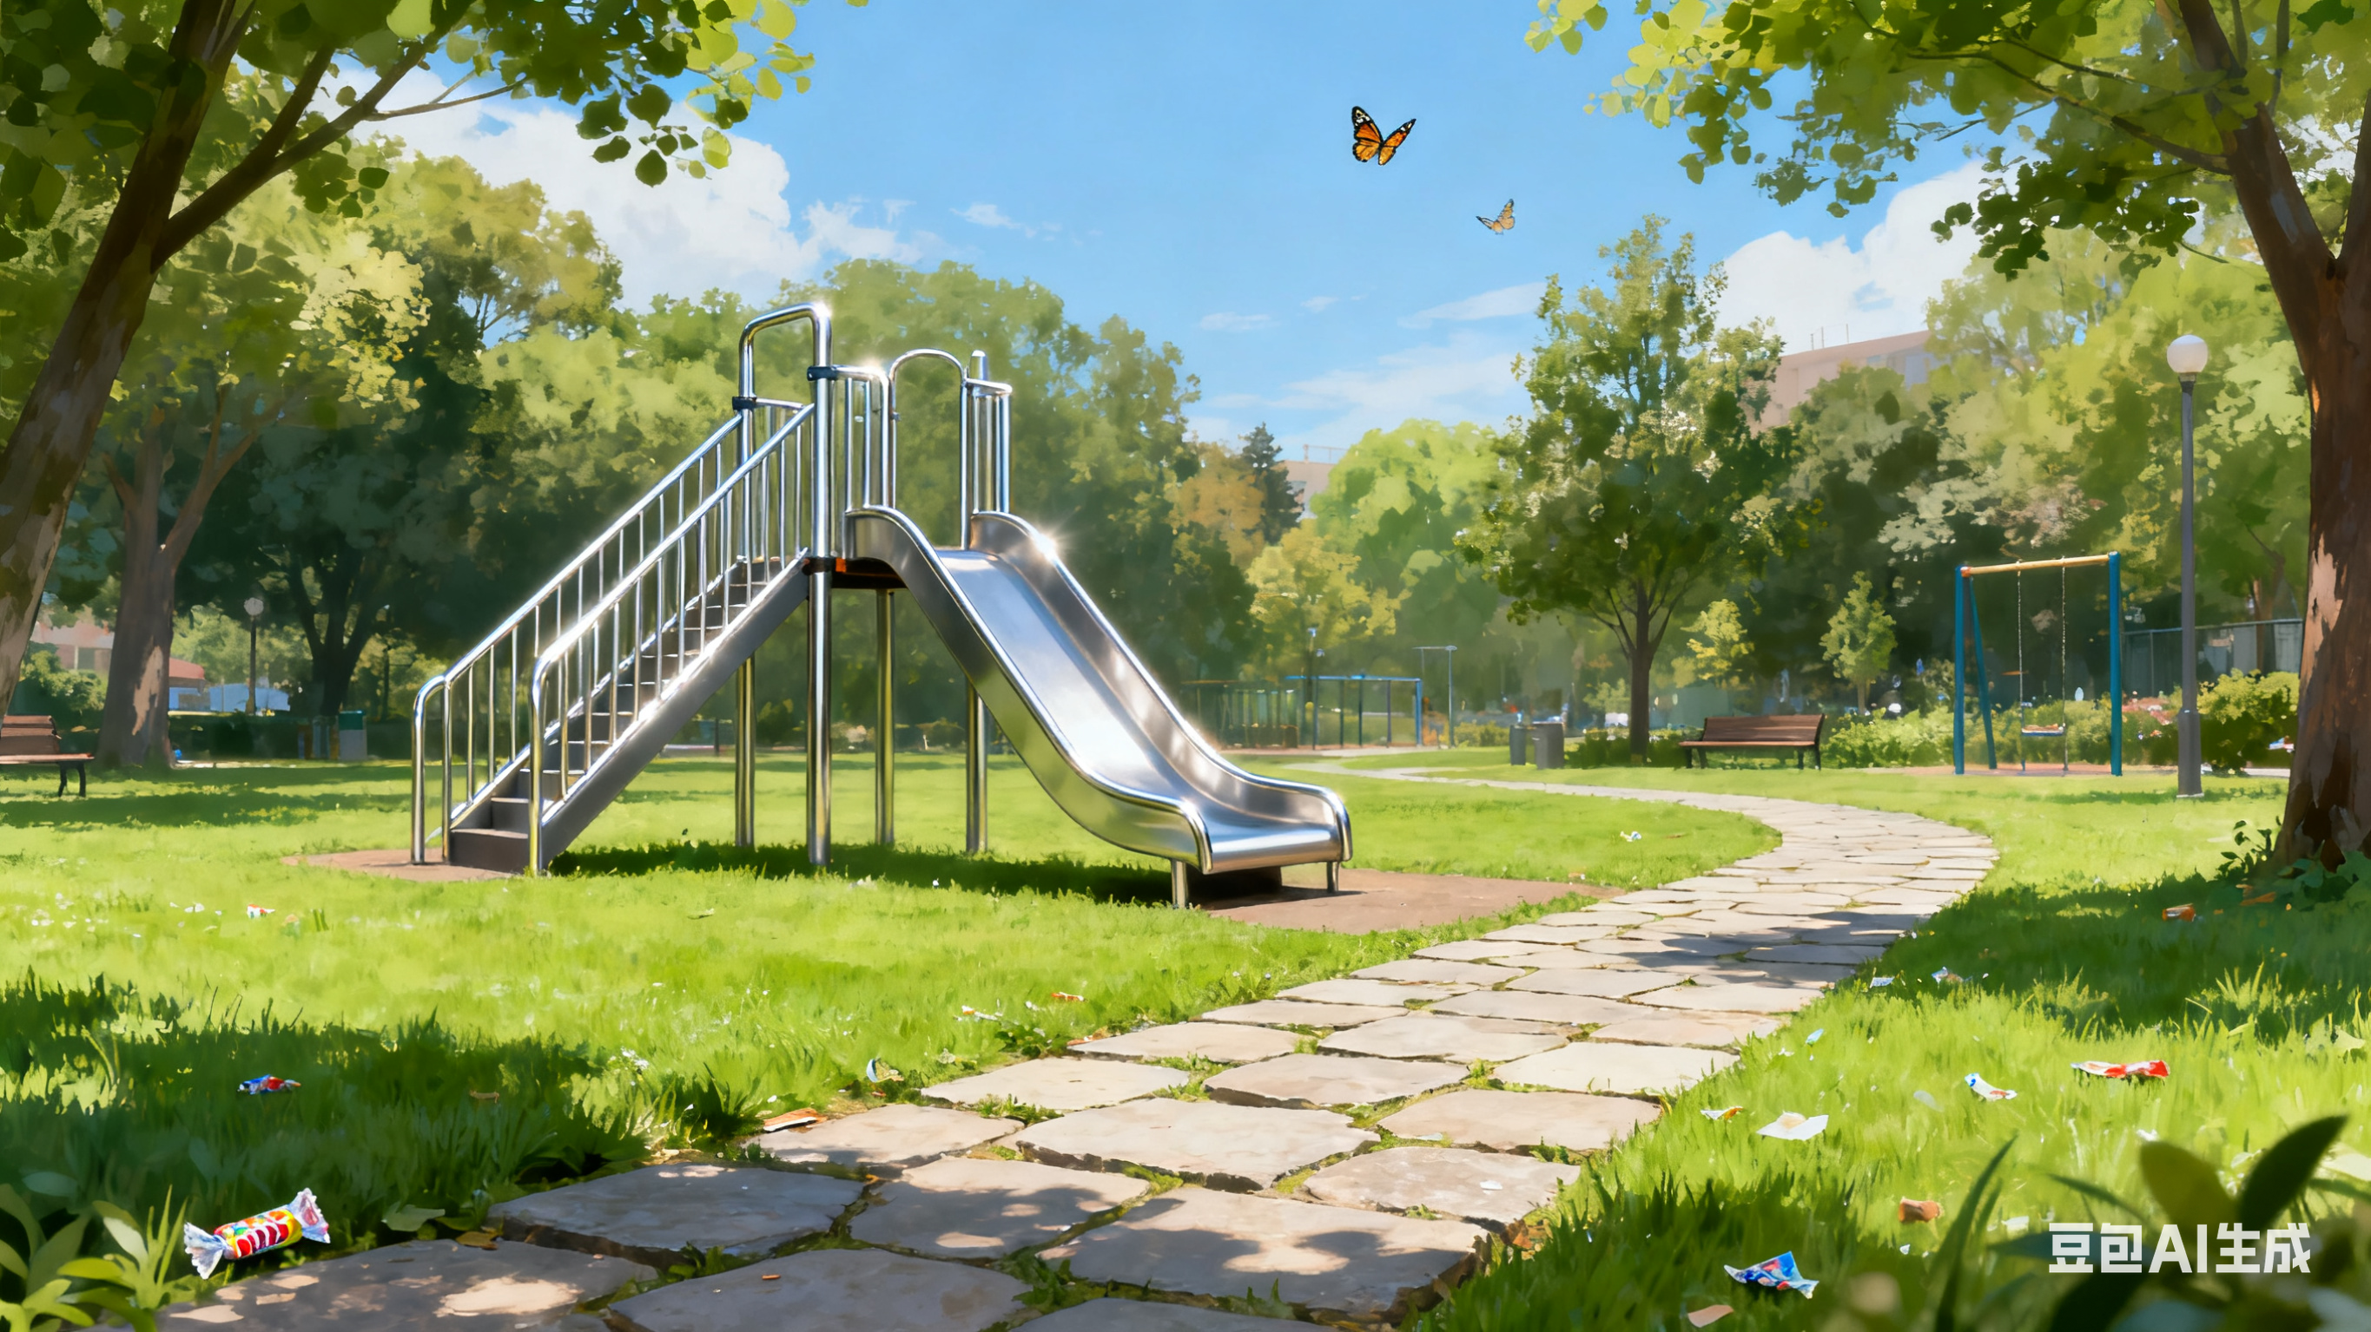
Appreciation of More Visual Descriptive Details
The once messy park now gleamed under the sun: the slide's metal bars sparkled like polished silver, free of candy wrappers; the stone trails were spotless with no litter in sight; and the grassy fields, a lush green carpet without debris, had butterflies fluttering low. Every corner felt fresh and beloved again, as if the chaos had never been.
曾经杂乱不堪的公园，如今在阳光下焕发出耀眼的光彩：滑梯的金属栏杆像抛光的银器般闪闪发亮，再也不见糖纸的踪影；石板小径一尘不染，视野所及没有丝毫垃圾；那片草地宛如一块葱郁的绿毯，没有任何杂物，蝴蝶在低空轻盈飞舞。公园里的每一个角落都重新变得清新宜人、惹人喜爱，仿佛往日的脏乱从未存在过。

Slide 22
基础句 They began to clean the park.
他们看见滑梯上粘着眼花缭乱的糖纸，还有塑料瓶在草地上滚来滚去。
See
They saw candy wrappers stuck to the slides and plastic bottles rolling across the grass.
^{Say}
萨姆小声说：“咱们从这儿开始吧 —— 一次捡一块。”
Sam murmured, “Let’s start here—one piece at a time.
垃圾袋的窸窣声和瓶子的哐当声在公园里回荡。
^{Hear}
The rustling of the trash bags and the clatter of bottles echoed through the park.
他们的愤怒化作了决心，一种使命感涌上了心头。
^{Feel}
Their anger turned into determination, and a sense of purpose filled their hearts.
马克斯弯腰捡起第一个皱巴巴的袋子，而艾娃则在整理现场，划分出每个人要负责的区域。
^{Do}
Max bent down to grab the first crumpled bag while Ava organized the area, assigning zones to cover.

Slide 23
基础句： They began to clean the park.
​​​增添细节后：They decided to take action and clean up the messy park themselves. Their eyes scanned candy wrappers clinging to slides and plastic bottles rolling across the grass. （所见）The rustle of trash bags and the clatter of bottles echoed in the quiet park as Sam whispered, “Let’s start here—one piece at a time.” （所闻）Max bent down to grab the first crumpled bag while Ava quickly organized the park into zones, assigning each of them a section. （所做）They worked tirelessly, picking up wrappers, cans, and discarded toys, feeling determination gradually replace their earlier frustration. （所感）With each bag filled, their hearts swelled with satisfaction, and the park slowly regained its former charm.（所感所见）

Slide 24
基础句: Volunteers work together to do the cleanup.
孩子、成人和老年志愿者们一起弯腰（清理），他们色彩鲜艳的衣衫在满是垃圾的场地间显得格外亮眼。
^{See}
Children, adults, and elderly volunteers bent down together, their colorful shirts bright against the trash-covered field.
空气中满是笑声与欢快的吆喝 ——“这儿还有一个！”“递给我个袋子！”
^{Say}
The air was filled with laughter and cheerful calls—“Here’s another one!” “Pass me a bag!”
^{Hear}
志愿者们互相大声鼓劲，还彼此传达着指引。
Volunteers shouted encouragement and gave instructions to each other.
^{Feel}
看着公园渐渐变了模样，伙伴们的心中涌起一阵自豪、喜悦与团结感。
Pride, joy, and a sense of unity swelled in the friends’ hearts as they saw the park gradually transform.
^{Do}
有人在捡垃圾，有人在递工具，还有几个人在清理步道和草地。
Some picked up trash, others passed tools, and a few cleared the pathways and grassy fields.

Slide 25
基础句: Volunteers work together to do the cleanup.
​​​增添细节后：Children, adults, and elderly volunteers bent down together, some picking up trash while others passed tools or cleared the pathways. (所做)The air was filled with laughter and cheerful calls—“Here’s another one!” “Pass me a bag!”—blending with the rustle of bags and the clatter of bottles. （所闻所说）Soon, the park was transformed: slides sparkled in the sunlight, the grass was clear, and swings were free of litter. （所见）Max, Ava, and Sam felt proud and joyful, realizing the power of teamwork. （所感）They learned that even small actions, when combined, can inspire others and create a real difference in their community. （所思）

Slide 26
Application: Expand the following basic sentence using the "five-sense" detail expansion method.
基础句：​​ The children played on the beach.
​​
​See:​​
​Hear:​​
​Say:​​
​Do:​​
​Feel:​​

Slide 27
Application: Expand the following basic sentence using the "five-sense" detail expansion method.
基础句：​​ The children played on the beach.
​​
​See:​​ 落日给沙滩洒下金色的光芒，小小的浪花在他们脚踝边泛起泡沫。
​Hear:​​ 他们兴奋的尖叫声与海浪持续不断的拍岸声、远方海鸥的鸣叫声交织在一起。
​Say:​​ 我的城堡比你的大！”一个孩子指着他那湿漉漉的沙雕作品喊道。
​Do:​​ 一个小女孩不知疲倦地用一把黄色塑料铲子挖着深深的护城河，另一个则在追逐退去的海水。
​Feel:​​ 一种纯粹而简单的快乐弥漫在温暖的午后空气中。
​

Slide 28
Expand the following basic sentence using the "five-sense" detail expansion method.
基础句：​​ The children played on the beach.
​增添细节后：​​
​See:​​ 落日给沙滩洒下金色的光芒，小小的浪花在他们脚踝边泛起泡沫。
​Hear:​​ 他们兴奋的尖叫声与海浪持续不断的拍岸声、远方海鸥的鸣叫声交织在一起。
​Say:​​ “我的城堡比你的大！”一个孩子指着他那湿漉漉的沙雕作品喊道。
​Do:​​ 一个小女孩不知疲倦地用一把黄色塑料铲子挖着深深的护城河，另一个则在追逐退去的海水。
​Feel:​​ 一种纯粹而简单的快乐弥漫在温暖的午后空气中。
The setting sun cast a golden glow over the sand as little waves foamed around their ankles.
Their shrieks of joy mixed with the constant crash of waves and cries of distant seagulls.
“My castle is bigger than yours!” one shouted, pointing at his dripping sand creation.
One girl tirelessly dug a deep moat with a yellow plastic shovel, while another chased the retreating water.
A sense of pure, uncomplicated happiness filled the warm afternoon air.

Slide 29
Expand the following basic sentence using the "five-sense" detail expansion method.
基础句：​​ The children played on the beach.
​增添细节后：​​​
The children played on the beach under the golden light of the setting sun. Their shrieks of joy mixed with the crash of waves and cries of seagulls. “My castle is bigger than yours!” one shouted, pointing at his sandy creation. Around him, one girl tirelessly dug a deep moat with a yellow plastic shovel, while another chased the retreating water, filling the warm air with a sense of pure, uncomplicated happiness.

Slide 30

Summary
"Five-sense" detailed sentences can construct scenes from multiple dimensions, make the plot more vivid and characters more three-dimensional, enable readers to deeply immerse themselves through sensory experiences, and enhance the appeal and readability of the text.“五感”细节句能多维度构建场景，使情节更生动、人物更立体，让读者从感官体验上深度代入，提升文本的感染力与可读性。
eyes---SEE
ears---HEAR
mouth---SAY
heart---THINK/FEEL
body parts---DO

