Slide 1


感恩遇见，相互成就，本课件资料仅供您个人参考、教学使用，严禁自行在网络传播，违者依知识产权法追究法律责任。
更多教学资源请关注
公众号：溯恩英语
知识产权声明

Slide 2
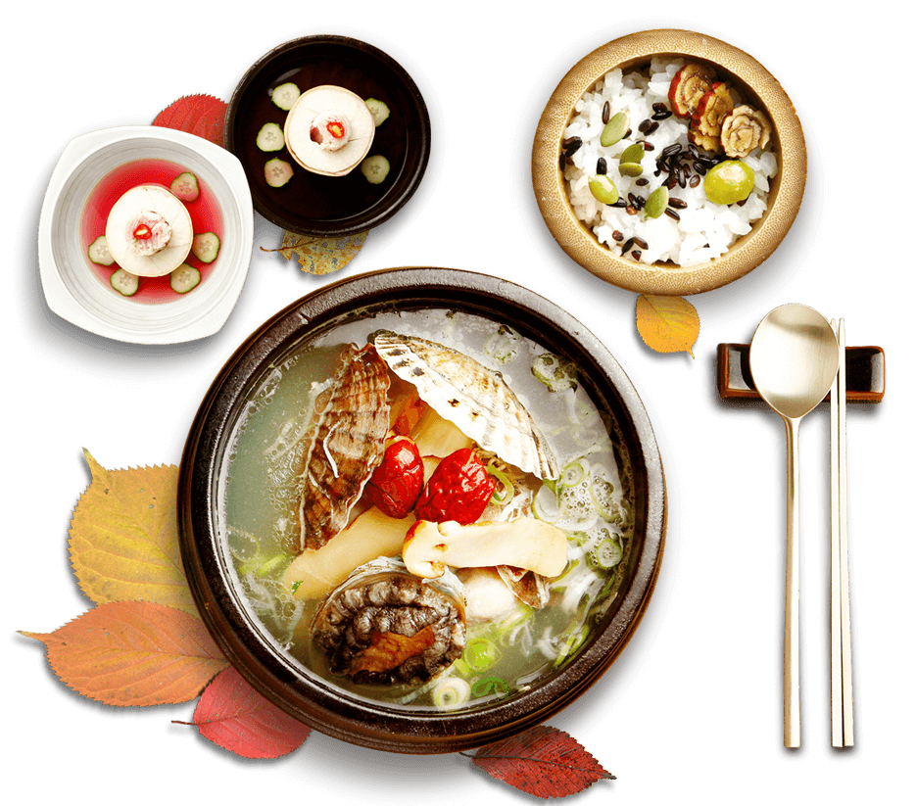
活用教材词汇，靶向高考写作
M5U3 单词拓展
Food And Culture

Slide 3
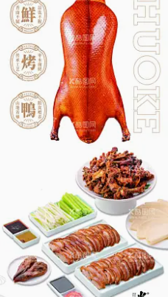
活用词汇
cuisine /kwɪˈzi:n/ n.菜肴;风味;烹饪
1.精致的淮扬菜以黄瓜雕花和玲珑汤包为特色，让外宾从饮食中领略中国美学。（应用文之推荐信）
The delicate Huaiyang cuisine, featuring carved cucumber garnishes and translucent soup dumplings, offers foreign visitors an edible insight into Chinese aesthetics.
2. 活动将展示中国菜、手工艺和书法，并设教学环节。(2023年天津卷应用文之Chinese Workshop)
The workshop will feature Chinese cuisine, handicrafts, calligraphy, and a session where we will teach others how to make traditional Chinese items.
3. 保护北京烤鸭等108道工序的传统菜肴，就是在抵御快餐同质化对文化基因的侵蚀。（应用文）
Protecting traditional cuisine like Peking Duck’s 108-step recipe is preserving living cultural DNA against fast-food homogenization.

Slide 4
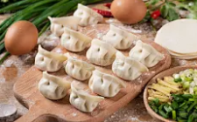
活用词汇
prior /ˈpraɪə(r)/ a.先前的;优先的
prior to /ˈpraɪə(r) tə/ 在…之前的
1. 春节前夕，包饺子和放烟花等活动将准备就绪。（应用文）
Prior to the Spring Festival, lots of activities will be well-prepared, such as making dumplings and setting off fireworks.
2. 台风登陆前，村民将牲畜迁往高地，用沙袋封窗，神色紧绷却有条不紊。（续写）
Prior to the typhoon’s landfall, villagers moved livestock to higher ground and barricaded windows with sandbags, their faces tense but movements methodical.
3. 建议将心理健康置于首位：安排每日“数字排毒”时段——关闭通知2小时阅读或冥想，可极大缓解焦虑。（应用文之建议信）
Prioritize mental health by scheduling daily "digital detox" periods—turning off notifications for 2 hours to read or meditate significantly reduces anxiety.

Slide 5
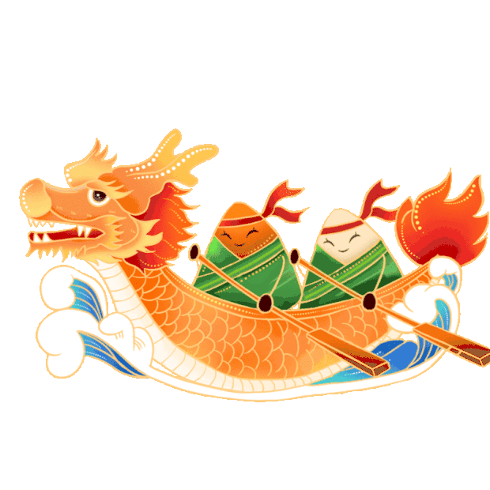
活用词汇
consist /kənˈsɪst/ vi.组成;构成
consist of /kənˈsɪst əv/ 由…组成(或构成)
1. 早餐由粥和三明治组成,闻起来美味极了。（续写）
The breakfast, consisting of/made up of porridge and sandwich, smelt extremely delicious.
2. 龙舟仪式由三个基本环节构成：祭祀河神、鼓声震天的竞渡、以及纪念屈原的粽子分享。（应用文）
The Dragon Boat ritual consists of three fundamental phases: the ceremonial offering to river deities, the thunderous drum-driven race, and sharing zongzi to commemorate Qu Yuan.
3. 真正的勇气不在于无畏，而在于双手颤抖心跳如雷时仍毅然行动。(读后续写之主题升华)
True courage consists not in the absence of fear, but in the resolute action taken despite trembling hands and a racing heart.

Slide 6
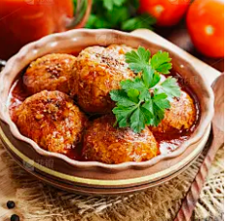
活用词汇
recipe /ˈresəpi/ n.烹饪法;食谱
1. 是的，当面对困难时，诚信是我过去二十年经营成功的诀窍。（续写）
Yes, when facing trouble, I believe honesty is always the best solution, which is the recipe for my successful management in the past twenty years.
2. 痴迷中国厨艺的外国学生求助：能否分享狮子头的食谱？我始终无法复现猪肉的嫩滑与高汤的鲜香。（应用文之求助信）
As a foreign student fascinated by Chinese culinary magic, could you share the recipe for lion’s head meatballs? The balance of tender pork and savory broth eludes my experiments.
3. 奶奶的旧笔记本不止记录食谱；每页油渍都是故事——酱油渍是李叔婚宴的回忆，姜黄污痕来自1998年的排灯节。（读后续写之细节描写）
Grandma’s weathered notebook held more than recipes; each stained page contained stories—a splatter of soy sauce recalling Uncle Li’s wedding feast, a turmeric smudge from Diwali 1998.

Slide 7

活用词汇
recipe /ˈresəpi/ n.烹饪法;食谱
4. 信任是社会凝聚力的必要配方；缺失它，再完美的政策也如无人愿尝的无味炖菜。（应用文）
Trust is the indispensable recipe for social cohesion—without it, even the most perfect policies become tasteless stews no one wishes to savor.
（应用文之议论文观点）
5. 坚持是将平凡努力化为非凡成就的秘方。（续写）
Perseverance is the secret recipe that transforms ordinary ingredients of effort into extraordinary banquets of achievement.

Slide 8

活用词汇
bold /bəʊld/ a.大胆自信的;敢于冒险的
1. 尽管手心出汗，我仍勇敢地相对流畅地完成了表演。（续写）
With boldness, I finished my performance relatively smoothly though palms were sweating.
2. AI诊断与传统中医把脉的大胆融合，用算法重构千年智慧，颠覆了个性化医疗。（应用文）
The bold integration of AI diagnosis with traditional Chinese pulse-reading techniques has revolutionized personalized healthcare, merging millennia-old wisdom with algorithms.
3. 我们倡议大胆改造城市：将废弃工厂变为垂直森林，让混凝土骨架披挂藤蔓与鸟鸣。(应用文之倡议书)
We advocate bold urban redesign: converting abandoned factories into vertical forests where concrete skeletons are cloaked with cascading ivy and birdsong.

Slide 9
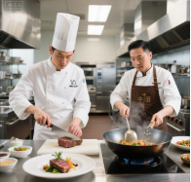
活用词汇
chef /ʃef/ n.厨师;主厨
1. 米其林主厨展示萝卜雕仙鹤技艺，刀工精准得令观众屏息惊叹。（续写）
The Michelin-starred chef demonstrated how to slice radishes into crane shapes, his knife moving with such precision that the audience held their breath in awe.
2. 与追求精确计量的西厨不同，中餐大师凭直觉调味——一撮盐、一勺料酒皆源自数十年经验。（续写）
Unlike Western chefs who focus on precise measurements, Chinese culinary masters rely on intuition—a pinch of salt or a splash of rice wine gauged by decades of experience.

Slide 10

活用词汇
stuff /stʌf/ vt.填满;把…塞进 n.东西
1.她把钱塞进乔治拳头后转身欲走。（续写）
She stuffed the money m George's fist and was about to leave.
2. 士兵踹开面包店门的瞬间，她惊慌地将密信塞进挖空的长棍面包。（续写）
Panic rising, she stuffed the incriminating letter into a hollowed-out baguette just as soldiers kicked open the bakery door.
3.莱利用报纸填塞鞋子，合脚后克雷格笑逐颜开。（续写）
Riley stuffed newspaper in them, they fit Craig couldn't stop smiling.

Slide 11
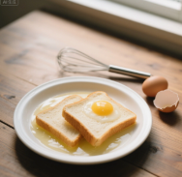
活用词汇
slice /slaɪs/ n.(食物)薄片 vt.把…切片
slice ... off /slaɪs ɒf/ 切下
1.珍娜找到面包，将两片浸入蛋液。（续写）
Jenna found the bread and put two slices into the egg mixture.
2. 他颤抖的手切下大块珍稀松露而非薄片，主厨的抽气声在寂静厨房回荡。（续写）
His trembling hand sliced off a chunk of the rare truffle instead of a thin shaving, the chef’s gasp echoing in the silent kitchen.
3. 时间将人生切片：童稚无忧，青春奋进，暮年沉静，每段皆值得品味。（续写）
Time slices life into segments—childhood’s careless joy, youth’s restless striving, old age’s reflective calm—each a flavor to savor.

Slide 12

活用词汇
elegant /ˈelɪgənt/ a.精美的;讲究的;文雅的
1. 他的文风既优雅又质朴，作品常体现对自然与平民的关怀。（应用文）
He wrote in a style that was both elegant and simple, and his works often reflected his love for nature and his concern for the common people.
2.《红绸》中京剧与现代舞的优雅融合，将带您进入传统与创新共舞的梦境。（应用文之邀请信）
The elegant fusion of Peking Opera and modern dance in "Red Silk" will transport you to a dreamscape where tradition pirouettes with innovation.
3. 她的优雅不在华服，而在将泪流满面的孤儿抱上膝头，用陈旧却洁净的手帕擦脸的神态。（续写之人物刻画）
Her elegance wasn’t in designer gowns but in the way she lifted tear-streaked orphans onto her lap, wiping cheeks with a threadbare but spotless handkerchief.

Slide 13
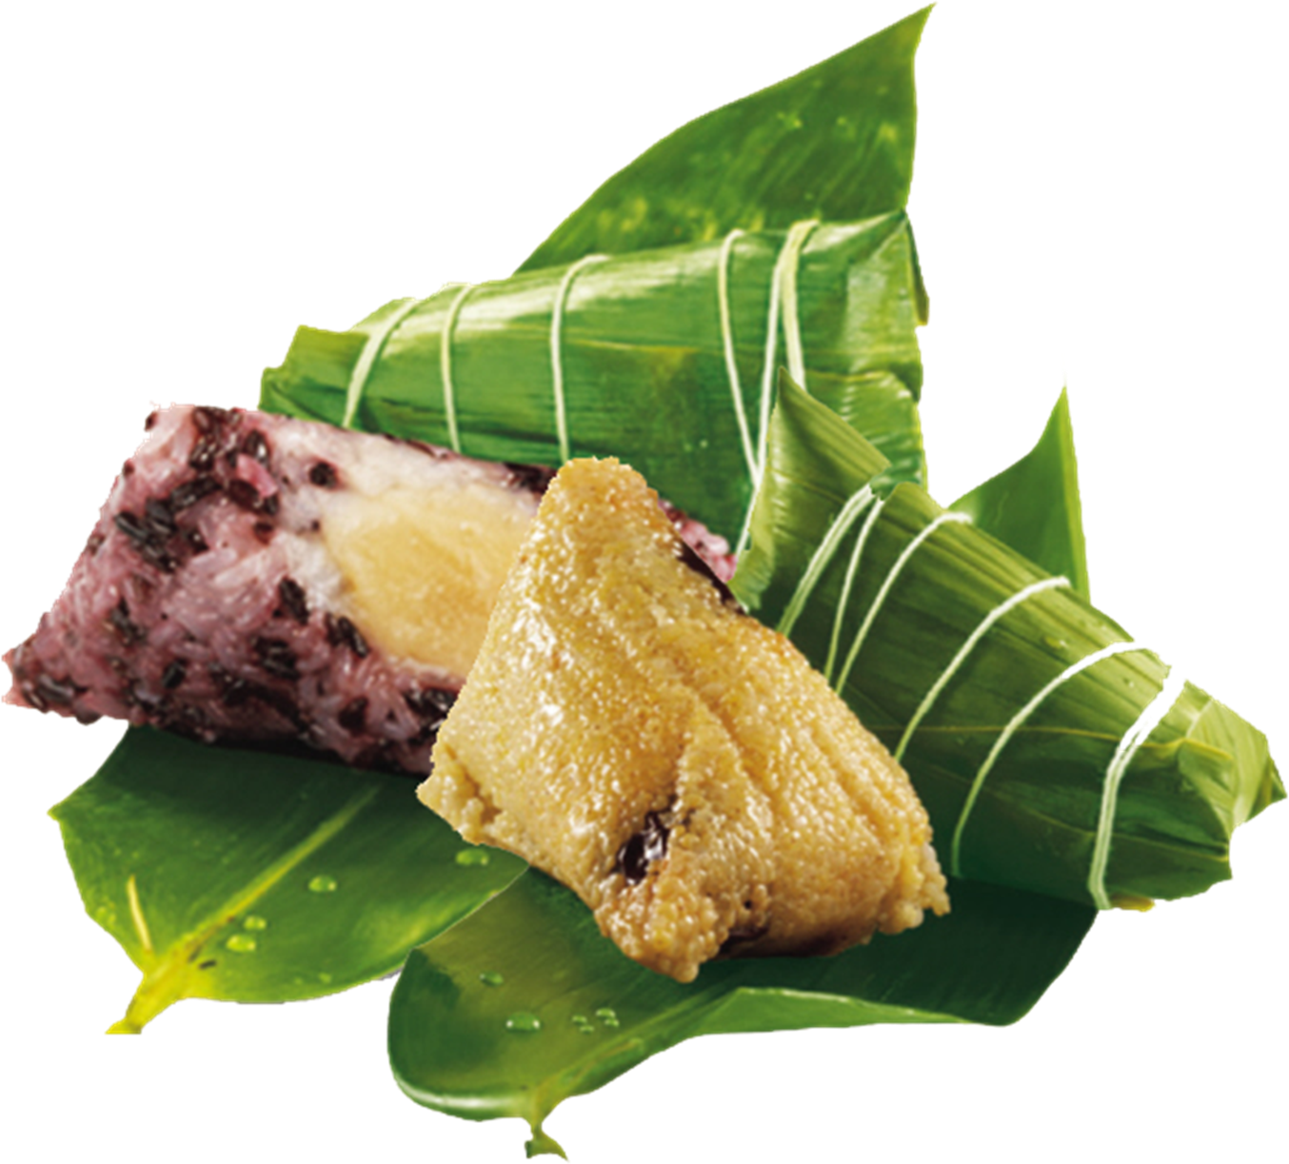
活用词汇
exceptional /ɪkˈsepʃənl/ a.特别的;罕见的
1. 随着风暴越来越强，我们的恐惧感也格外增强，渴望救援的到来。（续写）
As the storm gathered its strength, our fear grew exceptionally and desire for the arrival of rescue。
2.你知道，每个节日都有自己的典型食品，端午节也不例外。吃粽子，一种由竹叶包的蒸熟的大米，是你不能错过的。（应用文）
You know, every festival has its own typical food, and the Dragon Boat Festival is no exception. Eating zongzi, boiled rice wrapped by bamboo leaves, is what you can’t miss.
3.真正的领导力不仅在于卓越才华，更在于托举他人直至其光芒胜过自己。（ 续写之升华）
True leadership lies not in exceptional talent alone, but in elevating others until their strengths outshine your own.

Slide 14
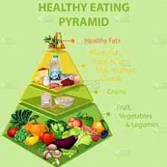
活用词汇
minimum /ˈmɪnɪməm/ n.最小值;最少量 a.最低的
1. 仅余最少供给品—半壶水和两块饼干的他们直面50公里山路，绝望侵蚀着决心。（续写）
With minimum supplies—a half-empty canteen and two biscuits—they faced a 50km mountain trek, desperation gnawing at their resolve.
2. 世卫组织建议每日蔬菜最低摄入量400克，但都市青年因快餐依赖仅达250克。（应用文）
The minimum daily intake of vegetables recommended by WHO is 400g, yet urban youth average merely 250g due to fast-food dependency.

Slide 15

活用词汇
consume /kənˈsju:m/ v.吃;喝;饮;消耗
1. 她被一阵愤怒所吞噬，打破了原本的宁静氛围。（续写）
She was consumed by a fit of rage that shattered the calm atmosphere.
2. 我买任何东西都倾向于咨询消费评级。（续写）
I tend to consult consumption ratings whatever I purchase.
3. 悔恨如酸液般吞噬他——每个“早知如此”都在灵魂刻下深痕，宽恕似遥不可及的岸。（续写）
Regret consumed him like acid—each "if only" etching deeper into his soul until forgiveness seemed an unreachable shore.

Slide 16

活用词汇
temper /ˈtempə(r)/ n.脾气;火气
1. 他们的纽带牢不可破，在逆境的火焰中锻造，在时间的考验中得到锤炼。（续写）
Their bond was unbreakable, forged in the fires of adversity and tempered by the tests of time.
2. 烈火锻钢铸韧性，苦难故炼就不摧品格。（续写）
Fire tempers steel into resilience; adversity thus forges unbreakable character.
3.她开朗的性情如孤儿院中的阳光——即兴歌声和口袋掏出的糖果，融化了冰冷的沉默。（续写）
Her cheerful temper was a sunbeam in the orphanage—melting frosty silences with impromptu songs and sticky candy shared from secret pockets.

Slide 17
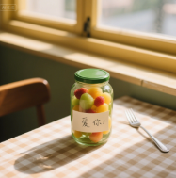
活用词汇
ingredient /ɪnˈgri:diənt/ n.(尤指烹饪)材料;成分
1.元宵灯谜、中秋饼模等节庆核心元素，是需保护的文化密码。（应用文）
Traditional festivals’ core ingredients—lantern riddles for Yuanxiao or mooncake molds for Mid-Autumn—are cultural codes needing preservation.
2.信任是维系关系的隐形要素——缺失它，再华丽的承诺也会如烤焦蛋糕般坍塌。（续写）
Trust is the invisible ingredient binding relationships—without it, even lavish promises crumble like overcooked cakes.
3.缺失的原料非藏红花或松露油——而是罐底奶奶手写“爱你”的字条。（续写）
The missing ingredient wasn’t saffron or truffle oil—it was the handwritten "love, Grandma" note she found tucked under the jar.

Slide 18
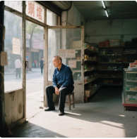
活用词汇
stable /ˈsteɪbl/ a.稳定的;稳重的
1.由于特蕾西的快速行动，柯克在塞勒姆医院的情况很稳定。（续写）
Due to the quick actions of Tracy, Kirk is in stable condition at the Salem Hospital.
2. 爸爸的生意不景气了，我们稳定的生活开始变得摇摇欲坠。（续写）
Dad's business wasn’t doing so well, and our stable life started getting shaky.

Slide 19

活用词汇
brand /brænd/ n.品牌
1.李宁等国潮品牌将龙纹融入街头服饰，把文化遗产变为全球时尚宣言。（应用文）
"Guochao" brands like Li-Ning fuse dragon motifs with streetwear, transforming cultural heritage into global fashion statements.
2.崭新的帐篷（尼龙面仍有工厂气味）成了暴风雪中他们唯一的庇护所。（续写）
The brand-new tent—its nylon sheen still smelling of factory freshness—became their sole shelter against the blizzard’s fury.
3.品牌价值不在商标而在始终如一的道德——如今消费者惩罚“漂绿”行为比产品缺陷更严厉。（应用文）
A brand’s value lies not in logos but in consistent ethics—consumers now punish greenwashing more harshly than product flaws.

Slide 20
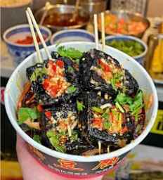
活用词汇
canteen /kænˈti:n/ n.食堂;餐厅
1.面试失败后，她躲进食堂昏暗储藏室，酱油和腌姜的气味掩盖了她的泪水。（续写）
She hid in the canteen’s dim pantry, the scent of soy sauce and pickled ginger masking her tears after the failed audition.
2. 交换生初尝食堂臭豆腐时退缩，但其浓烈风味终成他们Ins最多点赞的美食冒险。（应用文）
Exchange students initially recoiled at our canteen’s stinky tofu, but its bold flavor later became their most Instagrammed culinary adventure.

Slide 21
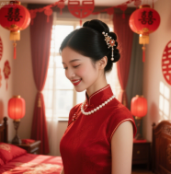
活用词汇
pearl /pɜ:l/ n.珍珠
1. 泪水，像悲伤的珍珠，沿着她的脸颊划出轨迹，每一滴都是她内心动荡的无声证明。（续写）
Tears, like pearls of sorrow, traced paths down her cheeks, each drop a silent testament to her inner turmoil.
2. 中华文化中珍珠象征纯洁智慧；新娘常佩戴以辟邪，信其光洁可照退厄运。（续写）
In Chinese culture, pearls symbolize purity and wisdom; brides often wear them to deflect misfortune, believing their luminous surface mirrors evil away.
3.月光将荷叶雨滴化作液态珍珠，颤动的美与她破碎的心形成残酷对比。（续写）
Moonlight transformed raindrops on lotus leaves into liquid pearls, their trembling beauty a stark contrast to her shattered heart.
4.苦难如沙粒侵入牡蛎；以坚韧包裹之，终成生命锦缎中闪亮的智慧珍珠。（续写）
Adversity layers pain like grit in an oyster; with resilience, we coat it into wisdom pearls that gleam in life’s tapestry.

Slide 22
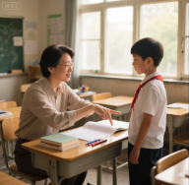
活用词汇
somewhat /ˈsʌmwɒt/ ad.有点;稍微
1. 我回头看向那栋楼，有些恼火，因为我妈空手又出现了。（续写）
I looked back to the building, somewhat annoyed, as my mom reappeared, empty-handed.
2. 这个计划有些冒险，但鉴于情况的紧迫性，他们别无选择。（续写）
The plan was somewhat risky, but given the urgency of the situation, they had no other choice.
3. 他有些尴尬地道了歉，一边揉着脖子，一边避开直视对方。（续写）
He apologized somewhat awkwardly, rubbing his neck while avoiding direct eye contact.
4. 起初她有些犹豫，但老师的鼓励话语最终在她心中点燃了自信的火花。（续写）
She was somewhat hesitant at first, but the encouraging words from her teacher finally ignited a spark of confidence in her heart.

Slide 23
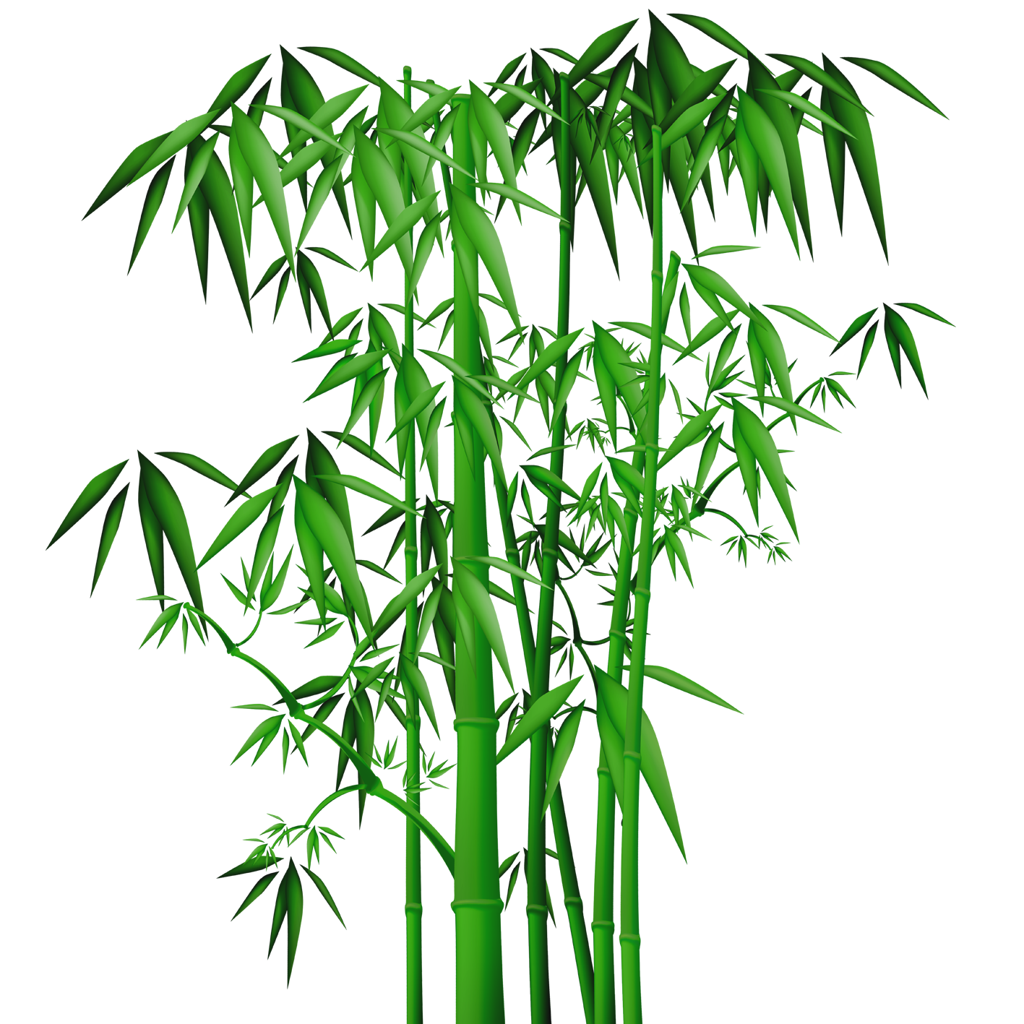
活用词汇
association /əˌsəʊʃiˈeɪʃn/ n.协会;关联
1. 贫困与教育匮乏的关联需系统性解决方案，而非临时救济。（应用文）
The association between poverty and limited education demands systemic solutions, not temporary charity.
2. 竹子与健康、富贵和阖家幸福有关。（应用文）
Bamboo plants are associated with health, abundance and a happy home.
3.参加活动前,父亲提醒我要和积极思考的人合作。（续写）
Prior to participating in the activity, my father reminded me to be in association with those thinking positively.
4. 摄影协会周末工作坊将在古镇探究光影技法，融合艺术与遗产保护。（应用文）
The Photography Association’s weekend workshop will explore light-shadow techniques at the ancient town, blending art with heritage preservation.

Slide 24

活用词汇
regardless /rɪˈgɑ:dləs/ ad.不顾;不加理会
regardless of /rɪˈgɑ:dləs əv/ 不管;不顾
1. 她不顾暴雨抽打脸颊，放飞受伤的鹰，看它如不屈灵魂冲入雷云。（续写）
She released the injured eagle regardless of the storm lashing her face, watching it soar into thunderclouds like a defiant spirit.
2. 不顾社会期待追求梦想——真实比顺从更具回响。（续写）
Pursue dreams regardless of societal expectations—authenticity resonates louder than conformity.
3. 无论结果如何，我们已在舞台留下印记。（续写）
Regardless of the final result, we knew we had left our mark on that stage

Slide 25

活用词汇
category /ˈkætəgəri/ n.类别;种类
1. 大赛设三大类别：创新设计/非遗复兴/可持续方案——每类需独立评审标准。（应用文）
The competition includes three categories: innovation design, cultural heritage revival, and sustainable solutions—each requiring distinct evaluation criteria.
2. 神秘盒内的器物超越已知类别：发条鸟鸣奏陶瓷音符，月光编织的地图。（续写）
The mysterious box contained artifacts defying all known categories—a clockwork bird singing ceramic notes and a map woven from moonbeams.

Slide 26

活用词汇
quantity /ˈkwɒntəti/ n.数量;数额
1. 了解到你在打篮球方面有丰富的经验,我写信真诚地邀请你加人我们的篮球俱乐部。(应用文写作之邀请信)
Learning that you have a large quantity of/large quantities of experience in playing basketball, I'm writing to sincerely invite you to join our basketball club.
2. 多么善良的一家人啊!他们给了我大量的帮助和一顿美餐,却不求任何回报。(读后续写主旨升华)
What a kind family! They offered me a large quantity of help and a good meal without any return.
3. 音乐节上有许多活动,如音乐剧,乐器演奏和歌唱比赛。(应用文之邀请信)
There are large quantities of activities, including musical plays, musical instrument performances and singing contests.
4. 萤火虫数量逐年锐减——昔时夏夜流淌的金色星河，今唯孤光零落。（续写）
The quantity of fireflies dwindled yearly—where once golden rivers flowed through summer nights, now only solitary sparks flickered.

Slide 27
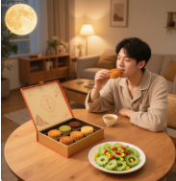
活用词汇
moderation /ˌmɒdəˈreɪʃn/ n.适度;合理
1. AI发展需伦理约束——失控算法恐成数字独裁者。（应用文）
AI development requires ethical moderation—unchecked algorithms risk becoming digital dictators.
2.营养师强调适度：中秋享月饼时配苦瓜沙拉调节血糖。（应用文）
Nutritionists emphasize moderation: enjoying mooncakes during Mid-Autumn but balancing with bitter melon salads to regulate blood sugar.
3.他的野心失度；筑起的梦之宫殿如饥饿巨碑吞噬亲情。（续写）
His ambition lacked moderation; the palace of dreams he built swallowed family bonds like a hungry monument.

Slide 28
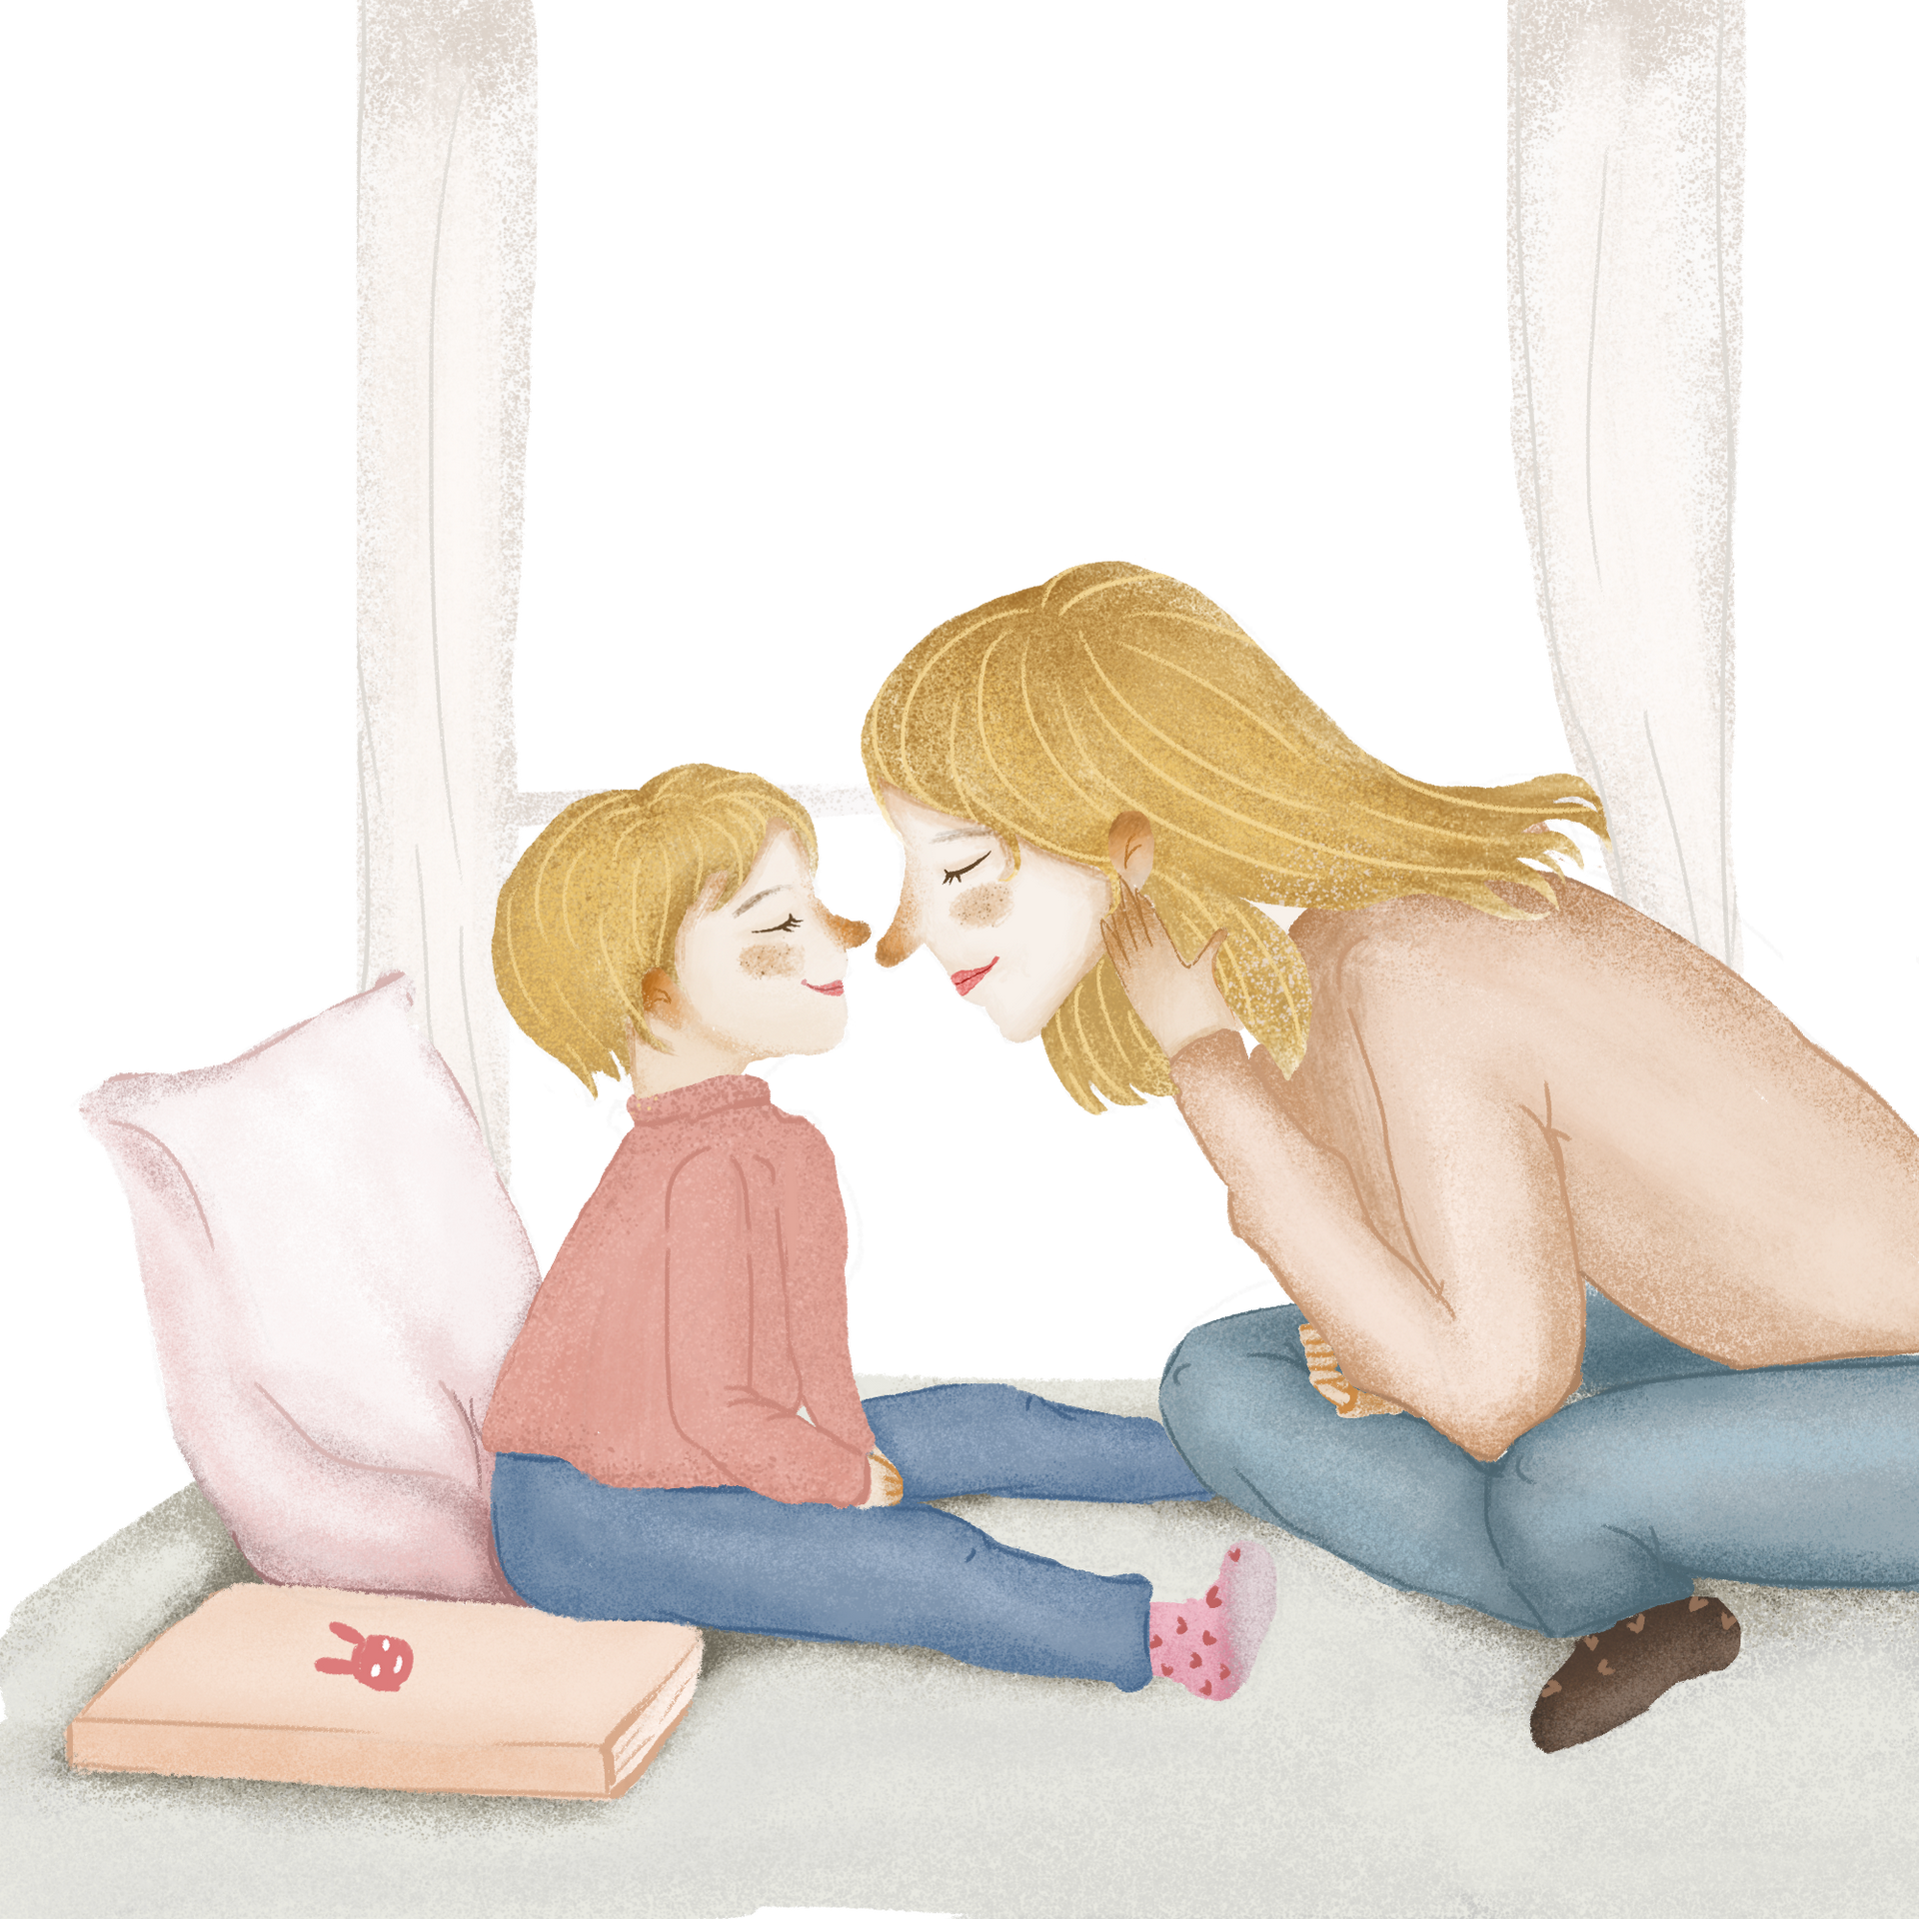
活用词汇
ideal /aɪˈdi:əl/ a.完美的;理想的 n.理想
1.一得知被心仪的大学录取了，Tim迫不及待地跑回家与妈妈分享他的喜悦。（续写）
Upon knowing he was admitted to his ideal university, Tim couldn’t wait to share his delight with his mom.
2. 因此，如果可能的话，能否请您给我们自由选择伙伴的权利，这样我们更有可能自己挑出理想的学习伙伴，无论是从性格还是语言技能方面。（应用文）
Therefore, were it possible, could you please give us the freedom to choose our partner by ourselves so that we are more likely to single out our ideal mate by ourselves, whether in aspects of personality or language skill.
3. 理想的亲子关系对成长至关重要。（应用文）
An ideal relationship between parents and children is very important for our growth.

Slide 29

活用词汇
fundamental /ˌfʌndəˈmentl/ a.根本的;基础的n.基本规律
1. 震后重建不仅需资金，更要重建对社区团结的根本信任。（续写）
Rebuilding the village after the quake required more than funds—it demanded restoring fundamental trust in communal solidarity.
2.尊老不仅是传统，更是维系代际家庭纽带的根本价值。（应用文）
Respecting elders isn’t just tradition; it’s a fundamental value cementing family bonds across generations.
3. 批判性思维是被应试训练掩盖的根本能力——改革须优先探究而非死记硬背。（应用文）
Critical thinking is a fundamental skill eclipsed by exam drills—reforms must prioritize inquiry over rote memorization.

Slide 30
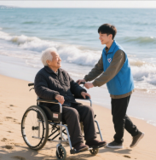
活用词汇
chew /tʃu:/ vi.&vt.咀嚼;嚼碎 n.咀嚼.
1.某些真相苦涩难咽；用反思慢嚼方能萃得智慧。（续写）
Some truths are too bitter to swallow immediately; chew them slowly with reflection to extract wisdom.
2. 他仔细琢磨着那位女士所说的话，并为此感到高兴，因为他能够帮助她实现最后的愿望。（续写）
He was chewing over what the madam said, and glad that he could help her realize the last desire.

Slide 31
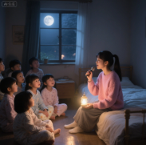
活用词汇
consistent /kənˈsɪstənt/ a.一致的;连续的
1.人生非仅阳光亦有风雨——此为共识。（续写）
It is universally acknowledged that life consists of not only sunshine but also storms.
2. 因此，我强烈建议将英语口语水平相近的学生进行分组，这样我们就能在一个支持性和高效的学习环境中进行合作与交流了。（应用文）
Accordingly, I highly suggest grouping students with consistent levels in English speaking, thus making it possible for us to collaborate and communicate in a supportive and efficient learning atmosphere.
3. 她一贯的善良在危机中最耀眼；停电时众人惊慌，她却点烛唱民谣安抚受惊孩童。（续写）
Her consistent kindness shone brightest in crisis; while others panicked during the blackout, she calmly lit candles and sang folk songs to soothe frightened children.

Slide 32

活用词汇
modest /ˈmɒdɪst/ a.些许的;谦虚的;朴素的
1. 火场救三童后她谦言"换了谁都会这么做"，质朴话语彰显非凡勇气。（续写）
Her modest reply—"I simply did what anyone would"—after rescuing three children from flames, revealed extraordinary courage clothed in humility.
2. 竹子深深的根系象征着坚韧不拔的精神，而其笔直且空心的茎干则代表着正直和谦逊的品质。（应用文）
Bamboo's deep roots symbolize determination and its straight and hollow pole represents integrity and modesty.
3. 她主动提出拿出自己微薄的积蓄，希望能住过来并帮忙照顾他——但我清楚，马克的自尊心绝不会允许这样做。（续写）
She offered her own modest saving seven offered to move in and help take care of him---but I knew Mark's pride wouldn't allow it.

Slide 33

活用词汇
trick /trɪk/ n.诀窍;计谋;把戏
1. 他被骗了一大笔钱,绝望得以酒浇愁。(读后续写情感描写)
Tricked into giving up a large quantity of money, he got so desperate that he drowned his sadness in wine.
2. 那个顽皮的男孩捉弄那个害羞的女孩,使她气得两颊通红。(读后续写情感描写)
The naughty boy played tricks on the shy girl, making her cheeks flame with anger.
3.作为一名来自美国的交换生，我喜欢吃水饺。你可以告诉我包水饺的诀窍吗？(应用文写作之求助信)
As an exchange student from America，I like eating dumplings. Would you please tell me the trick of making dumplings?
4. 很快我就想出了一个办法来弥补这个尴尬的空白。（续写）
I soon came up with a little trick to make up for the embarrassing blank.

Slide 34

活用词汇
overall /ˌəʊvərˈɔ:l/ ad.总体上;大致上 a.全面的
1. 总的来说，我们认为在线投票是一种便捷且具有包容性的方式，能够选出校园十佳歌手。（应用文）
Overall, we think online voting is a convenient and inclusive means for choosing the top ten campus singers.
2. 总的来说，“课前三分钟演讲”这一活动激发了我们学生对英语学习的热情，如果稍作调整，它在提升我们的英语口语方面将会更加有效。（应用文）
Overall, the "3-Minute Speech Before Class" activity has fueled us students ’ passion for English, and with some adjustments, it will be even more effective in enhancing our spoken English.

Slide 35
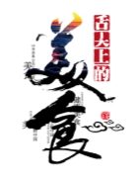
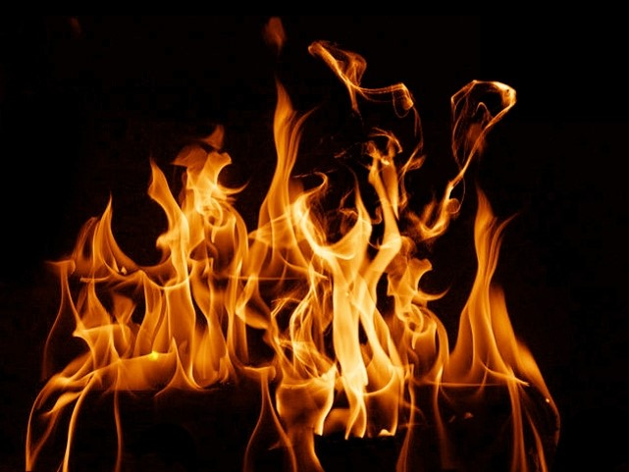
Thanks

