Slide 1


感恩遇见，相互成就，本课件资料仅供您个人参考、教学使用，严禁自行在网络传播，违者依知识产权法追究法律责任。
更多教学资源请关注
公众号：溯恩英语
知识产权声明

Slide 2
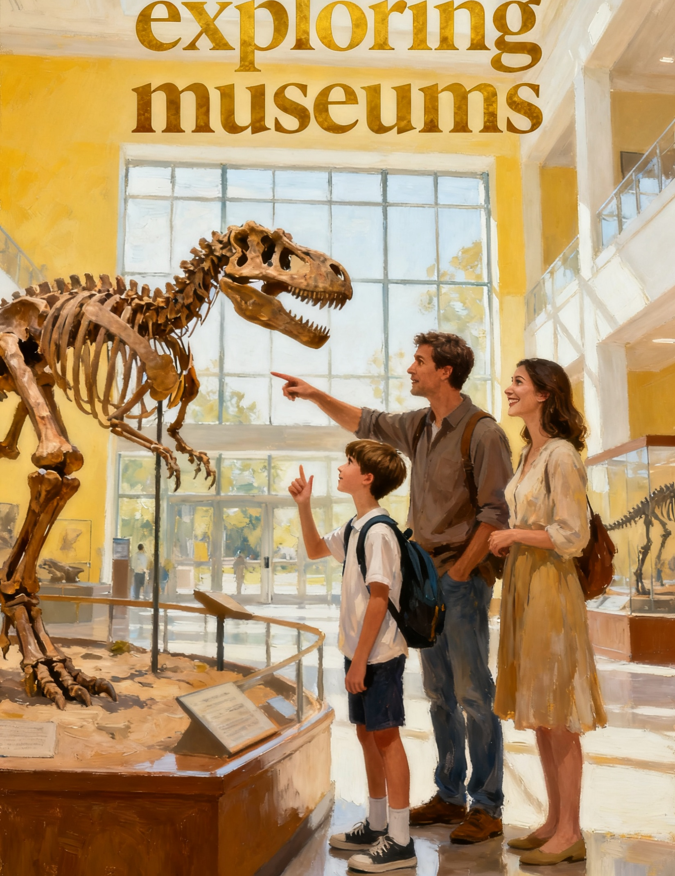
应用文写作思辨性思维训练：
议论文：
“图表+评论建议”类
描得清，评得准，建议实

Slide 3
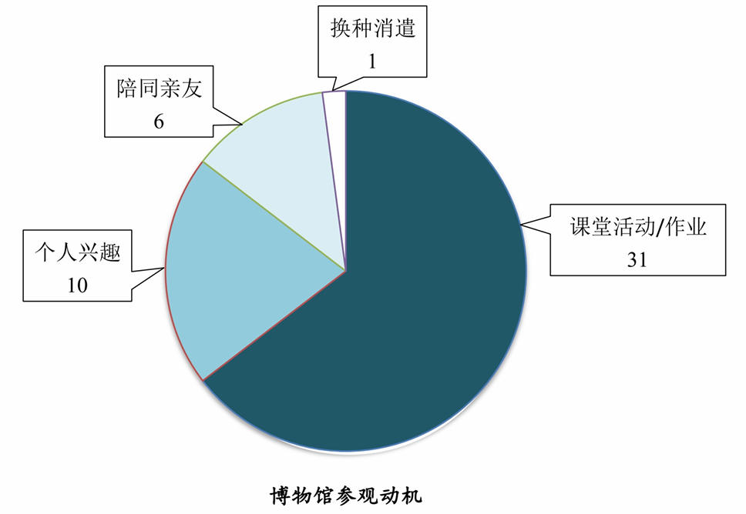
5步审题法+思维第一
咬文嚼字审题
学校英文报正在开展以 “Exploring Museums” 为题的讨论。你对本班 48 位同学进行了 “博物馆参观动机” 问卷调查，请使用图表中的调查结果写一篇短文投稿，向学校提出建议，内容包括：
(1) 参观动机状况描述；(2) 简单评论；
(3) 你的建议。
1 文体：投稿
2 时态：一般现在时
3 主题：参观博物馆动机+评论建议
4 要点分层：
P1：开门见山+描述结果
P2：评论
P3：建议
5 语气：正式，有理有据

Slide 4
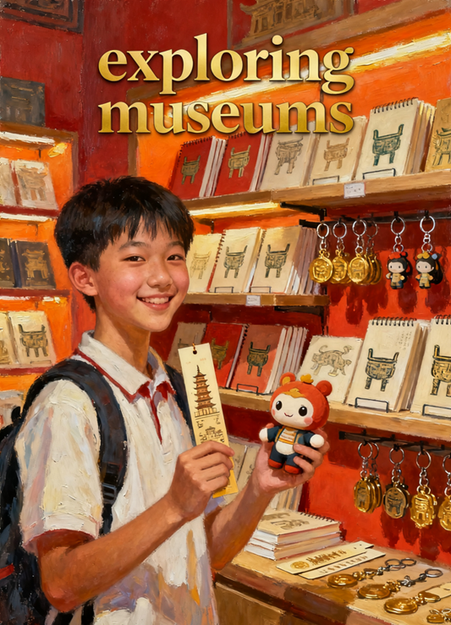
瓶颈：要点的挖掘：
P1： 描述调查结果（表格 / 数据呈现）
思维指导：
1 “调查背景”（谁、调查什么），
2 “各动机数据”（从多到少 / 从主到次），
3“对比差异”（突出最明显的数量区别），
避免罗列数字

Slide 5
句型结构 | 汉语描述 | 英语表达
carry out a survey among sb. to find out sth. | 总起，交代 “我对 48 名同学进行调查，目的是了解他们参观博物馆的动机” | Recently, I carried out a survey among 48 classmates to find out their motivations for visiting museums.
The most common reason is...; [数量] students choose this, accounting for... of the total. | 分述占比最高的动机：“最常见的原因是课堂活动或作业，31 名学生选择这一项，占总数的近三分之二” | The most common reason is class activities or homework: 31 students choose this, accounting for nearly two-thirds of the total.
Followed by..., [数量] classmates said they... because... | 分述次高的动机：“其次是个人兴趣，10 名同学表示他们参观博物馆只是因为对展品好奇” | Followed by personal interest: 10 classmates said they visit museums simply because they are curious about the exhibits.
Only [数量] students go to..., and the least popular reason is "..." — merely [数量] student mentioned it. | 分述占比低的两个动机：“只有 6 名学生是陪同亲友去的，最不受欢迎的原因是‘换种消遣方式’—— 仅 1 名学生提到这一点” | Only 6 students go to accompany their relatives or friends, and the least popular reason is "finding a new way to relax" — merely 1 student mentioned it.
There is a striking difference between... and...: [数量] more students... than... | 对比最主要和最次要动机的差异：“最主要原因和最次要原因之间存在显著差异：为学校任务参观博物馆的学生比为放松去的多 30 人” | There is a striking difference between the top reason and the least one: 30 more students visit museums for school tasks than for relaxation.

Slide 6
瓶颈：要点的挖掘：
P2：评论调查结果 :“肯定合理 + 指出不足 + 表达感受” 三层逻辑
思维指导：
1 评论不能脱离数据！
2先从数据中找 “积极点”（如课堂任务体现学习价值）
3 再找 “待改进点”（如主动兴趣少、休闲认知弱）
3 最后用 “感受”（遗憾、期待）衔接，让评论有温度

Slide 7
思维逻辑 | 汉语表达（紧扣数据的评论） | 英语表达
肯定 积极点 | 从调查结果中，我们首先能看到积极的一面：大多数同学把博物馆和学习联系起来 —— 为课堂活动去参观有助于他们把课本知识和实物展品联系起来，这是加深理解的好方法。 | From the survey results, we can see something positive first: most students link museums with learning — visiting for class activities helps them connect textbook knowledge with real exhibits, which is a good way to deepen understanding.
指出不足 | 然而，也存在明显的不足。只有 10 名同学是出于个人兴趣去的，这意味着我们大多数人没有主动去探索博物馆的乐趣；此外，仅 1 名同学把博物馆当作放松的地方，说明我们没注意到它们的 “休闲价值”。 | However, there are also obvious shortcomings. Only 10 students go out of personal interest, meaning most of us don’t take the initiative to explore museums’ fun; besides, merely 1 student sees museums as a relaxation place, showing we fail to notice their "leisure value".
表达感受 | 有点可惜的是，博物馆大多被看作是 “作业场所”，而非 “兴趣或放松的地方”。我希望这种情况能尽快改变。 | It’s a little pity that museums are mostly seen as a "homework place" rather than a "place for interest or relaxation". I hope this can change soon.

Slide 8
瓶颈：要点的挖掘：
P3：提出建议 ——“分主体 + 对应问题 + 可操作” 原则
思维指导：
1建议必须 “针对前面的不足”，且对 “学校提建议
2 每个建议要写清 “做什么”“解决什么问题”，拒绝空泛的 “多去博物馆”

Slide 9
调查核心问题 | 调查核心问题 | 学校解决措施 | 学校解决措施（英语）
近 2/3 学生（31 人）因作业被动参观，仅 10 人因兴趣，作业成被动参观推手 | Nearly 2/3 students (31) visit passively for assignments; only 10 for interest—assignments drive passivity | 优化作业：取消单一报告，改兴趣任务（如分享展品故事），激活主动意愿 | Optimize assignments: Replace single reports with interest tasks (e.g., sharing exhibit stories) to boost initiative
仅 1 人因消遣参观，学校未连休闲需求，学生误认博物馆仅能学习 | Only 1 student visits for relaxation; schools lack leisure links—students think museums are only for learning | 联合博物馆办开放日：设友好体验板块，自愿参与 + 分享趣事，凸显休闲属性 | Cooperate with museums for open days: Add student-friendly activities, voluntary participation + story-sharing to highlight leisure value
缺长期引导，学生仅作业时参观，难转主动兴趣 | No long-term guidance; students visit only for assignments, hard to shift to active interest | 成立探索社团：教师指导，月办非作业活动（如寻宝），促主动探索 | Set up exploration clubs: Teacher-guided monthly non-assignment activities (e.g., treasure hunts) to promote active exploration

Slide 10
思维总结：
写作环节 | 核心规律 | 避坑提醒
数据描述 | 总（背景）→分（从多到少）→比（差异）；用 “account for”“Followed by” 表逻辑 | 避免只罗列数字，不体现对比
结果评论 | 肯定（扣数据）→不足（扣数据）→感受；每句都要对应问卷结果（如 “10 人因兴趣”） | 避免脱离数据空谈 “学生不主动”
学校建议 | 对应不足 + 具体动作（写 “做什么”）；聚焦学校可操作的措施（作业、合作、社团） | 避免空泛表述（如 “多关注博物馆”）

Slide 11

下水作文
Exploring Museums: From Requirements to Curiosity
Recently, I surveyed 48 classmates about why they visit museums. The top reason is class work or homework—31 students (nearly two-thirds) choose this. Next is personal interest (10 students), only 6 go with relatives, and just 1 goes for relaxation. The difference between the top and least reasons is striking.
From the results, there’s something good: most students connect museums with learning, which helps them understand better. But there are problems too: few go for interest or relaxation. It’s a little pity that museums are mostly seen as a “homework place.”
Here are some suggestions for our school: First, improve museum assignments. Instead of just writing reports, let us share stories of our favorite exhibits—it makes us explore more actively; second, work with local museums to hold “Interest Days.” We can join freely and share fun moments later, which helps us see museums aren’t just for studying.

Slide 12
参考范文
Exploring Museums: From Requirements to Curiosity
Recently, I surveyed 48 classmates about why they visit museums. The results show that 31 students go mainly for class trips or assignments, 10 out of personal interest, 6 to accompany family or friends, and 1 simply for something different. In short,visits are still largely requirement-driven rather than curiosity-driven.
To spark genuine interest in museums, I suggest that the school redesign coursework to offer more interesting assignments, such as treasure hunts and volunteer hours. The school can also partner with local museums to run hands-on workshops. Finally,it is advisable to launch a student museum club to plan weekend visits and share highlights.
I sincerely hope the school will consider these suggestions to foster students' internal motivation to explore museums.

Slide 13
描得清，评得准，建议实
不脱依据、
不混逻辑、
不做空泛建议！

