Slide 1


感恩遇见，相互成就，本课件资料仅供您个人参考、教学使用，严禁自行在网络传播，违者依知识产权法追究法律责任。
更多教学资源请关注
公众号：溯恩英语
知识产权声明

Slide 2
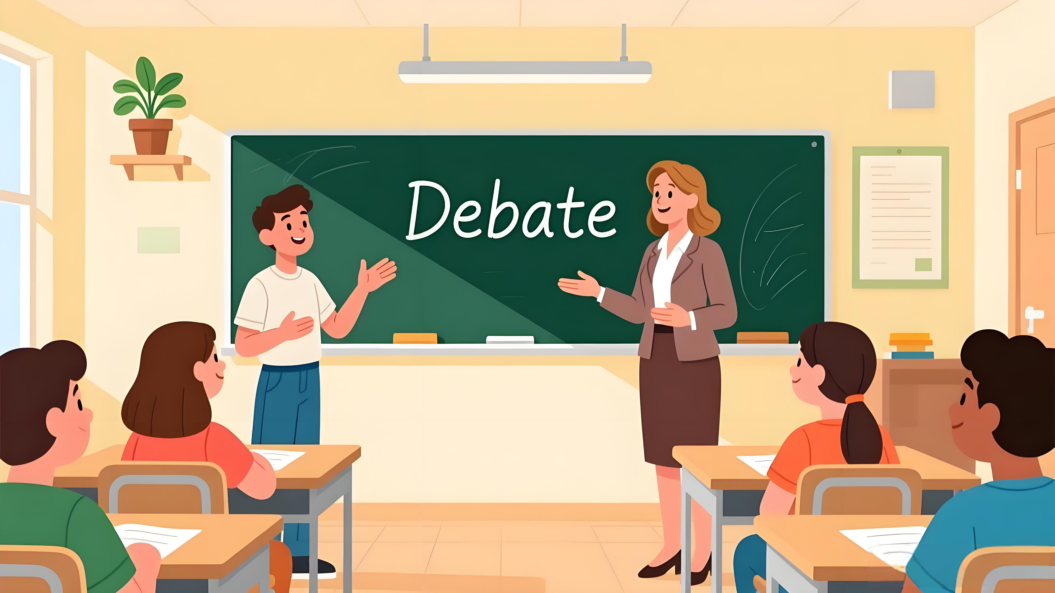
My Choice Between Two Debate Topics
Mobile phones in class V.S. Group or individual study
—2025.10强基联盟应用文分析

Slide 3






What makes a good debate topic ?
Lead-in
Debatable
Balanced
Both sides have valid points
Equal opportunity to win
Relevant
Thought-Provoking
Relatable to real life
spark genuine interest
Stimulate deep thinking
Probe the core
Controversial
Timely
Provide ample room
for both sides
Connect to current events to
capture audience interest

Slide 4
Analyze
Genre
Reader
Background
Writing Puporse
Content
Tense
Person
Tone
a persuasive E-mail
假定你是李华，外教老师 Jenny 准备在班里举办一次辩论赛，她给出了 “Mobile phones in class” 和 “Group or individual study?” 两个题目供大家选择。请给 Jenny 写一封邮件，内容包括：
1.你的选择；
2.说明理由。
The Decision-Maker: Foreign Teacher Jenny
Jenny has provided two topics for the approaching class debate
To persuade Jenny to adopt the debate topic I recommend.
Clearly state the recommendation
Provide persuasive reasons
Reinforce the recommendation
Primarily Simple Present Tense
First person "I" and "we"
Polite, Confident, and Persuasive

Slide 5
Construct
What is the recommendation?
directly and clearly
Why this is an excellent choice?
Core Logic Chain of a persuasive writing
value/benefits
to students
to the class
to the debate
Summarizing the Core Value
a persuasive
ending
Appreciating Your Consideration
Anticipating Positive Outcomes
Wishing the Event a Success

Slide 6

Brainstorm
How do you state the recommendation clearly?
基础版—直接陈述法
升级版—比较选择法
I strongly recommend...
My clear preference is for ...
After meticulous consideration, I believe...would be ideal.
Having evaluated both options meticulously, I strongly vote for...
While both have merits, ...clearly outweighs...
+非谓语
+从句

Slide 7
Discussion
Mobile phones in class?
value/benefits
to students
to the class
to the debate
Engage Direct Personal Interest激发直接的个人兴趣
Encourage Critical Thinking
鼓励批判性思维
Weigh Diverse Views Fairly
公平地权衡不同观点
Develop Digital Citizenship
培养数字公民素养
Spark Strong Opinions
激发强烈的观点
Ensure Lively Discussions
确保活跃的讨论
Relate to Everyone's Experience
关联每个人的体验
Establish Collective Norms
建立集体规范
Present Clear Opposing Arguments
呈现清晰的对立论点
Explore a Practical and Engaging Issue
探讨一个实际且引人入胜的问题
Generate Immediate, Relatable Evidence
产生即时、相关的论据

Slide 8
Brainstorm
Group or individual study?
value/benefits
to students
to the class
to the debate
Address a Universal Student Dilemma
解决学生的共同困惑
Improve Personal Study Habits
改进个人学习习惯
Understand Diverse Learning Strengths
理解不同的学习优势
Develop Self-Awareness
培养自我意识
Equip Students with Strategic Flexibility
使学生掌握策略灵活性
Inform Varied Learning Styles
了解多样化的学习风格
Foster a Supportive Learning Environment
营造互助的学习氛围
Optimize Future Collaboration
优化未来的合作
Build Mutual Respect for Differences
建立尊重差异的班级文化
Generate a Practical and Insightful Discussion
引发务实而深刻的讨论
Present Balanced Natural Arguments
呈现天然平衡的论点
Draw upon Abundant Personal Experiences
汲取丰富的个人经验作为论据

Slide 9
Practice
Summarize/appreciate
anticipate/wish
a persuasive ending
Version 1
I sincerely appreciate you taking the time to evaluate this proposal and I Iook forward to a lively discussion!（appreciate+anticipate）
Version 2
I am confident that this debate will prove insightful, offering fresh perspectives and practical benefits for everyone involved.(anticipate)
Version 3
We are confident that this debate, with its significant educational and interactive value, is sure to be a great success and a treasured memory for everyone!(summarize+wish)

Slide 10

Official Writing One
Dear Jenny,
I'd like to recommend "Mobile phones in class?" as our debate topic. It's a practical and engaging issue that affects all of us directly.
This topic sparks strong opinions. Some argue phones aid learning through online search and apps, while others believe they distract students. A debate would help us weigh these views fairly. Plus, it encourages critical thinking about technology's role in education.
I hope this suggestion is helpful. It's a topic everyone can relate to, ensuring lively discussions. Looking forward to your feedback!
Yours,
Li Hua
亲爱的珍妮：
我想推荐"课堂上使用手机？"作为我们的辩论题目。这是一个切合实际且引人入胜的话题，与我们每个人都息息相关。
该议题能引发多元观点碰撞：有人认为手机能辅助学习，支持资料查询和应用软件使用；也有人认为手机会分散注意力影响课堂效率。通过辩论可以让我们客观权衡不同立场，更能促使我们深入思考科技在教育中扮演的角色。
相信这个贴近生活的议题能激发热烈讨论，期待你的反馈！
李华

Slide 11
Official Writing Two
Dear Jenny,
I'd like to suggest "Group or individual study?" as our debate topic. This is a meaningful choice that every student encounters in their learning process.
Group study encourages collaboration and diverse perspectives, while individual study allows for personalized focus. Some students thrive in team discussions, whereas others prefer quiet and independence. Exploring both approaches would help us understand their respective strengths in different learning situations.
I believe this topic will lead to a practical and insightful discussion. It could even help classmates improve their study habits. Hope you find this suggestion useful!
Yours,
Li Hua
亲爱的珍妮：
我想提议以"小组学习还是个人学习？"作为我们的辩论主题。这是每位同学在学习过程中都会面临的有意义的选择。
小组学习能促进合作交流与观点碰撞，而个人学习则有利于专注深入与独立思考。有些同学在团队讨论中收获更多，另一些同学则更适应安静自主的学习模式。通过探讨这两种方式，我们能更好地理解它们在不同学习情境中的独特优势。
相信这个贴近实际的话题能引发许多有价值的讨论，甚至帮助同学们优化自己的学习方法。期待这个建议能为你提供参考！
李华

Slide 12
Sample Writing
Dear Jenny,
I am thrilled to learn about the upcoming class debate.Having evaluated both topics meticulously, I strongly vote for “Group or individual study”.
To begin with, this topic could keep students hooked by tapping into their personal learning experiences. Plus, more students will contribute actively, making the debate lively and inclusive. Also, it serves as a powerful catalyst for strengthening mutual understanding, building a supportive learning community, and promoting a positive classroom culture where every style is valued.
I am confident that this debate will prove insightful, offering fresh perspectives and practical benefits for everyone involved.Thank you for considering my recommendation.
Yours,
Li Hua
亲爱的珍妮：
得知班级即将举行辩论赛，我内心十分激动。在认真斟酌两个备选议题后，我坚决支持将"小组学习还是个人学习？"定为辩题。
首先，该议题能让学生沉浸其中，因为它与每个人的学习体验息息相关。其次，更多学生会积极参与，使辩论充满活力、包容并蓄。此外，它还能有效增进同学间的相互理解，构筑互助共进的学习共同体，培育尊重不同学习风格的积极班级文化。
我坚信这场辩论将富有启发意义，为所有参与者带来全新视角与实质收获。感谢您考虑我的建议。
李华

Slide 13
Accumulate
a practical and engaging issue
spark strong opinions
help us weigh these views fairly
encourage critical thinking about technology's role in education
a topic everyone can relate to
ensure lively discussions
encourage collaboration and diverse perspectives
thrive in team discussion
lead to a practical and insightful discussion
evaluate both options meticulously
I strongly vote for...
tap into their personal learning experiences
contribute actively, making the debate lively and inclusive
strengthen mutual understanding
build a supportive learning community
promote a positive classroom culture
this debate will prove insightful
offer fresh perspectives and practical benefits for everyone involved
keep students hooked by
serve as a powerful catalyst for
一个切合实际且引人入胜的议题
引发强烈反响
帮助我们公正权衡不同观点
促进对技术教育作用的批判性思考
人人都能感同身受的话题
确保讨论热烈进行
促进协作与观点碰撞
在团队讨论中如鱼得水
带来富有实践意义与真知灼见的讨论
仔细权衡两个选项
我坚决支持
契合每个人的学习体验
积极参与，使辩论生动全面
增进相互理解
构建互助型学习共同体
培育积极班级文化
这场辩论必将启发性十足
为所有参与者带来新视角与实质益处
让学生保持高度兴趣
成为强有力的催化剂

Slide 14

Homework
(2025.6全国一卷)
假定你是李华，你班的英语报要增设一个栏目。外教Jenny提出“Fun at my school”和“Guess who I am”两个选项供大家选择。请给Jenny写一封邮件，内容包括：
1.你的选择
2.说明理由。
Dear Jenny,
I really like the idea of adding a new column to our English newspaper.

Slide 15
Sample Writing
Dear Jenny,
I really like the idea of adding a new column to our English newspaper.Having evaluated both options meticulously, I strongly vote for “Fun at my school”.
To begin with, this column could keep readers hooked by showcasing a rich tapestry of school life, from memorable daily joys,thrilling/exuberant sports meet or dynamic club activities. Plus,more students will contribute actively, making the newspaper truly "by students, for students“ Also,it serves as a powerful catalyst for strengthening class bonding, building a harmonious campus, and promoting a positive school culture.
I do believe that this column could become a highlight of our newspaper, bringing fun and learning to everyone.
Yours,
Li Hua
我真的很喜欢在英文报上增设新栏目的想法。经过仔细评估两个选项后，我坚决支持"校园趣事"这个栏目。
首先，本专栏将通过展现校园生活的丰富画卷——从令人难忘的日常欢乐、激动人心的运动会，到充满活力的社团活动——牢牢吸引读者的兴趣。此外，更多学生的积极参与将使这份报纸真正成为“由学生创作，为学生服务”的平台。同时，它也将成为加强班级凝聚力、构建和谐校园、弘扬积极校园文化的强大催化剂。
我相信这个栏目能成为我们报纸的亮点，为大家带来乐趣和学习的机会。

Slide 16

Thank you!

