Slide 1



感恩遇见，相互成就，本课件资料仅供您个人参考、教学使用，严禁自行在网络传播，违者依知识产权法追究法律责任。
更多教学资源请关注
公众号：溯恩英语
知识产权声明

Slide 2
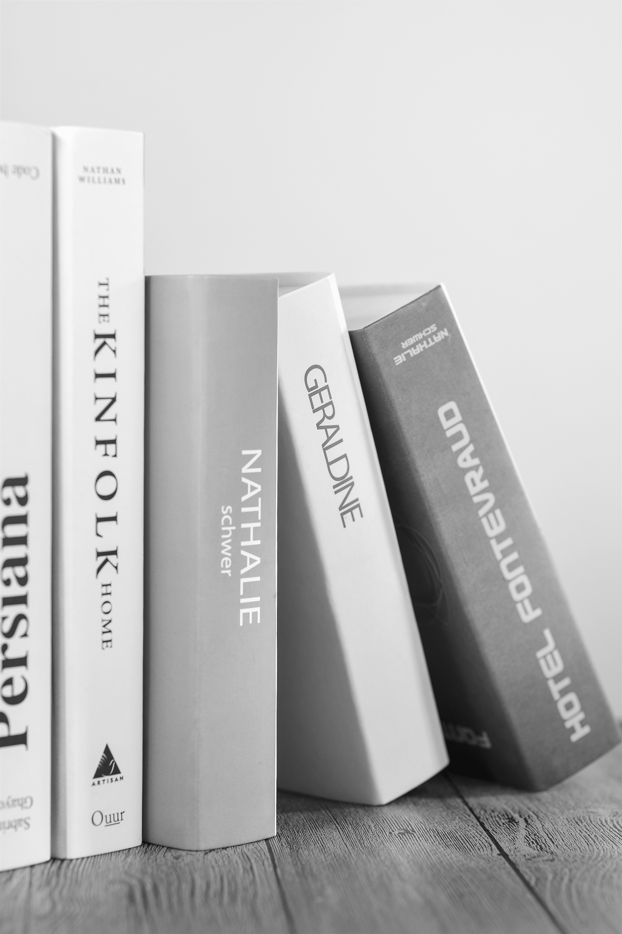
浙南联盟
应用文
Shirley Tong

Slide 3
Part one
IBAOTU.COM
审题

Slide 4

第一、二人称（I/you）。以“我”的分享视角拉近距离，用“你”的称呼直接对话读者。
语气必须是尊重、鼓励和分享语言需真切平等，避免居高临下。内容侧重书籍的激励性、启发性，贴合青少年成长需求。
审题
假定你是李华，你校英语节将举办主题为 “Gift a Book, Gift Hope” 的捐书活动，旨在为偏远地区学生募捐书籍。请你为你所捐赠的最喜爱的一本书写一篇短文附在书中，内容包括： (1) 书本简介； (2) 赠书理由； (3) 寄语希望。
注意：(1) 写作词数应为80左右； (2) 请按如下格式在答题纸的相应位置作答。
第一步：审清核心要素（“谁在写”、“写给谁”、“为什么写”）
深层目的：解释这本书的价值，分享你的感受，并借此传递知识、希望与鼓励，与收书人建立一种精神上的连接。“Gift a Book, Gift Hope” 这个主题是灵魂，全文都要围绕“书”与“希望”的关联展开。
第二步：解析内容要点
（1）书本简介：书名、作者。用一两句话概括这本书的主要内容或核心思想。避免冗长的情节复述，重点是抓住书的“神”，而非“形”。要让一个没读过的人立刻明白这是一本关于什么的书。
（2）赠书理由：这是短文的核心。解释你为什么选择捐赠这本你“最喜爱”的书。它如何打动了你？给你带来了什么影响（如快乐、勇气、知识、思考）
（3）寄语希望：直接对远方的朋友表达祝福和期望。这部分要直接点题 “Gift Hope”。可以希望这本书能成为他的朋友，希望故事给他力量，希望知识为他打开新世界的大门等。语言要真挚、温暖、有感染力。
时态： 一般现在时（介绍书籍内容；表达赠书理由；表达寄语希望（或者将来时）；一般过去时（回忆个人阅读体验）

Slide 5
Part two
多维度解读

Slide 6

多维层次解析
第一层：书本简介（建立连接）
维度1：客观描述。 简单介绍书名、作者、类型。
维度2：情感引入。 不局限于“这是什么书”，而是点出“这本书对我意味着什么”，从一开始就建立与你——未来的读者——的情感连接。
第二层：赠书理由（深化价值）
维度3：个人成长。 分享这本书如何具体地影响了你，改变了你的某个观念或给了你力量。这赋予了书籍超越其本身的生命力。
维度4：普世价值。 点明这本书所探讨的主题（如勇气、梦想、好奇心）是放之四海而皆准的，从而将个人体验升华，证明它同样适用于你。
第三层：寄语希望（升华主题）
维度5：情感共鸣。 表达对你处境的理解和鼓励，让你感到被看见、被理解。
维度6：未来期许。 将书籍作为一把“钥匙”或一扇“窗户”，鼓励你用它来探索更广阔的世界，并勇敢追求自己的梦想。
维度7：行动召唤。 最终，将这次赠与变成一个“接力”的起点，鼓励你将这份力量和希望传递下去。

Slide 7
Part three
结构

Slide 8

1. 向收信人问候，表达温暖关心； 2. 简要说明捐书背景（呼应活动主题 Gift a Book, Gift Hope）； 3. 引出你所赠书籍的名称与简介。
Para.1
问候：
Hope this book finds you in high spirits.
Hope this book brings you warmth and light.
I hope this book finds you surrounded by warmth and hope, shining a little light on your journey ahead.
说明捐书背景+引出所赠送的书籍的名称与简介：
As our school launches the campaign “Gift a Book, Gift Hope,” I’m offering/gifting you The Little Prince—a tiny volume, yet a radiant star that shines with love, innocence, and the courage to see with the heart.
As part of our school’s charity event “Gift a Book, Gift Hope,” I’d love to share with you my favorite book The Little Prince, a masterpiece that glows quietly with warmth and timeless wisdom.
In our school’s “Gift a Book, Gift Hope” drive, I’m pleased to gift you The Little Prince, a book small in size but vast in meaning—one that speaks of love, loss, and the light that never fades.

Slide 9
描述书籍可用同位语
a timeless classic whose quiet wisdom continues to console（安慰；慰藉）and awaken young hearts.
a small volume, yet a bright lighthouse/a quiet compass, guiding/navigating readers through loneliness, love, and the courage to see with the heart.
a book that charms in its language, enlightens in its themes, and endures in its gentle truths.
not only a fable of stars and roses, but also a mirror of the heart that quietly shapes who we become.
slight in size yet rich in soul—simple in story, profound in meaning, and steadfast in the comfort it brings.

Slide 10
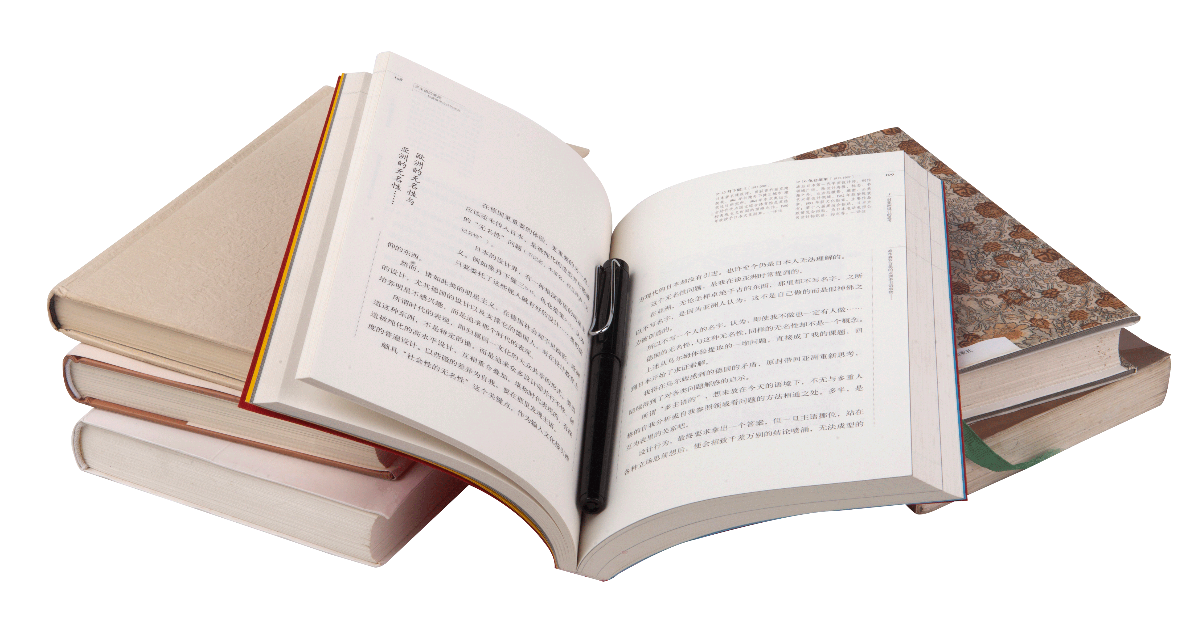
书本简介：书名、作者。用一两句话概括这本书的主要内容或核心思想。避免冗长的情节复述，重点是抓住书的“神”，而非“形”。要让一个没读过的人立刻明白这是一本关于什么的书。
赠书理由：这是短文的核心。解释你为什么选择捐赠这本你“最喜爱”的书。它如何打动了你？给你带来了什么影响（如快乐、勇气、知识、思考）
Para.2
应用文的具体分值分配(供参考)：（总分15分）
要点一：书本简介 (4分)：书本名称+内容简介；
要点二：赠书理由 (7分): 书籍对你的影响+角色的象征意义（供参考，合理即可）；
要点三：寄语希望 (3分):
其它： 卷面+格式(1分)。

Slide 11
（维度1+2 客观描述+情感引入）书本简介：书名、作者。用一两句话概括这本书的主要内容或核心思想。避免冗长的情节复述，重点是抓住书的“神”，而非“形”。要让一个没读过的人立刻明白这是一本关于什么的书。
Para.2
1. 点名核心主题：
The story depicts / portrays / unfolds the journey of…
…explores / delves into the depths of… /reflects upon…
…conveys / illustrates /interprets / encapsulates /ɪnˈkæpsjuleɪt/ / celebrate(赞颂）/symbolizes…
The central theme of the book revolves around/centers on/ captures the essence of...
Beneath its simple storyline lies a reflection on…（全部倒装句）
2.揭示深刻内涵：
the resilience of the human spirit. (人类的坚韧精神)
the complex journey of self-discovery and growth. (自我发现与成长的复杂旅程)
illustrates the triumph of hope and faith
reflects on the journey from innocence to maturity
conveys a universal truth about love and courage
strikes a deep chord in the reader’s heart

Slide 12

⑦resonates deeply with readers, reminding them of...
⑧Each page seems to whisper to the reader’s soul, awakening hope and tenderness.
⑨Through its poetic simplicity, the book evokes empathy and reflection that go beyond /transcend time and distance.
3. 定义作品风格：
a heartwarming coming-of-age novel. (一部暖心的成长小说)
a profound philosophical allegory. (一个深刻的哲学寓言)
an epic adventure story. (一个史诗般的冒险故事)
a compelling work of historical fiction. (一部引人入胜的历史小说)
The Little Prince, written by Antoine de Saint-Exupéry, is a profound philosophical allegory（/ˈæləɡɔːri/ 寓言）（作品风格）that portrays the journey of a young prince across distant planets in search of love and meaning.（核心主题）
Through its poetic simplicity, it explores the resilience of the human spirit and encapsulates a universal truth about innocence, loneliness, and the power of genuine connection.（内涵1）
/ Beneath its gentle narrative lies a reflection on the essence of humanity, reminding readers that “only with the heart can one see rightly.”（内涵2）
/ Each page seems to whisper to the reader’s soul, awakening empathy and tenderness that transcend time and distance.（内涵3）

Slide 13

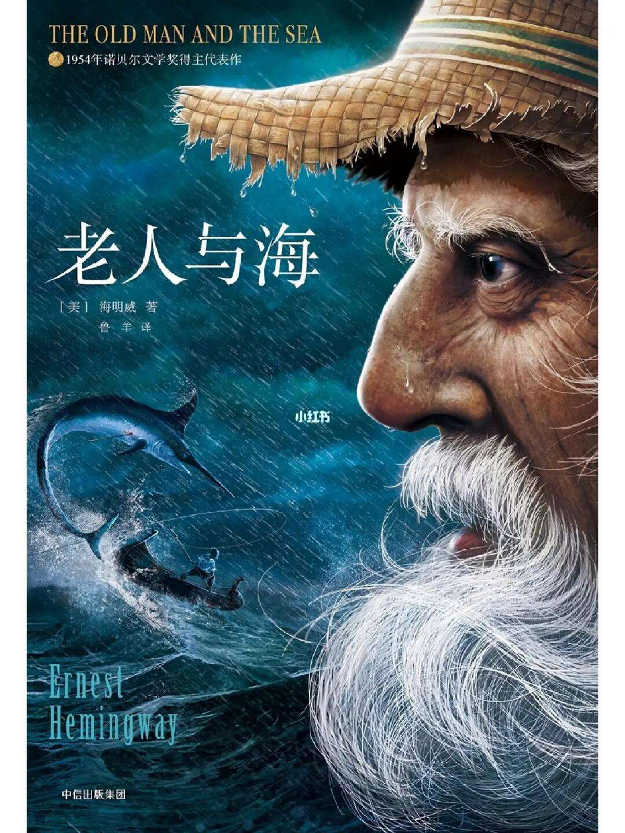
《老人与海》由欧内斯特·海明威所著，这是一部内涵深刻、富有哲理的小说，它描绘了一位年迈渔夫独自与浩瀚大海以及自身局限进行抗争的历程。
通过其简洁有力的语言，它展现了人类精神的坚韧，并诠释了在坚持与信念中所体现的默默的英雄主义。
在其简单的情节背后，隐藏着对勇气、尊严以及对梦想的不懈追求（即便面对失败）的永恒思考。
每一页都能深深触动读者的心灵，提醒我们真正的胜利不在于成功，而在于永不放弃希望。
The Old Man and the Sea, written by Ernest Hemingway, is a profound philosophical novel（风格） that depicts the solitary journey of an old fisherman battling against the vast sea and his own limits. Through its minimalist yet powerful language, it encapsulates the resilience of the human spirit and illustrates the quiet heroism found in perseverance and faith.（内涵1） Beneath its simple storyline lies a timeless reflection on courage, dignity, and the unyielding pursuit of dreams, even in the face of defeat.（内涵2） Each page strikes a deep chord in the reader’s heart, reminding us that true victory lies not in success, but in never giving up hope.（内涵3）

Slide 14
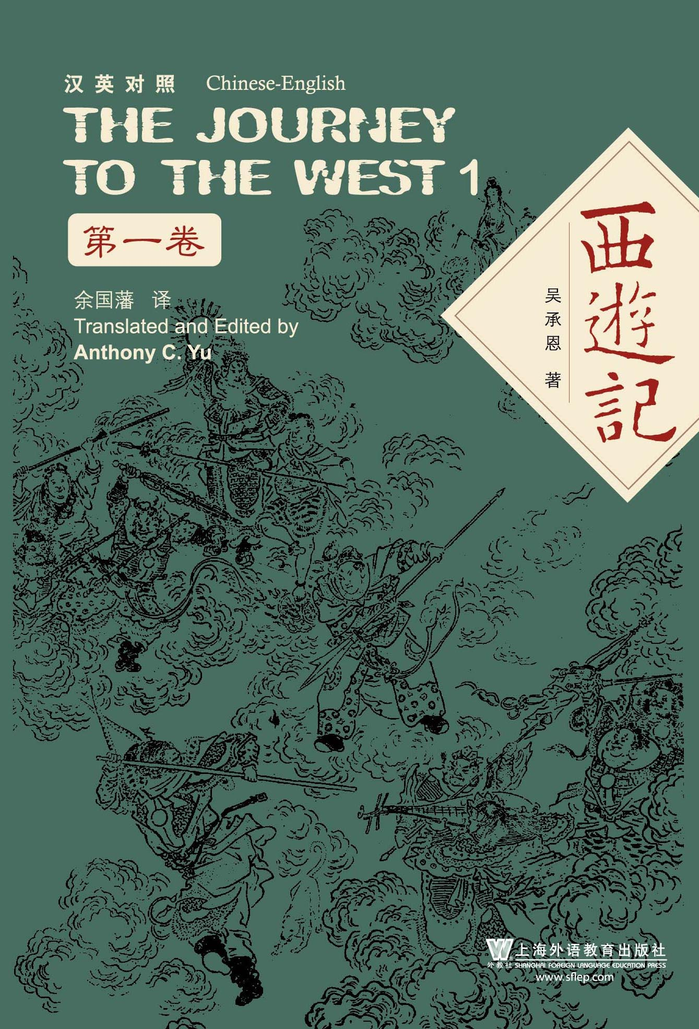
《西游记》由吴承恩所著，是一部充满传奇色彩的冒险故事，它描绘了一位僧侣及其弟子们为寻求神圣智慧而进行的英勇朝圣之旅。
这部作品融合了神话、幽默和哲理，展现了信仰的坚韧、坚持不懈的胜利以及人类欲望与精神觉醒之间的斗争。
在其充满神话色彩的冒险背后，蕴含着对坚持不懈、忠诚以及艰难旅程对塑造个人性格的变革力量的深刻思考。在其奇幻的冒险故事之下，还有一层对毅力、忠诚以及艰苦旅程对塑造个人品格的影响力的深刻反思，提醒读者，无论旅程多么艰难，都始于坚定的一步信仰。
通过其永恒的智慧和生动的想象，这部故事深深触动了读者的心灵，唤醒了跨越时代的希望和力量。
Journey to the West, written by Wu Cheng’en, is an an epic adventure story（风格） that portrays the adventurous pilgrimage/ˈpɪlɡrɪmɪdʒ/ （朝圣之旅）of a monk and his disciples（/dɪˈsaɪpl/信徒） in search of sacred wisdom. Blending myth, humor, and philosophy, it encapsulates the resilience of faith, the triumph of perseverance, and the struggle between human desire and spiritual enlightenment. Beneath its mythical adventures lies a profound reflection on perseverance, loyalty, and the transformative power of an arduous journey in forging one's character, reminding readers that every journey, no matter how difficult, begins with a single step of faith. Through its timeless wisdom and vivid imagination, the story resonates deeply with readers, awakening hope and strength that transcend generations.

Slide 15
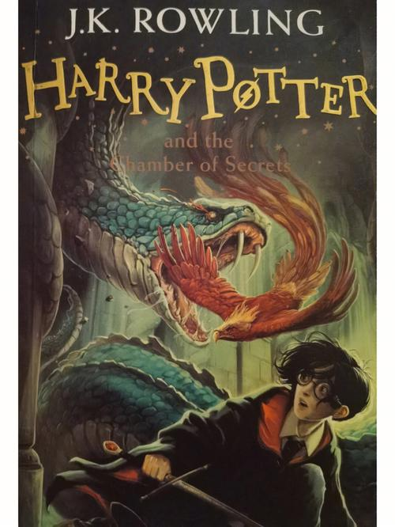
《哈利·波特》由 J.K. 罗琳创作，是一部充满激励的奇幻系列作品，它讲述了一个年轻男孩的非凡历程：在与黑暗势力的斗争中，他逐渐领悟到了勇气、友谊和爱。
这部作品以其充满魔力和神秘色彩的幻想世界，展现了善与恶之间永恒的斗争，并颂扬了爱、忠诚和希望所蕴含的默默力量。
在其扣人心弦的冒险故事背后，蕴含着对勇气的意义以及信仰的力量的深刻思考。
这部作品深深触动着读者的心灵，唤起了即使在最黑暗时刻也闪耀着希望与光明的力量。
Harry Potter, written by J.K. Rowling, is an inspiring fantasy series that portrays the extraordinary journey of a young boy who discovers courage, friendship, and love while fighting against darkness.
Through its imaginative world of magic and mystery, it encapsulates the eternal struggle between good and evil and celebrates the quiet power of love, loyalty, and hope.
Beneath its thrilling adventures lies a profound reflection on the meaning of courage and the strength of faith.
The story resonates deeply with readers, awakening hope and light that shine even in the darkest times.

Slide 16
Para.2
2. 赠书理由：这是短文的核心。解释你为什么选择捐赠这本你“最喜爱”的书。它如何打动了你？给你带来了什么影响（如快乐、勇气、知识、思考）
维度3 个人成长
情感影响：
resonated with me profoundly (引起我深刻共鸣)
struck a deep chord within me (深深触动我的心弦)
left an indelible mark on my perspective (给我的观念留下了不可磨灭的印记)
个人成长：
fundamentally reshaped my understanding of (从根本上重塑了我对...的理解)
became a beacon of hope/a spark of light during…/ rekindle hope in one’s heart
provided immense solace when (在...时给予了巨大的慰藉)/ show unyielding resilience / find inner strength
lift me out of despair / give me strength to carry on（带我走出绝望 / 给我力量继续前行）

Slide 17
推荐书籍可用句型
It transcends the form of a simple story, becoming a journey that whispers …
What made this book exceptionally precious/enlightening to me is how it revealed ...
Among all the books I’ve read, this one stands out because...
This book holds a special place in my heart for...
The story whispers to me that...（personification拟人）
Without this book, I might never have...（虚拟语气）
比喻 Metaphor
Like a lighthouse in a storm, this book offered me guidance when I felt lost.
The story acts as a key, unlocking doors to new ways of thinking.
拟人 Personification
The story whispers strength and faith into my heart.
排比 Parallelism
It taught me about resilience in adversity, about hope in despair, and about light in darkness.
It taught me to dream bravely, to love deeply, and to live hopefully.
对比 Antithesis
Even in despair, it taught me to see light; even in loss, to find meaning.

Slide 18

维度4 普世价值
“个人体验”提升到“普遍真理”
It made me understand that hope is not given, but created.
It proves that even ordinary people can do extraordinary things.
It reminds me that every ending carries a seed of new beginning.
It shows that love and faith can outshine fear and darkness.
It taught me that real strength lies in gentle hearts.
寄语希望：直接对远方的朋友表达祝福和期望。这部分要直接点题 “Gift Hope”。可以希望这本书能成为他的朋友，希望故事给他力量，希望知识为他打开新世界的大门等。语言要真挚、温暖、有感染力。
维度5:情感共鸣 表达祝福（温暖真挚）
I hope this book will be a gentle companion on your journey.
May this book become your companion in moments of solitude, your guide in times of confusion, and your inspiration when facing challenges.
I wish this book could light up your days just as it once brightened mine.

Slide 19
维度6:未来期许 强调知识与成长（打开新世界的大门）
I hope this book will open a window to a wider world for you.
May you discover in these pages the beauty of learning and the power of imagination.
Each page holds a small world waiting for you to explore.
维度7 行动召唤 传递力量（激励、勇气、信念）
Let this story whisper to you that you are stronger than you think.
May this story walk beside you, whispering courage when you need it most.
I believe every page carries a spark of hope waiting to reach you.
Just as it lit a light in my heart, I hope it will warm yours too.
Through this book, I wish to share not only a story, but the power of believing in yourself.
呼应主题 + 升华结尾（Gift Hope）双关 Pun
To gift a book is to gift hope — a hope that will quietly bloom within you, no matter where life leads.
Let this book remind you that hope, once given, never fades away.
Every page is a spark — when you read it, hope begins to glow.
Between its lines lies not just ink, but light.
Through this book, our worlds meet halfway.
This book is a seed — may it take root in your heart and grow into dreams.
Every word planted in your mind will bloom into hope someday.

Slide 20
Part Four
Possible version

Slide 21
Dear friend,
Hope this book brings you warmth and light. As our school launches the campaign “Gift a Book, Gift Hope,” I’m gifting you The Little Prince—a tiny volume, yet a radiant star that shines with love, innocence, and the courage to see with the heart.
Written by Antoine de Saint-Exupéry, this profound philosophical allegory (/ˈæləɡɔːri/) follows a young prince on his journey across planets in search of love and the meaning of life. Among all the books I’ve read, this story holds a special place in my heart. More than a simple tale, the book itself becomes a quiet journey that whispers strength and faith into my soul, guiding me to dream bravely, love deeply, and live hopefully. It reminded me that real strength often lies in gentle hearts and that hope can be created, not just found.
May this book be your gentle companion, lighting your path with courage and warmth. To gift a book is to gift hope — a hope that will quietly bloom within you, no matter where life leads. Yours, Li Hua

Slide 22

范文
Dear friend,
I am pleased to gift my favorite book Charlotte’s Web to you. This heartwarming novel tells the story of a pig named Wilbur and his clever spider friend Charlotte, who works tirelessly to save his life.
What makes this book special is its profound understanding of friendship and sacrifice. Charlotte’s selfless actions reveal that true strength lies in using our talents to help others, while Wilbur’s gratitude highlights the importance of cherishing those who stand by us. Their story ultimately conveys that even the most ordinary individuals can create extraordinary change through kindness and courage.
I sincerely hope this book brings you as much warmth and inspiration as it has brought me. May it encourage you to believe in the power of compassion and the beauty of selfless friendship. (129 words) Yours, Li Hua

Slide 23
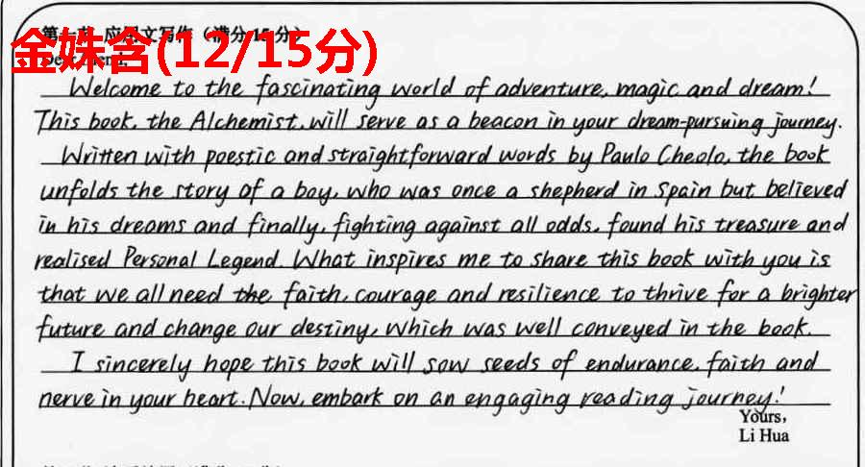
考场高分作文 12分

Slide 24
Assignment：
2024年4月济宁第二次模拟考试--推荐图书--英语读书会的应用文
假定你是李华，你校外教 Ryan 拟举办英语读书会(English Reading Bar) 活动，想了解哪类图书更能吸引学生。请你给外教写一封邮件，内容包括:
1.推荐的图书类别:
2.推荐理由。
注意:
1. 写作词数应为 80 个左右;2.请按如下格式在答题卡的相应位置作答。

Slide 25
Possible version
Dear Ryan,
Thrilled to hear about your plans for the English Reading Bar, I would heartily recommend fantasy novels as a captivating choice for our students.
Filled with thrilling adventures and memorable characters, fantasy novels can transport readers into magical and imaginative worlds. These narratives, often rich in detail and creativity, spark the imagination and curiosity of young minds. Moreover, they encourage us students to think outside the box and develop a deeper understanding of human nature and ethical dilemmas. By discussing these books, we students can engage in lively debates, exchange ideas, and broaden our perspectives, all enhancing our critical thinking skills.
In conclusion, I firmly believe that fantasy novels will be a thought-provoking addition to the English Reading Bar, fostering a deeper appreciation for literature among our students.Thank you for considering my suggestion.
Best regards,
Li Hua

Slide 26
Thank you

