Slide 1



感恩遇见，相互成就，本课件资料仅供您个人参考、教学使用，严禁自行在网络传播，违者依知识产权法追究法律责任。
更多教学资源请关注
公众号：溯恩英语
知识产权声明

Slide 2
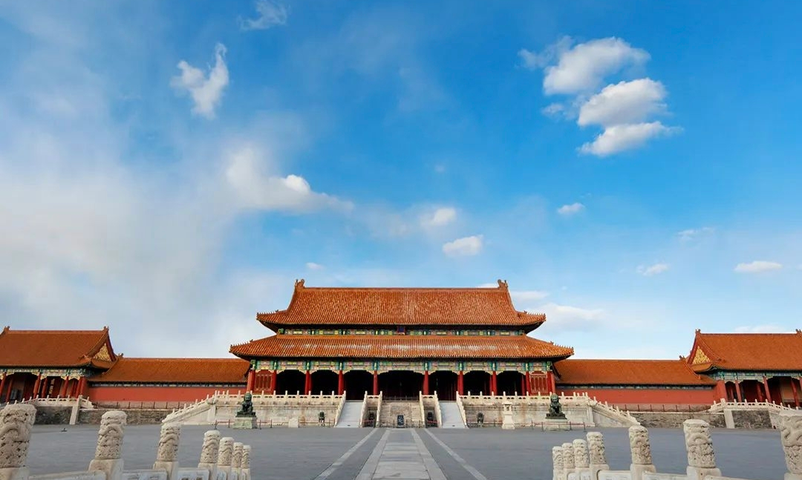

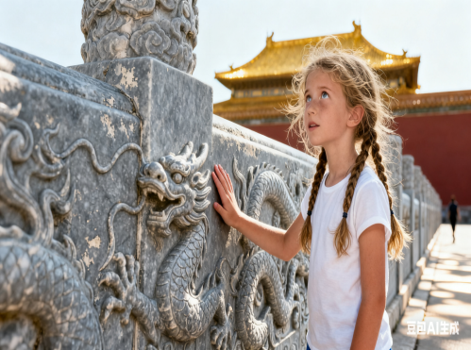
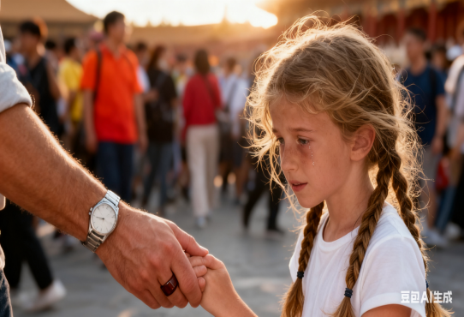
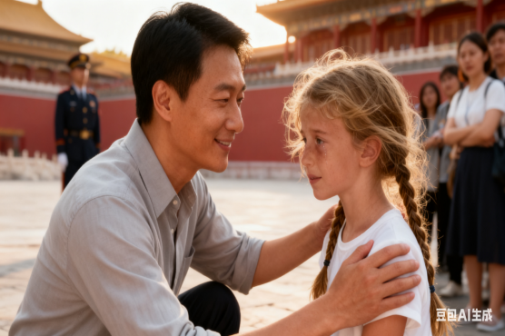
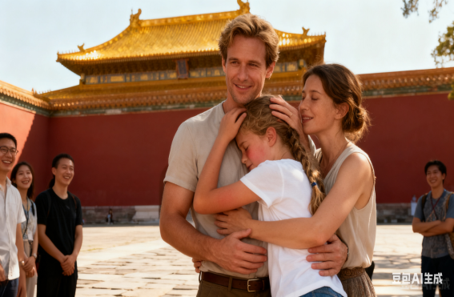
浙江强基联盟2025年10月高三联考英语读后续写讲评
语义连贯视角下的读后续写协同性策略及应用
十岁的一次迷路：故宫的魅力与温暖
——浙江省常山一中 吴俊峰名师工作室

Slide 3






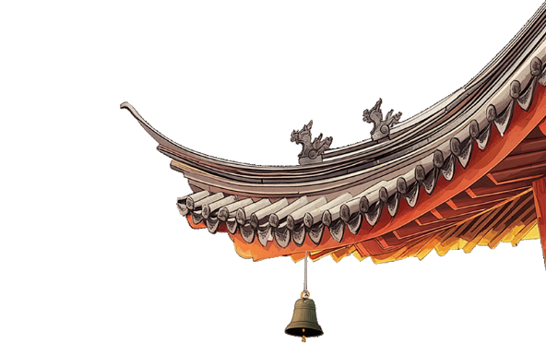




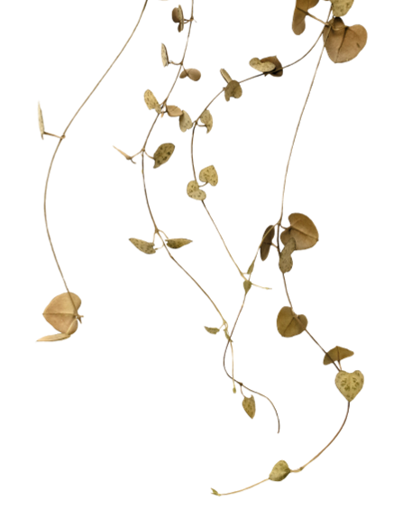


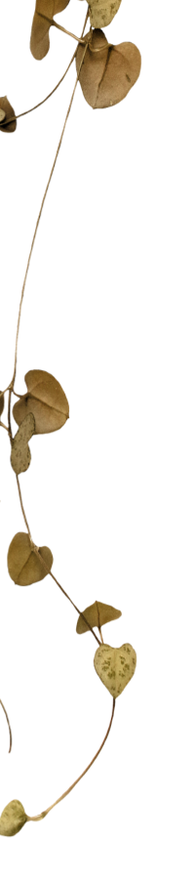
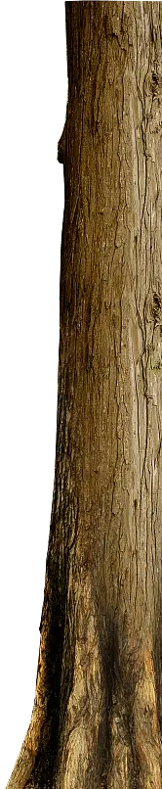






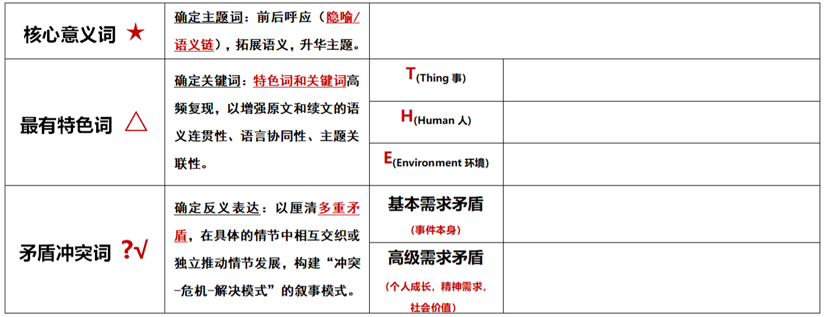


















读后续写思维模式路径优化——语义连贯标词和可视化快速构思
有意义的衔接链对语篇连贯有特殊作用，有意义标记的比例越高，语篇就越连贯。
在读后续写中标记关键词的能力越强，衔接纽带的衔接力会越强，语篇的连贯程度就越大，协同效应越好。

Slide 4
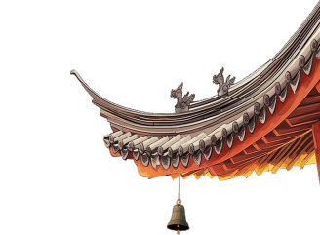




基于语义连贯标词扩展法的读后续写准确读题和可视化快速构思：
When I was ten, my parents told me we were going to China for our summer holiday. I was over the moon—I had only ever seen the Great Wall and the Forbidden City in books, and now I would actually get to walk through history!
For weeks, I imagined the towering palaces, the red-and-gold gates, and the stories hidden in every corner. Finally, the day arrived, and there I was, standing in the heart of Beijing, staring up at the most magnificent buildings I had ever seen.
The Forbidden City was even more incredible in real life. The golden roofs shone under the sun, the delicate carvings told silent tales of emperors and warriors, and the vast courtyards made me feel like I had stepped into a fairy tale. Every turn revealed something new—a dragon statue, a marble staircase, a hidden garden—and I couldn't stop taking pictures, desperate to capture every detail. My parents laughed as I dragged them from one spot to another, insisting on yet another photo.
What struck me most were the colors. The imperial yellow of the rooftops against the deep red walls looked brighter than any picture could show. Even the stone pathways seemed to glow with centuries of footsteps. I remembered running my fingers along a carved marble railing, wondering how many hands had touched that same spot over six hundred years.
The place was packed with tourists, all murmuring in different languages, their faces filled with the same amazement as mine. Some pointed at the architecture, others posed for pictures, and a few just stood quietly, taking it all in. The energy was infectious—everyone seemed to feel the magic of this ancient place.
As the afternoon wore on, we followed the crowd toward the exit. The sea of people was overwhelming, and I, being small for my age, grasped my father's hand tightly, afraid to get lost in the rushing crowd. The noise, the heat, and the excitement made everything feel like a blur—until suddenly, I looked down at the large hand I was holding—the wrong watch, the wrong-colored ring.
My blood turned to ice.
There he was, just three people away.
Step-1. 先找到矛盾冲突，以此为读写切口，
找准和发展情节主线；
领会原作者的写作意图和思想；
完成“冲突-解决-升华”闭环模式
浙江强基联盟2025年10月高三联考
Notes:
词汇与结构知识
正式语篇结构知识
内容/世界背景知识
自动识别技能
综合与评价策略
元认知知识与技能监控

Slide 5
基于语义连贯标词扩展法的读后续写准确读题和可视化快速构思：
H
H
When I was ten, my parents told me we were going to China for our summer holiday. I was over the moon—I had only ever seen the Great Wall and the Forbidden City in books, and now I would actually get to walk through history!
For weeks, I imagined the towering palaces, the red-and-gold gates, and the stories hidden in every corner. Finally, the day arrived, and there I was, standing in the heart of Beijing, staring up at the most magnificent buildings I had ever seen.
The Forbidden City was even more incredible in real life. The golden roofs shone under the sun, the delicate carvings told silent tales of emperors and warriors, and the vast courtyards made me feel like I had stepped into a fairy tale. Every turn revealed something new—a dragon statue, a marble staircase, a hidden garden—and I couldn't stop taking pictures, desperate to capture every detail. My parents laughed as I dragged them from one spot to another, insisting on yet another photo.
What struck me most were the colors. The imperial yellow of the rooftops against the deep red walls looked brighter than any picture could show. Even the stone pathways seemed to glow with centuries of footsteps. I remembered running my fingers along a carved marble railing, wondering how many hands had touched that same spot over six hundred years.
The place was packed with tourists, all murmuring in different languages, their faces filled with the same amazement as mine. Some pointed at the architecture, others posed for pictures, and a few just stood quietly, taking it all in. The energy was infectious—everyone seemed to feel the magic of this ancient place.
As the afternoon wore on, we followed the crowd toward the exit. The sea of people was overwhelming, and I, being small for my age, grasped my father's hand tightly, afraid to get lost in the rushing crowd. The noise, the heat, and the excitement made everything feel like a blur—until suddenly, I looked down at the large hand I was holding—the wrong watch, the wrong-colored ring.
My blood turned to ice.
There he was, just three people away.
E
E
T
E
Step-2. 对原文有效解读，标记原文中有意义的关键词、特色词、核心词，并创造性在续文中扩展逻辑语义关系，增强语境关联，促成协同效应。
浙江强基联盟2025年10月高三联考
浙江强基联盟2025年10月高三联考
Notes:
词汇与结构知识
正式语篇结构知识
内容/世界背景知识
自动识别技能
综合与评价策略
元认知知识与技能监控

Slide 6
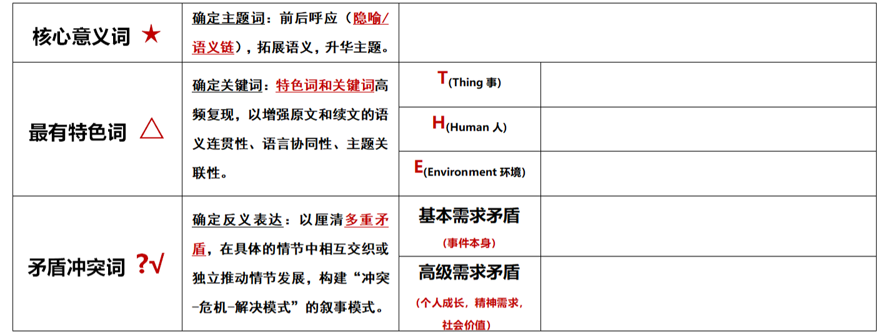
基于语义连贯标词扩展法的读后续写准确读题和可视化快速构思：
China/Beijing
taking pictures；
visiting architectures
ten-year-old
The 600-year-old Forbidden City
失散团聚find the parents
China/ the Forbidden City:
magnificent; a fairy tale; magic; incredible; amazement
浙江强基联盟2025年10月高三联考
浙江强基联盟2025年10月高三联考
浙江强基联盟2025年10月高三联考
Notes:
词汇与结构知识
正式语篇结构知识
内容/世界背景知识
自动识别技能
综合与评价策略
元认知知识与技能监控

Slide 7

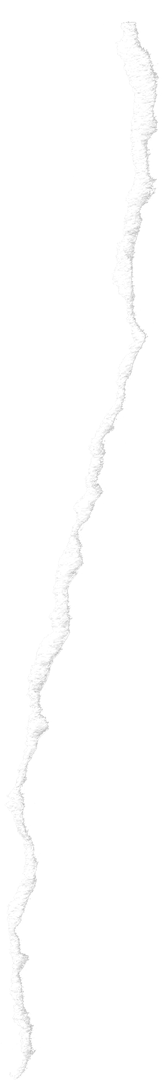





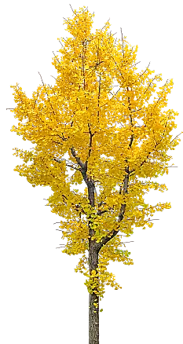



读后续写思维模式路径优化—— 语义连贯标词扩展法
语义连贯 方式 | 标记符号 | 在续文中的协同效应
1.在续文中同词复现 | ↓ | 时间、地点、人物、事件保持文本的稳定性和连续性
2.在续文中同义复现 | → | 保持所用词语的变化性和意义的连贯性
3.在续文中反义复现 | ← | 反义互补的词汇衔接有助于合理地激化冲突和化解矛盾
4.在续文中语义扩展 | →→ | 相关意义的词汇出现在同一语篇中，构成以某一话题为中心的词汇链，确保整个故事情节发展的一致性、延续性和语篇的连贯性。
5.在续文中意义升华 | ↑ | 主题词复现，赋予新义（延伸和增强语义，激活联想，升华主题）
语义连贯标词扩展法

Slide 8
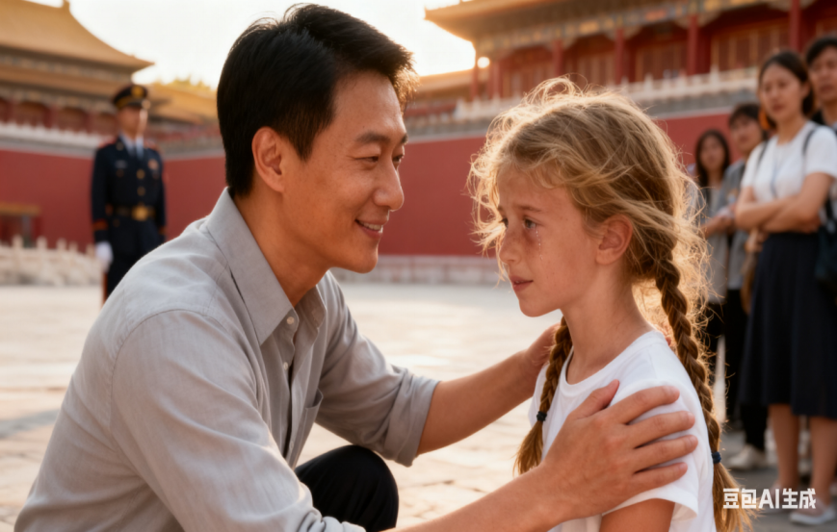
基于语义连贯标词扩展法的读后续写协同生成：
语义连贯方式 | 原文标词 | 续文协同
同词复现↓ | The energy of comfort was infectious; photos | “Are you okay, little lady? Did you get lost from your family?”He asked affectionately, patting my hair with a comfortable smile. I nodded hesitantly, eyes brimming with tears of trust. The energy of comfort was infectious — I picked up the camera, showing him the photos of myself and parents to convey more information. （*相关意义的词汇的语义关联，可以促成以某一话题为中心的词汇链或情境模式层面的协同效应，增强合理的画面感以及和谐的生动性） “小姑娘，你还好吗？是不是和家人走散了？”他关切地问道，带着温暖的笑容轻抚着我的头发。我迟疑地点了点头，眼中满是信任的泪水。这份温暖的力量有感染力的——我拿起相机，向他展示了我和父母那令人难忘的照片，以传达更多的信息。
“Are you okay, little lady? Did you get lost from your family?”He asked affectionately, patting my hair with a comfortable smile. I nodded hesitantly, eyes brimming with tears of trust. The energy of comfort was infectious — I picked up the camera, showing him the photos of myself and parents to convey more information.
浙江强基联盟2025年10月高三联考
浙江强基联盟2025年10月高三联考
Notes:
词汇与结构知识
正式语篇结构知识
内容/世界背景知识
自动识别技能
综合与评价策略
元认知知识与技能监控

Slide 9


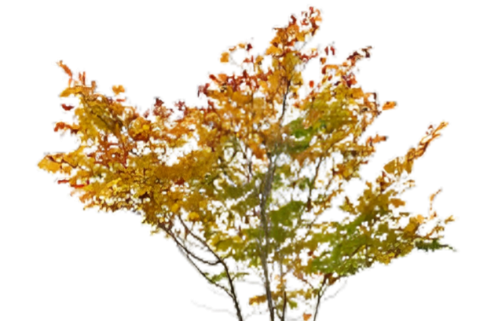


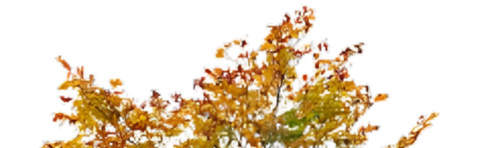
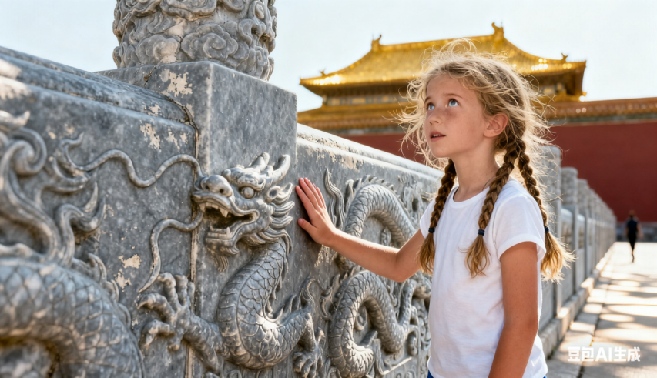
基于语义连贯标词扩展法的读后续写协同生成：
语义连贯方式 | 原文标词 | 续文协同
同义复现→ | China; history; architecture; amazement | Before leaving, that uncle also gave me an elaborately designed book on Chinese architecture history, which made me deeply amazed at the charm of traditional Chinese culture—I want to learn Chinese from now on. （*在读后续写中利用词汇衔接手段，创生出关联性和创新性强的优质词汇“book on Chinese architecture history——传播中华文化”，能够对语篇在逻辑和意义上的连贯产生促进作用） 在离开之前，那位叔叔还送给我一本精心设计的关于中国建筑历史的书籍，这让我深深领略到了中国传统文化的魅力——从现在起，我想要学习中文了。
Before leaving, that uncle also gave me an elaborately designed book on Chinese architecture history, which made me deeply amazed at the charm of traditional Chinese culture—I want to learn Chinese from now on.
浙江强基联盟2025年10月高三联考
浙江强基联盟2025年10月高三联考
Notes:
词汇与结构知识
正式语篇结构知识
内容/世界背景知识
自动识别技能
综合与评价策略
元认知知识与技能监控

Slide 10
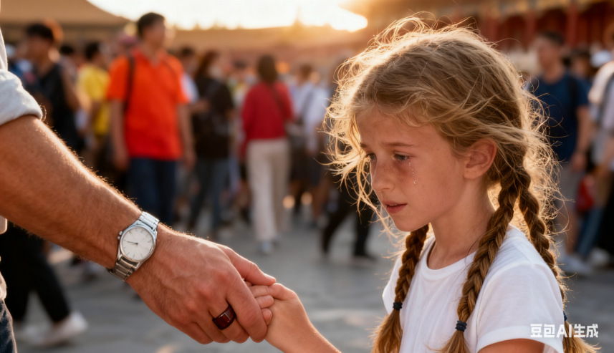
基于语义连贯标词扩展法的读后续写协同生成：
语义连贯方式 | 原文标词 | 续文协同
←反义复现 | the large hand; the wrong watch, the wrong-colored ring | In the crowd, I grasped at the large long-lost hand — the right watch, the right-colored ring with satisfaction. （*反义互补的词汇衔接有助于合理地激化冲突和化解 矛盾） 在人群中，我紧紧握住那只久违的大手——那是一只戴着正确手表、佩戴着正确颜色戒指的手，我心中满是满足感。
In the crowd, I grasped at the large long-lost hand — the right watch, the right-colored ring with satisfaction.
浙江强基联盟2025年10月高三联考
浙江强基联盟2025年10月高三联考
Notes:
词汇与结构知识
正式语篇结构知识
内容/世界背景知识
自动识别技能
综合与评价策略
元认知知识与技能监控

Slide 11
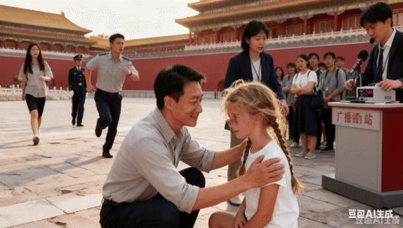
基于语义连贯标词扩展法的读后续写协同生成：
语义连贯方式 | 原文标词 | 续文协同
语义扩展 →→ | walk through history; China; warrior; the stories hidden in every corner; imperial; magic；fairy | Just like ancient imperial warriors, A group of kind-hearted Chinese people came to my rescue, chasing terrifying monsters all away. One person comforted me tenderly, another promptly went to call the police, and yet another went to the broadcasting station to announce the missing-person notice. Being protected like a fairy, I couldn't refrain from smiling through tears. Magic stories like this hidden in every corner, I was walking through history. (*①儿童视角和心理表现得非常真实；②热心助人的群体效应) 就像古代的帝王战士一样，一群善良的中国人来救我，把可怕的怪物都赶走了。一个人温柔地安慰我，另一个人立刻去报警，还有一个人去广播电台宣布失踪。在仙女般的呵护下，我忍不住破涕而笑。像这样神奇的故事隐藏在每一个角落，我正在穿越历史。
Just like ancient imperial warriors, A group of kind-hearted Chinese people came to my rescue, chasing terrifying monsters all away. One person comforted me tenderly, another promptly went to call the police, and yet another went to the broadcasting station to announce the missing-person notice. Being protected like a fairy, I couldn't refrain from smiling through tears. Magic stories like this hidden in every corner, I was walking through history.
浙江强基联盟2025年10月高三联考
浙江强基联盟2025年10月高三联考
Notes:
词汇与结构知识
正式语篇结构知识
内容/世界背景知识
自动识别技能
综合与评价策略
元认知知识与技能监控

Slide 12
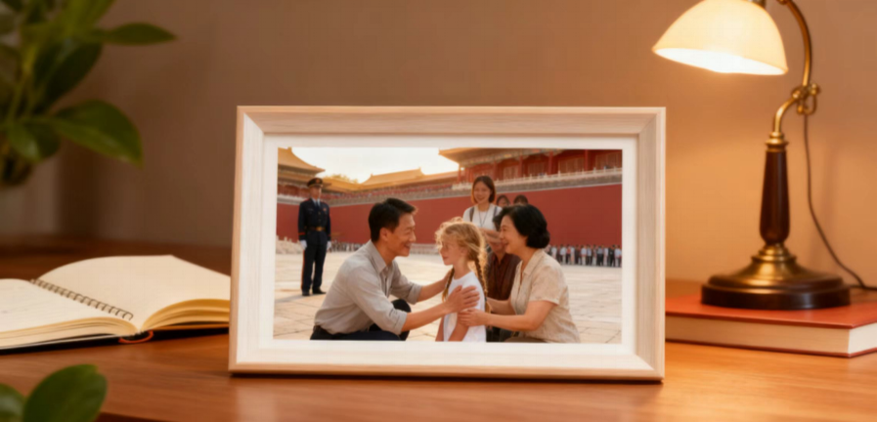
基于语义连贯标词扩展法的读后续写协同生成：
语义连贯方式 | 原文标词 | 续文协同
主题升华↑ | China; magnificent buildings | It was exactly that moment that I came into enlightenment that China boasts not only magnificent buildings, but also invaluable humanistic charm. 也正是在那一刻，我恍然大悟：中国不仅有宏伟的建筑，还有无价的人文魅力。
 | China;warrior； a fairy tale; the Forbidden City's magnificence | Just like ancient warrior, a Chinese stranger's kindness turned a terrifying episode into a fairy tale that, along with the Forbidden City's magnificence, would stay with me forever. 就像古代的勇士一样，这个陌生中国人的善意会将一段可怕的遭遇变成一个童话，连同故宫的壮丽，永远留在我的记忆里。 （*在读后续写中，抓牢核心关键词存在复现关系，紧扣主题，不出现偏题现象。再可结合原文语境积极模仿与创造，催化词汇新颖性，实现主题自然升华）
It was exactly that moment that I came into enlightenment that China boasts not only magnificent buildings, but also invaluable humanistic charm.
Just like ancient warrior, the Chinese stranger's kindness turned a terrifying episode into a fairy tale that, along with the Forbidden City's magnificence, would stay with me forever.
浙江强基联盟2025年10月高三联考
浙江强基联盟2025年10月高三联考
Notes:
词汇与结构知识
正式语篇结构知识
内容/世界背景知识
自动识别技能
综合与评价策略
元认知知识与技能监控

Slide 13


语篇衔接的三个“一定”实现语义连贯和逻辑衔接
根据衔接连贯理论，通过词汇的有效衔接_{（词汇同现或词汇复现）}实现语义连贯和逻辑衔接。
这种复现位置较近的显性的衔接方式旨在减少读者或阅卷老师处理信息所花费的力气，提高交际效率，既不会感到累赘，也不会产生误解、曲解、难解现象。
第一段结尾
①一定要有与第二段段首句中的同词或同义词。
②实现无缝衔接
第一、二段开头
①一定要把段首句的名词或动词（尤其是后半句），用在写作开头，实现语义连贯。
②力争高分开头
第二段结尾
①一定要呼应原文中体现主题或伏笔的关键词。
②实现主题升华
浙江强基联盟2025年10月高三联考

Slide 14
语篇衔接的三个“一定”实现语义连贯和逻辑衔接
My blood turned to ice. So furious was I that_{（倒装句）} I was tripped and fell occasionally. Heart pounding and palms sweating, I glanced up at the unfamiliar man cautiously. _{（我的动作描写和心理描写与段首句紧密衔接）}..... With his help, the announcement to find my family started, and just then I heard a familiar voice calling my name—it was Dad!（一定要出现dad, 与第二段段首句中的he指代同一人，形成逻辑无缝衔接。）
There he was, just three people away. Excitement mingled with happiness_{（独立主格结构）}, an upsurge of delight swept over me. In the crowd, I grasped at the large long- lost hand —the right watch, the right-colored ring with satisfaction._{（找到爸爸的心理描写与动作描写，自然生动）} ......It was exactly that moment that I came into enlightenment that China boasts not only splendid natural landscapes, but also invaluable humanistic charm._{（突显中国的人文美，主题鲜明）}
浙江强基联盟2025年10月高三联考

Slide 15
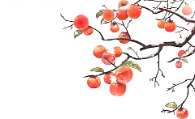
“冲突-解决”的闭环模式+“思维-语言-思想”三维写作指导：
一、“冲突-解决”的闭环模式：
下午离园时，“我”因人群拥挤牵错了手。 直接引出续写的核心任务：解决“失散”危机，以“失散—寻找—团聚”为核心逻辑，完成故事闭环。
二、“思维-语言-思想”三维写作指导：
1. 情节逻辑：
- 开篇（My blood turned to ice.）：立刻渲染“失散”的恐慌感，通过动作（如“松开手、颤抖、哭喊”）、心理（如“大脑空白、心跳骤停”）描写强化紧张氛围。
- 发展（There he was, just three people away.）：设计“团聚”的合理路径，可借助陌生人帮助（如热心中国游客、景区工作人员）、相机的照片、自身记忆（如记得父母约定的集合点）推进情节，避免“凭空出现父母”的突兀感。
- 结尾：团聚后可加入“对紫禁城的新感悟”（如历史与人文温暖的结合），升华主题。
2. 人物塑造：
- “我”（儿童视角）：保持10岁孩子的胆怯与依赖，比如“因害怕而攥紧衣角”“找到父母后扑进怀里”。
- 父母：体现担忧与疼爱，比如“父亲额头的汗珠”“母亲哽咽的声音”。
- 不可或缺的角色（中国人的援助）：陌生人需友善机智，有礼节，通过“蹲下平视”“轻声安慰”，“广播寻人”等细节塑造。
3. 语言风格：
- 复刻原文的诗意描写，如将人群比作“潮水”，将失散的自己比作“迷宫里的小蚂蚁”。
- 运用感官细节（视觉：红墙金瓦；听觉：人群喧嚣；触觉：大理石的冰凉），增强画面感。
浙江强基联盟2025年10月高三联考
浙江强基联盟2025年10月高三联考
Notes:
词汇与结构知识
正式语篇结构知识
内容/世界背景知识
自动识别技能
综合与评价策略
元认知知识与技能监控

Slide 16




容易踩坑误区：
1. 情节突兀：
若直接让父母“突然出现”，缺少“寻找过程”，会让故事失去张力。
2.素材同质化，未能展开合理逻辑建构：
过度使用常见的素材，大量描写的迷失恐慌，父母感激。
没能塑造“陌生人的帮助（最合理的是中国人）”的情节，没有读懂文章的伏笔——让“文化之美”与“人性之美”共振 ，让故事从“个人遇险”升华为“文化与人性的双重感悟”，立意会更深刻高远。
3. 人物OOC（脱离人设Out Of Character）：
“我”若表现得过于冷静（如独自淡定找父母），不符合10岁孩子的心理；父母若对失散毫不着急，也违背常理。
4. 主题偏离：
若只写“失散团聚”，忽略对紫禁城“历史感”或“人文温暖”的呼应，会让故事深度不足。
浙江强基联盟2025年10月高三联考
浙江强基联盟2025年10月高三联考
Notes:
词汇与结构知识
正式语篇结构知识
内容/世界背景知识
自动识别技能
综合与评价策略
元认知知识与技能监控

Slide 17
范文赏析：
My blood turned to ice. My heart pounded violently when I realized I was holding a stranger's hand. I looked up at the man—he had kind eyes and a gentle smile. "Are you lost?" he asked, crouching down to my height. I nodded, fighting back tears. Without hesitation, he asked a nearby guard for help, describing my parents and keeping me calm. Though he was a stranger, his patience and warmth made the terrifying moment feel a little safer. Then I heard Dad's voice calling my name.
There he was, just three people away. He came rushing toward me through the crowd, his face pale with worry. The second he saw me, his shoulders relaxed, and he pulled me into a tight hug. He thanked the kind stranger again and again, his voice shaking. As we walked away, I glanced back at the man, already lost in the crowd. That day, I learned something — Beijing's beauty wasn't just in its golden rooftops or ancient walls, but in people like him, who stopped to help a scared little child.
1. 情绪渲染：精准传递“恐慌→安心”的层次变化
开篇“My blood turned to ice”“heart pounded violently”用夸张和动作描写，瞬间将“发现牵错手”的恐慌感拉满，与原文“走失”的情节冲突完美衔接；
后续“fighting back tears”“keeping me calm”则细腻地展现了孩子从强忍泪水到逐渐安心的过程，情绪转折自然且有说服力。
2. 人物塑造：用“微动作”让角色更立体
陌生人的善意通过“crouching down to my height”（蹲到与孩子平视）、“asking a guard for help”（向保安求助）等细节体现，既符合成人对孩子的关怀逻辑，又避免了“过度完美”的失真感；
父亲的形象通过“face pale with worry”“voice shaking”（声音颤抖）等描写，将“找到孩子时的紧张与感激”刻画得淋漓尽致，让“亲子情感”和“陌生人善意”形成呼应。
3. 主题升华：让“文化之美”与“人性之美”共振
结尾“Beijing's beauty wasn't just in its golden rooftops or ancient walls, but in people like him”（北京的美不仅在建筑，更在助人的陌生人），巧妙地将原文对故宫“历史壮美”的描写，升华到“人性温暖也是城市魅力”的层面，让故事从“个人遇险”升华为“文化与人性的双重感悟”，立意更深刻。
整体而言，这篇续写逻辑通顺、语言地道，协同性强，是一篇符合高考要求的优秀范文。
浙江强基联盟2025年10月高三联考
浙江强基联盟2025年10月高三联考
Notes:
词汇与结构知识
正式语篇结构知识
内容/世界背景知识
自动识别技能
综合与评价策略
元认知知识与技能监控

Slide 18

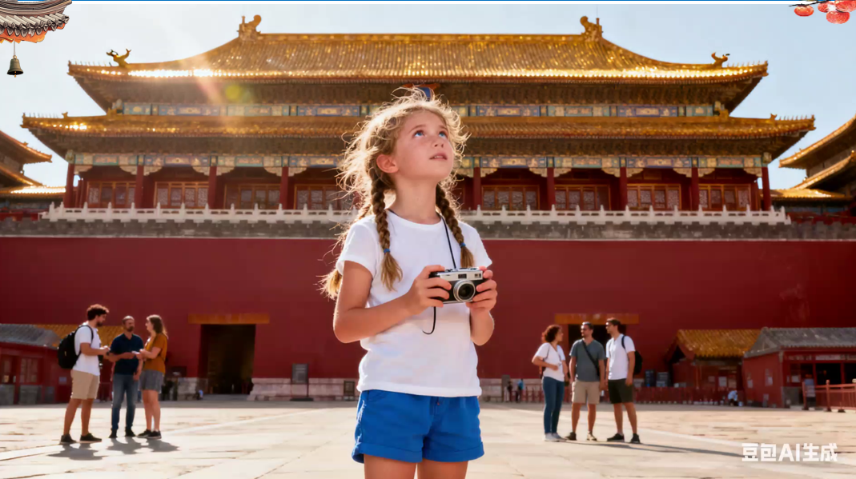
AI赋能的听说读写综合素养提升（视频播放）：
视频
浙江强基联盟2025年10月高三联考
浙江强基联盟2025年10月高三联考
Notes:
词汇与结构知识
正式语篇结构知识
内容/世界背景知识
自动识别技能
综合与评价策略
元认知知识与技能监控

Slide 19


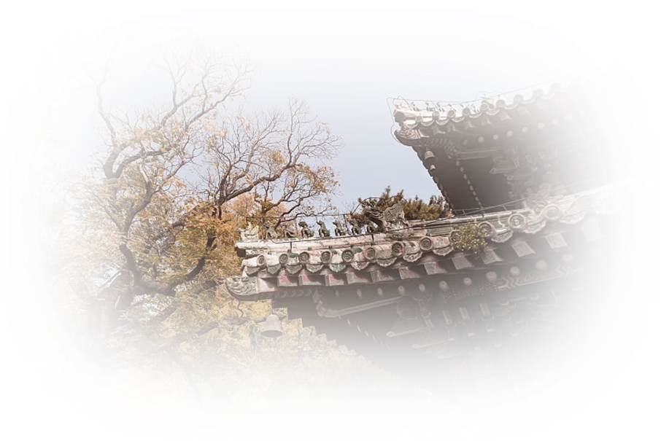
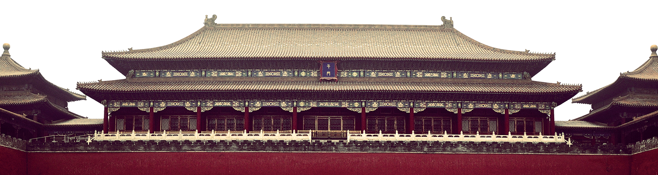


在读后续写中，从关键词汇、段首句、语境、语篇、主题等层面运用语义连贯的手段，可实现原文与续文的高度关联，进而促成高度协同，如语言协同、语篇协同、语境协同、结构协同、主题协同。

