Slide 1



感恩遇见，相互成就，本课件资料仅供您个人参考、教学使用，严禁自行在网络传播，违者依知识产权法追究法律责任。
更多教学资源请关注
公众号：溯恩英语
知识产权声明

Slide 2

指向 “语言+思维”的阅读素养提升
2025.10
浙南名校联盟客观题讲评
浙江省永康市第一中学 佟晓庆

Slide 3
听力：1-5: ACCBB
6-10: CBABA
11-15: CABAC
16-20: ABBAC
阅读：A: CAA
B: DCBD
C: DACA
D: BBAB
七选五：GFBEA
完型： BCDAB
CACCA
CDBDA
语法
56．completing
57．competition
58．developed
59. reliably
60．mountainous
61．have joined.\have been joining
62．what
63．despite
64．that
65．The

Slide 4
听力：1-5: ACCBB
6-10: CBABA
11-15: CABAC
16-20: ABBAC
阅读：A: CAA
B: DCBD
C: DACA
D: BBAB
七选五：GFBEA
完型： BCDAB
CACCA
CDBDA
语法
56．completing
57．competition
58．developed
59. reliably
60．mountainous
61．have joined.\have been joining
62．what
63．despite
64．that
65．The

Slide 5
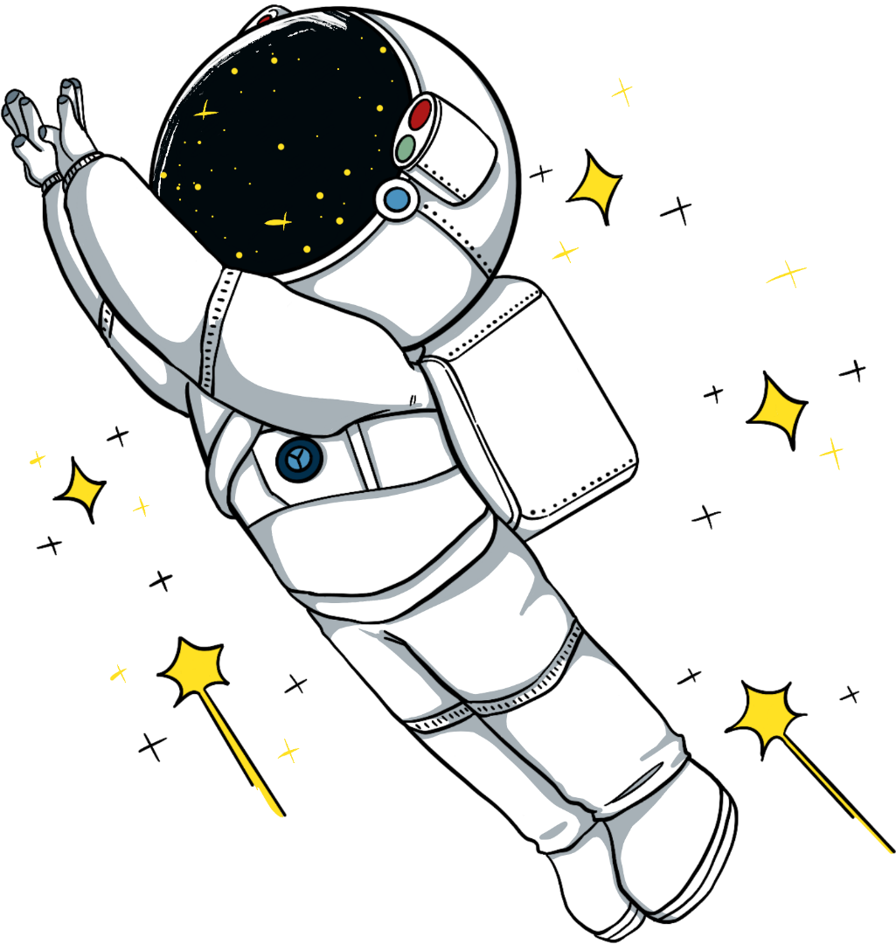

1
Listening

Slide 6

1.
W: Lisa just returned from her business trip __________. Have you talked to her yet?
M: I'm meeting her for coffee _________________.
W: But _________________________________?
M: Actually, I moved it to __________________________.
2.
M: Sunshine Electronics. How may I assist you?
W: Hi! I just called to ______________________________. _____________________________the FastCharge Pro, not the basic one.
M: Ah, that'll change the price quite a bit.
3.
M: Good evening! I've prepared a quiet ____________ for you with a lovely garden view.
W: That sounds wonderful. Could you recommend your signature ____?
M: Certainly!
4.
W: You're really _______________, aren't you? We're supposed to be at the cinema by nowM: I just need to wrap up this report. I promise I’ll be quick, just a few more minutes.
5.
M: I heard that ___________________________________________________.
W: Oh, that sounds interesting! I've been looking for a way to ________. What's the time commitment like?
M: They're pretty flexible, but weekend mornings are their busiest.
yesterday
tomorrow morning
isn't your dentist appointment at that time?
the next day, Friday afternoon
place an order for a wireless charger
Sorry, I gave the wrong model. It's
corner table
dish
招牌菜
从容不迫
taking your time
结束,完成
the animal shelter needs help cleaning cages and walking dogs
give back
回报
时间付出/时间承诺：指在某项活动、项目或任务中所需投入的时间量。

Slide 7
8-10 (Text 7)
M: Shirley, weren't you watching TV?
W: Mom said I could watch TV or online videos for at most an hour every day. So ________________________. It's just so-so, but we can pick up some tips about how to avoid bear attacks in the wilderness.
M: So what should we do if we encounter a bear?
W: We should avoid turning and running, let alone___________________ . Instead, ___________________and ______________________________
M: We’ll take a hiking trip out of town this weekend. Are you afraid?
W: You must be kidding. There aren't any bears in the suburbs, and it's safe from wild animals' attacks. I can't wait to see those small animals in the mountain.
11-13 (Text 8)
W: Hey, Steve, do you think Al will replace hunan jobs completely one day?
M: Not entirely. Al excels at routine tasks like data entry数据输入, sorting files, or moving items along production lines生产线, but creativity and emotional intelligene like writing poetry or comforting patients are still uniquely human strengths.
W: But AI can write articles and even compose music. Isn't that creative?
M: It follows patterns from existing data, but lacks true understanding. Still, it's useful ____________________
W: True. But relying too much on Al might ____________________.
M: Balance is key. ________________________________________________.
你没看电视吗？
I'm doing some reading now
climbing up a tall tree
back away gradually
never take your eyes off the threat.
更不用说
v. （使）后退，倒退
like helping doctors identify diseases faster.
weaken their own skills
Let AI handle data, humans focus on decisions and values

Slide 8
signature dish
adj. 标志性的，惯有的
n. 签名，署名
14-18 (Text 9)
W: David, thank you for joining us today. Your wildlife photos are amazing!
M: My pleasure! I'm glad to share my passion.
W: Your recent Arctic series went viral. What challenges did you face there?
M: ____________was the biggest part! _____________________________
And waiting hours for the perfect shot tested my patience.
W: We heard you're donating all earnings from your new book. Why?
M: Yes! _________________________________________________________ in Kenya.
W: Your career shifted from fashion to wildlife photography. What inspired this change?
M: ____________________________ awakened my love for nature. My journalism degree actually helped. Storytelling through a camera feels similar.
W: How was your experience teaching photography at the conservation camp?
M: It wasn't as simple as I originally thought. The kids had trouble with the cameras at first. But seeing kids develop both skills and environmental awareness was _______ .
W: Thank you for your inspiring work, David!
back
v. （使）后退，倒退
adv. 回原处，恢复原状；回报，回复
ranger
n. （公园、森林或乡村地区的）看守人，护林员
Extreme cold
Low temperatures made the batteries die quickly.
Every penny goes to support wildlife rangers fighting illegal hunting
A journey through wild habitats
priceless

Slide 9
18-19 (Text 10)
Good morning, everyone! Today, I want to share an inspiring story. _______ her age, 73-year-old Suzie reached the Mt. Qomolangma Base Camp, located more than 5,000 m above sea level.
To prepare herself for the challenge, Suzie climbed Mount Kinabalu and spent 25 hours climbing the G7 mountain. Then, Suzie began her Qomolangna journey with two other friends. Accompanied by a guide and two porters each day, before reaching the base camp at the end, they spent _________________________ before reaching the base camp ___________________.
Apart from the physical aspect, Suzie's _____________was another challenge that she had to deal with. But her determination eventually shone through as she reached her destination. Suzie said she was thoroughly absorbed in the scenery and hardly had any time to take pictures along the way. She was extremely focused on the path and did not dare to look down, for fear of the frightening heights.
As for why she did not climb to the peak of Mount Qomolangma, Suzie said it was due to safety concerns that her family raised. Yet her base camp adventure was still a great success.
Despite
six hours climbing each day,
at the end of Day 8
vegetarian diet
shine through
清晰可见
19A. advance
v.（使）前进，（使）向前移动；发展
n.前进；进步

Slide 10
Reading
comprehension
2

Slide 11
Word Bank
正式权威（Formal authority）通常来自职位或职务，例如经理、领导等。这种权威通过职务和责任的规定来行使。
非正式权威（Informal authority）则来源于个人的影响力、经验或人际关系，而非职位。比如，某些人可能由于其专业知识、经验或个人魅力，在团队中拥有较高的影响力。
这两种权威在工作场所、团队合作或组织中都起着重要作用，理解它们有助于更好地与他人合作、领导和解决冲突。
the crises of our time
adaptive challenges
mobilize to do
introductory course
take thoughtful action on the work
video transcript
associated skills
diagnostic-and-action process
identify and break down complex challenges
understand the role of formal and informal authority
build personal authority
approach conflict
instructor
tech companies
professionals seeking leadership certificate
maintain complex systems
我们这个时代的危机
适应性挑战
动员去（做某事）
入门课程
在工作中采取深思熟虑的行动
视频文字稿 （transcript 文字本）
相关技能
诊断与行动流程
识别并分解复杂难题
理解正式与非正式权威的作用
建立个人权威
处理冲突
讲师 （富有教益的；增长知识的 instructive）
科技公司
希望获得领导力证书的职业人士
维护复杂系统（maintenance）

Slide 12


HarvardX is Harvard University's online learning initiative. It offers a wide range of courses across different fields of study that are available to anyone with internet access, often free of charge. These courses are part of Harvard's effort to extend its educational resources to learners worldwide through the edX platform.
21. What is the minimum time required to complete this course?
A. 2 hours. B. 3 hours. C. 8 hours. D. 12 hours.
Exercising Leadership: HarvardX Foundational Principles
Duration
4 weeks, 2–3 hours per week; start from Nov. 5.
2*4=8

Slide 13

22. Who is the course intended for?
A. Individuals facing leadership challenges.
B. Experienced managers in tech companies.
C. Professionals seeking leadership certificates.
D. High school students planning to learn business.
Tip：Make judgments based on the main idea or the writing style of the article, paying attention to the first and last paragraphs
About this course
The crises of our time generate enormous adaptive challenges for our families, organizations, communities, and societies. The need for leadership that can mobilize people to meet these challenges and improve life is critical.
In this introductory course, you will explore strategies for leading in a changing world where adaptive pressures will continue to challenge all of us. You will discover new ways to approach complex organizational systems and take thoughtful action on the work we all face ahead. Most importantly, you will reflect on how to move forward on the leadership challenges you care about most.

Slide 14
23. What key skill does the course teach?
A. Rebuilding trust bonds. B. Building personal authority.
C. Avoiding daily conflicts. D. Maintaining complex systems.
❌建立个人权威
❌避免日常冲突
❌维护复杂的系统
What you’ll learn
In this short introductory course, you will discover a diagnostic-and-action process for exercising leadership that explores the following foundational principles and strategies:
How to identify and break down complex challenges.
How to understand the role of formal and informal authority.
How to build and renew trust relationships.
How to approach conflict.
识别并分解复杂的难题
理解正式权威与非正式权威的作用
如何建立和重建信任关系
解决冲突
renew：If you renew a relationship with someone, you start it again after you have not seen them or have not been friendly with them for some time.恢复 (关系)

Slide 15


B篇
B篇讲述作者父亲患肌萎缩性侧索硬化症后，作者与母亲通过编织寻求慰藉，同时介绍了 Gatto 开设的 “悲伤与编织”通过编织这样的手工活动，人们可以在心理和身体上共同处理悲伤，从而获得疗愈。

Slide 16
Word Bank
be diagnosed with
a progressive and fatal disease
be skilled at crafts
find comfort/solace in textile
knit a granny-square blanket
in one’s twenties
game (熟词生义）
churn/tʃɜːn/ out dozens of multicolored squares
We need a volunteer for this exercise. Who's game to try?
我们需要有人自告奋勇来做这个练习，谁愿意来试试？
被诊断为 sb (as/with) (sth)~ sth (as sth）
（diagnose——n diagnosis diagnostics 诊断学 ——adj diagnostic 诊断的）
2. 一种渐进性且致命的疾病
3. 擅长手工艺
4.从纺织品中获得慰藉/安宁感
5. 编织奶奶方格毯=（weave- wove- woven）
6. 在二十多岁时
7. ~ (for sth/to do sth)ready and willing to do sth new, difficult or dangerous adj 甘愿尝试；有冒险精神
8. 不断制作大量多彩方块 （快速大量生产）
The water churned beneath the huge ship.
水在巨轮下面剧烈翻滚。
My stomach churned as the names were read out.
名单一宣布，我就觉得胃里翻腾得难受。
Conflicting emotions churned inside him.
相互矛盾的情绪使他感到心烦意乱。

Slide 17
Word Bank
9. incredible -(变副词）
10. mindful
11. mindfulness
12.grieve
13. sit in her closet
14. That is part of really sitting
with something.
9. incredibly
10. ~ of sb/sth~ that... ( formal ) remembering sb/sth and considering them or it when you do sth = conscious 记着；想着；考虑到；留意的
•mindful of our responsibilities
11. 正念 mindfulness meditation
正念禅修；正念冥想正念修行
12. ~ (for/over sb/sth) to feel very sad, especially because sb has died（尤指因某人的去世而）悲伤，悲痛，伤心
It grieved him that he could do nothing to help her.
他因无法帮助她而伤心。
It grieved her to leave.
她要走了，心里很难过。
——n （尤指因某人去世引起的）悲伤，悲痛 grief
13.藏起来 或搁置(closet 衣柜）
14. sit with something 理解为“面对”或“处理”某件事，强调的是耐心、接受和深思的过程，而不是急于解决或逃避。
We must be mindful of the consequences of selfishness.
意识到我们的责任

Slide 18
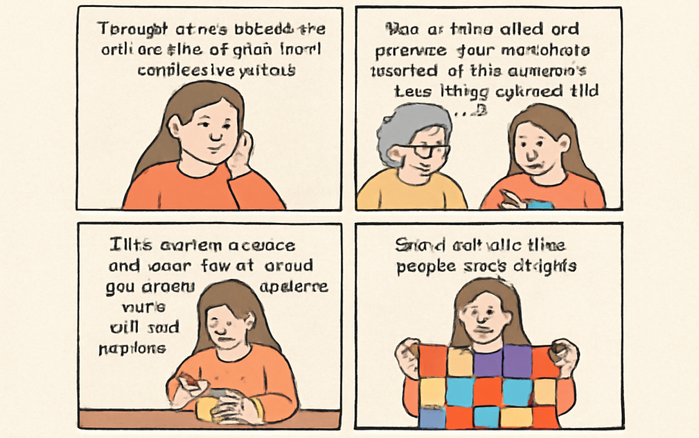

24. What does the underlined word “game” in paragraph 2 mean?
A. Resistant. B. Hesitant. C. Curious. D. Willing.
反对
犹豫
好奇
Though never skilled at crafts, I’ve always found comfort in textiles. My mother, who had knitted a granny-square blanket in her twenties, was game to re-learn how to do it. In her youth, Granny squares became the after-dinner routine and soon I was churning out dozens of multicolored squares. And it felt like this project was, maybe, helping?
in her twenties
now
re-learn
willing
25. Why did the author turn to knitting after her father’s diagnosis?
A. To create a gift for her father. B. To follow her mother’s hobby.
C. To seek comfort and distraction. D. To master a new professional skill.

Slide 19


On a Tuesday evening, Gatto sets up a snack table inside the cemetery’s church, preparing for the start of her monthly interactive workshop, “Grieving & Weaving.” “I think it was important to have that in the name as well,” she says. “We are going to talk about grief, death and loss. But we’re also going to create happy memories together, eating and drinking a bunch of things.”
It’s a project that had been sitting in her closet for months. Earlier this year, after both her grandmothers died, she lost what she calls the “knitting light” for a while. Rafferty, who is also a therapist, says she almost skipped the workshop to stay home with her dog, but she’s glad she didn’t — being here is therapeutic.
As Gatto says, after all, it’s not the end product that’s the therapy. It’s the act of doing it. “A big thing with grief is moving through it both mentally and physically,” Gatto says. “And that’s exactly what we do here. We bring something that is maybe heavy on our minds or our hearts. And then we work with our hands. We work with it, and we work together.”
therapy 治疗，疗法；心理治疗
therapeutic 治疗的，有疗效的；使人镇静的，使人放松
ship the workshop
26. What is Rafferty’s attitude to the workshop?
A. Cautious. B. Supportive. C. Critical. D. Dismissive.
27. What is the key to the therapy process according to Gatto? A. Forgetting sadness by keeping busy.
B. Creating a valuable product as a symbol. C. Achieving high efficiency through teamwork.
D. Turning inner pain into a shared physical activity.
小心的，谨慎的
批评的
轻蔑的，鄙视的
正如 Gatto 所说，“最终的成品并不是治疗的关键，做这件事的过程才是治疗的关键。” Gatto 说，“处理悲伤的一个重要方面是在心理和身体上一起走过这个过程。” “这正是我们在这里所做的。我们把那些可能困扰我们心灵或心头的事情带到这里。然后我们用手去做，用手去处理它，并且一起去做。”

Slide 20
Perspective and Attitude
favorable
approving
supportive
positive
appreciative
desirable
optimistic
sympathetic（赞同的）
disapproving
critical
negative
warning
pessimistic
opposed
（反对的）
neutral（中立的）
objective（客观的）
impartial （公平的）
unbiased （没有偏见的）
doubtful ；cautious（谨慎的）；suspicious（怀疑的）；reserved （保留的）
🙅 ambiguous 模棱两可；indifferent 漠不关心；uncaring 冷漠的
其他态度： unclear 不清楚的；vague（模糊的）；tolerant（宽容的）；sarcastic（讽刺的）ironic（反讽的）；hostile（敌对的）

Slide 21
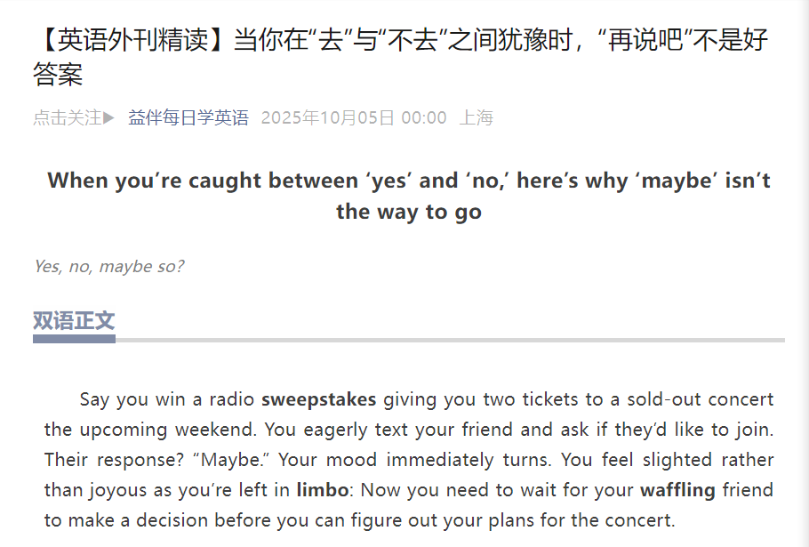
C篇
“收到音乐会门票邀请后朋友回复‘也许’” 为例，分析人们对邀请回复 “也许” 的心理原因（动机性推理），并建议社交中应优先给出明确回应而非保留模糊选项。

Slide 22
1. be sold out 卖光
2. a common yet annoying (让人恼火的) aspect of social life
annoyed 感到恼火的
annoyance 恼人的人或是事 What an annoyance!
3. a delicate dance 一场微妙的博弈
delicacy 娇嫩；脆弱；美味佳肴
4. overestimate an inviter’s likelihood (可能性likely的名词形式) of preferring a “maybe” over a “no” 高估了邀请者更倾向于听到“可能”而非“拒绝”的可能性
inviter ----invitee interviewer---interviewee employer---employee
trainer---trainee payer（付款人；交款人）---payee（受款人；收款人）
5. interpret（解读、阐释) information in a biased(偏见的) way 带有偏见地去解读信息
interpreter 口译译员 interpretation 解释；解读
6. recipients (接收者) of an invitation （recipient /rɪˈsɪpiənt/）
7. put oneself in the shoes of sb 换位思考
the shoe is on the other food 情况、形势完全逆转
8. refuse 拒绝---refusal n
9. navigate (指应对复杂社交环境的能力)social situations can be tricky
= challenging/ demanding
IBAOTU.COM

Slide 23
Picture this, you win two tickets to a sold-out concert and eagerly text to ask your friends if they’d like to join. There comes their response “ Maybe.” Your mood immediately turns, for you need to wait for their decisions before you can figure out your plans for the concert.
If you’ve experienced anything like the above anecdote, you’re not alone. People responding “maybe” to invitations is a common yet annoying aspect of social life. What goes on in people’s heads when they aren’t sure whether to accept an invitation? Social invitations can be a delicate dance. People often misread what someone extending an invitation wants to hear and overestimate an inviter’s likelihood of preferring a “maybe” over a “no.” Moreover, they fail to realize how much more disrespected people feel when they receive a “maybe” in response to their invitation.
Naturally, we wanted to figure out why this awkward dynamic plays out. We found that it’s largely due to something called “motivated reasoning.” Motivated reasoning occurs when a person interprets information in a biased(有偏差的) way to suit their own wishes. In other words, invitees convince themselves that inviters want to hear “maybe” instead of “no” because a “maybe” is better for the invitees, allowing them to leave their options open. Besides, people tend to overestimate the negative consequences of saying “no” to invitations, thinking it will upset, anger and disappoint inviters.
However, there were certain situations that made people more comfortable saying “no” to an invitation. When recipients of an invitation put themselves in the shoes of the person extending the invitation, they are more likely to realize that they’d probably prefer a definite answer. When the participants get invited to do something they didn’t want to do, they had no desire to keep their options open. The motivated reasoning then became irrelevant.
While navigating social situations can be tricky, being direct and definitive is sometimes best. It might reduce your options. But it’ll keep those who invite you from being left uncertain and maybe they’ll still think of you when the next concert comes to town.
Introduction： the annoyance of receiving a "maybe" response to an invitation.
Background Analysis：Why "maybe" is common but frustrating.
The psychological mechanism behind the “maybe”
Solution： Understanding the inviter’s perspective.
Conclusion： Benefits of clear responses.

Slide 24
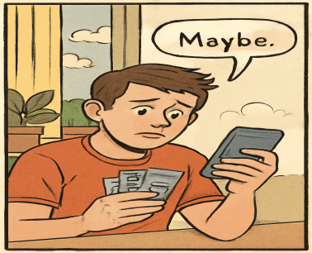
28. Why is the concert anecdote mentioned at the beginning? （TIP：首段作用——To capture the reader‘s interest，provide background or introduce the topic）
A. To explain the background of the invitation. B. To stress the importance of quick replies.
C. To encourage immediate decision-making. D. To introduce a common social situation.
to resonate with the readers, thereby leading into the subsequent discussion.
Picture this, you win two tickets to a sold-out concert and eagerly text to ask your friends if they’d like to join. There comes their response “ Maybe.” Your mood immediately turns, for you need to wait for their decisions before you can figure out your plans for the concert.
If you’ve experienced anything like the above anecdote, you’re not alone. People responding “maybe” to invitations is a common yet annoying aspect of social life. What goes on in people’s heads when they aren’t sure whether to accept an invitation? Social invitations can be a delicate dance. People often misread what someone extending an invitation wants to hear and overestimate an inviter’s likelihood of preferring a “maybe” over a “no.” Moreover, they fail to realize how much more disrespected people feel when they receive a “maybe” in response to their invitation.
文章的首段通过描述一个非常常见的社交情境（赢得演唱会门票，等待朋友回应“maybe”）引出主题。这个情境让读者容易产生共鸣，因为许多人可能在社交中经历过类似的情形——对方给出的回答是模棱两可的“maybe”，而不是明确的“yes”或“no”。这一点为文章的主题设定了基础：人们在收到“maybe”时常常感到困扰和不确定，这种模糊的回应常常导致社交中不必要的焦虑和困扰。

Slide 25
29. What is the main reason for the response of “maybe” to an invitation?
A. A biased interpretation of social cues.
B. A desire for harmonious communication.
C. An underestimation of refusal consequence.
D. An understanding of the inviter’s expectation.
动机推理（Motivated Reasoning） 是一种心理现象，指的是人们根据自己的需求、欲望或偏好，偏向性地解释信息或做出决策，而不是依据客观事实或逻辑来推理。
Naturally, we wanted to figure out why this awkward dynamic plays out. We found that it’s largely due to something called “motivated reasoning.” Motivated reasoning occurs when a person interprets information in a biased(有偏差的) way to suit their own wishes. In other words, invitees convince themselves that inviters want to hear “maybe” instead of “no” because a “maybe” is better for the invitees, allowing them to leave their options open. Besides, people tend to overestimate the negative consequences of saying “no” to invitations, thinking it will upset, anger and disappoint inviters.
动机性推理发生在一个人以偏颇的方式解读信息，以迎合自己的愿望。换句话说，受邀者说服自己认为邀请者更希望听到“maybe”而不是“no”，因为“maybe”对受邀者更有利，允许他们保持选择的余地。
社交线索指的是邀请者通过语言、肢体语言等方式传达的信息，受邀者可能会根据自己的需求或愿望，偏颇地解读这些线索。例如，受邀者可能误解了邀请者并不在乎“maybe”回应，认为“maybe”比直接拒绝更符合邀请者的期望（这是动机性推理的表现）。
易错选项：C. An underestimation of refusal consequence（低估拒绝的后果）： 这个选项认为人们会低估拒绝的后果，但文章中提到的其实是高估拒绝的后果，认为直接拒绝会让邀请者失望、愤怒等，因此选择“maybe”来避免这些负面后果。高估才是人们选择“maybe”的原因，而不是低估。文章题目，主要原因，Besides,… 这并不是主要原因

Slide 26
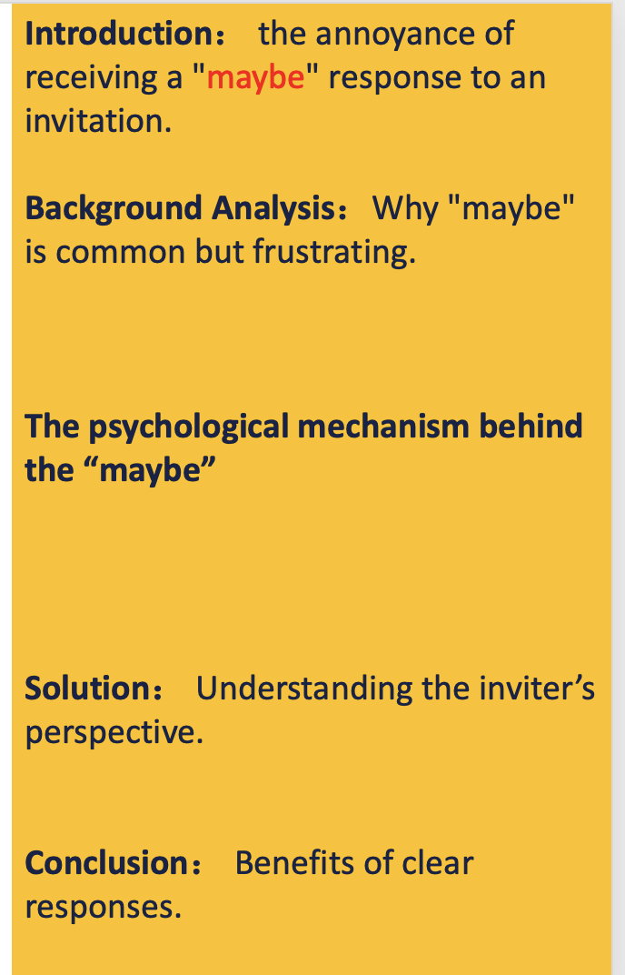
30. What is the author’s suggestion in the last paragraph?
A. Keeping your options open for better plans.
B. Accepting invitations to maintain friendships.
C. Prioritizing clear response over open options.
D. Thinking twice before refusing an invitation.
prioritize： to treat sth as being more important than other things 优先处理= is sometimes best
good over evil （“胜过”或“优于”）
Love over hate（爱胜过恨）
A blanket over the bed（床上的毯子）
Family over work（家庭比工作更重要）
Rising over the horizon（从地平线上升起）
31. What is the best title for the passage? A. The Psychology behind “Maybe”
B. The Hidden Consequence of “Maybe”
C. “Maybe”: A Polite Escape from Conflict
D. “Maybe”: A Perfect Solution to Invitations
While （虽然）navigating social situations can be tricky, being direct and definitive is sometimes best. It might reduce your options. But it’ll keep those who invite you from being left uncertain and maybe they’ll still think of you when the next concert comes to town.
“Maybe”的隐藏后果（缩小范围）
无关
对社交线索的偏见性解读
高估拒绝的负面后果
无关
这篇文章主要讨论了为什么人们在社交场合中，特别是在接受邀请时，常常使用模糊的回应（如“maybe”）。文章深入分析了这种现象背后的心理机制——动机性推理（motivated reasoning），即人们倾向于根据自己的需求、愿望或情感来解读信息，而不是客观地处理社交线索。文章还提到，人们常常高估拒绝他人邀请的负面后果，因此会选择“maybe”，以避免直接拒绝可能带来的失望。
换位思考的效果

Slide 27
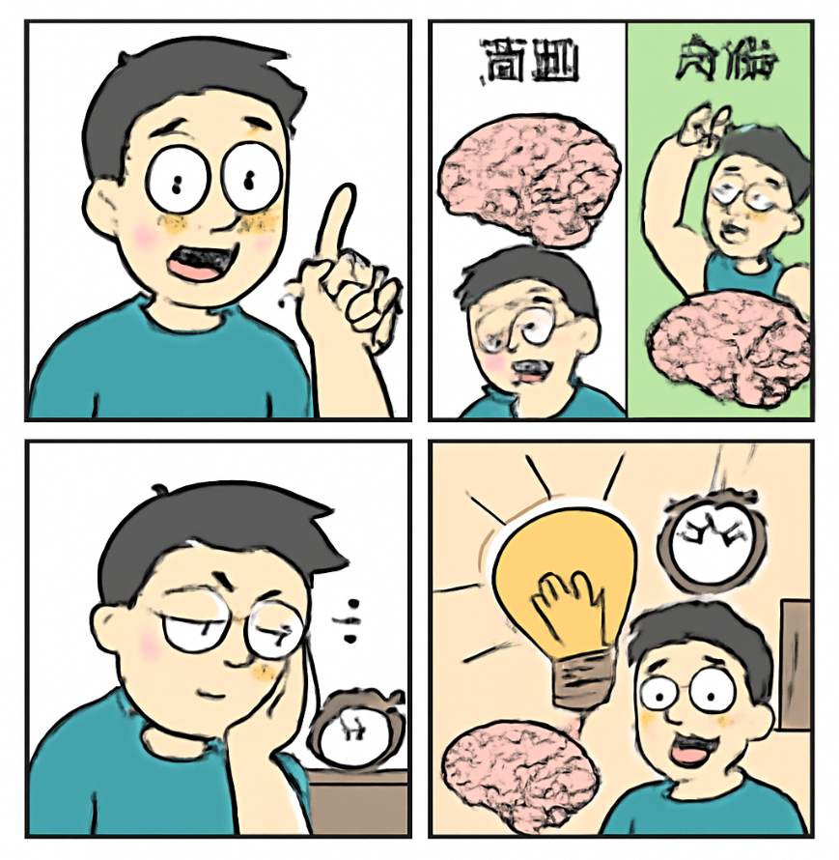
D 篇
这项研究强调了我们的行为对大脑活动的持久影响，短期和长期的行为变化都会对注意力、认知和记忆产生影响。

Slide 28
Word Bank
1. have significant implications 有重要的启示/影响
imply--- v 暗示；表明
2. take a snapshot of our lived experience 捕捉生活经历的瞬间
3. in response to specific behaviors
specific= concrete 具体的 specifically (副词形式) ---publicly
4. be tied to attention and memory 与...注意力和记忆有联系
= be linked with/ connected with
tie a knot 打结
the ties of friendship 友谊的纽带
England tied 2-2 with Germany in the first round.
第一轮比赛中英格兰对与德国队2：2 打平。
5. provide a more comprehensive and dynamic view of brain function
提供更全面、动态的大脑功能视图
6. the long-term impact of A on B A对B产生的长期影响
impact= effect= influence n
affect vt 影响

Slide 29
Your behavior today could affect your brain activity in two weeks’ time, new research suggests. These findings have significant implications for our mental health as well as our attention, cognition and memory.
Our behavior and our brains are closely linked. And yet, the majority of studies only take a snapshot of our lived experience. “We know little about the response of brain functional connectivity to environmental, physiological, and behavioral changes on different timescales, from days to months,” said Triana, a professor from Aalto University.
To investigate these effects, Triana and his colleagues tracked their own brain activity and behavior over a five-month period using a combination of brain scans, wearable devices and their smartphones. “We studied brain activity using FMRI (functional magnetic resonance imaging), sleep and physical activity patterns using a smart-ring, heart and respiration rates using a smartwatch, and mood using questionnaires prompted on their smartphone,” Triana said.
Triana’s brain was scanned twice a week, followed by qualitative(定性的) data from mood surveys. The team identified two distinct brain patterns in response to specific behaviors: a short-term wave lasting less than a week and a long-term wave lasting up to 15 days. The short-term wave was reflective of rapid responses to a behavior, like struggling to focus after a poor night’s sleep. Meanwhile, the long-term wave suggests more gradual, lasting effects of a particular behavior. These were particularly apparent in areas of the brain tied to attention and memory. In other words, a workout or restless night from two weeks ago could still be affecting you — positively or negatively — today.
While this study only shows the brain activity of one individual, the researchers hope that it demonstrates the importance of studying brain activity in the context of our wider lifestyle and behavior, rather than a single snapshot in the lab. “This research is important because it provides a more comprehensive and dynamic view of brain function, highlighting the long-term impact of everyday behaviour on brain health,” Triana said.
Introduction: Behavior affects brain activity, impacting health and cognition.
Background: Lack of long-term behavioral studies on brain function.
Methods: Tracking brain and behavior with scans, devices, and surveys.
Findings: Short-term and long-term brain activity patterns identified.
Conclusion: Importance of studying brain activity in everyday behavior.

Slide 30

Your behavior today could affect your brain activity in two weeks’ time, new research suggests. These findings have significant implications for our mental health as well as our attention, cognition and memory.
Our behavior and our brains are closely linked. And yet, the majority of studies only take a snapshot of our lived experience. “We know little about the response of brain functional connectivity to environmental, physiological, and behavioral changes on different timescales, from days to months,” said Triana, a professor from Aalto University.
To investigate these effects, Triana and his colleagues tracked their own brain activity and behavior over a five-month period using a combination of brain scans, wearable devices and their smartphones. “We studied brain activity using FMRI (functional magnetic resonance imaging), sleep and physical activity patterns using a smart-ring, heart and respiration rates using a smartwatch, and mood using questionnaires prompted on their smartphone,” Triana said.
Triana’s brain was scanned twice a week, followed by qualitative(定性的) data from mood surveys. The team identified two distinct brain patterns in response to specific behaviors: a short-term wave lasting less than a week and a long-term wave lasting up to 15 days. The short-term wave was reflective of rapid responses to a behavior, like struggling to focus after a poor night’s sleep. Meanwhile, the long-term wave suggests more gradual, lasting effects of a particular behavior. These were particularly apparent in areas of the brain tied to attention and memory. In other words, a workout or restless night from two weeks ago could still be affecting you — positively or negatively — today.
While this study only shows the brain activity of one individual, the researchers hope that it demonstrates the importance of studying brain activity in the context of our wider lifestyle and behavior, rather than a single snapshot in the lab. “This research is important because it provides a more comprehensive and dynamic view of brain function, highlighting the long-term impact of everyday behaviour on brain health,” Triana said.
Tip： 注意转折词汇——yet；however；but；while（虽然）
32. What inspired Triana to conduct the study?
A. Her colleagues’ prior research findings.
B. A gap in long-term brain-behavior study.
C. A demand to upgrade digital equipment.
D. The wide use of brain scanning technology.

Slide 31
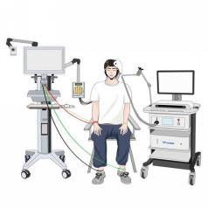
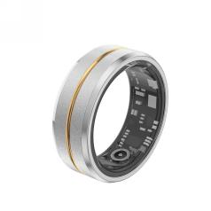
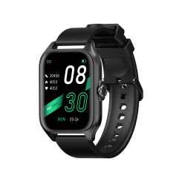

To investigate these effects, Triana and his colleagues tracked their own brain activity and behavior over a five-month period using a combination of brain scans, wearable devices and their smartphones. “We studied brain activity using FMRI (functional magnetic resonance imaging), sleep and physical activity patterns using a smart-ring, heart and respiration rates using a smartwatch, and mood using questionnaires prompted on their smartphone,” Triana said.
Triana’s brain was scanned twice a week, followed by qualitative(定性的) data from mood surveys. The team identified two distinct brain patterns in response to specific behaviors: a short-term wave lasting less than a week and a long-term wave lasting up to 15 days. The short-term wave was reflective of rapid responses to a behavior, like struggling to focus after a poor night’s sleep. Meanwhile, the long-term wave suggests more gradual, lasting effects of a particular behavior. These were particularly apparent in areas of the brain tied to attention and memory. In other words, a workout or restless night from two weeks ago could still be affecting you — positively or negatively — today.
Sleep and Physical Activity Patterns
The researchers carried out their study by combining multiple data collection methods— over several months with scans conducted twice a week.
Brain Activity Tracking
Heart and Respiration Rates
Mood Tracking
33. How did the researchers carry out their study?
A. By tracking the participant’s sleeping pattern.
B. By analyzing brain data and personal mood report.
C. By using only data from the most advanced scanner.
D. By interviewing participants how they felt after scanning.

Slide 32
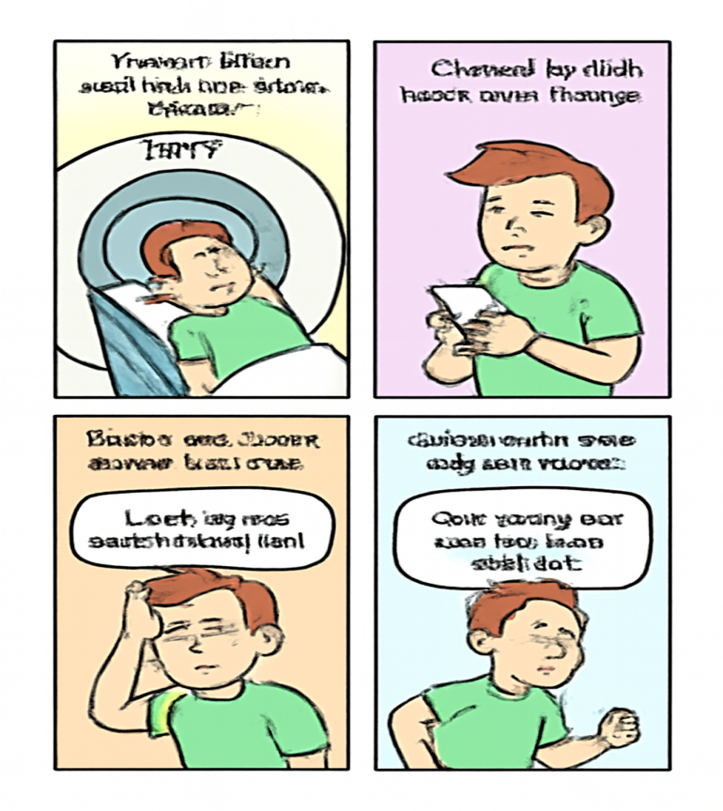
Triana’s brain was scanned twice a week, followed by qualitative(定性的) data from mood surveys. The team identified two distinct brain patterns in response to specific behaviors: a short-term wave lasting less than a week and a long-term wave lasting up to 15 days. The short-term wave was reflective of rapid responses to a behavior, like struggling to focus after a poor night’s sleep. Meanwhile, the long-term wave suggests more gradual, lasting effects of a particular behavior. These were particularly apparent in areas of the brain tied to attention and memory. In other words, a workout or restless night from two weeks ago could still be affecting you — positively or negatively — today.
IBAOTU.COM
restless: without real rest or sleep 没有真正休息的；没有睡眠的
unable to stay still or be happy where you are, because you are bored or need a change 坐立不安的；不耐烦的
The audience was becoming restless. 观众开始不耐烦了。
两周前的一次锻炼或失眠之夜，今天仍可能影响你的脑部活动
34. What is the key finding of the Triana’s research?
A. Behaviors have lasting effects on brains.
B. Brain scans can best track mood changes.
C. Short-term waves matter more for memory.
D. Poor sleep affects the brain for over 15 days.

Slide 33


While this study only shows the brain activity of one individual, the researchers hope that it demonstrates the importance of studying brain activity in the context of our wider lifestyle and behavior, rather than a single snapshot in the lab. “This research is important because it provides a more comprehensive and dynamic view of brain function, highlighting the long-term impact of everyday behaviour on brain health,” Triana said.
IBAOTU.COM
significance
35. What is expected of future brain research?
A. More precise laboratory snapshots.
B. Brain activity in real-life situations.
C. Promotion of brain function and health.
D. Short-term effects of specific behaviors.
“实验室快照”是作者明确否定的 rather than a single snapshot in the lab
研究意义，不是未来研究的预期方向
文章强调的是长期影响（long-term effects）
context
the situation in which sth happens and that helps you to understand it（事情发生的）背景，环境，来龙去脉
This speech needs to be set in the context of Britain in the 1960s.
这篇演说需要放到20世纪60年代的英国这一背景之下来看待。
You should be able to guess the meaning of the word from the context.
你应该能从上下文猜出这个词的含义。 （上下文；语境）

Slide 34
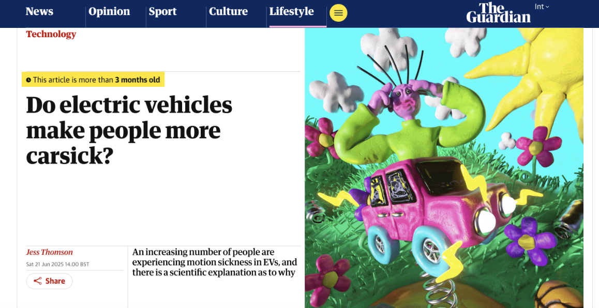
3
Gap -filling

Slide 35
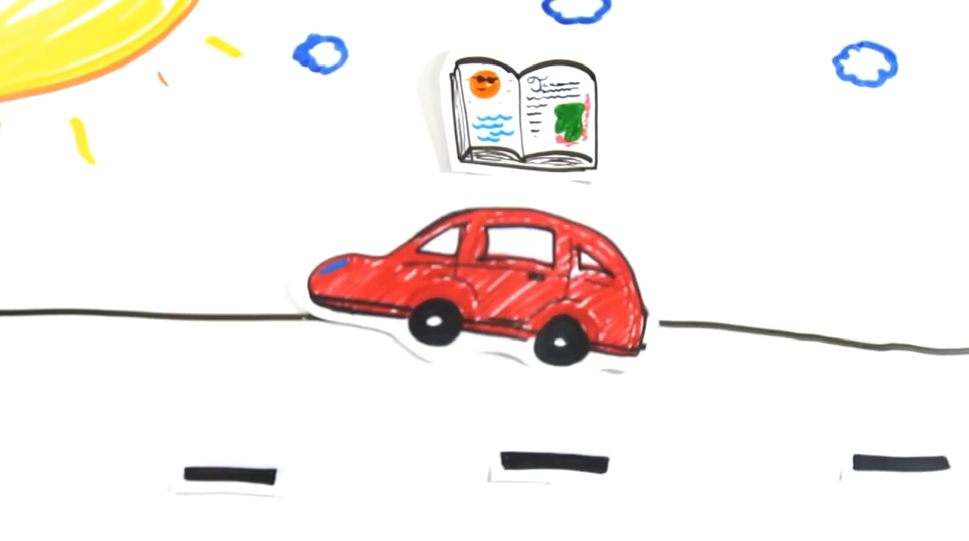
视频1

Slide 36
Nouns (名词):
1. popularity 普及，流行
2. passengers 乘客
3. motion sickness 晕动病（晕车）
4. vehicles 车辆
6. phenomenon 现象
9. predictions 预测
10. acceleration 加速
11. engine 引擎
12. vibrations 振动
13. discomfort 不适
15. kinetic kɪˈnetɪk/ energy 动能
16. battery 电池
17. conflict 冲突
18. symptoms 症状
19. manufacturers 制造商
20. suspension systems 悬挂系统
21. mechanism 机制
Verbs (动词):
1. account for 占（比例）；解释；对……负责
3. operate 操作，运转
5. indicate 表明
6. contribute to 促成，导致
7. transform 转换
8. lengthen 延长
9. worsen 恶化
13. minimize 最小化
14. trigger 引发
15. identify 识别
Adjectives (形容词):
1. electric 电动的
3. significant 显著的
4. familiar 熟悉的
5. specific 特定的
6. gradual 逐渐的
7. contradictory 矛盾的
8. sensory 感官的
9. neural 神经的
10. regenerative 再生的
Phrases (短语):
2. due to 由于
3. in regard to 关于
4. add to 增加
5. a lack of 缺乏
悬停系统：与车辆轮胎相连的系统，用于减少在不平坦路面行驶时的影响。

Slide 37
Why Do Electric Vehicles Make People More Carsick?
With electric vehicles (EVs) gaining significant popularity globally — accounting for 22% of new car sales in 2024 — many passengers report experiencing increased motion sickness compared to traditional vehicles. Social media platforms are filled with such personal experiences, particularly from those riding in passenger or back seats. 36
A primary reason for this phenomenon is the lack of familiarity with EV motion patterns. As William Emond, a PhD researcher in France specializing in motion sickness, explains, people’s brains heavily depend on past experiences to predict and interpret motion. 37 For instance, experienced drivers naturally expect acceleration after hearing engine revs in fuel-powered cars, but EVs operate without such familiar auditory signals.
38 Recent research indicates that specific seat vibrations and the complete absence of traditional engine noise in EVs contribute significantly to motion discomfort. Furthermore, the regenerative braking systems — innovative technology that transforms kinetic energy(动能) into battery power — cause an unusually gradual slowdown. 39
Beyond this, motion sickness fundamentally occurs when the brain receives contradictory sensory signals about body movement. The inner ear, visual cues, and physical sensations send mixed messages to the brain, creating what experts call a “neural mismatch”. 40 This mechanism explains why drivers themselves rarely experience carsickness — they control and predict the vehicle’s movements.
Phenomenon: Many people tend to get carsick when riding in electric vehicles (EVs).
Scientific Explanation ①: People are unfamiliar with the motion patterns of electric vehicles.
Scientific Explanation ②: EV-specific vibrations and braking features make motion sickness worse.
Scientific Explanation ③: The brain receives conflicting sensory signals from vision, the inner ear, and body movement, leading to motion sickness.

Slide 38

Why Do Electric Vehicles Make People More Carsick?
With electric vehicles (EVs) gaining significant popularity globally — accounting for 22% of new car sales in 2024 — many passengers report experiencing increased motion sickness compared to traditional vehicles. Social media platforms are filled with such personal experiences, particularly from those riding in passenger or back seats. 36
A primary reason for this phenomenon is the lack of familiarity with EV motion patterns. As William Emond, a PhD researcher in France specializing in motion sickness, explains, people’s brains heavily depend on past experiences to predict and interpret motion. 37 For instance, experienced drivers naturally expect acceleration after hearing engine revs in fuel-powered cars, but EVs operate without such familiar auditory signals.
38 Recent research indicates that specific seat vibrations and the complete absence of traditional engine noise in EVs contribute significantly to motion discomfort. Furthermore, the regenerative braking systems — innovative technology that transforms kinetic energy(动能) into battery power — cause an unusually gradual slowdown. 39
Beyond this, motion sickness fundamentally occurs when the brain receives contradictory sensory signals about body movement. The inner ear, visual cues, and physical sensations send mixed messages to the brain, creating what experts call a “neural mismatch”. 40 This mechanism explains why drivers themselves rarely experience carsickness — they control and predict the vehicle’s movements.
抓主题，找指代，看逻辑，锁关键词
主题词（EVs, drivers, technology, conflict, experience）
逻辑词（another, such, without, due to, this）
动词词组（trigger symptoms, add to the problem, struggle to estimate, lengthen the process）
看到 “another / furthermore / in addition” → 表示新原因或补充；
看到 “this / such” → 一定是指代前一句内容；
看到 “drivers / technology / experience / conflict” → 去文中找相同或近义词呼应。
A. Such long-term conflict can trigger motion sickness symptoms.
B. Another contributing factor is that EV-specific features add to the problem.
C. Some manufacturers are improving suspension systems to minimize vibrations.
D. Drivers usually don’t experience carsickness due to their control over the vehicle.
E. This technology lengthens the stopping process and may worsen feelings of sickness.
F. Without previous EV experience, the brain has to struggle to estimate forces accurately.
G. In regard to this phenomenon, researchers have identified several scientific explanations.
A. Such long-term conflict can trigger motion sickness symptoms.
B. Another contributing factor is that EV-specific features add to the problem.
C. Some manufacturers are improving suspension systems to minimize vibrations.
D. Drivers usually don’t experience carsickness due to their control over the vehicle.
E. This technology lengthens the stopping process and may worsen feelings of sickness.
F. Without previous EV experience, the brain has to struggle to estimate forces accurately.
G. In regard to this phenomenon, researchers have identified several scientific explanations.

Slide 39


抓主题，找指代，看逻辑，锁关键词
Why Do Electric Vehicles Make People More Carsick?
With electric vehicles (EVs) gaining significant popularity globally — accounting for 22% of new car sales in 2024 — many passengers report experiencing increased motion sickness compared to traditional vehicles. Social media platforms are filled with such personal experiences, particularly from those riding in passenger or back seats. 36
A primary reason for this phenomenon is the lack of familiarity with EV motion patterns. As William Emond, a PhD researcher in France specializing in motion sickness, explains, people’s brains heavily depend on past experiences to predict and interpret motion. 37 For instance, experienced drivers naturally expect acceleration after hearing engine revs in fuel-powered cars, but EVs operate without such familiar auditory signals.
38 Recent research indicates that specific seat vibrations and the complete absence of traditional engine noise in EVs contribute significantly to motion discomfort. Furthermore, the regenerative braking systems — innovative technology that transforms kinetic energy(动能) into battery power — cause an unusually gradual slowdown. 39
Beyond this, motion sickness fundamentally occurs when the brain receives contradictory sensory signals about body movement. The inner ear, visual cues, and physical sensations send mixed messages to the brain, creating what experts call a “neural mismatch”. 40 This mechanism explains why drivers themselves rarely experience carsickness — they control and predict the vehicle’s movements.
A. Such long-term conflict can trigger motion sickness symptoms.
B. Another contributing factor is that EV-specific features add to the problem.
C. Some manufacturers are improving suspension systems to minimize vibrations.
D. Drivers usually don’t experience carsickness due to their control over the vehicle.
E. This technology lengthens the stopping process and may worsen feelings of sickness.
F. Without previous EV experience, the brain has to struggle to estimate forces accurately.
G. In regard to this phenomenon, researchers have identified several scientific explanations.
G
F
B
“for instance”举例说明大脑对“过去经验”的依赖
语义场“原因”
“this / such” → 指代前一句内容
A
逻辑递进
这种技术延长了停车过程，可能加重晕车感。
没有电动车驾驶经验，大脑难以准确预估运动力量。
承上启下的“研究者对此现象的科学解释”

Slide 40
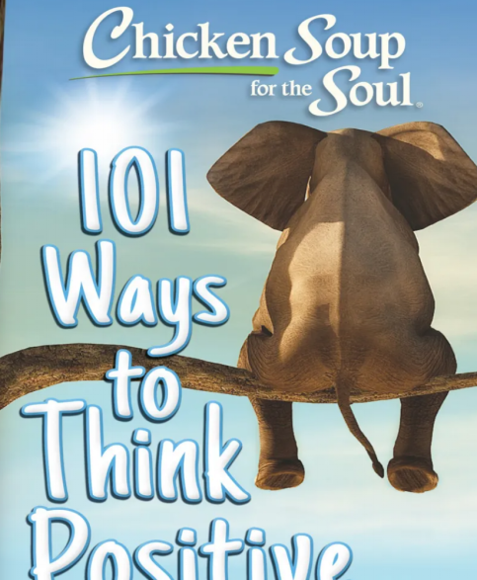
4
Cloze test
本篇主要讲述了我的朋友Karen在帮助老人Rose过程中碰到的问题，在经过观念转变之后把被迫做的任务就可以变成自愿志愿服务。通过改变心态（reframing mindset），我们可以把原本沉重的责任转化为有意义的自愿行为，从而找到快乐和满足。

Slide 41
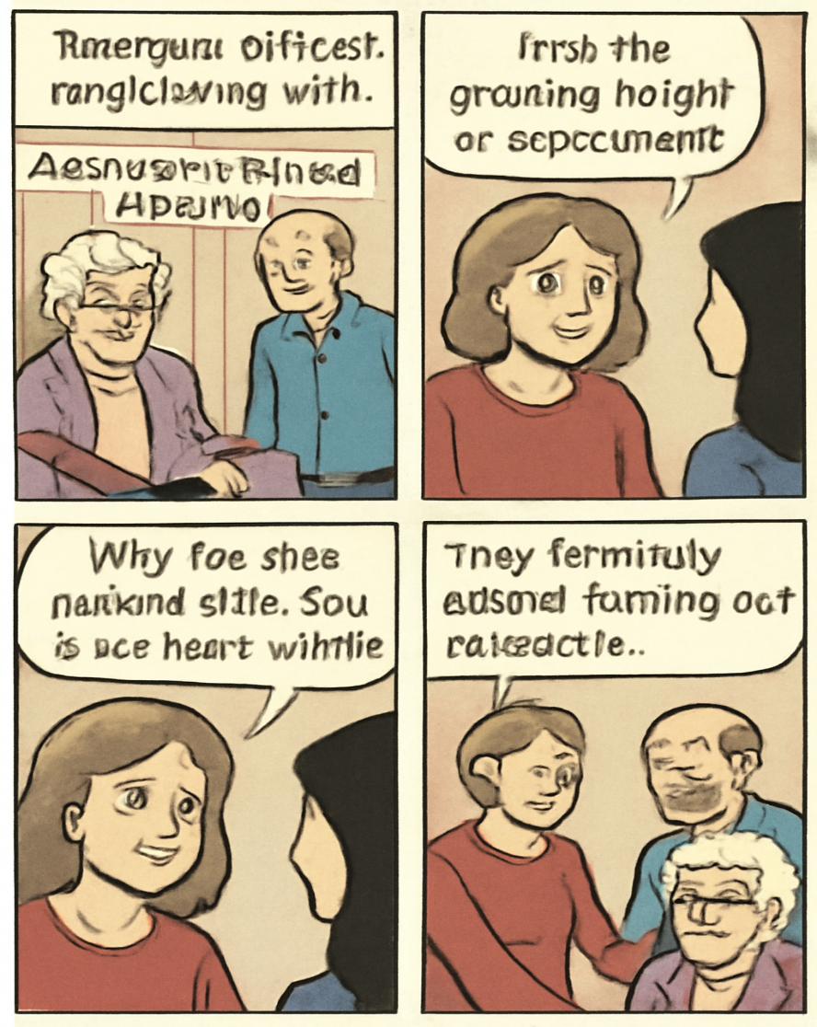
关注首尾段
My friend Karen and her husband David were acquainted with an elderly lady, Rose, who fell ill with no one to help her. Though not 41 , they offered to act like family. For years, they took turns 42 Rose in her home, then moving her into an assisted-living facility and eventually into a nursing home due to her 43 health.
However, Rose was difficult to get along with. She would take them out for dinner but then 44
what they could order, and complained about everything they did. This led to their confusion, leaving them feeling increasingly 45 . One day, Karen shared with me the growing weight of 46 she felt from caring for Rose. When I asked if she had any volunteer 47 , she responded that she had no time. I then suggested that she 48 looking after Rose as volunteer work. Instantly, it was like a light bulb went on. Karen’s 49 shifted. She told David the same that night, and the idea changed everything. From then on, they still did the same work, but as “volunteers,” it felt 50 — no longer a duty, but a choice. For the rest of Rose’s life, they still 51 helped, finding joy in the role.
We often talk about volunteering, which makes us feel good. But there’s also a way to 52 a burdensome commitment as “volunteering”. By doing so, a task we feel forced to do can become a voluntary act.
Let’s take Karen and David as an example. Their 53 to helping Rose at first seemed like an unwanted 54 . But after the shift, a chore turned into a 55 experience.
Change in perspectives
被迫的负担（burden）” →
变成了 “自愿的善意（volunteer act）

Slide 42
My friend Karen and her husband David were acquainted with (熟悉) an elderly lady, Rose, who fell ill with no one to help her. Though not_41. they offered to act like family. For years, they took turns __42 Rose in her home, then moving her into an assisted-living facility and eventually into due to her 43__ health.
41. A. friends B. relatives C. neighbors D. colleagues 同事
42. A. looking for B.arguing with C. attending to 照顾. 照料 D.checking on 检查
43. A. improving B.ruined毁坏 C. manageable 可控、可管理的 D.declining 衰退的
an assisted-living facility ：老年辅助居住机构
这是指一种为老年人或身体不便者提供日常生活帮助的居住机构。居民仍然能自己生活，但有工作人员提供必要的协助，比如：做饭、打扫、洗衣；提醒吃药；日常护理（如洗澡、穿衣、行动帮助）24小时安全照看
a nursing home：养老院：指照顾和治疗非常年老的病人的地方。
decline：a continuous decrease in the number, value, quality, etc. of sth
（数量、价值、质量等的）减少，下降，衰落，衰退
IBAOTU.COM

Slide 43
However, Rose was difficult to get along with. She would take them out for dinner but then 44 what they could order and complained about everything they did. This led to their confusion, leaving them feeling increasingly_45. One day, Karen shared with me the growing weight of 46 she felt from caring for Rose. When I asked if she had any volunteer 47. she responded that she had no time. I then suggested that she 48 looking after Rose as volunteer work. Instantly, it was like a light bulb went on（像受到了启发）. Karen's 49 shifted. She told David the same that night, and the idea changed everything. From then on, they still did the same work, but as “volunteers,” it felt _50 no longer a duty, but a choice. For the rest of Rose's life, they still 51_ helped, finding joy in the role.
44.A.limit 限制 B. recommend C.distribute 分配 D.predict
mixed signals：Rose 一方面 邀请他们吃饭、接受照顾，看起来是信任他们；但另一方面又 限制他们点菜、挑剔他们的做法、不断抱怨。又要别人帮忙、又对别人不满”的矛盾行为，让 Karen 和 David 无法判断：“她到底感激我们，还是讨厌我们？” emotional conflict：他们真心想帮 Rose，出于善意行事；但 Rose 的态度让他们受伤、沮丧，甚至怀疑自己是不是做错了。
于是他们感到 confused（困惑）
45.A.guilty 愧疚的 B frustrated 沮丧的 C. relieved宽慰的 D.excited
46.A. dependence B.impact 影响，撞击 C.responsibility 责任 D.debt
Karen 感到责任越来越重，是因为她长期照顾一个难相处的老人，在情感上又把自己看作“必须承担的家人”，导致她从“自愿帮助”变成“被责任压得喘不过气”。
47. A. experience B. interest C. ambition D. training
“Have any volunteer experience” 是固定搭配，意为“有志愿经历”。
48.A. describe B.classify 分类 C.view sth as 把...看作 D.dismiss 解雇；驳回
49.A. emotion B.routine C. perspective观点看法 D. priority 优先事项
？

Slide 44
However, Rose was difficult to get along with. She would take them out for dinner but then 44 what they could order and complained about everything they did. This led to their confusion, leaving them feeling increasingly_45. One day, Karen shared with me the growing weight of 46 she felt from caring for Rose. When I asked if she had any volunteer 47. she responded that she had no time. I then suggested that she 48 looking after Rose as volunteer work. Instantly, it was like a light bulb went on（像受到了启发）. Karen's 49 shifted. She told David the same that night, and the idea changed everything. From then on, they still did the same work, but as “volunteers,” it felt _50 no longer a duty, but a choice. For the rest of Rose's life, they still 51_ helped, finding joy in the role.
51. reluctantly B. briefly C. faithfully D. occasionally 偶尔
虽然心态转变，但是他们“still”（仍然）说明一如既往的照顾她。因而用faithfully
faithfully 用来形容一个人“长期、忠诚、坚持地”做某事，带有责任感 + 稳定性 + 真诚的含义。
to follow instructions faithfully
严格遵循指示 （ accurately; carefully准确地；如实地；仔细地）
We often talk about volunteering, which makes us feel good. But there's also a way to 52 a burdensome commitment(负担沉重的承诺) as “volunteering". By doing so, a task we feel forced to do can become a voluntary act.（从一开始定义承诺责任到志愿活动）
Let's take Karen and David as an example. Their 53 to helping Rose at first seemed like an unwanted 54 . But after the shift, a chore turned into a_55 experience.(通过观念的转变，一件烦恼的事情转变成了一件 值得做的经历)
52.A.escape B.ignore C.simplify D.redefine 重新定义
53.A. approach B. commitment 承诺 C.objection 反对 D.attitude
54.A.task B.routine C.joke D.burden （负担）
55.A.rewarding值得做B. pains-taking痛苦的 C. time-consuming 费时的 D.refreshing 振奋精神

Slide 45

一、心理机制：从“义务”到“选择”
当人觉得自己“被迫做某事”时（duty / obligation），大脑会产生压力感（stress）和抗拒心理（resistance），因为这件事看起来是在“消耗自己”。
而一旦把同样的事情重新定义为“志愿行为（voluntary act）”， 大脑会认为：“我是在选择帮助别人，而不是被迫去做。”
这种“自主感（sense of autonomy）”会带来积极情绪（positive emotion）， 让人产生控制感和成就感，从而减轻心理负担。
二、情感层面：从负担到意义
当 Karen 把照顾 Rose 视为“义务”，她只看到：
“我必须去做；她又挑剔；我很累。”结果是压抑、烦躁、疲惫。
当她把它看成“志愿工作”，她想到：
“我是在帮助一个孤独的老人，这是我自愿的善举。” 结果是自豪、温暖、满足。
Karen 把照顾 Rose 看作志愿活动后不那么累了，是因为她的心态从被迫转为自愿，这种“自主选择的感觉”让她重新找到意义与快乐，从而减轻了心理压力和疲劳感。
IBAOTU.COM

Slide 46
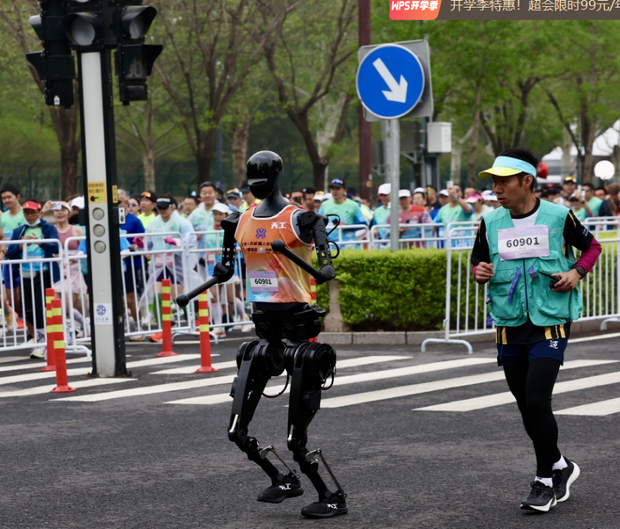
5
Grammar
本篇介绍了北京最近创造了技术历史，举办了世界上第一场人形机器人半程马拉松比赛，这标志着机器人技术发展的一个重要里程碑

Slide 47
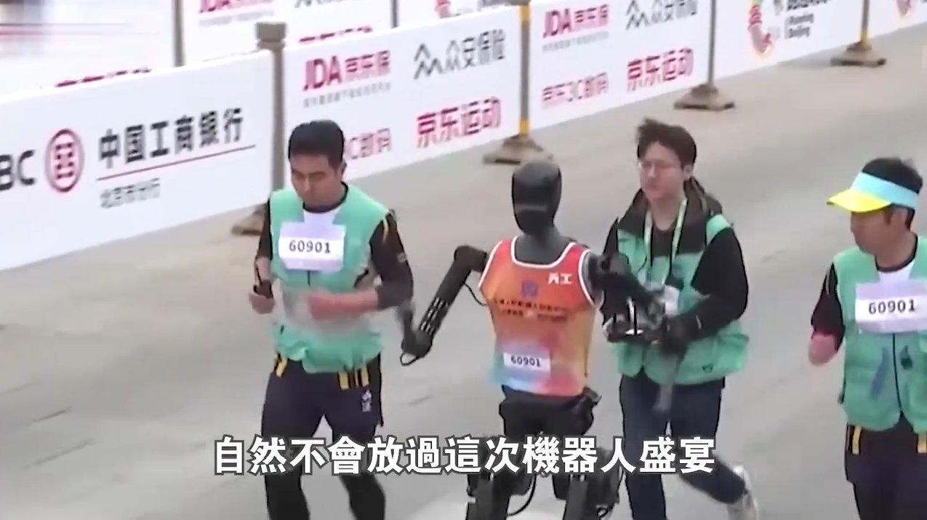
视频2

Slide 48
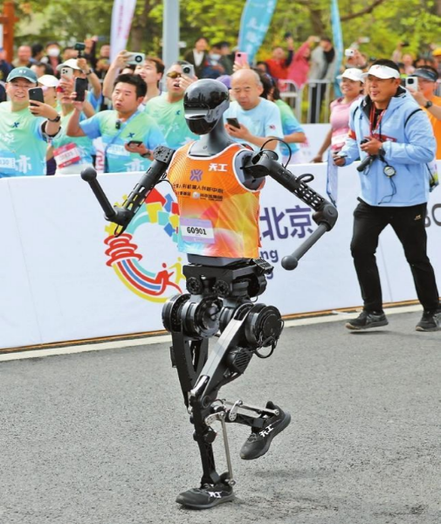
Word Bank
创造了技术史上的新篇章
人形机器人
超快的
开创性的
马拉松比赛那变幻莫测的户外环境
专门的检查机器人
关键的转变
适应能力和耐力
中国南方电网
科技巨头
汽车业领导者
人工智能决策制定
作为证明
障碍，难关
对即将出现的诸多卓越创新成果的预览
made technological history
humanoid robots
Ultra-fast
groundbreaking
the marathon’s unpredictable outdoor conditions
the specialized inspection robots
a crucial transition
adaptability and endurance capabilities
China Southern Power Grid
tech giants
automotive leaders
AI decision-making
serve as a testament to
hurdle
a preview of the remarkable innovations still to come

Slide 49
Beijing recently made technological history by hosting the world’s first half-marathon for humanoid robots, marking a significant milestone in robotics development. Twenty teams from top universities and tech firms participated, with six robots 56 (complete) the 21-kilometer race. The winner, Tiangong Ultra, finished it in just 2 hours and 40 minutes.
with + 名词 / 代词 + （宾语补足语）有六台机器人完成了这场21公里的比赛 主动形式 completing
This groundbreaking 57 (compete) represented a crucial transition from controlled laboratory testing to real-world application.
groundbreaking 形容词+ n compete---competition比赛----competitor 参赛者---competitive 竞争性的
Unlike artificial lab environments, the marathon’s unpredictable outdoor conditions tested the robots adaptability and endurance capabilities. Beyond sports, such robots are already in use — for example, the specialized inspection robots 58 (develop) by China Southern Power Grid, can operate 59 (reliable) in temperature extremes ranging from -40°C to 80°C while maintaining power lines in remote 60 (mountain) regions.
过去分词作定语结构 develop to think of or produce a new idea, product, etc. and make it successful开发；研制
reliable——reliably ； “-able”/“-le”结尾的形容词变副词需去掉末尾的“e”并加“-y”，形成“-ably” possible → possibly；probable → probably；advisable → advisably terrible--terribly, simple---simply possible--possibly, probable---probably, gentle---gently “以e结尾的形容词通常不去掉e，直接加-ly” immediate → immediately（立刻地）；fortunate → fortunately（幸运地）；entire → entirely（完全地）；wide → widely（广泛地）；absolute → absolutely（绝对地）；polite → politely（有礼貌地）；wise → wisely（明智地）；nice → nicely（漂亮地）；approximate →approximately；desperate→ desperately；large → largely；accurate→ accurately
注意：sole-solely（唯一地，仅仅）；whole-wholly；true-truly
mountain--mountainous ；courage---courageous；mystery---mysterious；envy--envious

Slide 50
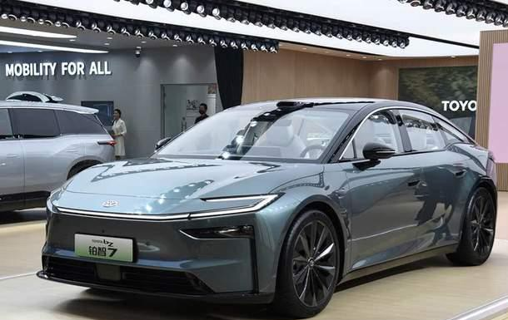
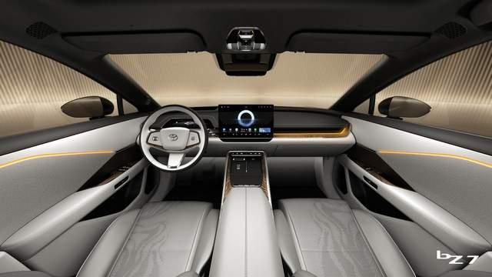
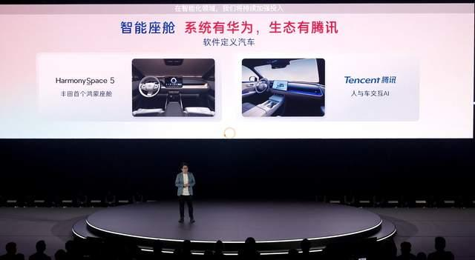
Since the beginning of this year, Chinese tech giants like Xiaomi and Huawei, well aware of the opportunities, 61 (join) forces with automotive leaders including Tesla and Toyota in 62 has become an international race to advance this technology.
考察谓语 join force with 联合行动；（军队）会师；合作 ；join 谓语，现在完成时；主语是tech gaints（科技巨头）所以 have joined/ have been joining；
考察宾语从句 in 是介词+宾语/宾语从句；从句中 “has become” 缺少主语，需用连接代词 “what” 相当于 “the thing that”，意为“在这已经成为国际竞赛的事情中”
自今年年初以来，小米和华为等中国科技巨头意识到这一机遇，与特斯拉和丰田等汽车领导者联手，投入到这场推动该技术发展的国际竞赛中。
However, experts caution that 63 rapid progress, significant technical hurdles remain. Most robots currently operate at Level 2 autonomy but achieving Level 4 — full independence — needs breakthroughs in AI decision-making.
考察介词：上文通力合作，话锋一转，专家caution（警告；告诫；提醒）道：“_____取得了快速进展，仍然存在重大的技术障碍”两部分之间存在 转折或让步关系，因为虽然有进展，但仍有困难。despite 尽管 是介词+n/doing；

Slide 51
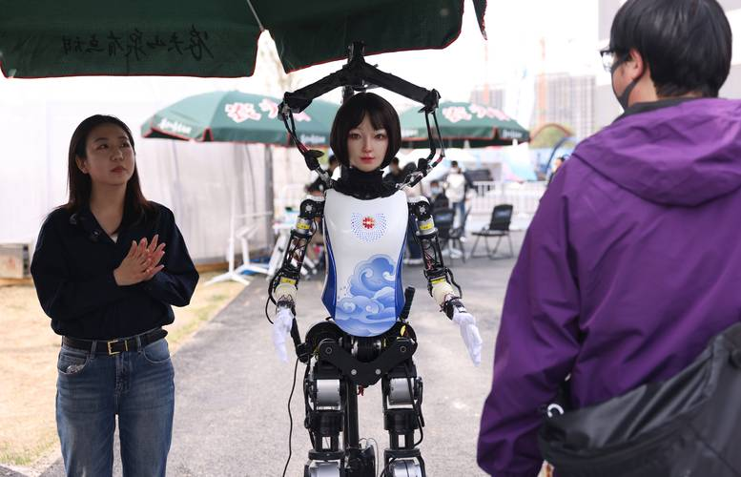
For students considering future careers in technology, humanoid robotics represents one of the most exciting and promising fields 64 may transform industries and daily life. 65 successful Beijing marathon serves as both a testament to how far we have come and a preview of the remarkable innovations still to come.
考察定语从句“对那些考虑未来从事科技职业的学生来说，人形机器人代表着最令人兴奋和最有前景的领域之一，___ 可能会改变工业和日常生活。”“one of the most exciting and promising fields”（一个领域），后面是从句说明这个领域的特征。这个从句修饰 fields，所以需要一个关系代词引导定语从句。
在英语定语从句中，只用“that”而不用“which”：
先行词为不定代词“all, everything, nothing, something, anything, little, much”等不定代词时，关系代词用“that”。
先行词被序数词或最高级修饰 3. 先行词被“the very, the only, the same”等词修饰时， 4.先行词既有人又有物 5. 主句以疑问词开头 6.定语从句为there be 结构
只用“which”而不用“that”的情况：
非限制性定语从句 2. 介词 + which
考察冠词；上文已经出现过北京马拉松比赛，所以特指 “对于那些考虑未来从事科技职业的学生来说，人形机器人代表着最令人兴奋、最有前景的领域之一，它可能会改变工业和日常生活。这场成功的北京马拉松既是我们取得巨大进步的见证，也预示着未来更加非凡的创新。”

Slide 52

Thank you

