Slide 1



感恩遇见，相互成就，本课件资料仅供您个人参考、教学使用，严禁自行在网络传播，违者依知识产权法追究法律责任。
更多教学资源请关注
公众号：溯恩英语
知识产权声明

Slide 2
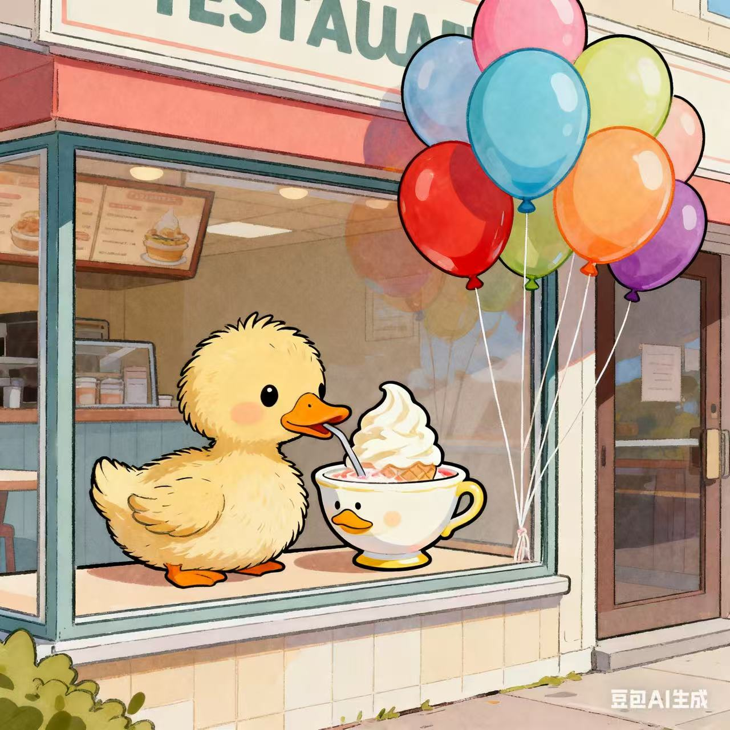
指向思维品质培养的读写策略
Mason’s Souper Idea
---202510 天域协作体联盟读后续写讲评
郑素红

Slide 3

原文复现
Mason Martin was unenthusiastic on the subject of soup. He could take it or leave it. His mother, on the other hand, loved soup. She made two different kinds every day of the week. Some days, it was chicken soup and tomato soup steaming in big pots. Other days, it was beef stew and mushroom soup. The only thing Mason’s mom loved as much as soup was ducks. The Martin house overflowed with duck decorations. Duck curtains hung from every window. Duck doormats, duck dishware, and duck throw pillows filled the house.
When Mason was eight years old, his mother combined her two favorite things and opened a small restaurant called Soup and Quackers. When it was cold outside, Mason didn’t mind some chicken soup or tomato soup, even if his mother served it with a duck-shaped spoon into a duck-shaped bowl. But when she offered cold soup in the summer, he politely refused.

Slide 4

Other than Mason’s dad, who loved everything Mason’s mom made, it seemed that the entire town felt the way Mason did. In winter, customers young and old filled Soup and Quackers. The soup warmed their insides and prepared them for the freezing outdoors. But when the steamy days of summer crept in, business dropped off sharply.
Mason knew that one more bad summer would mean the end of the business. One boiling summer Sunday, Mason sat with his friends at the ice-cream shop. They were trying to escape the fry-an-egg-on-the-sidewalk heat. Mason absently moved his spoon in circles, watching his orange ice cream melt in the bottom of his bowl. How could he help save his mother’s restaurant? He kept stirring as he thought — until suddenly, he opened his eyes wide. “Oh, man, I’ve got it! I’ve got it! Ice-cream soup!” Cold, sweet, and perfect for beating the summer heat — just what Mom’s restaurant needs!
Para1: Mason rushed home, his mind racing with the possibilities of his new idea.
Para2: On the day of the launch, the Martins were nervous but hopeful.

Slide 5
Read for elements
characters： Mason Martin; Mrs. Martin ( leading )
Mr. Martin, customers, Mason’s friends( supporting)
2. narrative perspective: third -person
3. time： in boiling summer
place： Mason’s home & Soup and Quackers
Event : Mrs. Martin combined her love for warm soup and ducks and opened a restaurant named Soup and Quackers. However, in burning summer, its business dropped off sharply and with one more terrible summer Soup and Quackers wouldn’t survive. Mason came up with a new idea to help save it.

Slide 6

5.
story
line
Climax
Mason got a souper idea to save the family restaurant when he had ice-cream with his friends. That was ice-cream soup!
Para1: Mason rushed home, his mind racing with the possibilities of his new idea.
Mason didn’t mind some warm soup on winter days and refused cold soup in summer just as the entire town did. The business on boiling summer days dropped off sharply and with one more terrible summer Soup and Quackers wouldn’t survive.
Para2:Weeks later, the moveable library program started, bringing libraries to different communities.
conflict
Mrs. Martin combined her love for warm soup and ducks and opened a restaurant named Soup and Quackers.
Ending
Beginning

Slide 7
Read for clues and echoes
hidden clues | echoes
Mason Martin was unenthusiastic on the subject of soup. He could take it or leave it. His mother, on the other hand, loved soup. ….The Martin house overflowed with duck decorations. Duck curtains hung from every window. Duck doormats, duck dishware, and duck throw pillows filled the house. | 1. Wearing a radiant smile across his face, Mason handed out small cups to customers and passers-by, enthusiastically introducing the new recipe. 2. The restaurant overflowed with newly-designed posters ---an adorable duckling is sipping a duck-shaped bowl of ice-cream soup!

Slide 8
Read for clues and echoes
hidden clues | echoes
The only thing Mason’s mom loved as much as soup was ducks. The Martin house overflowed with duck decorations. Duck curtains hung from every window. Duck doormats, duck dishware, and duck throw pillows filled the house. ……When it was cold outside, Mason didn’t mind some chicken soup or tomato soup, even if his mother served it with a duck-shaped spoon into a duck-shaped bowl. But when she offered cold soup in the summer, he politely refused. | 3. Eventually, the Martins settled on three flavors for the launch and redecorated their restaurant with newly-designed posters---an adorable duckling is sipping a duck-shaped bowl of ice-cream soup!

Slide 9
Read for clues and echoes
hidden clues | echoes
Other than Mason’s dad, who loved everything Mason’s mom made, it seemed that the entire town felt the way Mason did. In winter, customers young and old filled Soup and Quackers. The soup warmed their insides and prepared them for the freezing outdoors. But when the steamy days of summer crept in, business dropped off sharply. | 4. From that summer on, Soup and Quackers thrived / boomed / flourished all year round, all thanks to Mason’s super idea.

Slide 10
Read for clues and echoes
hidden clues | echoes
Mason knew that one more bad summer would mean the end of the business. One boiling summer Sunday, Mason sat with his friends at the ice-cream shop. They were trying to escape the fry-an-egg-on-the-sidewalk heat. Mason absently moved his spoon in circles, watching his orange ice cream melt in the bottom of his bowl. How could he help save his mother’s restaurant? He kept stirring as he thought — until suddenly, he opened his eyes wide. “Oh, man, I’ve got it! I’ve got it! Ice-cream soup!” Cold, sweet, and perfect for beating the summer heat — just what Mom’s restaurant needs! | 5. The Martins’ constant painstaking efforts paid off and their restaurant survived! 6. Mason explained how he had watched his ice cream melt in the bowl and realized it was like a cold, sweet soup perfect for beating the summer heat // for escaping the fry-an-egg-on-the-sidewalk heat. 7. Streams of people poured into their restaurant, spooned the cold, tasty, sweet soup and enjoyed the cool respite from the summer heat.

Slide 11
心理描写
神态描写
动作描写
外貌描写
环境描写
对话描写
语言
无灵主语
动作链
分词作状语
With 复合结构
独立主格
从句
倒装句
虚拟语气
强调句
长短句结合
考生构思情节的同时，要考虑合适的语言句式以及修辞

Slide 12
Plot the continuation story
Para1: Mason rushed home, his mind racing with the possibilities of his new idea.
Para2: On the day of the launch, the Martins were nervous but hopeful.
Link1: What did Mason say to his mother? How did his mother feel and react? Body: How to make ice-cream soup?
Link2: What preparations did they make for the launch?
Link3: How was the restaurant now? What did the Martins do for business?
Body: How did customers respond? What about the business now?
Ending: ① What eventually happened to Soup and Quackers?
② What lesson did the story teach us?

Slide 13
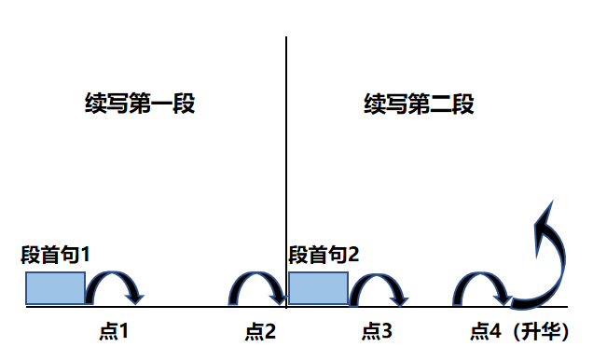
Plot Continuation
点1：位于续写第一段段首，流畅衔接前面的故事（常与原文最后一段呼应）和第一段段首语；
点2：位于续写第一段段尾，流畅衔接第二段段首句；
点3：位于续写第二段段首，续写衔接第二段段首语；
点4：文章结尾升华，给予读者正能量，揭示和强调主题。

Slide 14
Design link1
Para1: Mason rushed home, his mind racing with the possibilities of his new idea.
Link1A: (与“所给首句叙事人称及其动作 rushed home + his new idea + 可能在家的人即母亲’’协同 ) Puffing and panting, Mason burst through the door and couldn’t wait to share his souper idea with his mother.
Link1B: : (与Mason rushed home 协同，理解为Mason 已经到家，那么看到忧心忡忡的母亲就很合理。） Hardly had he entered the kitchen when his eye fell on his mother’s weary, concerned and wrinkled face, which made his heart ache.

Slide 15
Design link2
Para1: Mason rushed home, his mind racing with the possibilities of his new idea.
Para2: On the day of the launch, the Martins were nervous but hopeful.
Link2 A: (做为ice-cream soup发布的准备工作） Eventually, the Martins settled on three flavors for the big launch and redecorated their restaurant with newly-designed posters---an adorable duckling is sipping a duck-shaped bowl of ice-cream soup!
Link2B: ( 母亲或父亲宣布第二天开始上ice-cream soup）With the new recipes for ice-cream soup developed, Mrs./ Mr. Martain declared excitedly, “ Tomorrow we’ll launch the new menu!”

Slide 16
Design link3
Para2: On the day of the launch, the Martins were nervous but hopeful.
Link3B: ( describe the new look of the restaurant) Colorful balloons bobbing in the breeze and swinging posters waving to customers, Soup and Quackers took on a new look, ready to treat its customers to its brand-new ice-cream soup.
Link3A: ( 直接描写饭点时间顾客的态度） As the clock struck noon, a few curious customers trickled in, intrigued by the new offering. Instantly word spread about the delicious and fun dessert. And the restaurant was packed with streams of customers/ diners, totally beyond the Martins’ expectation!

Slide 17
Design ending
Para2: On the day of the launch, the Martins were nervous but hopeful.
Ending A: (饭店生意火爆) The Martins’ constant painstaking efforts paid off and their restaurant survived! From that summer on, Soup and Quackers thrived / boomed / flourished all year round, all thanks to Mason’s super idea.
Ending B: (从Mason 的角度进行感悟式结尾①) It dawned on Mason that the best solution to a tricky challenge may come from blending creativity with love, turning a simple idea into a soaring success.
Ending B: (从作者的角度进行感悟式结尾②) The innovative soup not only helped Soup and Quackers survive but also became a must-taste treat for those with a sweet tooth both on boiling summer days and freezing winter days.

Slide 18
Para1: Mason rushed home, his mind racing with the possibilities of his new idea. Puffing and panting, Mason burst through the door and couldn’t wait to share his souper idea with his mother. “ Mom! Ice-cream soup!” Mason exclaimed, eyes sparkling with thrill. Hesitant and confused, “ Cold soup? ” Mrs. Martin asked, eyebrows frowning. Mason explained how he had watched his ice cream melt in the bowl and realized it was like a cold, sweet soup perfect for escaping the fry-an-egg-on-the-sidewalk heat. Hearing the innovative concept, Mrs. Martin resolved to give it a try. The following days witnessed numerous trials and experiments with the new recipe in the laughter-packed kitchen. Eventually, the Martins settled on three flavors for the big launch and redecorated their restaurant with newly-designed posters---an adorable duckling is sipping a duck-shaped bowl of ice-cream soup! (126)

Slide 19
Para2: On the day of the launch, the Martins were nervous but hopeful. Colorful balloons bobbing in the breeze and swinging posters waving to customers, Soup and Quackers took on a new look, ready to treat its customers to its brand-new ice-cream soup. Wearing a radiant smile across his face, Mason handed out small cups to passers-by, enthusiastically introducing the new recipe. Upon touching the tongue, the refreshing ice-cream soup exploded in the diner’s mouth like little flavor bombs. Word spread across the town straightaway. Streams of people poured in , spooned the cold, delicious, sweet soup and enjoyed the cool respite from the summer heat in the restaurant overflowing with duck-shaped items. The Martins’ constant painstaking efforts paid off and their restaurant survived! From that summer on, Soup and Quackers thrived / boomed / flourished all year round, all thanks to Mason’s super idea. (129)

Slide 20
本文续写值得思考的点：
研发新的汤品， 考生可以结合平时吃过的冰激凌各种口味进行创作；
美食可以通过味觉来描写，需要积累味觉方面的语言素材；
Eg.① Every taste bud on his tongue awakened, one customer sipped the strawberry- flavored ice-cream soup, exclaiming , “ I love it !”
②Upon touching the tongue, the ice-cream soup exploded in customer’s mouth like little flavor bombs. (2021-新高考I卷七选五改编）
③Once tasting the refreshing sweet treat, customers couldn’t help taking a second bite.
3. 新的菜品（以及产品）需要宣传，考生结合一下平时看的产品的广告，海报，试吃等老店新开的宣传手段，描写老店的新气象。
上述几点提醒我们考生，要灵活地把实际生活结合到写作中去。

