Slide 1


感恩遇见，相互成就，本课件资料仅供您个人参考、教学使用，严禁自行在网络传播，违者依知识产权法追究法律责任。
更多教学资源请关注
公众号：溯恩英语
知识产权声明

Slide 2
Better, Greener Lives away from the City
Shriley Tong

Slide 3

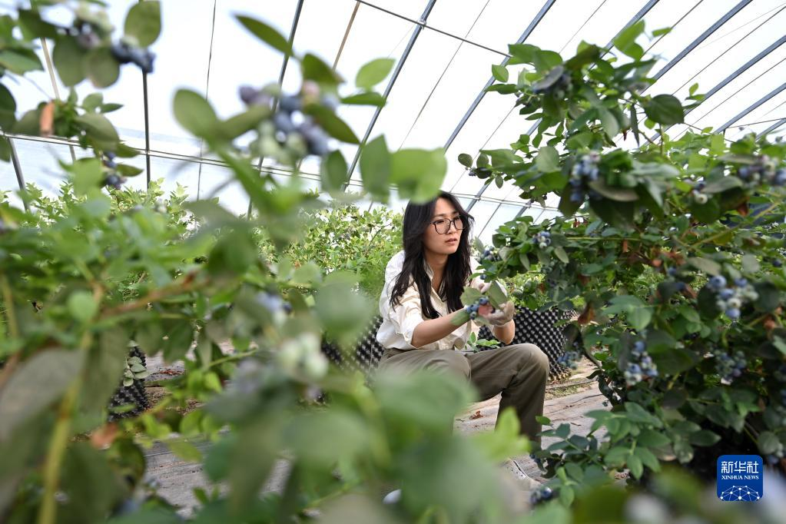
If you were the university graduates, would you choose to start a career in a big city or in the country (乡村）? Why?

Slide 4
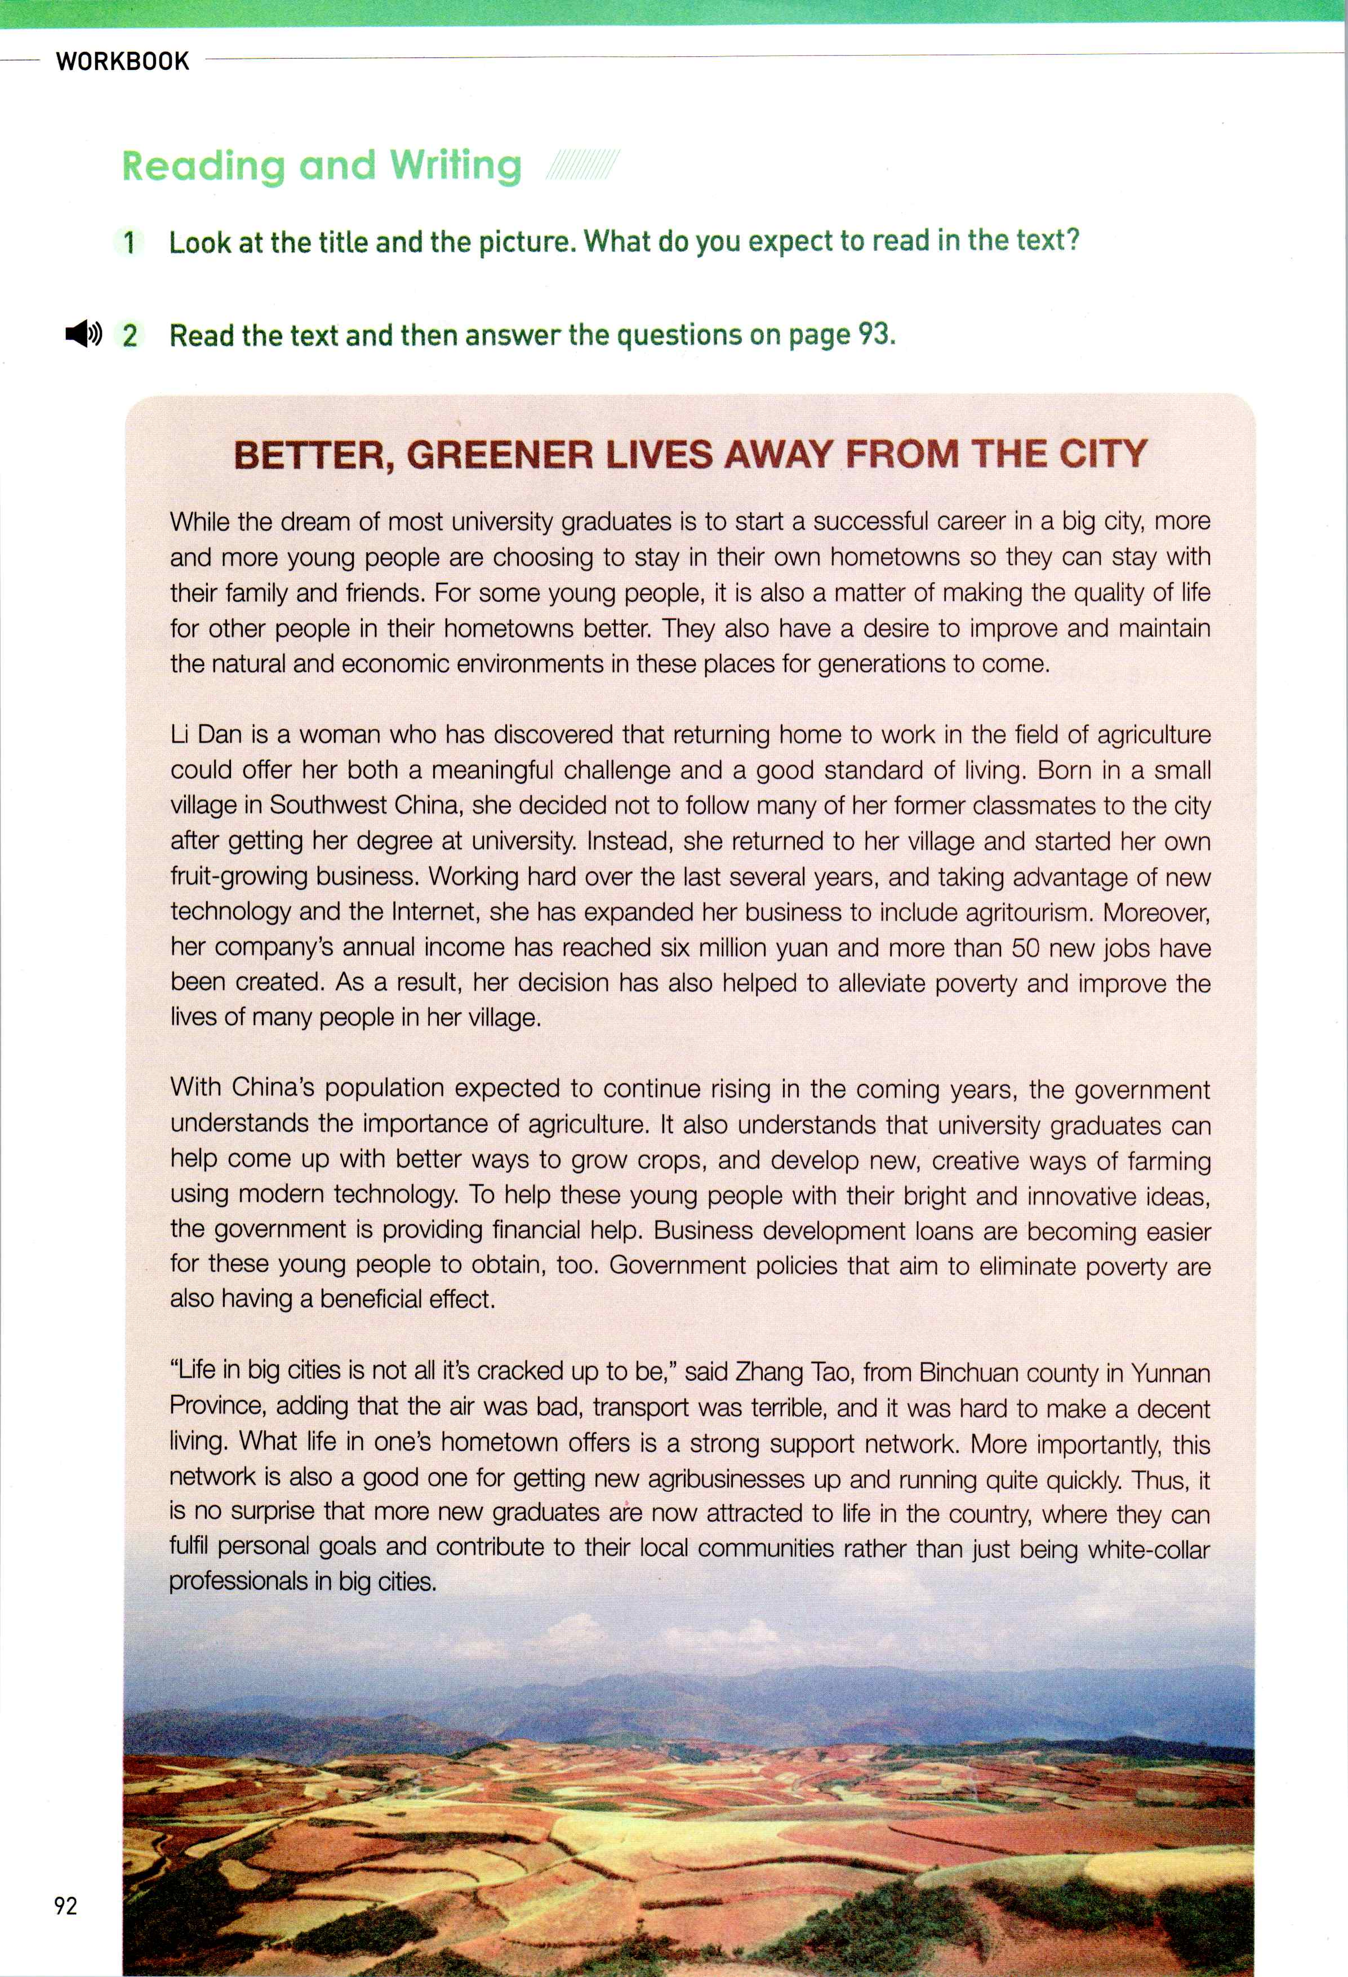
Better, Greener Lives away from the City
Where= country（乡村）
Look at the title and picture.
What do you expect to read in the text?
Start your questions with “wh-”
Who
What
Why...
Notes:
Who live in the country why do they choose to live/ advantages ?

Slide 5

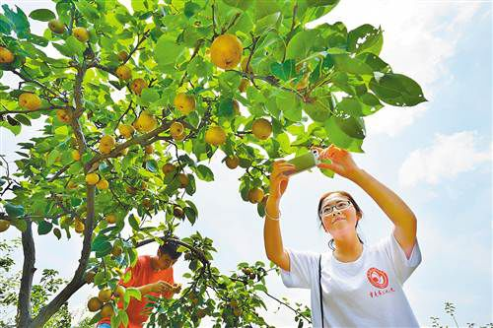

Who choose to live a live away from the city?
an example
Name:
Occupation:
Reasons:
Li Dan
fruit-growing businesswoman
offer her both a meaningful challenge and a good standard of living
Contributions:
helped to alleviate poverty and improve the lives of many people in her village.
Li Dan is a woman who has discovered that returning home to work in the field of agriculture could offer her both a meaningful challenge and a good standard of living....Working hard over the last several years, and taking advantage of new technology and the Intemet, she has expanded her business to include agritourism. Moreover, her company's annual income has reached six milion yuan and more than 50 new jobs have been created. As a result, her decision has also helped to alleviate poverty and improve the lives of many people in her village.
for themselves
for others
Notes:
Give us a example...

Slide 6
Why do they choose to live a live away from the city?
Para.1
While the dream of most unversity graduates is to start a successful career in a big city more and more young people are choosing to stay in their own hometowns so they can stay with their family and friends. For some young people, it is also a matter of making the quaity of life for other people in their hometowns better. They also have a desire to improve and maintain the natural and economic envionments in these places for generations to come.
A. offer a meaningful challenge and a good standard of living
B. stay with family and friends
C. make a quality life for other people in hometowns
D. improve and maintain the natural and economic envionments for next generations
for themselves
for others
for next generations

Slide 7


Why does the government support young people who want to stay and work in their hometowns?
How does government support them?
Para.3
With China’s population expected to continue rising in the coming years, the goverment understands the importance of agriculture. It also understands that university graduates can help come up with better ways to grow crops, and develop new, creative ways of farming using modem technology. To help these young people with their bright and innovative ideas,the government is providing financial help. Business development loans are becoming easier for these young people to obtain, too. Govemment policies that aim to eliminate poverty are also having a beneficial effect.
financial help & policy support
How
come up with better ways to grow crops
develop new, creative ways of farming using modem technology

Slide 8

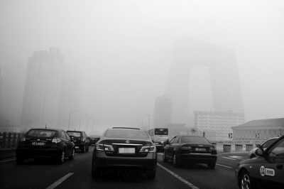
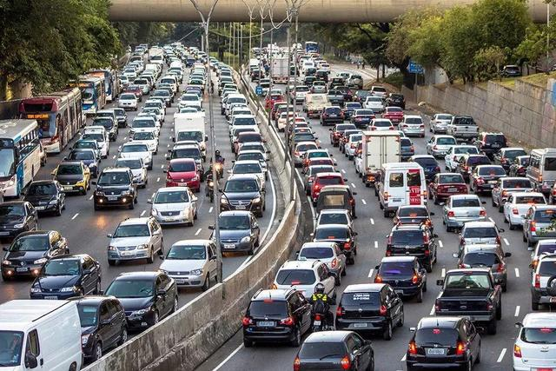
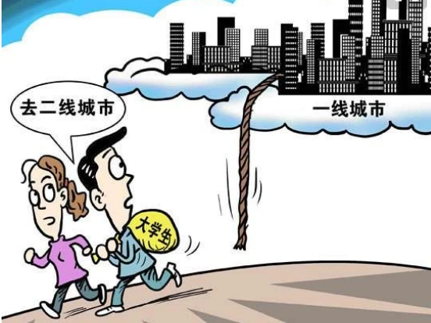
What is meant by “a strong support network”?
What are the advantages of life in the country?
What do you think this sentence mean?
Advantages of life in the country
Para.4
“Life in big cities is not all it's cracked up to be,”said Zhang Tao, from Binchuan county in Yunnan Province, adding that the air was bad, transport was terrible, and it was hard to make a decent living. What life in one's hometown offers is a strong support network. More importantly, this network is also a good one for getting new agribusinesses up and running quite quickly. Thus, it is no surprise that more new graduates are now attracted to lfe in the country, where they can fulfill personal goals and contribute to their local communities rather than just being white-collar professionals in big cities.
Disadvantage of life in the city
a strong support network
family and friends

Slide 9
Group work:
What are the advantages of life in the city and disadvantages of life in the country?
get new agribusiness up and running quite quickly
it was hard to make a decent life
a strong support network
transport was terrible
the air was bad
lives in the country
lives in the city
fulfil personal goals and contribute to their local communities
be white-collar professionals
disadvantages
advantages
Notes:
Everything is going on in the social environment. What about the government’s attitude towards university graduates’ starting a career in the country?

Slide 10



Why does the author write this article?
Para.4 disadvantages of city life and advantages of country life
contribute to their local communities
Para.3 governments’ supportive attitudes
fulfill personal goals
Para.2 an example
Better, Greener Lives away from the City
Para.1 More and more young peopole choose to stay in hometowns.
for themselves
for others
for next generations

Slide 11


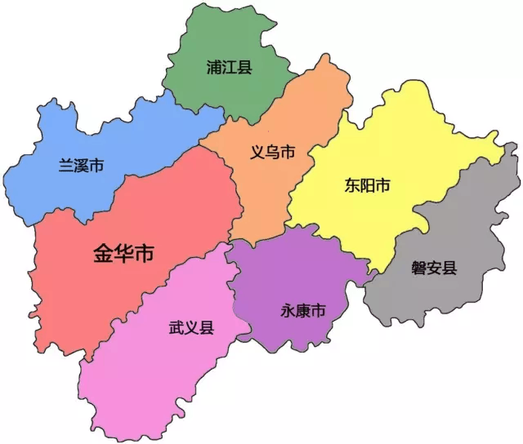
If you choose your hometown, what can you do to help your hometown?
Talk about what you are good at.
Think about what your hometown needs.
eg. I am good at teaching and communicating with people. My hometown needs more support for children’s education. So, I help by tutoring younger students after school. I teach them English and math to help them do better in their studies. This way, I can use my skills to help my hometown grow stronger.
Name: Zhu Wenqian
Birthplace: Pujiang, Jinhua
Occupation: Chinese torreya(香榧) bussiness

Slide 12

Assignment
Assignment
“新农村建设”
视频征集大赛
Let’s write a
script(脚本) to introduce
a successful case of new rural construction (新农村建设）

